Slide 1


Flat Towing

Slide 2

Flat Towing

Slide 3
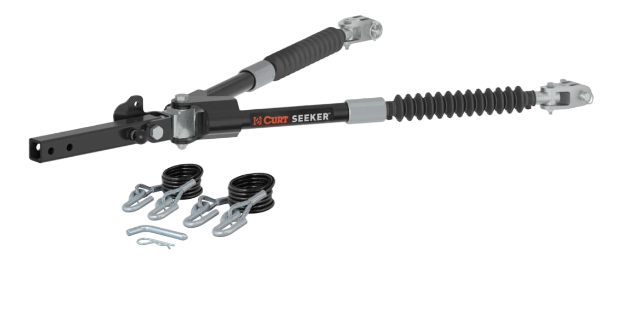
Flat Towing
Seeker Steel Tow Bar #70012
Rated for 10,000 lbs. gross towed vehicle weight
Innovative sleeve lock for easy hook-up and release on uneven ground
Auto-locking arm design ensures you are ready tow
Three-lug shackle ends for less stress on the base plate tabs
Extended arm length for extra hookup radius and clearance
Rigorously tested for proven safety and performance
Auto-locking pin allows for quick and easy stowing
Three stowing positions to avoid obstructions and maximize versatility
Active slide resistance provides enhanced control when extending the arms
Polymer isolator washers reduce friction for smooth, anti-rattle operation
Safety cables and pin & clip included

Slide 4

Flat Towing
Seeker Steel Tow Bar #70012
Rubber sleeves and fully sealed design protect against dirt and debris
Premium textured black finish for lasting corrosion and wear resistance
High-strength steel construction
Standard shank fits 2" x 2" trailer hitch receiver tubes
Two hitch pin holes for adjustable length and added clearance as needed

Slide 5

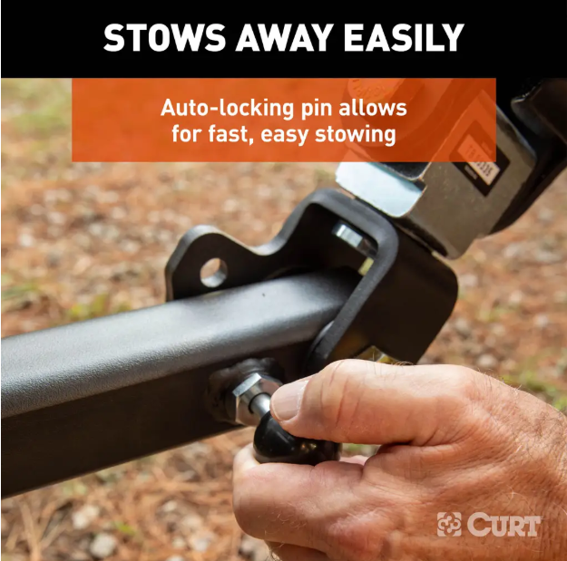

Flat Towing
Seeker Steel Tow Bar #70012

Slide 6
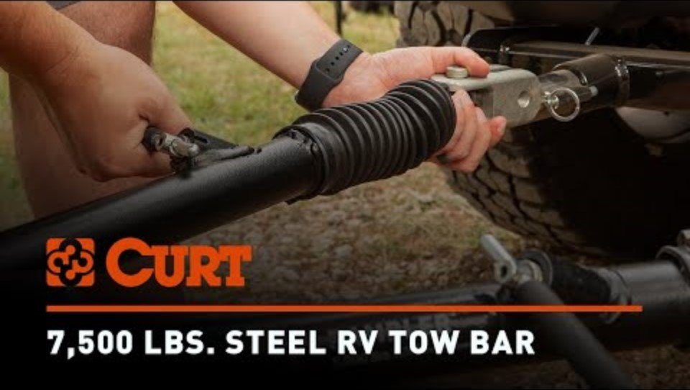
Flat Towing

Slide 7
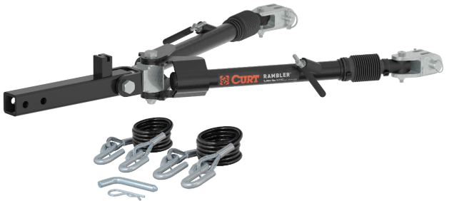
Flat Towing
Rambler™ Steel Tow Bar #70015
Rated for 7,500 lbs. gross towed vehicle weight
Non-binding latches for easy release on uneven ground
Automatic, hands-free locking mechanism ensures you are ready to tow
Three-lug shackle ends for less stress on the base plate tabs
Extended arm length for extra hookup radius and clearance
Weighs less than 40 pounds for easy handling and setup
Rigorously tested for proven safety and performance
Patented stowing method, with three positions to avoid obstructions
Active slide resistance provides enhanced control when extending the arms
Safety cables and pin & clip included

Slide 8
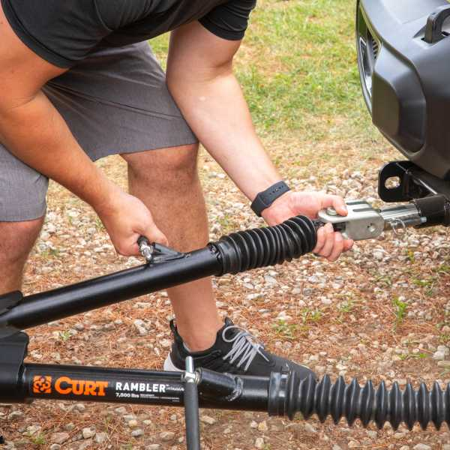
Flat Towing
Rambler™ Steel Tow Bar #70015
Polymer isolator washers reduce friction for smooth, anti-rattle operation
Rubber sleeves and fully sealed design protect against dirt and debris
Premium textured black finish for lasting corrosion and wear resistance
High-strength steel construction
Standard shank fits 2" x 2" trailer hitch receiver tubes
Two hitch pin holes for adjustable length and added clearance as needed

Slide 9

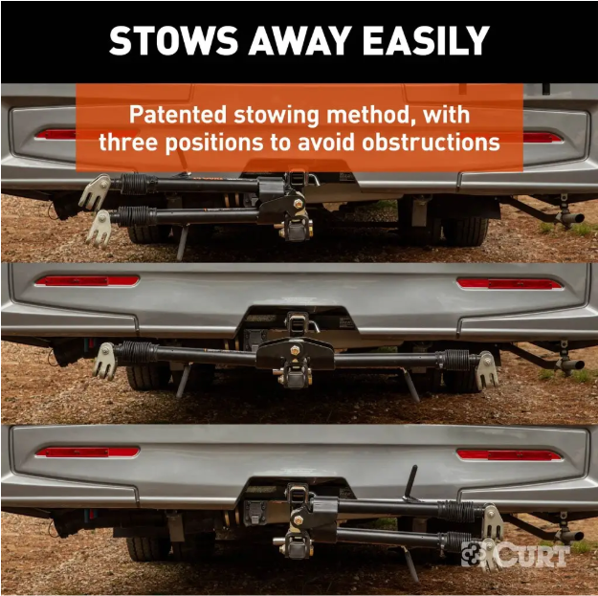

Flat Towing
Rambler™ Steel Tow Bar #70015

Slide 10

Flat Towing

Slide 11

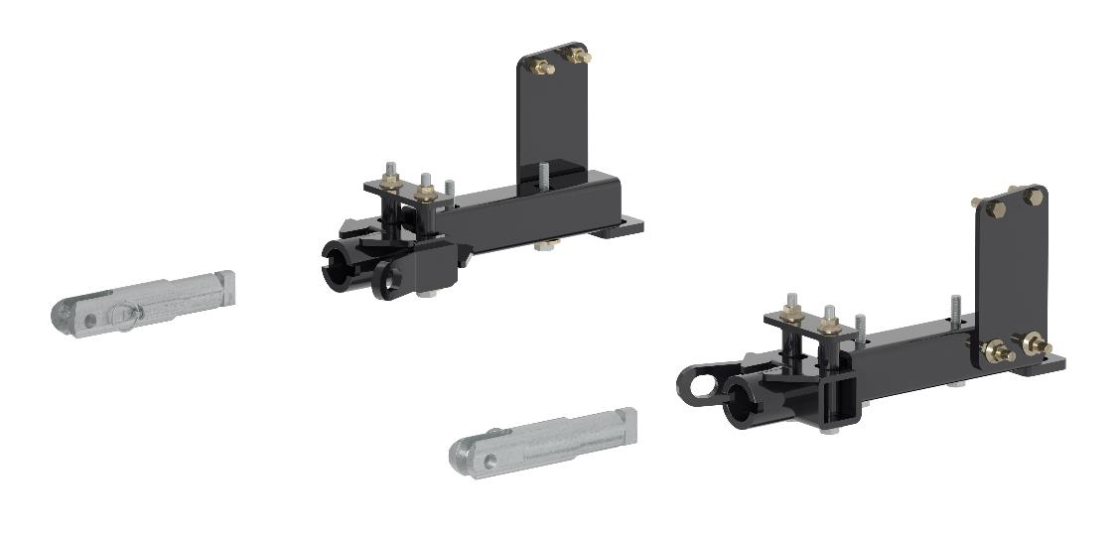
Flat Towing
Tow Bar Base Plates
Twist-lock tabs for easy installation and removal as needed
Spreads towing forces equally for reduced stress on the vehicle frame
Physically tested to gross vehicle weight rating (GVWR)
Engineered with a vehicle- specific design for a custom fit
Concealed main body for OE look and seamless integration with the vehicle
Protected by a dual-coat high-gloss black powder coat and liquid A-coat finish
Tabs machined from billet alloy steel

Slide 12
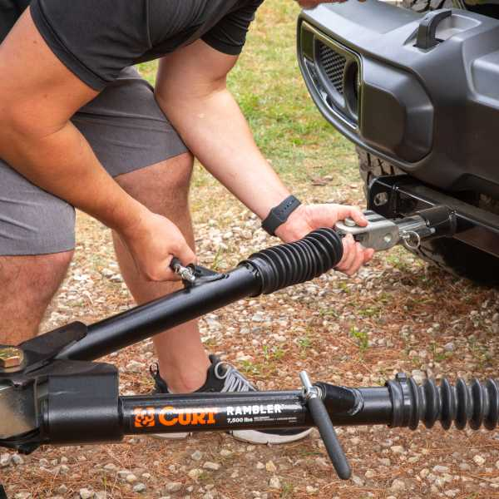
Flat Towing
Unique Advantages of CURT Base Plates
Improved Installation
Stronger, Higher-Quality Components
Comprehensive Physical Testing

Slide 13

Flat Towing

Slide 14
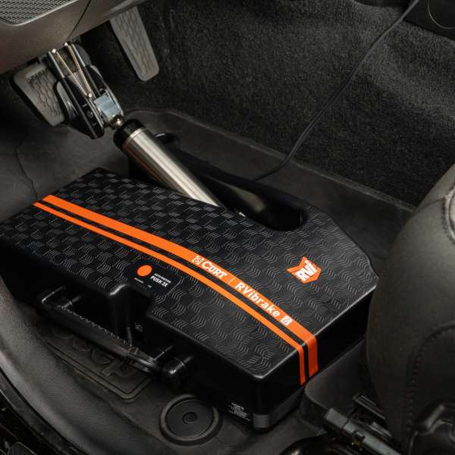
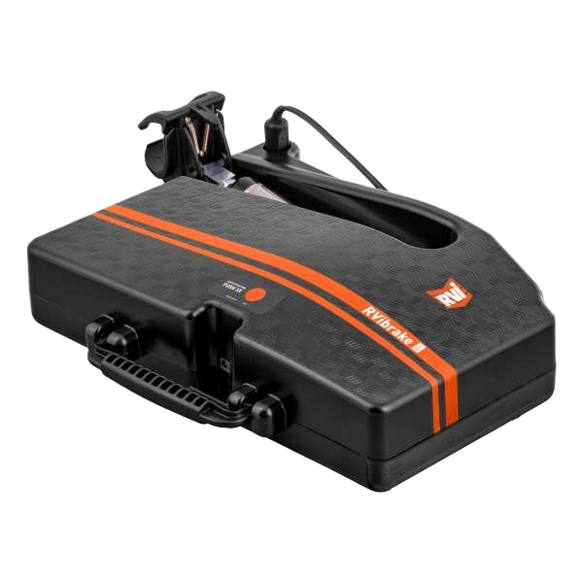
Flat Towing
RVibrake 4 Portable Flat Tow Brake System
Adds braking capabilities to your towed vehicle when flat towing behind an RV
Required by law in 49 of 50 states and all of Canada
0.5-second reaction time keeps you safe on the road
Brake-lock detection ensures proper installation to prevent towed vehicle brake damage
Simple, one-button interface automatically positions itself in the vehicle

Slide 15

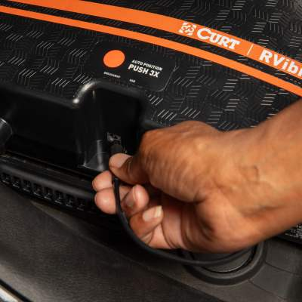
Flat Towing
RVibrake 4 Portable Flat Tow Brake System
Audio assistant effortlessly guides you through an easy, 30-second setup
Only breakaway kit requires installation (25-45 min.)
Guaranteed to fit any make, model, and year of a flattowable vehicle
Includes Bullseye wireless monitor and rangeextender for real-time monitoring

Slide 16

Flat Towing

Slide 17
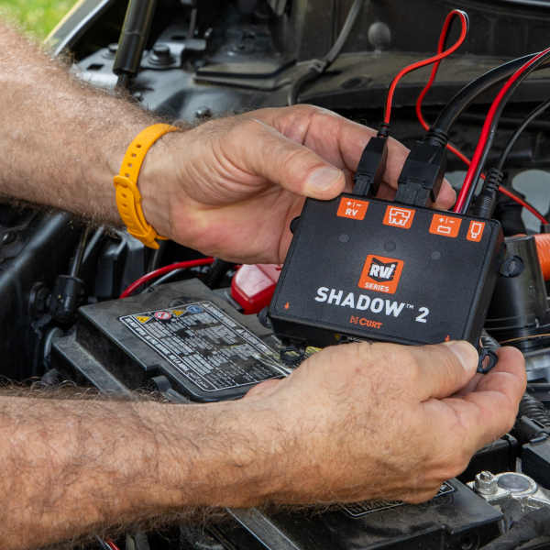
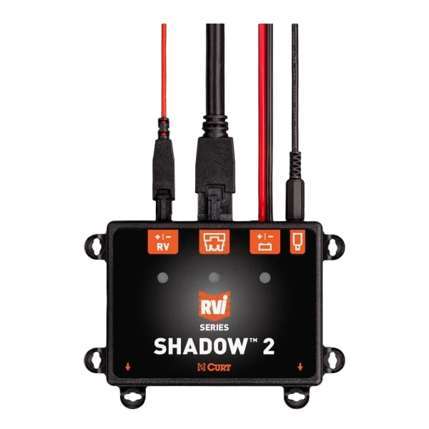
Flat Towing
RVibrake Shadow 2 Installed Flat Tow Brake System
Adds braking capabilities to your towed vehicle when flat towing behind an RV
Required in 49 of 50 states and all of Canada
Permanently installed design means no user setup after installation
0.5-second reaction time helps keep you safe on the road

Slide 18
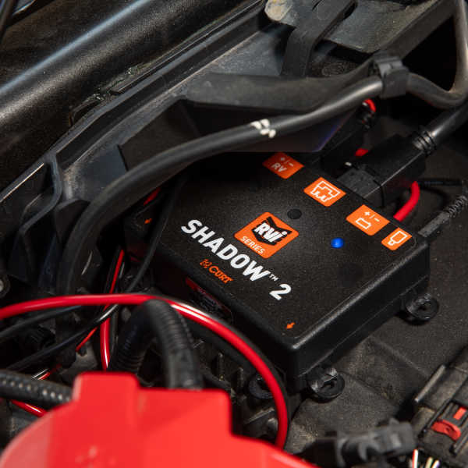
Flat Towing
RVibrake Shadow 2 Installed Flat Tow Brake System
Tow-mode detection automatically recognizes when you’re towing
Built-in battery charger allows you to charge up to 10amps
Plug-and-play design allows for fast, easy installation in under 2 hours
No wire crimping, soldering, or disassembling required
Fits most makes, models, and years of vehicles

Slide 19
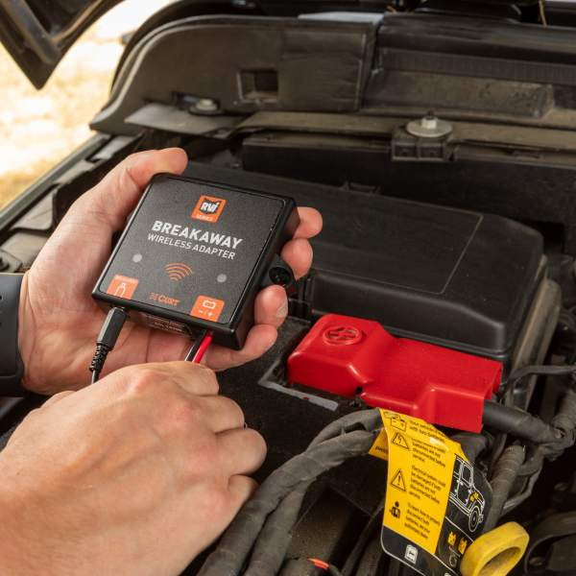
Flat Towing
Breakaway Wireless Adapter for RVibrake
Eliminates the need to drill through the firewall in your engine compartment
Wireless connection eliminates the need to plug in the breakaway each time
Provides a wireless link between the RVibrake 4 and breakaway wireless adapter
Emergency breakaway notifications are immediately displayed on dash monitor
Multi-colored LEDs give instant feedback on proper installation and performance
Compatible with RVibrake 4 and RVibrake 3
Limited lifetime warranty (one-year finish, one-year parts)

Slide 20
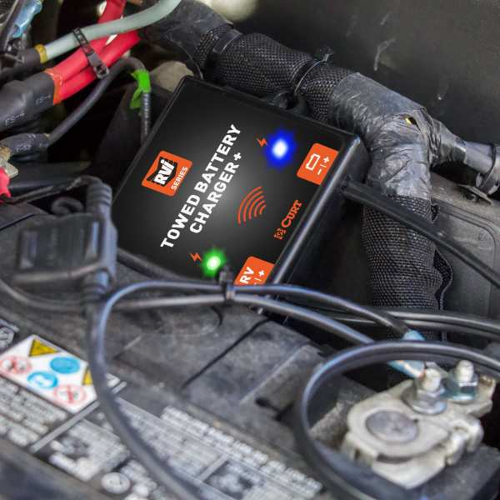
Flat Towing
RVibrake Towed Battery Charger Plus for Flat Towing
Prevents unseen parasitic loss, ensuring your towed vehicle’s battery stays charged
LEDs provide real-time feedback on voltage levels, charging status, and RV voltage levels
Compatible with all 12V batteries (including trailers)
Connection protection guards your electrical system from damage if installed incorrectly

Slide 21
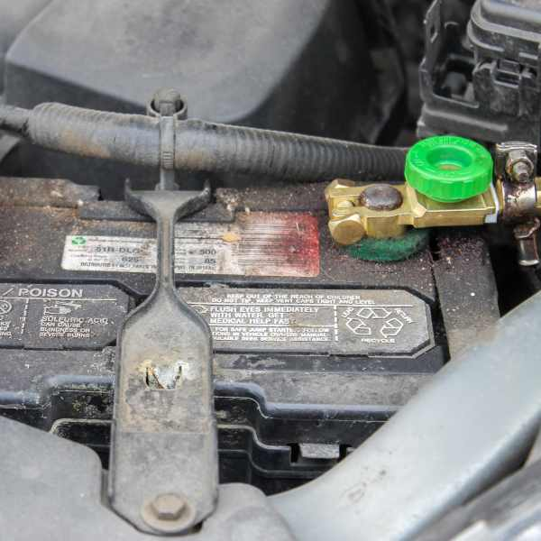
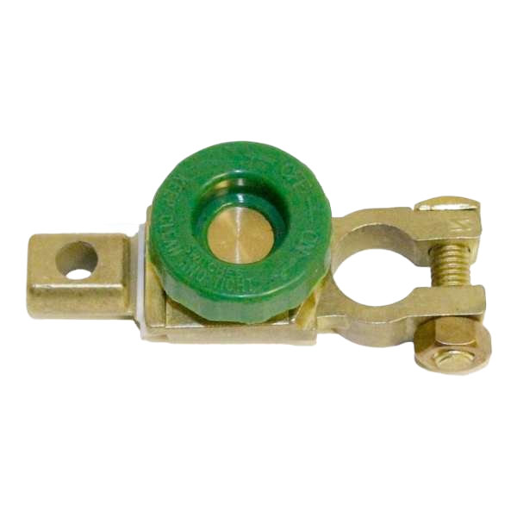
Flat Towing
Towed Battery Disconnect for RVibrake
Cuts off power to the battery to avoid unwanted battery consumption
Connects to negative battery terminal only
Rated at 500-ampere surge and 125 amperes continuous at 12 volts
High-conductivity zinc alloy construction
Brass plated to prevent corrosion
For use with top-post-style lead-acid batteries (6V, 12V, or 24V DC)

Slide 22
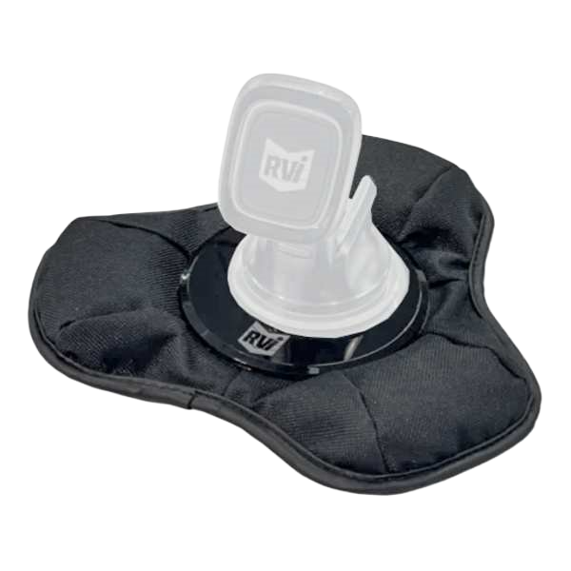
Flat Towing
RVibrake Bean Bag Dash Mount
Positions your Bullseye monitor or Command Center tablet for easy viewing
Magnet for easy mounting to the magnetic dash mount (not included)
Bean bag base provides added stability
Works with vehicles with unsuitable dashboards

Slide 23
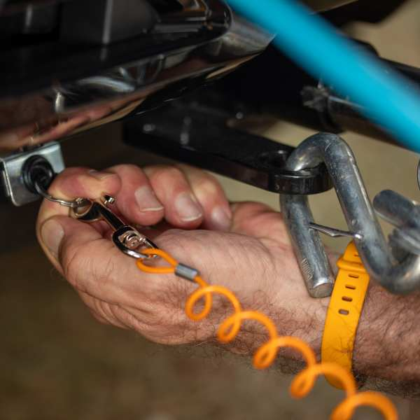
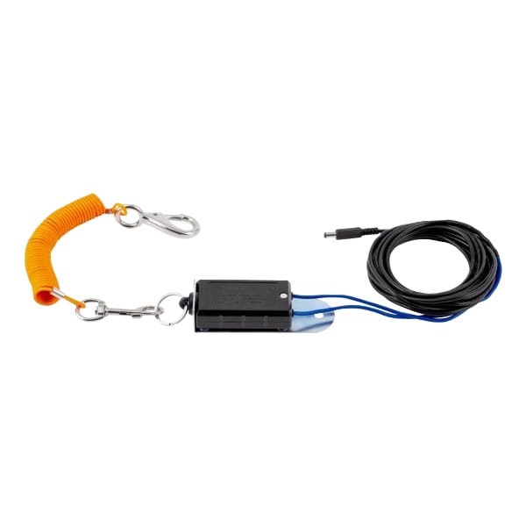
Flat Towing
Breakaway System for RVibrake
Automatically activates the towed vehicle’s braking system in an emergency
Includes all components for hassle-free installation in under 45 minutes
Works seamlessly with all RVibrake flat tow braking systems
Required by law in most states and Canada
Limited lifetime warranty (one-year finish, one-year parts)

Slide 24
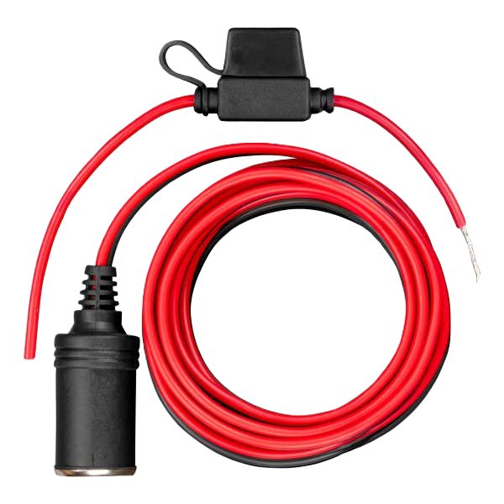
Flat Towing
12-Volt Battery Direct Kit for RVibrake
Dedicated 12V outlet attaches directly to the battery of your towed vehicle
16-gauge duplex wire for stable power and premium operation
20-amp inline fuse protects your system from potential overload
Provides a dedicated 12V outlet if your vehicle does not have one or if you need to pull a fuse
Includes all components for hassle-free installation in under 45 minutes
Limited lifetime warranty (one-year finish, one-year parts)

Slide 25
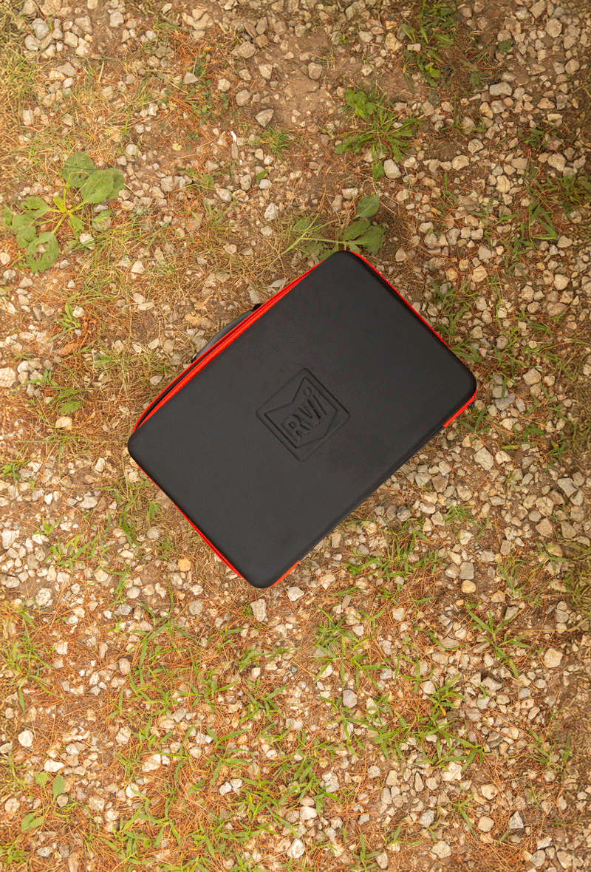
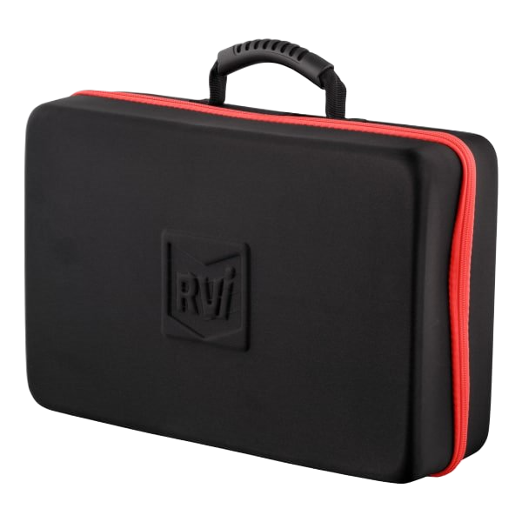
Flat Towing
Roadie Soft Shell Case for RVibrake
Soft-sided case for easy portability
Durably constructed to fight against wear and tear
Carry handle for easy transport
Fits RVibrake 4 and RVibrake 3

Slide 26
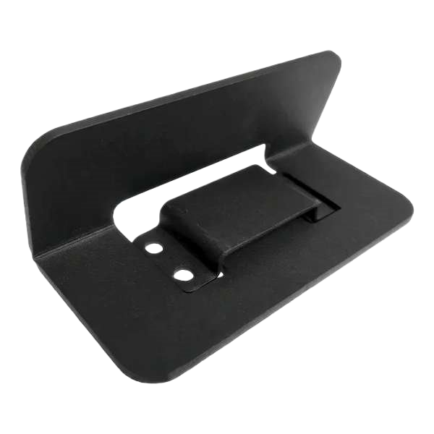
Flat Towing
Phantom Universal Stop Plate for RVibrake
Gives the RVibrake 4 and RVibrake 3 something to push back against
Powder-coated steel construction for years of dependable use
Quick and easy to install
Universal design is compatible with most makes and models
Fits RVibrake 4 and RVibrake 3
Includes mounting hardware

Slide 27
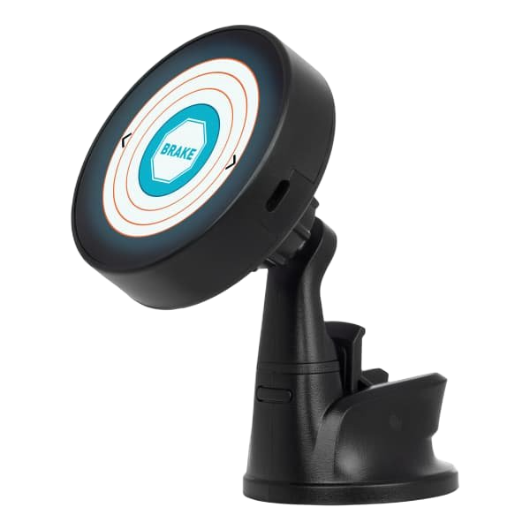
Flat Towing
Bullseye Wireless Monitor for RVibrake
2.1” vibrant touchscreen displays braking performance and battery charging
Manual braking button for quick corrections and increased driver control
Audible and visual alerts for improved driver awareness
Wireless connectivity for for a clean, simple setup
Works with RVibrake 4, Towed Battery Charger Plus, and Breakaway Wireless Adapter for RVibrake 4
Backwards compatible with RVibrake 3 and RVibrake Shadow
Includes Bullseye monitor, 6' USB-C cable, dual USB-C car charger, and range extender

Slide 28

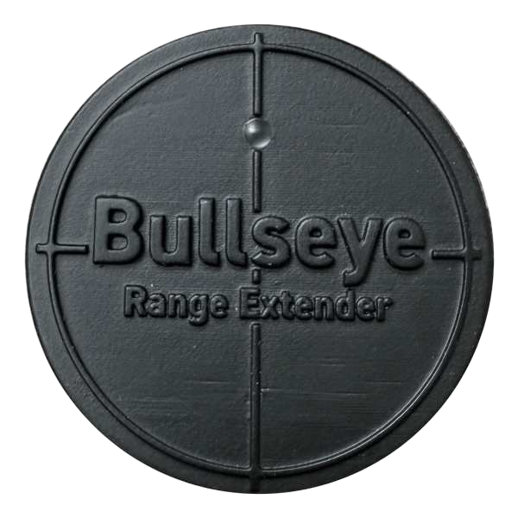
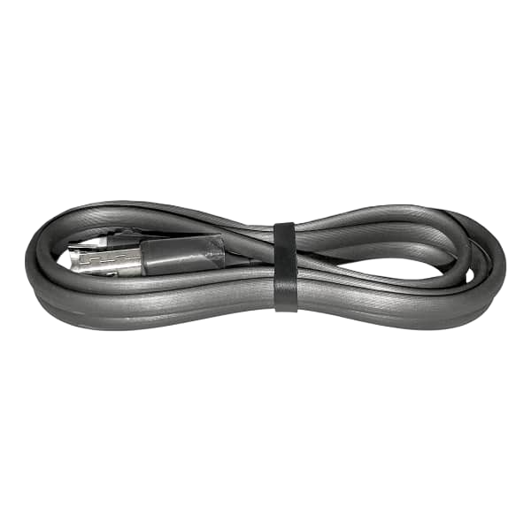
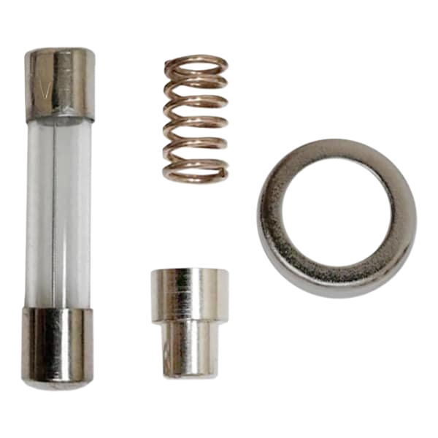
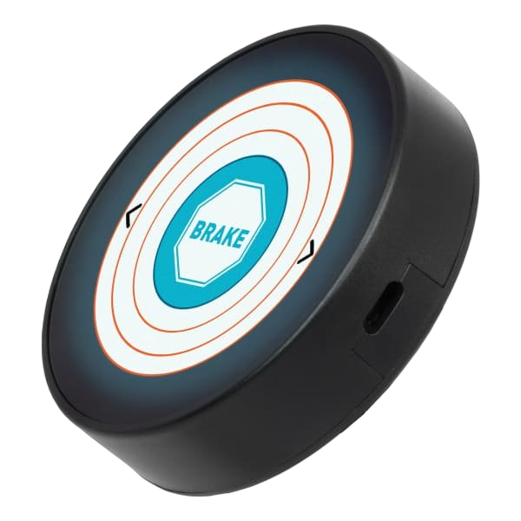
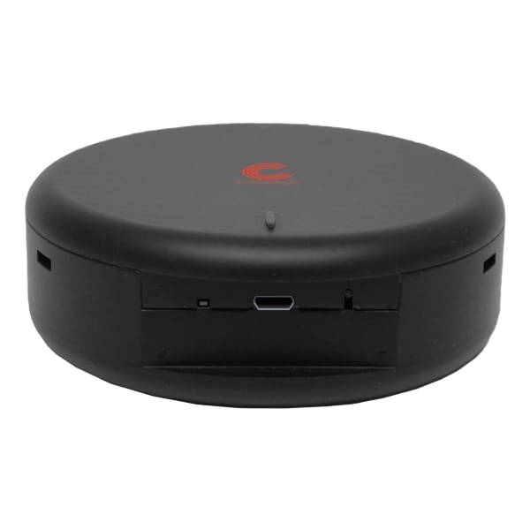

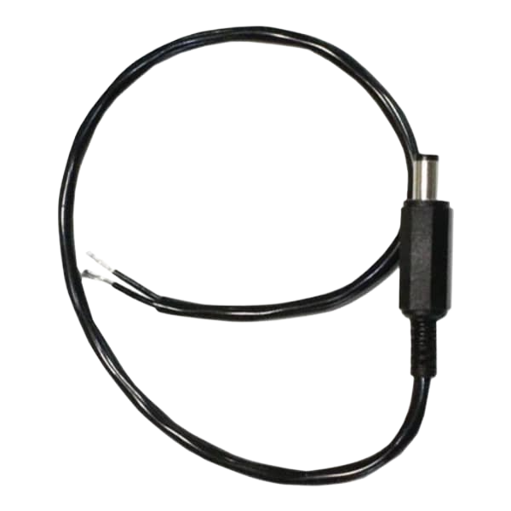
Flat Towing
RVibrake Replacement Parts
Micro USB Flat Cable
Brake Power Plug Hardware
Command Center Tablet
Bullseye Range Extender
Breakaway Plug with 12" Wire Lead
Command Center Hub
Bullseye Wireless Monitor
Command Center Tablet & Hub

Slide 29
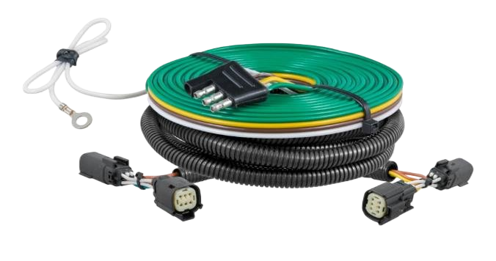
Flat Towing
Towed-Vehicle RV Harnesses
Connects a towed vehicle to an RV using a standard 4-way flat trailer plug
Simple plug-and-play design eliminates the need for cutting or splicing
Integrated block diodes isolate sensitive vehicle electronics from RV signals
Uses towed vehicle's existing tail lights, brake lights and turn signals
Includes harness, 4-flat extension, mounting bracket and hardware

Slide 30
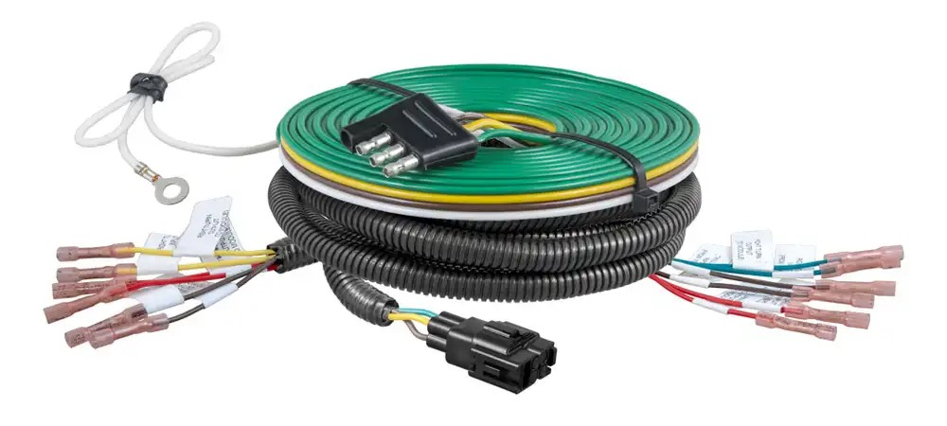
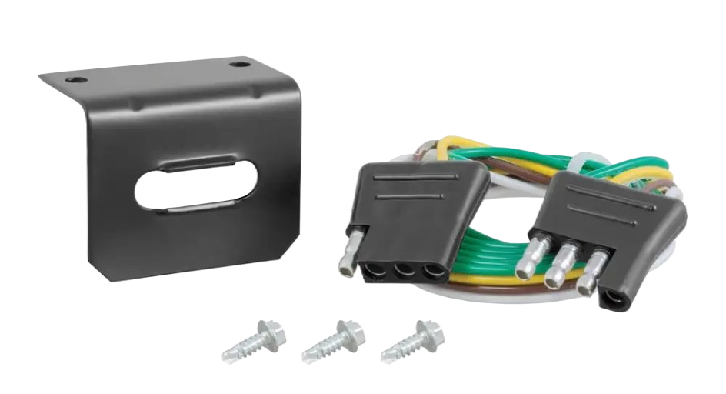
Flat Towing
Splice-in RV Harness
Connects a towed vehicle to an RV using a standard 4-way flat trailer plug
Splices into vehicle's electrical system with included butt connectors
Color-coded wires with wiring guide for easy installation
Integrated block diodes isolate sensitive vehicle electronics from RV signals
Uses towed vehicle's existing tail lights, brake lights, and turn signals
Not compatible with PWM electrical systems
Includes 4-way flat extension, mounting bracket, and hardware

Slide 31
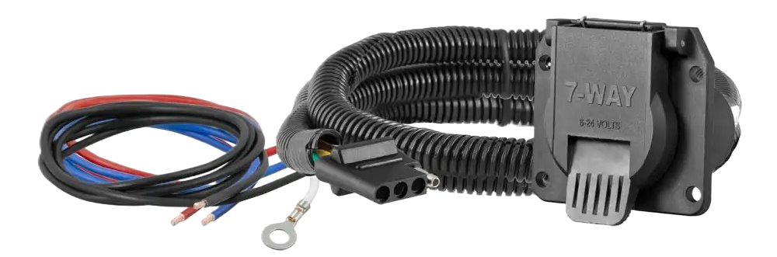
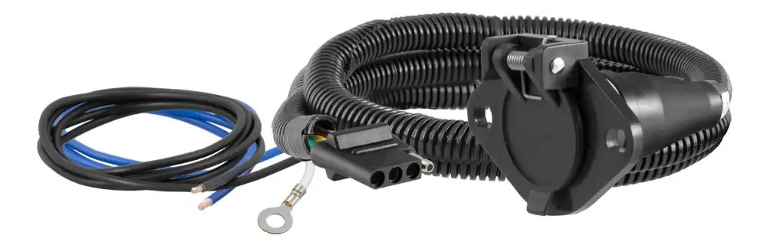
Flat Towing
Dinghy Towing Adapter Harnesses
Plugs into CURT RV harness 4-way flat to provide a standard connector under the dinghy vehicle's hood
Allows for flexible mounting on the front of the dinghy vehicle
6' length is ideal for equipping dinghy vehicle for flat towing behind RV
Some manual wiring required
#58980 4-Way Flat to 7-Way RV Blade
#58981 4-Way Flat to 6-Way RV Round

Slide 32
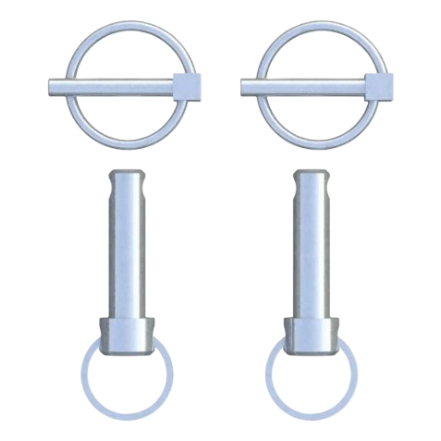
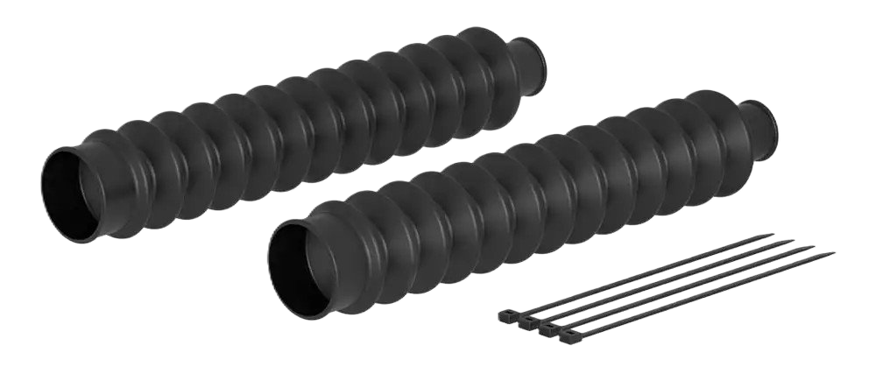
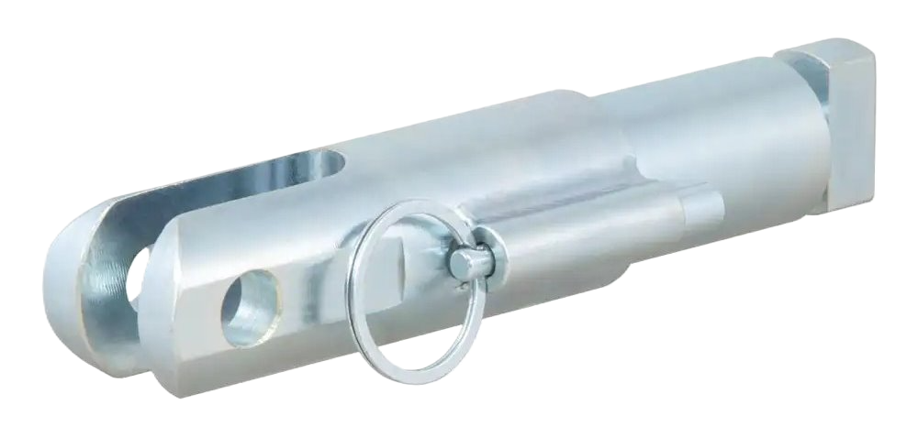
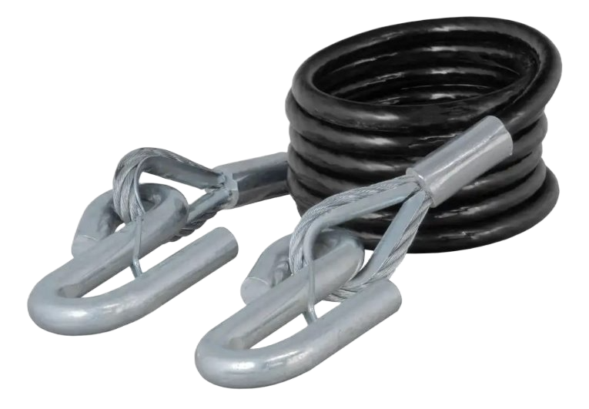
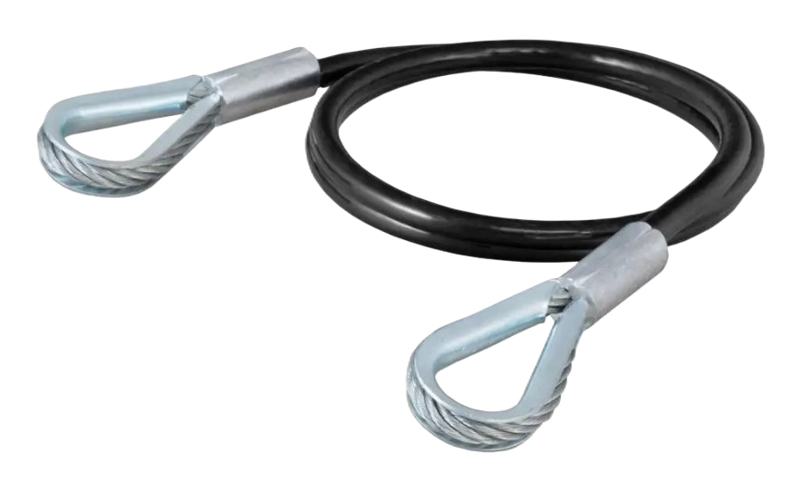
Flat Towing
Tow Bar & Base Plate Replacement Parts
#19261
#19262
#19263
#70006
#70008

Slide 33

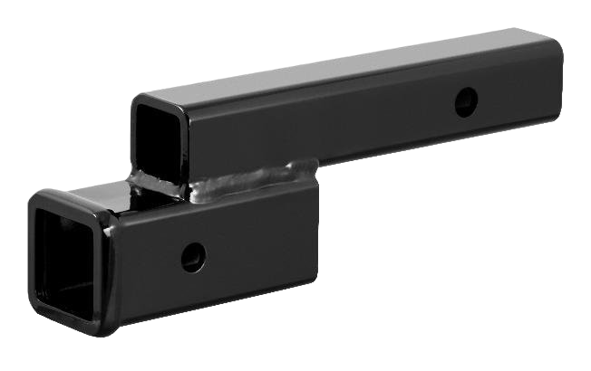
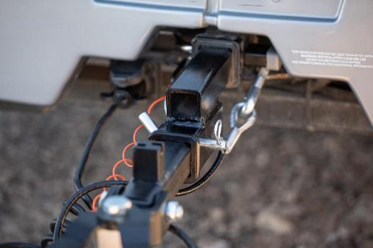
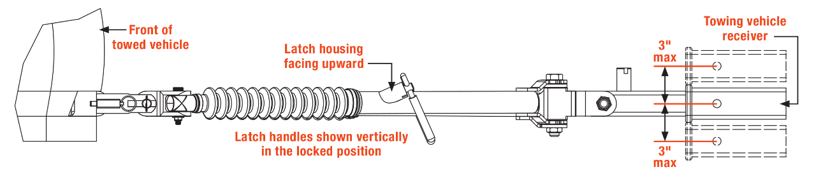
Flat Towing
Drop / Rise Hitch Adapters
Provides drop or rise for level dinghy towing
2”, 4”, and 6” options available
Rated for 7,500 lbs. gross towed vehicle weight
Fits any industry-standard 2" x 2" hitch receiver tube
The height of the vehicle base plates and RV hitch must be within 3” of each other

Slide 34
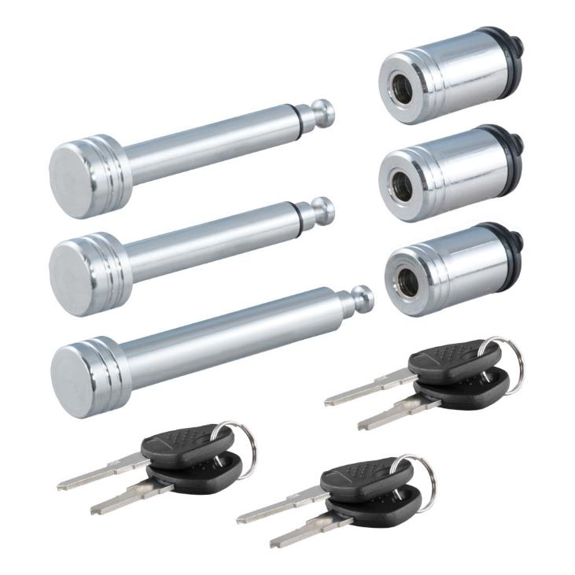
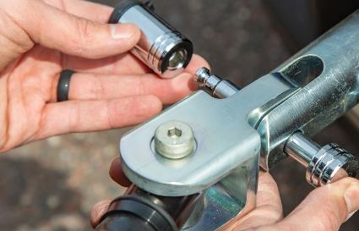
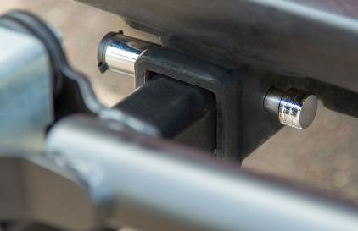
Flat Towing
Tow Bar Lock Set #70005
Secures tow bar vehicle and RV attachment points
Helps protect dinghy setup when left unattended
Locks keyed alike for convenient one-key operation
Protected by a durable chrome-plated finish
Easy-to-operate, 1/4-turn lock activation
Watertight dust cap prevents internal corrosion
Includes six keys for added convenience

Slide 35
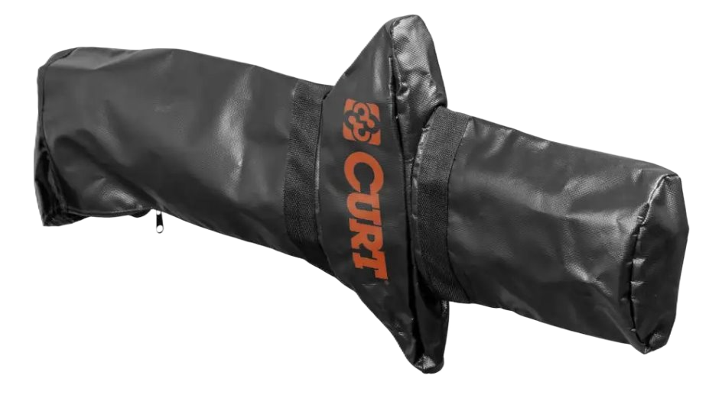
Flat Towing
Rambler™ Tow Bar Cover #70010
Designed for use with CURT Rambler tow bar #70012
Form-fitted cover provides a comfortable fit over tow bar
Durably constructed with UV-resistant vinyl and zipper
Weather-resistant design protects against the elements
Shank fits within the cover when tow bar is folded
Doubles as a storage bas when not in use

Slide 36

Flat Towing
Towing Accessories Storage Bag #70004
Durable fabric with high-strength webbing straps
Zipper closure to keep items secure
Great for storing and carrying towing accessories and related tools
Also ideal for chains, straps, greasy tow balls and safety chain attachments
Metal lining along the opening keeps bag open and upright for easy access
8 interior pockets and 6 exterior for storage of small components
Comfort-grip handles for easy portability

Slide 37
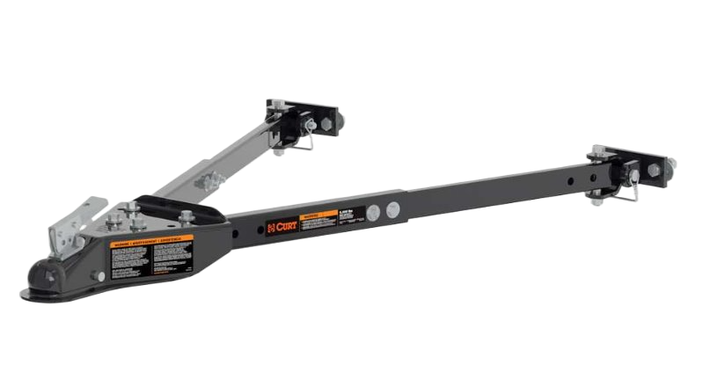


Flat Towing
Adjustable Tow Bar #19750
Complete assembly only weighs 31 lbs. for easy handling
Adjusts in width from 26" to 40"
Features a 2" heavy-duty coupler
Rated for up to 5,000 lbs.
Brackets mount to the frame of the vehicle (trimming may be required)

Slide 38



Flat Towing
Extended View Tow Mirror #20002
Attaches to side mirror to expand view with a trailer
Articulating head allows precise angling
Compatible with pickup or SUV left or right side mirror
Fully adjustable design can be used in a horizontal or vertical position
Hinging arm and elastic straps for secure installation
Adds 5" to 7-1/2" to existing mirror
Fits mirrors 4" to 11" high

Slide 39

Flat Towing
Towing Lights
Easily add tow lights to a dinghy-towed vehicle or trailer without lights
Non-scratch magnetic base protects finish
Perfect for boats, RVs, and flat towing applications
20' cord with 4-way flat plug allows for plug-and-play convenience
Snap locks included for simple, secure splice-in connection
#53200 (lights only), #53204 (includes sturdy case)

Slide 40






Flat Towing
RV Trailer Hitches
Designed for towing a trailer or small vehicle behind an RV
Built with a 3-piece, adjustable design
Available to fit up to 72” wide frames
Bumper hitches available to fit 2” x 4” or 4” x 4” bumper beams

Slide 41


Flat Towing
Fuse Bypass Switches
Helps avoid having to remove and replace fuses when flat towing your vehicle
Vehicle-specific application for a custom fit
Integrates with CURT RV harness (sold separately)

Slide 42


Flat Towing
RV Harness Diode Kit
Allows RV to power lights only on the towed vehicle without power feeding back
Requires trailer-side 4-way flat plug with 20' wires or similar
24 volts max, 3 amps
Includes four diode blocks,12 spade terminals

Slide 43

Flat Towing
Dinghy Towing Adapters
Ideal for connecting motor homes to dinghy vehicle for flat towing
UV-resistant coiled cable extends without scraping the ground
Simple plug-and-play design eliminates splicing
Die-cast or durable plastic construction
#57271
#57280
#57281
#57282
#57283
#57284
#57285
#57286

Slide 44


Flat Towing
Limited Lifetime Warranty
CURT provides limited lifetime warranty coverage against defects in factory workmanship and materials for CURT products sold by authorized CURT dealers for use by retail (end use) consumers.
https://storage.googleapis.com/curt-group-warranties/CURT_Warranty.pdf

