Slide 1
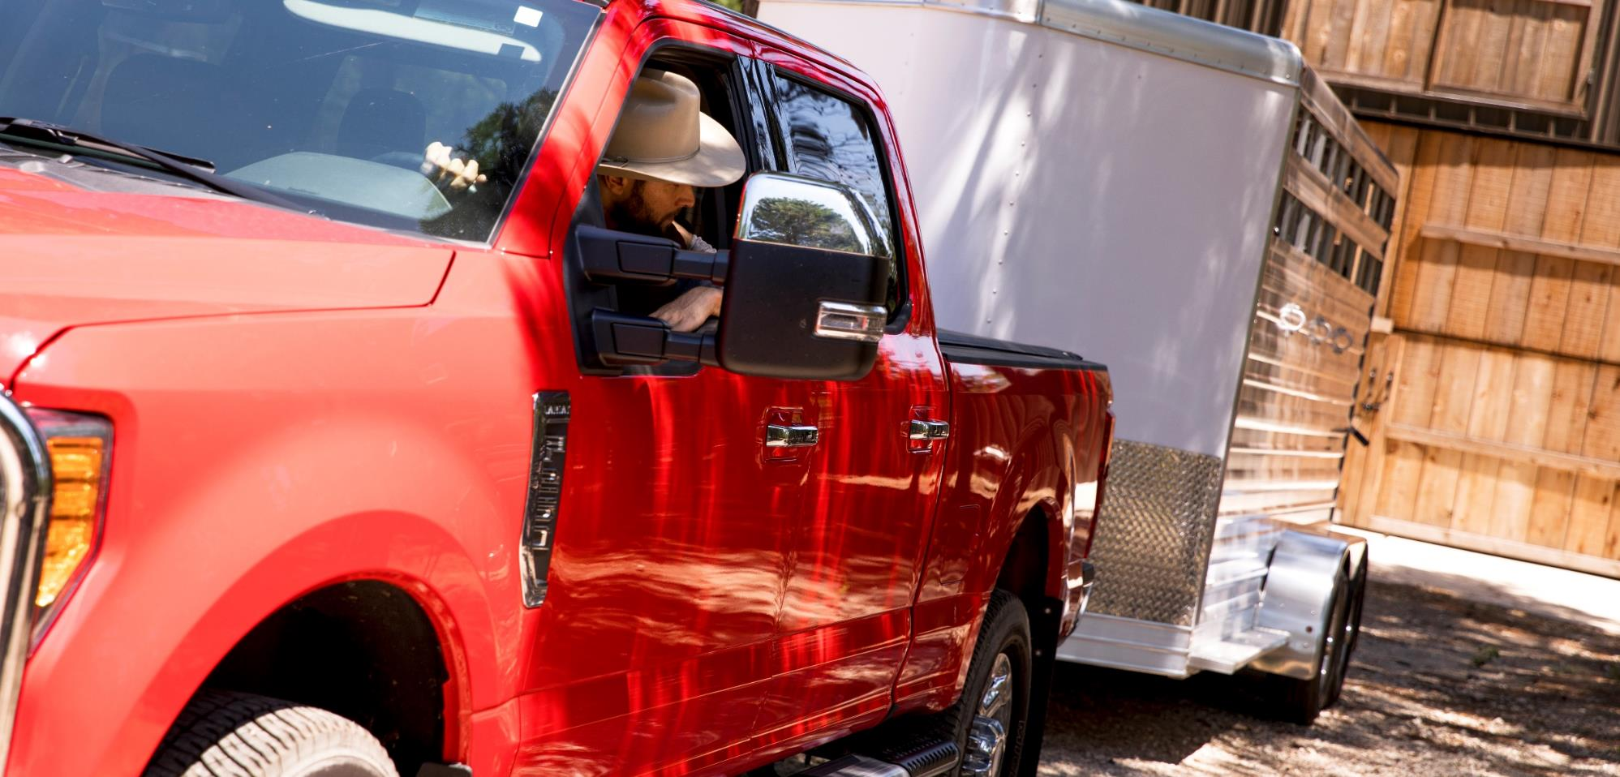

Trailer Hitches

Slide 2


Slide 3

Trailer Hitches
What makes our hitches unique?
CURT trailer hitches are uniquely engineered, tested and finished right here in the USA*. With dedicated engineering teams, we manufacture over 1,000 different hitch models to provide a custom fit for your exact vehicle. *May include imported hardware
So, whether you are towing 20,000 lbs. of industrial machinery or just taking the family out for a weekend camping trip, CURT offers more than just a hitch – we offer confidence to enjoy every mile of your adventure.

Slide 4


Trailer Hitches
Manufactured in the USA
All CURT custom-fit receiver hitches are manufactured in the USA. This means each hitch is engineered, fabricated, welded, finished, tested and finally shipped out from our headquarters in Eau Claire, Wisconsin.
Industry-leading first-to-market track record
Real vehicles brought in for prototype designs
Manual and robotic welding capabilities
ISO / TS 16949 certification for quality manufacturing
May include imported hardware

Slide 5
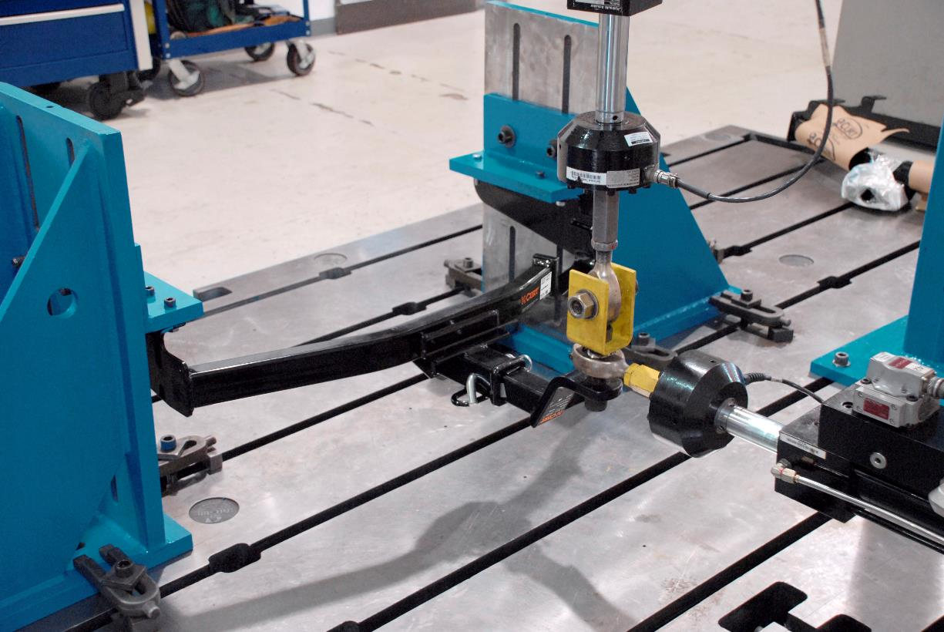
Trailer Hitches
Rigorous Safety Testing
At our Detroit testing facility, each hitch is rigorously tested in-house for safety to SAE J684. This ensures reliability in each hitch design.
R&D facility immersed in the heart of the automotive industry
Real-time, three-axis testing to simulate actual towing conditions
Unique on-vehicle capabilities

Slide 6
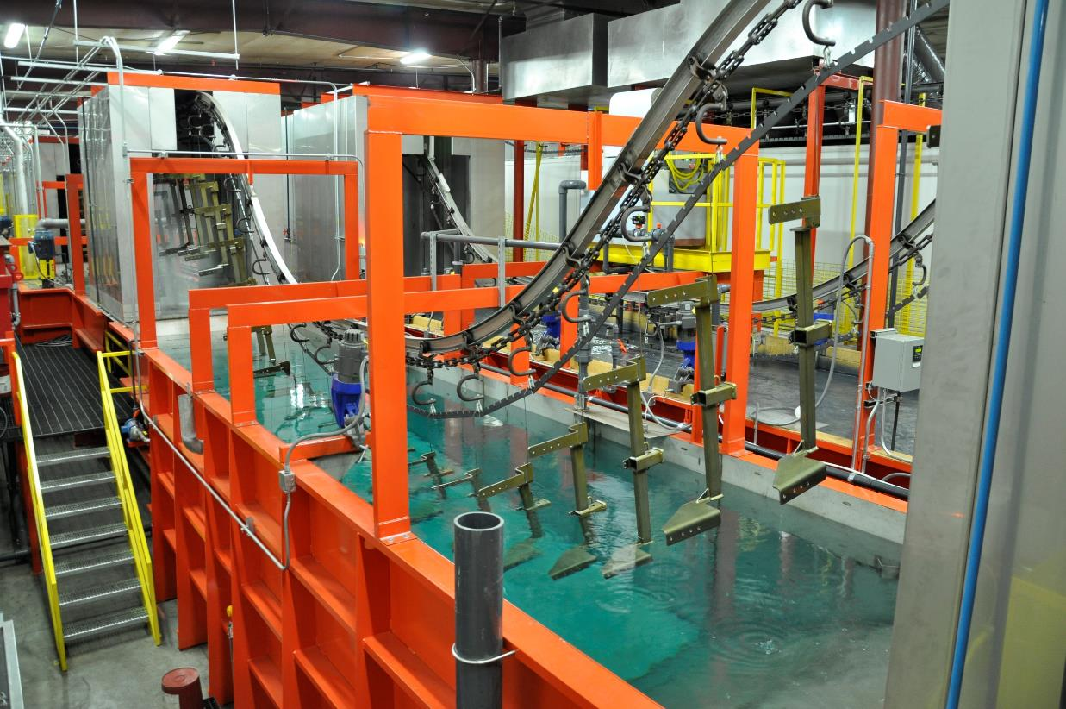
Trailer Hitches
Industry-Leading Finish
Every one of our hitches undergoes a co-curing process, being protected inside and out with an industry-leading, rust-resistant finish.
Mechanical and chemical descaling for a smooth finish
Submersed in A-coat to coat inside and out
Covered in a durable black powder coat finish
Heated to cure the two finishes together and create industry-leading protection

Slide 7
Trailer Hitches
Five Custom Hitch Classes
Hitch Class | Receiver Size | Gross Trailer Weight | Tongue Weight | Weight Distribution | WD Tongue Weight | Powder Coat Finish
Class 1 | 1-1/4" | Up to 2,000 lbs. | Up to 200 lbs. | N/A | N/A | Gloss black
Class 2 | 1-1/4" | Up to 3,500 lbs. | Up to 350 lbs. | N/A | N/A | Gloss black
Class 3 | 2" | Up to 8,000 lbs. | Up to 800 lbs. | Up to 12,000 lbs. | Up to 1,200 lbs. | Gloss black
Class 4 | 2" | Up to 10,000 lbs. | Up to 1,000 lbs. | Up to 12,000 lbs. | Up to 1,200 lbs. | Gloss black
Class 5 (XD) | 2" | Up to 17,000 lbs. | Up to 2,550 lbs. | Up to 17,000 lbs. | Up to 2,550 lbs. | Carbide black
Class 5 (CD) | 2-1/2" | Up to 20,000 lbs. | Up to 2,700 lbs. | Up to 20,000 lbs. | Up to 2,700 lbs. | Carbide black

Slide 8
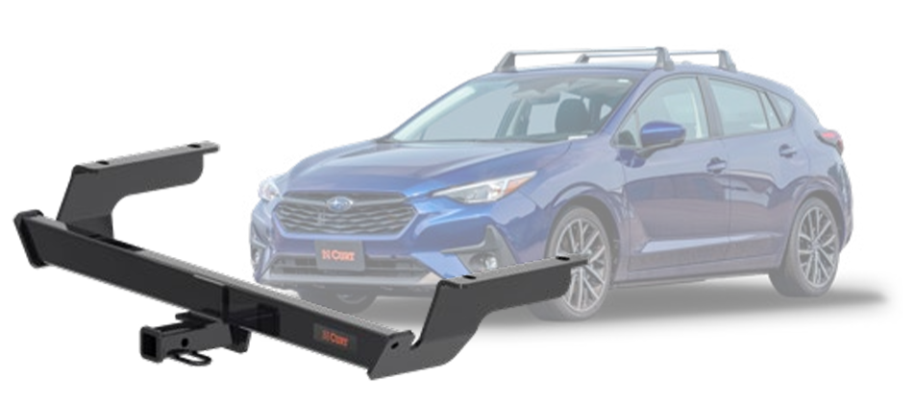
Trailer Hitches
Class 1
GTW/TW: Up to 2,000/200 lbs.
1-1/4” receiver tube opening
Applications: Subcompact cars to crossovers
Made in USA with imported hardware
Class 2
GTW/TW: Up to 3,500/350 lbs.
1-1/4” receiver tube opening
Applications: Sedans to light SUVs
Made in USA with imported hardware

Slide 9
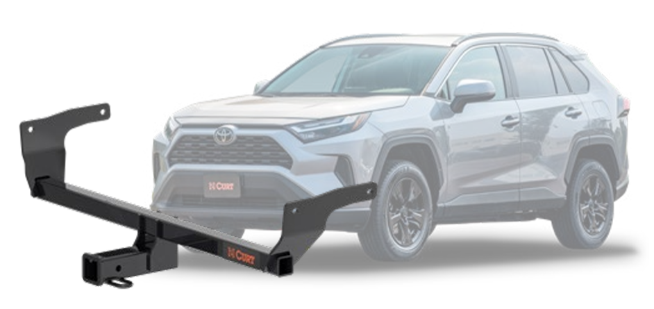
Trailer Hitches
Class 3
GTW/TW: Up to 8,000/800 lbs.
WD/WDTW: Up to 12,000/1,200 lbs.
2” receiver tube opening
Applications: Full-size sedans to pickups
Made in USA with imported hardware
Class 4
GTW/TW: Up to 10,000/1,000 lbs.
WD/WDTW: Up to 12,000/1,200 lbs.
2” receiver tube opening
Applications: Large SUVs and pickups
Made in USA with imported hardware

Slide 10
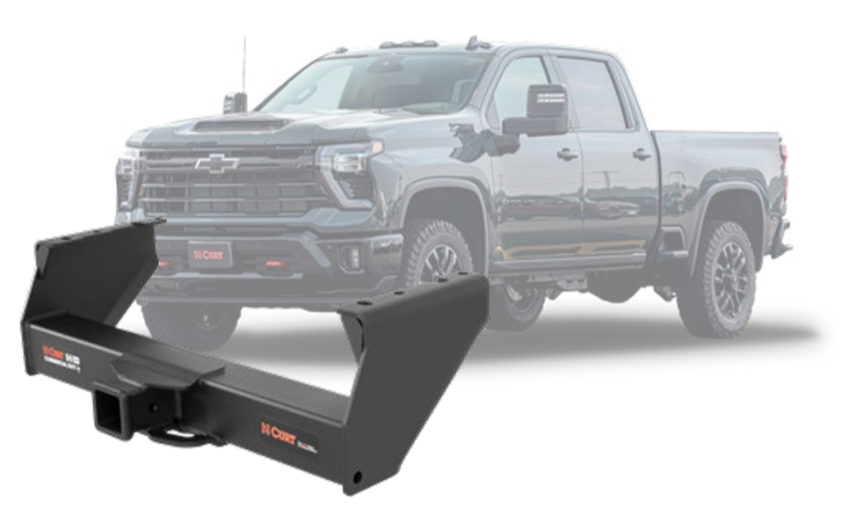
Trailer Hitches
Class 5 Xtra Duty
GTW/TW: Up to 17,000/2,550 lbs.
WD/WDTW: Up to 17,000/2,550 lbs.
2” receiver tube opening
Applications: Full-size pickups
Made in USA with imported hardware
Class 5 Commercial Duty
GTW/TW: Up to 20,000/2,700 lbs.
WD/WDTW: Up to 20,000/2,700 lbs.
2-1/2” receiver tube opening
Applications: Full-size pickups
Made in USA with imported hardware

Slide 11
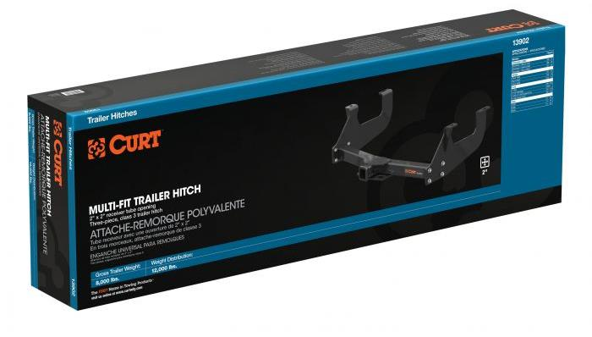
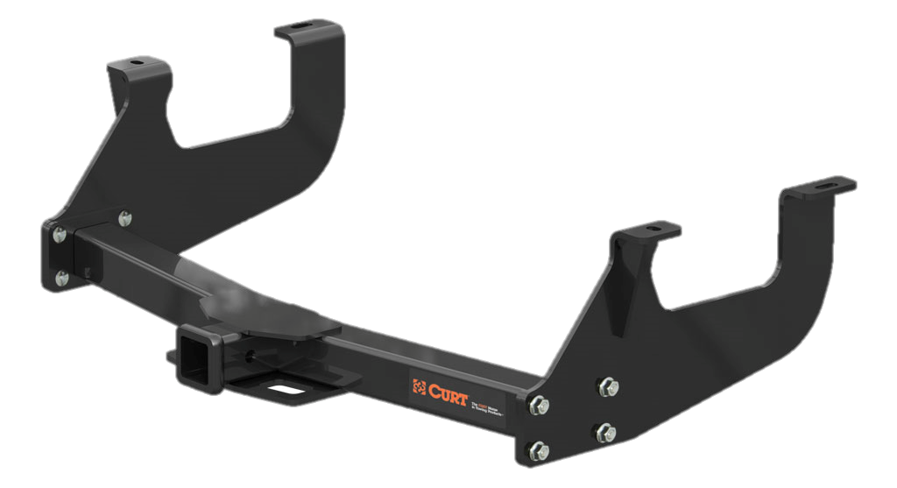
Trailer Hitches
Multi-Fit Trailer Hitches
Designed to fit a wide variety of vehicle applications
Most require little or no drilling
Great for retail settings
GTW capacities from 3,500 up to 15,000 lbs.
Available in class 2, 3 and 5
1-1/4” and 2” receiver tube size options
Robotically welded for superior strength and fit
Limited lifetime warranty
Did You Know?
13902 and 13903 together provide a comprehensive retail offering, covering most full-size truck applications.

Slide 12
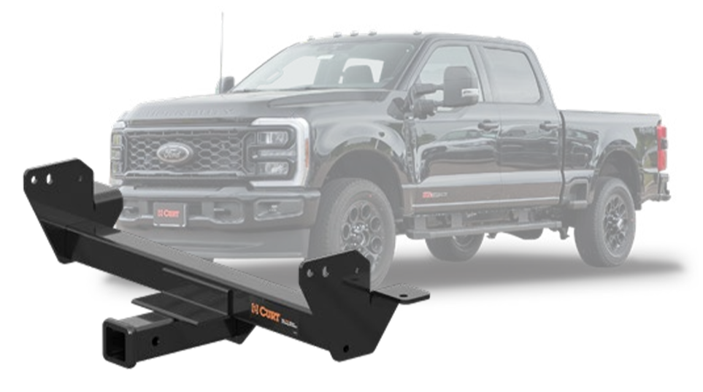
Trailer Hitches
Front Mount Hitches
Vehicle-specific design for a custom fit
2” x 2” receiver tube opening
Up to 5,000 lbs. GTW and 500 lbs. TW, 9,000 lbs. straight line pull
Provides a convenient mount for a snowplow or hitch accessory
Allows for easy maneuvering of a trailer into a tight spot
Tested for safety in accordance with SAE J684
Precisely welded for superior strength and fit
Made in USA with imported hardware
Limited lifetime warranty

Slide 13
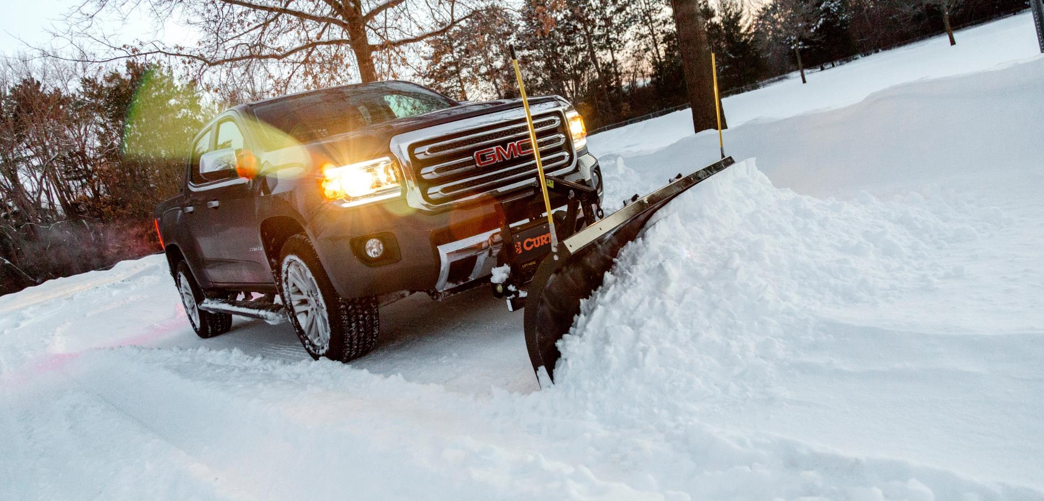
Trailer Hitches

Slide 14
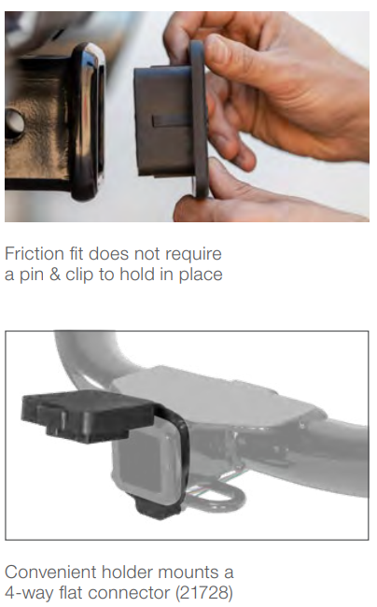
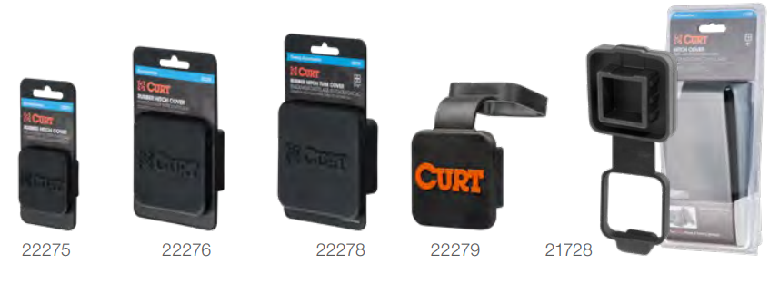
Trailer Hitches
Rubber Hitch Tube Covers
Protects 1-1/4", 2" or 2-1/2" receiver tube opening
Adds a clean, finished look and keeps debris out

Slide 15
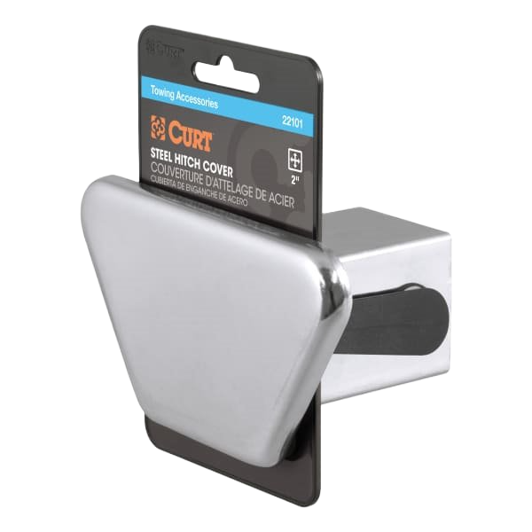
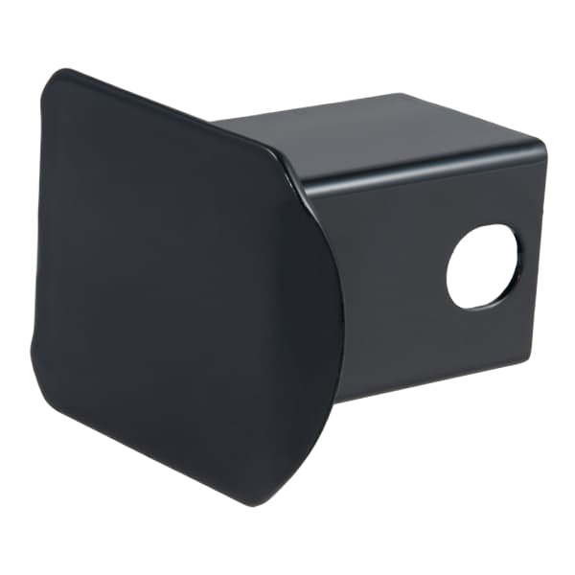
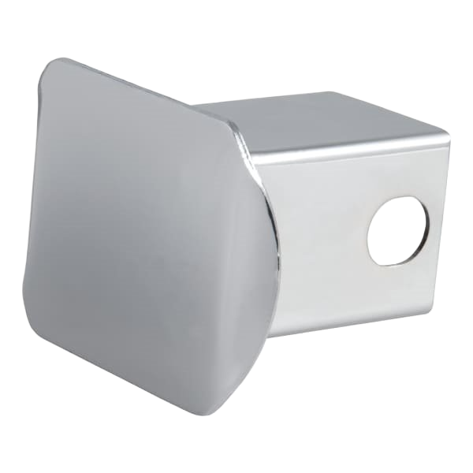
Trailer Hitches
Steel & Plastic Hitch Tube Covers
Adds a clean, finished look and keeps debris out
Available in high-strength steel or rust-free plastic
Protected by a durable chrome-plated finish (#22101, #22111, #22171 only)
Securely mounts using a pin and clip (not included)

Slide 16
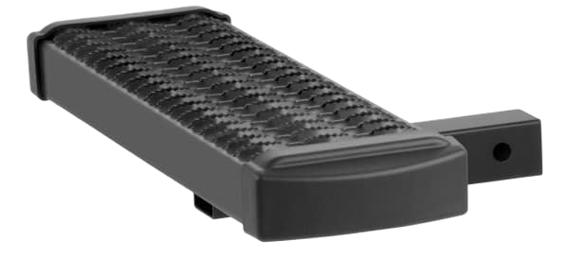
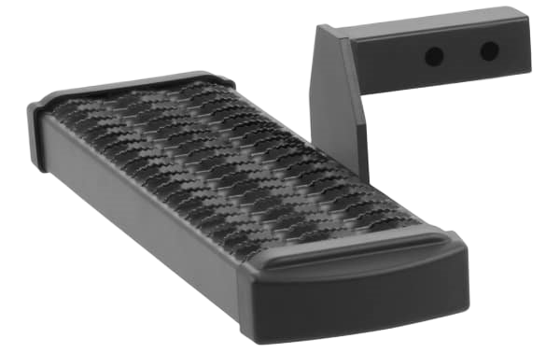
Trailer Hitches
Grip Step™ Hitch Steps
Fits any 2" x 2" receiver tube opening
Provides a 26" hitch-mounted step on the front or rear of the vehicle
Fleet-approved, expanded metal treads for maximum traction and safety
Powder-coated aluminum construction to be strong, lightweight and rust-free
6" drop provides easier access into larger vehicles (designed for use in drop position only - #32002)
Includes hitch pin & clip

Slide 17
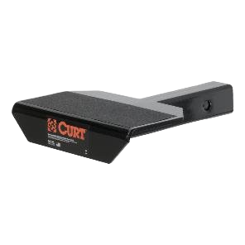
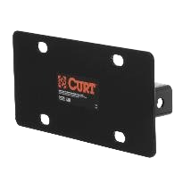
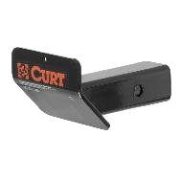
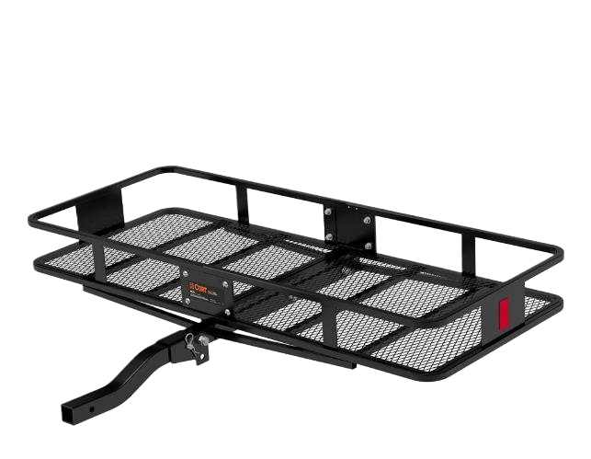
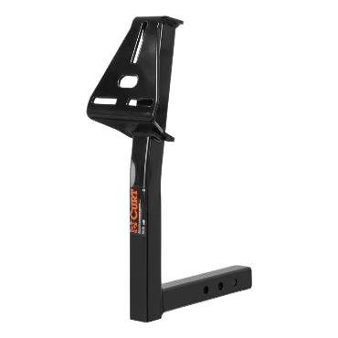
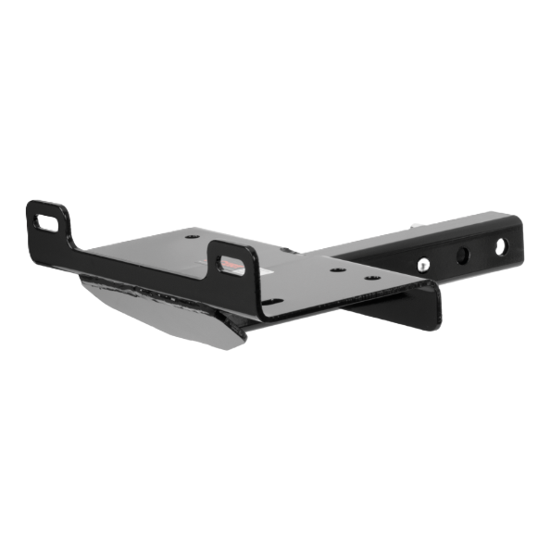
Trailer Hitches
Hitch-Mounted Accessories
Step pad
License plate holder
Skid shield
Spare tire mount
Winch mount
Cargo carrier

Slide 18
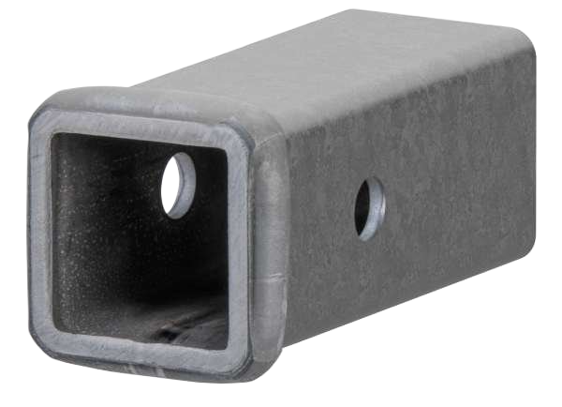
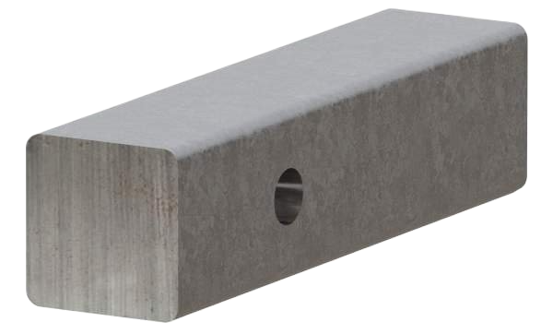
Trailer Hitches
Raw Steel Receiver Tubing
Raw finish allows for immediate welding
1/2" reinforcing collar for increased strength
Features a pre-drilled hitch pin hole
Raw Steel Hitch Bars
Raw finish allows for immediate welding
Rounded corners for easier insertion into the receiver
Constructed from high-strength, hot-rolled steel
Features a pre-drilled hitch pin hole

Slide 19
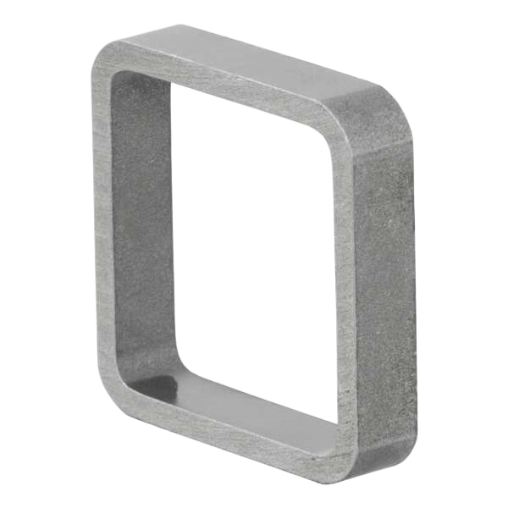
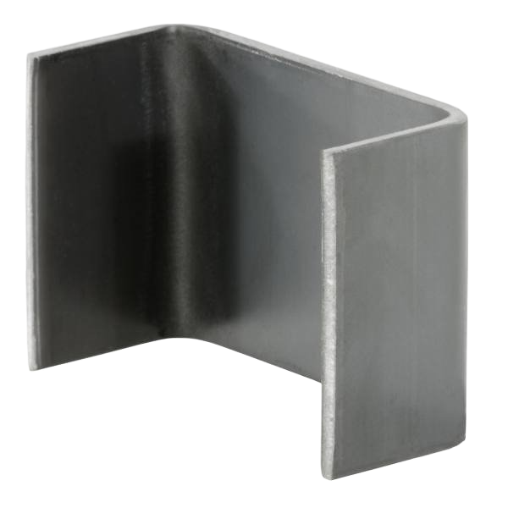
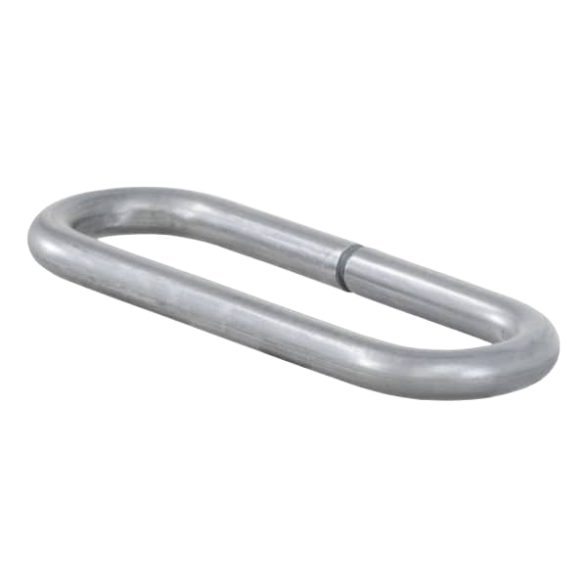
Trailer Hitches
Weld-on Accessories
Reinforcing collar provides added strength (#49770)
Accepts 2x4 studs or adds a tiedown for straps and chains (#83072)
Provides a safety chain attachment point (#49950)

Slide 20
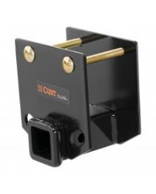
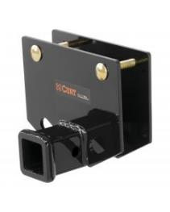
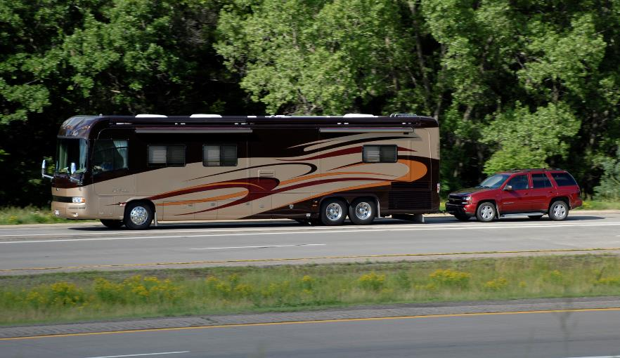
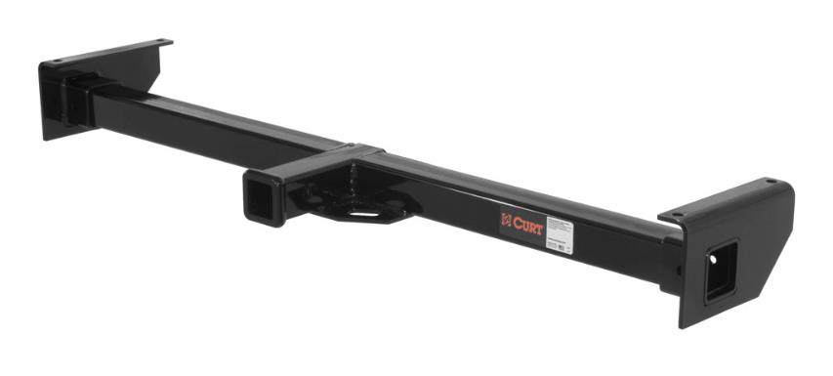
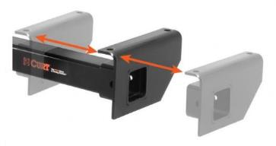
Trailer Hitches
RV Trailer Hitches
Designed for towing a trailer or small vehicle behind an RV
Built with a 3-piece, adjustable design
Available to fit up to 72” wide frames
Bumper hitches available to fit 2” x 4” or 4” x 4” bumper beams

Slide 21
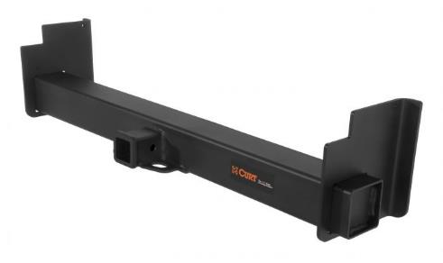
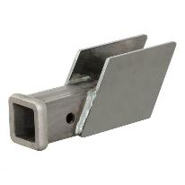
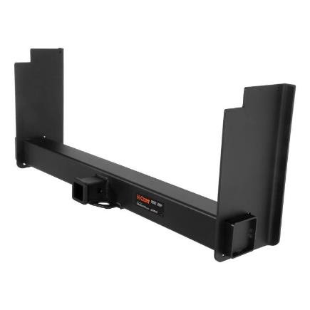
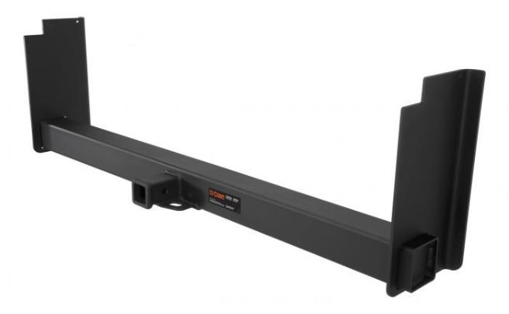
Trailer Hitches
Universal Weld-On Trailer Hitches
Adjustable frame fits a variety of vehicles (side plates do not come pre-welded)
Great for use with service body trucks
Rated up to 20,000 lbs. GTW
Co-cured in a rust-resistant liquid A-coat
Drop options up to 18” and widths up to 62”
Protected by a durable carbide powder coat finish
Raw steel, weld-on hitch box also available #49717
Tested for safety in accordance with SAE J684
Limited lifetime warranty

Slide 22
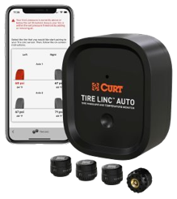
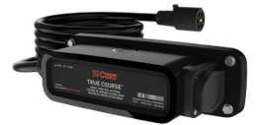
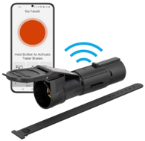


Trailer Hitches
Safety Suite with OneControl Auto
Powered by a Bluetooth®-enabled system and the OneControl® app, The CURT safety suite provides ultimate protection and peace of mind for the road ahead.
True Course Emergency Sway Control Emergency braking system combats sway caused by side winds, slippery roads and sudden movement.
TireLinc Auto TPMS This system allows you to monitor tire pressure and temperature as you tow in real-time, helping you to stay aware and safe.
Echo Series Brake Controllers The Echo brake controller family connects through Bluetooth® and is compatible with an array of vehicles and towing applications.

Slide 23

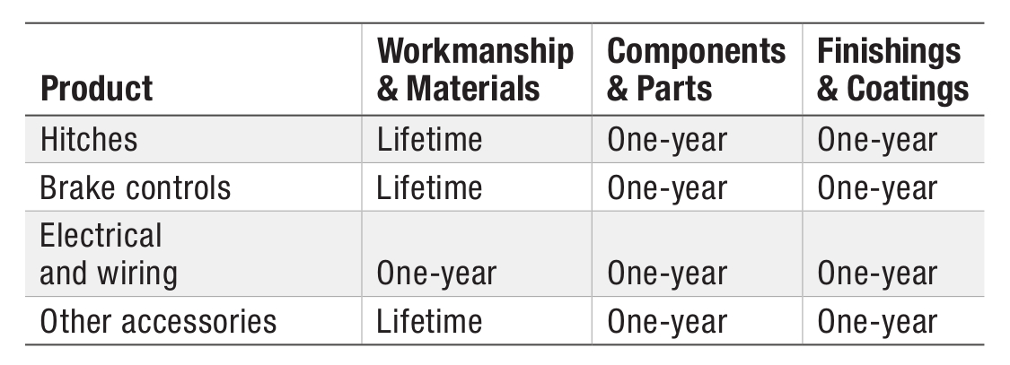
Trailer Hitches
Limited Lifetime Warranty
CURT provides limited lifetime warranty coverage against defects in factory workmanship and materials for CURT products sold by authorized CURT dealers for use by retail (end use) consumers.
https://storage.googleapis.com/curt-group-warranties/CURT_Warranty.pdf

