Slide 1
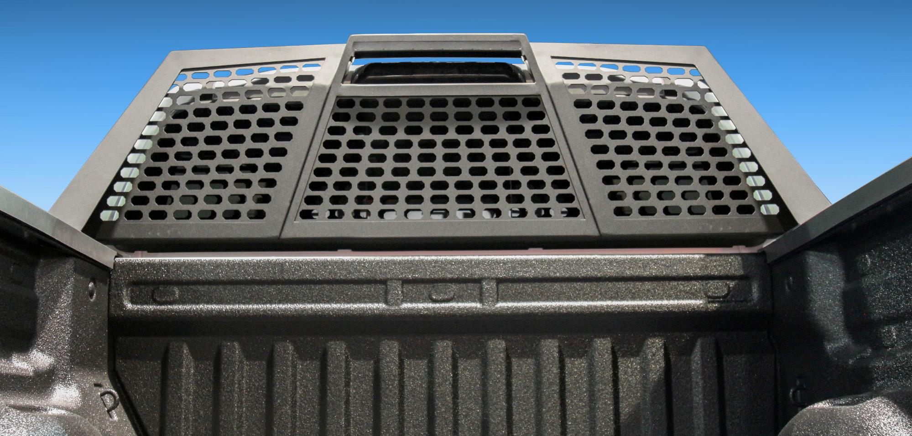

Headache Racks

Slide 2
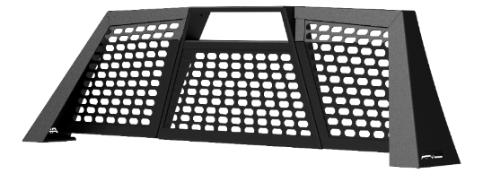
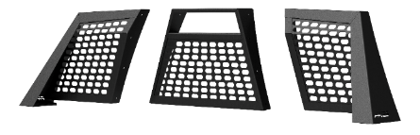
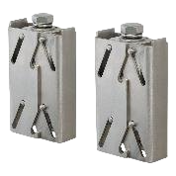
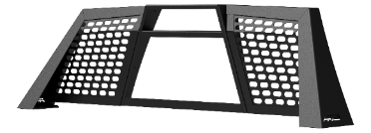
Headache Racks
Switchback® Headache Rack
All-aluminum construction to be strong,
lightweight and rust-free
Full-width, slotted top edge
accepts various LED lights
Patented stake pocket mounting
system for simple, secure installation
Knockdown assembly ships in three pieces
for reduced shipping requirements
Center section can be removed
for convenient access to the rear window
Highly durable carbide powder coat finish
for maximum corrosion resistance
Replacement stake pocket anchors #2090613

Slide 3
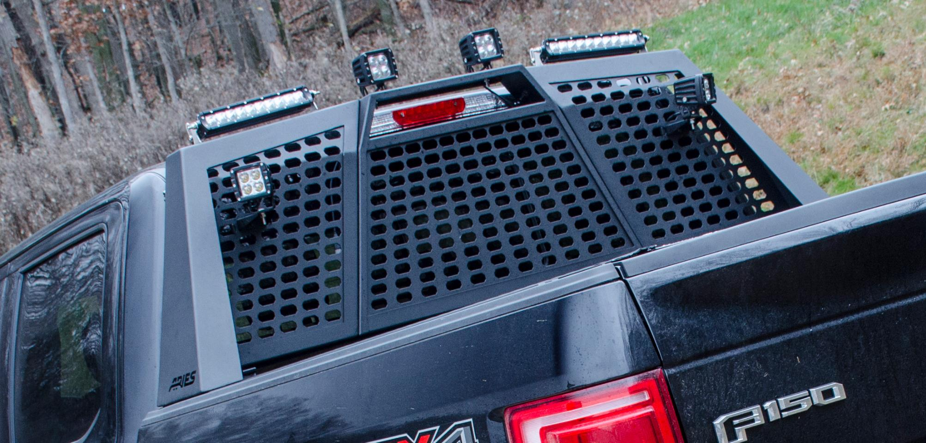
Headache Racks

Slide 4
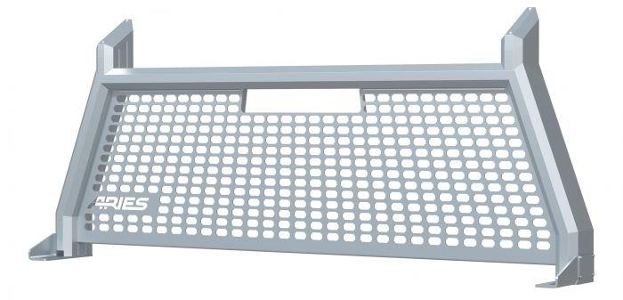
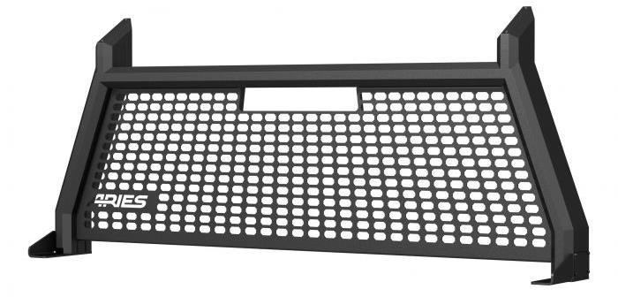
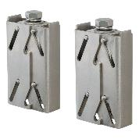
Headache Racks
AdvantEDGE™ Headache Rack
Unique, eight-sided tube profile to
complement the style of modern trucks
Topside track accepts LED
lights and tie-down anchors
Extruded, all-aluminum construction
to be strong, lightweight and rust-free
Available in carbide black
or chrome powder coat finish
Stamped aluminum, octagonal grid
center section for a distinct look
Patented stake pocket mounting
system for simple, secure installation
Made to complement other
AdvantEDGE™ accessories
Replacement stake pocket anchors #2090613

Slide 5
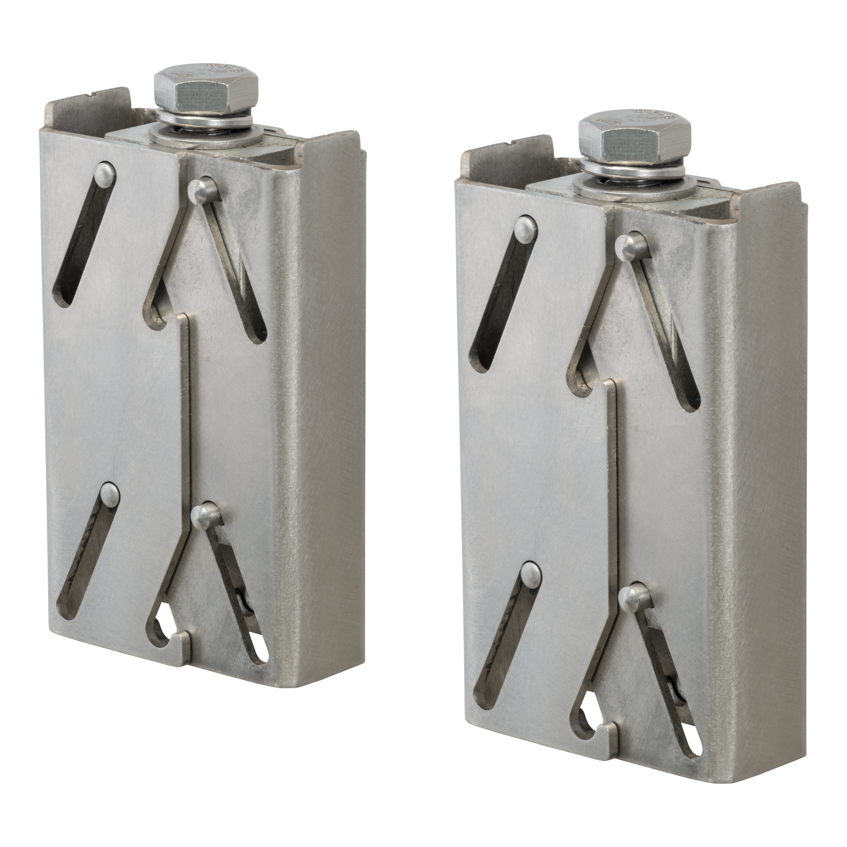
Headache Racks
Replacement Headache Rack Stake Pocket Anchors, 2 Pack
Compatible with AdvantEDGE or Switchback headache racks
Rust-resistant stainless steel and aluminum construction
Patented design for no-drill installation
Includes two stake pocket anchors
Not compatible with Toyota Tacoma applications
Patent #US 10023247 B2

Slide 6
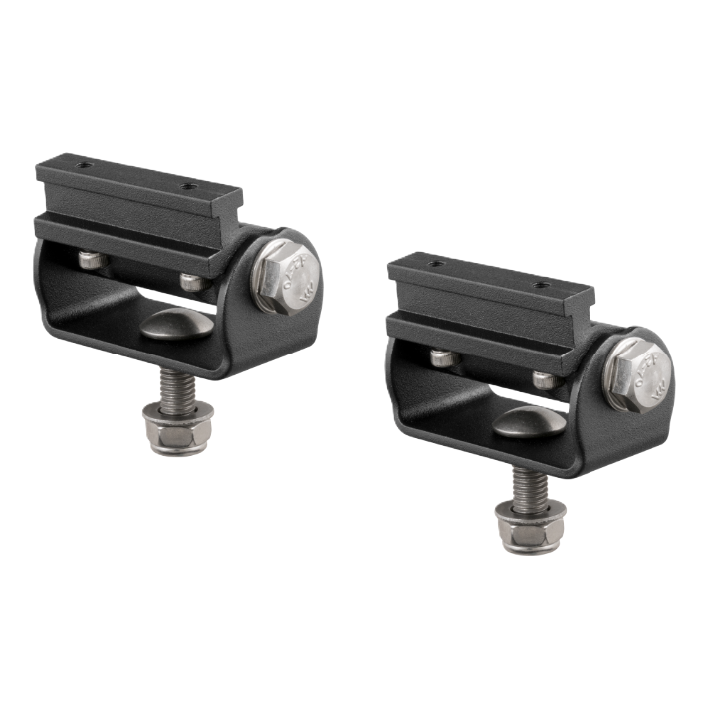
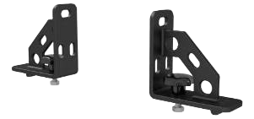
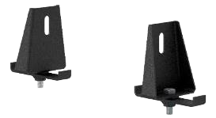
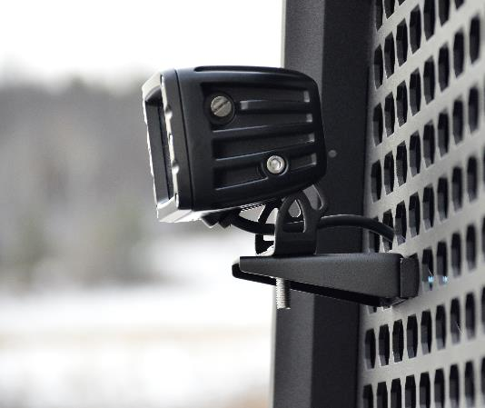
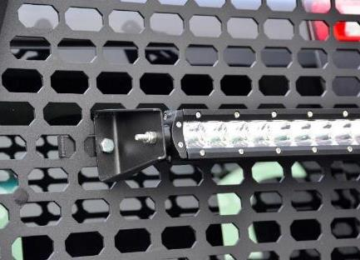
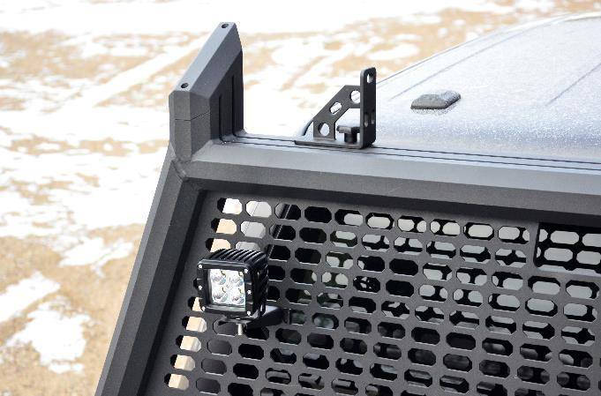
Headache Racks
AdvantEDGE™ Accessories
​
Tie-down anchors #1110310
Mesh-Mount Light Mounting Brackets #1110311​
Base-Mount Light Bar Bracket #1110312

Slide 7
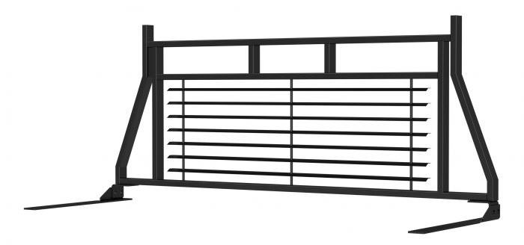
Headache Racks
Classic Headache Rack
Heavy-duty 1" x 2" steel tube
construction for a solid frame
Durable semi-gloss black powder
coat finish for rust and chip resistance
Fully louvered center section to
protect the cab and passengers
Louvers also help keep the cab
cooler by blocking direct sunlight
Flat steel brackets bolt onto the truck
bed walls (drilling may be required)
Compatible with most
crossover truck tool boxes

Slide 8
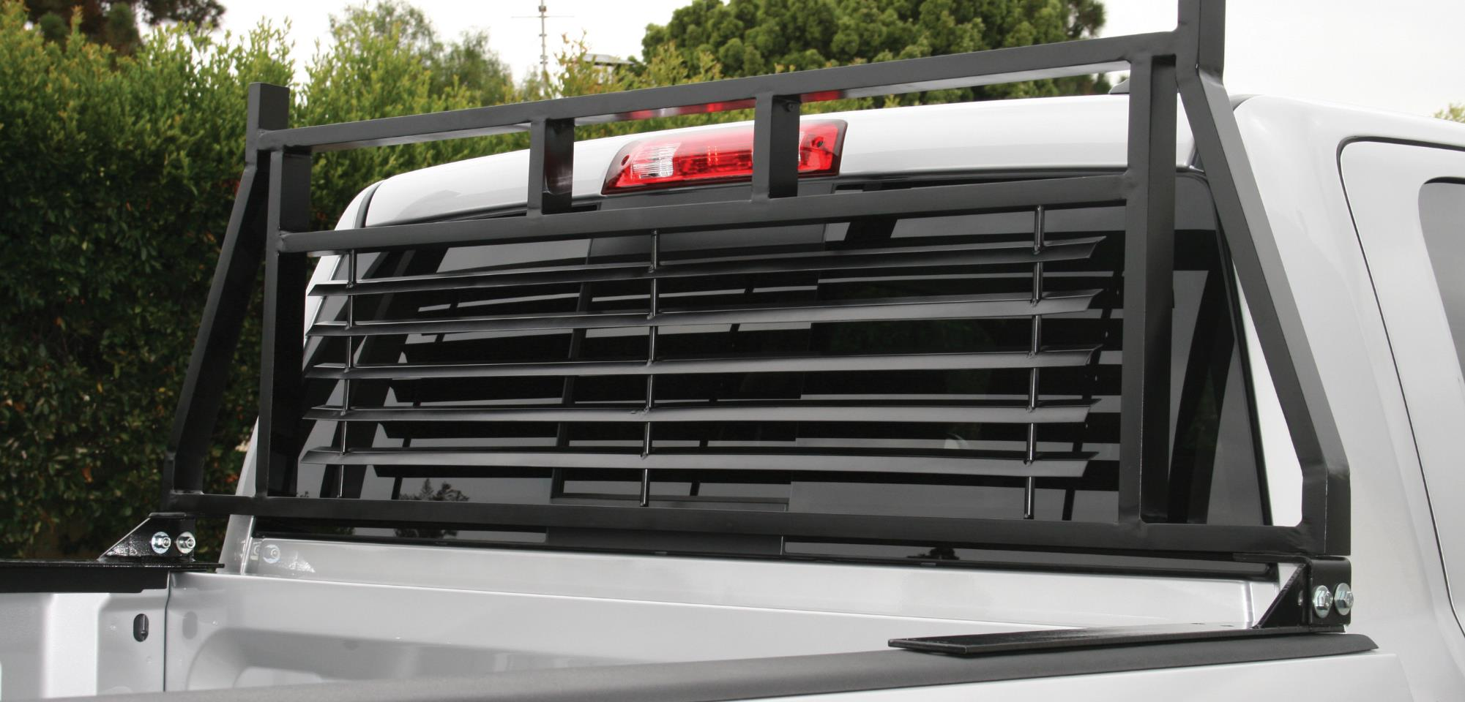
Headache Racks

Slide 9
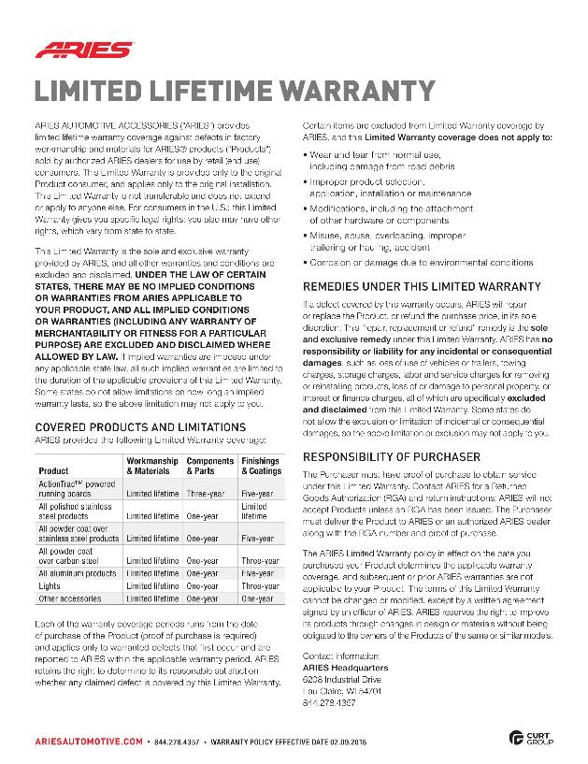
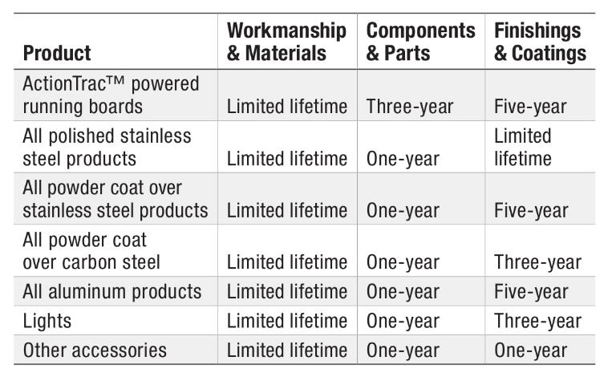
Headache Racks
Limited Lifetime Warranty
ARIES provides limited lifetime warranty coverage against defects in factory workmanship and materials for ARIES products sold by authorized ARIES dealers for use by retail (end use) consumers.
https://storage.googleapis.com/curt-group-warranties/ARIES_Warranty.pdf

