Slide 1
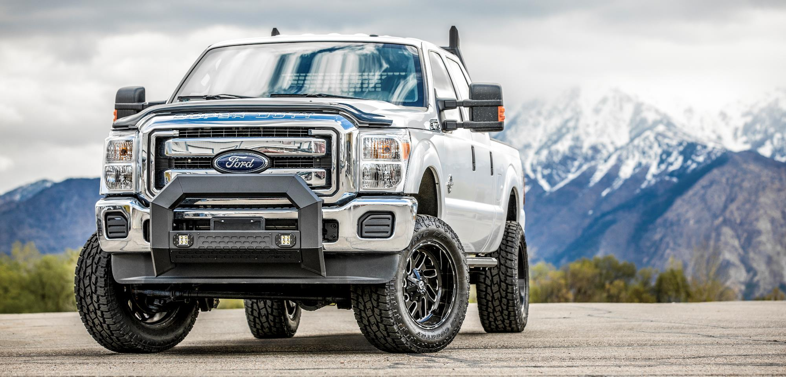

Bull Bars

Slide 2
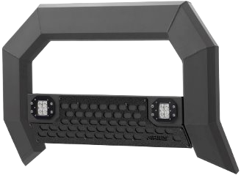
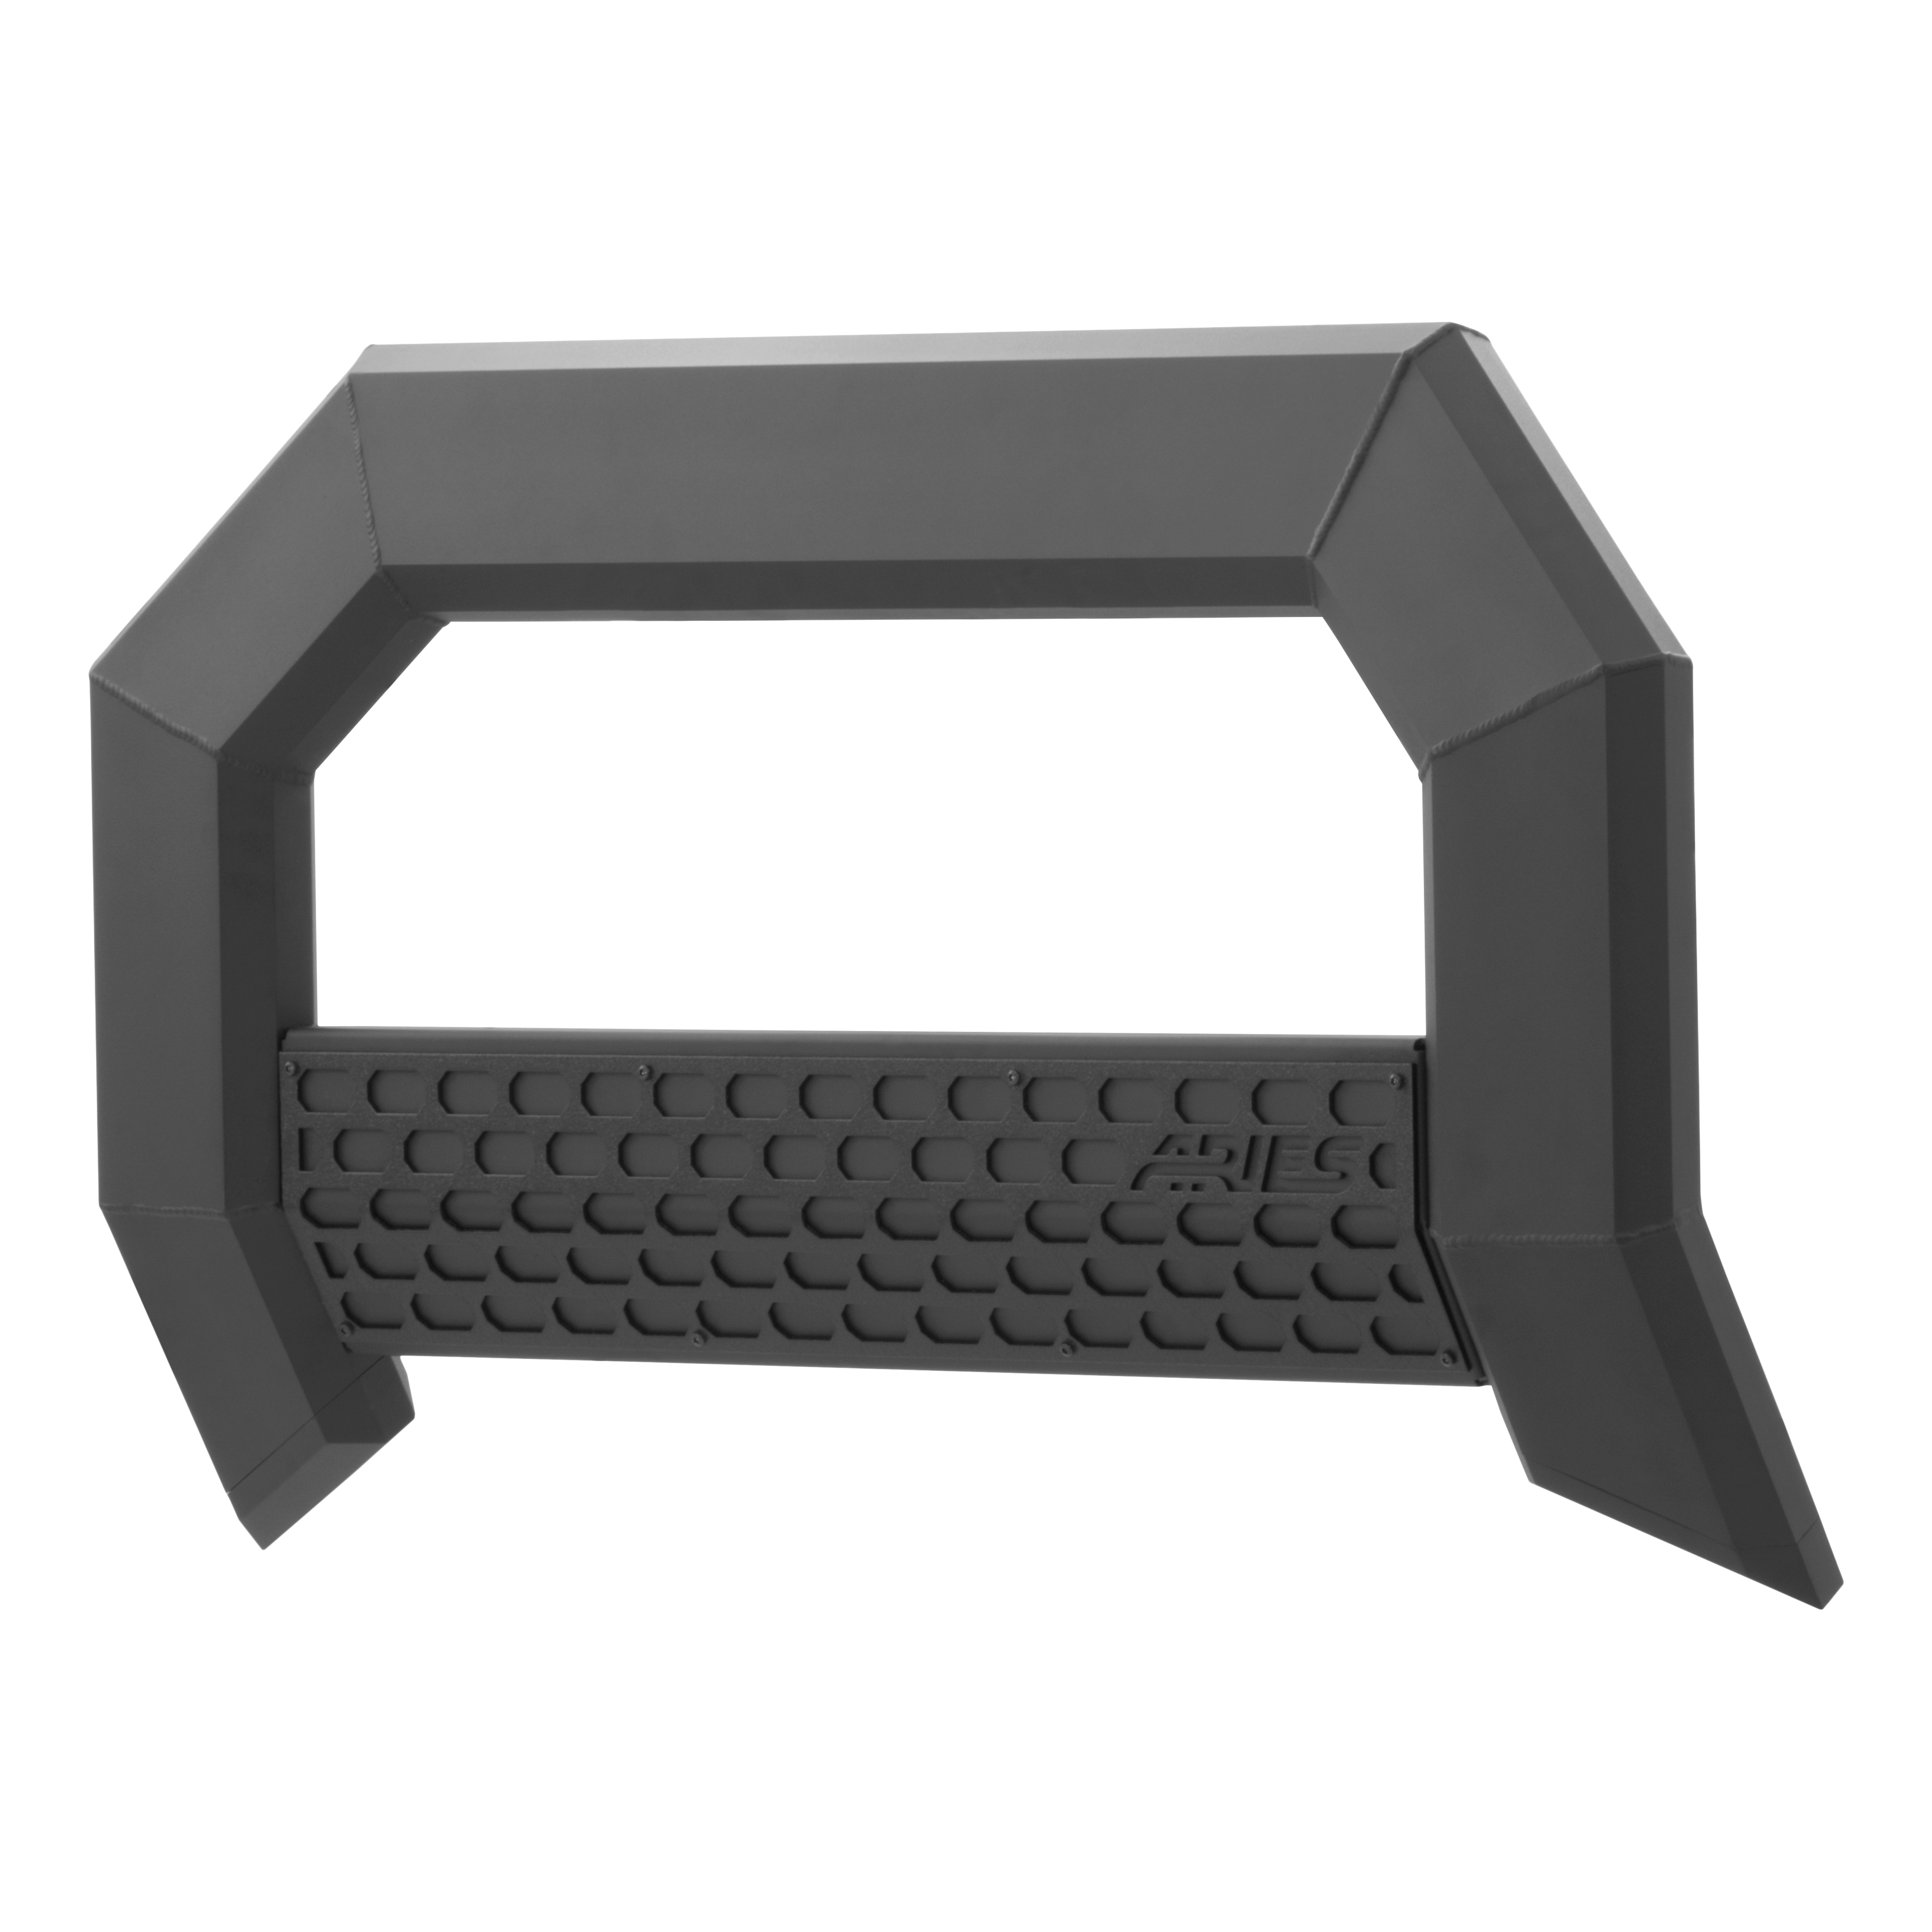
Bull Bars
AdvantEDGE™ 5-1/2” Bull Bars
Unique, eight-sided tube profile to
complement the style of modern trucks
Extruded, all-aluminum construction to
be strong, lightweight and rust-free
Optional crossbar with two 2” LED lights
No-drill, vehicle-specific application for a custom fit
Durable carbide black powder coat finish
Side bars and headache rack also available

Slide 3
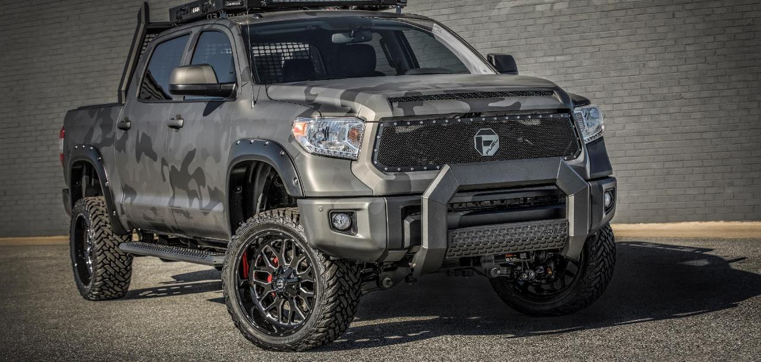
Bull Bars

Slide 4
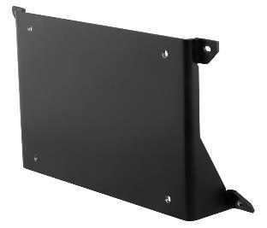
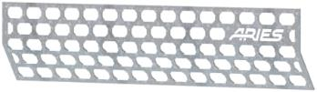

Bull Bars
AdvantEDGE™ Accessories
Paintable cover plates
Raw aluminum finish
to be easily painted
Two styles to fit bull bar
with LEDs or without
Light bar brackets
Provides an adjustable
mounting point for most
LED light bars
Equipped with an 8mm stud
License plate bracket
Easily bolts onto crossbar, using existing cover plate hardware
Provides a solid mount to
keep license plate visible

Slide 5
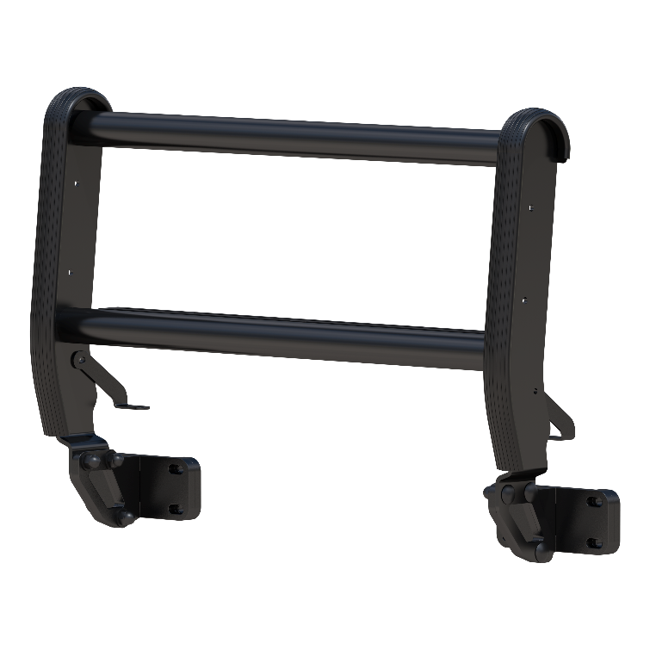
Bull Bars
ForeFront™ Bull Bar for Ford Bronco
Designed exclusively for the Ford Bronco
Carbon steel frame provides durable,
high-quality front-end protection
Four-point frame mount
system for exceptional stability
One-piece, welded build to
maximize strength and durability
Form-fitting, sleek design
complements the lines of the vehicle
Integrated tow hooks for
towing and hauling capabilities
Built-in light mounts for aftermarket LED lights
Highly corrosion-resistant zinc primer
and textured black powder coat finish

Slide 6
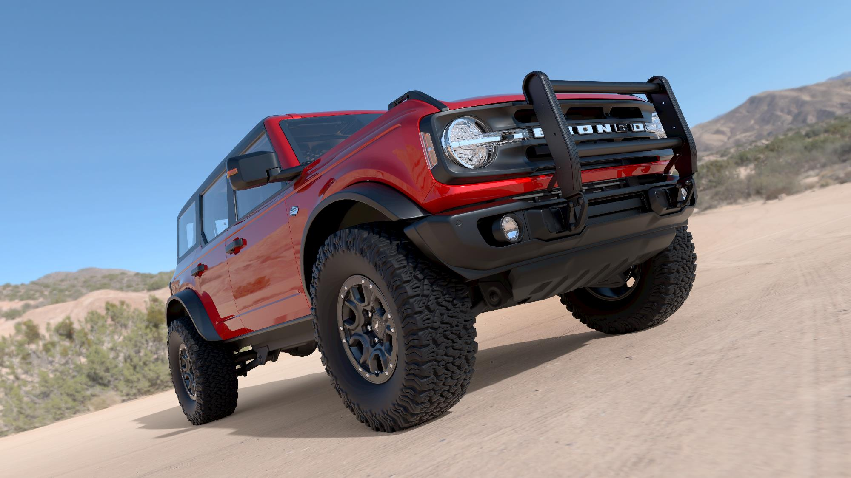

Slide 7
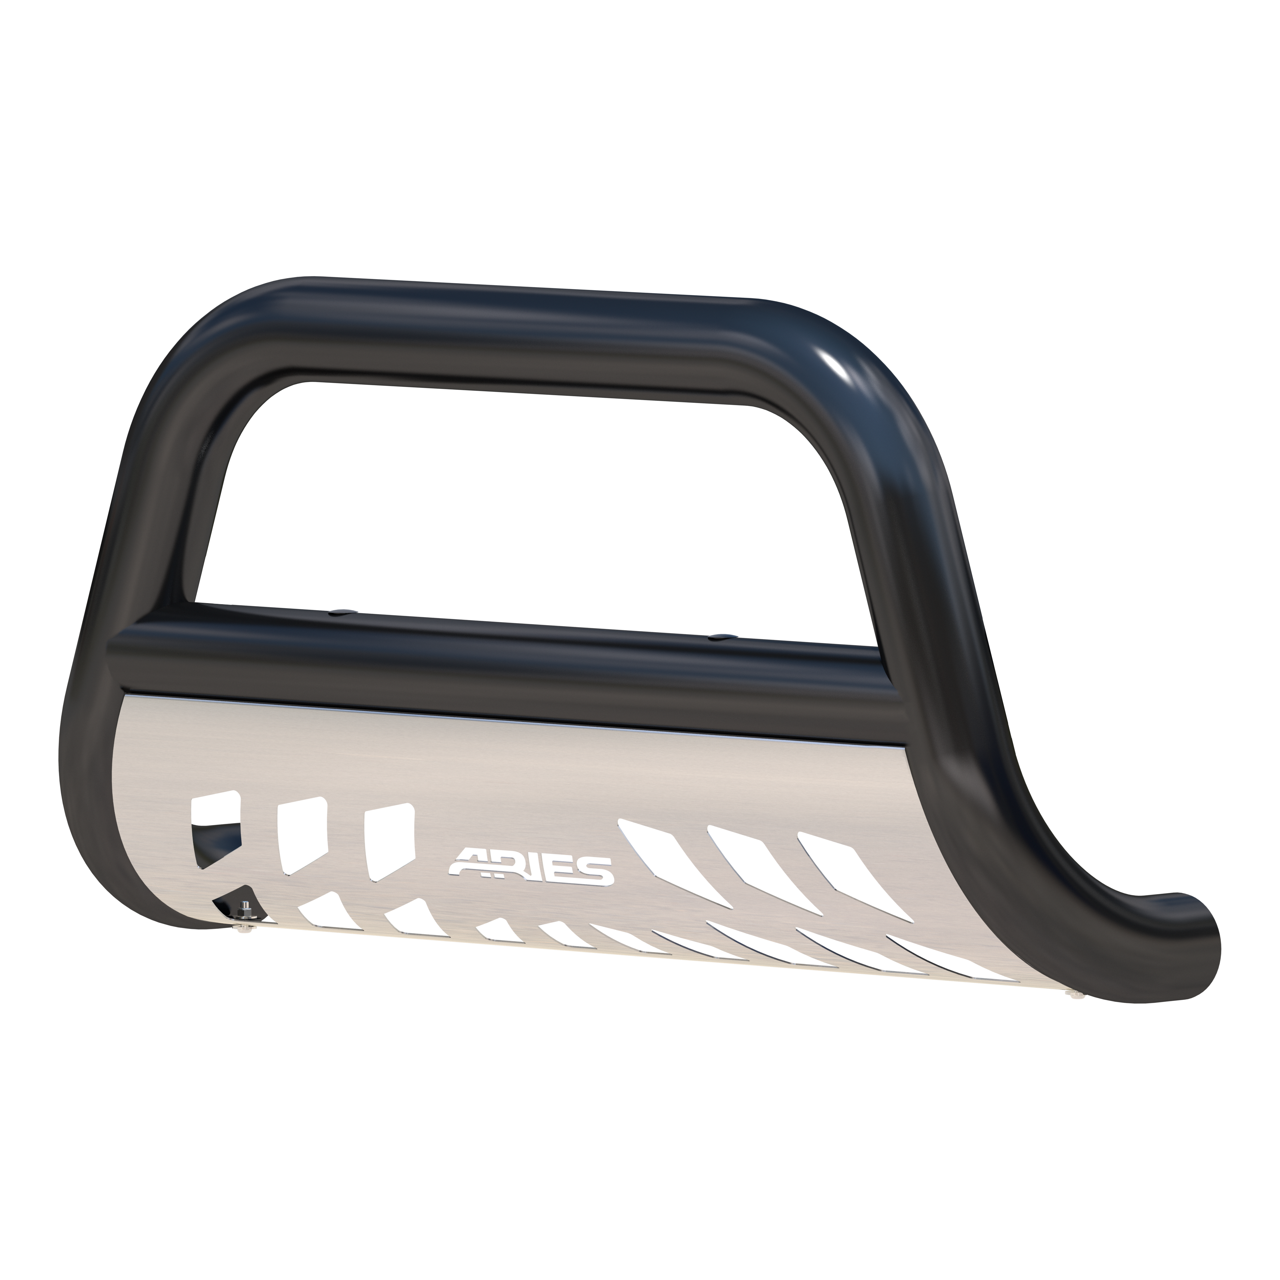
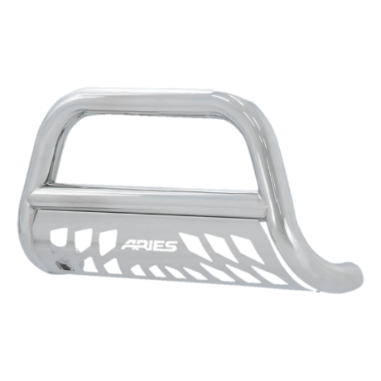
Bull Bars
3” Bull Bars
Hundreds of applications,
including for older trucks
Light mounting holes in the crossbar
Available in two finishes:
  Polished 304 stainless steel
  Semi-gloss black carbon steel

Slide 8
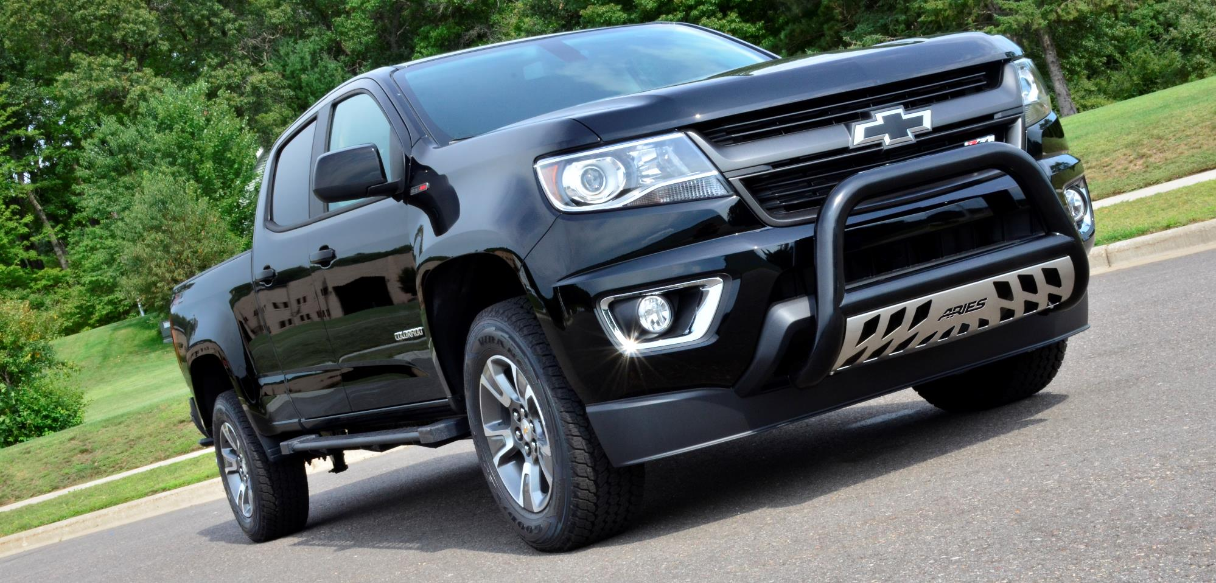
Bull Bars

Slide 9
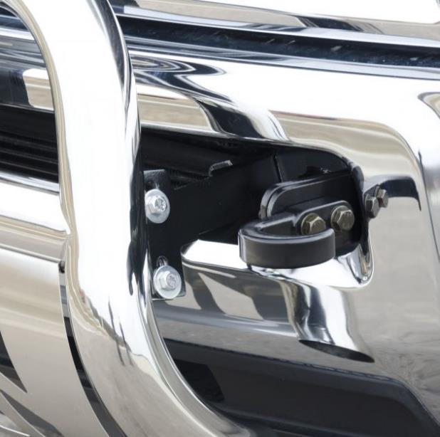
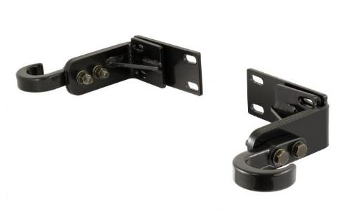
Bull Bars
Ram 2500 / 3500 Tow Hooks #35-5TOW
ARIES is the only brand to offer a solution for the loss
of the factory tow hooks on 2010-2019 Ram 2500 / 3500
Compatible with 3” and 4” bull bars
Up to 10,000 lbs. load capacity

Slide 10
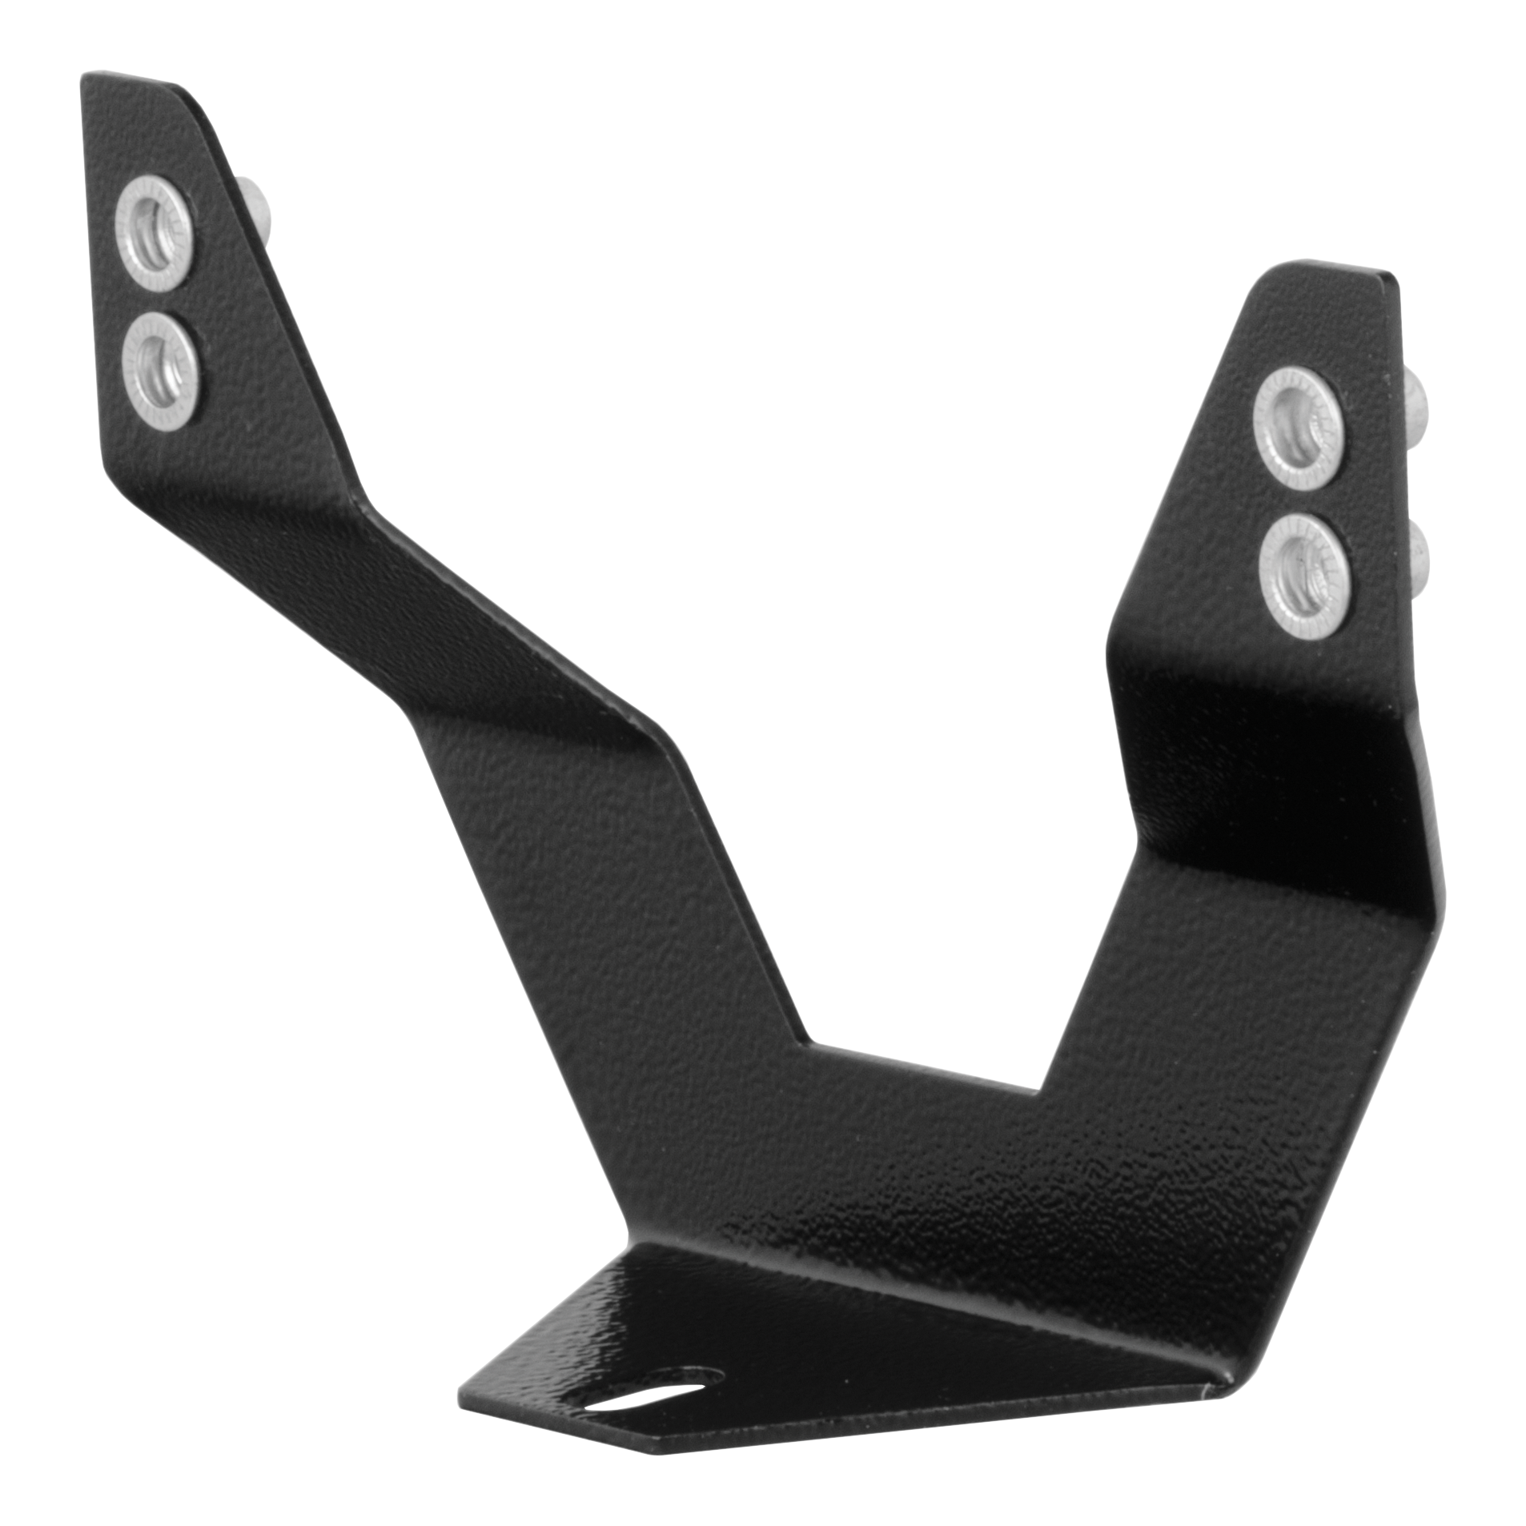
Bull Bars
License Plate Brackets
Easily bolts onto crossbar, using existing cover plate / skid plate hardware
Provides a solid mounting location to keep license plate visible
Includes license plate mounting bolts

Slide 11
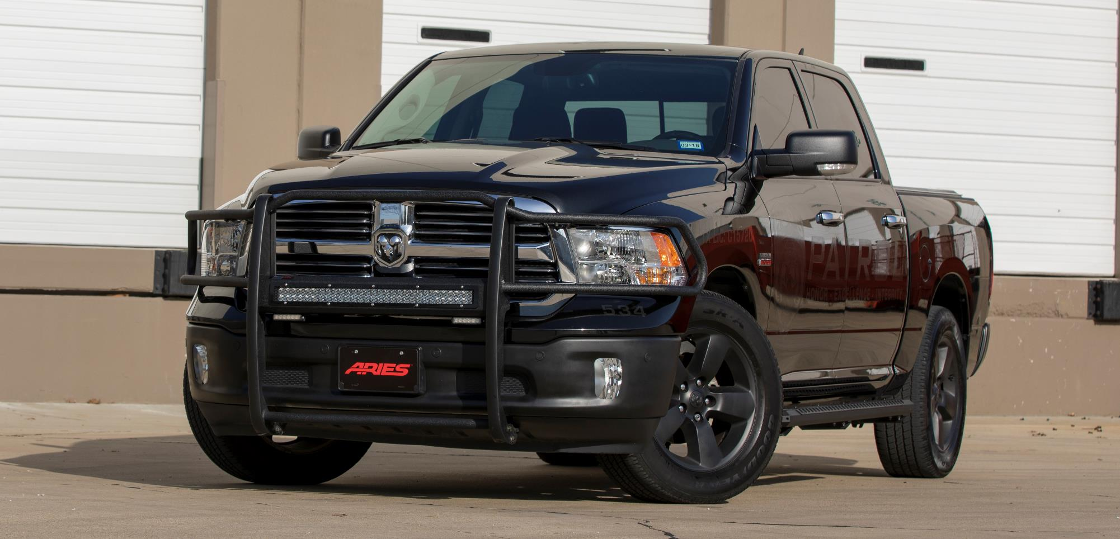

Grille Guards

Slide 12
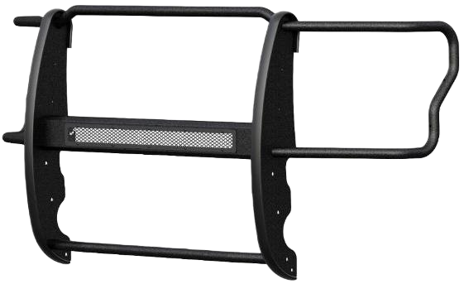
Grille Guards
Pro Series™ Grille Guards
Patented crossbar houses a single-row
LED light bar (also available without light bar)
Articulating bracket allows light
to be mounted at a custom angle
Highly durable, black powder coat finish
with rust-resistant E-coat
One-piece, 1-1/2" diameter,
heavy-wall tubing in high-strength steel
Vertical rubber stripping along the
risers to help maintain a clean finish
No-drill, vehicle-specific fit

Slide 13
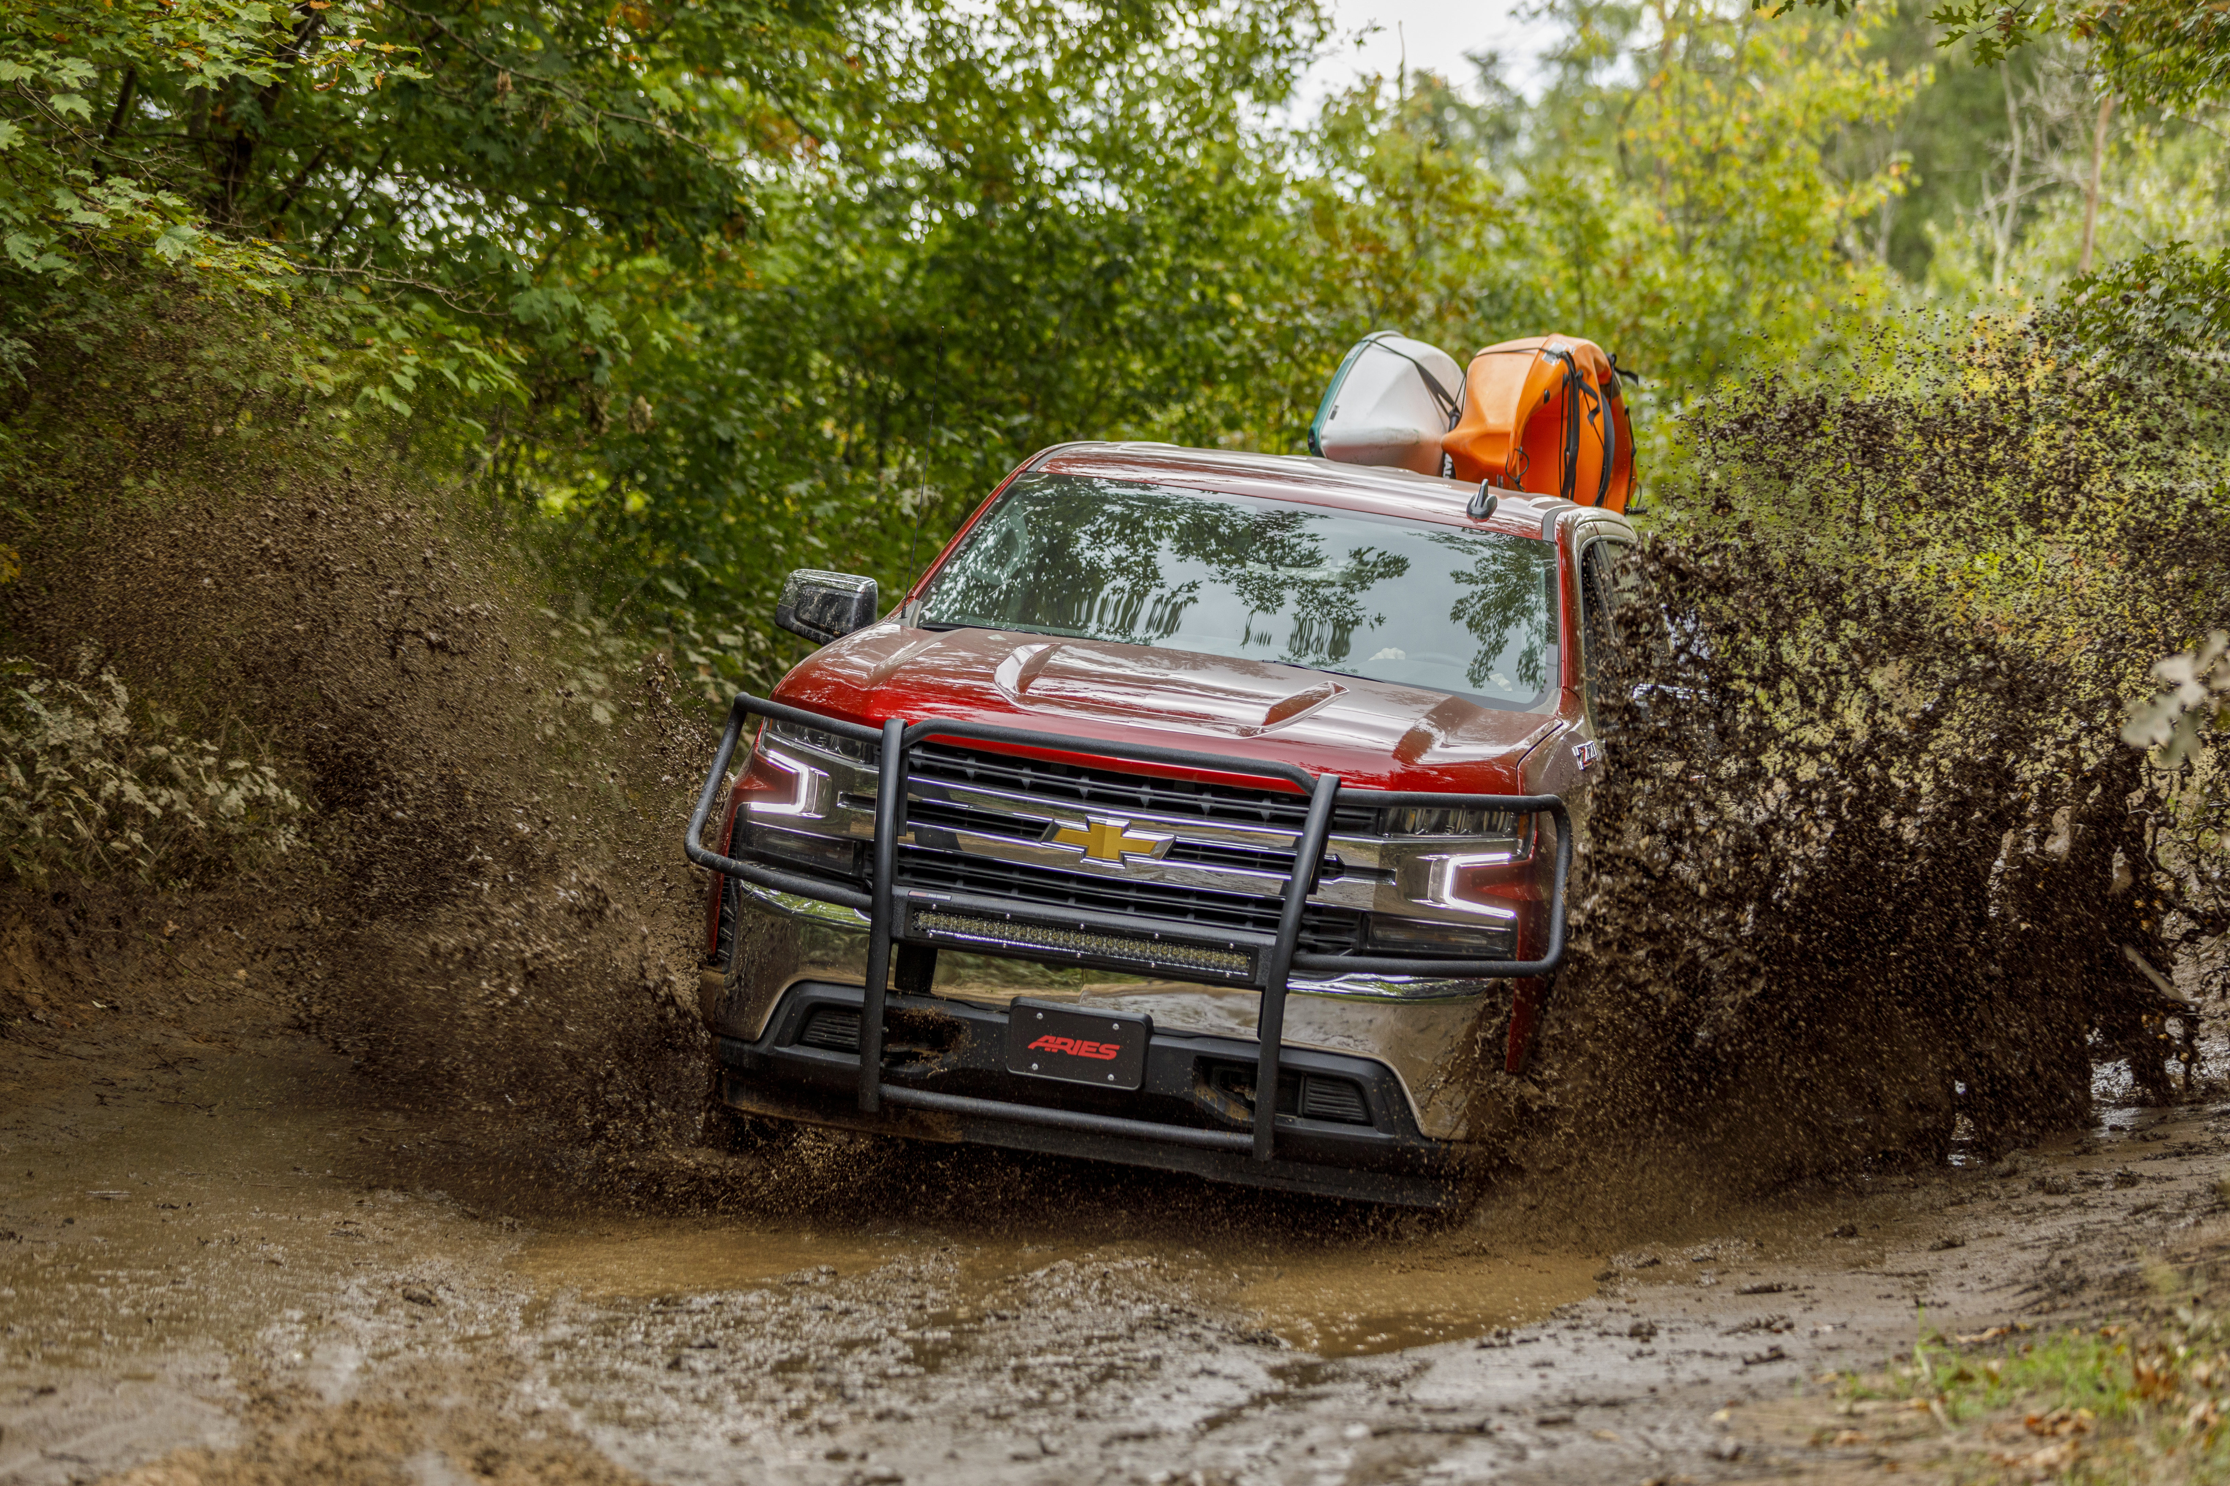
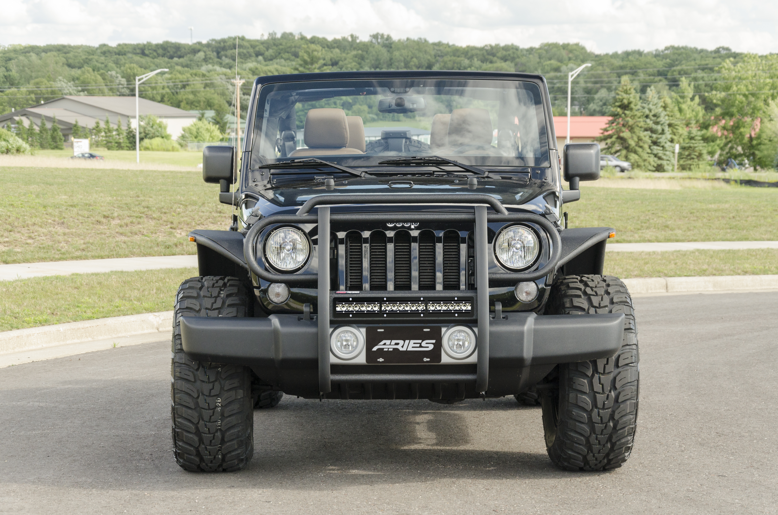
Grille Guards
Pro Series™ Grille Guards
Jeep version offers a unique look
(20” light bar housing, instead of 30”)

Slide 14
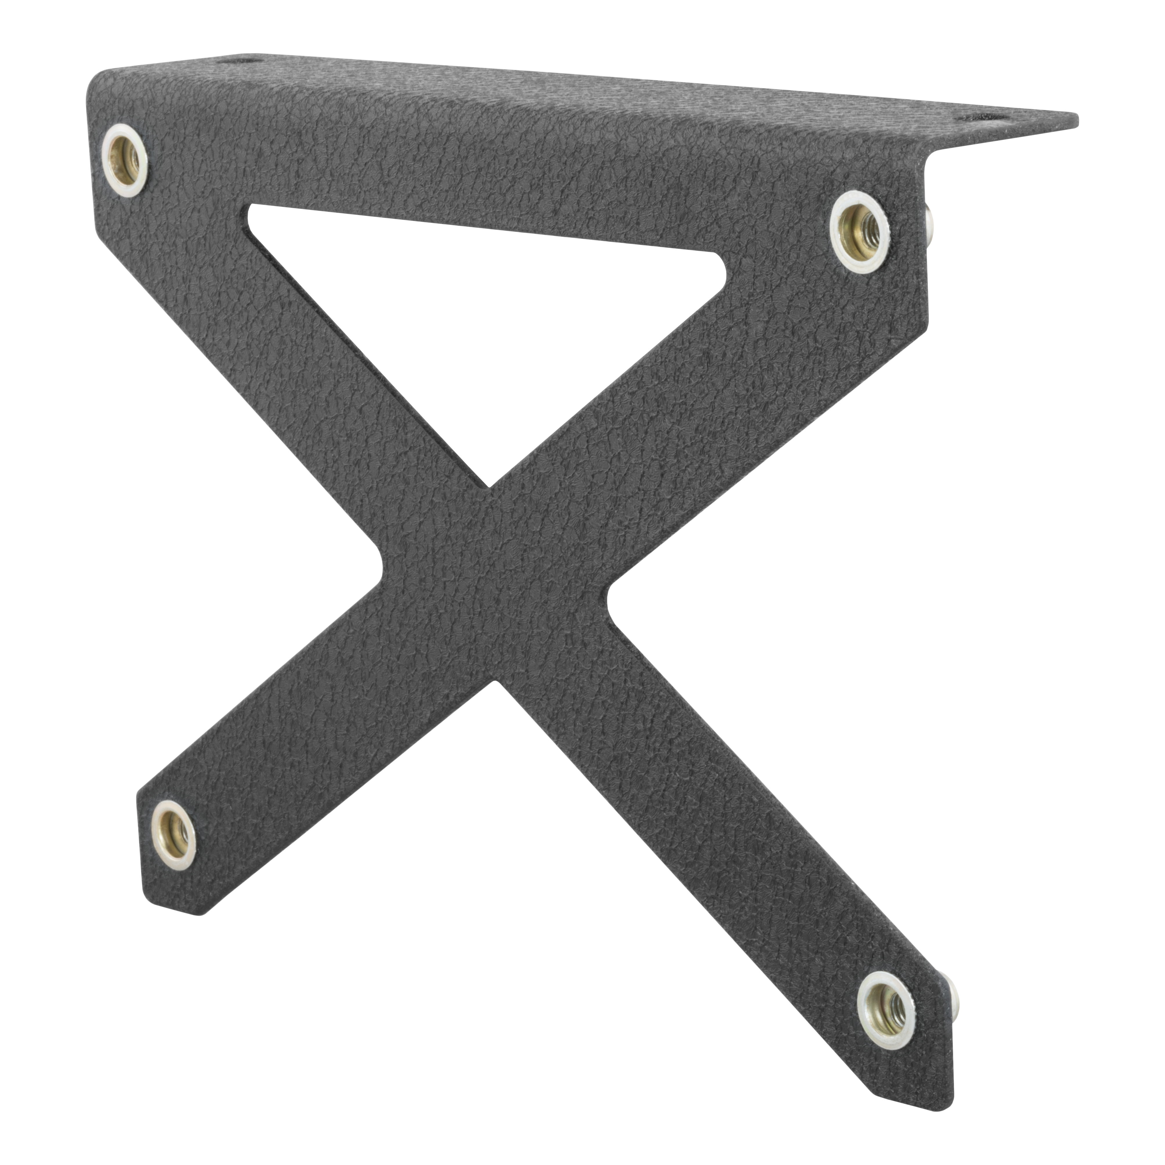
Grille Guards
License Plate Bracket
Easily bolts onto the crossbar,
using included hardware
Provides a solid mounting location
to keep license plate visible
Strong steel construction with a durable black powder coat finish
Includes license plate mounting bolts

Slide 15
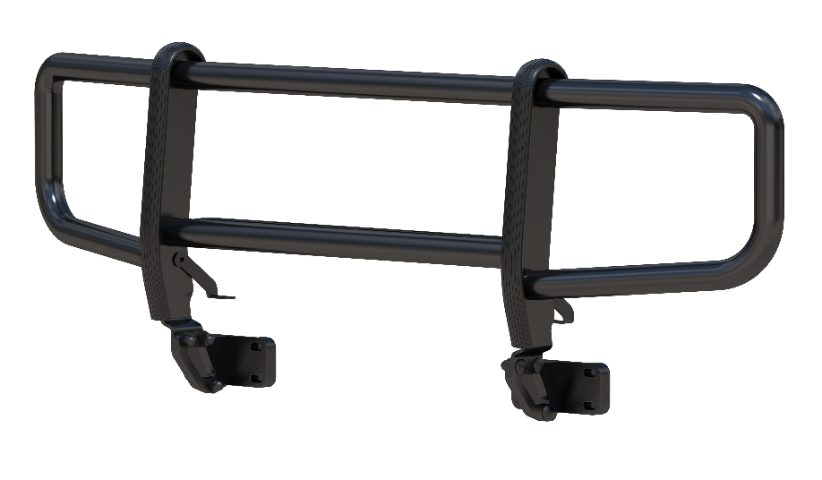
Grille Guards
ForeFront™ Grille Guard for Ford Bronco
Designed exclusively for the Ford Bronco
Carbon steel frame provides durable,
high-quality front-end protection
Four-point frame mount
system for exceptional stability
One-piece, welded center piece
to maximize strength and durability
Side brush guards provide
added headlight protection
Form-fitting, sleek design
complements the lines of the vehicle
Highly corrosion-resistant zinc primer
and textured black powder coat finish

Slide 16
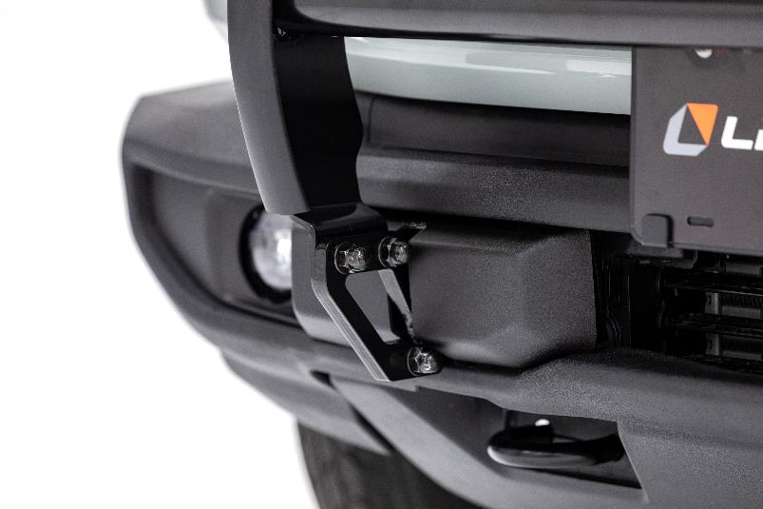
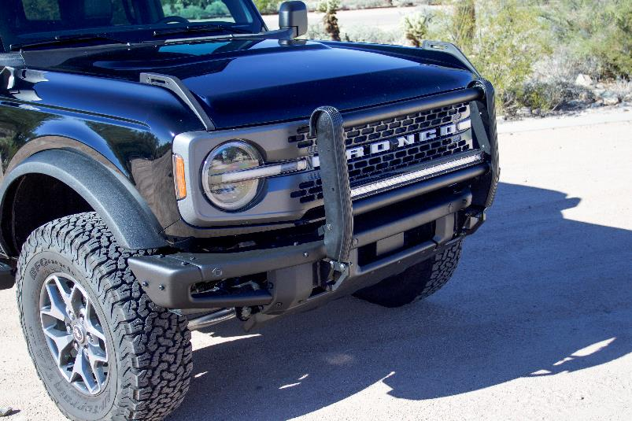
Grille Guards
ForeFront™ Grille Guard for Ford Bronco
Integrated tow hooks for
towing and hauling capabilities
Built-in light mounts for
aftermarket LED lights
Bull bar version shown with LED light bar

Slide 17
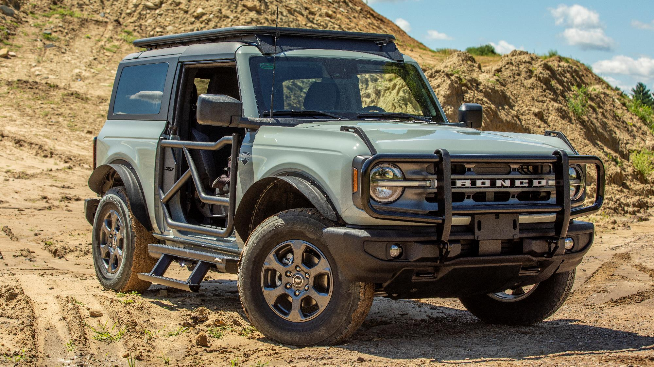

Slide 18
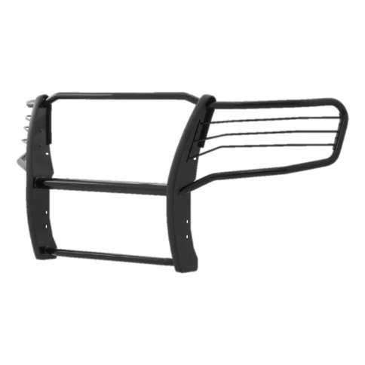
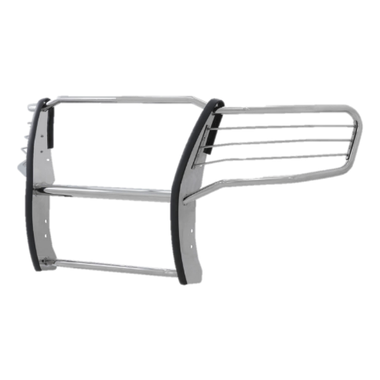
Grille Guards
Grille Guards
Hundreds of applications,
including for older trucks
One-piece, 1-1/2" diameter,
heavy-wall tube design
Pre-drilled crossbar for
mounting auxiliary lights
Removable headlight
cages for a custom look
Available in polished stainless steel
or semi-gloss black powder-coated steel

Slide 19
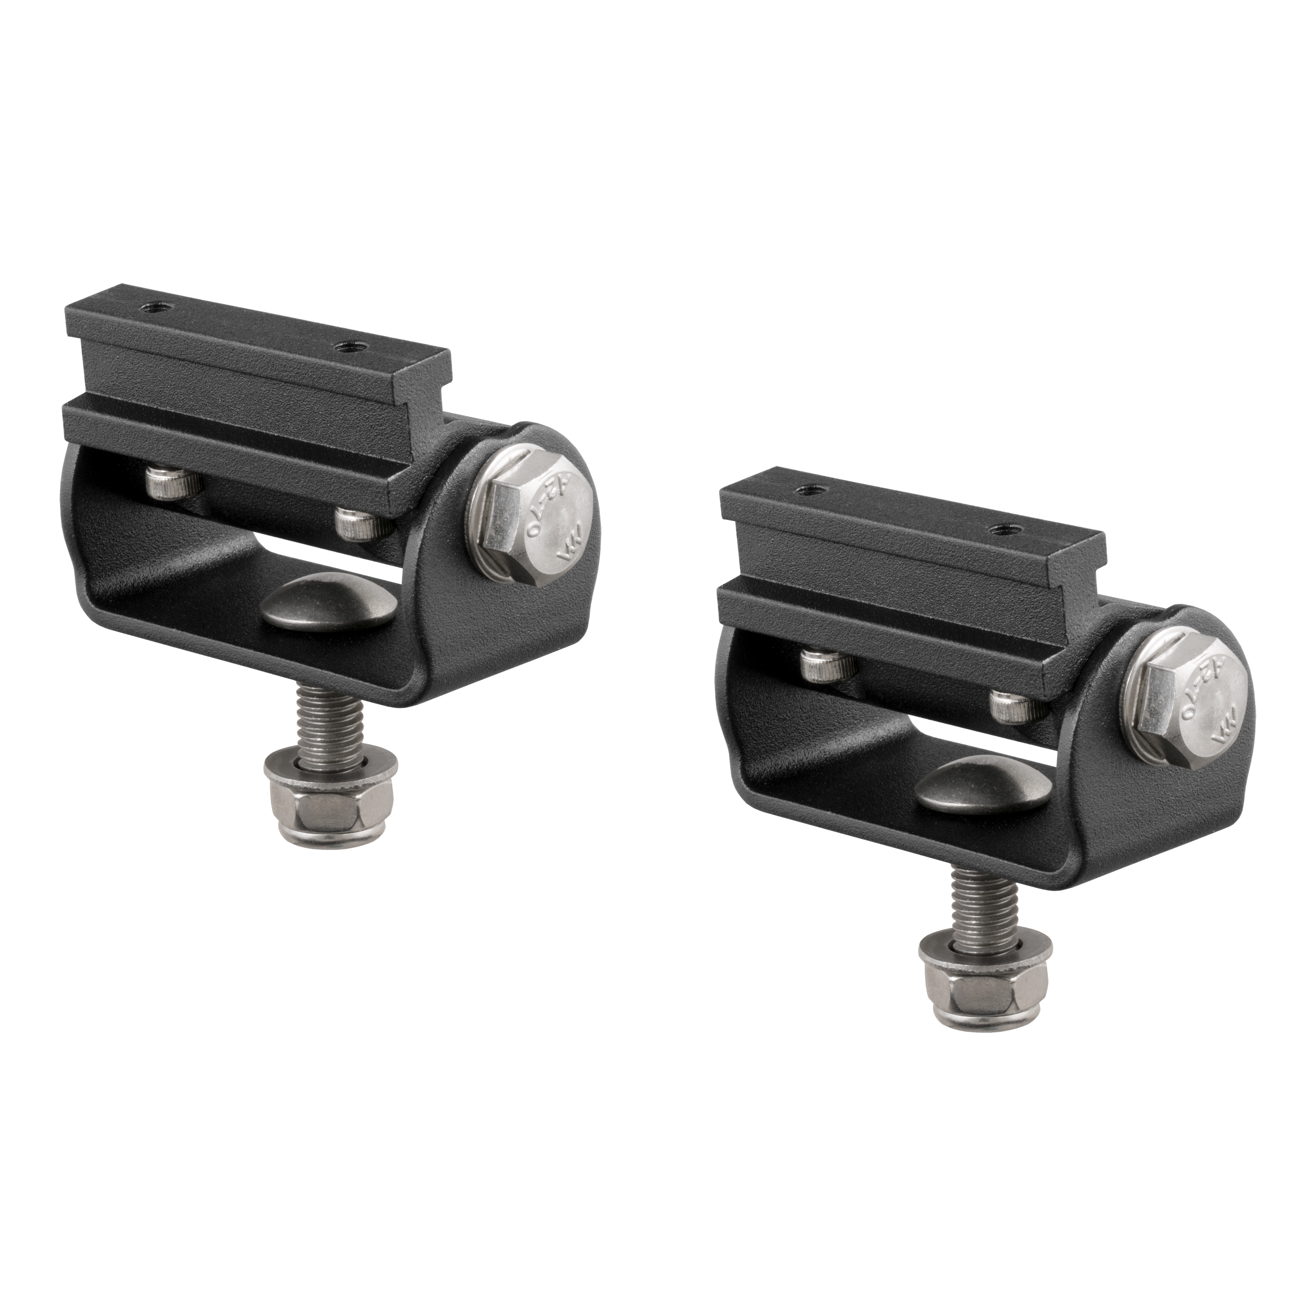
Grille Guards
Base-Mount Light Bar Brackets
Provides a solid, adjustable mounting point for ARIES LED light bars
Perfect for adding light bars to bull bars, grille guards and headache racks
Equipped with an 8mm stud (light bar mounting hardware not included)
Die-cast aluminum construction to be strong, lightweight, and rust-free
Some drilling and additional hardware may be required for installation

Slide 20
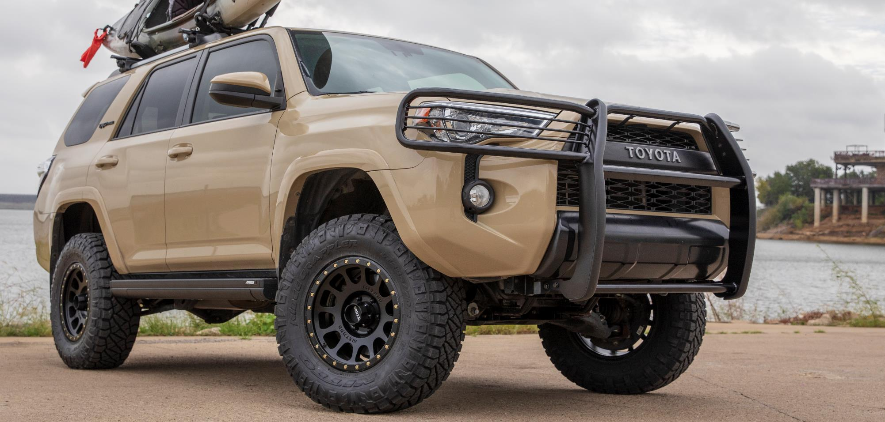
Grille Guards

Slide 21
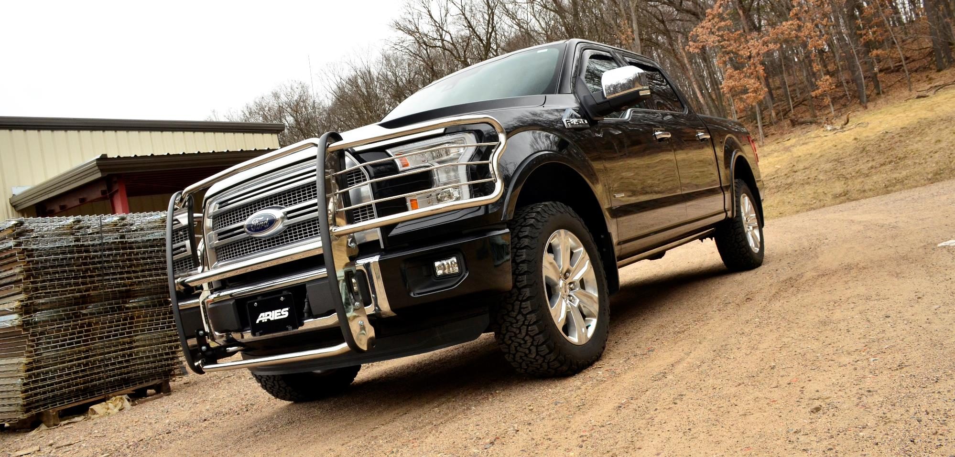
Grille Guards

Slide 22
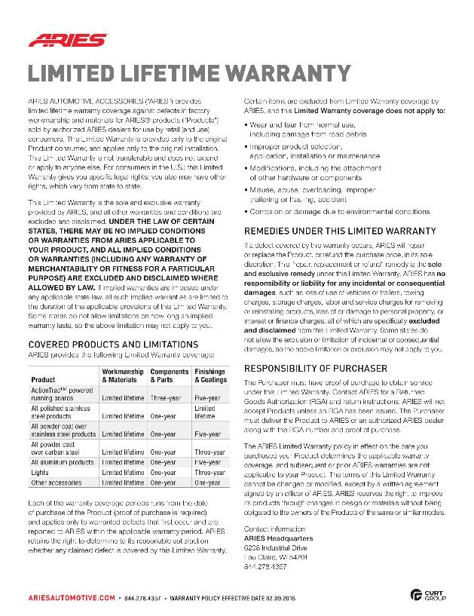
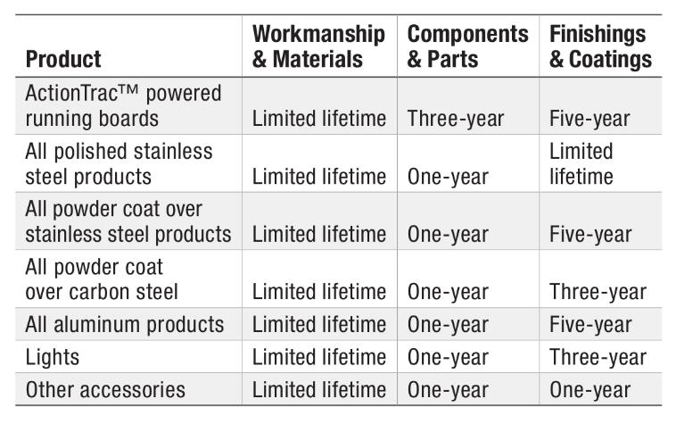
Grille Guards & Bull Bars
Limited Lifetime Warranty
ARIES provides limited lifetime warranty coverage against defects in factory workmanship and materials for ARIES products sold by authorized ARIES dealers for use by retail (end use) consumers.
https://storage.googleapis.com/curt-group-warranties/ARIES_Warranty.pdf

