Slide 1



Insert Headline
Here
Product Description
Product Name
Item# | Flavor | Pack Size | Distributor#
MDM # | Flavor here | Size here | # here
Keep Frozen: Months // Ambient Shelf Life: Days once thawed
NOW AVAILABLE
3001 Broadway Street NE, Suite 400, Minneapolis, MN 55413 | 888.444.0322 | RiseBakingCompany.com
^{1132v6 06.26}

Slide 2
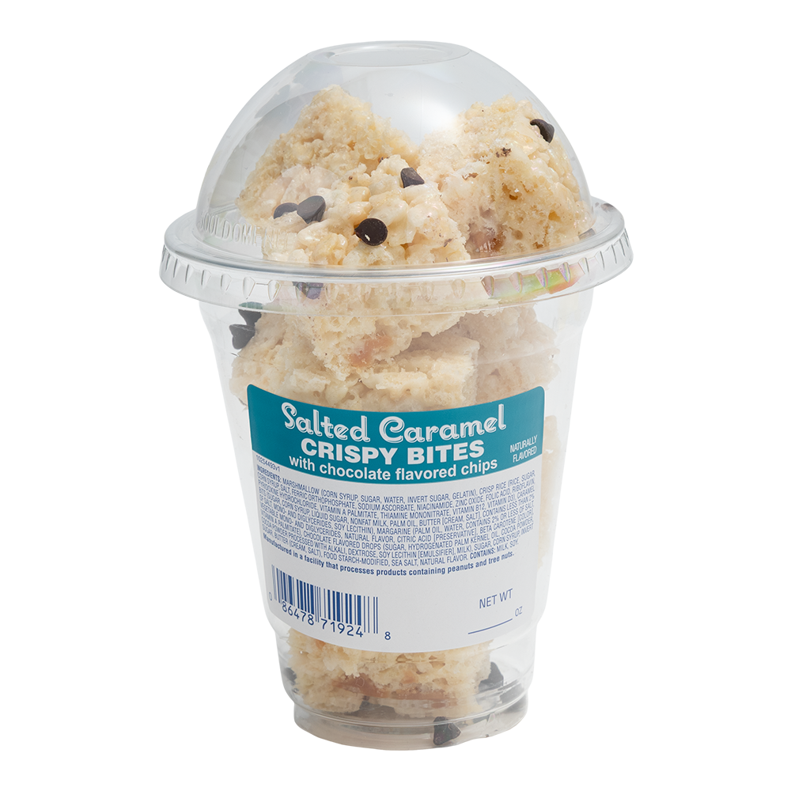
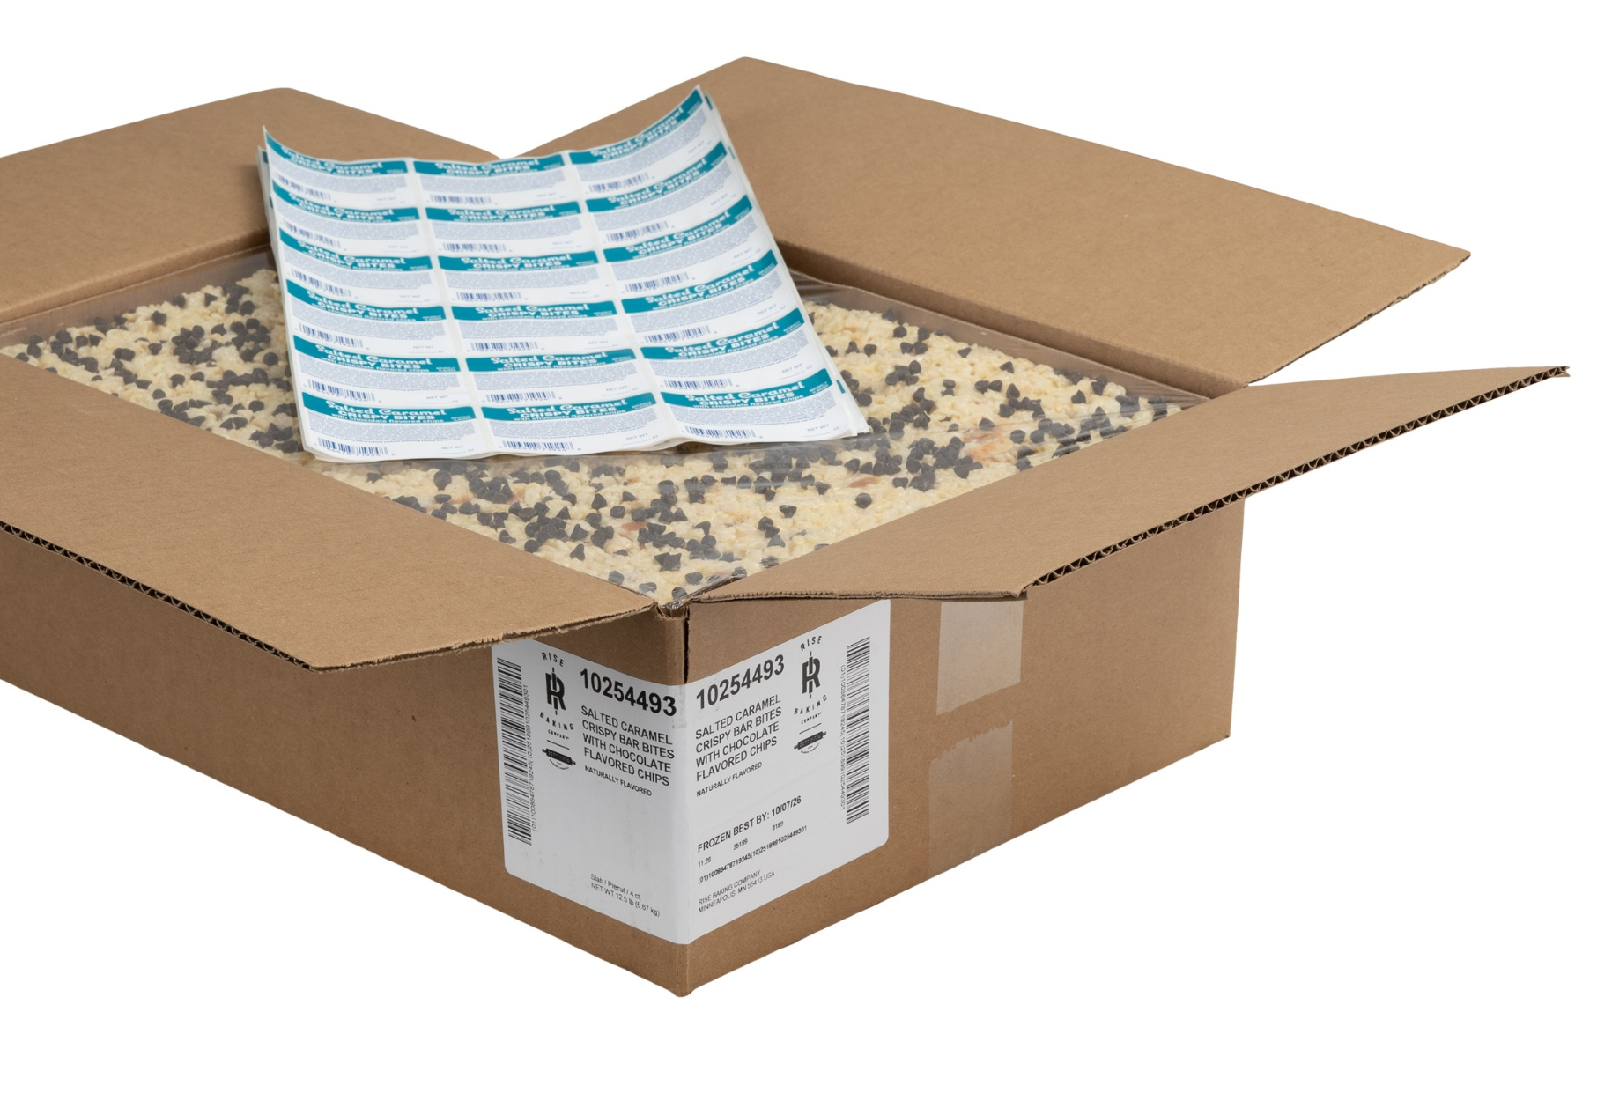
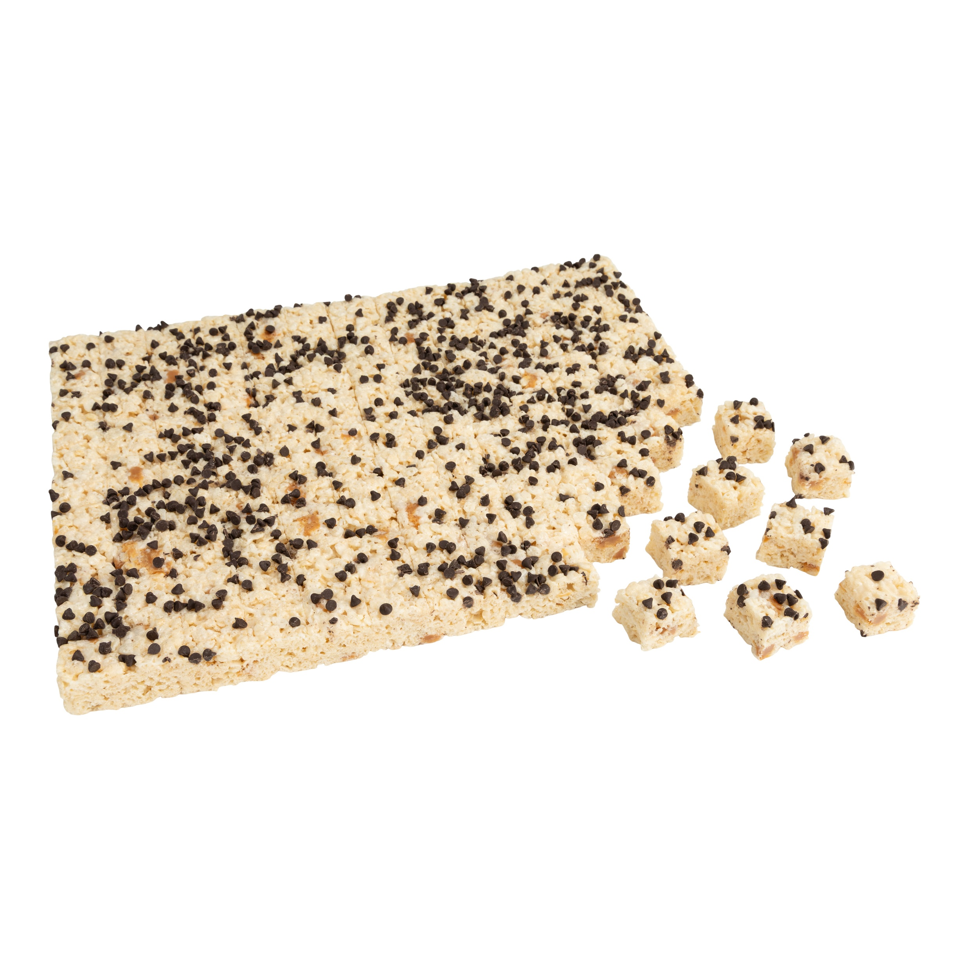
Best Maid
Crispy Bites
This nostalgic favorite is made with the marshmallowy goodness and crisp rice your customers love. These adaptable crispy bites are a crowd-pleasing treat, perfect for retailers looking to appeal to all age groups.
Precut Crispy Bites
Item# | Flavor | Pack Size | Distributor#
10254493 | Salted Caramel with Chocolate Flavored Chips | 1” x 1” – 117ct 4 – ½ trays | 12345
EXAMPLE
Frozen Shelf Life: 456 Days // Ambient Shelf Life: 21-28 Days
NOW AVAILABLE
3001 Broadway Street NE, Suite 400, Minneapolis, MN 55413 | 888.444.0322 | RiseBakingCompany.com
^{1132v6 06.26}

Slide 3
Brand Style Guide
This guide clearly defines what Rise stands for and how it should come to life in the world. It assures that our brand has a clearly defined foundation, strong brand graphics, and effective brand collateral.
Recommended Fonts
Charter and Avenir are the primary typeface for Rise Baking Company. In situations where access to Charter and Avenir are not available, Georgia and Arial should be used.
Primary Color Palette
Rise Blue
Pantone 7686c
R 29 G 79 B 145
C 100 M 73 Y 0 K 10
HTML 1D4F91
Rise Yellow
Pantone 136c
R 255 G 191 B 63
C 0 M 28 Y 87 K 0
HTML FFBF3F
Rise Light Blue
Pantone 2915c
R 100 G 188 B 234
C 55 M 9 Y 0 K 0
HTML 64BCEA
Accent Colors
Text & Graphs
Medium Blue
Pantone 3005c
R 0 G 119 B 200
C 100 M 31 Y 0 K 0
HTML 0077C8
Vivid Blue
Pantone 2925c
R 0 G 156 B 222
C 85 M 21 Y 0 K 0
HTML 009CDE
Golden Yellow
Pantone 137c
R 255 G 163 B 0
C 0 M 41 Y 100 K 0
HTML FFA300
Grey (Text)
Pantone 75% Black
R 99 G 100 B 102
C 0 M 0 Y 0 K 75
HTML 636466
For more examples, check out the Rise Baking Company Style Guide.
3001 Broadway Street NE, Suite 400, Minneapolis, MN 55413 | 888.444.0322 | RiseBakingCompany.com
^{1132v6 06.26}

