Slide 1



Slide 2
BLACK FRIDAY SPECIALS
GET THE VIP TREATMENT
Swipe to see our limited-time deals

Slide 3
HOLIDAY SHOPPING MADE EASY
We’re rolling out the red carpet to make your holiday shopping effortless!
Simply select the offers you like and let your Black Friday concierge know.
You can even shop Modere products not listed here, and your concierge will help you save as much as possible!
We value you and appreciate you! Happy shopping!

Slide 4
TABLE OF
CONTENTS
LIVE CLEAN ON YOUR BODY
Modere Personal Care
LIVE CLEAN IN YOUR BODY
Liquid BioCell® Collagen
Weight Management
Gut Health
LIVE CLEAN IN YOUR HOME

Slide 5
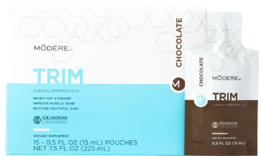
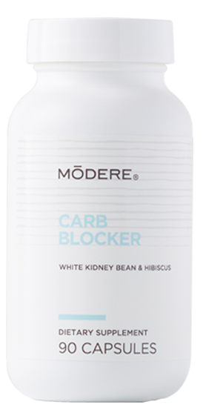
FREE GIFT WITH PURCHASE
HOLIDAY GUILT-FREE FAVORITES!
Spend $99** get a FREE Carb Blocker ($23.99 value)
OR
Spend $199** get FREE Trim Chocolate Singles ($59.99 value)
Carb Blocker: Natural white kidney bean and hibiscus flower slow digestion and help to minimize the caloric impact of starchy foods.*
Trim: Combines a clinical dose of CLA & our multi-patented, award-winning Collagen/HA Matrix®. This fat blaster supports fat metabolism, inhibits fat storage and reduces fat cell size. It even helps improve muscle tone and restore youthful-looking skin.*
*These statements have not been evaluated by the Food and Drug Administration. These products are not intended to diagnose, treat, cure or prevent any disease.
**Offer ends November 27 at 11:59 PM MT. While supplies last. Excludes new and existing SmartShip orders. Subtotal before tax and shipping

Slide 6
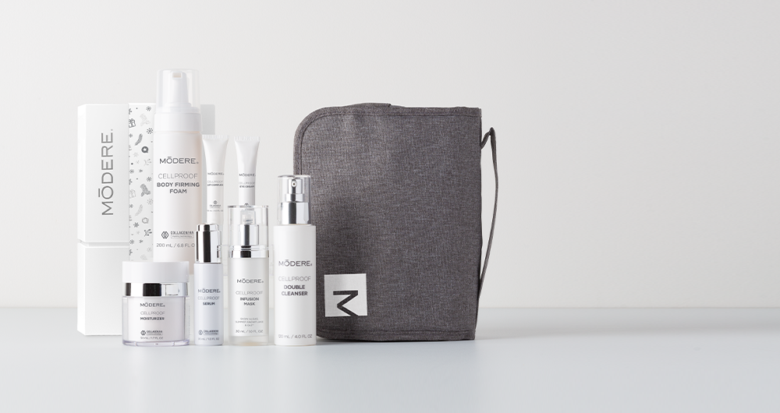
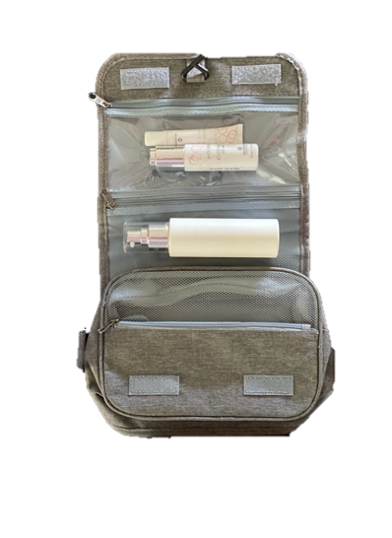
HOLIDAY CELLPROOF
GIFT SET +
FREE HANGING TRAVEL ORGANIZER ($19.99 VALUE)
#1
SAVE
$106.93
REG: $351.93
NOW: $264.99
Modere CellProof Collection:
Serum
Moisturizer
Double Cleanser
Infusion Mask
Body Firming Foam
Lip Complex
Eye Cream
^Offer ends November 27 at 11:59 PM MT. While supplies last. Excludes new and existing SmartShip orders.

Slide 7
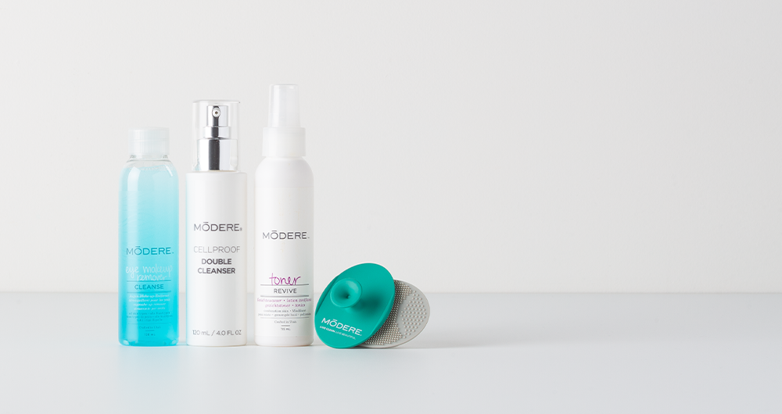
#2
SAVE
$15.97
HOLIDAY FACE CARE
+ FREE FACIAL SCRUBBIES
($5.99 VALUE)
REG: $63.97
NOW: $53.99
Modere CellProof Double Cleanser
Toner
Eye Makeup Remover
^Offer ends November 27 at 11:59 PM MT. While supplies last. Excludes new and existing SmartShip orders.

Slide 8
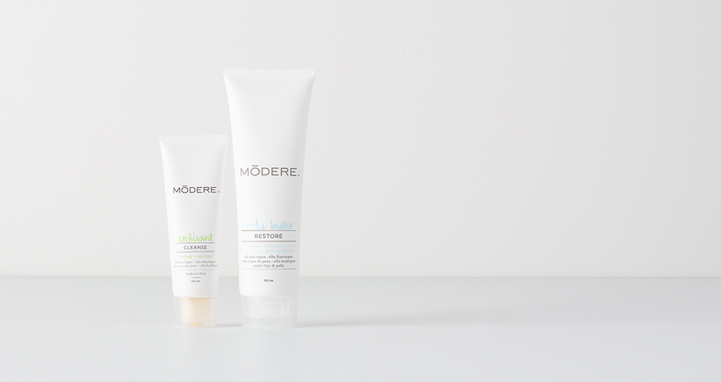
#3
SAVE
$4.99
HOLIDAY HEALTHY HANDS
REG: $34.98
NOW: $29.99
Body Butter: Luxurious, smooth lotion to help rescue dry skin. Cocoa butter, jojoba, and avocado oil provide soothing relief, and a neutral fragrance.
Exfoliant: Sweeps away dead skin cells and surface impurities without scrubbing or harsh enzymatic chemicals. Massages and polishes skin surface with jojoba beads, olive oil and amino acids, leaving it smooth and luminous.
^Offer ends November 27 at 11:59 PM MT. While supplies last. Excludes new and existing SmartShip orders.

Slide 9
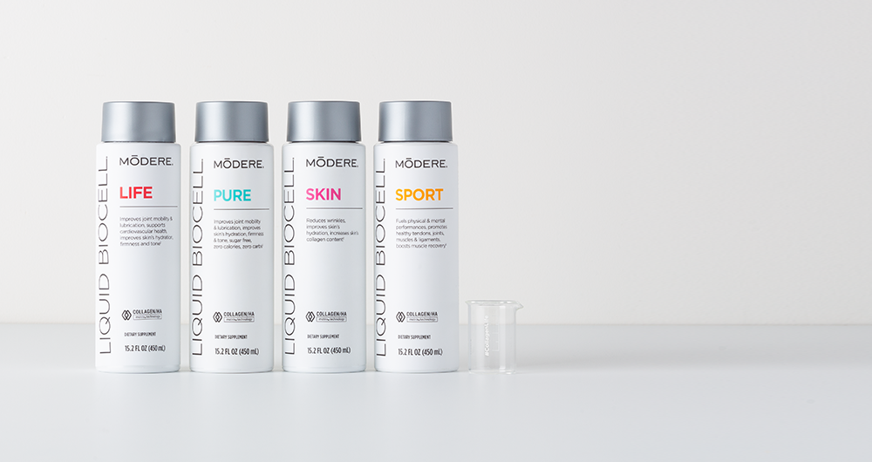
#4
SAVE
$94.96
HOLIDAY LIQUID BIOCELL® COLLECTION
+ FREE #COLLAGENLIFE BEAKER ($7.99 VALUE)
REG: $289.96
NOW: $202.99
A 30% SAVINGS
Improves joint mobility and lubrication*
Reduces joint discomfort*
Promotes healthy cartilage and connective tissue*
Improves muscle tone*
Reduces wrinkles from the inside out*
^*Offer ends November 27 at 11:59 PM MT. While supplies last. Excludes new and existing SmartShip orders.
*These statements have not been evaluated by the Food and Drug Administration. These products are not intended to diagnose, treat, cure or prevent any disease.

Slide 10
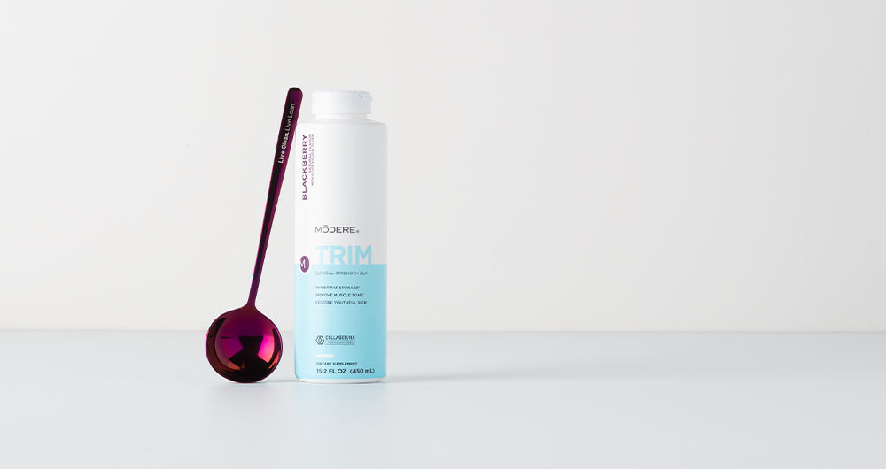
#5
SAVE
$14.99
TRIM BLACKBERRY
+ FREE SPOON ($4.99 VALUE)
NEW LIMITED-TIME TRIM FLAVOR
REG: $99.99
NOW: $89.99
Supports fat metabolism*
Inhibits cellular fat storage*
Supports a reduction in fat cells*
Improves muscle tone*
Restores youthful-looking skin*
Supports joint, muscle fitness and connective tissue health*
^Offer ends November 27 at 11:59 PM MT. While supplies last. Free spoon valid through November 20 at 11:59 PM MT or while supplies last. Excludes new and existing SmartShip orders.
*These statements have not been evaluated by the Food and Drug Administration. These products are not intended to diagnose, treat, cure or prevent any disease.

Slide 11
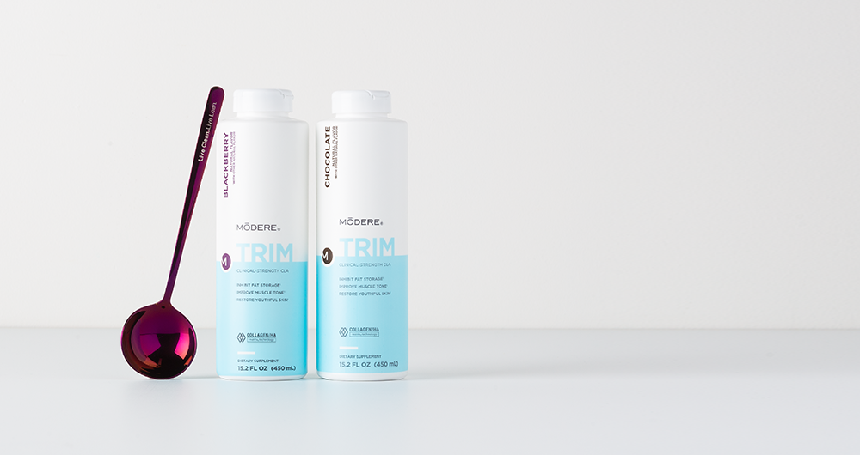
#6
SAVE
$44.99
HOLIDAY TRIM DUO
+ FREE SPOON ($4.99 VALUE)
TRIM BLACKBERRY & CHOCOLATE
REG: $199.98 NOW: $159.98
A 20% SAVINGS
Supports fat metabolism*
Inhibits cellular fat storage*
Supports a reduction in fat cells*
Improves muscle tone*
Restores youthful-looking skin*
Supports joint, muscle fitness and connective tissue health*
^Offer ends November 27 at 11:59 PM MT. While supplies last. Free spoon valid through November 20 at 11:59 PM MT or while supplies last. Excludes new and existing SmartShip orders.
*These statements have not been evaluated by the Food and Drug Administration. These products are not intended to diagnose, treat, cure or prevent any disease.

Slide 12
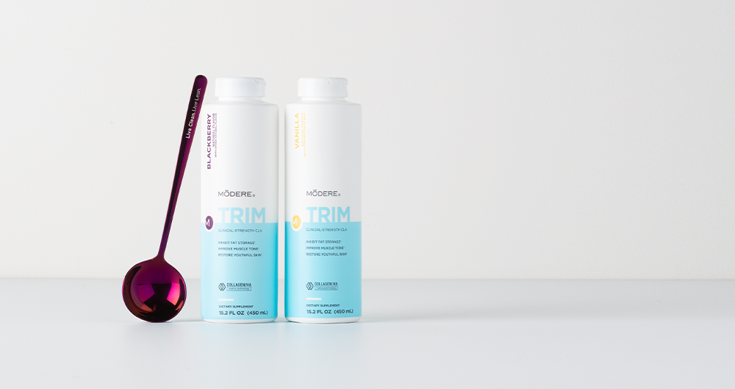
# 7
SAVE
$44.99
HOLIDAY TRIM DUO
+ FREE SPOON ($4.99 VALUE)
TRIM BLACKBERRY & VANILLA
REG: $199.98 NOW: $159.98
A 20% SAVINGS
Supports fat metabolism*
Inhibits cellular fat storage*
Supports a reduction in fat cells*
Improves muscle tone*
Restores youthful-looking skin*
Supports joint, muscle fitness and connective tissue health*
^Offer ends November 27 at 11:59 PM MT. While supplies last. Free gift valid through November 20 at 11:59 PM MT or while supplies last. Excludes new and existing SmartShip orders.
*These statements have not been evaluated by the Food and Drug Administration. These products are not intended to diagnose, treat, cure or prevent any disease.

Slide 13
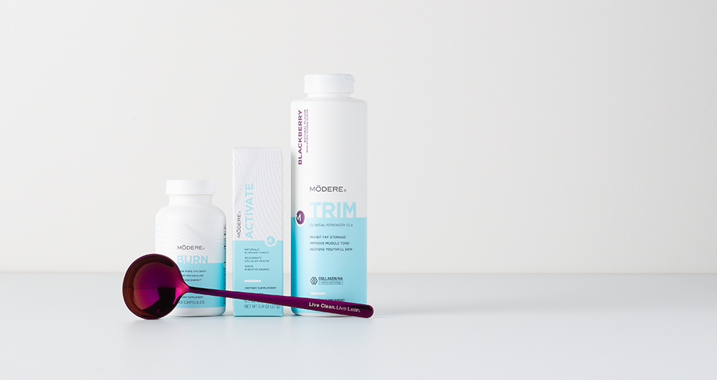
LEAN BODY SYSTEM BLACKBERRY
+ FREE SPOON ($4.99 VALUE)
#8
SAVE
$63.97
NEW LIMITED-TIME TRIM FLAVOR
REG: $194.97 NOW: $135.99
A 30% SAVINGS
Our Lean Body System is an exclusive collection of scientifically designed products—Trim, Burn and Activate—to help you burn fat, lose inches and promote lean body composition.*
^Offer ends November 27 at 11:59 PM MT. While supplies last. Free gift valid through November 20 at 11:59 PM MT or while supplies last. Excludes new and existing SmartShip orders.
*These statements have not been evaluated by the Food and Drug Administration. These products are not intended to diagnose, treat, cure or prevent any disease.

Slide 14
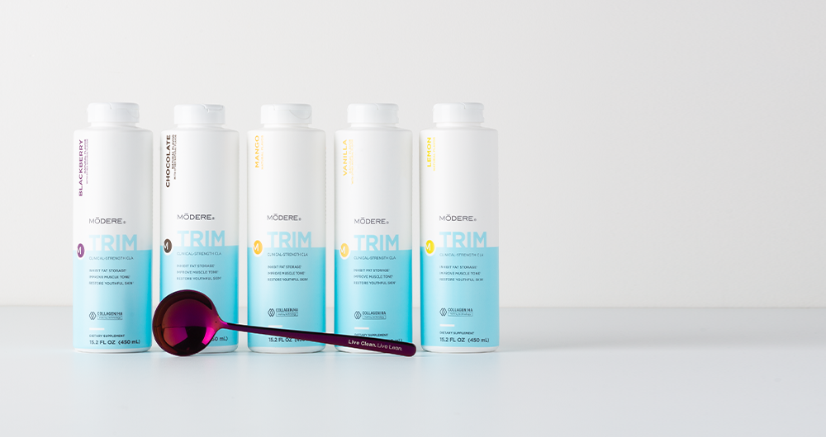
#9
SAVE $104.98
HOLIDAY TRIM
VARIETY COLLECTION
+ FREE SPOON
($4.99 VALUE)
REG: $499.95 NOW: $399.96
Vanilla / Chocolate / Mango / Lemon / Blackberry
Trim features an innovative, first-in-the-world combination of two leading technologies for a body transformation experience—CLA to accelerate fat reduction, and Collagen/HA Matrix® Technology to improve muscle tone and restore youthful skin.*
^Offer ends November 27 at 11:59 PM MT. While supplies last. Free gift valid through November 20 at 11:59 PM MT or while supplies last. Excludes new and existing SmartShip orders.
*These statements have not been evaluated by the Food and Drug Administration. These products are not intended to diagnose, treat, cure or prevent any disease.

Slide 15
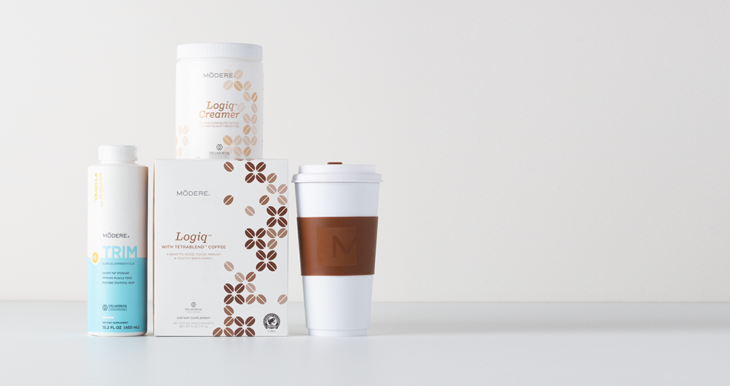
#10
SAVE
$67.97
HOLIDAY CHEER LOGIQ™ COLLECTION + FREE INSULATED 16OZ TUMBLER ($12.99 VALUE)
REG: $204.97 NOW: $149.99
Logiq / Creamer / Trim Vanilla
Rich, flavorful Modere Logiq™ with TetraBlend™ Coffee delivers outstanding cognitive support plus award-winning Collagen/HA Matrix® Technology. Combine it with Logiq™ Creamer for high-quality brain fuel from C8 MCTs, so you can stop coping and start conquering.*
^*Offer ends November 27 at 11:59 PM MT. While supplies last. Excludes new and existing SmartShip orders.
*These statements have not been evaluated by the Food and Drug Administration. These products are not intended to diagnose, treat, cure or prevent any disease.

Slide 16
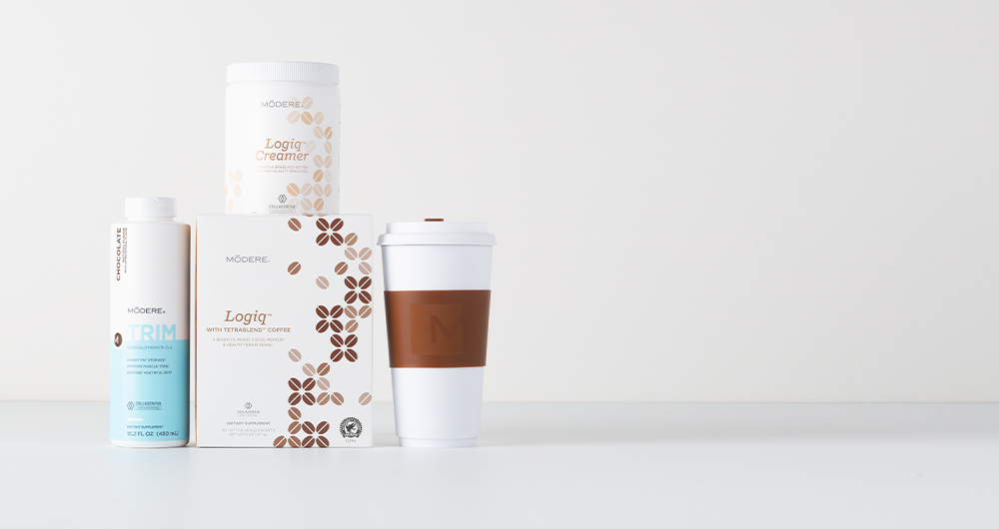
#11
SAVE
$67.97
HOLIDAY CHEER LOGIQ™ COLLECTION + FREE INSULATED 16OZ TUMBLER ($12.99 VALUE)
REG: $204.97 NOW: $149.99
Logiq / Creamer / Trim Chocolate
Rich, flavorful Modere Logiq™ with TetraBlend™ Coffee delivers outstanding cognitive support plus award-winning Collagen/HA Matrix® Technology. Combine it with Logiq™ Creamer for high-quality brain fuel from C8 MCTs, so you can stop coping and start conquering.*
^*Offer ends November 27 at 11:59 PM MT. While supplies last. Excludes new and existing SmartShip orders.
*These statements have not been evaluated by the Food and Drug Administration. These products are not intended to diagnose, treat, cure or prevent any disease.

Slide 17
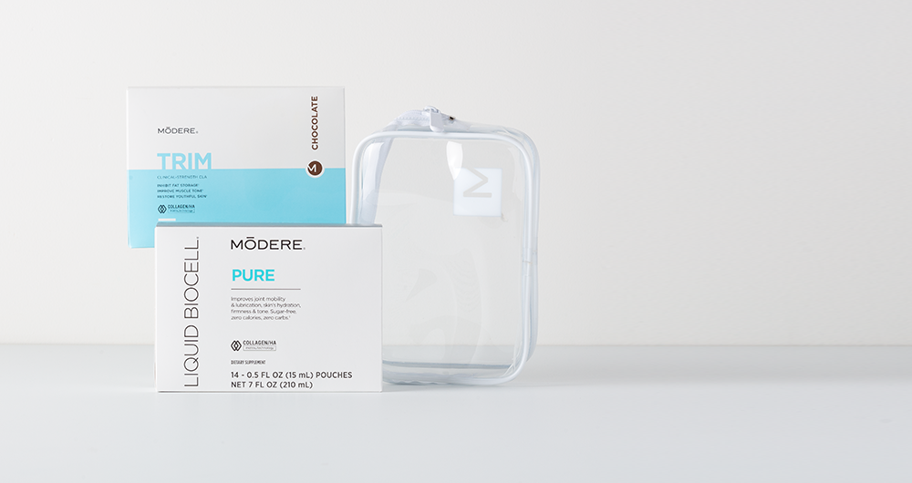
HOLIDAY TRAVEL SAMPLER +
FREE TRAVEL CASE ($5.99 VALUE)
REG: $114.98
NOW: $99.99
Trim Chocolate Singles
Liquid BioCell Pure Singles
#12
SAVE
$20.98
^*Offer ends November 27 at 11:59 PM MT. While supplies last. Excludes new and existing SmartShip orders.

Slide 18
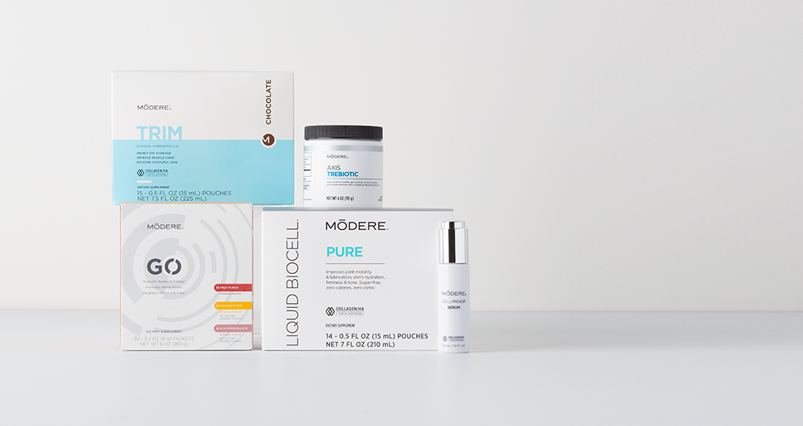
HOLIDAY SPARKLE & SHINE SAMPLER
#13
SAVE
$78.96
REG: $312.95
NOW: $233.99
CellProof Serum
Axis TreBiotic
GO Variety
Trim Chocolate Singles
Liquid BioCell Pure Singles
Feel good and look even better with your favorite Modere products in one unique holiday bundle!
^*Offer ends November 27 at 11:59 PM MT. While supplies last. Excludes new and existing SmartShip orders.

Slide 19
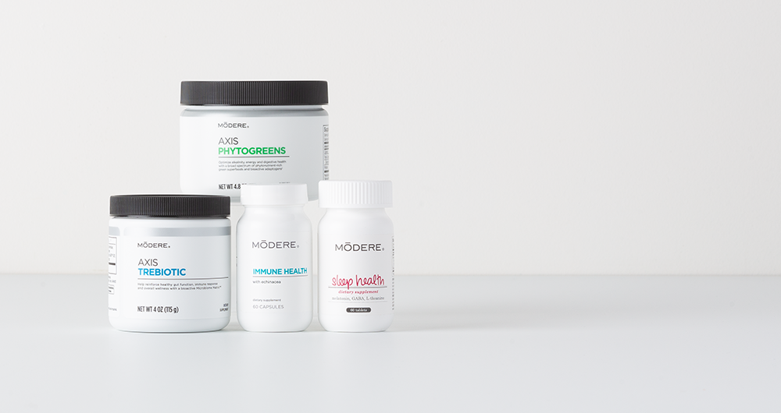
#14
SAVE
$25.99
HEALTHY HOLIDAYS
— AXIS™ COLLECTION
REG: $149.96
NOW: $123.97
Axis TreBiotic
Immune Health
Sleep Health
Axis PhytoGreens
^*Offer ends November 27 at 11:59 PM MT. While supplies last. Excludes new and existing SmartShip orders.

Slide 20
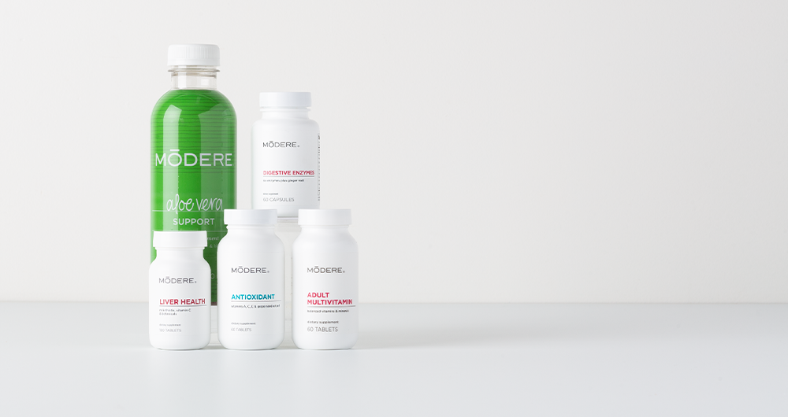
HEALTHY HOLIDAYS
— MULTI COLLECTION
#15
SAVE
$19.99
REG: $119.45
NOW: $99.46
Adult Multivitamin
Aloe Vera
Antioxidant
Liver Health
Digestive Enzymes
^*Offer ends November 27 at 11:59 PM MT. While supplies last. Excludes new and existing SmartShip orders.

Slide 21
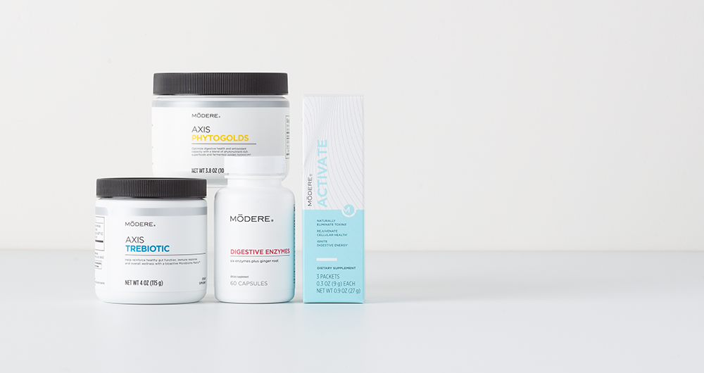
#16
SAVE
$30.97
HEALTHY HOLIDAYS
— AXIS™ GUT HEALTH
REG: $150.96
NOW: $119.99
Axis TreBiotic
Digestive Enzymes
Activate
Axis PhytoGold
^*Offer ends November 27 at 11:59 PM MT. While supplies last. Excludes new and existing SmartShip orders.

Slide 22
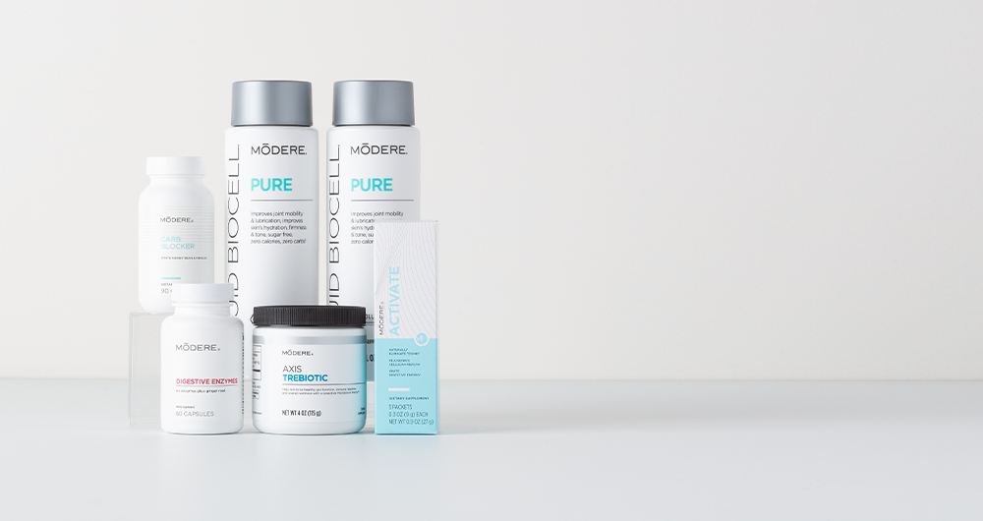
HEALTHY HOLIDAYS
— AXIS™ + LIQUID BIOCELL
REG: $288.94
NOW: $222.21
#17
SAVE
$66.73
Axis TreBiotic
Digestive Enzymes
Activate
Liquid BioCell Pure (2ct)
Carb Blocker
^*Offer ends November 27 at 11:59 PM MT. While supplies last. Excludes new and existing SmartShip orders.

Slide 23
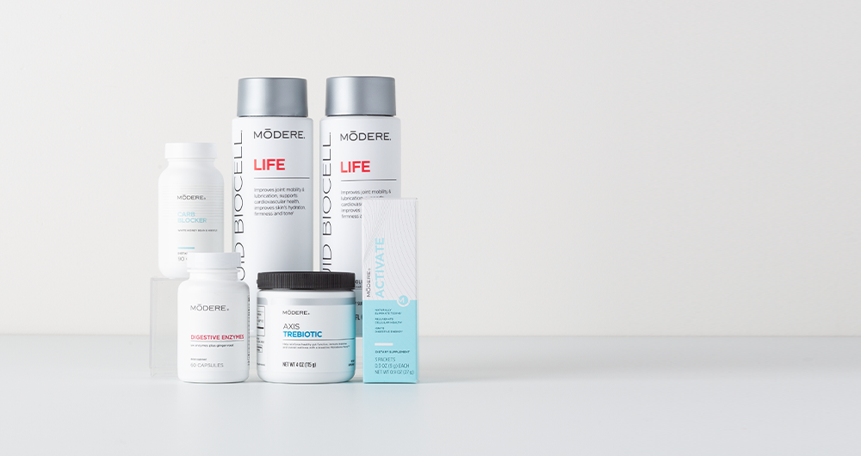
HEALTHY HOLIDAYS
— AXIS™ + LIQUID BIOCELL
REG: $288.94
NOW: $222.21
#18
SAVE
$66.73
Axis TreBiotic
Digestive Enzymes
Activate
Liquid BioCell Life (2ct)
Carb Blocker
^*Offer ends November 27 at 11:59 PM MT. While supplies last. Excludes new and existing SmartShip orders.

Slide 24
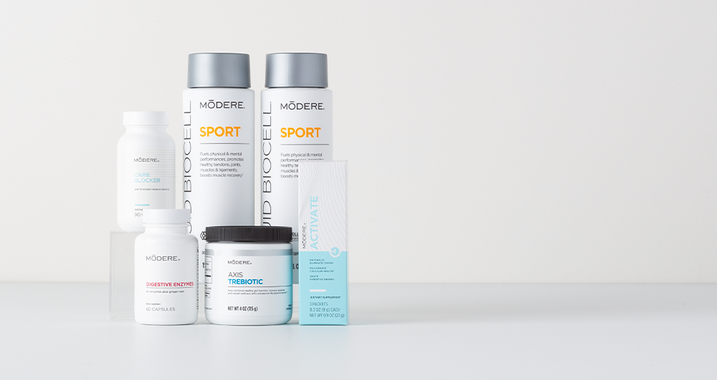
HOLIDAY HELPER AXIS™
+ LIQUID BIOCELL
REG: $298.94
NOW: $222.21
#19
SAVE
$76.73
Axis TreBiotic
Digestive Enzymes
Activate
Liquid BioCell Sport (2ct)
Carb Blocker
^*Offer ends November 27 at 11:59 PM MT. While supplies last. Excludes new and existing SmartShip orders.

Slide 25
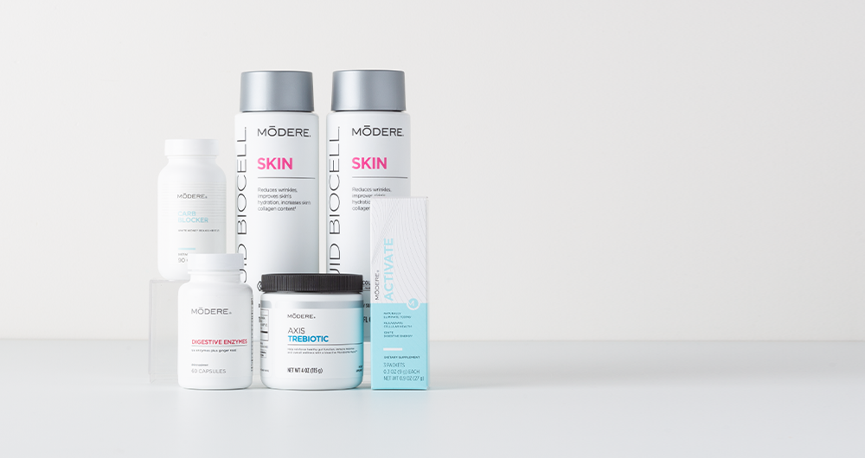
HOLIDAY HELPER AXIS™
+ LIQUID BIOCELL
#20
SAVE
$76.73
REG: $298.94
NOW: $222.21
Axis TreBiotic
Digestive Enzymes
Activate
Liquid BioCell Skin (2ct)
Carb Blocker
^*Offer ends November 27 at 11:59 PM MT. While supplies last. Excludes new and existing SmartShip orders.

Slide 26
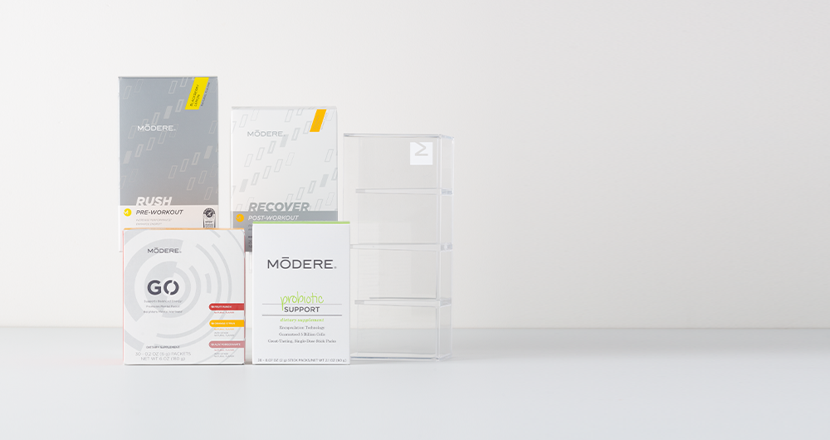
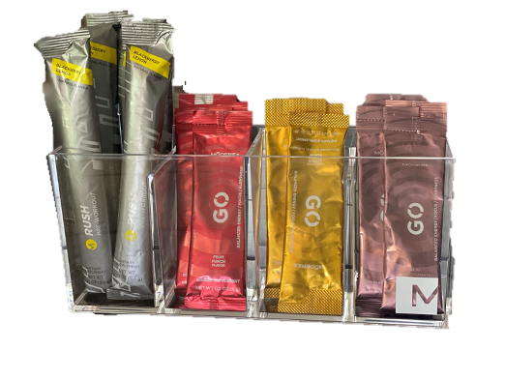
#21
SAVE
$23.96
HOLIDAY MERRY & BRIGHT COLLECTION + FREE GRAB & GO CADDY ($9.99 VALUE)
REG: $163.96
NOW: $149.99
Rush
Recover
GO Variety
Probiotic
^*Offer ends November 27 at 11:59 PM MT. While supplies last. Excludes new and existing SmartShip orders.

Slide 27
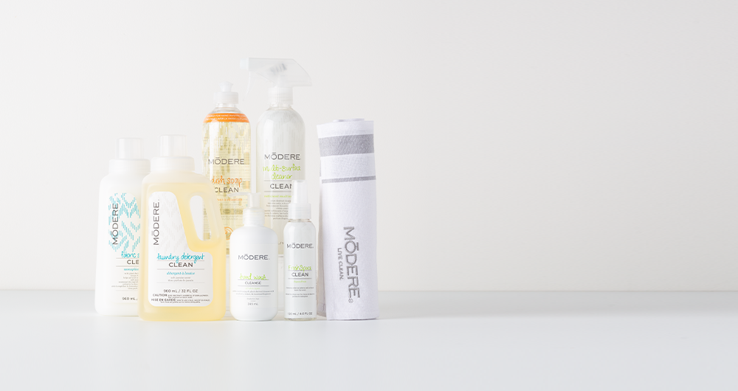
#22
SAVE
$15.44
HOLIDAY HOME COLLECTION + FREE MODERE LIVE CLEAN KITCHEN TOWEL
($9.99 VALUE)
REG: $55.44
NOW: $49.99
Dish Soap
Multi-Surface Cleaner
Fresh Space
Liquid Laundry Detergent
Hand Wash
Fabric softener
From the kitchen to the laundry to the bathroom, transform your entire home into a live-clean haven with this special holiday collection.
^*Offer ends November 27 at 11:59 PM MT. While supplies last. Excludes new and existing SmartShip orders.

Slide 28
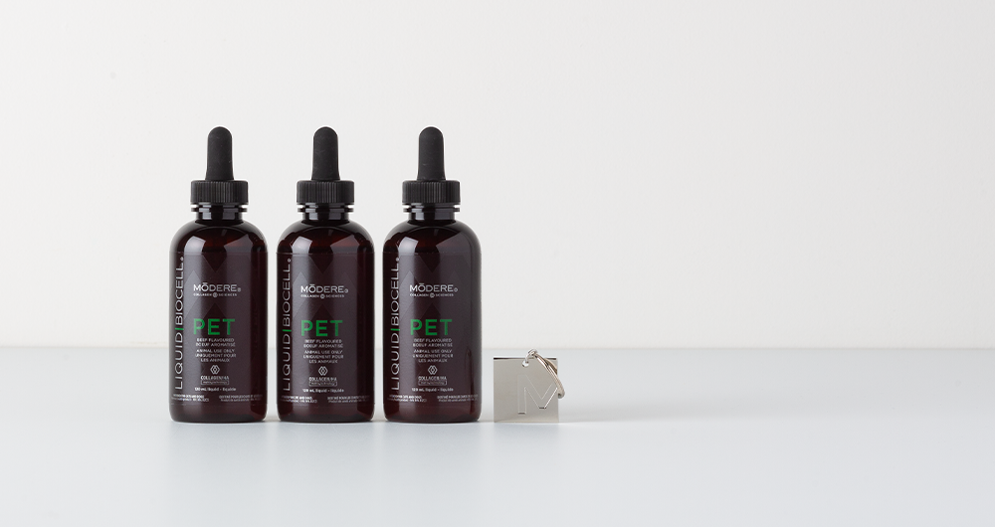
#23
SAVE
$57.98
HOLIDAY PET BUNDLE +
FREE “I DRINK COLLAGEN TOO”
PET TAG ($7.99 VALUE)
REG: $149.97
NOW: $99.98
Promotes healthy, flexible joints, tendons, ligaments
Supports joint mobility & lubrication
Promotes healthy cartilage & connective tissue
Maintains healthy skin and a shiny coat
^*Offer ends November 27 at 11:59 PM MT. While supplies last. Excludes new and existing SmartShip orders.

