Slide 2
BLACK FRIDAY SPECIALS GET THE VIP TREATMENT Swipe to see our limited-time deals

Slide 3
HOLIDAY SHOPPING MADE EASY
We’re rolling out the red carpet to make your holiday shopping effortless!
Simply select the offers you like and let your Black Friday concierge know.
You can even shop Modere products not listed here, and your concierge will help you save as much as possible!
We value you and appreciate you! Happy shopping!

Slide 4
TABLE OF
CONTENTS
LIVE CLEAN ON YOUR BODY
Modere Personal Care
LIVE CLEAN IN YOUR BODY
Liquid BioCell® Collagen
Weight Management
LIVE CLEAN IN YOUR HOME

Slide 5
FREE GIFT WITH PURCHASE
HOLIDAY FAVORITES!
Spend $99** get a FREE Body Butter
($26.99 value)
OR
Spend $199** get FREE Modere CellProof Lip Complex & Eye Cream
($71.98 value)
Body Butter: Luxurious, smooth lotion to help rescue dry skin . Cocoa butter, Jojoba, and avocado oil provide soothing relief, and a neutral fragrance.
CellProof Lip Complex: Our exclusive multi-tasking lip treatment serum will leave your lips looking smooth, plump and kissably soft. CellProof Eye Cream: Keep your eyes looking youthful with patented BioCell Collagen® CG plus energizing ginger, pomegranate and natural caffeine to gently hydrate, visibly firm and de-puff.
**Offer ends November 27 at 11:59 PM MT. While supplies last. Excludes new and existing SmartShip orders. Subtotal before tax and shipping

Slide 6
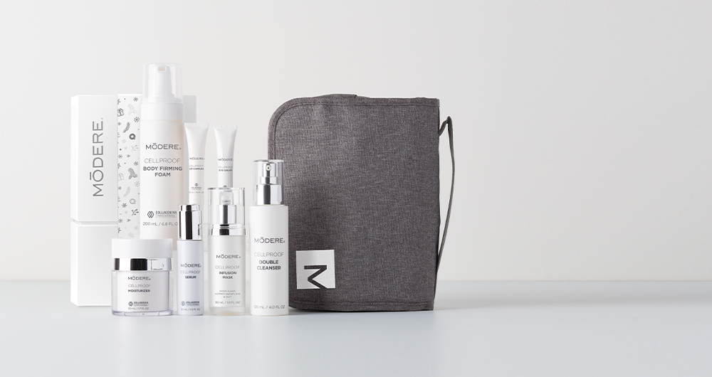
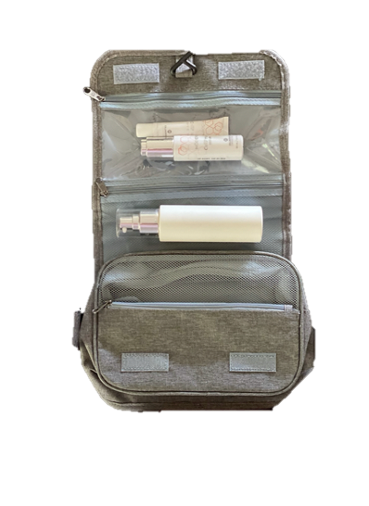
HOLIDAY CELLPROOF
GIFT SET +
FREE HANGING TRAVEL ORGANIZER ($26.99 VALUE)
#1
SAVE
$139.43
REG: $451.93
NOW: $339.49
Modere CellProof Collection:
Serum
Moisturizer
Double Cleanser
Infusion Mask
Body Firming Foam
Lip Complex
Eye Cream
^Offer ends November 27 at 11:59 PM MT. While supplies last. Excludes new and existing SmartShip orders.

Slide 7
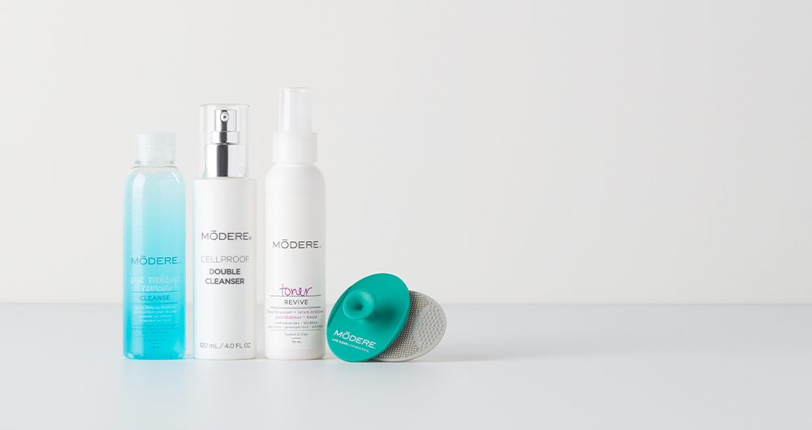
#2
SAVE
$19.97
HOLIDAY FACE CARE
+ FREE FACIAL SCRUBBIES
($6.99 VALUE)
REG: $81.97
NOW: $68.99
Modere CellProof Double Cleanser
Toner
Eye Makeup Remover
^Offer ends November 27 at 11:59 PM MT. While supplies last. Excludes new and existing SmartShip orders.

Slide 8
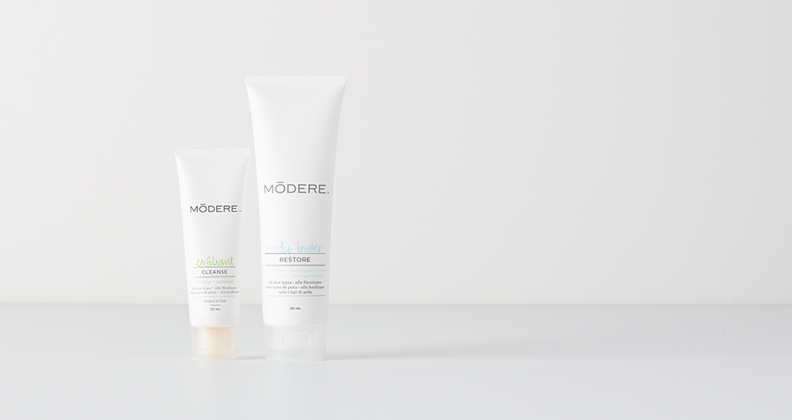
#3
SAVE
$6.99
HOLIDAY HEALTHY HANDS
REG: $44.98
NOW: $37.99
Body Butter: Luxurious, smooth lotion to help rescue dry skin. Cocoa butter, jojoba, and avocado oil provide soothing relief, and a neutral fragrance.
Exfoliant: Sweeps away dead skin cells and surface impurities without scrubbing or harsh enzymatic chemicals. Massages and polishes skin surface with jojoba beads, olive oil and amino acids, leaving it smooth and luminous.
^Offer ends November 27 at 11:59 PM MT. While supplies last. Excludes new and existing SmartShip orders.

Slide 9
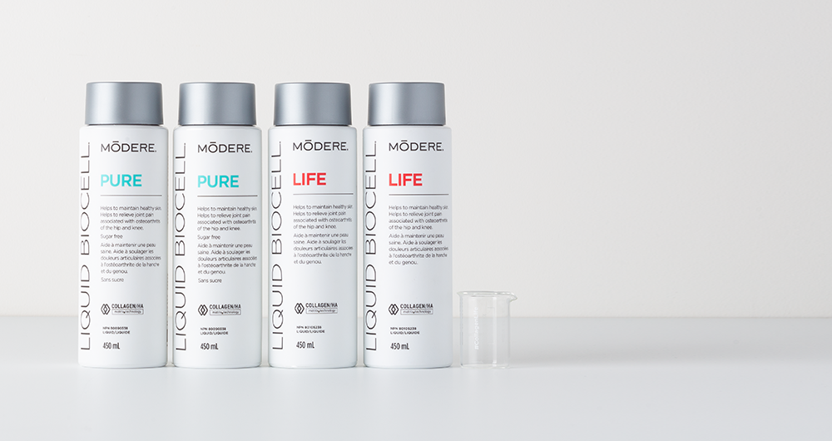
#4
SAVE
$107.96
HOLIDAY LIQUID BIOCELL® LIFE & PURE COLLECTION
+ FREE #COLLAGENLIFE BEAKER ($8.99 VALUE)
REG: $329.96 NOW: $230.99 A 30% SAVINGS
Helps to relieve joint pain associated with osteoarthritis of the hip and knee
Helps to reduce the number of deep wrinkles and fine facial lines
Helps to maintain healthy skin
Helps improve skin elasticity
^*Offer ends November 27 at 11:59 PM MT. While supplies last. Excludes new and existing SmartShip orders.

Slide 10
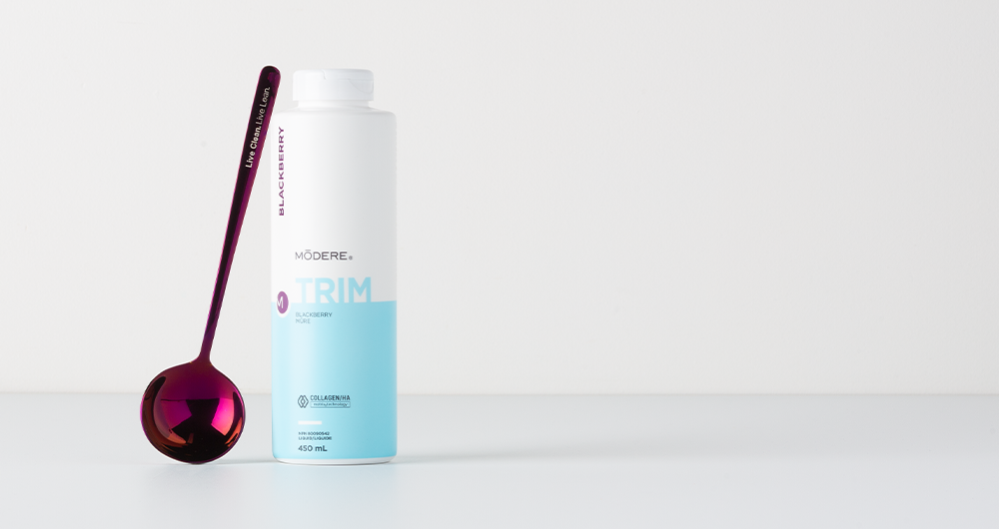
TRIM BLACKBERRY
+ FREE SPOON ($5.99 VALUE)
NEW LIMITED-TIME TRIM FLAVOR
#5
SAVE $17.99
REG: $119.99 NOW: $107.99
Trim features an innovative, first-in-the-world combination of two leading technologies for a body transformation experience—conjugated linoleic acid (CLA) and Collagen/HA Matrix® Technology. This potent blend is designed to boost your efforts and bring your ideal shape within reach.
^Offer ends November 27 at 11:59 PM MT. While supplies last. Free spoon valid through November 20 at 11:59 PM MT or while supplies last. Excludes new and existing SmartShip orders.

Slide 11
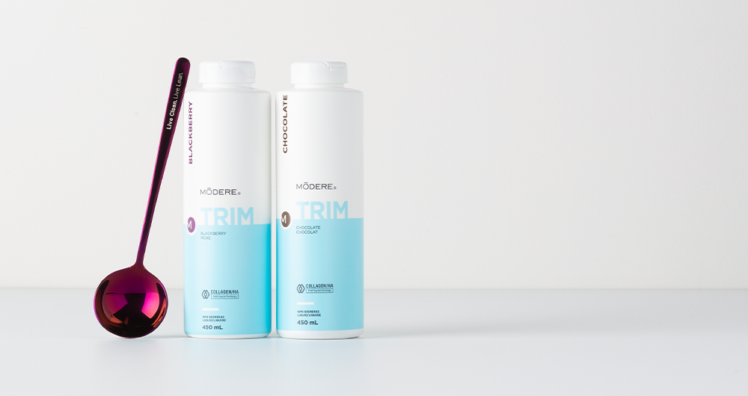
#6
SAVE
$53.99
HOLIDAY TRIM DUO
+ FREE SPOON ($5.99 VALUE)
TRIM BLACKBERRY & CHOCOLATE
REG: $239.98 NOW: $191.98
A 20% SAVINGS
Trim features an innovative, first-in-the-world combination of two leading technologies for a body transformation experience—conjugated linoleic acid (CLA) and Collagen/HA Matrix® Technology. This potent blend is designed to boost your efforts and bring your ideal shape within reach.
^Offer ends November 27 at 11:59 PM MT. While supplies last. Free spoon valid through November 20 at 11:59 PM MT or while supplies last. Excludes new and existing SmartShip orders.

Slide 12
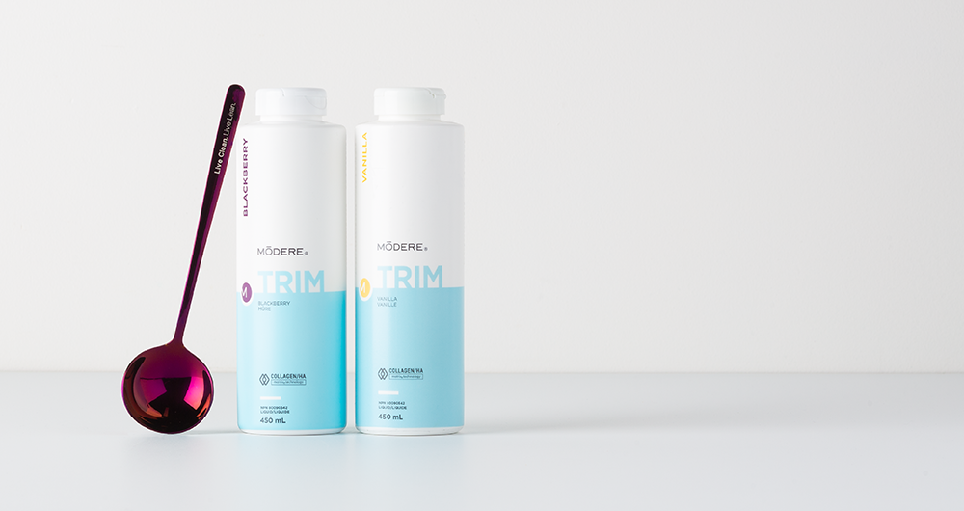
#7
SAVE
$53.99
HOLIDAY TRIM DUO
+ FREE SPOON ($5.99 VALUE)
TRIM BLACKBERRY & VANILLA
REG: $239.98 NOW: $191.98
A 20% SAVINGS
Trim features an innovative, first-in-the-world combination of two leading technologies for a body transformation experience—conjugated linoleic acid (CLA) and Collagen/HA Matrix® Technology. This potent blend is designed to boost your efforts and bring your ideal shape within reach.
^Offer ends November 27 at 11:59 PM MT. While supplies last. Free spoon valid through November 20 at 11:59 PM MT or while supplies last. Excludes new and existing SmartShip orders.

Slide 13
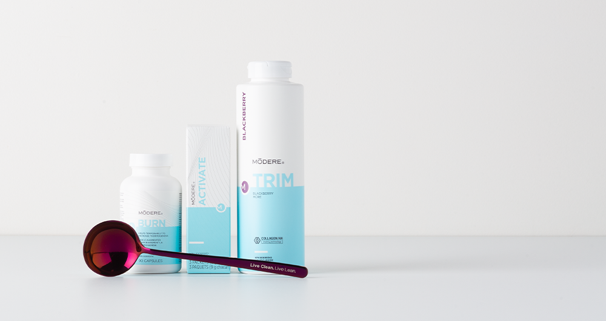
LEAN BODY SYSTEM BLACKBERRY
+ FREE SPOON ($5.99 VALUE)
#8
SAVE
$78.97
NEW LIMITED-TIME TRIM FLAVOR
REG: $242.97 NOW: $169.99
A 30% SAVINGS
The Lean Body System is an exclusive collection of scientifically designed products—Trim, Burn and Activate—to help you reduce fat, lose centimeters and promote lean body composition.
^Offer ends November 27 at 11:59 PM MT. While supplies last. Free gift valid through November 20 at 11:59 PM MT or while supplies last. Excludes new and existing SmartShip orders.

Slide 14
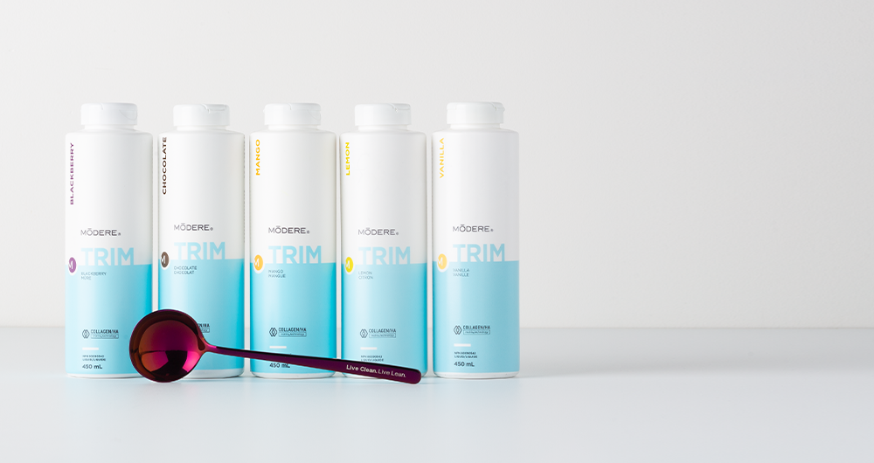
#9
SAVE $125.98
HOLIDAY TRIM
VARIETY COLLECTION
+ FREE SPOON
($5.99 VALUE)
REG: $599.95 NOW: $479.96
Vanilla / Chocolate / Mango / Lemon / Blackberry
Trim features an innovative, first-in-the-world combination of two leading technologies for a body transformation experience—conjugated linoleic acid (CLA) and Collagen/HA Matrix® Technology. This potent blend is designed to boost your efforts and bring your ideal shape within reach.
^Offer ends November 27 at 11:59 PM MT. While supplies last. Free gift valid through November 20 at 11:59 PM MT or while supplies last. Excludes new and existing SmartShip orders.

Slide 15
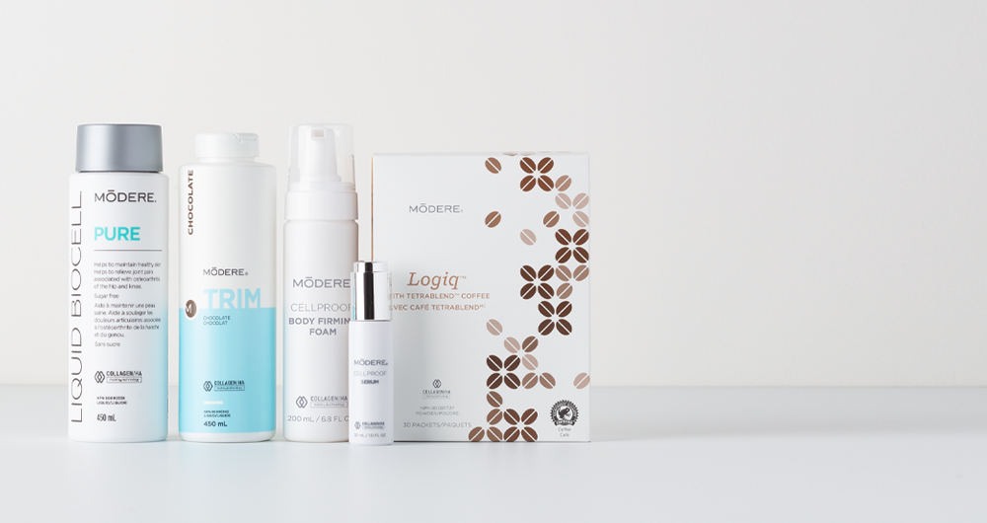
HOLIDAY SPARKLE & SHINE SAMPLER
#10
SAVE
$109.46
REG: $434.45 NOW: $324.99
CellProof Serum
Trim Chocolate
Logiq
CellProof Body Firming Foam
Liquid BioCell Pure
Feel good and look even better with your favorite Modere products in one unique holiday bundle!
^*Offer ends November 27 at 11:59 PM MT. While supplies last. Excludes new and existing SmartShip orders.

Slide 16
#11
SAVE
$80.47
HOLIDAY CHEER LOGIQ™ COLLECTION + FREE INSULATED 16OZ TUMBLER ($15.99 VALUE)
REG: $251.97 NOW: $187.49
Logiq / MCTs / Trim Vanilla
This collection features our revolutionary Modere Logiq with TetraBlend™ Coffee and keto-friendly Modere Logiq Logiq MCTs. This product duo enhances cognitive performance and bolsters natural energy production, so you can stop coping, and start conquering.
^*Offer ends November 27 at 11:59 PM MT. While supplies last. Excludes new and existing SmartShip orders.

Slide 17
#12
SAVE
$80.47
HOLIDAY CHEER LOGIQ™ COLLECTION + FREE INSULATED 16OZ TUMBLER ($15.99 VALUE)
REG: $251.97 NOW: $187.49
Logiq / MCTs / Trim Chocolate
This collection features our revolutionary Modere Logiq with TetraBlend™ Coffee and keto-friendly Modere Logiq Logiq MCTs. This product duo enhances cognitive performance and bolsters natural energy production, so you can stop coping, and start conquering.
^*Offer ends November 27 at 11:59 PM MT. While supplies last. Excludes new and existing SmartShip orders.

Slide 18
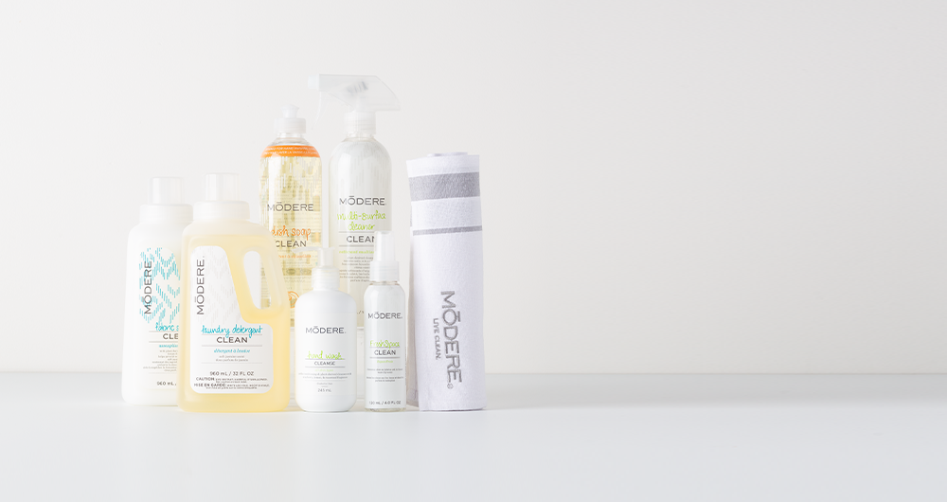
#13
SAVE
$20.44
HOLIDAY HOME COLLECTION + FREE MODERE LIVE CLEAN KITCHEN TOWEL ($12.99 VALUE)
REG: $71.94
NOW: $64.49
Dish Soap
Multi-Surface Cleaner
Fresh Space
Liquid Laundry Detergent
Hand Wash
Fabric softener
From the kitchen to the laundry to the bathroom, transform your entire home into a live-clean haven with this special holiday collection.
^*Offer ends November 27 at 11:59 PM MT. While supplies last. Excludes new and existing SmartShip orders.

Slide 19
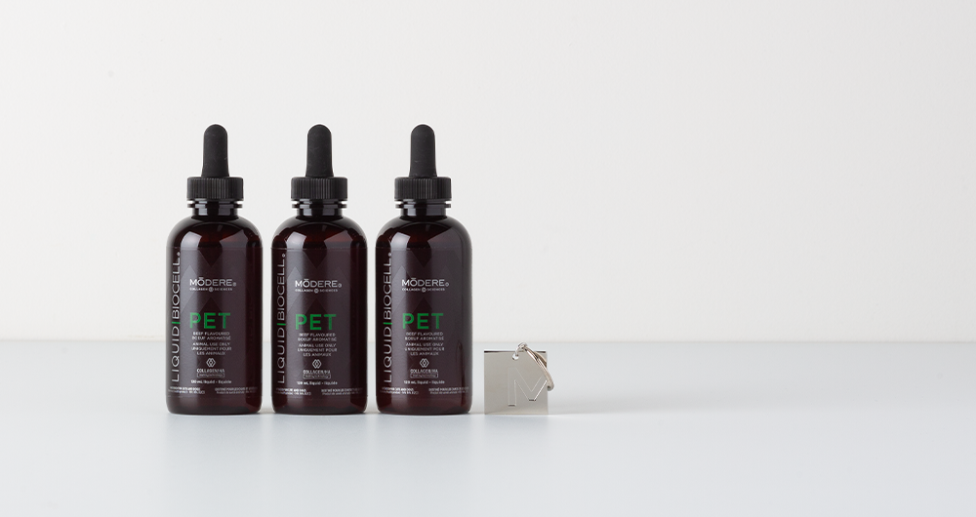
#14
BUY 2 GET 1 FREE
HOLIDAY PET BUNDLE +
FREE “I DRINK COLLAGEN TOO”
PET TAG ($8.99 VALUE)
REG: $179.97
NOW: $119.98
Supports the function of the joints and hips
Helps maintain a healthy, shiny coat
Great-tasting natural flavor
^*Offer ends November 27 at 11:59 PM MT. While supplies last. Excludes new and existing SmartShip orders.

