Slide 1
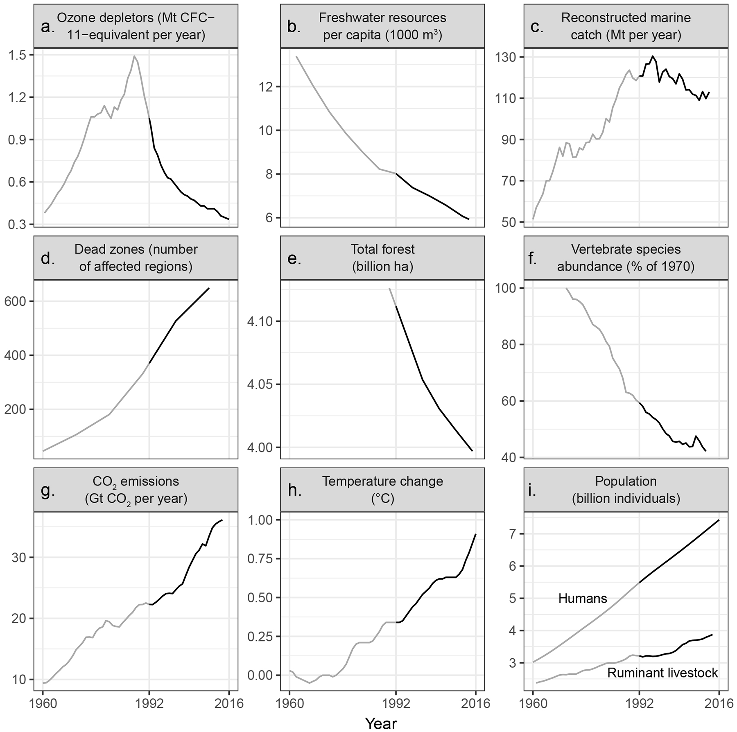

Figure 1. Trends over time for environmental issues identified in the 1992 scientists’ warning to humanity. The years ...
Notes:
Figure 1. Trends over time for environmental issues identified in the 1992 scientists’ warning to humanity. The years before and after the 1992 scientists’ warning are shown as gray and black lines, respectively. Panel (a) shows emissions of halogen source gases, which deplete stratospheric ozone, assuming a constant natural emission rate of 0.11 Mt CFC-11-equivalent per year. In panel (c), marine catch has been going down since the mid-1990s, but at the same time, fishing effort has been going up (supplemental file S1). The vertebrate abundance index in panel (f) has been adjusted for taxonomic and geographic bias but incorporates relatively little data from developing countries, where there are the fewest studies; between 1970 and 2012, vertebrates declined by 58 percent, with freshwater, marine, and terrestrial populations declining by 81, 36, and 35 percent, respectively (file S1). Five-year means are shown in panel (h). In panel (i), ruminant livestock consist of domestic cattle, sheep, goats, and buffaloes. Note that y-axes do not start at zero, and it is important to inspect the data range when interpreting each graph. Percentage change, since 1992, for the variables in each panel are as follows: (a) –68.1%; (b) –26.1%; (c) –6.4%; (d) +75.3%; (e) –2.8%; (f) –28.9%; (g) +62.1%; (h) +167.6%; and (i) humans: +35.5%, ruminant livestock: +20.5%. Additional descriptions of the variables and trends, as well as sources for figure 1, are included in file S1.
Unless provided in the caption above, the following copyright applies to the content of this slide: © The Author(s) 2017. Published by Oxford University Press on behalf of the American Institute of Biological Sciences. All rights reserved. For permissions, please e-mail: journals.permissions@oup.com

