Slide 1
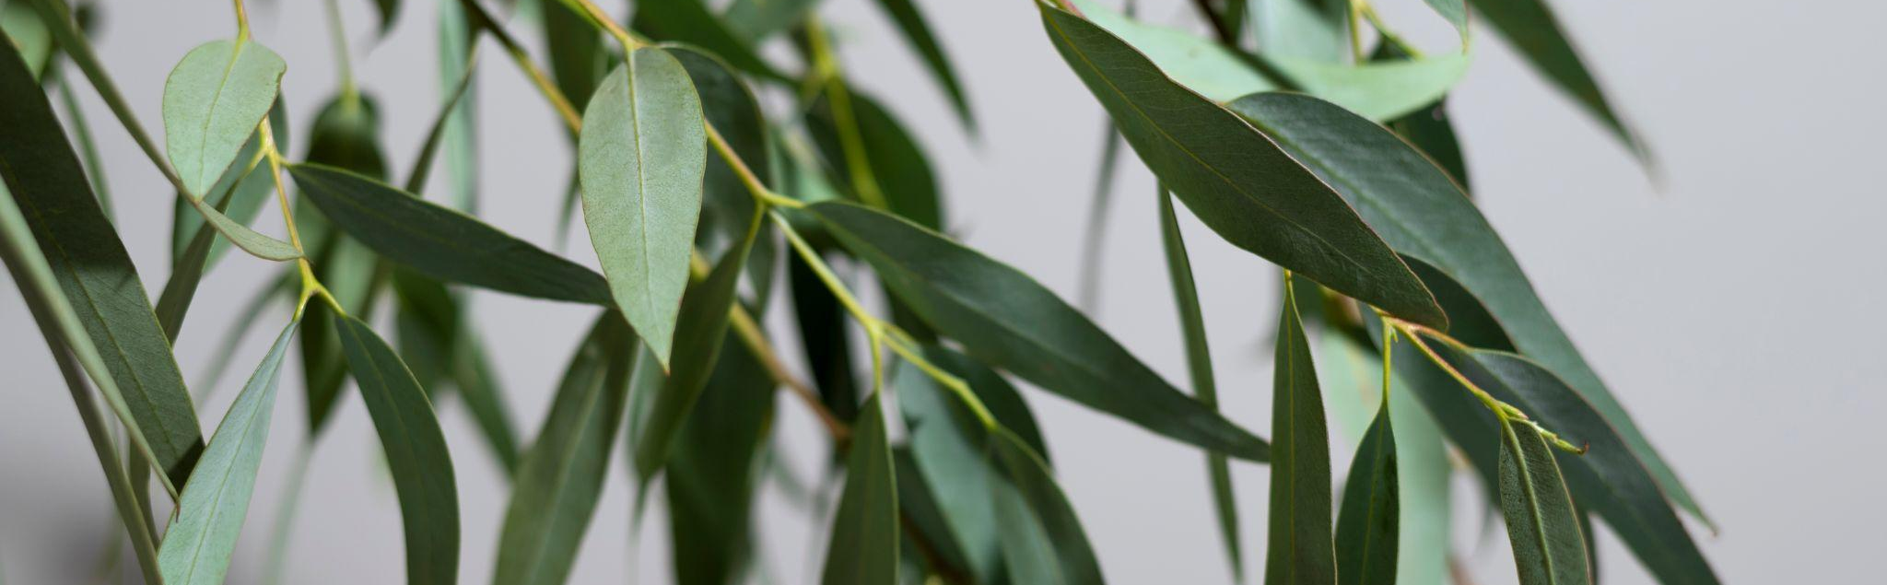

CHHAYA GLOBAL EXPORTS PVT. LTD.

Slide 2

01
About Us

Slide 3
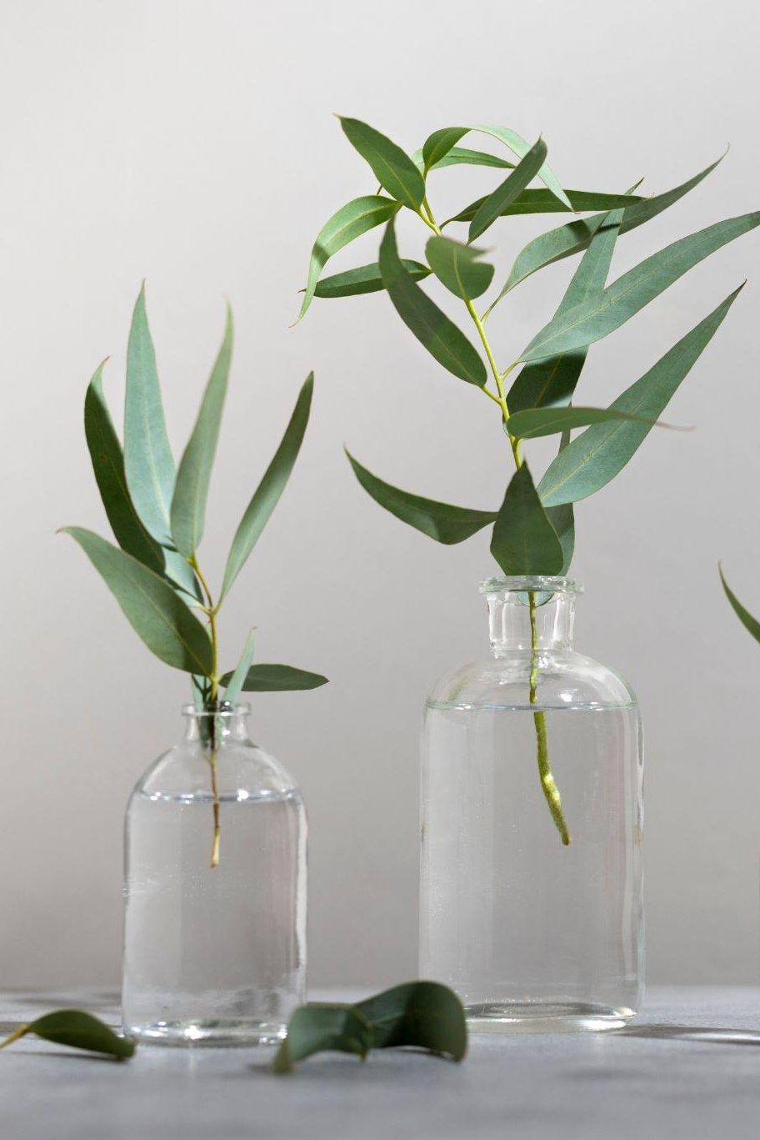
Introduction
A leading supplier of nutraceutical, herbal, ayurvedic, and pharmaceutical ingredients across the world from India.
For the past 5 years, we have been dealing with these products in the market and have an extensive network.
At Chhaya Global Exports, we bridge the gap between buyers and manufacturers and build strong relationships within all parties.

Slide 4
We regularly work with customers from various countries such as the USA, Canada, UK, Europe, France, Turkey, Egypt, Poland, Australia, Spain, Greece, Germany, UAE, and India, and stay in regular communication regarding their requirements.
We have garnered rich experience and expertise in sourcing and supplying high-quality Nutraceutical, Herbal, Ayurvedic and Pharmaceutical ingredients.
We believe in conducting business in a clean and transparent manner, earning the trust and loyalty of our clients.

Slide 5
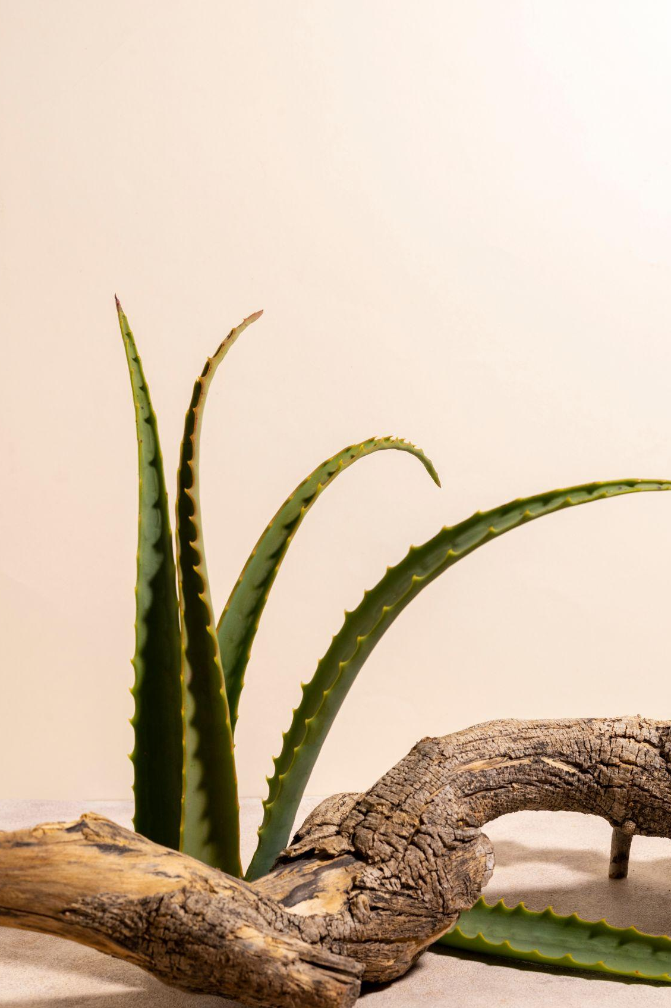
Our Vision
Our vision is to contribute to human health and promote Earth's sustainability.

Slide 6
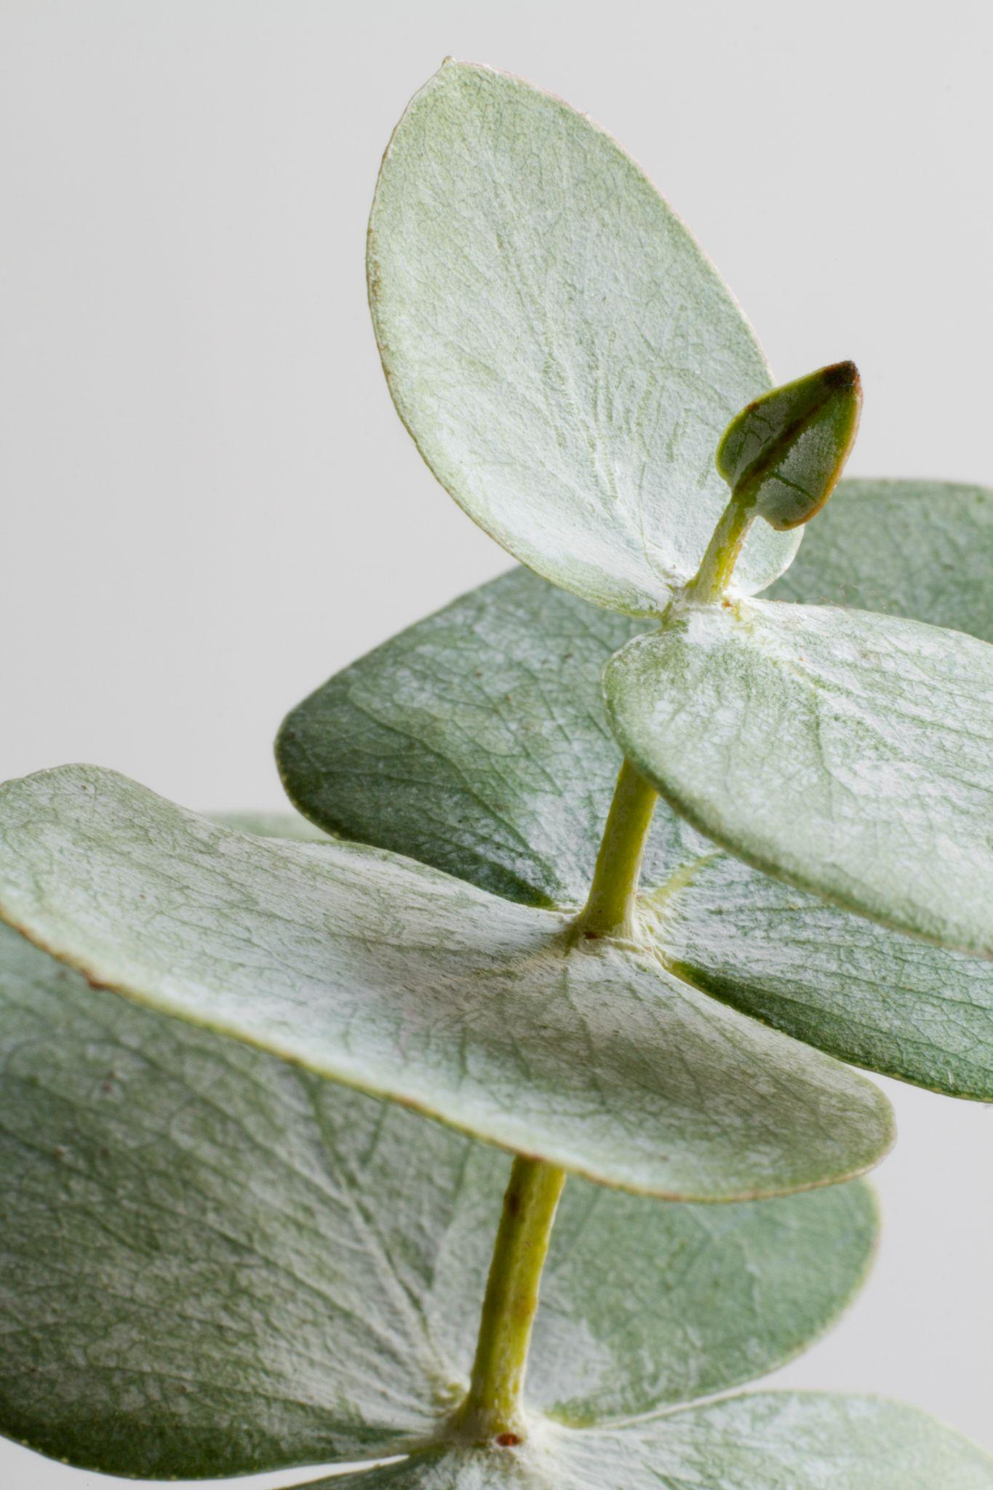
We Deal in:-
Nutraceutical
Ayurvedic
Food components that provide health benefits beyond basic nutrition
Remedies derived from the ancient Indian medical system of Ayurveda
Herbal
Pharmaceutical
Substances derived from plants and used for therapeutic purposes
Substances used to treat, prevent, or diagnose diseases
Enzymes
Oil Seeds
Protein that acts as a biological catalyst by accelerating chemical reactions
Seeds grown primarily for the extraction of oil

Slide 7
Top Sellers Nutraceutical Products
Aloevera
Spirulina
Moringa
Available in leaf, powder & extract
Available in extract & powder
Available in leaf, powder & extract
Caffeine
Soya
Vanilla
Also known as Coffea Robusta
Available in powder, lecithin, extract
Available in extract & powder

Slide 8
Top Sellers Herbal Products
Cumin
Fenugreek
Green Tea
Available in seeds, powder & extract
Available in seeds, extract & powder
Available in extract
Neem
Psyllium Husk
Tulsi
Available in extract, leaf & powder
Available in powder
Available in extract, leaf & powder

Slide 9
Top Sellers Enzymes
Bromelain
Chymotrypsin
Trypsin
Eq. to 225 FIP units
Eq. to 300 FIP units
Eq. to 720 FIP units
Pancreatin
Papain
Amylase
Eq. to 164 FIP units
Eq. to 164 FIP units

Slide 10
Top Sellers Ayurvedic Products
Shilajit
Guggul
Ginger
Available in raisin & extract
Available in extract & powder
Available in extract & powder
Triphala
Cardamom
Ashwagandha
Available in extract & powder
Available in powder
Available in extract & powder

Slide 11
Top Sellers Pharmaceutical Products
Rabeprazole
Sitagliptin
Ketoprofen
Atenolol
Bumetanide
Famotidine
Naproxen
Pantoprazole
Pregabalin

Slide 12
Top Sellers Oil Seed Products
Chia
Groundnut
Mustard
Castor
Niger
Tamarind
Sunflower
Sesame
Peas

Slide 13
Our Network
USA
India
Europe
Egypt
UK
Australia

Slide 14
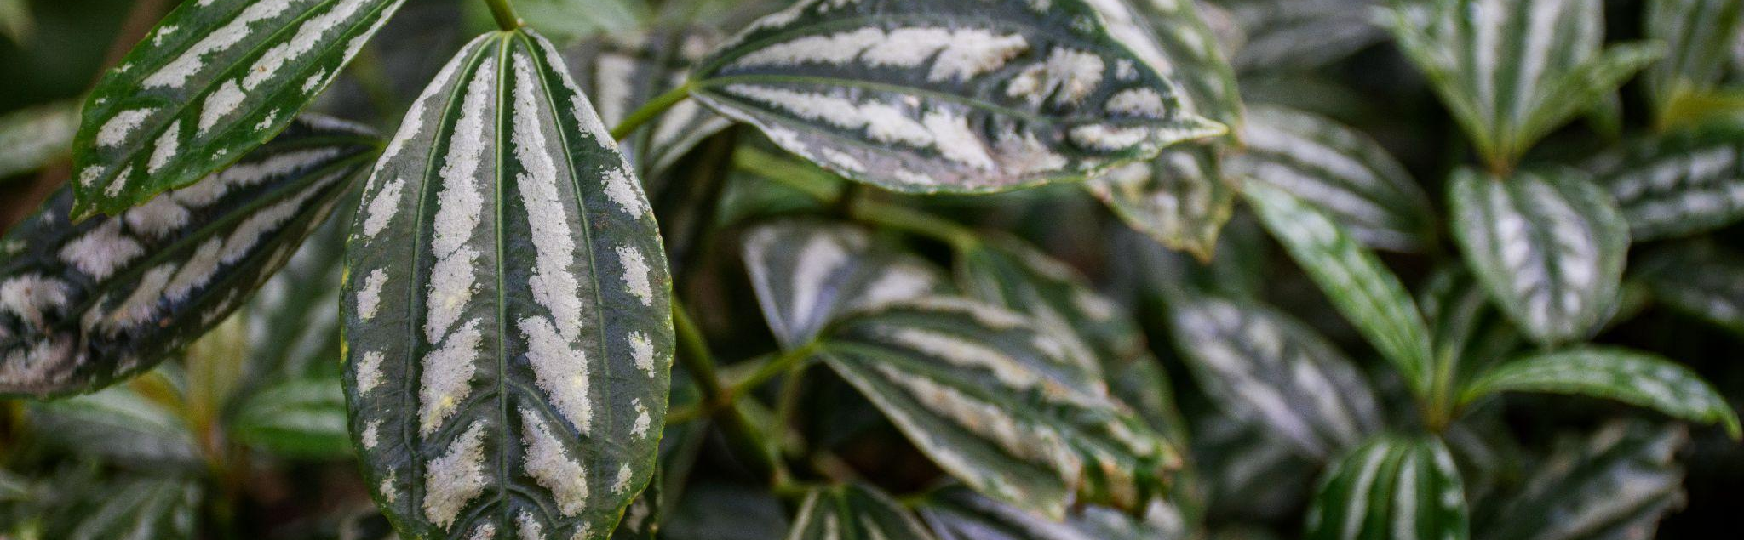
Conclusion
Choose us as your partner for all your ingredient needs and experience the difference our expertise and trustworthiness can make

Slide 15
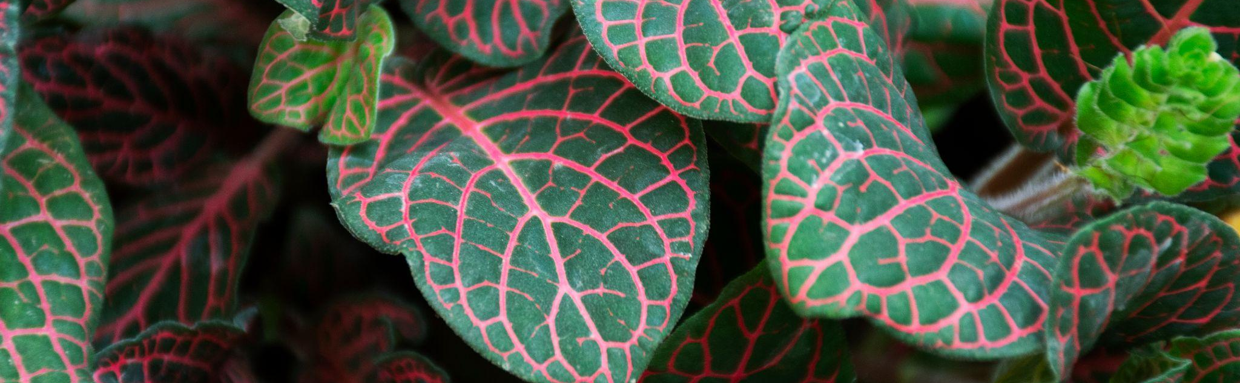


Thanks!
Do you have any questions?
+91 887-881-7746
Business@chhayaglobal.com

