Slide 1
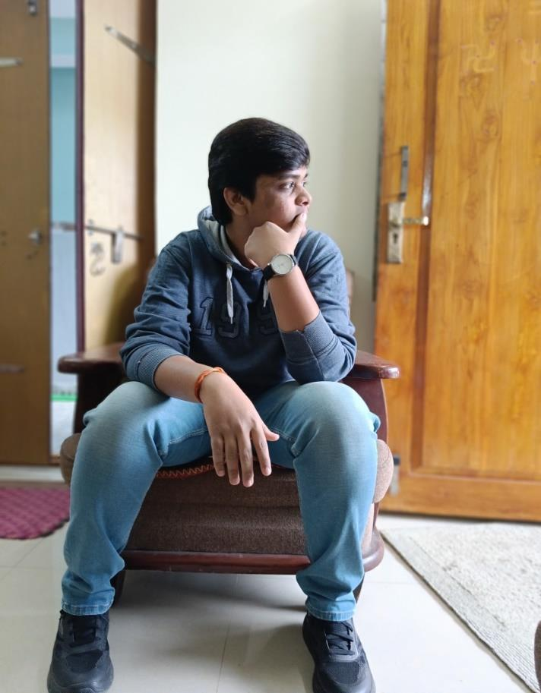
Maddela Sahithya Rai
DETAILS
Age : 18
Eye Colour : Black
Contact : 7330663388
Height : 5’11 (or) 6 Feet
Instagram : m.sahi.rai_0206
Languages : Telugu,Hindi,English
Email id : Sahith2006rai@gmail.com
Location : Telangana,Khammam
District
Notes:
Maddela Sahithya Rai

Slide 2
