Slide 1

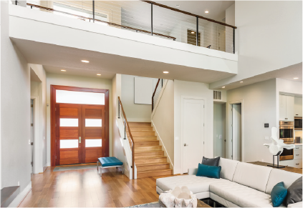
RE/MAX
NEW NAME
1234 SOMEWHERE ROAD
ANYWHERE, US

Slide 2
RE/MAX
NEW NAME
1234 SOMEWHERE ROAD
ANYWHERE, US

Slide 3
RE/MAX OFFICE NAME
1234 SOMEWHERE ROAD
ANYWHERE, US

Slide 4
RE/MAX OFFICE NAME
1234 SOMEWHERE ROAD
ANYWHERE, US

