Slide 1
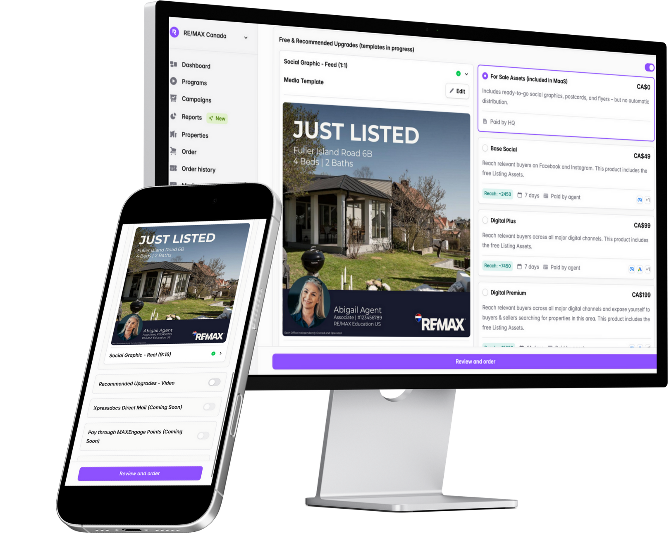
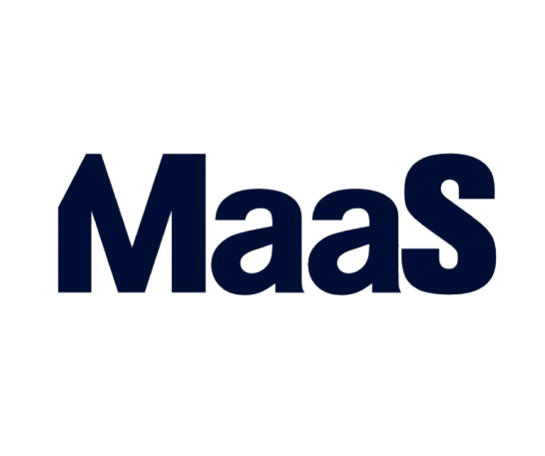
Marketing as a Service
​
©2025 RE/MAX, LLC. Each Office Independently Owned and Operated. 25_250

Slide 2



Maximum Impact. Minimum Effort.
Give sellers insight with real-time marketing results and performance data.
Automated marketing packages for new and active listings
No-cost materials as well as advanced paid campaign options.
©2025 RE/MAX, LLC. Each Office Independently Owned and Operated. 25_250

Slide 3



Maximum Impact. Minimum Effort.
Smarter marketing powered by AI and REMAX data — MaaS automatically targets the most likely buyers to maximize campaign performance.
MaaS lets you tailor REMAX-branded templates to match your style or team, or automate everything with set it and forget it ease.
©2025 RE/MAX, LLC. Each Office Independently Owned and Operated. 25_250

Slide 4
What makes MaaS different?
Not Just Another Marketing Tool
MaaS expands reach and targets the right audience through:
  Instagram
  Facebook
  Google Pay Per Click
  and Google Display Network
All leveraging AI targeting
©2025 RE/MAX, LLC. Each Office Independently Owned and Operated. 25_250

Slide 5
MaaS vs. the Industry
25%
13%
vs.
Current click through rate for MaaS advertising campaigns.
The average click through rate for our industry.
©2025 RE/MAX, LLC. Each Office Independently Owned and Operated. 25_250

Slide 6
Early Feedback & What's Next
What Brokers Love So Far:
What's Next:
Ease of use
Added value for sellers
AI-generated property videos
Print materials
So much more
©2025 RE/MAX, LLC. Each Office Independently Owned and Operated. 25_250

Slide 7

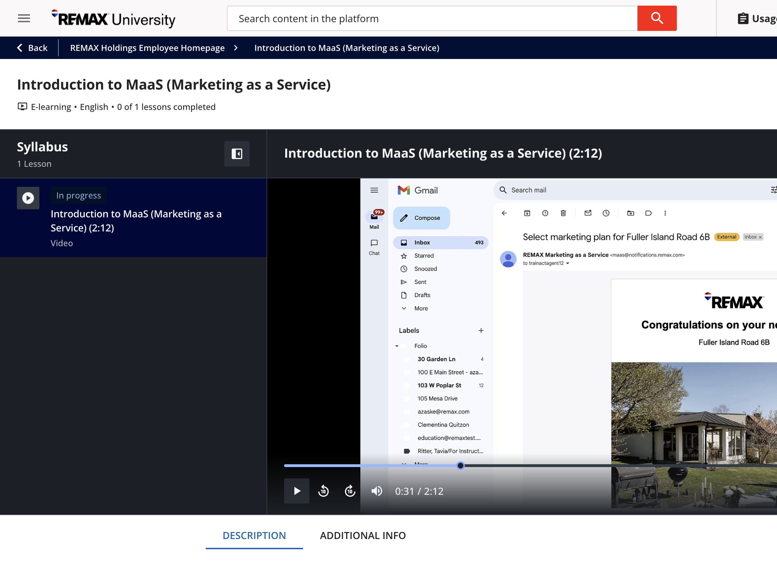


How do affiliates tap in?
Brokers meet with RealForce to choose customization options
Watch the training video on REMAX University to learn more
Watch for emails from RealForce to kick off their first campaign
©2025 RE/MAX, LLC. Each Office Independently Owned and Operated. 25_250

