Slide 1
The Value Behind Onboarding

Slide 2

Why Onboarding?
The Onboarding experience will define the ongoing relationship your customer has with the RE/MAX Brand. It is critical.

Slide 3

Why Onboarding?
Seven years ago, RE/MAX, LLC. created the Onboarding Team, dedicated to helping new franchise owners open their office.
Before then, there was a huge gap between the sales process and when an office officially opened. We created a bridge to help.

Slide 4

Keep In Mind
We compare the Onboarding Process to the “Honeymoon Period.” It’s a new and exciting journey.
Notes:
-New owners just went through with a large investment,
-they’re probably reading through their Franchise Agreement.
-They need to wind down from the stress and get comfortable with their decision.
-We make the first phase a celebration

Slide 5

Keep In Mind
You must understand the Psychology behind your Client/Customer.
Overwhelmed
Anxious or Excited
Maybe Experiencing Buyer’s Remorse
Notes:
-During the Onboarding Process, we use Video to create a strong connection with the Broker/Owners.
-Both video email and zoom conferencing.

Slide 6

Keep In Mind
Help eliminate those feelings by creating a system.
A system is a fancy word for a Checklist or Timeline.
Anything that is repeated more than 3 times needs a checklist.
Notes:
I cant stress this enough…
One of the keys to Onboarding is to be organized.
Systems run businesses, People run systems
Having a detailed Timeline and Checklist allows your system to be repeated and leveraged to staff.
At a region level, this makes the process a dynamic selling point to franchise prospects

Slide 7

We Believe In First Impressions
We believe first impressions are vital with all new relationships. Use this to your advantage by implementing a dynamic Onboarding/Transition system
Internally, the mindset we must establish is that the Renewal process begins as soon as the contract is signed.

Slide 8

We Also Believe
Onboarding doesn’t stop with the franchisee.
Onboarding must be emphasized to the office level when they add agents.
It’s the #1 driver of Agent Retention.
Notes:
Another benefit to an office with a healthy onboarding system is that it allows the Owner to focus on $$$ producing activities as oppose to
You must work ON your business, not IN your business

Slide 9


Keep It Simple
Onboarding is Two Dimensional:
  Compliancy
      State and Local Laws and Regulations
      RE/MAX Brand Standards
  Value
      Show the Value Behind the BRAND
Notes:
Yard signs, Exterior signage, protect the BRAND
What can you do to show your owners value?
Can you offer Momentum training?
This was our biggest challenge on the front side. We had too much value it was hard to consolidated.
Owners had a difficult time sharing their Value Proposition outside of Brand recognition

Slide 10
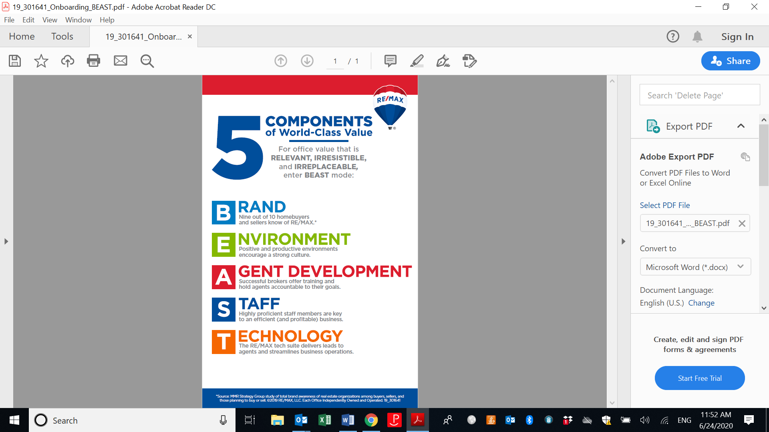
Notes:
A while back, a RIS media survey went out to thousands of Agents to see what made brokerages attractive
They broke it down to the BEAST.

Slide 11

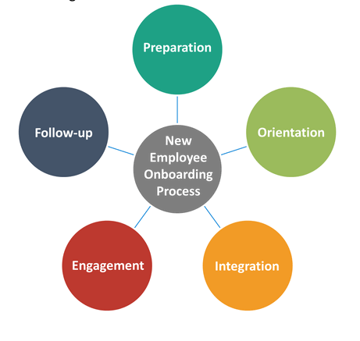

Onboarding Musts:
Simplify: Keep the process simple and predictable
Structure: Reduce complexity and creates accountability and timelines
Systemize: Any redundant actions must be turned into a checklist. Strive for a turnkey process
Notes:
Structure- Give them deadlines, onboard with a sense of urgency

Slide 12



Other Ways to Make Onboarding Impactful for Your Customer
Use Video Early and Often and Leverage Teleconferencing
Surveying or Checking In On Your Offices after Onboarding
Leverage Your Team at Headquarters

Slide 13
Onboarding vs. No Onboarding
With Onboarding vs. Without Onboarding
ATO average in last 3 years went from ~90 to ~60
  Owners who onboard more quickly can recruit quicker– expediting growth
  Driving up broker engagement into systems (Brokers utilize resources and can better train and develop their agents)
  100% of our owners have their MAX/Profile set up, websites set up, etc.
Wellness/Feedback tapping in to continued engagement
  Trainings, events, in region events, incentive contests, etc.
ATO is generally higher (~150 days)
  Owners typically take longer to open and don’t hit the ground running
  Aren’t able to recruit earlier = making less money, less quickly
  Never tapping into systems and facing continual challenges (recruiting, development, growth)
Miss out on valuable engagement opportunities such as:
  Building a relationship with HQ departments
  Learning Momentum concepts earlier
  Tapping into events, trainings, networking

Slide 14
Thank you.

