Slide 1

RE/MAX Teams

Slide 2

Teamwork Makes the Dream Work
In Canada, RE/MAX teams average
22.2 transactions per agent
(average of 20.0 transactions per
independent agent not on a team*)
The RE/MAX network is home to top-producing teams of all sizes
RE/MAX offers the brand strength, tech tools, support and global network to power up teams.

Slide 3
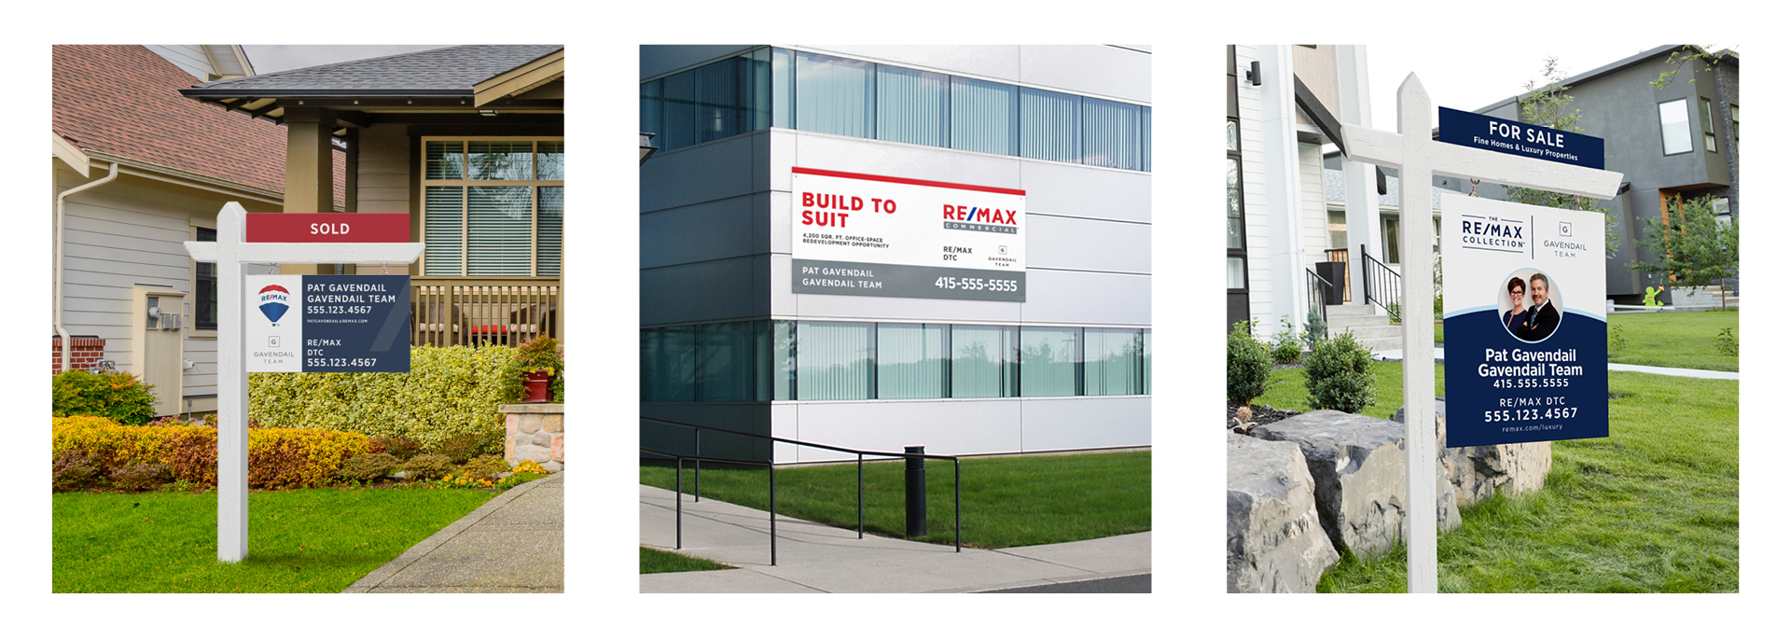
Elevate Your Team with Professional Signage
Notes:
RE/MAX recognizes the importance of personal promotion when attracting consumers to their listings.
That’s why we provide a variety of modern, sleek, agent-centric team signage options. ​

Slide 4
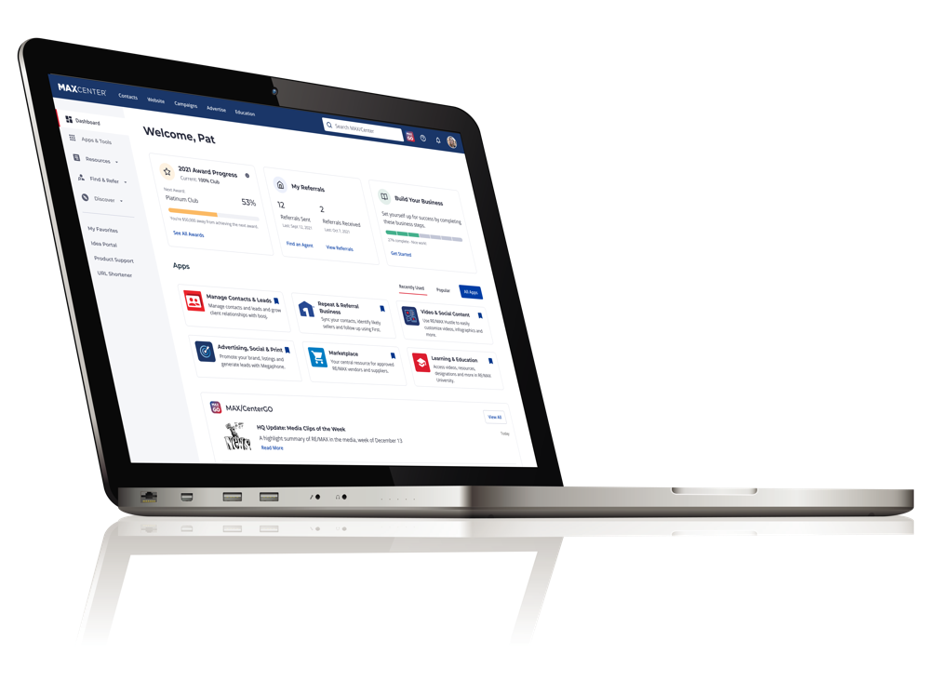
Business Building Tools and Resources
MAX/Center:® Your Access Point to Build Your Business
Your personalized MAX/Center dashboard allows you to:
Send and receive referrals
Access core apps to help you build your business
Track your progress toward your club award level
View RE/MAX events and industry news

Slide 5
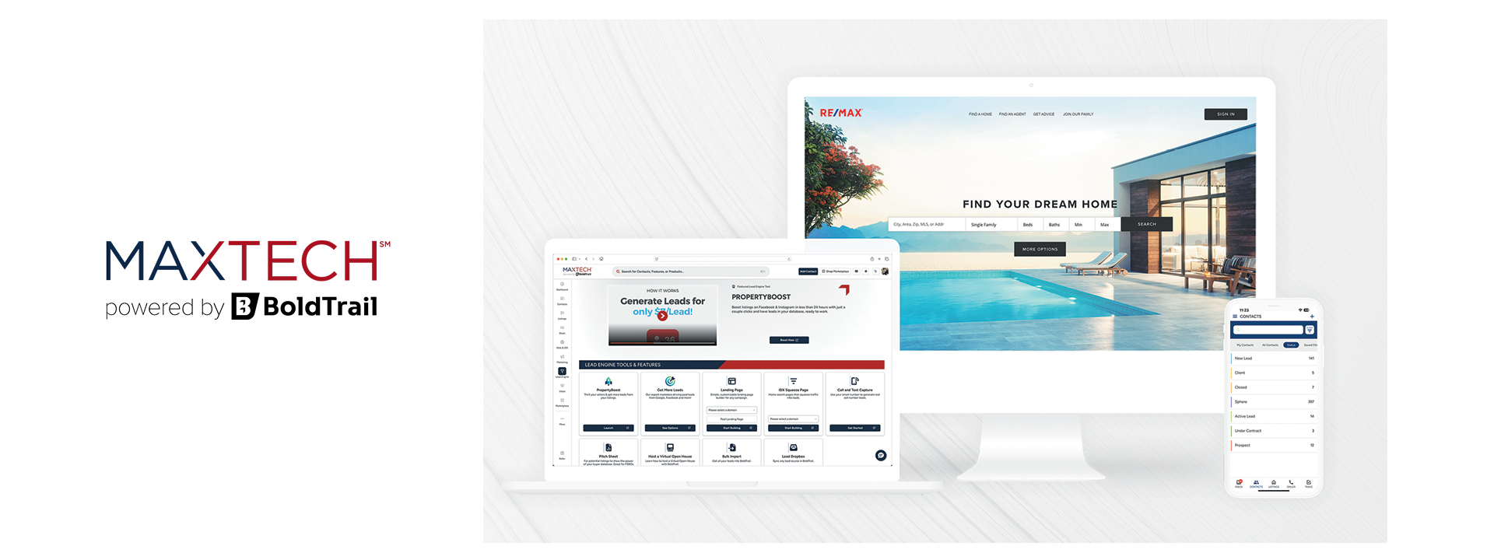
Tech To Power Your Business
Notes:
With websites, landing pages, CRM system, smart campaigns, marketing tools, an integrated CMA tool, and so much more, MAX/Tech powered by BoldTrail simplifies and streamlines every aspect of running and managing your business, creating a single end-to-end platform with many solutions for efficiency and growth.

Slide 6
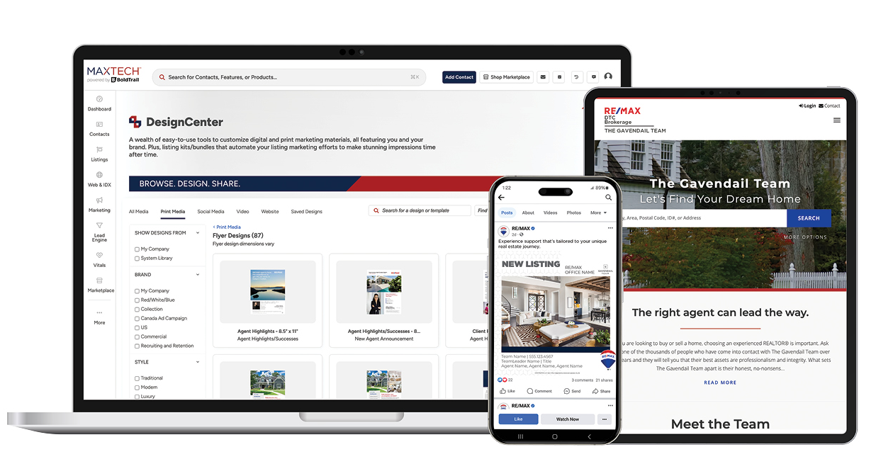
Tech Solutions To Power Your Team
Lead-generating Team Websites
Social Graphics
Paid Advertising
Print Materials
Notes:
The Teams add-on within MAX/Tech powered by BoldTrail leverages the most powerful features of the platform to help teams run more efficiently.
These features can help make your team more productive, supercharge recruiting and save valuable time and money.
The best part? This powerful add on is available at no additional cost! ​

Slide 7


Customized Video, Digital and Print Marketing
Notes:
RE/MAX DesignCenter, Hustle & PhotofyTM
Use branded templates to easily customize marketing materials such as flyers, postcards, presentations and more
Use approved print partners to help
with your promotional needs
Personalize national campaigns and create digital campaigns to send to contacts
Create customized virtual tours and personal brand videos
Receive fully designed automated
listing packages
Share customizable RE/MAX branded content on social media with automated mass marketing tools

Slide 8
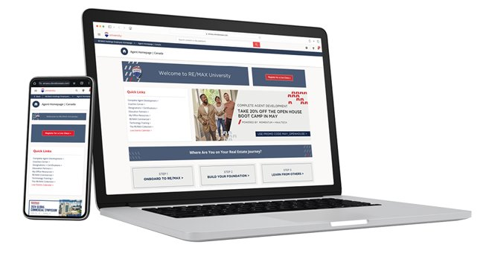
Build and Excel Within Your Team — Your Way
RE/MAX University® offers the right courses to help you and your team develop and grow.
Building a Team
Team Leadership
Growing Your Team
Developing High-Performing Teams
Team Fundamentals
Momentum:® Master Team Builder
Notes:
The RE/MAX network is home to top-producing teams from small and medium, to large and mega.
RE/MAX University offers team leaders and team members courses to help them develop and grow.
-Building a Team
-Team Leadership
-Growing Your Team
-Developing High Performing Teams
-Team Fundamentals
-Master Team Builder

Slide 9

Mastermind, Learn and Expand Your Referral Database
RE/MAX Events:
The Ultimate RE/MAX Teams Event
Team Focused Masterminds
RE/MAX R4® Convention
Activate Canadian National Conference
Local and Regional Events

