Slide 1



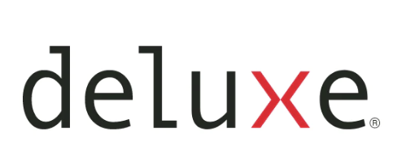






U.S. Automated Listing Distribution – Residential
RE/MAX Sites
Real Estate Portals
(with 50 languages and 72 currencies)
Listing Promotion Tools
Agent/Team/Office Websites
CRM
©2024 RE/MAX, LLC. Each Office Independently Owned and Operated. 24_313_US

Slide 2




U.S. Automated Listing Distribution – Commercial
RE/MAX Sites
(with 50 languages and 72 currencies)
Listing Promotion Tools
Agent/Team/Office Websites
(Only if the commercial listing is on the MLS)
©2024 RE/MAX, LLC. Each Office Independently Owned and Operated. 24_313_US

