Slide 1


Slide 2


Slide 3


Slide 4


Slide 5

Notes:
REMAX is the #1 name in real estate
When people think real estate, they think REMAX – and then they think of you. The agent they already know, like and trust.
Placing the balloon beside your name gives you instant credibility
In fact…

Slide 6

Notes:
Consumers trust the REMAX brand, and it is 4x more likely to be recommended than other real estate brands.
This may make it easier for you to attract more clients and close more deals!

Slide 7

Notes:
More buyers and sellers think of REMAX – that means you automatically begin with an edge against your competition.
You never have to explain who you’re with in listing presentations or conversations with buyers and sellers.
You can offer them the power of the REMAX reputation as the starting point for the value you will deliver.

Slide 8

Notes:
Did you know that REMAX is voted most reputable real estate company in Canada? REMAX is also among the top 100 most reputable companies across Canada.
Pride runs deep in the brand’s reputation, credibility and unwavering support for agents.

Slide 9

Notes:
Consumers want to work with people they can trust, and a recent study shows REMAX agents are the most trusted real estate agents in Canada and the US. And year after year REMAX accomplishes this.
REMAX agents have a competitive advantage by being the most trusted.

Slide 10

Notes:
And when a consumer decides to buy or sell, more choose REMAX than any other brand. In fact, REMAX in 2023 REMAX agents closed over 1.5 million total transaction sides.

Slide 11
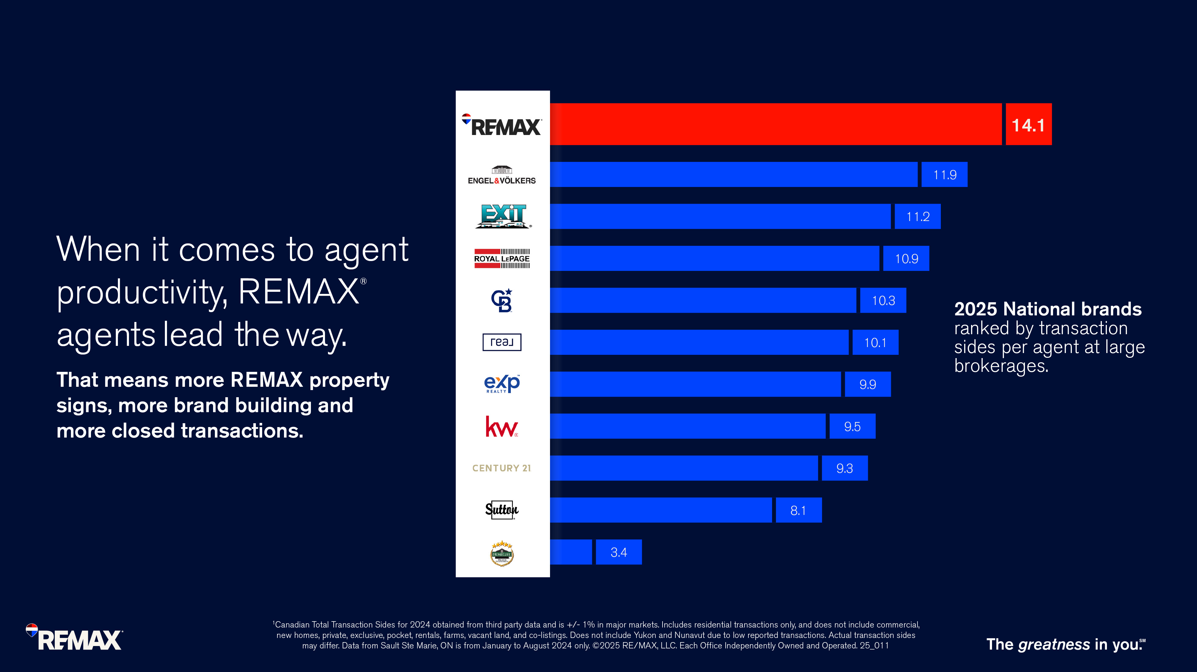
Notes:
REMAX agents closed more transactions than any other competitor in 2024.
Productivity is inspiring… productive agents want to be around other productive agents.
REMAX agents motivate you to grow your business and energize your career.
Productivity means more REMAX yard signs and more times at the closing table for you.
The is no limit to what you can achieve at REMAX.
In fact…..

Slide 12
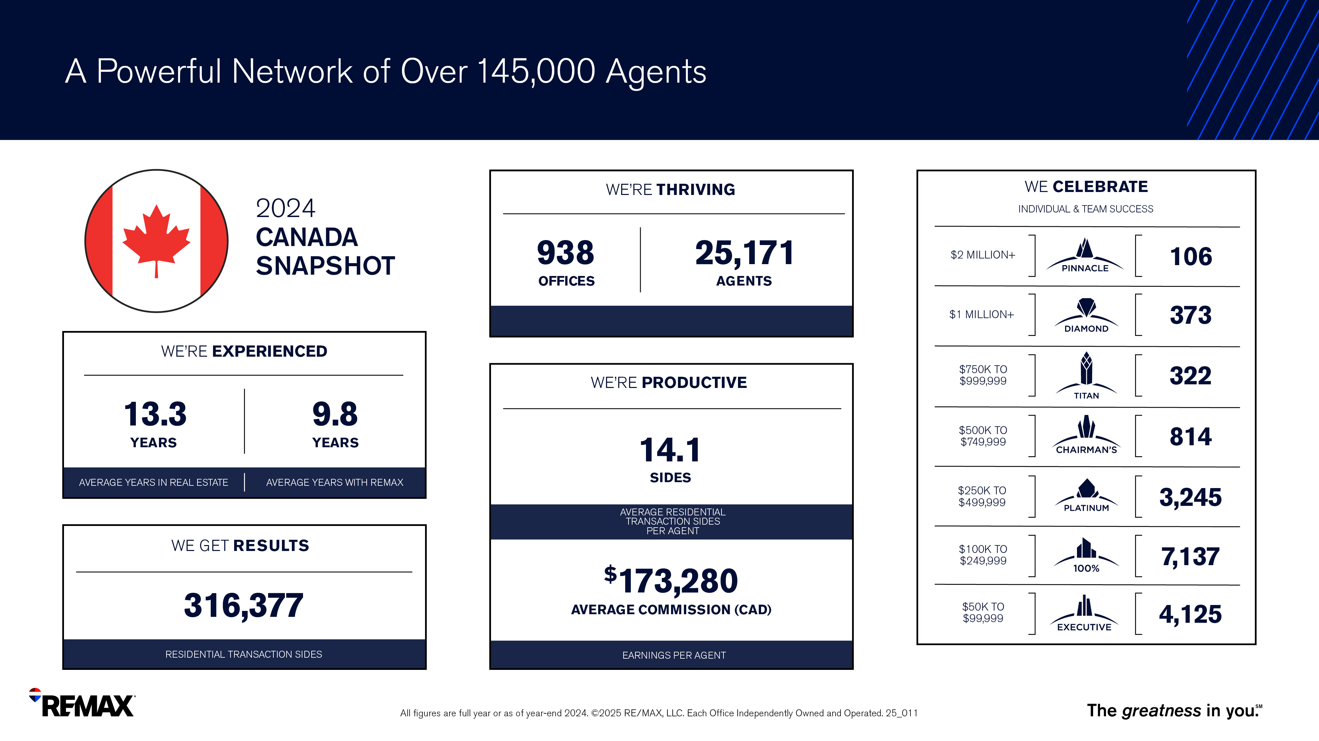
Notes:
Take a look at these numbers from 2024.
REMAX agents in Canada closed an average of 14.1 transactions and earned over $173,280 CAD in commissions on average.
Opportunities abound at REMAX.

Slide 13
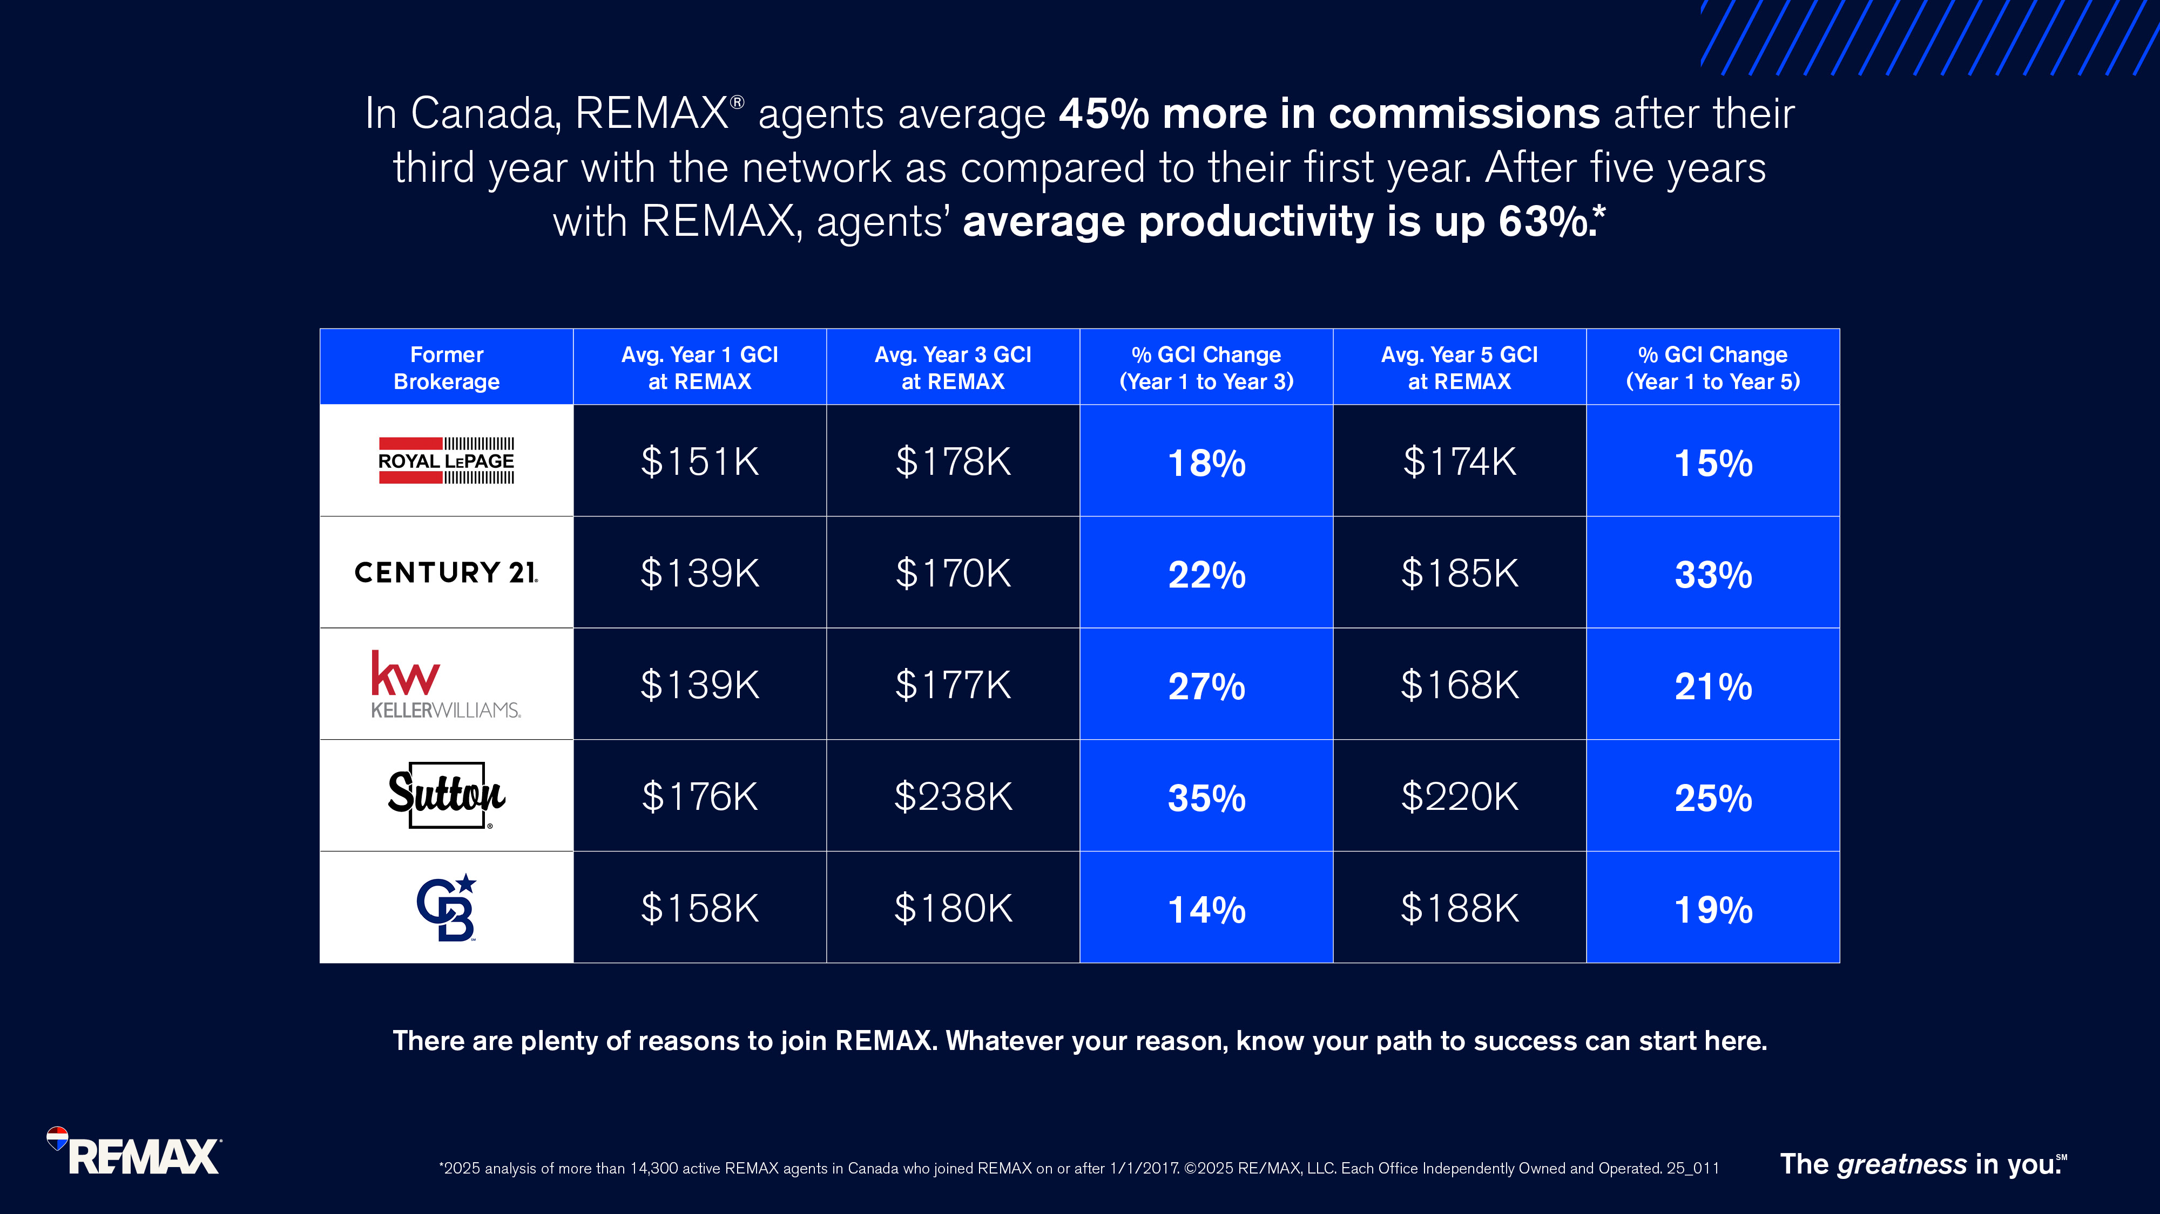
Notes:
At REMAX, when you’re around the best, you just get better.
REMAX agents average 45% more in commissions after their third year with the network as compared to their first year. After five years, average productivity is up 63%. ​
Your path to success can start at REMAX.

Slide 14
The Power of REMAX Office Name

Slide 15
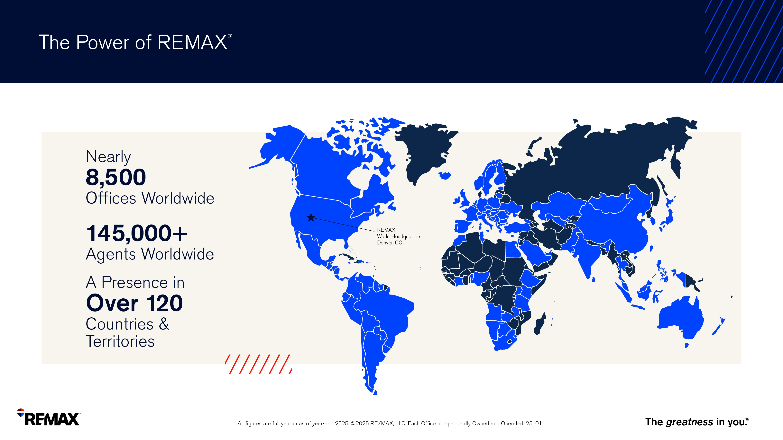
Notes:
The power of REMAX means global reach, global connections and the potential for more referrals
With over 145,000 agents & a presence in over 110 countries and territories… wherever your clients go, you can rest assured you are connecting them with the best.

Slide 16

Notes:
At REMAX, we believe in supporting the dream of homeownership for all, equally.
The process of buying or selling a home is complicated, and every individual should have a feeling of trust, respect and confidence as they navigate this important step in their life.
And that’s what REMAX agents do, across more than 110 countries and territories.
REMAX is proud to support industry partners that are committed to increasing homeownership across all demographics.
Over 300 educational events are available through these leading partners to help agents better serve their buyers and sellers.

Slide 17

Notes:
REMAX was built on a culture of giving.
The REMAX and Children’s Miracle Network partnership provides a way for you to give back to your local community and changes kids lives.
REMAX’s 33-year partnership with CMN Hospitals is an example of what can happen when we all pull together.
Every dollar donated by a REMAX agent stays in their local community.
Our support is generated primarily through the REMAX Miracle Home and Miracle Property (Commercial) Programs

Slide 18

Notes:
The Quest for Excellence scholarship program is a cash scholarship that recognizes students for their ongoing community contributions and pursuit of leadership.
REMAX Canada is pleased to offer 40 scholarships of $1,000 each to students across Canada (except for Quebec).
For more information visit: rem.ax/questforexcellence

Slide 19
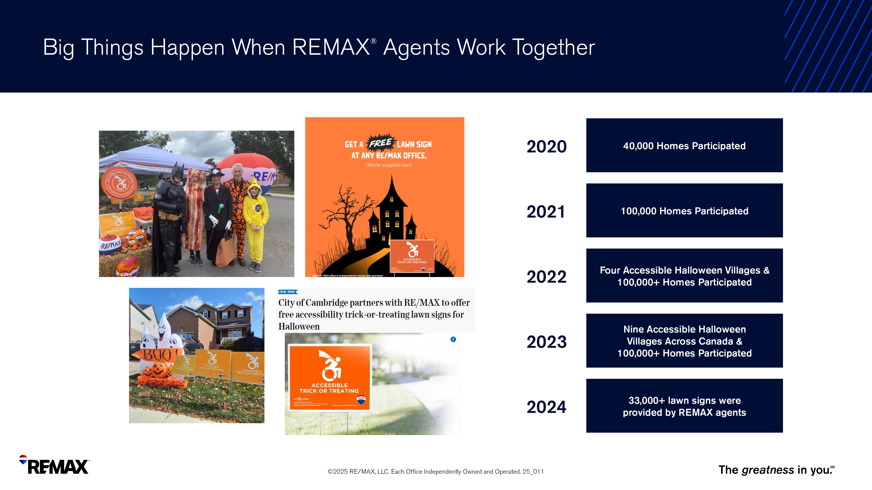
Notes:
Treat Accessibly is a program that encourages homeowners to bring “treats to the streets” in the name of inclusivity and accessibility during Halloween.
REMAX agents can use the lawn signs to build relationships and increase client base with this non-profit program.

Slide 20

Notes:
REMAX agents are hardworking… but they also know how to have fun.

Slide 21
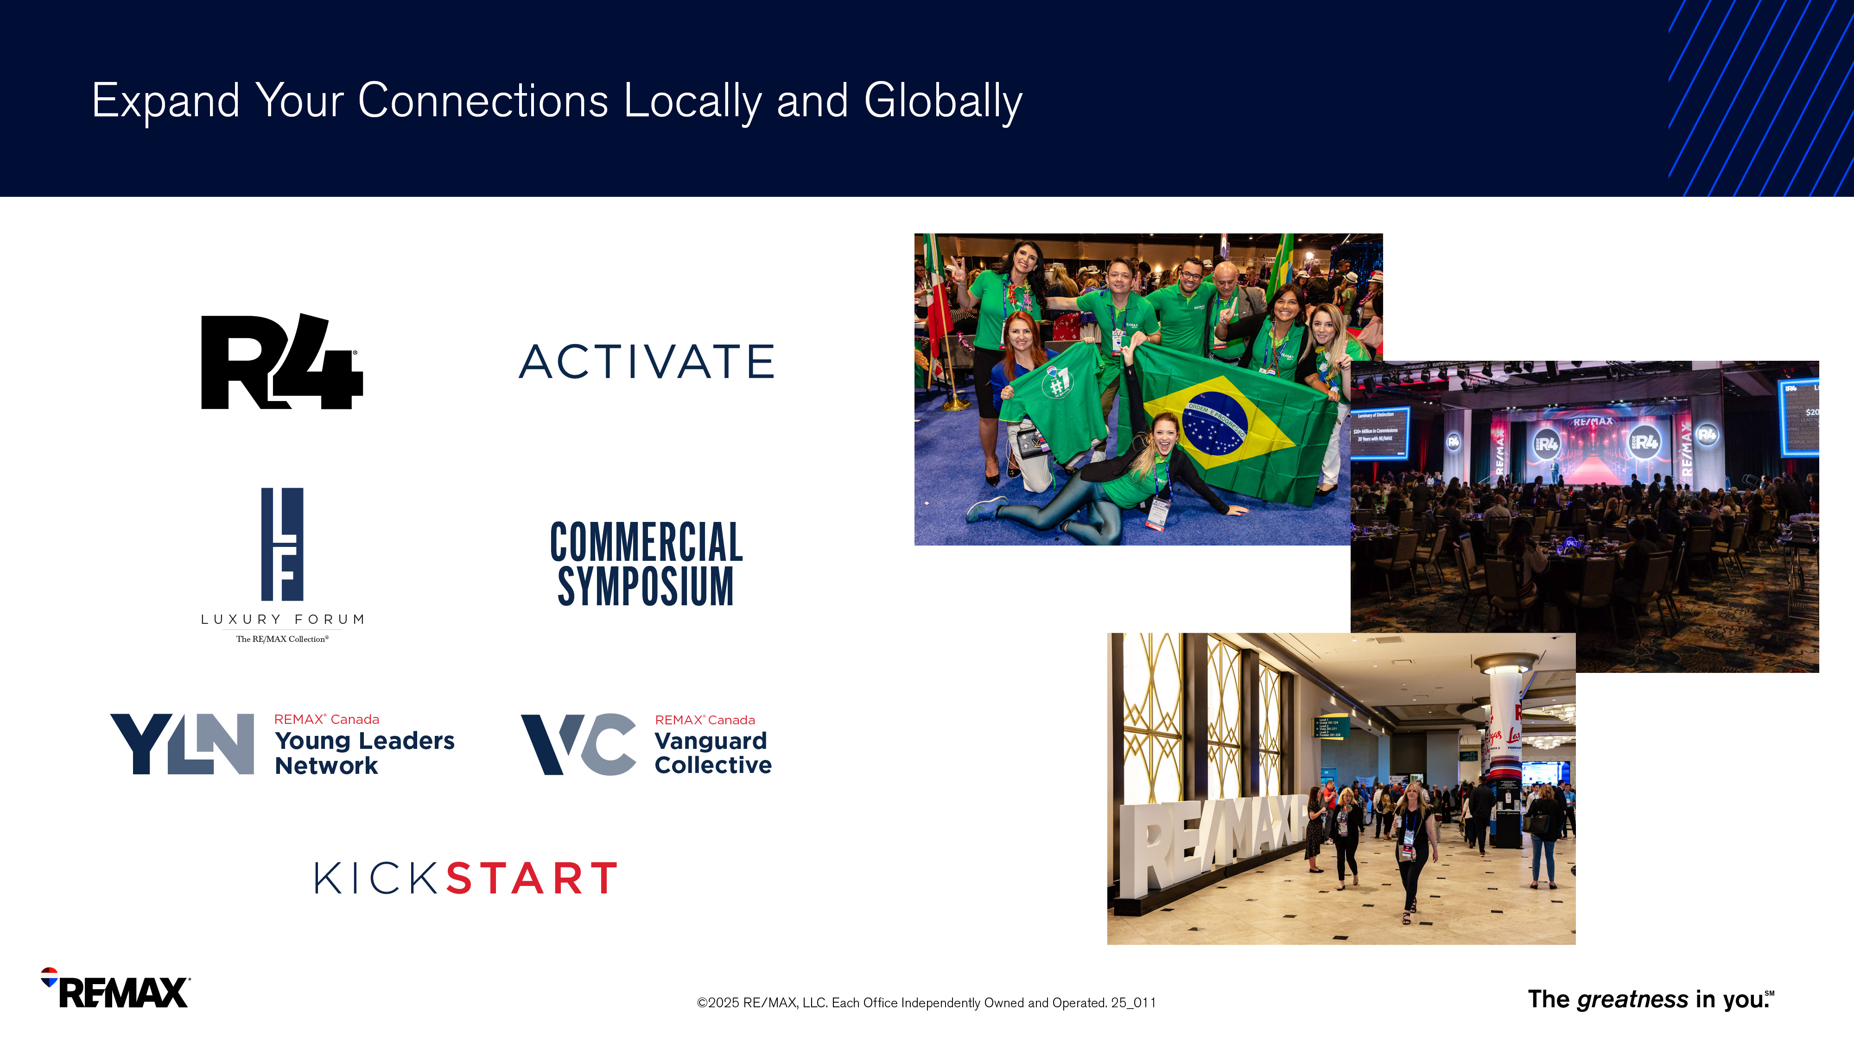
Notes:
With over 145,000 agents in the REMAX network, you have a huge opportunity for networking, learning, connecting and building your referral pipeline.
R4 is REMAX’s largest global event held annually where you can see people from across the globe – learn from your peers, gain insights and celebrate your accomplishments.
Activate is REMAX’s largest Canadian event also held annually, offering numerous educational sessions and networking opportunities.
Annual events occur all year long so you can take advantage of them to increase your knowledge, expand your connections and create relationships to help you build your business.

Slide 22

Notes:
This year’s Activate conference is being held in Nova Scotia from October 7-9th.
Will you be there to get the REMAX experience?

Slide 23

Western Canada
Manteo at Eldorado Resort
Kelowna, BC
• September 22-23
• November 17-18
Eastern Canada
The Waterside Inn
Mississauga, ON
• December 2-3
Notes:
Kickstart events are held across the country to welcome agents to REMAX and help ‘kickstart’ their success using the resources, tools and power of the brand.
The dates for each event are noted on the slide.
Western CAN: https://www.remaxevents.com/event/2025WCKickstart/summary
Eastern CAN: https://www.remaxevents.com/event/2025ECKickstart/summary

Slide 24

Notes:
As a member of REMAX Canada’s Young Leaders Network, agents under the age of 40 can come together and exchange ideas, knowledge and experiences with other like-minded agents across Canada.
They can share their passion as they work towards the common goal of collaborating to help shape not just the future of REMAX, but the real estate industry as a whole.
They also gain access to numerous exclusive groups and events including top producer panel opportunities, the exclusive Annual Young Leaders Network Event, and more.

Slide 25
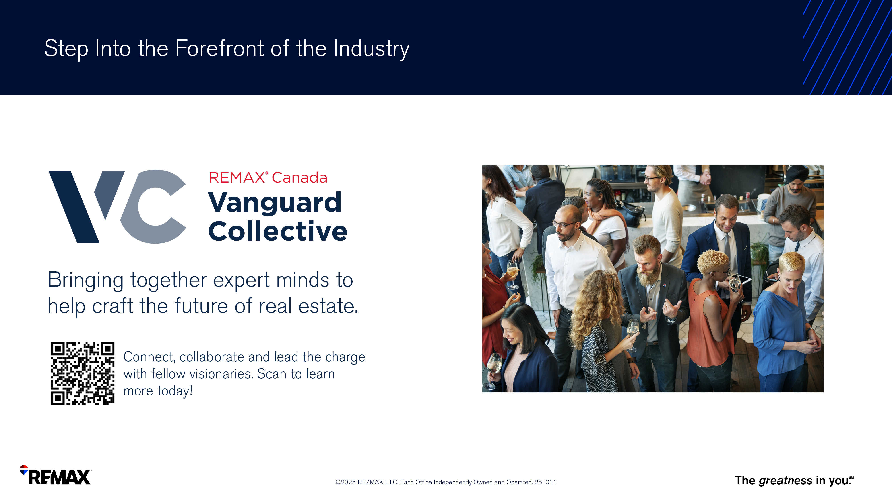
Notes:
Step into the forefront of real estate with Vanguard Collective (VC), an elite network within REMAX Canada for agents and team leaders aged 40 and above.
This exclusive circle is where seasoned professionals merge leadership and experience to redefine industry standards.
Connect, collaborate, and lead the charge with fellow visionaries, all while enjoying many perks and opportunities that will enrich your professional journey.

Slide 26

Notes:
From the REMAX balloon to The REMAX Collection and REMAX Commercial - REMAX means instant recognition and credibility.
Whatever your focus is – residential, luxury or commercial – you can better serve your clients based on their needs.
In order to keep REMAX – and you – top-of-mind with consumers, we focus heavily on identifying what consumers want.

Slide 27
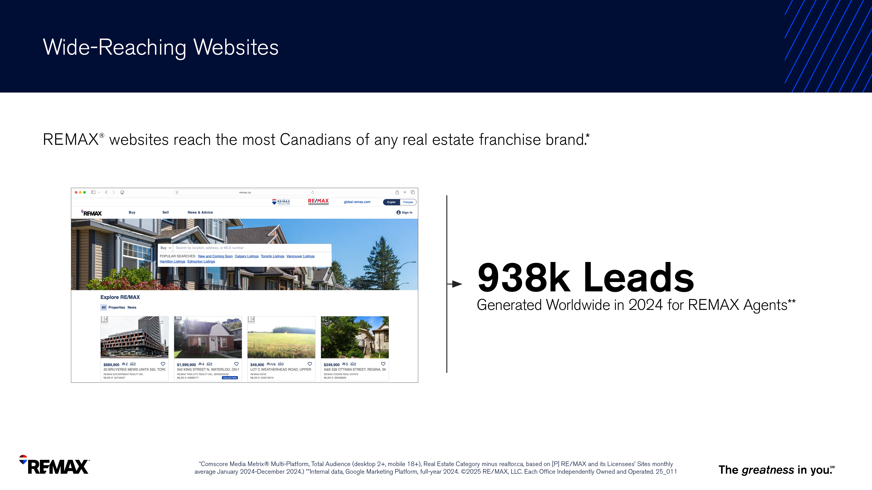
Notes:
Leads are extremely important to your business – and REMAX delivered 938k Million leads to REMAX agents in 2024!
REMAX generates leads for agents through multiple sites and apps including:
Remax.ca and Remax.com
Global.remax.com
Remax.ca/luxury
Remax.ca/commercial
MAXTech powered by BoldTrail​
Agent Websites​
And more.

Slide 28
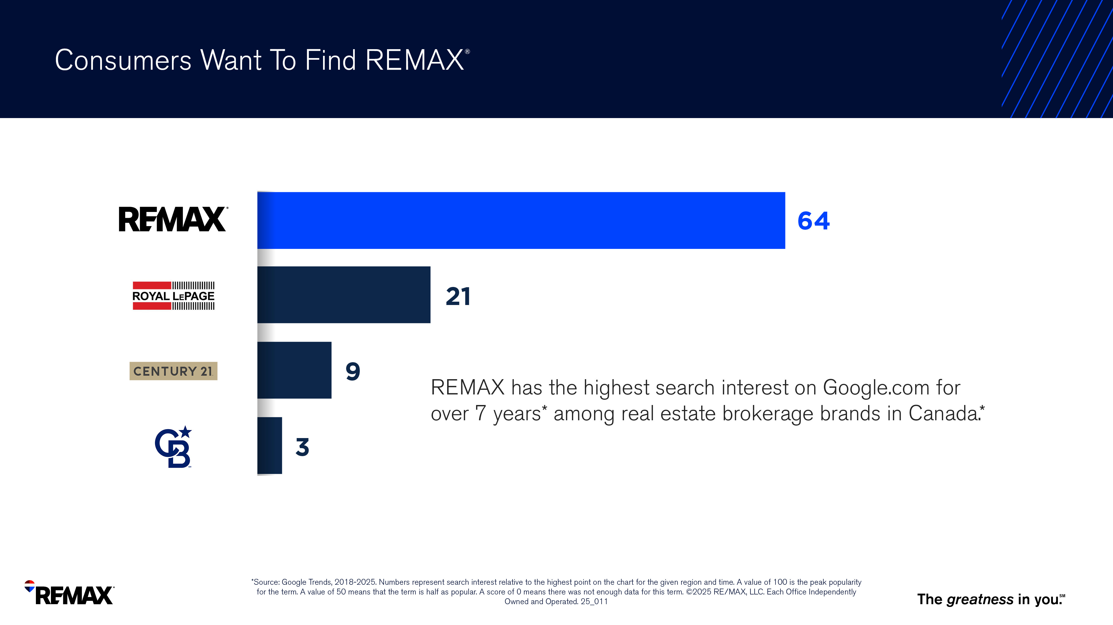
Notes:
When it comes to real estate brokerages in Canada, REMAX has the highest search interest on Google.com for over seven years.
This is good news for when you attach the REMAX name to yours. When REMAX gets attention, so do you.
Being part of the brand consumers search for could help build your business.

Slide 29
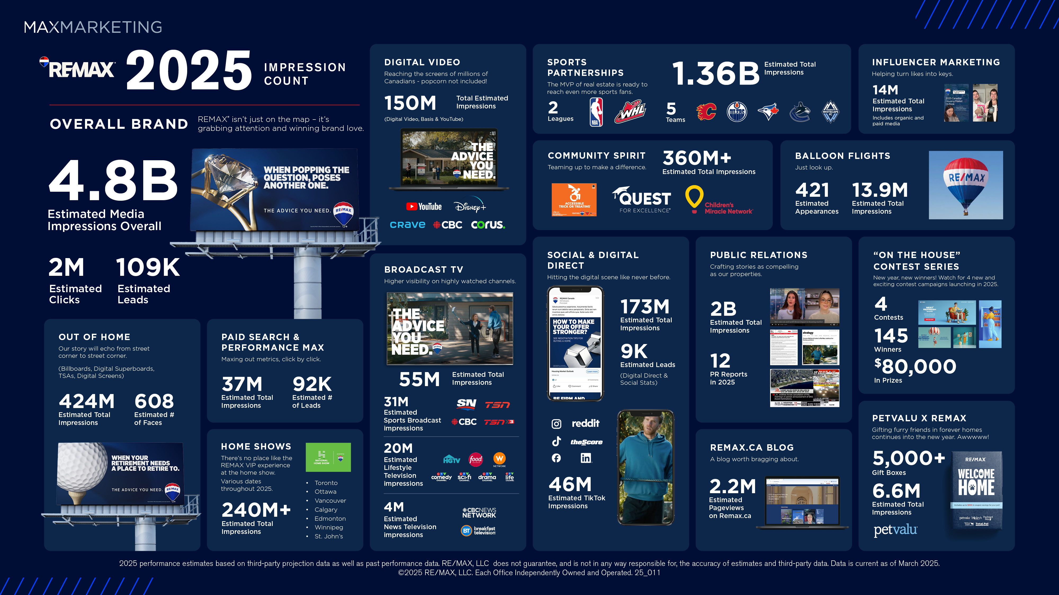
Notes:
At a national level, we keep REMAX in front of consumers through video and television, radio, out of home and online creating billions of consumer impressions nationally and locally.
That means billions of potential buyers and sellers are seeing the REMAX brand wherever they go.
By creating awareness at a national level, leads are generated for agents at a local level through remax.ca.
Consumers will already know the brand and trust the brand… meaning they know and trust you before they even meet you.

Slide 30
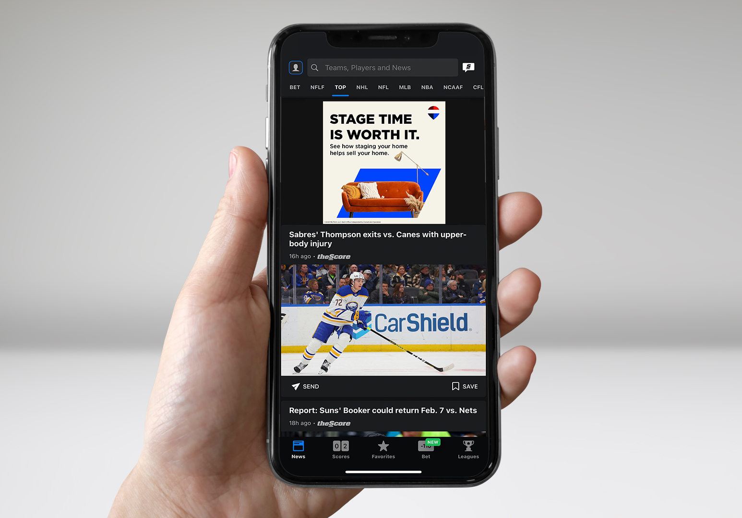




Slide 31
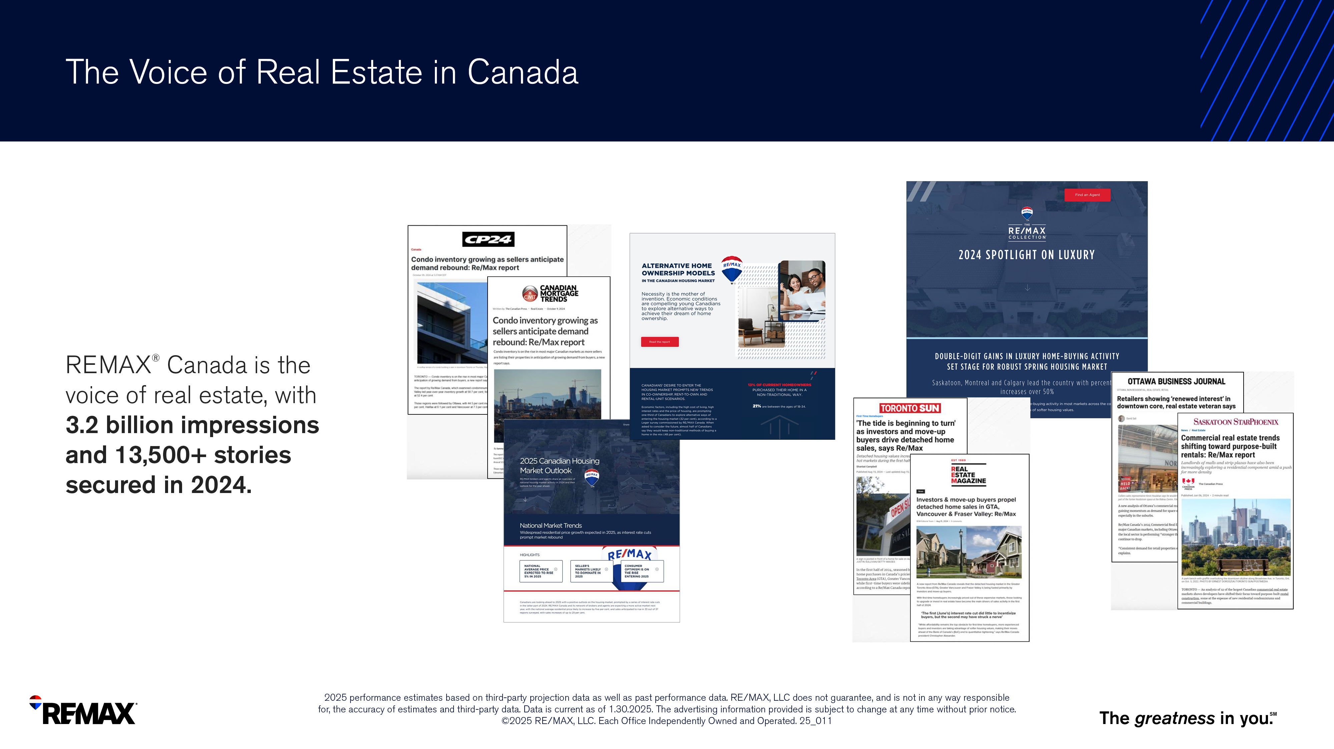
Notes:
REMAX reaches home buyers and sellers nationally and locally with the knowledge and advice they need.
REMAX Reports analyze market trends, create headlines and put current insights into your hands to show your expertise.
REMAX Canada is the voice of real estate, with over 3.2 billion impressions and 13,500 stories secured in 2024.
*

Slide 32
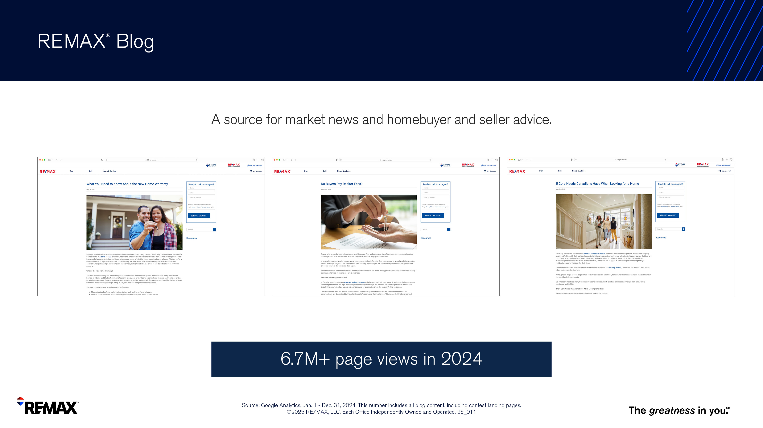
Notes:
Easily share educational content to your own website, blog or social media accounts.
Stories help generate leads and referrals inside and outside your client network.
Blog.remax.ca received 6.7M page views in 2024.

Slide 33
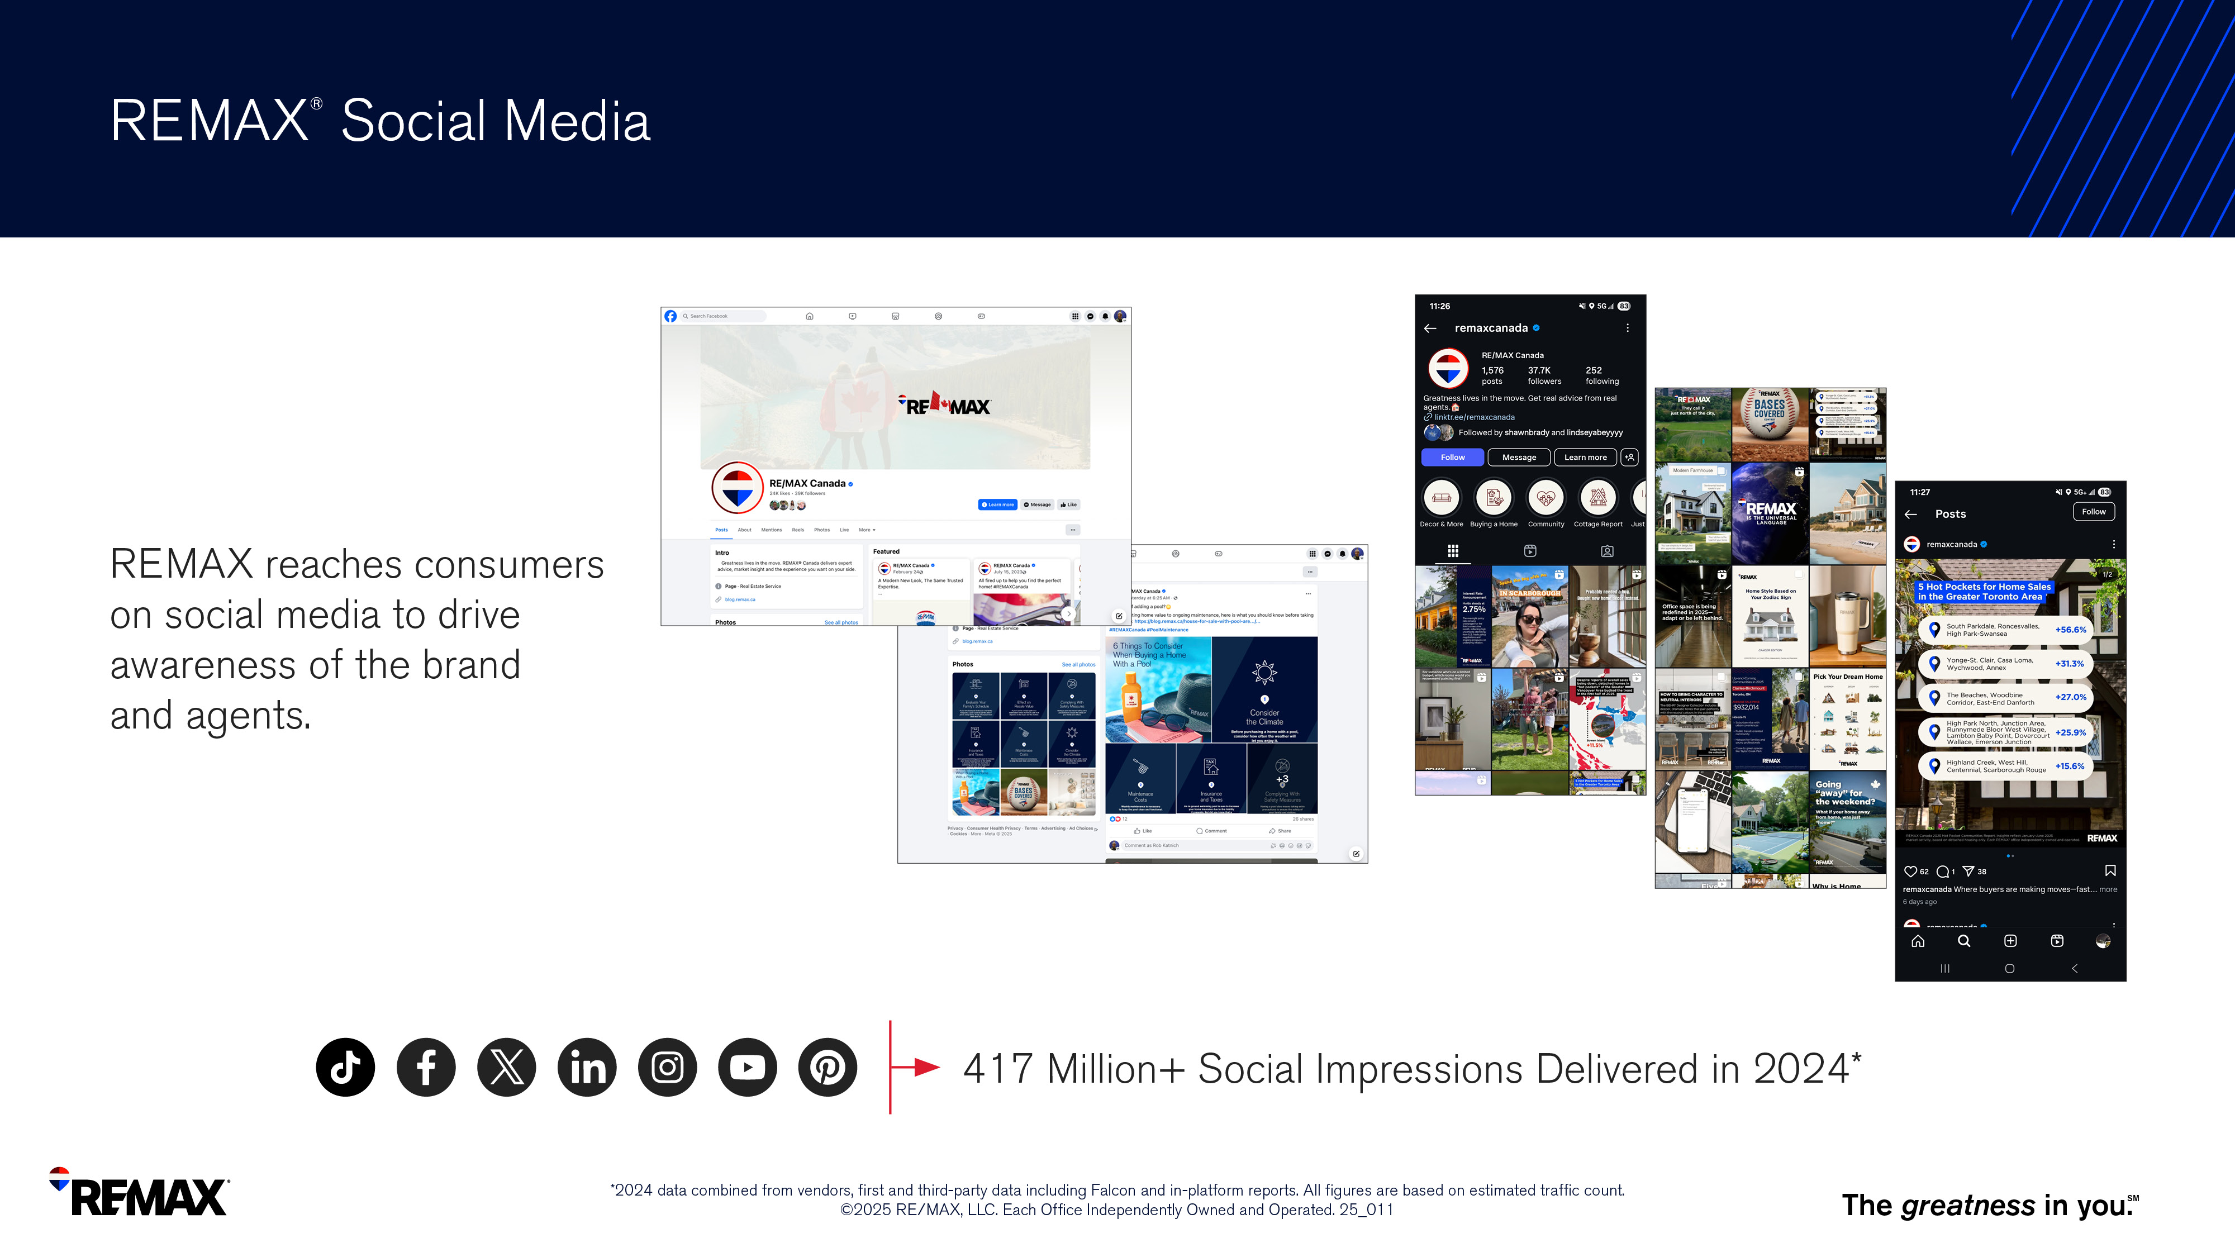
Notes:
We know consumers are online – so REMAX has social media channels on all platforms.
From Facebook to X, LinkedIn to Instagram and TikTok – REMAX is developing content to reach consumers and stay top-of-mind, so you’re thought of first when they are ready to move forward. ​
​
Social media builds awareness and increases your digital reach – in 2024 alone, REMAX social channels delivered over 417 Million impressions​.
​
Leverage the content on the REMAX channels to easily build your own social media reputation and online community.

Slide 34
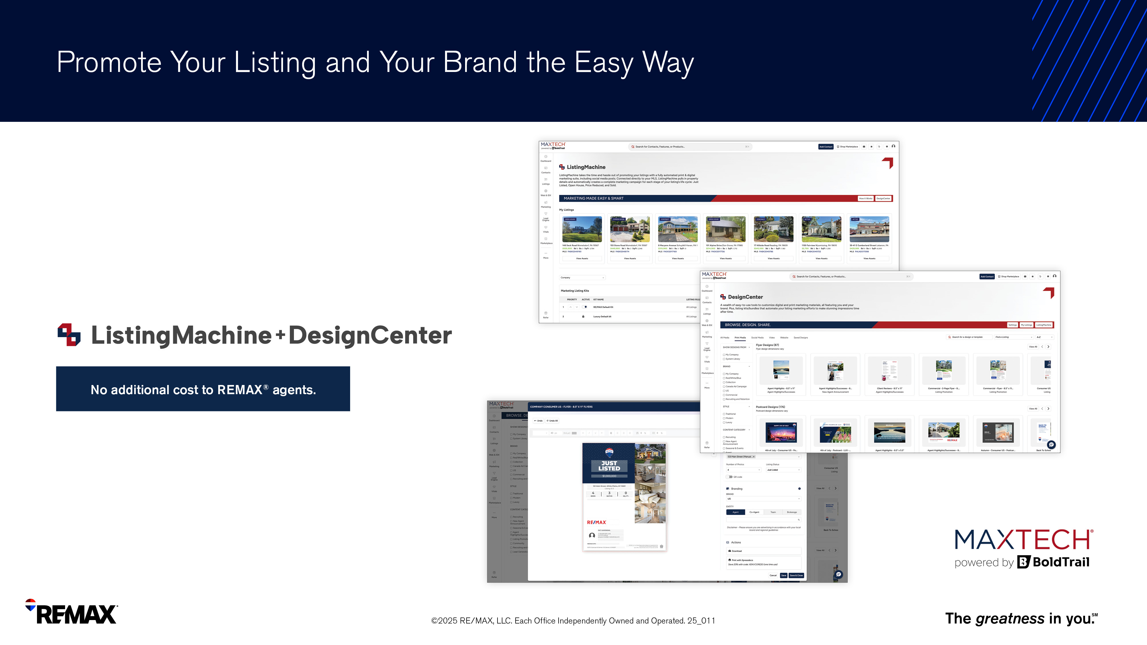
Notes:
ListingMachine & DesignCenter provides:
-Customizable marketing kits for all states of listings
-Single property sites
-Automated social media posting
-Modern marketing design center
-Custom branded content
-Digital and ready-to-print assets
-Branded Content marketing library

Slide 35
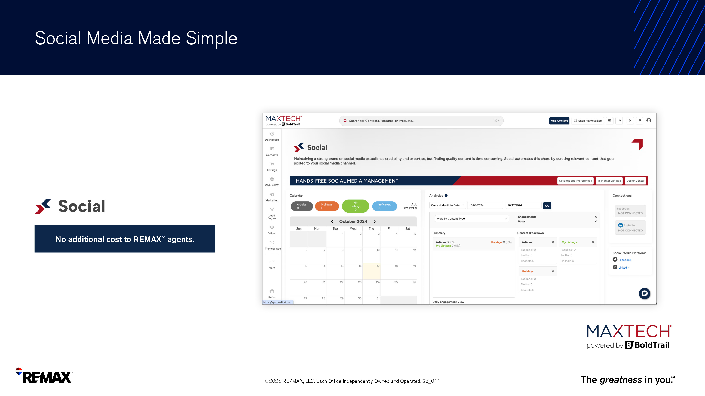
Notes:
Social is social media made simple, allowing you to:
-Create organic content and publish automatically
-Leverage the automation tool to stay-top-mind
-Provide a consistent branded social me

Slide 36
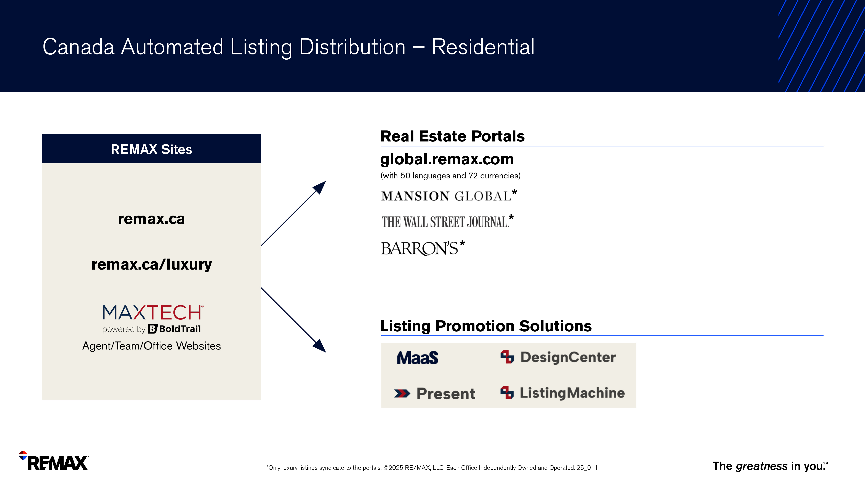

Slide 37


Notes:
REMAX offers various tech, tools and resources to power up teams.

Slide 38

Notes:
REMAX recognizes the importance of personal promotion when attracting consumers to their listings.
That’s why we provide a variety of modern, sleek, agent-centric team signage options. ​

Slide 39
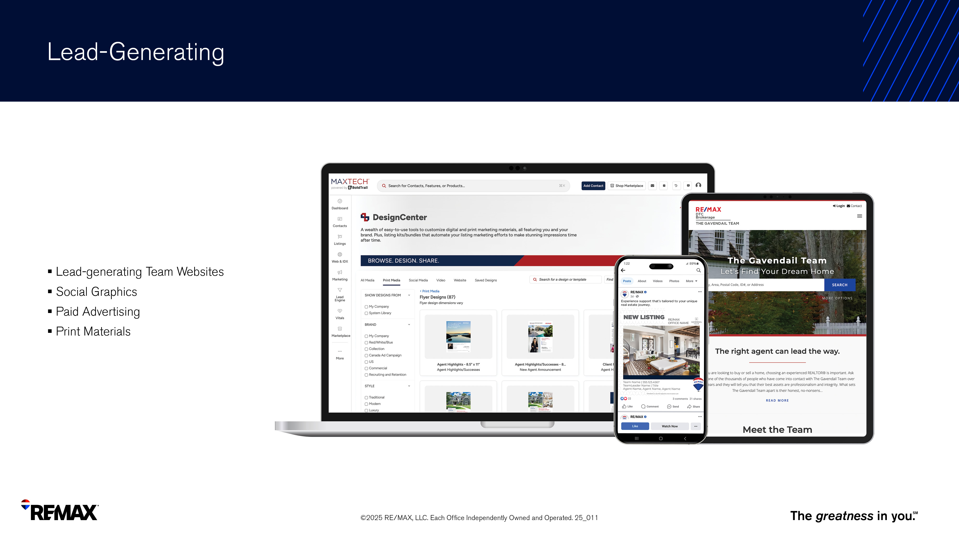
Notes:
The Teams add-on within MAXTech powered by BoldTrail leverages the most powerful features of the platform to help teams run more efficiently.
These features will help make a team more productive, supercharge recruiting and save valuable time and money.
The best part? This powerful add on is available at no additional cost! ​

Slide 40

Notes:
The REMAX network is home to top-producing teams from small and medium, to large and mega.
REMAX University offers team leaders and team members courses to help them develop and grow.
-Building a Team
-Team Leadership
-Growing Your Team
-Developing High Performing Teams
-Team Fundamentals
-Master Team Builder

Slide 41

Notes:
For agents who may want to get into the luxury market – or are already successful luxury agents, there are a number of resources available to help you stand out from the competition.

Slide 42

Notes:
It’s easy to build your luxury presence using The REMAX Collection brand and better serve your clients who expect a luxury presence with their listing.
For any listing two times the average sales price in an area – it is considered a luxury listing and will be posted to The REMAX Collection website.
For any listing over $1.3 million CAD , the listing is automatically posted to mansionglobal.com and the Wall Street Journal website.
For anyone interested in learning more about serving the luxury market, REMAX offers The Certified Luxury Home Marketing (CLHMS) course.
The course is designed through The Institute to learn the habits and behaviours of the affluent customer. It also teaches marketing techniques and has networking advantages.

Slide 43

Notes:
When marketing yourself as a luxury agent – or promoting a listing as a luxury listing, agents can use Luxury Hubs.
Luxury Hubs offers customizable marketing materials to make your listing stand out from the competition including a video tool editor, social and digital graphics.

Slide 44

Notes:
For those who dabble in Commercial real estate or are full time practitioners, REMAX Commercial will help you better serve your buyers and sellers.

Slide 45

Notes:
REMAX Commercial has been part of REMAX since the beginning.
A network founded on freedom and entrepreneurship – REMAX practitioners are free to work any property type in any market.
Marketing materials and tools are available to help market yourself as a Commercial Practitioner, as well as your listings as Commercial listings.
The Commercial website is designed to help you promote your listings and generate leads.
With over 15,000 commercial practitioners and over 145,000 agents worldwide, Commercial Practitioners are in a unique position to utilize the global referral network to help generate business.

Slide 46
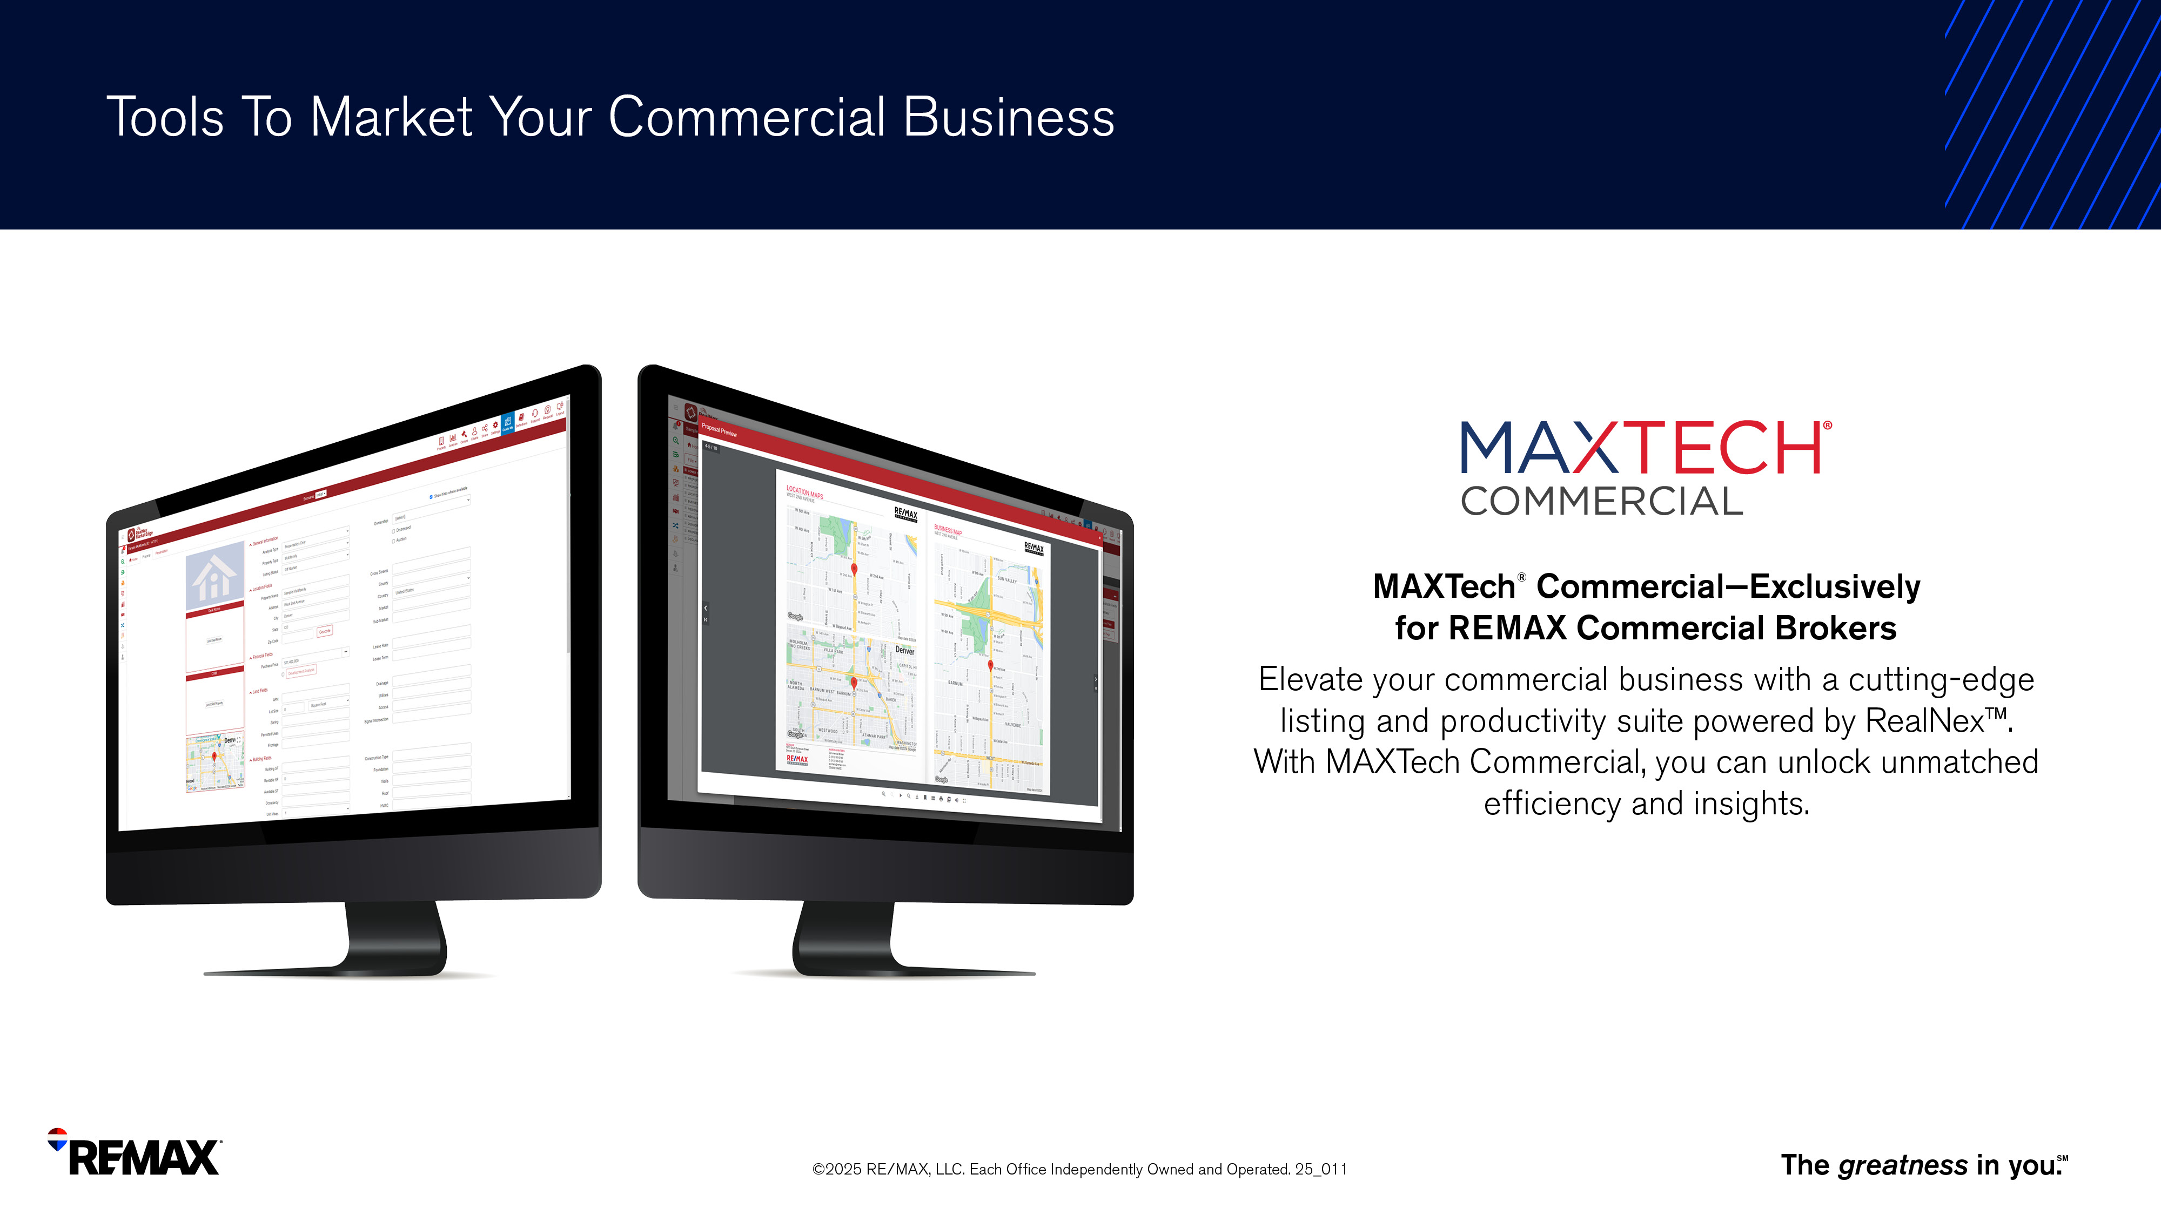
Notes:
RealNex is an industry-leading platform already used by many top REMAX Commercial Brokers and powers MAXTech Commercial.
The new MAXTech Commercial platform provides resources and tools to help in every stage of commercial deals to ensure that your commercial agents are always equipped with what they need.​

Slide 47
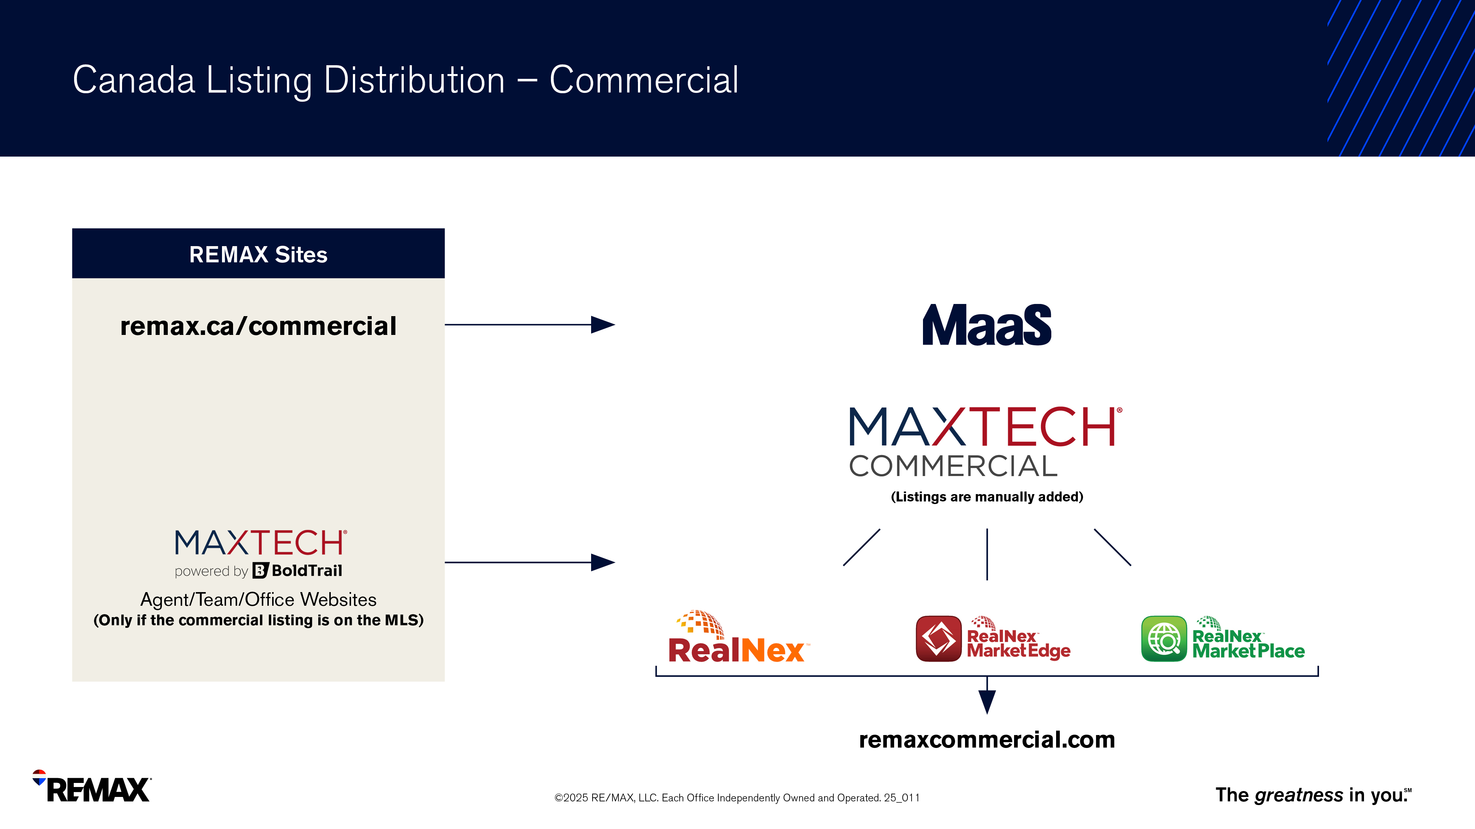

Slide 48

Notes:
Developing your skillset and knowledge of the industry is key to being unstoppable. Take a look at what REMAX University offers agents.

Slide 49
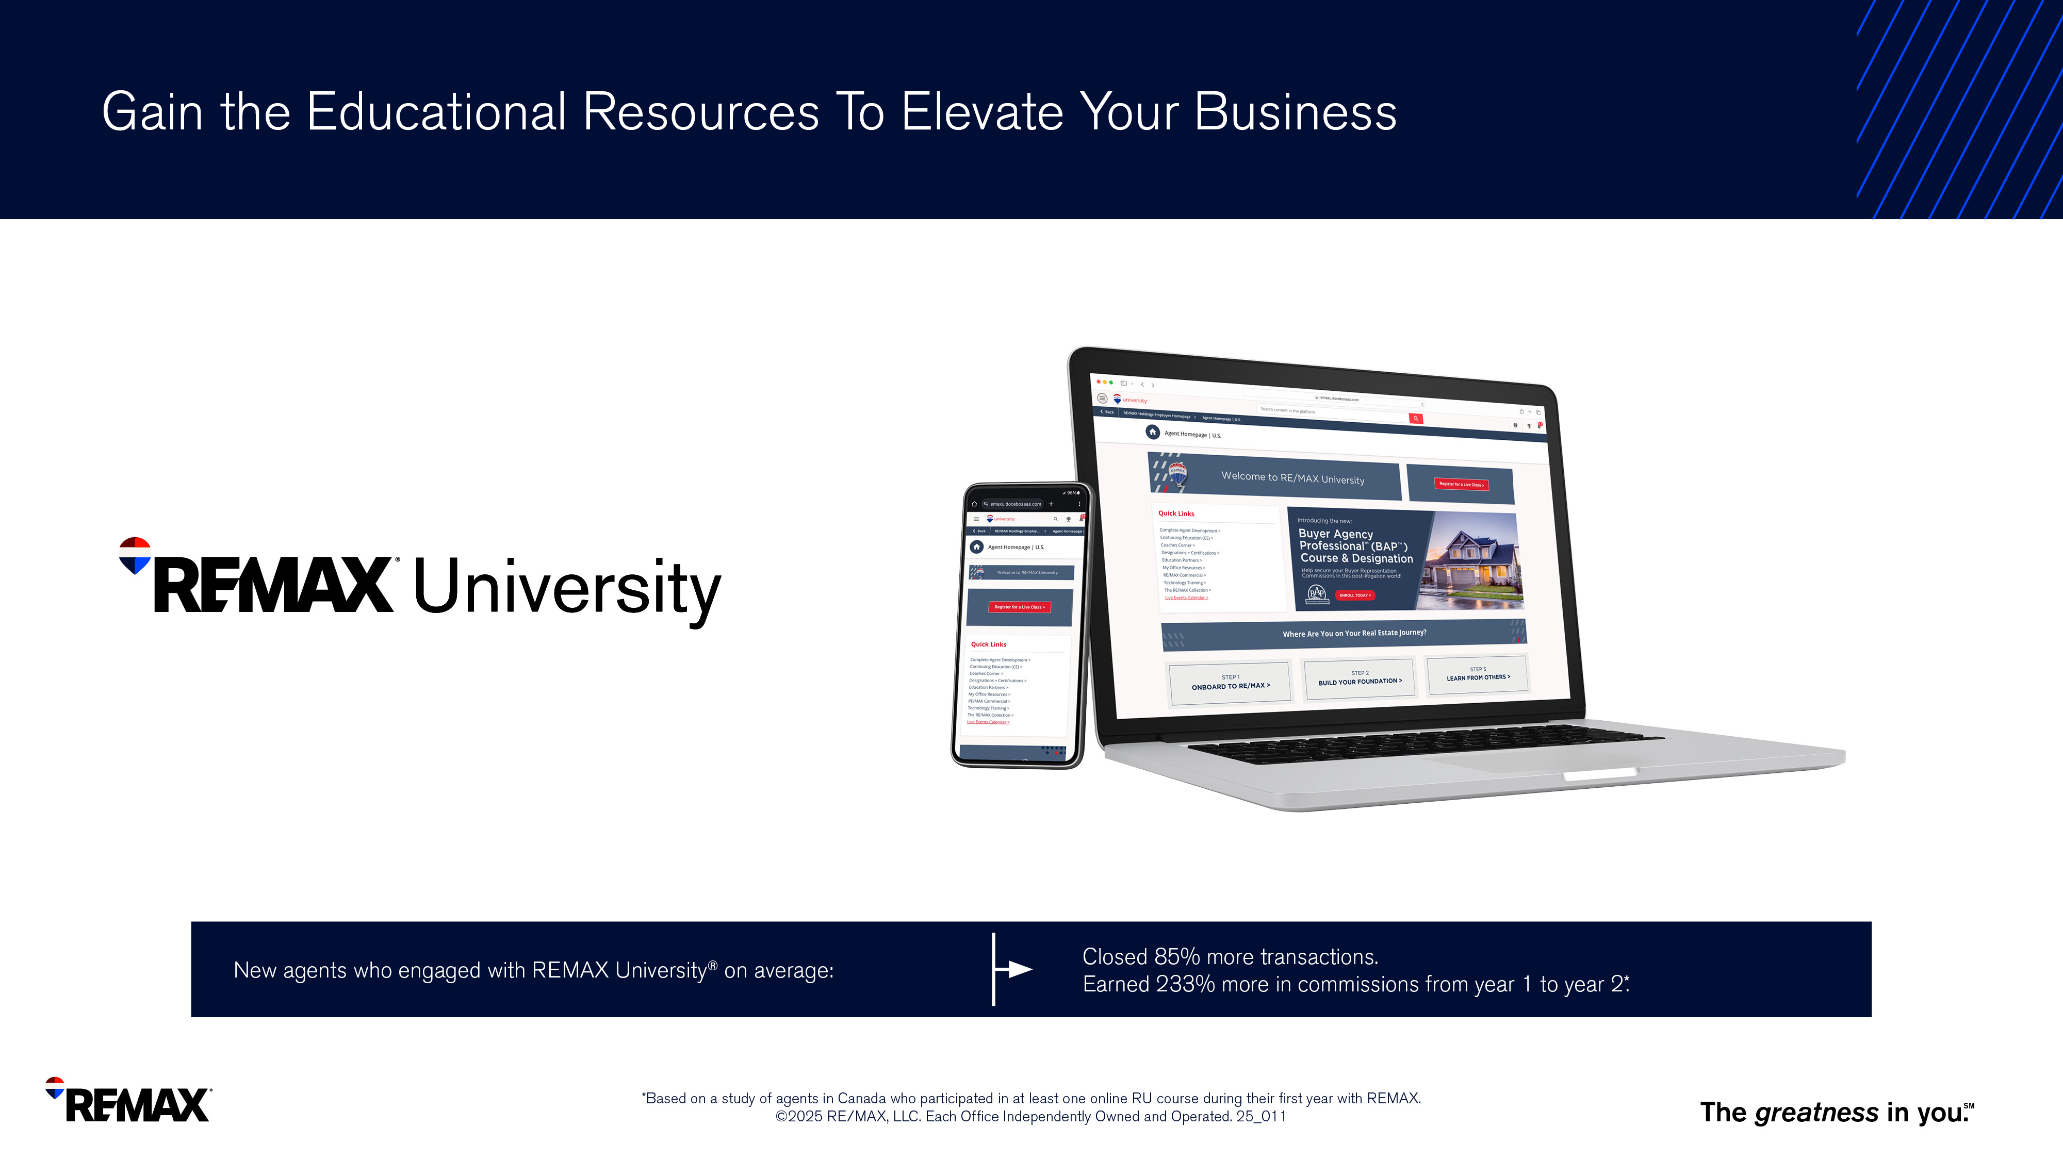
Notes:
REMAX University is your one-stop shop for all things education and training.
The content is curated to address your needs and skill level.
You can learn from anywhere – start on your desktop and continue on your mobile device with the new RU app.
You can also track your progress and the AI virtual bot will help you stay on track.
New agents who engaged with REMAX University on average closed 85% more transactions and earned 233% more in commissions from year 1 to year 2.

Slide 50

Notes:
While REMAX University remains your cornerstone for learning and development, we believe in expanding your educational journey.
Through strategic relationships with various organizations, you can access a range of certifications, designations, and courses to expand your expertise, diversify your portfolio, and take your career to new heights.
By growing your knowledge, you will become the expert and can better serve your buyers and sellers – and attract new clients.

Slide 51
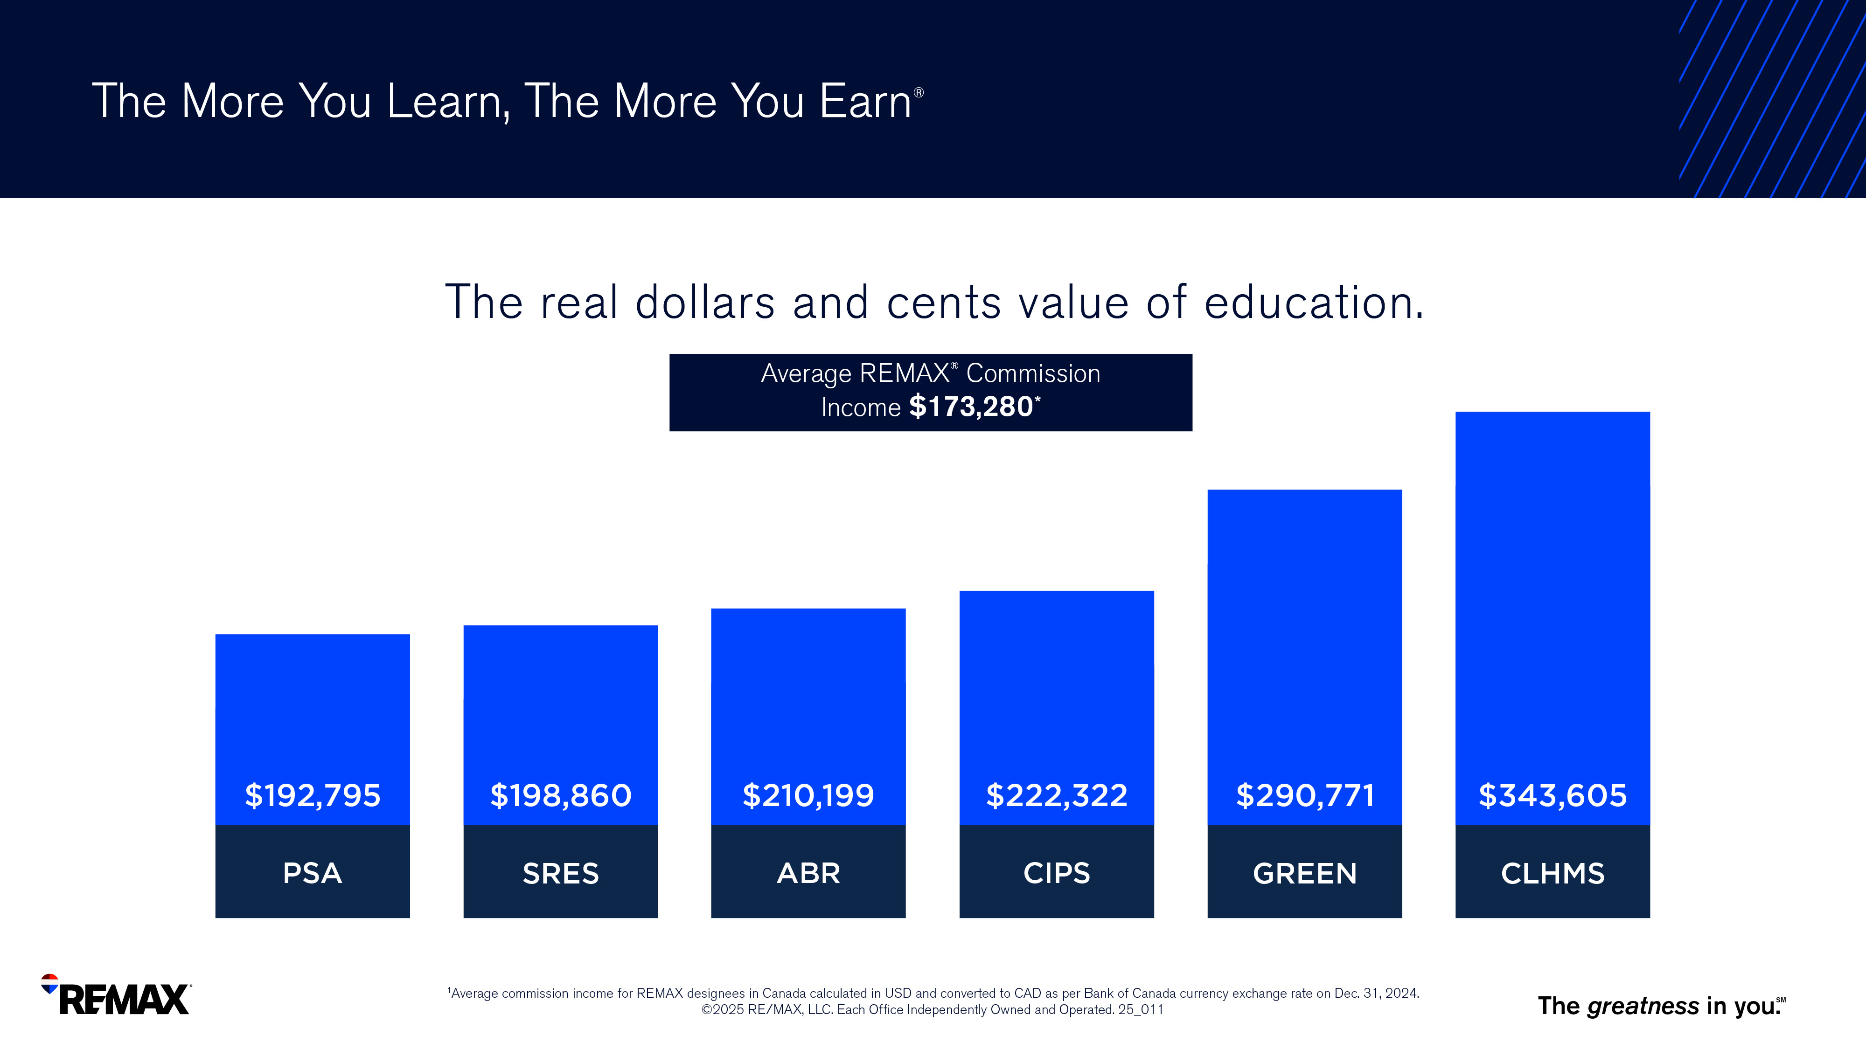
Notes:
You can see on this chart how much more someone with certain designations can make in commissions compared to the average REMAX commission income.

Slide 53

Notes:
REMAX invests in the best tech so you don’t have to.

Slide 54
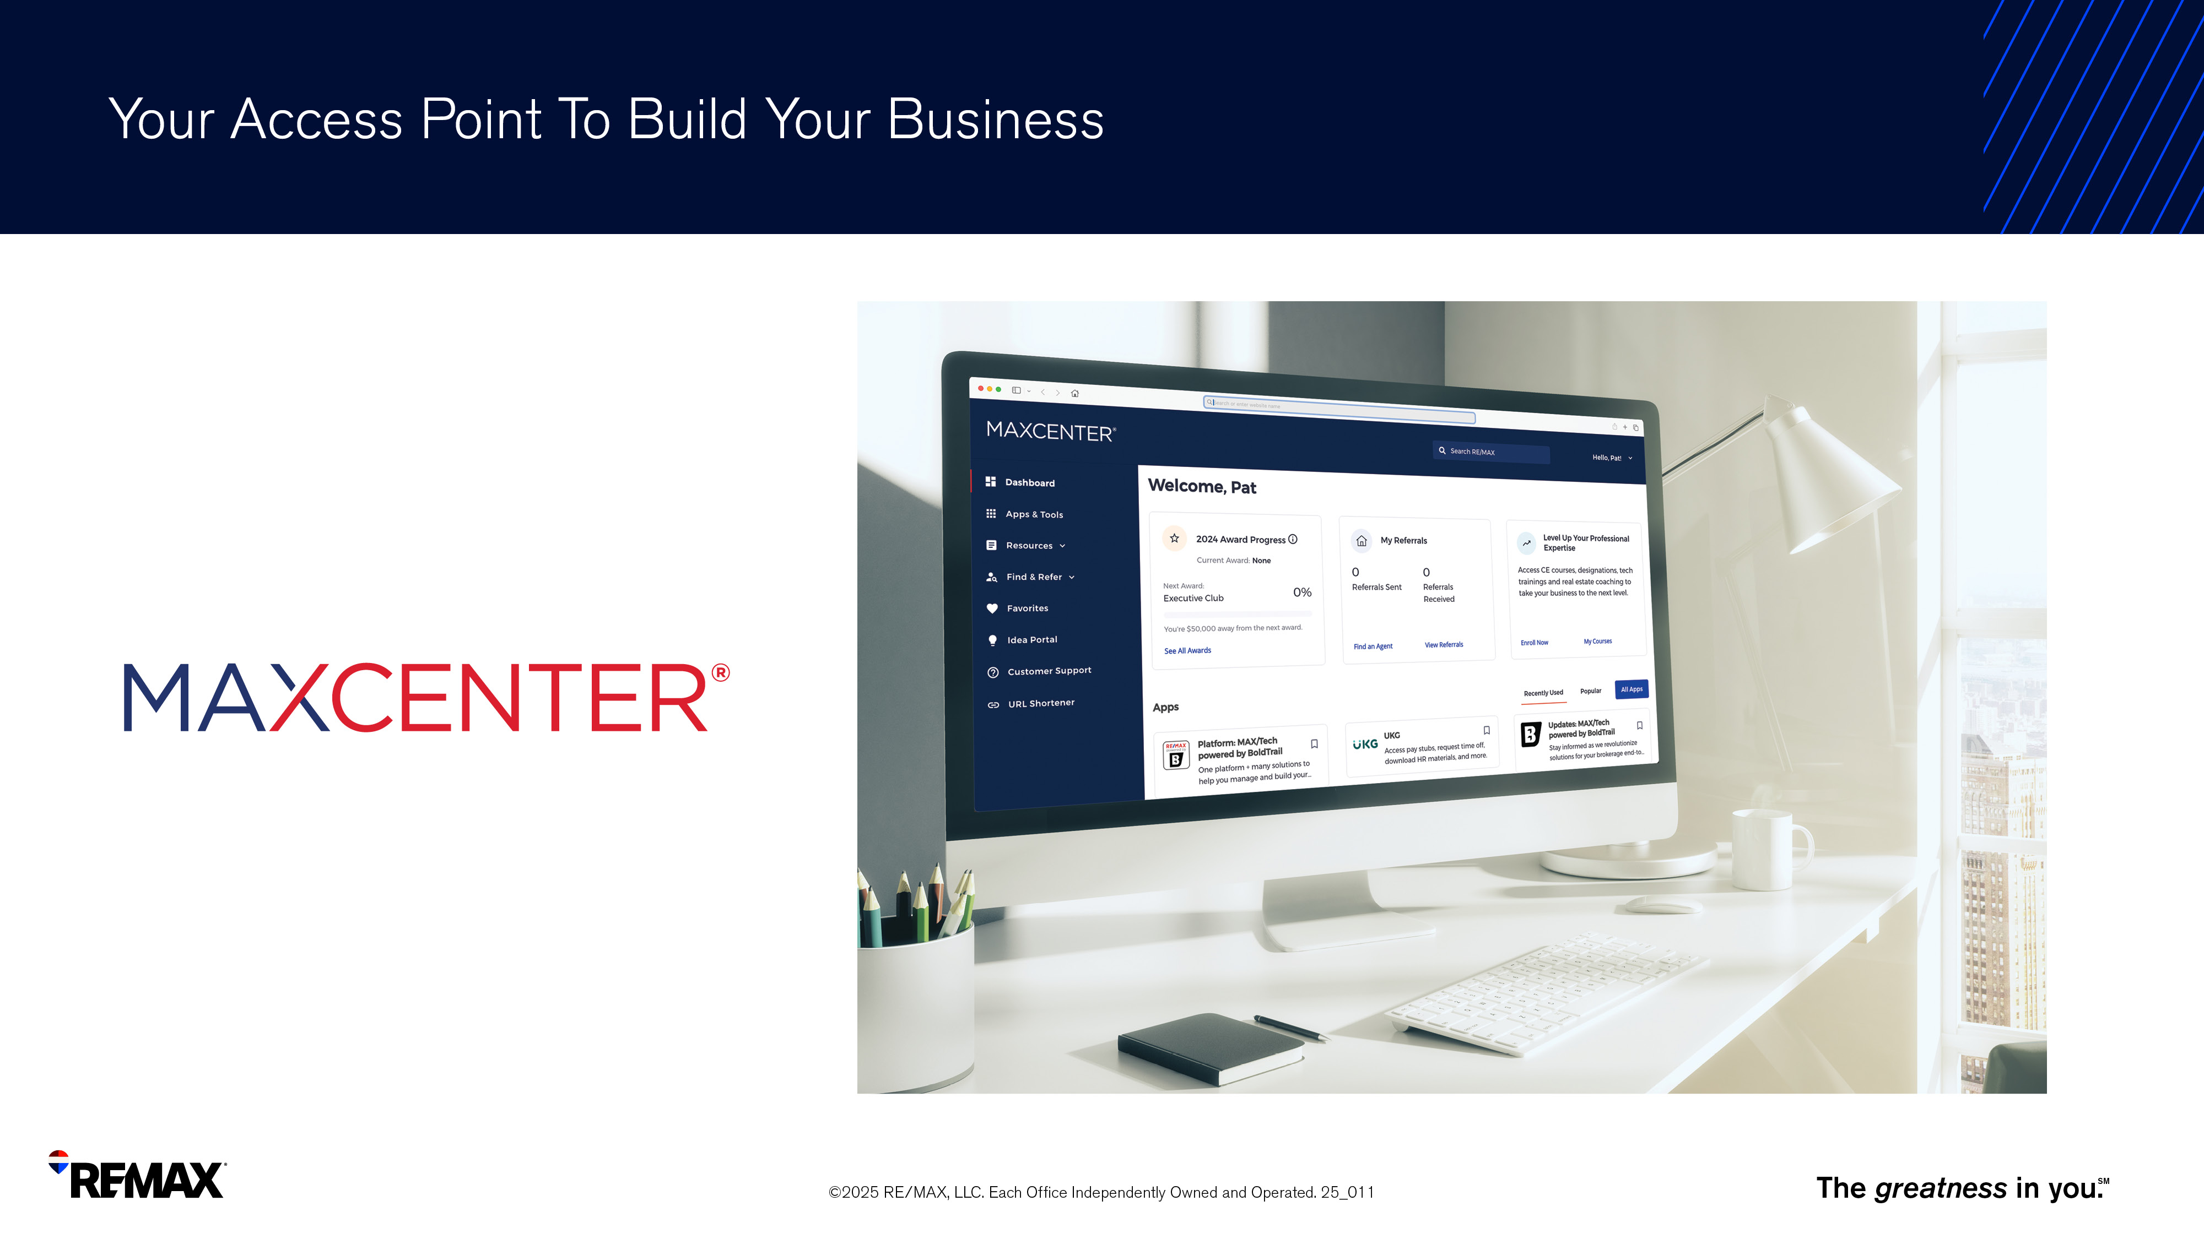
Notes:
MAXCenter is the starting point to access all things REMAX tools and resources. Within MAXCenter, you can also:
Send and receive referrals
Access core apps to help you build your business
Track your progress toward your club award level
View REMAX events and industry news

Slide 55
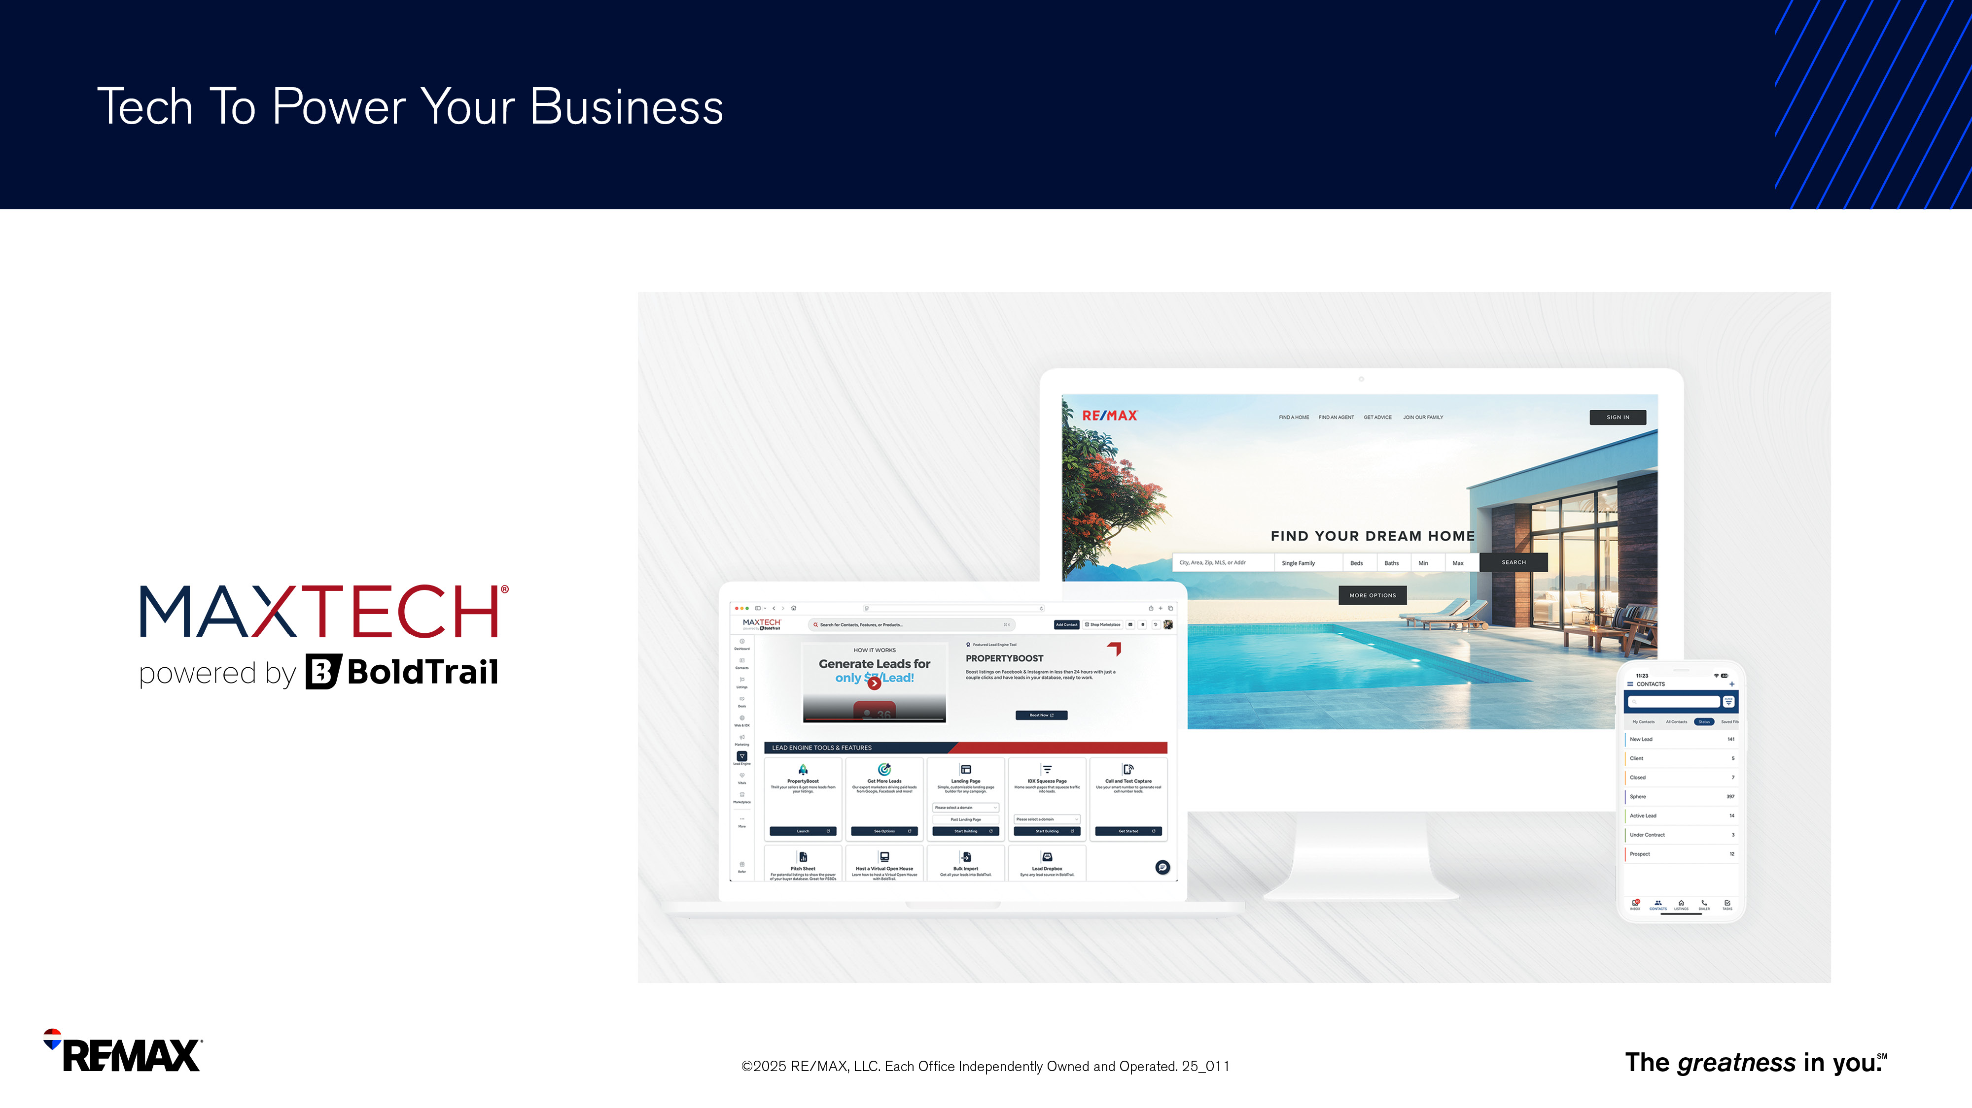
Notes:
With websites, landing pages, CRM system, smart campaigns, marketing tools, an integrated CMA tool, and so much more, MAXTech powered by BoldTrail simplifies and streamlines every aspect of running and managing your business, creating a single end-to-end platform with many solutions for efficiency and growth.

Slide 56
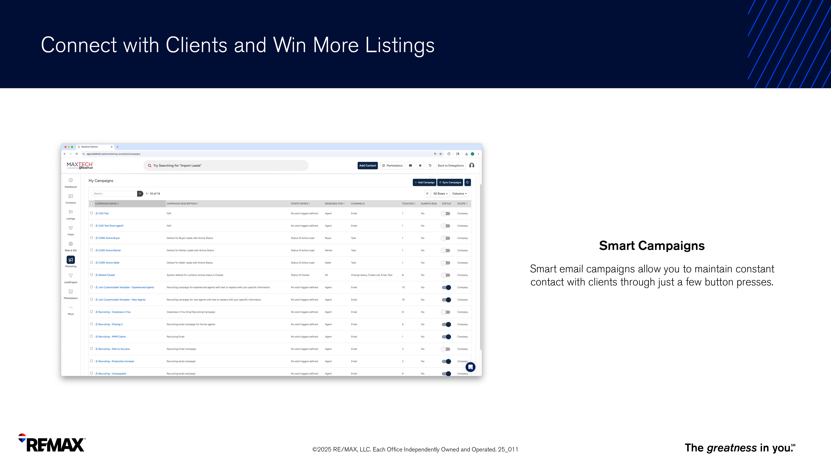
Notes:
Through BoldTrail, customizable Smart Campaigns allow you to maintain constant contact with clients through just a few button presses.

Slide 57
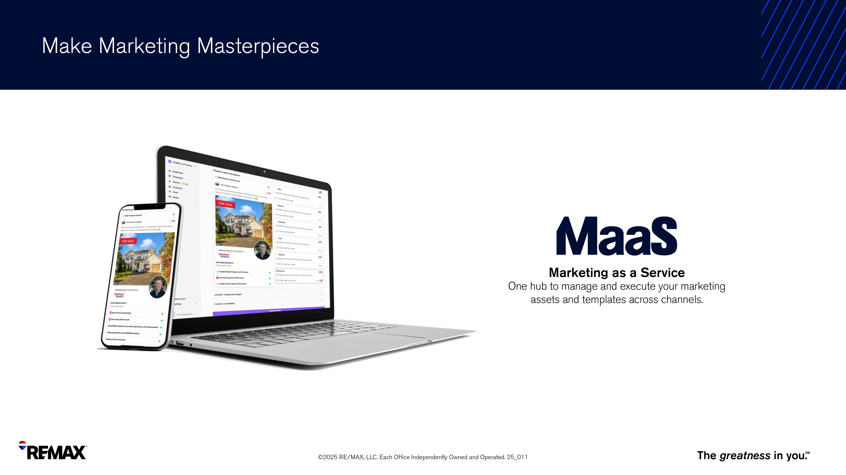
Notes:
MaaS centralizes and simplifies REMAX marketing offerings in one simple solution. That way you can focus less on creating marketing materials and more on winning listings and building a strong, lasting business.
Smarter Marketing Starts with Smarter Data
Flexibility and Customization
Track Performance, Keep Clients Informed

Slide 58
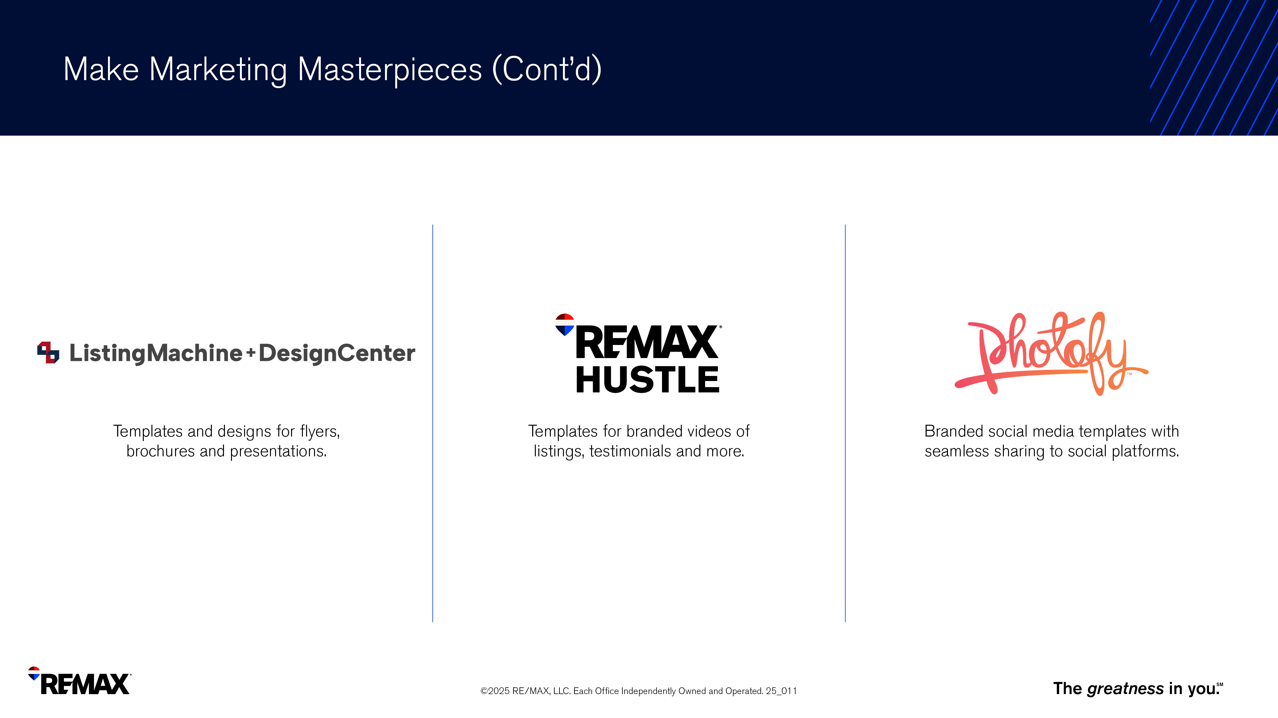
Notes:
Use these tools to create customizable marketing materials

Slide 59
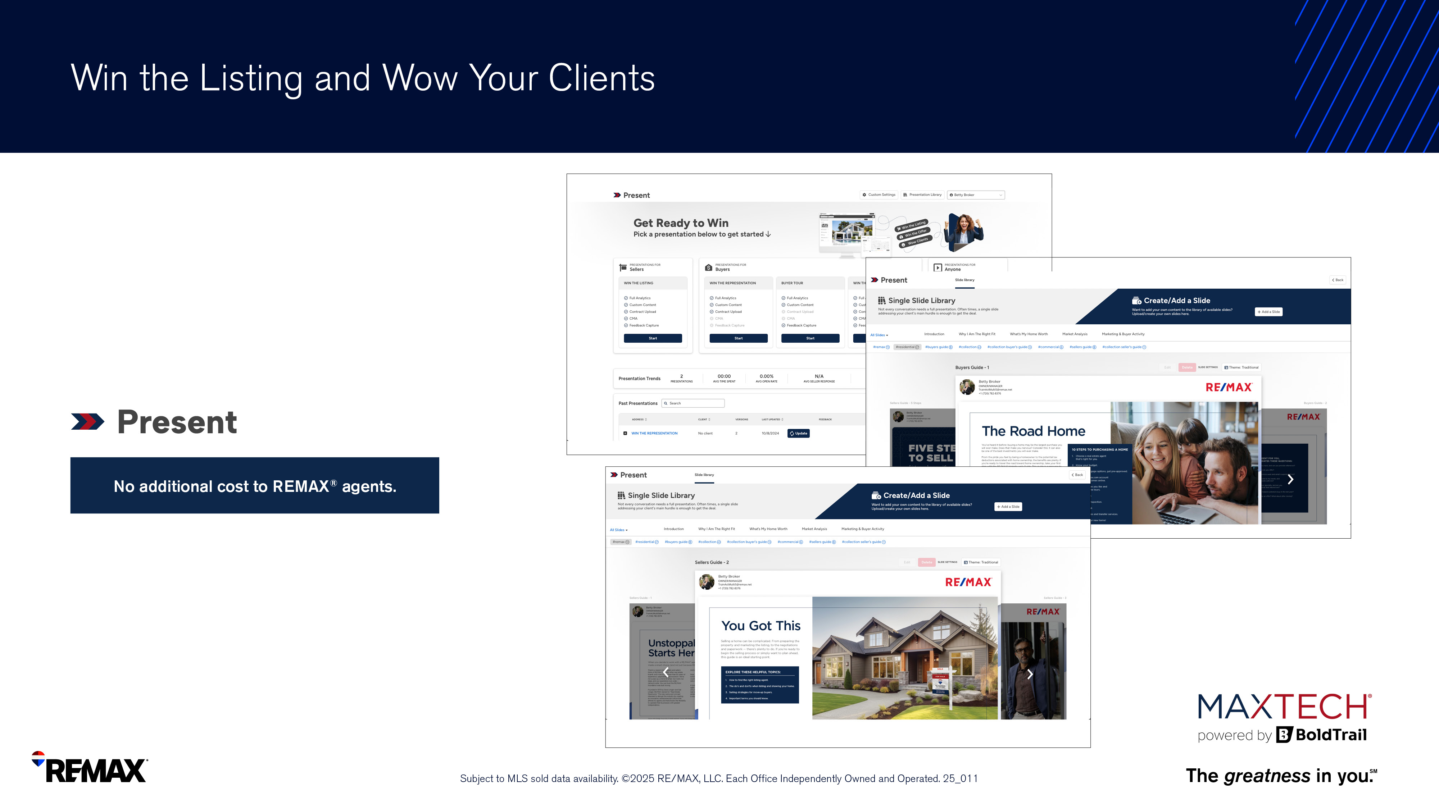
Notes:
Present is a next-generation CMA and presentation builder that helps you guide clients through an interactive and compelling pricing discussion.

Slide 60
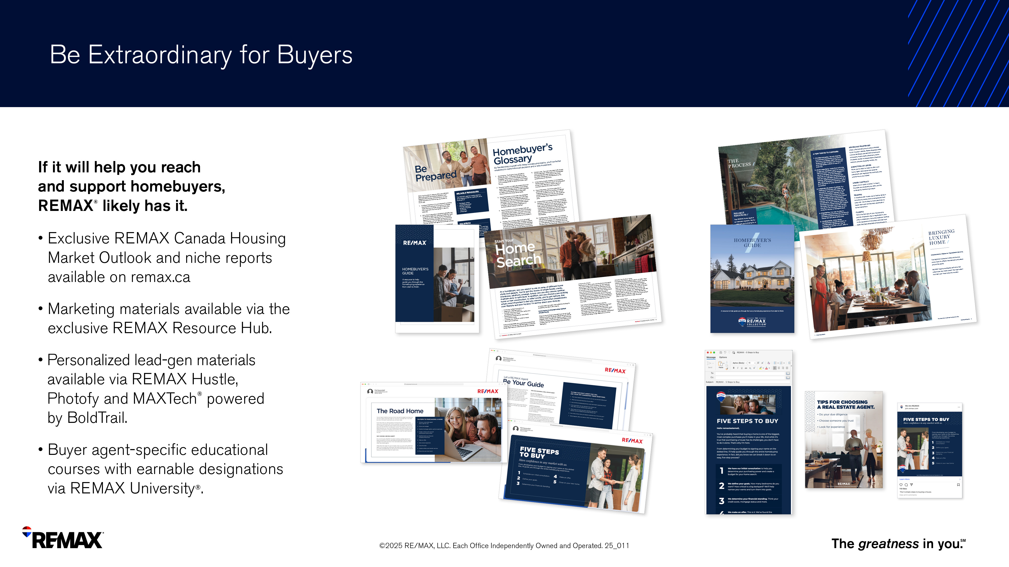

Slide 61


Slide 62
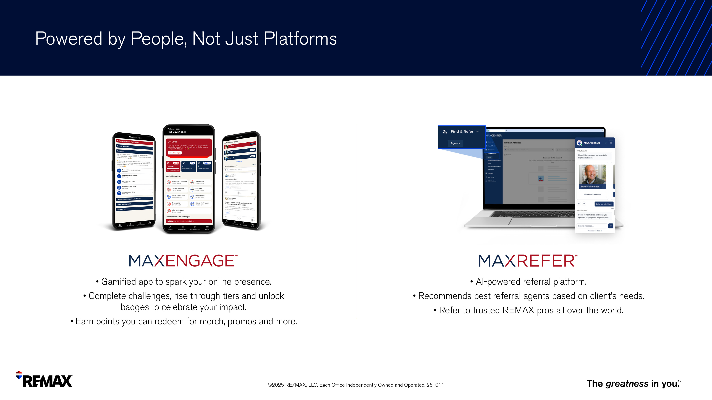

Slide 63
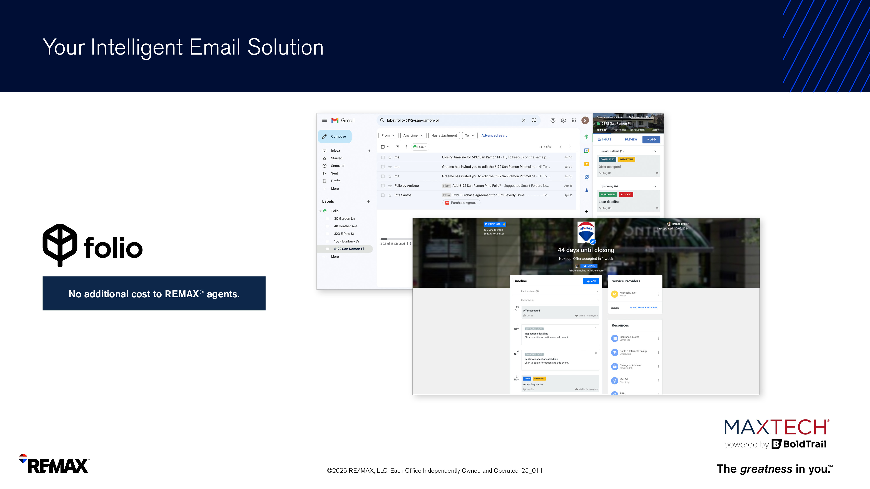
Notes:
Keep important transaction emails and timelines organized with this AI-powered email productivity solution. Serving as your email smart assistant, intelligently organize your inbox, manage transaction conversations, share consumer-facing transaction timelines and more.
Folio includes:
-Transaction Email Detection
-Inbox Organization into Smart Folders Document Tracking
-Deal Task Management
-Client-Facing Transaction Timelines
-Calendar Sync
-Document Summaries with DocGPT
-Integration with Gmail + Outlook

Slide 64


Slide 65

Notes:
Want branded swag and office materials to enhance your client outreach? Look no further than MAXShop.

Slide 66
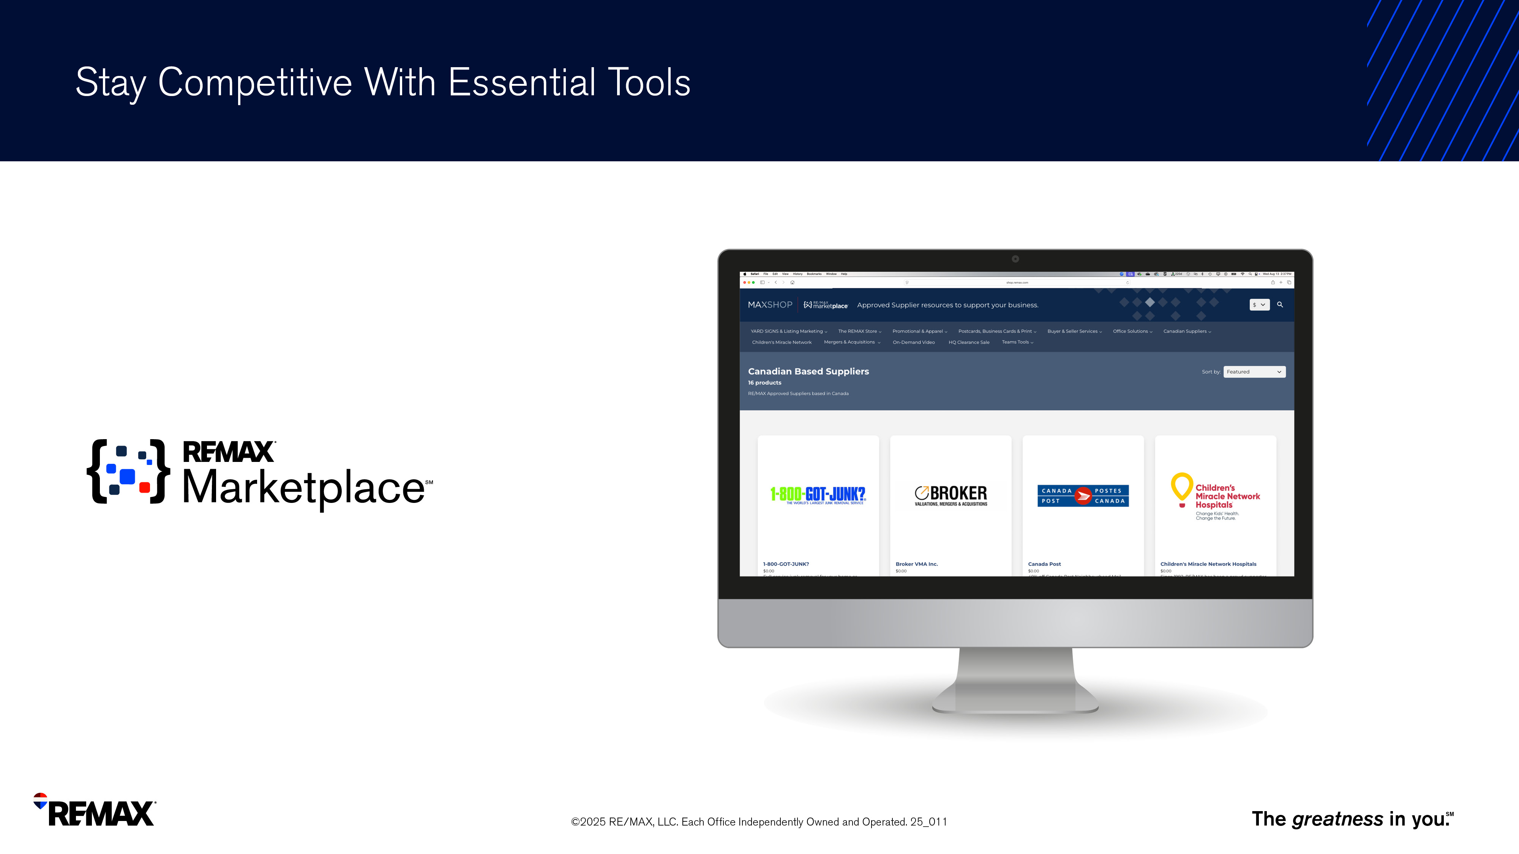
Notes:
REMAX Marketplace offers an array of tools and services to help you run your business, including products, software and services.
Finds solutions for back-end management, office-branded collateral or integrated technology offerings for the entire office.
Over 90 carefully vetted brands and approved suppliers provide solutions for many aspects of your business.

Slide 67
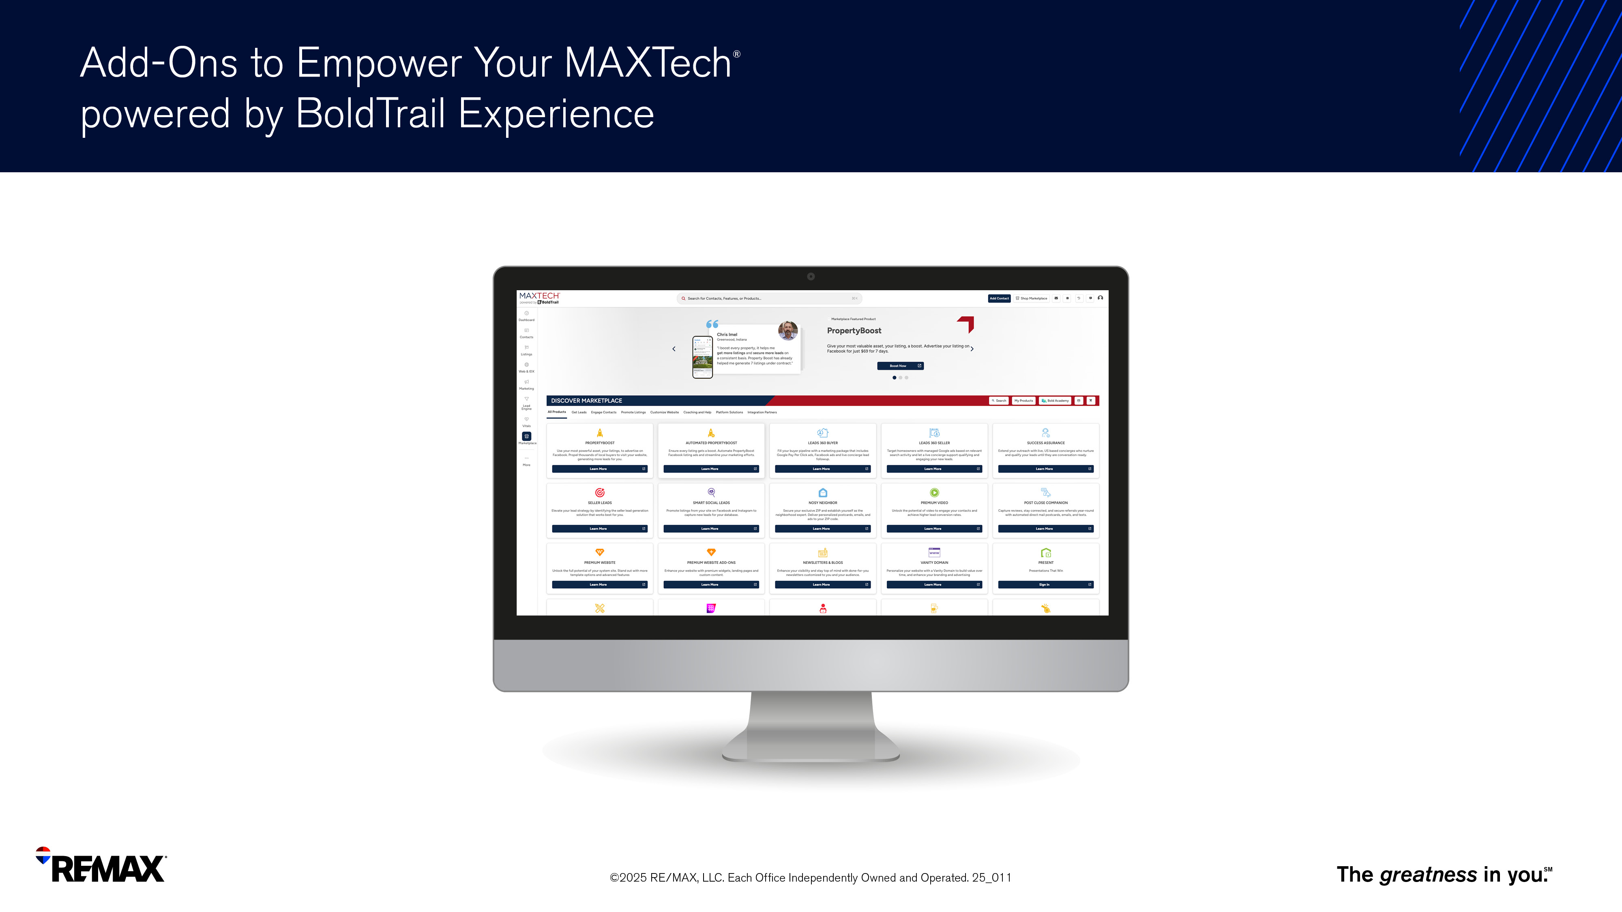
Notes:
REMAX Marketplace also allows you to further customize your MAXTech powered by BoldTrail experience with the right solutions to help you build, nurture and convert your clients with ease and automation.

Slide 68
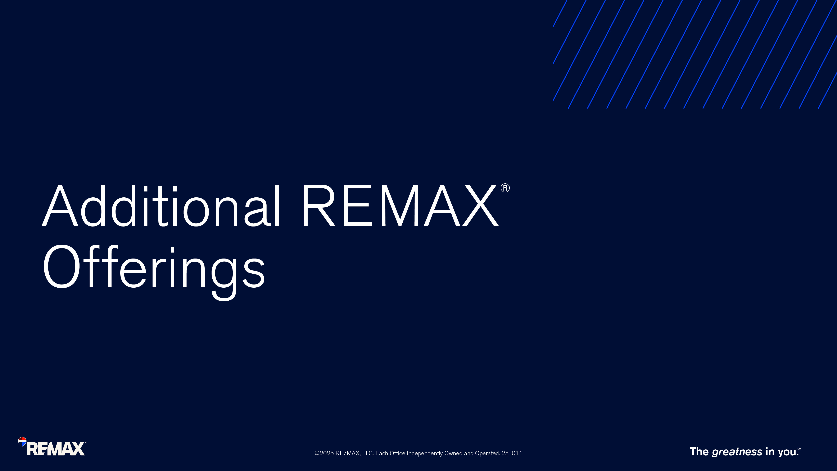
Notes:
There’s more REMAX has to offer to ensure your business needs are met.

Slide 69

Notes:
REMAX Group Benefits with SimplyBenefits
•The REMAX group insurance plan reflects the evolving needs of agents and offers a competitive program and premiums with the addition of more choice.
•REMAX has leveraged the power of the brand to negotiate an exclusive group benefits plan for REMAX members.
•The group benefits plan is designed for agents and brokerage employees, and includes benefits like dental, prescription drugs, massage, chiropractic, travel insurance and much more.
Who is Eligible?
REMAX members that are permanent employees who continue to actively work at least 30 hours per week are eligible for coverage.
Why Simply Benefits:
Enhanced Plan Member Experience and Technology
Simplified enrollment process via the digital enrollment tool
Choice of coverage-match or better your current plan, or reduced plan to match your current lifestyle and needs
Competitive premiums
For agents wanting to take advantage of the insurance, all of the details can be found on the Agent Broker Hub. https://agentbrokerhub.remax.ca/group-benefits-provided-by-capricmw-for-re-max/

Slide 70

Notes:
Take advantage of the recent partnership between REMAX and Dominion Lending Centres for increased collaboration, referral opportunities, and exclusive networking events.

Slide 71


Slide 72


