Slide 1


+

Slide 2


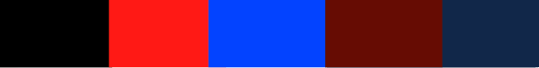
Your Marketing – Branded From the Start

Slide 3
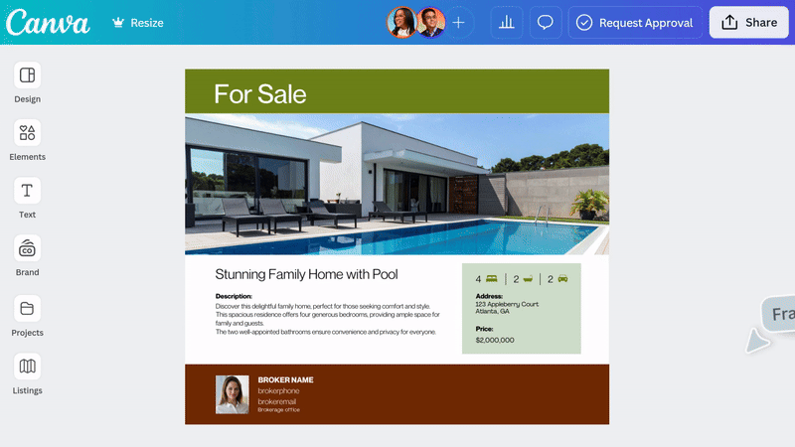
Your Marketing – Branded From the Start

Slide 4



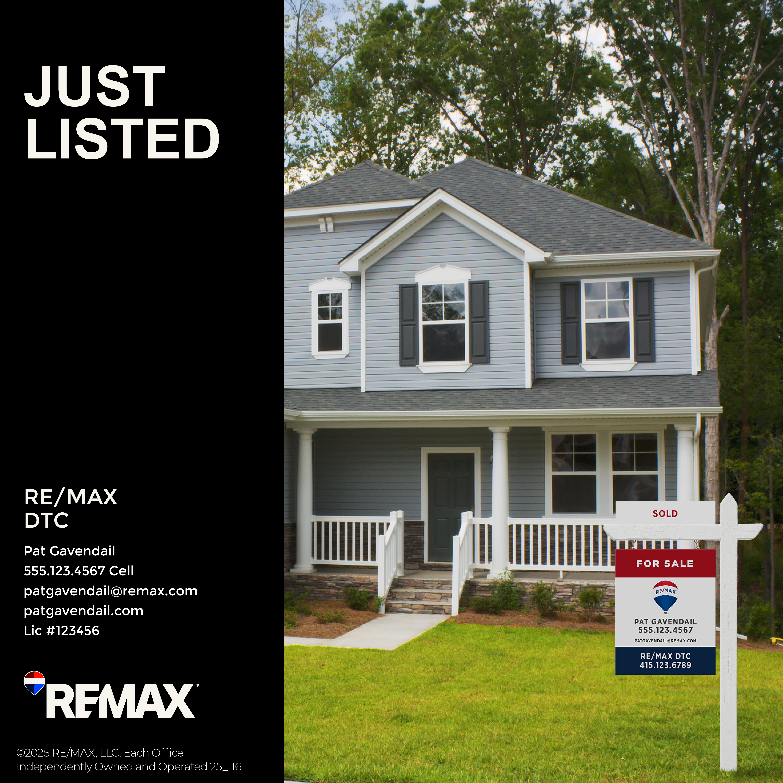




Branded Templates at Your Fingertips

Slide 5
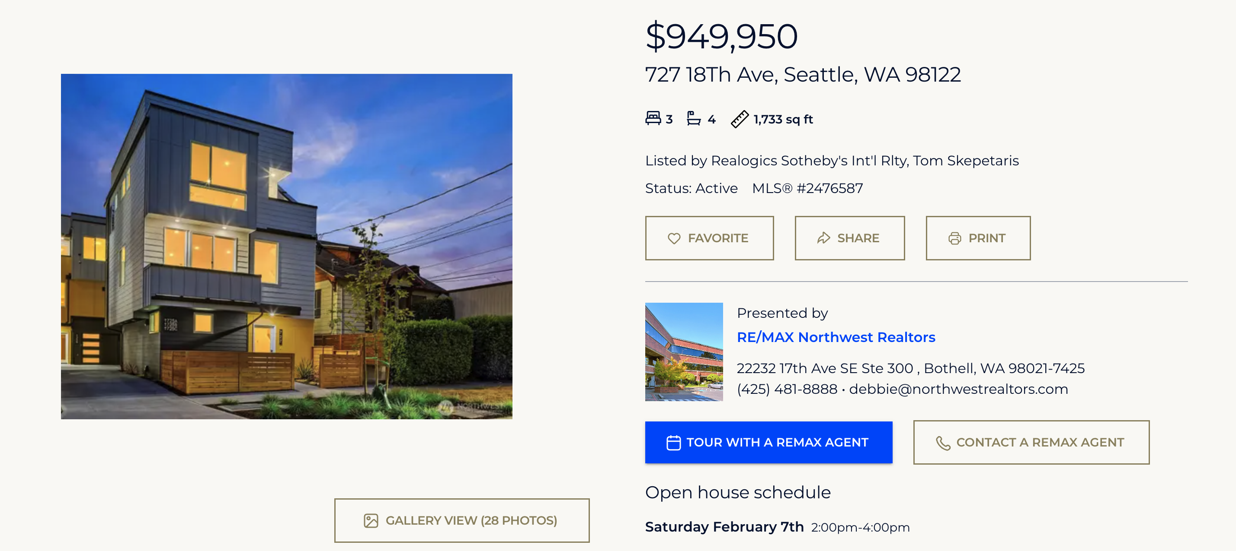
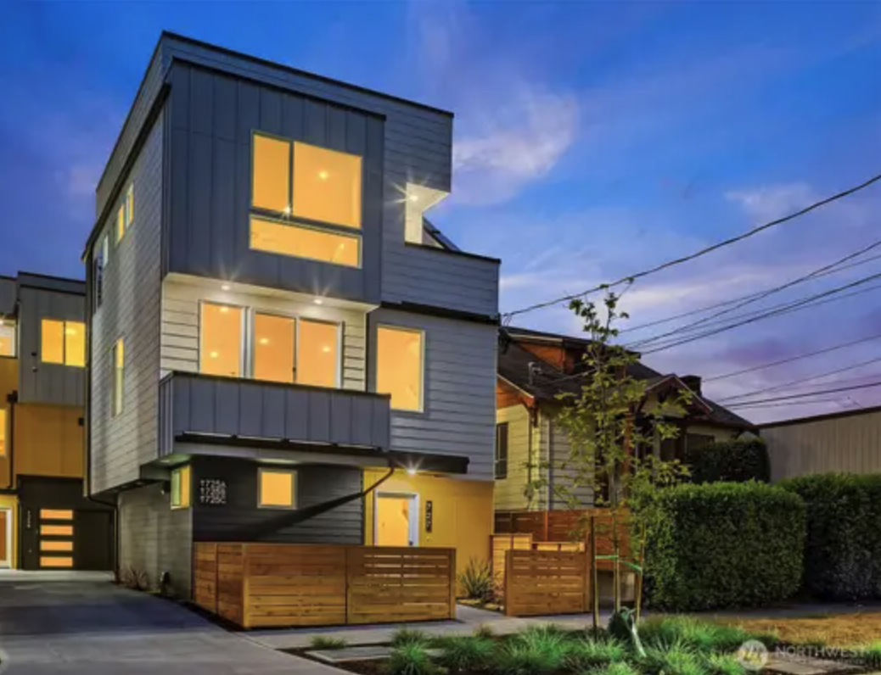
Your Listing Data,

Slide 6
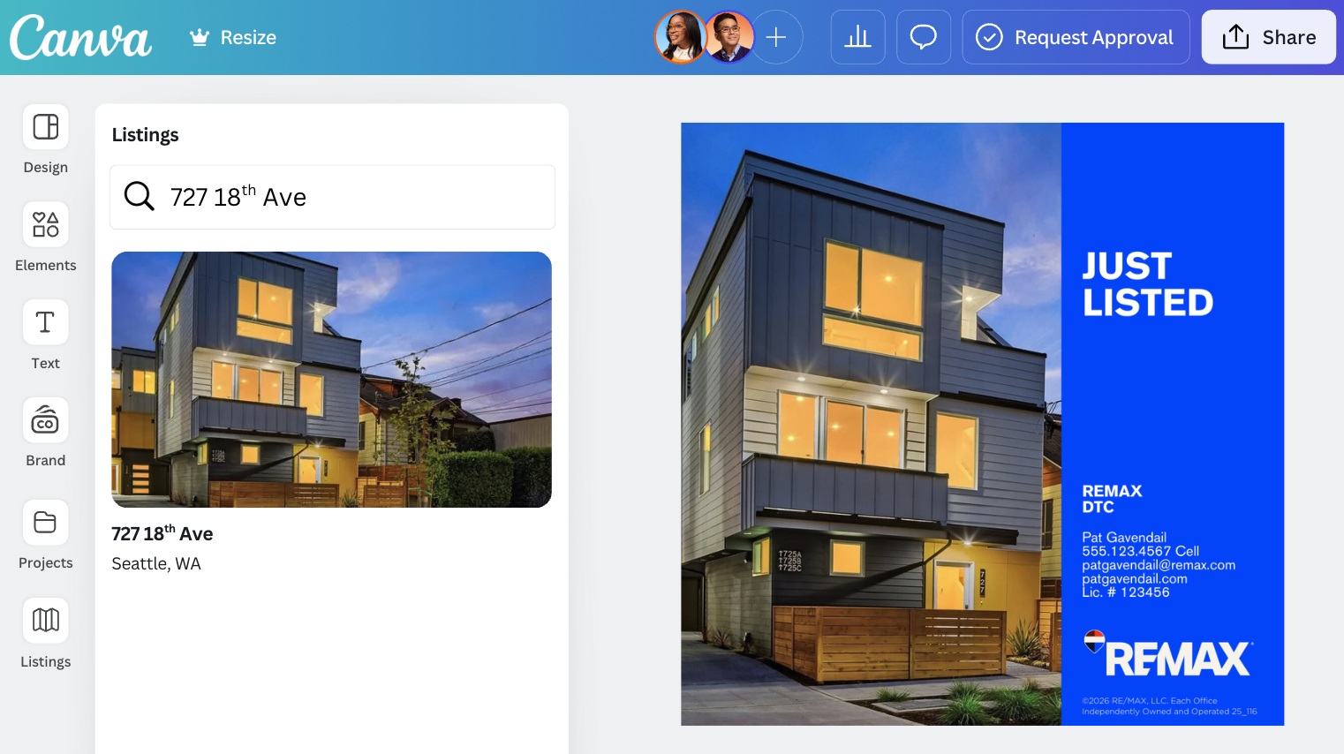
Your Listing Data, Instantly Ready to Use

Slide 7
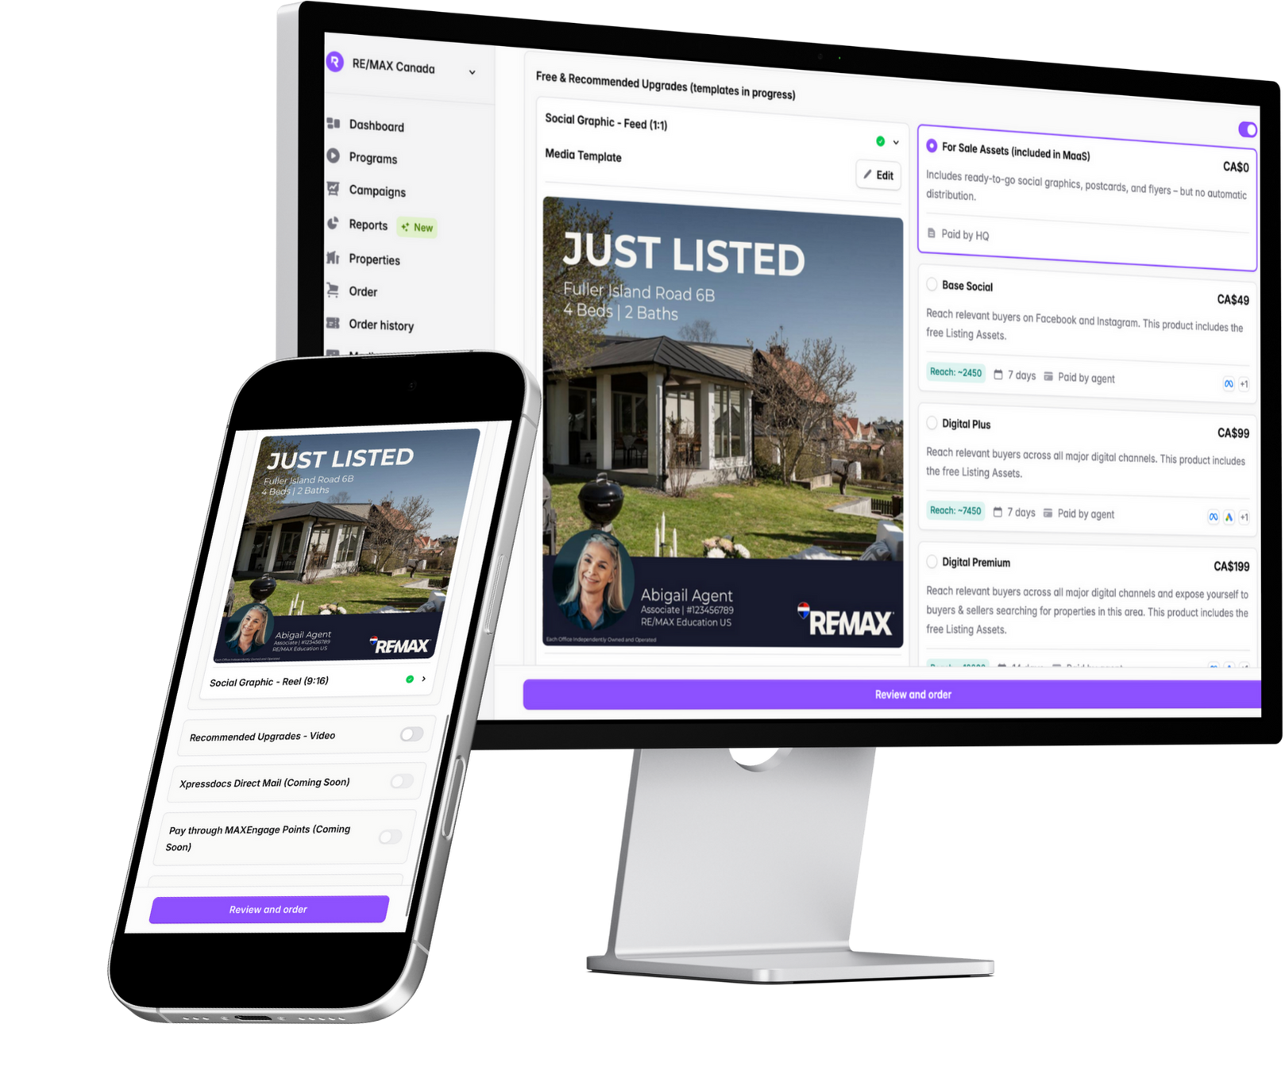
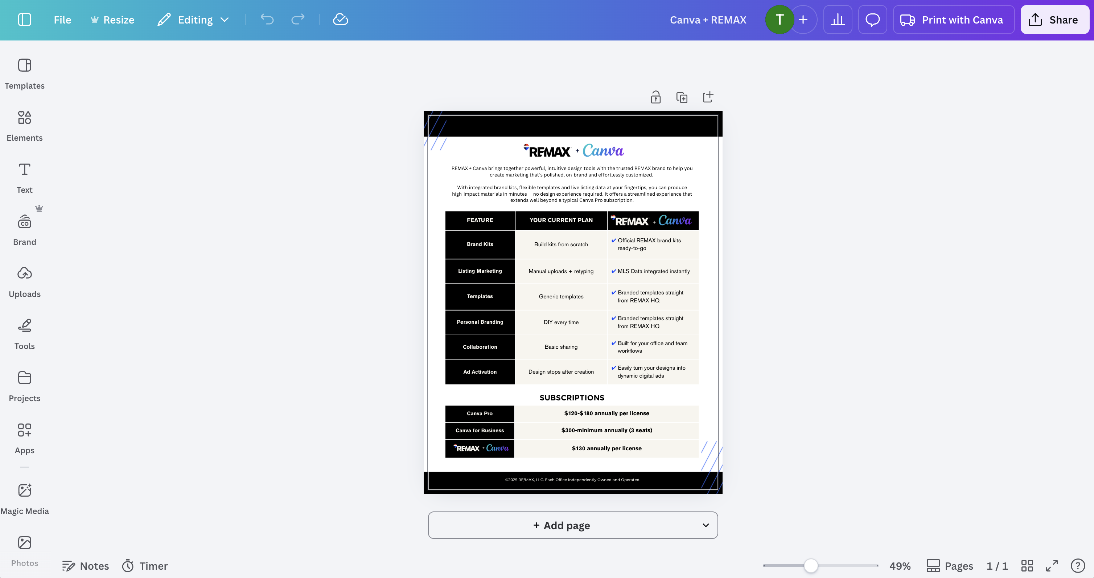
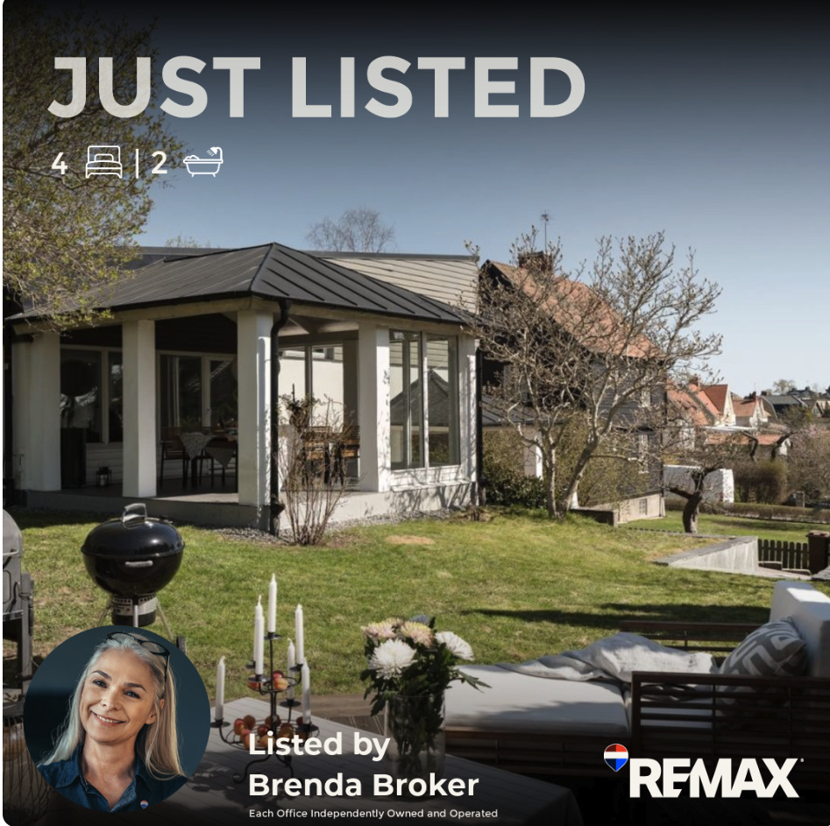
Turn Your Designs Into Dynamic Ads

Slide 8
FEATURE
Brand Kits
Listing Marketing
Templates
Personal Branding
Collaboration
Ad Activation
YOUR CURRENT PLAN
Build kits from scratch
Manual uploads + retyping
Non-REMAX template
DIY every time
Basic sharing
Design stops after creation
+
Official REMAX brand kits ready-to-go
Live MLS data integrated instantly
Branded templates straight from REMAX HQ
Branded templates straight from REMAX HQ
Built for your office and team workflows
Easily turn your designs into dynamic digital ads

