Slide 1
State of the Dental Practice
How to overcome the Challenges of the pending recession and increasing inflation

Slide 2
Insert inspirational quote here

Slide 5
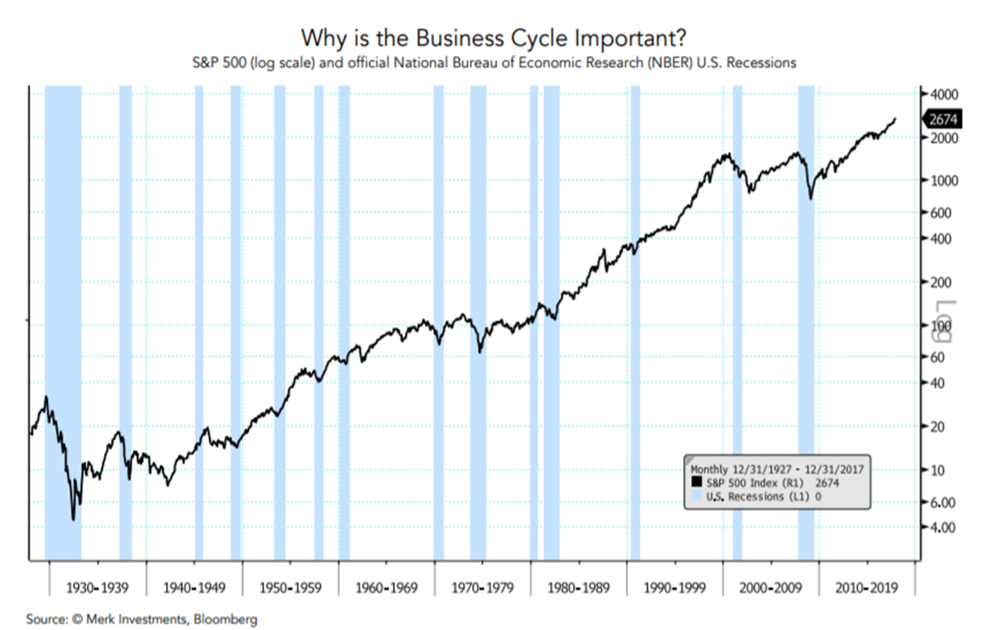

Slide 6
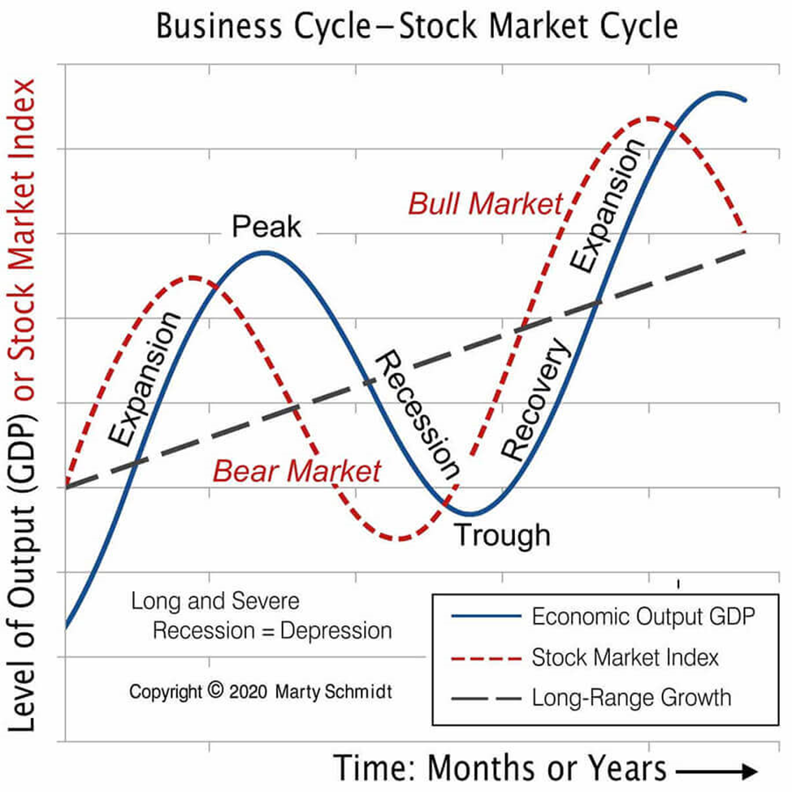

Slide 10
What does inflation look like to the dental practice?
Increasing pressure on the bottom line
Dentists need to pay closer attention to how they generate revenue
Dentists need to pay more attention to the financial trends in their practice (we’re going to keep looking at that, decay doesn’t go away on its own)

Slide 11
Dental Practice Overhead
CASH IN 100%
1
CASH OUT (OPERATING EXPENSES) 60%
2
Doctor Compensation 30%
3
Practice profit 10%
4

Slide 12
OPERATING EXPENES OF 60% THE BENCHMARK
30% Employee Costs
15% Dental Supplies & Lab fees
5% Occupancy
10% Everything else
60%

Slide 13
Strategies to Control Overhead
It’s a function of two factors,
Increasing practice Revenue
Decreasing practice Expenses
You will get more impact by growing revenue rather than reducing expenses

Slide 14
Grow the top line
Renegotiate your reimbursement rates with insurance companies
How about going out of network with all plans?
Collect GRT on copayments and deductibles (all patient payments)
Review your accounts receivables and aggressively collect older accounts,
Add other services such as Invisalign or Implants, teeth whitening
In office membership plans

Slide 15
Know and improve your revenue metrics
New patient growth from advertising, referrals,
Reappointment percentage rates greater than 80%
Pre-appointment percentage
Hygiene reappointment rate,
Periodontal maintenance percentage
Treatment plan acceptance rates
Unscheduled treatment plans
Do you use a coach?

Slide 16
Other suggestions
Look back over the last year or two, find the months or weeks where you did really well;
What happened in that period?
Is it repeatable?
What do you want a strong revenue month to look like?
What is that by week?
What does that look like by day?
By Doc
By Hygienist
Set up a simple reward system, reward quickly, and celebrate the success immediately.

Slide 17
Expense Managment
Salary and benefits
Dental Supply Costs
Likely the most Challenging
Can you improve efficiency with the team you have,
Get one or two more patients in a day, most revenue falls to the bottom line.
Who does the ordering?
How often?
How much do you have on the shelves
Are buying the right things for the right prices

Slide 18
Other financial metrics to measure
Average accounts receivable collection time (Days in A/R)
A/R greater than 90 days
Days cash on hand
Personal cash reserves
Using a “Profit First” cash management program

Slide 19
Stay positive, some key points from “Industry Report Dentists in the US IBIS World, July 2022”
Over the next five years, the number of retiring dentists will exceed the number of dentists graduating from dental school.
The dental industry is expected to largely benefit over the next ten years as the population grows and government healthcare programs are expended to include dental care.
The industry is growing faster than the overall economy.
The average industry profit margin is anticipated to remain high.

Slide 20
In Summary
Grow the top line
Cash is KING
This too shall pass
We’ve been through this before,
Last Great Recession
Pandemic and shut down
Focus creative and team energy here
Know what you need to weather your storm

