Slide 1
Extranet User Instructions

Slide 2
Filters and Data Grids
Before we start looking at the extranet, let’s take some time to discuss settings that can be configured by each individual user when using the extranet.
Filters – Allow users to narrow display results by changing their filter settings. Filters can be updated by clicking the Manage Filters* option in the top right corner of this section.
Data Grids –Columns can be configured for the individual's preferences. Each default column heading in a data grid can be modified by clicking the sprocket* icon in the top right corner of the grid.
* Remember, any adjustments made with the sprocket or the Manage Filters apply only to the person making the changes.

Slide 3
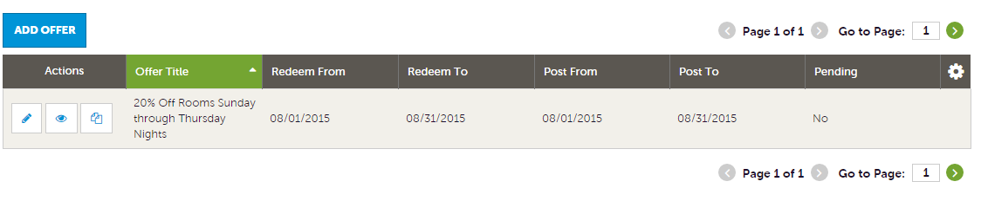
Filters and Data Grids (cont’d)
Once the filters have been applied, the data grid will update with the matching results. Several icons may appear on the records within the grid. The appearance of these icons will depend on the page being viewed.
These icons are:
Pencil – allows editing of a record
Eyeball – allows viewing of a record
Clone – allows duplicating of a record
Add Button - Depending on the page, an Add button may appear in the top left of the data grid. When this option is available, clicking allows the addition of a new record.
Notice the sprocket icon that was mentioned previously.

Slide 4
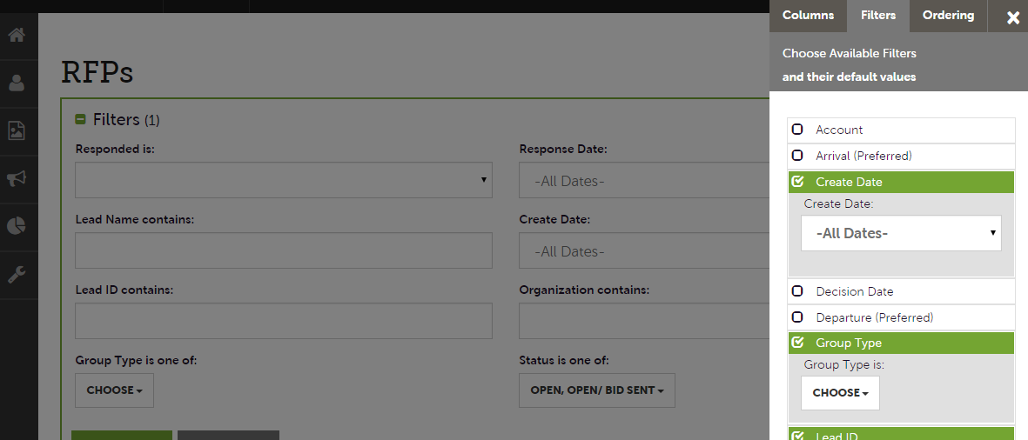
Filters and Data Grids (cont’d)
Clicking on the sprocket icon or the Manage Filters button will trigger a menu as shown here. This menu provides options for personalizing the filters, data grid columns, and ordering of each. By changing these options, changing of these options affects ONLY the person making the changes.

Slide 5
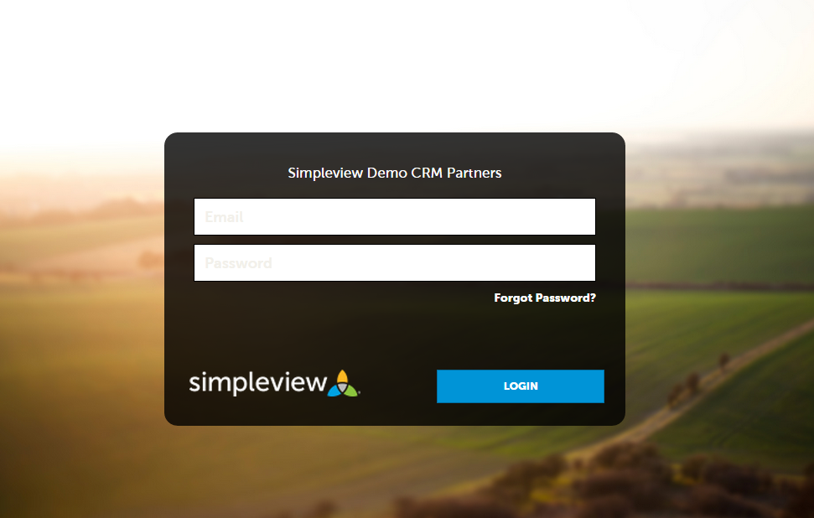
Login Screen

Slide 6
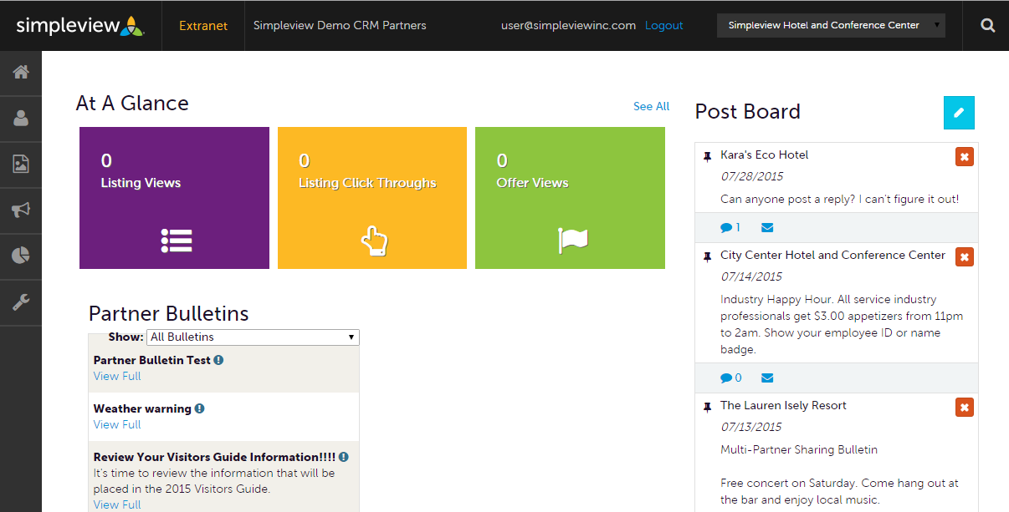
Home Screen
Post Board allows a user to communicate with other properties within their destination. Clicking on the caption bubble icon allows a user to reply to a post. There is also an email icon for contacting the poster via email.

Slide 7
Home Screen (cont’d)
Partner Bulletins are important notices, documentation, events, etc. posted by the Bureau. Important bulletins will be marked with a blue and white exclamation mark.

Slide 8
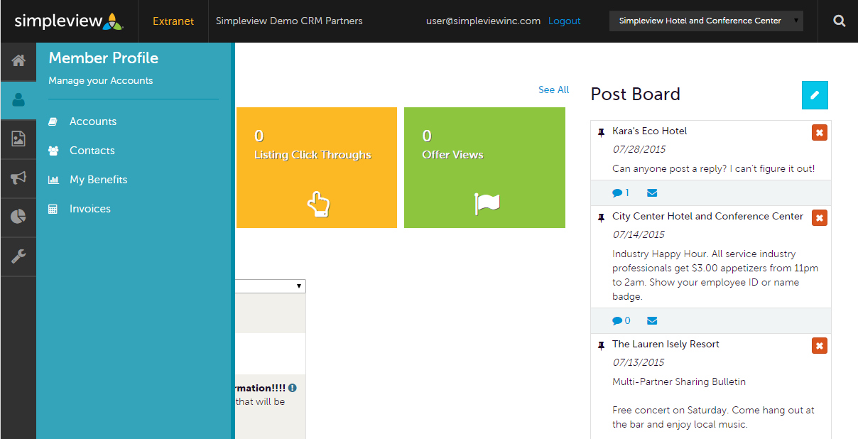
Home Screen (cont’d)
Clicking the Member Profile icon displays a property’s information, such as contacts, Account details and information about interaction with the Bureau.
Note: Some of these options are just view and/or edit and/or add. More on these options later in the presentation.

Slide 9
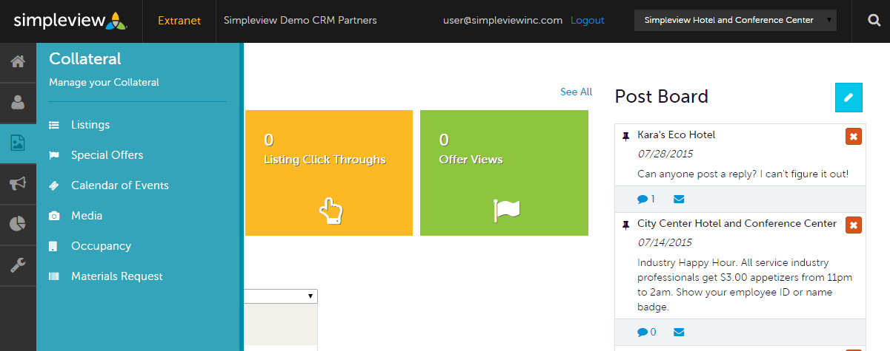
Home Screen (cont’d)
Clicking the Collateral icon, displays options for listings/publication guides, special offers, calendar of events, media (i.e. images), occupancy data, and materials request from the Bureau.
Note: Some of these options are just view and/or edit and/or add. More on these options later in the presentation.

Slide 10
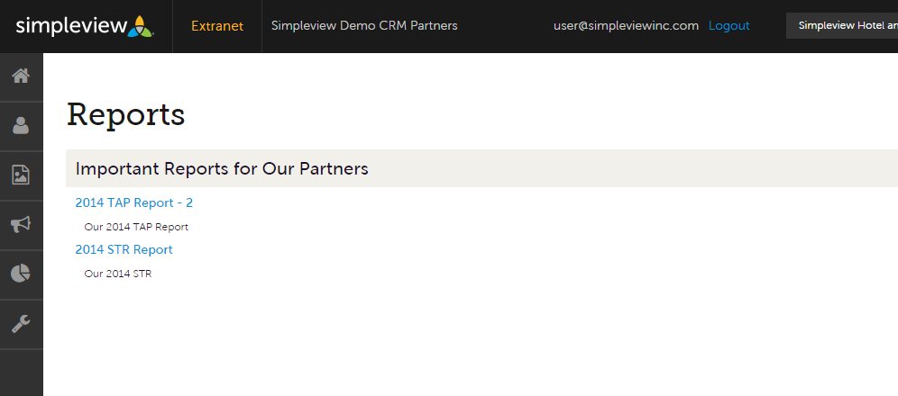
Home Screen (cont’d)
By clicking the Reports icon, displays reports the Bureau has posted. To view a report just click the name of the report.

Slide 11
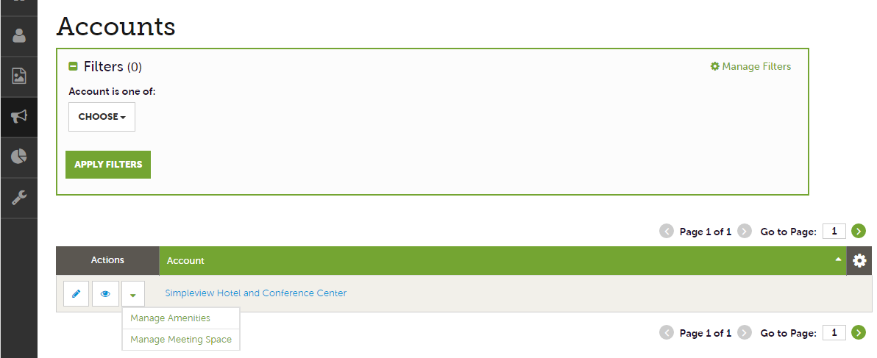
Manage Profile - Accounts
After you click the Profile icon and then Accounts, you will be presented with your account name and various action you can perform. If you see multiple account names, this is due to your property being associated with another property. The pencil icon will allow you to edit your property information. By clicking the eyeball icon, you can view your property information. The down arrow icon will allow you to view and edit your amenity and meeting space information.

Slide 12
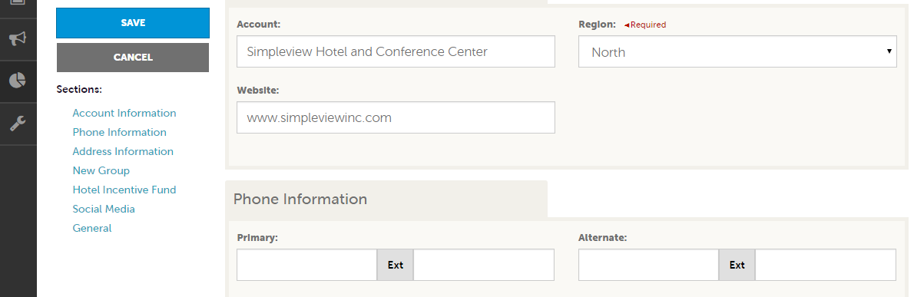
Manage Profile - Accounts (cont’d)
When you view or edit your property information, you can quickly scroll to a section on the page by clicking the links on the left of the page. If you are viewing the account , the top left will display an Edit button. If you are editing the account , the top left will display a Save button. You must click the Save button before changes are applied!

Slide 13
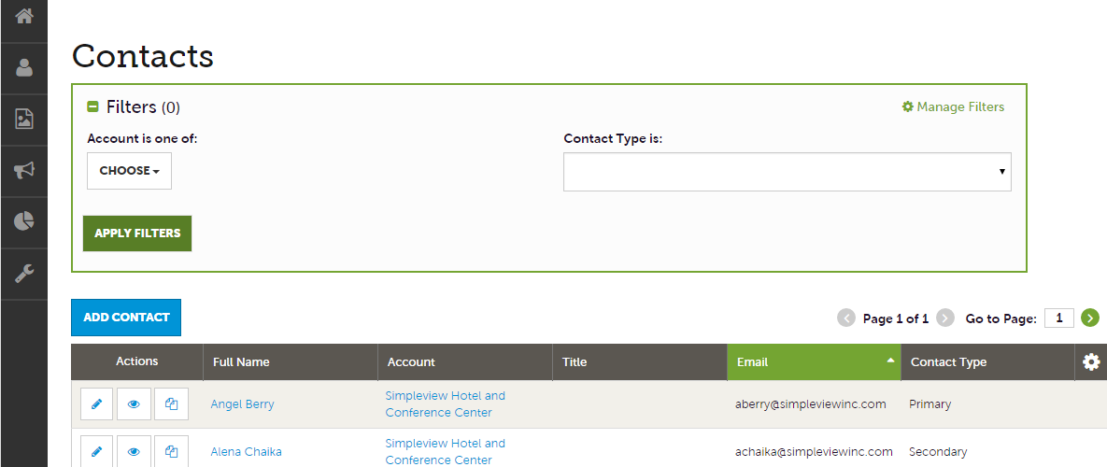
Manage Profile - Contacts
After you click the Profile icon and then Contacts, you will be presented with a list of all the contacts associated with your property. On this page you can Add, Edit, View, or Clone (i.e. duplicate) a contact depending upon your extranet permissions.

Slide 14
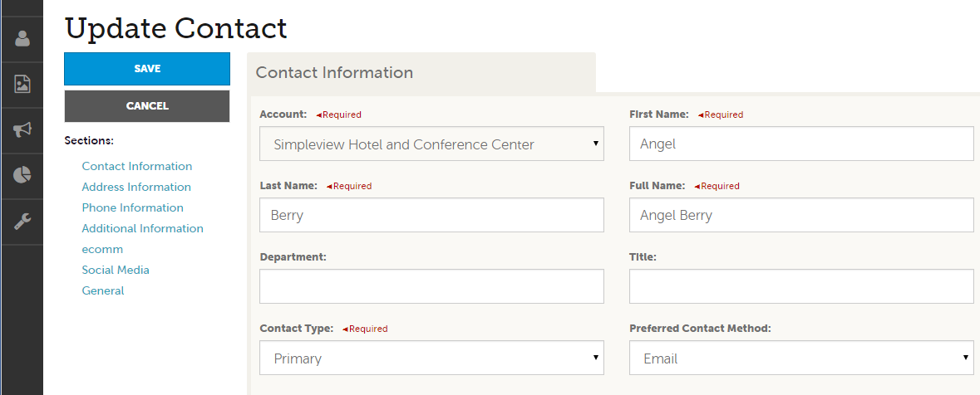
Manage Profile - Contacts (cont’d)
When you view or edit a contact, you can quickly scroll to a section on the page by clicking the links of the left of the page. If you are viewing a contact, the top left will display an Edit button. If you are editing a contact, the top left will display a Save button. You must click the Save button before changes are applied!
IMPORTANT NOTE: If a contact has left your property it is your responsibility to notify the Bureau and/or change their contact type to “Inactive”.

Slide 15
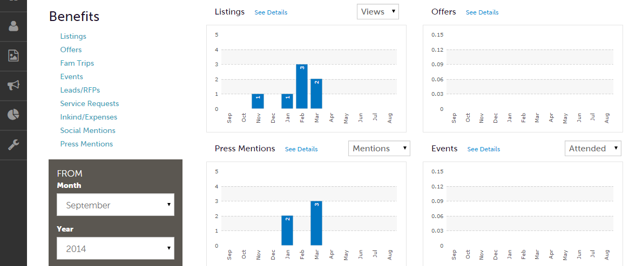
Manage Profile - My Benefits
After you click the Profile icon and then My Benefits, you will be presented summary reports based on the Bureau’s interaction with your property. The information you see on this page is specifically related to your property.

Slide 16
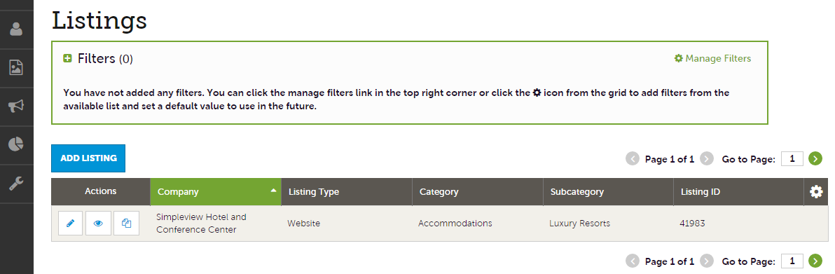
Collateral - Listings
After you click the Collateral icon and then Listings, you will be presented with your property’s listings. These listings may be website listings or publication guide listings. The pencil icon will allow you to edit your listing information. By clicking the eyeball icon, you can view your listing information. The clone icon will allow you to duplicate a listing. You can also create a new listing by clicking the Add Listing button.
NOTE: Add Listing and Clone will only be available if the Bureau has enabled this feature.

Slide 17
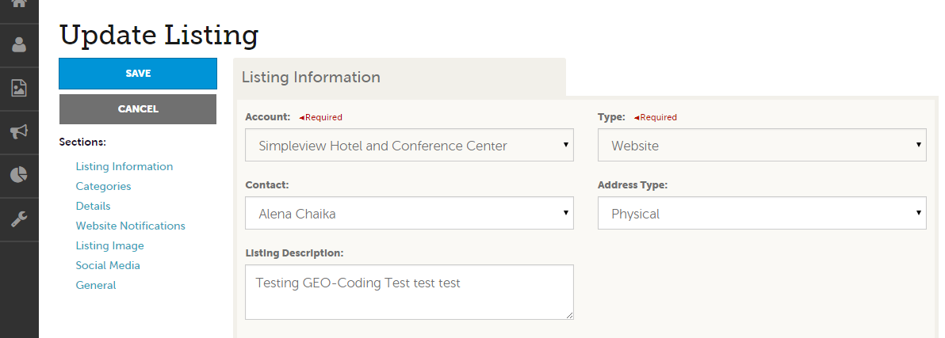
Collateral – Listings (cont’d)
When you view, edit, or add (if enabled) a listing, you can quickly scroll to a section on the page by clicking the links of the left of the page. If you are viewing a listing, the top left will display an Edit button. If you are editing a listing, the top left will display a Save button. You must click the Save button before changes are applied!
IMPORTANT NOTE: Any edits or adding of listings will require approval from the Bureau. Upon saving your updates, the Bureau will be notified of your changes/additions.

Slide 18
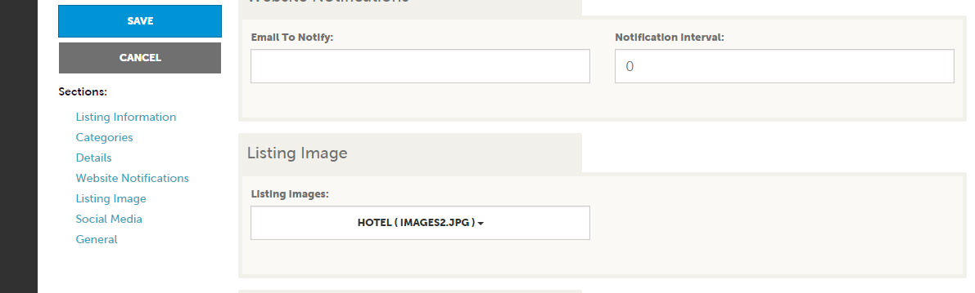
Collateral – Listings (cont’d)
When you edit or add (if enabled) a listing, you can select one or multiple images to associate to the listing by selecting the Listing Images pull down menu. As mentioned previously, any edits or adding of listings will require approval from the Bureau. Upon saving your updates, the Bureau will be notified of your changes/additions. More on images in the Collateral – Media slide.
NOTE: Not all listing types allow for images to be added.

Slide 19
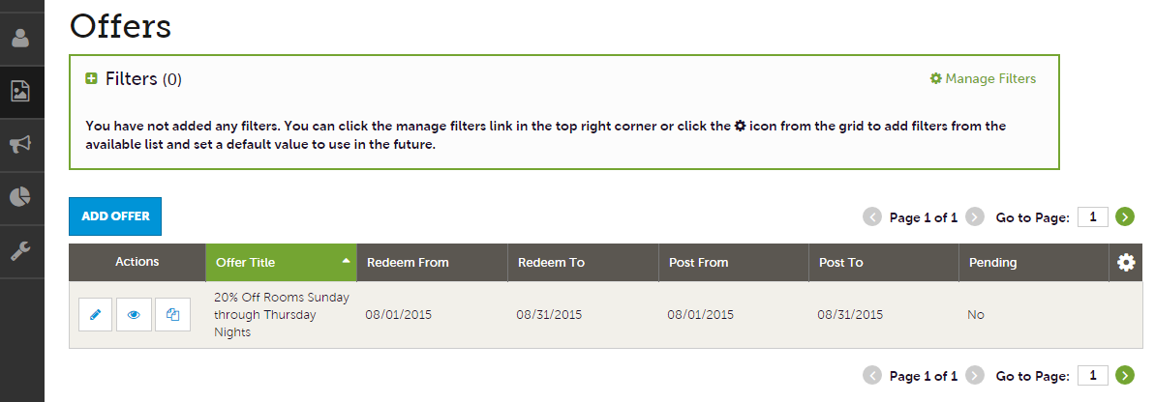
Collateral – Special Offers
After you click the Collateral icon and then Special Offers, you will be presented with your property’s offers. The pencil icon will allow you to edit an existing offer. By clicking the eyeball icon, you can view the existing offer. The clone icon will allow you to duplicate an offer. You can also create a new offer by clicking the Add Offer button.

Slide 20
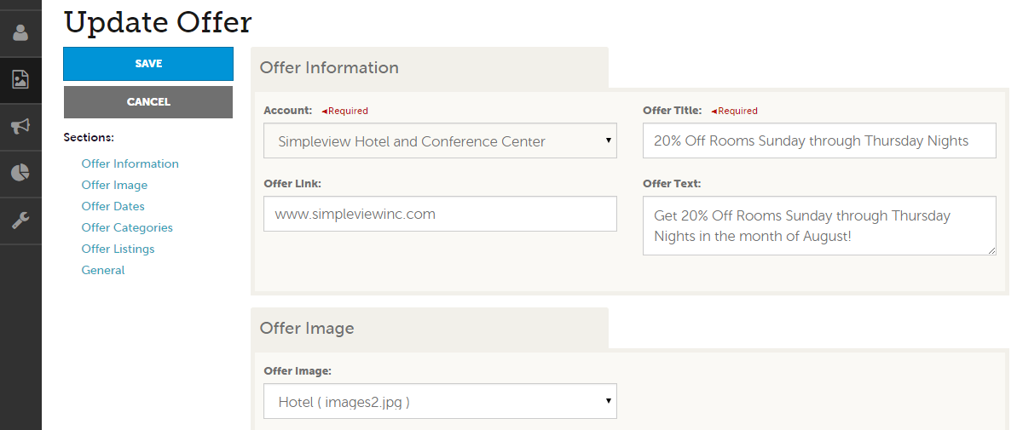
Collateral – Special Offers (cont’d)
When you view, edit, or add an offer, you can quickly scroll to a section on the page by clicking the links of the left of the page. If you are viewing an offer, the button in the top left will say Edit. If you are editing an offer, the top left will display a Save button. You must click the Save button before changes are applied! As with listings, you have the ability to attach images to your offers.
IMPORTANT NOTE: Any edits or adding of offers will require approval from the Bureau. Upon saving your updates, the Bureau will be notified of your changes/adds.

Slide 21
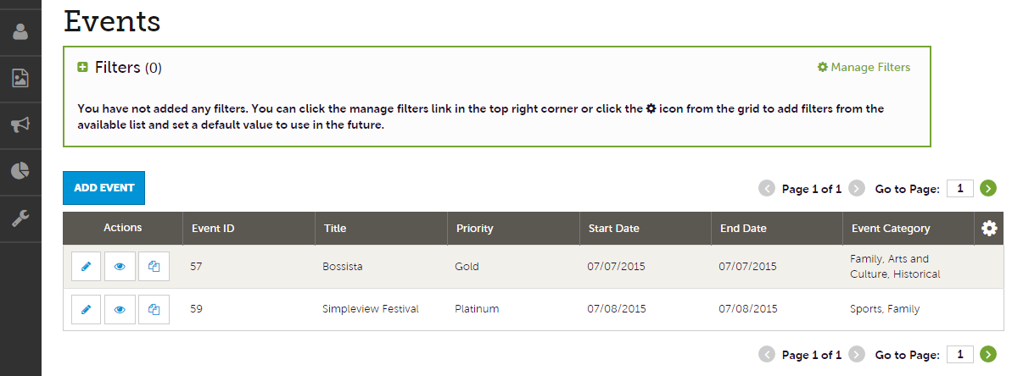
Collateral – Calendar of Events
After you click the Collateral icon and then Calendar of Events, you will be presented with your property’s events. The pencil icon will allow you to edit an existing event. By clicking the eyeball icon, you can view the existing event. The clone icon will allow you to duplicate an event. You can also create a new event by clicking the Add Event button.

Slide 22
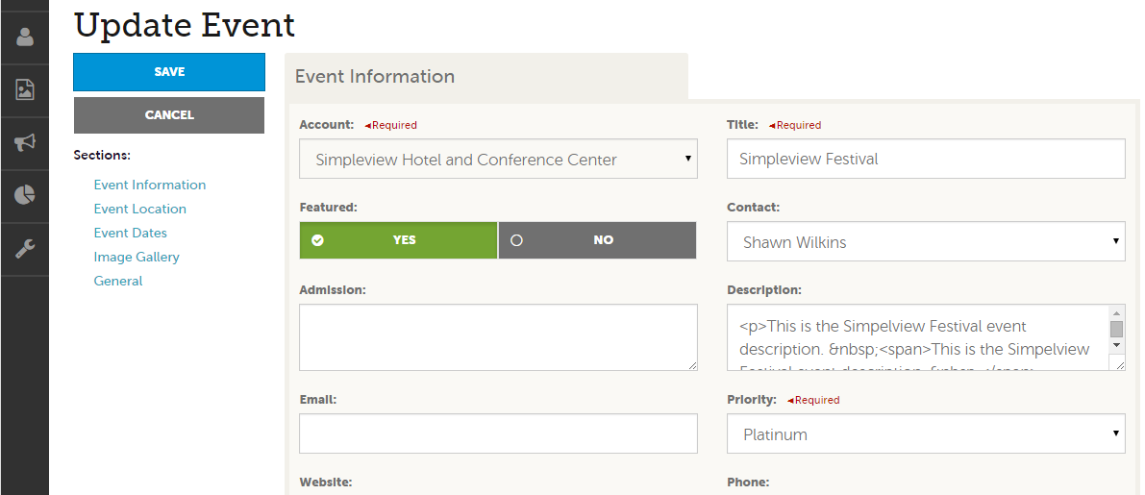
Collateral – Special Calendar of Events
When you view, edit, or add an event, you can quickly scroll to a section on the page by clicking the links of the left of the page. If you are viewing an event, the top left will display an Edit button. If you are editing an event, the top left button will say Save.
IMPORTANT NOTE: Any edits or adding of events will require approval from the Bureau. Upon saving your updates, the Bureau will be notified of your changes/adds.

Slide 23
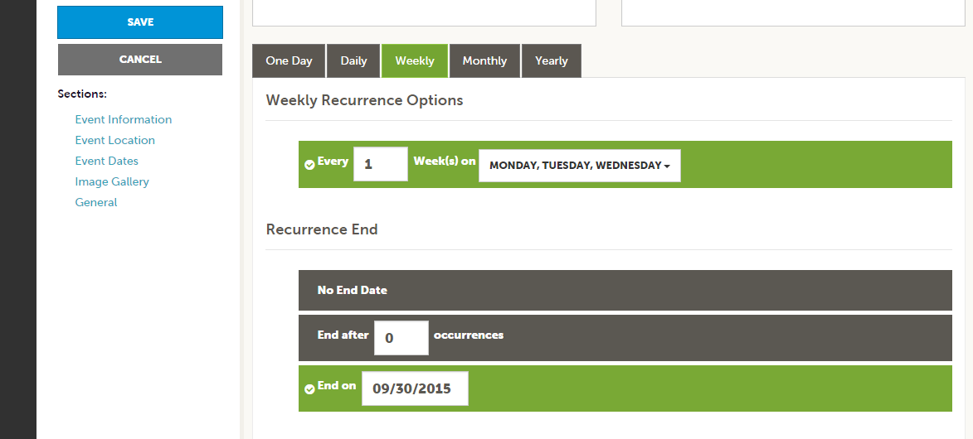
Collateral – Special Calendar of Events
The Calendar of Events has a recurrence model built in. You can make your event a one-time event, daily, weekly, monthly, or yearly. If it is not a one day event, you can choose your recurring days of the event. Depending upon if it is daily, weekly, monthly, or yearly, your recurrence may change. At the bottom of the recurrence section, you can choose to end your event after a certain number of occurrences or on a specified date.

Slide 24
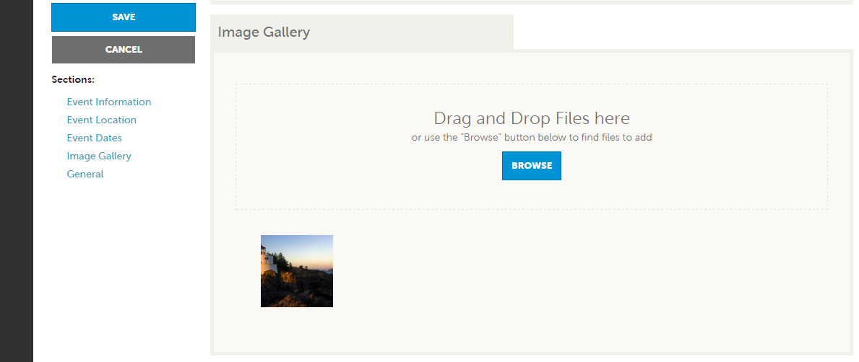
Collateral – Special Calendar of Events
As with Listings and Special Offers you can add images to your event. Adding images to an event is a little different though. In the image Gallery section on the event, you can drag and drop an image or click the Browse button to search your computer for an image.

Slide 25
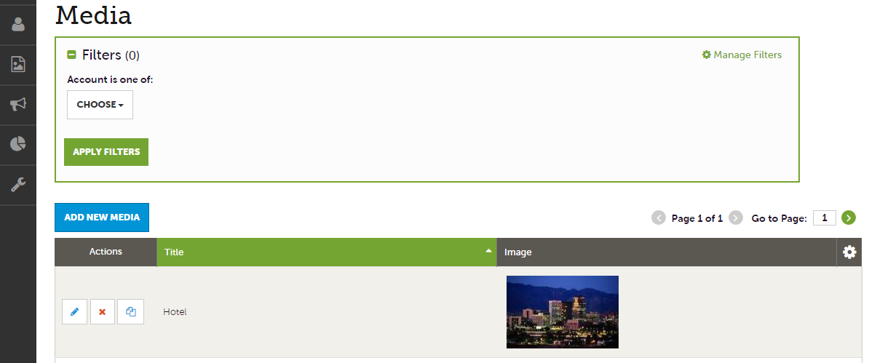
Collateral – Media
After you click the Collateral icon and then Media, you will be presented with your property’s images available for use on listings and special offers. The pencil icon will allow you to edit an existing image. By clicking the red x icon, you can delete an existing image. The clone icon will allow you to duplicate an image. You can also create a new event by clicking the Add Event button.

Slide 26
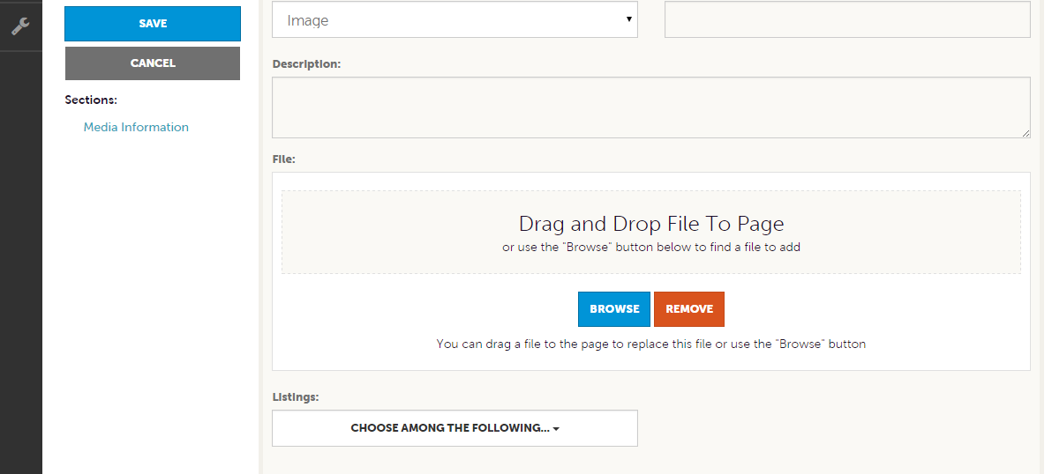
Collateral – Media (Cont’d)
As with Calendar of Events you can browse your hard drive or drag and drop an image. Once you upload a new image or edit an existing one you can attach the image to one or multiple listings by selecting the Listings pull down menu.

