Slide 1

Good Afternoon!
“
s”
JEFF CROUSHORE

Slide 2
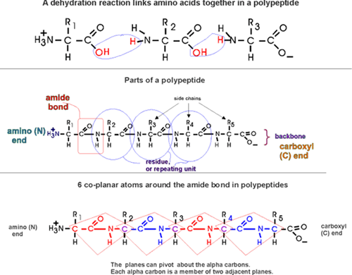
Structure of a Polypeptide
Notes:
Today, I’d like to talk about the complex structure of a Polypeptide.
No. When thinking about what I wanted to speak about today, …past Interactive Marketing summits, feedback, ….We don’t have all professional marketers in the room. Small business owners, salespeople, office managers, others. While all the speakers are great, I wanted to simplify the concepts of marketing today into easier to understand terms.

Slide 3
B A S I C S
b
a
s
i
c
s
OF MARKETING
TODAY
Notes:
I even went a little old-school and will present my points as an acronym.

Slide 4
BUY IN
B
b
“
s”
Notes:
First off, you need to buy in to the idea that marketing today is very different that it was just a few years ago. 10 -15 years ago, the process was pretty straight forward and your options were defined. Executing a marketing strategy might involve advertising on tv, taking out some ads in a local newspaper or radio show, throw in a little PR and a trade show or two and you could call it a day.
Of course today, the media scene has shattered into a million pieces. The rules of engagement shift on a daily basis. What worked for sonsumers last week may not work next week because the rules are changing dramtaically.

Slide 5
$ buy in $
B
b
“
”
Notes:
Sometimes then, you do have to literally buy in, and reallocate funds that you were using in traditional marketing and experiment in new platforms to keep up with your competitors. Perhaps move more money to digital campaigns and less traditional.

Slide 6
ANALYTICS
A
a
“
”
Notes:
Understanding your analytics make it possible for you to evaluate the success of your marketing initiatives. Make it possible to report on the past -What eblast generated the most revenue? Anaylyze the present – How are our customers engaging with us, and can influence the future – What new areas should we target? And this is something that many of us don’t have the time for, but it is very important.

Slide 7
ask for help
A
a
“
”
Notes:
IF we are responsible for the success of our business, then I think it is perfectly OK to ask for help. I know that many people in this room are overworked. We may handle many aspects of our business not just marketing. Some businesses are downsizing, and when an employee leaves, the workload just gets absorbed by another employee. So it’s always good to remember that its OK to ask for help….reach out to counterparts, and ask them what tools they are using that are beneficial.

Slide 8
SOCIAL MEDIA
S
s
“
s”
“You can buy attention (advertising). You can beg for attention from the media (PR). You can bug people one at a time to get attention (sales). Or you can earn attention by creating something interesting and valuable and then publishing it online for free.” –David Meerman Scott, Best-Selling Author & Speaker
Notes:
Social Media of course is very important today. Customer engagement is the most important benefit of social media marketing. This helps to retain your existing customers and also increase brand credibility, plus it can be a lot of fun. It can be a lot of work, but indeed a lot of fun. Find a tool to help you plan your social media.

Slide 9
storytelling
S
s
“
”
Notes:
Of course, Storytelling is not new to marketing, but it continues to be important. It conveys your brand’s personality, It helps you stand out, it scores with you customers on an emotional level (Extra commercial – young lovers), Keeps them coming back for more. Stories of your brand, your product, your employees, your customers, all are potential goldmines for a good story.

Slide 10
INTERACTIVE CONTENT
I
i
“
s”
Notes:
In the current digital landscape, engagement is everything, and marketers succeed when their audience not only consumes content, but also enjoys it, and acts upon it. Interactive content generates conversions better than static content. It can work also work to differentiate you from your competitor. Interactive content can come in many forms, it can be quizzes, polls, contests, personality test, Which Game of Thrones character are you?. By its nature, interactive content engages particpants in an activity, answering questions, making choices, exploring scenarios. It’s a great way to capture their attention from the start, they have to think and respond. There are many platforms out there to help interact with your customers, one that we use is WYNG.

Slide 11
interns
I
i
“
s”

Slide 12
CUSTOMER
UNDERSTANDING
C
c
“
s”
Notes:
Understanding what customers need and want is critical for businesses if they want to be successful, but it can be difficult. Some ways to understand your customers and what they need from you, FOCUS GROUPS – interview a small group of people that are representative of your target market. SOCIAL LISTENING – to track what people are saying about you, KEYWORD SEARCH – can provide insight – if you know how they are searching for your company, you can determine some of what they are looking for.

Slide 13
customer relationship management
C
c
s”
“
Notes:
A good CRM program is vital. It lets you store your prospects, leads, current customers in one central location, and can help you increase leads, close more deals, and drive customer loyalty and satisfaction. Ex. - Salesforce….

Slide 14
strategy
S
s
“
s”
Notes:
To make it, you definitely need a strategic marketing plan laid out and followed. It can be long and exhausting to put together, but the rewards will be great. It will include your SWOT analysis, define your areas of opportunity, and your areas of weakness. In it, you lay out your emails, your press releases, you advertising for the entire year. The majority of your plan you have to stick to, while other areas can be more liquid, but having a strategic plan is vital to your success.

Slide 15
seize opportunity
S
s
“
s”
Notes:
In today’s busy society, make sure you take advantage of any opportunity to market your business that you get. For instance, say you were in front of a room full of people……it may a good opportunity to tell that audience that your amusement park can deliver quality family fun moments, and memories that last a lifetime. And also remind them to follow you on social media, to see how the park can deliver those great family moments, and so that they can be the first to know about valuable savings and opportunities, such as an early black Friday sale starting next week, at the park voted Best Children’s Park in the world for the last eight years, and consistently ranked as one of the best parks for the entire family. Seize Opportunity.

