Slide 2
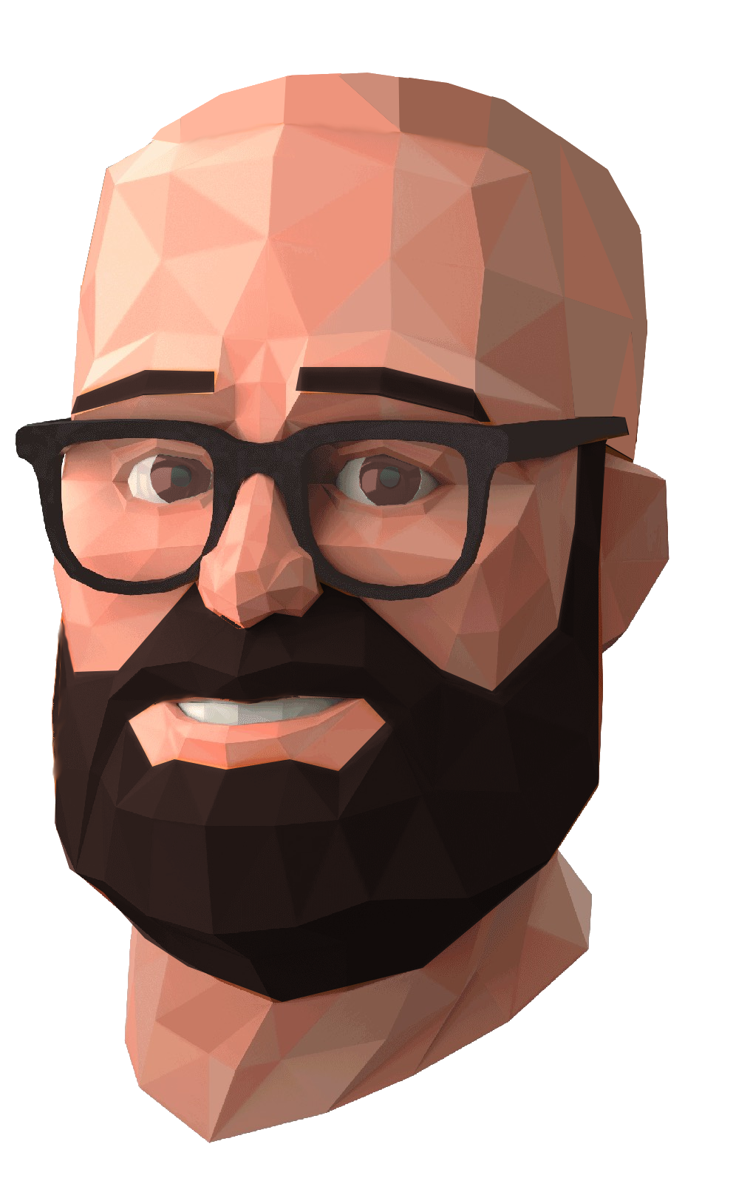
Ed Saxton Vice President of Production
Ed Saxton is the Vice President of Production for Schell Games. With a focus on team safety and trust, he supervises the company’s production team and sets the tone for the production style.
Prior to joining Schell Games, Ed worked in management and capital project development in the theme park industry. This background led to a deep understanding of priority and process, along with a love of creating experiences that make lasting memories for the end user.
Ed’s love of working on teams and problem solving led him to Schell Games. At Schell Games, Ed focuses on mentoring and managing within the production department, collaborating with teams to ensure projects finish on time and on budget, and incorporating positive team dynamics within the studio.
You don’t have hair anymore!

Slide 3
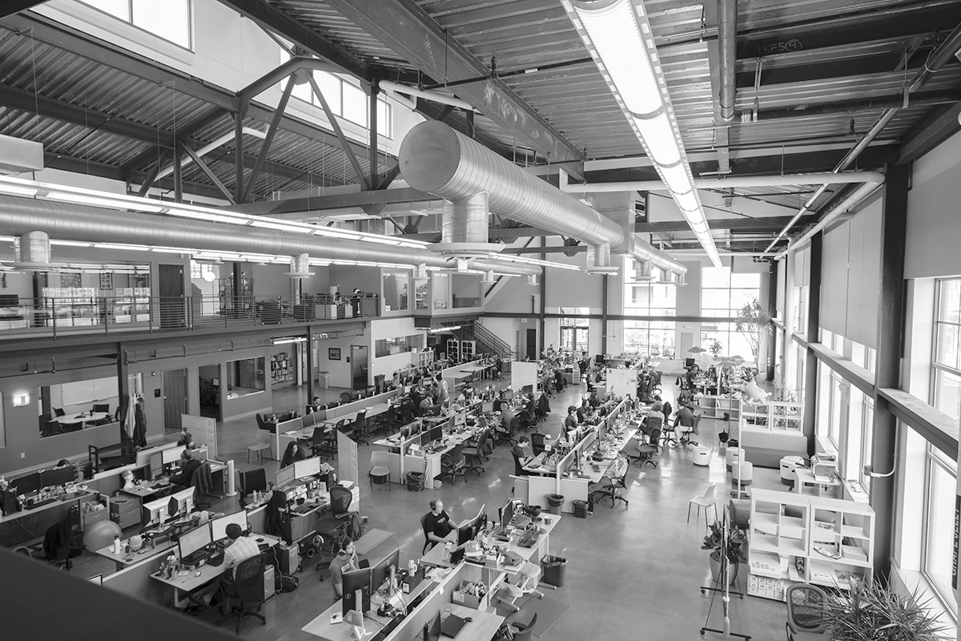
ABOUT US
Schell Games is a full-service game design and development company, which specializes in creating transformational games and innovative, interactive experiences. The company was founded in 2002 by world-class game designer and esteemed author Jesse Schell and is located in Pittsburgh, Pennsylvania. We are one of the largest independent game studios in the world.

Slide 4
Mission Statement
To make experiences we are proud of with people we like, so we can make the world a better place.
Don’t forget the core values. Amazing Teams, Amazing Fun, Amazing Transformation

Slide 5
Be brave. If you aren’t,
who will be?
Ask “How does our experience change the guest?”
OUR CORE VALUES
& PRINCIPLES
AMAZING TRANSFORMATION
If we believe in
what we are doing,
anything is possible.
Ask “Is there a better way?”
It’s not a decision
until the team
is on board.
At Schell Games we live and breathe our principles. These are not just words that live on a powerpoint, but lenses we hold up to all that we do, everything we build, and everyone we partner with.
Experiences should
be beautiful both
inside and out.
If you don’t believe in your work,
speak up!
MAGIC
Playtest constantly. It’s the only way to know.
AMAZING
TEAMS
Information flow is essential to quality.
Treat everyone with respect.
AMAZING
FUN
Beauty is in the details, so give attention to every little thing.
Know, respect, and defend the guest.
The experience is for them.

Slide 6
WHO ARE OUR CLIENTS?
Schell Games counts some of the world’s most respected brands as clients, including Pixar, Microsoft, Yale University, Facebook, Oculus, SeaWorld Parks and The Fred Rogers Company. We’ve completed numerous projects for Fortune 100 companies, such as The Walt Disney Company and Microsoft Corporation. In addition, we work with many small to mid-sized companies across many industries, including Toys and Games, Entertainment, Healthcare, Technology, and Education.

Slide 7
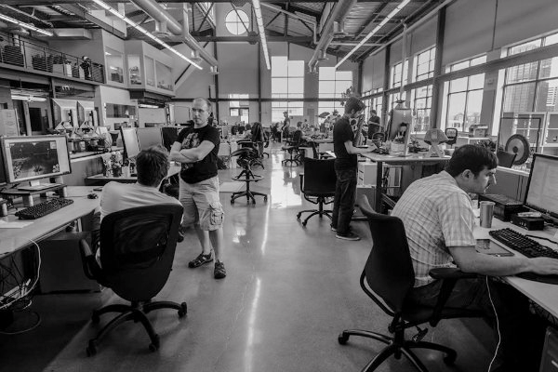
Retrospectives

Slide 8
Retrospectives
PART OF OUR PROCESS
Plans are great, but only when they are elastic, when they can respond to change, when they can embrace feedback!
SPRINT
BUILD
INSPECT
PLAYTESTS
ADAPT
YOUR GOALS
REVIEW
BUILDS
LIVE GAME
OUR EXPERIENCE
ONGOING SUPPORT

Slide 9
Problem with Teams and Processes
(What are we trying to solve?)
How do we as a Team address problems quickly and always get better
How do we get better at communicating with one another.
How do we get more efficient
Schell Games Principle: Always ask, "Is there a better way"

Slide 10
We are always solving problems
(Aren’t we doing this already?)
We are so focused that we tend to focus on the problems directly in front of us.
We tend to think that if we see a problem others must see it too
Team's don't feel empowered
This process gives Teams to power to solve problems
These conversations can be hard without a proper culture of Team Safety
Retrospectives can help build this culture!

Slide 11
How to conduct a retrospective
(There are so many ways)
Today I will focus on my favorite way to conduct a retrospective
1 hour, post-its, a wall, an open mind, the entire Team
You can be the entire Team. You can use this to evaluate your own progress or processes
Even retrospectives are a process that we are always evolving
We just had a retrospective about retrospectives!!
Always ask, "Is there a better way"

Slide 17
10 mins

Slide 25
Everyone should do Retrospectives
TEAMS GET:
Faster
Happier
Healthier
Better
More Trusting
Better at mitigating risks
More Empowered

Slide 26
Retrospectives
(Tips, links, info, )

Slide 27
“What is the point of hiring smart people, we asked, if you don’t empower them to fix what’s broken?”
― Ed Catmull-President, Walt Disney and Pixar Animation Studios and Disneytoon Studios, Creativity, Inc.

Slide 28
Thank you.
Questions? Come find me...

