Slide 1
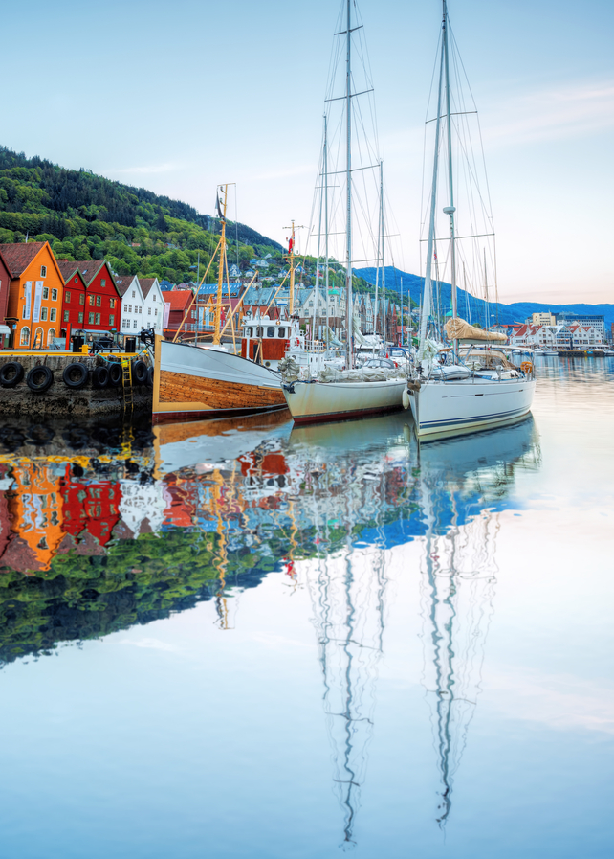

Germans view on holidays abroad
Censydiam qualitative study
December 2016
Janine Freudenberg and Denise Sindermann

Slide 2
Contents
51
The ideal holiday abroad
3
Background & Objectives
54
Understanding competitive markets
6
Key findings
62
Norway as a holiday destination
9
Cultural background
71
Outdoor activities, culture, LOHAS and food in Norway
17
Fundamental Meaning for holiday abroad
76
Conclusions & Recommendations
25
Motivations for holiday abroad
79
Appendix – respondent list

Slide 3
Background
Innovation Norway would like to update the Censydiam study from 2011 for the German market.
The last Censydiam study from 2011 focused on “nature based holidays” in a wider perspective. The target groups are the same, but now we want to take a deep dive into four important segments. We will have 4 full Censydiam-groups with respondents with specific field of interests (one group for each):
      Outdoor activities (skiing, hiking, bicycling etc)
      Culture interest (local culture, history, art etc)
      Lohas (Lifestyle of health and sustainability - sustainable ecotourism, interest in organic and locally grown food)
      Local food (Scandinavian food)
    The study should explore all this aspect with going on a holiday abroad. However, sun and beach holidays and pure shopping holidays are excluded from this study.

Slide 4
Research objective
  Identify consumers’ motivations, emotions, drivers and barriers when choosing a destination abroad for different kind of holidays/different occasions. What do they expect from their holiday abroad?
  Identify consumers’ emotions, motivations, drivers & barriers towards taking a vacation to a Nordic country such as Norway
  Explore holiday behaviour, rituals and occasions, seasons, travel groups in the local culture
  Explore the holiday landscape
  Explore the role of activities on holiday abroad (what/why)
  Explore the role of culture on holiday abroad including local culture, history, art etc. (what/why)
  Explore the role of food on holiday abroad (what/why)
  Explore the role of sustainability on holiday abroad (what/why)
  Understand potential & positioning of Norway as a destination including their perception of possible activities, local culture, sustainability and food in Norway.
  These research objective need to be answered in the report.

Slide 5
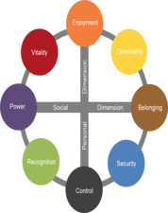
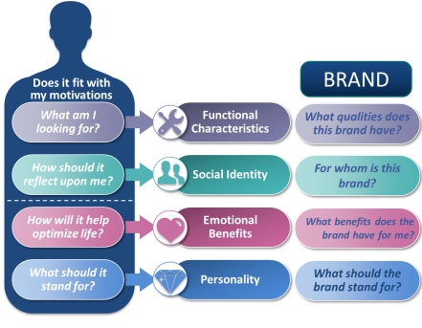

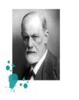

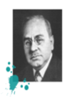

Censydiam in a nutshell
People first
All decisions are made with fundamental consumer needs at the heart
Universal
Comparison possible across markets
Customizable
Needs are tailored by context, category and markets.
theories about the unconscious mind and the mechanisms of release and repression
Each is deconstructed on key emotional and functional benefits, brands need deliver on in order to be relevant for consumers in various usage occasions/situations.
These benefits help build rich networks and allow consumers to easily identify the best solutions for their needs.
Validated
Over 30+ years experience across the globe & scientific thesis
The double mechanism for satisfaction: a striving for power & superiority and for belonging & community
Comparison
Allows comparison over time and markets

Slide 6
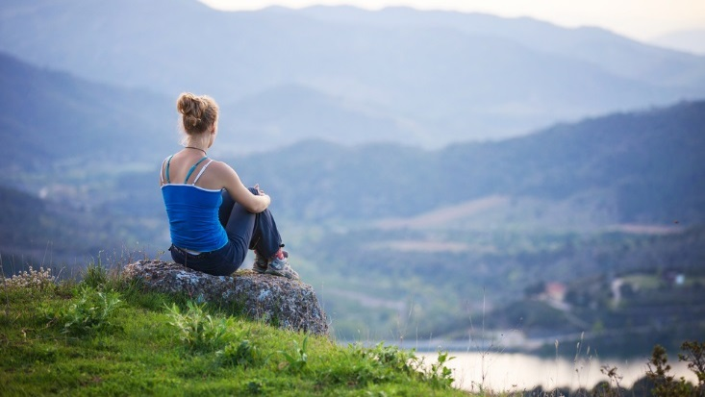

Key findings

Slide 7
A few words to the research circumstances
Key Findings
Season/ location bias
Project has been conducted in cold and dark season: respondents were longing for warmth and therefore felt a stronger rejection to Nordic countries and Norway – associations and aspirations might have been different when conducting this project in summer time
The line of vision in Frankfurt groups directed more towards south which would may have been different when conducting focus groups additionally in different locations, e.g. Hamburg or Berlin

Slide 8
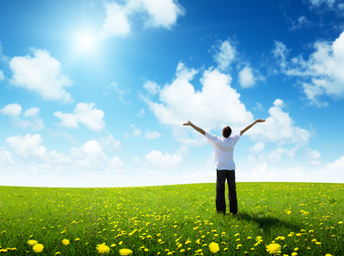
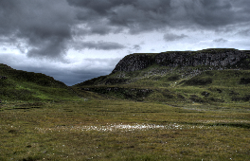
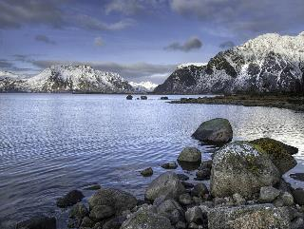
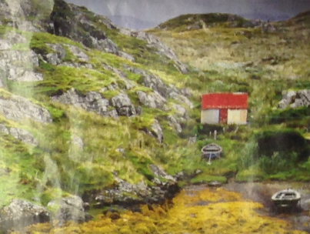
Main findings from this research
Key Findings
Ego shift in meaning of holiday abroad
Image of Scandinavia and its countries Mostly differ in terms of knowledge
Norway is known for its nature, but has to fight Some prejudiceS
However, image also contains The Need for A comfort and safety
Holiday is not anymore the sole and social annual family summer vacation, but has shifted to a more egoistic-driven conglomeration of individual get-aways
Whereas Iceland is known for its natural phenomena and Sweden for its popcultural references, Finland is perceived as rather exotic and meager
People have only little knowledge about Norway and mostly associate it with a pristine, yet cold and dark landscape
Coldness and darkness prevails need to establish a comfort zone where one can also spend an even more intense time in withdrawal, calm and self-exposure

Slide 9


Cultural background
9
© 2016 Ipsos.

Slide 10

Germans strive for security and control
Cultural Background – Germans and their way of living
Enjoyment
In the core: Germany is a black/ blue motivation – strong demand for security and control
Germany is known as a country that sets limits and boundaries – this is important as people usually seek the opposite in their holidays, to escape the daily routine and reach a feeling of freedom
The recent flood of refugees in Germany has risen new insecurities and fears: once more, the need for security and control is crucial for everyday life
However, this motivation is softening, since Germany is getting more multicultural and social media / internet broadens horizon and social adaption on a global level
Especially in big cities, there has been a boom in the recent years for sustainable and healthy living, especially among younger people who entered working life: organic and local food has an increased importance
Vitality
Conviviality
Power
Belonging
Recognition
Security
Control
GERMANY

Slide 11

Holidays are about ...
Cultural Background – Germans and their way of living

Slide 12
From the annual family holiday to the individual weekend get-away
Cultural Background – Types of holidays
Nowadays, it is not only the classic annual summer family holidays anymore. In addition, other types of holidays appeared and now have to share the limited holiday time of Germans (average: approx. 30 days). The increase of amount and types of holidays has different reasons:
  Increase of the performance-oriented society: demands towards holidays changed and are put in a bigger context: globalization and social media develop a pressure that holidays need to be something extraordinary and apart from mainstream
  No more focus on certain people: Holiday is not anymore limited to the classic family holiday and can be done alone, with friends, partner, in a travel group etc.
  Holiday split: Holiday is not anymore only focused and centered on the „annual big trip“, but rather split into different holiday types, short weekend get-aways etc.
  Decrease of costs: travelling abroad/ long-haul flights are getting cheaper (“A week in Frankfurt costs about as much as flying to Turkey and have a week of holidays there”)
  Increased openness: e.g. towards other cultures, exotic locations; increased tolerance and solidarity and the wish to explicitly confront oneself with foreign cultures

Slide 13
From this base, different types of holidays exist
Cultural Background – Types of holidays
DURATION?
WHO?
THEME?
ORGANIZED?
Main summer holidays
(2 up to 4 weeks)
Family holidays
Cultural holidays
Individual holidays
(Extended) weekend trip
Couple holidays
Active holidays
Packaged holidays
Short holiday (1 week)
Mother-daughter/ father-son holidays
Education holidays
Mix of individual / packed
Single holidays
Wellness/ relax holidays
Last minute
Holidays with close friends
Winter sport holidays
Holidays with a (bigger) group of friends
City trip
Shopping
Beach holiday
Summer/ late summer/ autumn: strongly depends on children‘s holiday, usual family holiday time, but: more expensive
Off-season (autumn, spring, end of year): cheapest, mostly in faraway and warm countries
Winter: mostly for winter sport holidays or winter escape into faraway warm countries
WHEN?
MAIN HOLIDAY
NEW FORMS OF HOLIDAY
NOT RELEVANT IN THIS STUDY

Slide 14
A detailed look at holiday categories
Cultural Background – Types of holidays
Packaged holidays
Individual holidays
WHY?
Stress-free, carefree, secure, relaxing
WHAT?
Mostly booked via travel agency, mostly when children are present or travelers are not affine for organization, appropriate for most countries as packaged holidays provide a “safe haven”
WHY?
Freedom, more exciting, more flexibility, just as the fancy takes one, not dictated
WHAT?
Mostly booked online, choice of different hotels per trip than only staying in one, mostly without kids, not appropriate for all countries as strongly depends on local security

Slide 15
Durations can vary a lot more…
Cultural Background – Types of holidays
Main summer holidays a.k.a. “the classic family holiday”
(Extended) weekend trip
Short holiday (1 week)
WHY?
Pleasure, relaxation, reward
WHAT?
Mainly with family and kids, in Europe or longer distances, warm countries, getting a massage, at least 2 weeks
WHY?
Short break-out, active seeking for cultural input
OR
Seek for short relaxation and recovery
WHAT?
Mainly with friends or partner, big cities, shopping, museums, architecture, mainly within Europe/ short distances
OR
Being active in nature, hiking etc.

Slide 16
… and themes reach from relaxing to active holidays
Cultural Background – Types of holidays
Cultural holidays
Active holidays
Wellness/ relax holidays
Education holidays
Winter sport holidays
WHY?
Relaxation and recovery, reward for hard work, pleasure
WHAT?
Sleeping in, getting pampered, long walk in the woods, Finnish sauna, good food
City trip
WHY?
Deep-dive into nature and landscape, getting head free through activity
WHAT?
Hiking, riding, surfing, biking, climbing, skiing, can be with/ without children
WHY?
Satisfying curiosity, pleasure and enjoyment, enhancing oneself by learning something new
WHAT?
Learning language, foreign cultures and people, trying new food,
sightseeing, architecture, mainly without kids

Slide 17
The Fundamental meaning of holiday abroad
17
© 2016 Ipsos.

Slide 18
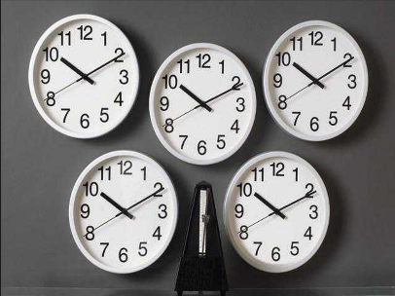
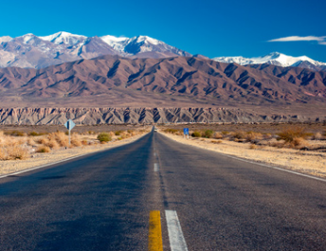
Holidays are not only an escape, but a salvation
Cultural Background – Types of holidays – Fundamental meaning
ESCAPE FROM DAILY ROUTINE
Change of scenery gives possibility to go on a distance and not be responsible or tangible (not only for job, but also neighbors, relatives etc.)
Goal: feeling of lightheartedness, no pressure, pleasure, empty the head and to reach a floating stadium of relaxation, recovery, no thinking etc.
BROADEN OWN HORIZON
Receiving input to broaden own horizon, such as new culture/ food
Getting new impressions by special architecture, people, landscapes
SALVATION FOR MYSELF
As a result and outcome, holiday is about oneself and to establish a wellbeing, inner piece and calmness
Holiday is a reward for hard daily work and routines
Furthermore, holiday should not be the mere “living for the moment”, but also long-lasting and a possibility for fundamental change

Slide 19
Qualitative hypothesis: the dimensions for holidays – vertical axis
The Fundamental meaning of holiday abroad
Excessive/ Explore/ receiving input – Getting something out of the holidays
Experience the holiday without limits, by solely focusing on the joyful side of it. Only by setting the basic black motivation, this motivation can fully unfold.
PERSONAL DIMENSION
Contradicts initial holiday motivation as holidays are usually used to break out of the routine. However, basic control instances can be set and vary across motivations. This motivation is absolutely necessary to be able to ‘enjoy’.
Control/ Routine
Setting the scene, put a structure on it

Slide 20
Qualitative hypothesis: the dimensions for holidays – horizontal axis
The Fundamental meaning of holiday abroad
Holidays consist of moments that fully connect me to others and the world around me because I make them the focus of my attention. I am adaptive and restraining because through others I will learn more about myself.
Standing out/ differentiating myself/ I am the center
The focus shift solely on me and my image (due to social pressure)
Restraining/ Taking myself out/ I am out of the center
The focus shift from the self to the surrounding of the person, e.g. to family, friends or the different culture – is the center
SOCIAL DIMENSION
The globalization and the presence of social media puts more social pressure – holidays and moments have to be something extraordinary, something away from the mainstream. This will form my image of being a different and special being.

Slide 21
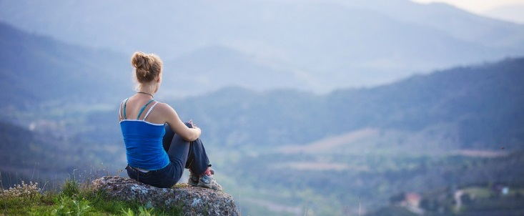
A journey to arrive at myself
The Fundamental meaning of holiday abroad
The motivation to go on a holiday is based on a paradox phenomenon: You must travel (far) away in order to arrive at a quiet natural and close place: your real identity and inner harmony!
It is crucial to understand that arriving at myself can only be achieved through a holiday abroad (a holiday at home is not described as a ‘real’ holiday). This aspect has become much more relevant today, since an overloading every day life makes us forget who we really are. It means that the fundamental meaning of holiday is shifting nowadays with direct impact on the ideal holiday experience. Holidays are egocentric and are about getting to know and develop oneself. Holidays are not only the moment, but a long-lasting impact on the personality.
Notes:
Basert på psykologiske forståelse om at mennesker blir drevet av to hovedkrefter:
Hvordan vi føler I forhold til oss selv: Den personlige dimensjonen: Nord-sør retning
Hvordan vi føler I forhold til andre: Den sosiale dimensjonen: Øst-vest retning. N
Noen ganger vil vi føle oss bedre enn andre og noen ganger vil vi bare passe inn
Resten av dimensjonene kombinerer elementer fra den personlige og sosiale dimensjonen.

Slide 22
Qualitative hypothesis: the dimensions for holidays – center of gravity
The Fundamental meaning of holiday abroad
Experience the outer world/ putting in to experience something
I am striving for as much input as possible in order to form myself, to learn more about me and to show who I really am.
Experience the inner world/ taking away to experience something
Taking away disruptive elements in order to fully focus on determined instances – e.g. surroundings, other people, food etc. . This will enable me to develop and to find my inner self.
Holidays abroad=
A journey to arrive at myself
Notes:
Basert på psykologiske forståelse om at mennesker blir drevet av to hovedkrefter:
Hvordan vi føler I forhold til oss selv: Den personlige dimensjonen: Nord-sør retning
Hvordan vi føler I forhold til andre: Den sosiale dimensjonen: Øst-vest retning. N
Noen ganger vil vi føle oss bedre enn andre og noen ganger vil vi bare passe inn
Resten av dimensjonene kombinerer elementer fra den personlige og sosiale dimensjonen.

Slide 23
HOLIDAY ABROAD MOTIVATIONS
// 6 Motivations for travelling abroad
Theoretical motivation that is not existing in this research. Implies completely letting go off structure, excessively living off the edge. Holiday cannot fulfill this motivation by nature.
JOURNEY TO MY EXTREMES
JOURNEY TO MY INNER HARMONY
Holiday is about gaining new inspiration by fully diving into adrenaline, cultural shock and new point of views.
Holidays are a light, balanced get-away with a good atmosphere and that is best enjoyed in company – to achieve the perfect harmony.
Holiday can be spontaneous and luxurious, as long as it shows that I am a really worldly, interesting person. Social media enhances this pressure to please.
JOURNEY TO MY ANTICI-PATED EGO
HOLIDAY ABROAD IS: A Journey to arrive at myself
JOURNEY TO MY CULTURAL SURROUND-ING
Holiday is about appreciating oneself and gaining educational input for intellectual development.
During holidays, own needs are put aside to fully focus on the family and/or the culture.
JOURNEY TO MY DIFFERENT ME
JOURNEY TO MY ROOTS
Holiday means breaking out of daily routine. However, the black motivation means to stay in this routine and do not break out. Therefore, it is not a holiday motivation.
A holiday can only work when a relaxing and securing frame is set. Once this is achieved, the person can fully let him-/herself go.
23

Slide 24
EGO SHIFT IN MEANING OF HOLIDAY ABROAD
The Fundamental meaning of holiday abroad
Escaping daily routine/ Being someone different
Journey to myself/ arriving at myself
Shift from plain „escaping daily routine“ to gaining a longer lasting holiday experience that still has an impact after the return – it’s about growing as a person. It is a shift from „going for the unknown“ and „being someone different“ to getting to know oneself by change of perspective.
Holidays not anymore have the mere motivation of enjoying and relaxing and forgetting the everyday life. Ideally, they should go beyond that provide inspiration and input for life, work and personality.
Holiday has developed from a social institution to a range of egoistic moments.

Slide 25
MotivATIONS FOR HOLIDAY ABROAD
25
© 2016 Ipsos.

Slide 26

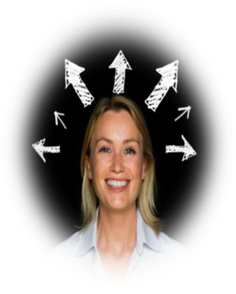
PEOPLE CENTRIC FRAMEWORK
Censydiam…
… Provides Innovation Norway with a compass on how they can connect holiday abroad with these deeper human motivations
NEEDS
&
ASPIRATIONS
JOURNEY TO MY EXTREMES
JOURNEY TO MY INNER HARMONY
HOLIDAY ABROAD IS: A journey to arrive at myself
JOURNEY TO MY ANTICI-PATED EGO
JOURNEY TO MY CULTURAL SURROUND-ING
JOURNEY TO MY DIFFERENT ME
JOURNEY TO MY ROOTS

Slide 27
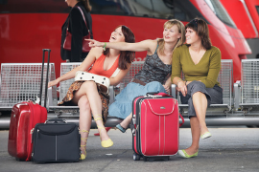
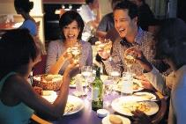
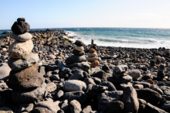
Journey to my inner harmony
  Holidays are sprinkling me with different light impressions, connect me to other people and let me completely enjoy myself. For my holidays, atmosphere is key: a warm climate, light-hearted environment and no stress are most important. I strive for harmony and balance, calming down and to fully relax: this can be achieved through varied activities, fun and relaxing. Most of all, I enjoy the community feeling when together with friends, relatives or my partner – however, I chose wisely who will accompany me on my holiday in order to achieve the perfect harmony.
  Shift of meaning of holiday abroad:
  The goal of holidays has shifted and intensified: holidays are primarily about finding my inner piece and harmony. Further-more, the demands have increased when it comes to the ideal holiday.
  Therefore, atmosphere is still crucial and the basis for such a holiday
“I remember my first holiday in Brazil. We met people, they had a VW bus and for little money they took us to places which you will not reach as a tourist, lonely beaches etc. It was so much fun. We caught fish and ate it at the beach.”

Slide 28
Type of holiday - behavior/ features:
Holidays are all about finding happy moments, where oneself can fully unfold and indulge
Especially other people, such as friends, family or new acquaintances can contribute to those moments of joy, e.g. unfolding in a deep and inspiring conversation, enjoy a glass of whine together, locals showing off-the-beaten-path locations
A harmonic holiday includes a great atmosphere: good weather, good food, light and different activities to free one’s mind, carefreeness on-site (e.g. through pre-booked hotel), having as little stress as possible, spending time with each other
The key is a balance of relaxing and active elements which contributes to the all-round well-being; relaxing alone is not ideal.
Food is a connecting element: one loves the sociable and relaxed atmosphere of eating/ sharing food with others, to get to know foreign recipes.
Spending time with family, including little kids, in family hotel – where they do not need to take care of anything
Functional characteristics
Nice weather, no rain
Perfect balance of relaxation and activities
Spending time with loved ones
High service-orientation
quality hotel room
Social Identity
Spontaneous
Positive-thinking
Harmonic
Freedom-loving
Being very social
Emotional Benefits
Spending time with loved ones
Enjoy the time as friends or as a family together
Have fun together, do activities and relax together
Personality
Light
Positive, friendly
Easy-going
Balanced
Warm-hearted
Open-minded
Uncomplicated

Slide 29
Occasions / holiday moments
Enjoying a glass of whine
Having a good conversation
Enjoying a good meal
Enjoying the sun/ good weather
Having a walk in nature
Enjoying the experience of a broad view from a top of a mountain
In general, great variety of moments that differ from individual to individual – however, it is about the sole moment of pure joy
Ideal experience
Mediterranean, lively, warm-hearted and outgoing atmosphere/ culture – weather stability is crucial, but no need for ongoing sunshine, as long as it is not raining
Choosing a destination (e.g. Asia) that is known for its uncomplicated, open-minded and care-free lifestyle.
Families: holiday in a family hotel, on a family farm etc.
Friends: enjoying a city-trip, wellness-weekend or short get-away together.
“Her typical holiday moment is sitting at the lake with a nice drink, nice food and to talk about everything and anything.
“He likes to snorkel or doing light sporty activities. He enjoys having a nice dinner in the evening, even without kids. Could be that he sends them shopping so he has half a day off.”

Slide 30
Product qualities: what am I looking for?
I want a holiday that has the right balance of relaxation and activities and that is best enjoyed with friends or a partner.
Social Identity; how does it reflect it upon me?
I am spontaneous, positive-thinking, harmonic, freedom-loving and a very social person.
Emotional benefits; what should it give me?
It should give me quality time with my loved ones, giving me a basis to enjoy the time and do fun things together.
Personality; what should holidays stand for?
Holidays should be a light- and warm-hearted, positive, friendly and uncomplicated get away.

Slide 31
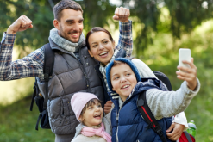
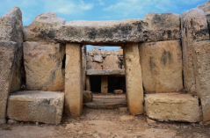
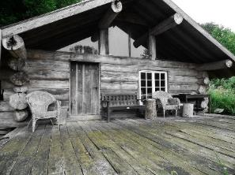
Journey to my cultural surrounding
  Holidays is not only about me, but mainly about others and my surroundings. I am okay with leaving at home all distracting things in order to be completely focused. In my holidays, I am modest, put my needs aside and adapt to my surrounding – only when everyone is happy, I am happy as well.
  Shift of meaning of holiday abroad:
  Holidays are not only to intensify the relationship with others, but also to fully dive into the foreign culture and connect with it.
  This motivation has become more intense as demands rise: the individual is less in focus and others (e.g. kids) are more important – the key is to make the best holidays for everyone and to meet everyone’s needs
  The home is not the castle anymore: even more, cutting oneself down to minimalistic equipment increases the concentration to the important things – myself, my family, my surrounding
“It’s the typical family holiday. We discuss what we are going to do today or tomorrow. Even if she’s not really up for it, she goes along.”

Slide 32
Type of holiday - behaviour/ features:
Holidays that promise a varied, eventful and entertaining character, which can be linked to:
  Nature and culture → trips to getting to know local culture and nature to its fullest.
  Entertainment → leisure/ amusement parks, sightseeing + shopping, to please each of the fellow travellers.
  Accommodation can be minimalistic and contain only the most important/ needed things – frills or things that distract are not wished
  Activities should meet everyone’s needs. If children/ partner/ friends are present, those needs are more important than own needs.
  Safety and comfort → especially family with children long for a safe refuge they can trust
Functional characteristics
Secure refuge
Variation of offers
Minimalistic equipment
Comforting atmosphere
Social Identity
Selfless
Empathic
Caring
Curious
Tolerant
Emotional Benefits
Bonding with family and/or culture
Withdrawing myself and my needs to increase the happiness of all
Withdrawing myself to fully adapt to the culture and to let it work on me
Personality
Secure
Welcoming
Plains
Diverse/ culturally rich

Slide 33
Occasions / holiday moments
Going on a hiking trip with buddies
Being in a remote cabin in the woods
Visit a museum/ cathedral/ monument
Having a great day at the center park with my family, seeing my kids laugh
Enjoying a local drink on a local bar – getting to know local people
Explore the surroundings
Ideal experience
Time/ place that allows to share activities together: destination provides a varied offer of different activities (for different age groups)
Surrounding needs to be trusted, country should not be too exotic
For families, package holidays or center parks offer the needed amount of security and carefreeness
For travelers with no children, rich culture is most enticing
“Going out and having a drink, preferably in locations with a lot of locals. I am interested in the people.”
“In holidays, I used to have my kids with me. Now I want to see cities and countries, getting to know people to learn who they are.“
“Trying out something new. You have other countries and other traditions. Something that is absurd for us is normal for them. It’s about trying out these traditions.“
“I have a 2-year-old daughter, we always pay attention that we know our way around, speak the language etc.”

Slide 34
Product qualities: what am I looking for?
I am looking for a basic and yet secure refuge for me and my family. It should give me a comforting atmosphere.
Social Identity; how does it reflect it upon me?
I am a person that feels most comfortable when others are happy because I care for my family and for the life that is surrounding us. I am selfless, caring and tolerant, but also curious and empathic.
Emotional benefits; what should it give me?
I want to bond with my family and/or my surroundings. It should give me the possibility to make everyone in my family happy.
Personality; what should holidays stand for?
The holiday should be culturally rich and diverse, but also secure, welcoming and plain in order to fully focus and not be distracted by other things.

Slide 35
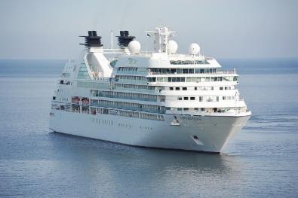
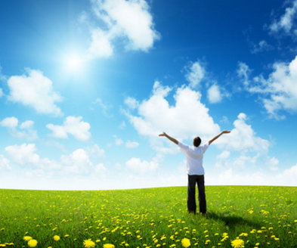
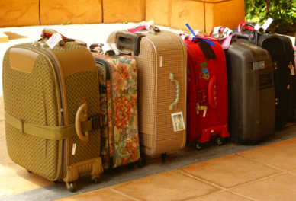
Journey to my roots
  Holiday can only be relaxing for me when I have taken care of everything: I do not like surprises and want to be prepared for every situation possible. Only when I have secured my surrounding, I can fully let myself go and enjoy my holidays. Holiday is about satisfying my basic needs. Holiday also means to put myself on a rest and not being responsible.
  Shift of meaning of holiday abroad:
  The strive for comfort and carefreeness is still present
  However, once this feeling is established, they are open to visit exotic places – but always from a safe distance and with not too much adventure or even risks
“Everything is planned, in order. She likes that. She also needs that in her holidays. A little bit of untidiness really annoys her.“

Slide 36
Type of holiday - behaviour/ features:
When preparing holidays, the basis has to be set: they need a “safe harbor” where one can return to and with which one feels secure and comfortable
From that point, one can enjoy to see the world and are open for any destination – as long as one can return to the safe harbor and it is not too exotic and stressful
When in holidays, protection from surprises is key: by taking an umbrella, shoes for any occasion or even the iron, one can fight any circumstance that could not be foreseen
Protection and safety also comes up when destination radiates something homelike and known and culturally close (to Germany)
Guided tours and trips are mostly preferred by this segment as they offer interesting sights without danger
Sightseeing and tourist spots are accepted and expected. No need to go off the beaten path or avoid other tourists as they are always a sign of safety.
Functional characteristics
All-inclusive
No surprises
High service-orientation
Above average quality standards
Social Identity
Prepared
Demanding
Frugal
In the need for relaxation
Emotional Benefits
Feeling of being safe
Happy with standard/ mainstream program
Need a safe harbour from where they can explore the whole world
Personality
Calm
Privacy oriented
Protective
Organized
Cozy

Slide 37
Occasions / holiday moments
Enjoying the sunset on a cruise
Enjoying city trips and returning to a hotel in the evening
Going out to eat instead of cooking
Trying out nice food that tastes good, but is not too exotic
Bringing souvenirs that lets the person relive the moment and focus on the bright side of the holiday
Bringing different pairs of shoes to be protected from any grounds and weathers
Taking some snapshots from tourist attractions
Ideal experience
Going on a long cruise which aims at a lot of countries, even exotic countries that the person can enjoy
The ship is the steady place where he/she can return to without being forced to stay in the same location – as he/she would like to see the world, but needs her calm refuge
This person also enjoys packaged all-inclusive holidays from which he/she can enjoy daily trips to cities, cultural sites or the beach
Guided tours are also a common means for exploring the surroundings
“Food has to be right. If not, I am in a bad mood. I once had a holiday where there was no Cola, no Fanta, only syrup. I had to go to the supermarket to get my stuff.

Slide 38
Product qualities: what am I looking for?
I am looking for an all-inclusive holiday that can give me all the comfort I need. I need high service orientation and high quality standards.
Social Identity; how does it reflect it upon me?
I am prepared for every situation, but also demanding, even a bit frugal. But most of all, I am in need for relaxation.
Emotional benefits; what should it give me?
I want a safe refuge where I can always return to and that gives me peace and comfort. Only then I can fully enjoy my holidays and explore the world.
Personality; what should the holiday stand for?
The holiday should stand for calmness, protection, organization and coziness.

Slide 39
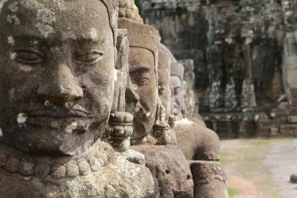
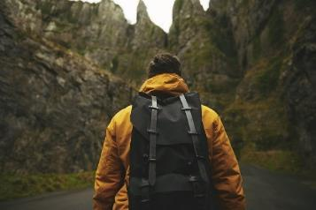
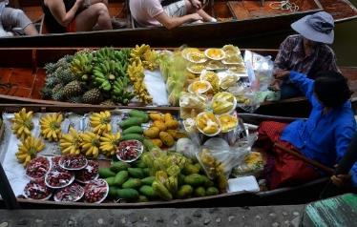
Journey to my different me
  Holidays are about giving me educational input and growing intellectually from it and bringing me to new ideas. The ideal holiday is when I forget the passwords of my computer at work and come home with new ideas, new knowledge and many cultural impressions. I appreciate myself by putting myself and my wellbeing in the centre.
  No shift in the motivation has been found.
“He wants to get new impressions, new experiences. He does not want to be one among 37.000 German tourists.“

Slide 40
Type of holiday - behavior/ features:
Holiday is about the enhancing oneself educationally and intellectually by getting to know the culture, food etc.
Authenticity is important: meeting locals, eating local food, go off the beaten track to discover true and authentic culture – furthermore, mere tourist spots are not interesting as, for them, authenticity cannot be found there
This motivation is especially developed for the culture and food segment: culture and food is a means to experience the country in an authentic way
Mostly individual holidays that center around own appreciation and getting to know oneself from a new perspective
The goal is to enhance own personality and pick up new ideas for everyday life or the job
Trips that are not aiming at the usual tourist spots, but seek for unusual destinations such as smaller cities (instead of large cities, capitals) or countries next to tourist magnets (e.g. Laos instead of Thailand)
The aim of the holiday is to reward oneself by doing something special/ enjoy special meals/ a special program
Functional characteristics
Authentic and local
Pure
No mass tourism
Modular
Provide insider tips
Social Identity
Open-minded
Offbeat
Have wide interests
Cultivated
Emotional Benefits
Enhancing myself by deep-diving into local culture and cuisine
Finding pure relaxation by forgetting my life home
Bring my personality to life with a special trip
Personality
Demanding
Enhancing
Surprising
Authentic
Unusual
Individual

Slide 41
Occasions / holiday moments
Have a deeper look at the streets around the usual attractions
Enjoying a great local meal
Taking the bus out of the city to see the surroundings
Visiting a local village
Having a look at buildings with an interesting architecture
Ideal experience
Chosing an interesting, culture-rich and rather unknown destination for the holidays
Diving into the local culture and food and having conversations with the locals
Destination is very interesting, but no tourist hotspot
Holidays are very dynamic and self-determined and led by the feeling and mind of the traveller
“Food is of importance. It has to be delicious and plenty.“
“He might be a bit naïve, but in his inner core he might be a narcissist who looks after self-gratification and who wants to fall in love again and again.“
“I think it’s a huge enrichment to go to other countries, getting to know and reflecting mentalities and cultural characteristics.“

Slide 42
Product qualities: what am I looking for?
I am looking for places which are pure and authentic and have not been overrun by tourists. I want to learn new things about this world.
Social Identity; how does it reflect it upon me?
I am striving for authentic experiences, fully diving into a different culture. I am very interested and versatile.
Emotional benefits; what should it give me?
Enhancing myself with new experiences and learnings. My holidays are a reward from my daily work and should reflect my personality.
Personality; what should holidays stand for?
Holidays should be unusual and individual. It should be demanding and enriching and bring me further as a person.

Slide 43
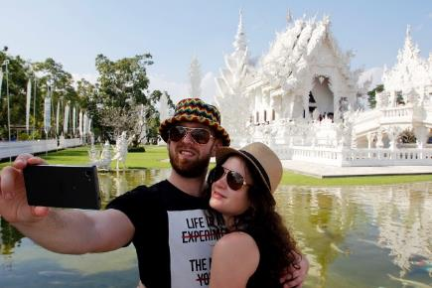
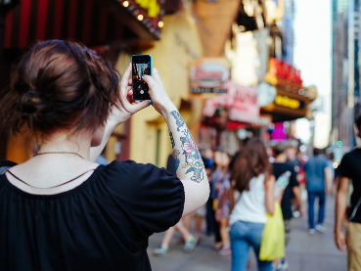
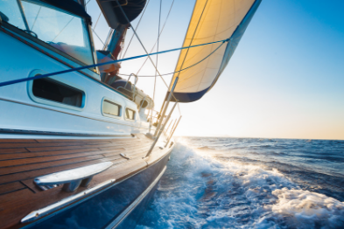
Journey to my anticipated ego
  Holiday means for me to go on a little ego trip and to fully indulge into everything I can get. Through my surroundings, friends and acquaintances I know what is in right now and I have to keep up with it to show I am a worldly person and have already made a lot of experiences.
  Shift of meaning of holiday abroad:
  This motivation did not yet exist in the previous research, but we found that through the evolving social pressure initiated by social media, holidays more and more go into the purple motivation, especially for young people who like to spend money on holidays to show that they are a very interesting person.
“He is very confident with himself, enjoys his life and worked hard for it. He has the one or other status symbol, not to show off, but for the inner satisfaction and to say, I can afford that.”

Slide 44
Type of holiday - behaviour/ features:
As holidays are a status symbol and need to fulfill the social pressure, one is exposed to, it should contain something worthwhile and interesting: e.g. an exotic location which is not on the radar of other tourists, a very good meal, inspiring pictures that were taken and posted on Instagram – it is likely that this person goes after recommendations from friends he/she trusts in terms of taste and style
All aspects of holidays that are worth mentioning (a beautiful landscape, authentic food, a nice purchase) are shared on social media – the respect and recognition is a confirmation
Holidays can be spontaneous and sometimes do not need big planning, as long as they are individual and non-touristy
High quality and even luxury is important – price does not necessarily play a role, especially since it is all about rewarding oneself
Holidays sometimes have to be exaggerated and can intervene with the everyday life, e.g. buying a holiday home for the weekends, purchasing an apartment in Dubai, buying a house in the US
Functional characteristics
Hip and aspiring
Impressive
One of a kind
Uplifted
Social Identity
Worldly
Open-minded
Cool and interesting
Emotional Benefits
Satisfaction about the choice
Confidence of oneself
Rewarding oneself
Personality
High quality
Extravagant
Exclusive

Slide 45
Occasions / holiday moments
Having a luxurious, delicious and big meal
Going on a holiday trip very spontaneous
Going out at night and have some drinks
Have nothing planned
Taking a holiday that is only for oneself (e.g. “Mama-holiday” with no kids)
Doing extravagant sports, e.g. wind surfing, sailing, land sailing
Ideal experience
Going on a spontaneous and individual trip to a destination that is not on everyone’s radar
Everything (accommodation, food etc.) is of high quality, but can be changed if not liked
Going on an adventurous trip and enjoying impressive views that will be shared on social media later
“It is really nice when you come back to Germany and then you see a TV feature on travelling and then you think, ah, you have been there. That’s enriching.“
“I don’t like packaged holidays because I want to decide where I go and what I do.“
“If I don’t like a hotel, I’ll simply take another one.“

Slide 46
Product qualities: what am I looking for?
I am looking for a hip and aspiring get away where I can impress my buddies at home and on social media.
Social Identity; how does it reflect it upon me?
I am a very worldly, open-minded and cool person because I always chose interesting locations and have the nicest pictures of them.
Emotional benefits; what should it give me?
Satisfaction and confidence that I made a right choice. To reward myself that I work hard.
Personality; what should holidays stand for?
Extravagance and high quality, unusual and exclusive.

Slide 47
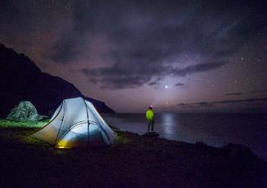
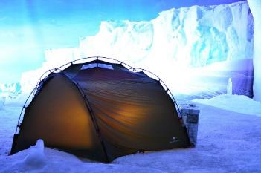
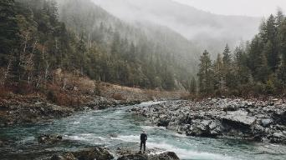
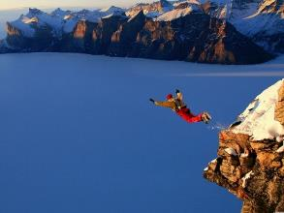
Journey to my extremes
  Holiday means overcoming cultural boundaries and confronting myself with a cultural shock. The goal is to take myself out of my daily environment and put myself into an extreme, raw and mostly natural context.
  It’s all about getting to know myself by exposing myself to adrenaline, cultural shock, new point of views, ideas and inspirations where I can draw from beyond my holidays.
  Shift of meaning of holiday abroad:
  Travelling/ holidays has intensified. It is not anymore about solely enjoying total freedom, to experience the unpredictable, to escape from the modernized and civilized world and feel the raw taste, but about to shock the inner core.
“For him, it’s a cultural shock. He has no idea about nature, farms and animals. But since he lives in a big city, he wants something completely different.

Slide 48
Type of holiday - behaviour/ features:
Trips that include core-shaking elements, e.g. getting to know a completely new culture, overcoming own boundaries
Challenging and active holidays and trips are crucial – physical as well as psychological barriers need to be overcome
Experience the intensity of the destination: meeting the origins, raw nature and culture/ Stay regional: want to fully incorporate with local culture (e.g. local food, local guides, language, mentality, history)
Extreme sports, experiences, e.g. survival trip in wilderness, safari, helicopter ride
Like to be challenged and inspired by special and daring activities, e.g. farm work, getting to know a completely new culture.
Aiming for authenticity: rough and pure countries, no mass-tourism, want to experience true character of the destination
Accommodation can be unconventional as well, e.g. sleeping in a tent or bivouac
Ideal state is to forget about own life for a certain time: to fully dive into the new adventure and culture and to not think about own life
Getting new inspiration for life, job etc. – need outside point of view to go on with own life → trip to self-discovery
Functional characteristics
Raw and pure, untouched
Impressive nature
Off the beat tracks
No tourist infrastructure
Social Identity
Curious and courageous
Adventure-loving and daring
Aiming for the unknown
Emotional Benefits
Feeling the cultural shock to the senses, as if taking a cold shower
Getting new inspiration for everyday life
Getting to know oneself through different perspectives
Personality
Raw
Authentic
Core-shocking

Slide 49
Occasions / holiday moments
Being alone in the wilderness
Going on a safari
Going on a helicopter ride
Doing extreme sports
Staying overnight in a tent or bivouac
Going snorkelling/ diving
Helping out on a farm
Going snorkelling with the son
Riding a jet ski
Ideal experience
Planning an individual trip that is full of exciting features that have never been tried before: e.g. going on a long backpacking/ hiking trip, trying out a new and exciting sport
The holiday is far away from one’s own life and has no touchpoints
“I could imagine helping on a mountain farm. You can dive into their life and getting to know it. There, you certainly are far away from your own life.”
“When he goes on holidays, he goes alone into the wilderness. He takes a helicopter to the Rocky Mountains, being abandoned there and then he fights his way 5 days through the jungle, through the mountains into the valley.”

Slide 50
Product qualities: what am I looking for?
I am looking for the raw and authentic experience that may shock my inner core and brings me forward as a person and inspires me for my life.
Social Identity; how does it reflect it upon me?
I am a curious, adventure-loving person that has no problem with going into the unknown.
Emotional benefits; what should it give me?
It should give me new inspiration for my everyday life. Through the shock I want to get to know myself from a different perspective.
Personality; what should it (the product or the brand) stand for?
Raw, authentic and core-shocking experiences that refocuses me.

Slide 51
Journey across my borders
  This motivation is very excessive and borderlining. It was not present in this research. It expresses holidays without limits and, logically, it is the opposite of black. It makes sense in such a way that holidays are rotating around these extremes, but are never one of them – as pure routine basically mean to not go on holidays and limitless are a theoretical basis. Holidays per se always contain some sort of structure and cannot ever go without them, e.g. even a plane flight is seen as structure-giving or a car ride which forces you to stop for gas, hence you will need money for it. Therefore, all 6 other motivations are always depending on a certain level of orange and black motivations.

Slide 52
Journey to my routine
  The black motivation is not a mere motivation as it symbolizes control and routine – aspirations that are not per se a part of holidays because it symbolizes motivations that one want to break out in his/ her holiday.
  Furthermore, we see the black motivation as a basis and standard of every motivation which differs from person to person. It serves as a “safety net” and can have different expressions – e.g. from having enough money to knowing where to sleep the next night to going on a package holiday.

Slide 53
The ideal HOLIDAY ABROAD
53
© 2016 Ipsos.

Slide 54
... Is in the center of gravity
The ideal holiday abroad
GREEN/ RED/ PURPLE ELEMENTS:
Broadening own horizon: diving into new cultures, learn something new
Going over my own borders and taking home new inspiration and ideas
Learning something new about myself
Focus on me: spending time for me, take care of me
Rewarding oneself for all the work and responsibility with special trips and moments
IDEAL HOLIDAY
YELLOW ELEMENTS:
Comfortable atmosphere: beauty of nature, pure wellbeing, relaxing accommodation
Sharing experiences with loved ones
General feeling of warmth: nice weather, but also: warmth from great memories
Freedom: doing whatever I please, going my own way and do not let myself dictate by others
Light-hearted and exciting activities
JOURNEY TO MY EXTREMES
JOURNEY TO MY INNER HARMONY
HOLIDAY ABROAD IS: A Journey arrive at myself
JOURNEY TO MY ANTICI-PATED EGO
JOURNEY TO MY CULTURAL SURROUND-ING
JOURNEY TO MY DIFFERENT ME
JOURNEY TO MY ROOTS
On the basis: breaking out of the daily routine, completely leave own life behind and dive into a different world in order to pick up new inspiration, ideas and moments that form my identity.

Slide 55
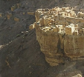

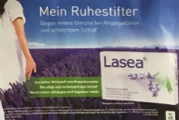





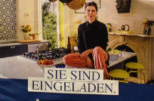


Quotes and images from respondents
The ideal holiday abroad
“Quietness, complete silence, reviving, hearing no sound.”
“The lake, the water, a nice landscape, nice weather, sunshine, having a carefree day .”
“I would have loved to travel to Kenia, to get to know different people, how they live, their food.”
“Getting out my environment, finding the way to myself, not getting lead the way by others, not letting myself dictate things like from by boss.”
“Riding camels, Saudi Arabia, getting to know other cultures.”
“Having no time pressure or appointments. Feeling of freedom. Only living for the moment, just as I please.”
“A little bit of culture, climbing in the mountains, a little fun, nature.”
“Being welcomed with open arms, hospitality.”
Pictures taken from collage „the ideal holiday“

Slide 56
Understanding competetive markets
56
© 2016 Ipsos.

Slide 57

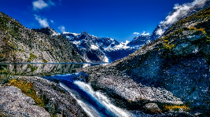
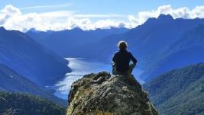
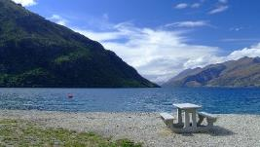
NEW ZEALAND – the ideal world
Understanding competitive markets
Virginal and untouched: nature that spread contemplative calm, sustainable agriculture, immersing in another world → image of New Zealand as a dream, floating landscape where everything is perfect
Emigrate country: far distance evokes the dream of leaving own life behind and have a new start and fully immersive into nature → image of natural dropouts
Raw, yet honest and integrative: possessive atmosphere, embracing landscapes, no feeling of being an outcast → image of feeling home in an instant
“You hear nothing negative about New Zealand. That is enticing.”
Attention: New Zealand no competitor per se – is not ranged into Scandinavian countries and has different standing, also in terms of accessibility and aspirations

Slide 58

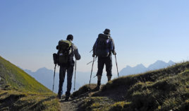
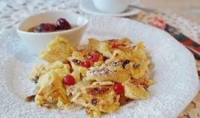
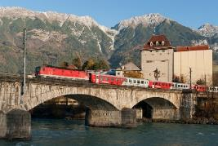
AUSTRIA – lighthearted and for everyone
Understanding competitive markets
Versatile and interesting: due to the Alps, different activities can be done (hiking, skiing, climbing) and therefore is a destination for whole family → Austria as a country that saps interesting image from existence of its mountains
“Austria was lucky because it has mountains. Otherwise it would be boring.”
Cultural and traditional with dark history: special food (Kaiserschmarrn, Schwammerln), Mozartkugeln, Sissi, Mozart, Schloss am Wörthersee (TV-show), however: dark history and right-winged politics are dulling the image
Easy accessibility: “around the corner”, easily accessible by car, therefore higher chances for spontaneous visits, especially for Southern Germany, speak the same language → Closeness to (Southern) Germany in terms of distance and tradition diminish image of Austria as pure holiday country

Slide 59
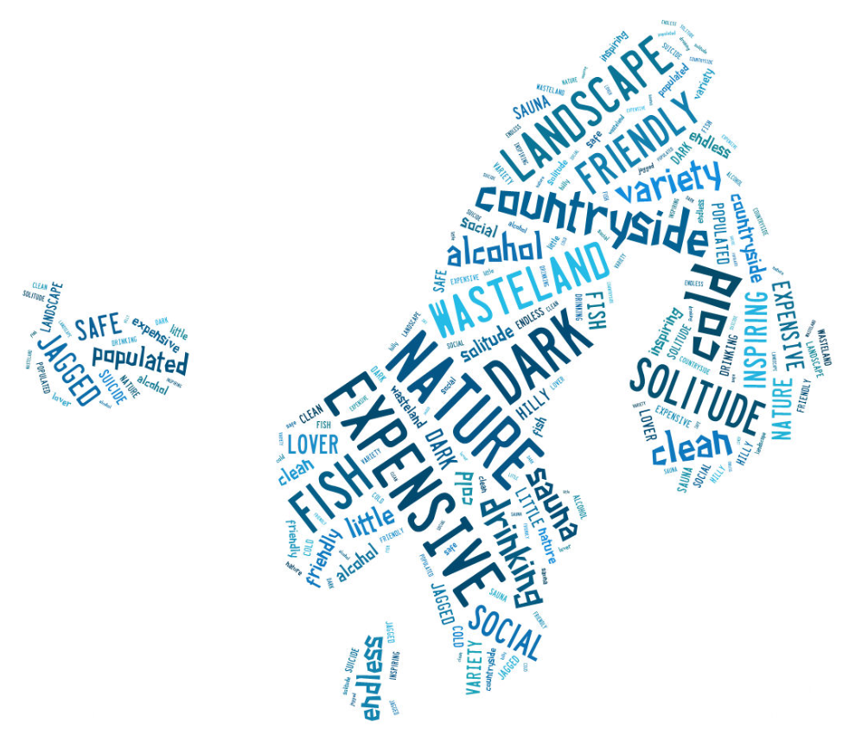
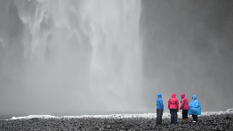
Northern Countries - Scandinavia
Understanding Competitive Markets
Scandinavia = one country
Most hardly distinguish between countries in Scandinavia. However, some countries are more outstanding because of broader knowledge on natural attractions (e.g. Iceland) and culture (e.g. Sweden).
Scandinavia = Nature
Impressive nature is USP. Versatility and spectacles (e.g. volcanos, geysers, glaciers) that cannot barely be found elsewhere.
City ≠ Land
Mostly known for its landscape and nature, less for cities. Furthermore, a big difference is being made between those.
People = friendly but sad
Inhabitants perceived as friendly, but distant. Image as heavy drinkers with high suicide rate.
“I would lump all Scandinavian countries together. When I think of Scandinavia, I always think of a package.”

Slide 60
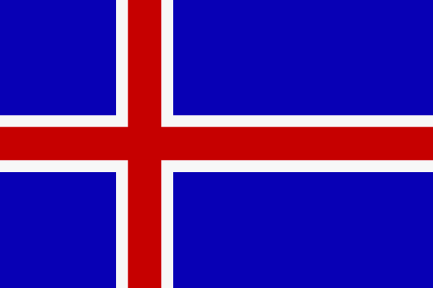
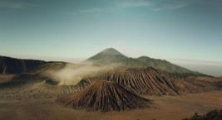
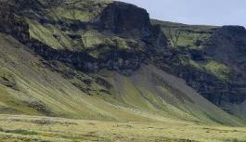
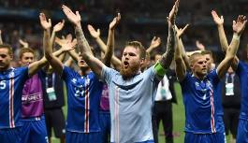
ICELAND – country with a dark captivation
Understanding competitive markets
Versatile and raw landscapes: volcanos, hot springs, beautiful landscapes, northern lights, country of fire and ice → image of a country with strong contrasts
Torn between fascination and subliminal fear: strange sounding language, mysterious, far away, lonely island, isolated, but also: different culture, mentality; in general, Iceland is perceived as most away from cultivation → image of raw and animal-killing men, lack of universities and knowledge and danger of incest
“An Icelander works with his hands and not with machines, kills animals so he can eat them.”
Cultural input via television: ash cloud after volcano eruption hindered air traffic, likeable appearance of Icelandic soccer team at European soccer championship (memory of their ‘rutting call’)

Slide 61


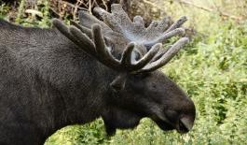
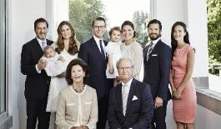
SWEDEN – most modern and cultivated country
Understanding competitive markets
Modern and cultivated: high quality of living, sustainable lifestyle, good education system, young and bright people that speak fluent English → image of a country that is similar to Germany
“I think Swedish people take more care about their nature and environment, their animals, flora and fauna, more than Germans.”
Comfortable nature: elks, salmon as well as tundra give and image of a comfortable, but not too exciting nature and wildlife
Culturally integrated in German mind-set: Abba, Swedish royal family, IKEA
“Swedish is more modern and less brachial and raw than the other Nordic countries.”

Slide 62




FINLAND – sparse landscape fits meager image
Understanding competitive markets
Little knowledge about land and people: origin of Santa Claus (Lapland) as stranger that appears in a dark time of the year, but little knowledge about country in general → Finland as most exotic and strange country in Scandinavia
Sparse and snowy landscape: image of Finland mostly exist of endless landscapes covered in snow and with minimalism of life
Dark and depressing: short days and no lights in winter, image of country with highest suicide rate, Finnish sauna → forms image of Finnish person as melancholic, but friendly being
“They have summer and winter solstice where you have a few months of light or complete darkness. High suicide rate.”

Slide 63
Locating the countries within the Censydiam wheel
Understanding competitive markets
JOURNEY TO MY EXTREMES
JOURNEY TO MY INNER HARMONY
FINLAND
ICELAND
HOLIDAY ABROAD IS: A Journey arrive at myself
JOURNEY TO MY ANTICI-PATED EGO
JOURNEY TO MY CULTURAL SURROUND-ING
- Austria and Sweden closest to European culture and knowledge
- Most away from European culture and safety: exotic language, raw nature, extremes
SWEDEN
JOURNEY TO MY DIFFERENT ME
JOURNEY TO MY ROOTS
AUSTRIA
Location of countries done without card sort exercise

Slide 64
Norway as a holiday destination
64
© 2016 Ipsos.

Slide 65

General perceptions of Norway – Some words…
Norway as a holiday destination
Norway has few distinctive characteristics that respondents could relate to
Since most think of „Scandinavia“ as a package, it was hard to keep countries apart
Even, some characteristics were mixed (e.g. respondents claiming that Eurovision Song Context 2006 winner was Norway with Lordi, although it was Finland)
There was a broad lack of cultural references as well as clear USPs for Norway and what exactly distinguishes this country from other Scandinavian countries except for being colder and darker than Sweden
It was known among respondents that Hurtigrouten regularly travel the fjords of Norway
Pictures taken from collages made in group of „image Norway“

Slide 66








General perceptions of Norway
Norway as a holiday destination
VARIETY AND PURITY OF NATURE
Nature related to: fjords, water, glaciers, fish (salmon)
Wilderness: adventure, but: survival of the fittest
Health: fresh and pure air
Purity: vast and extensive stretches of land
LONELINESS, ISOLATION AND MYSTICISM
Living happens mostly at home, no one is seen outside
Vast landscape, towns are in far distances, not close to each other → car for exploring is needed
Image of little infrastructure: what to do in case of car breakdown etc.
Stories of trolls and elves give the country some mysticism, vastness of countryside give feeling of powerlessness, there is a lot someone does not see
“Norway is tight because of the fjords, but still big. Not extensive, but hilly, jagged and exciting. More for the eye, you cannot get enough.”
Pictures taken from collages made in group of „image Norway“

Slide 67






General perceptions of Norway
Norway as a holiday destination
FEELING OF TOGETHERNESS
Live very homely and cozy
Life takes place at home
Are family people and do something together
Have many supplies, know how to survive long winters
However, also draws image of people who are for themselves, are not open to strangers, even fear strangers and foreigners and reject them
MINIMAL, RUDIMENTARY WAY OF LIVING
Image of fish- and meat-eaters that catch and hunt their food on their own and fry over bonfire
Unveils a barbaric, stone aged image of people that supply themselves
Image of wilderness and survival: pristine and grounded
“Norwegians live from their elks and fishing, they live relatively basic on the land.”
Pictures taken from collages made in group of „image Norway“

Slide 68

General perceptions of Norway
Norway as a holiday destination
LACK OF (POP)-CULTURAL REFERENCES
No memories of books or movies that come from Norway
No memories of famous musicians or sportspeople (only one person could relate to Norway as a heavy metal country, e.g. Dimmu Borgir)
Rather abstract associations to mystified history, e.g. legends, trolls, Vikings with no clear facts
Even food is quite mysterious and solely limited to meat and fish
Oslo as capital is known and also its offer of museums, but emotional distance between Oslo and its belonging to Norway
“You can hardly relate to Norway. There are no stories, no movies. You have seen a thousand Hollywood movies about America. New Zealand is present in a movie. I do not have any movie references for Norway. The only relation I have cruises through fjords, but this is only for old people.”
Pictures taken from collages made in group of „image Norway“

Slide 69
Present barriers that keeps tourist from going to Norway
Norway as a holiday destination
-
Clear USP is missing: although raw and vast nature is seen as plus, it is not seen as something that only Norway can offer. Furthermore, other countries (e.g. New Zealand, Iceland) seem to have to offer even more than “just nature”
Weather unpredictability: a strong barrier for most (especially those who only go on a “big” summer holiday once a year) as weather is a crucial factor why a location is chosen. In the mind of many, Norway is very cold and dark – summer is not prevalent with warm and long days.
Expensive: Holidays in Norway are only for those who can afford it – food and alcohol is perceived to be expensive because most of it has to be imported; furthermore it’s perceived to be necessary to rent a car in order to get more into the nature
Not suitable for families: weather extremes, costs and offer of only rather action-rich/ one-sided activities take away the perception of being family-friendly
“You could travel there, but what do you have in Norway that you don’t also have in Sweden or Finland?”
“I don’t think it would be a nice holiday in winter. In summer, when it’s 30 degrees here, you have 20, 21 degrees there. Perfect to explore the city and nature.”
“We should have done it before the kids or after them, when they are going their own ways. Now we have the issues: only 2 weeks of time, weather has to be good otherwise it’s no fun. And for that, it’s too much money, we only do holidays once a year.”

Slide 70
Hopes and aspirations towards Norway
Norway as a holiday destination
City trip
Couple holidays
Cultural holidays
Active holidays
Wellness/ relax holidays
(Extended) weekend trip
Mother-daughter/ father-son holidays
Getting to know a new way of living, getting to know the (perceived) rudimentary living of Norway‘s inhabitants
However: perception, that inhabitants are less tangible and open for tourists
But: possibilities for agriculture holidays, Airbnb, deep-diving into living culture and lifestyle, visiting museums/ the opera in Oslo
Winter sport holidays
Focusing on the me-moment and enhancing the feeling of coziness, relaxation
Enjoying nature, extreme opposites of cold and warmth
Possibilities: spa-holidays, sauna, recreation/ recovery, immersing in the healing power of fresh air and pure nature
Wellness/ relaxing holidays not yet top of mind
Short holiday
Holidays with close friends
Being in unity with nature and feeling its power
Activities such as: snowboarding, skiing, snowmobile, cross-country skiing, sled-dog, going hunting, collecting fungi, watching reindeer,
Mostly connected to capital city Oslo as country is too big and for nature, one has to have more time
Oslo offers a variety of possibilities for weekend-get-away such as culture, food, relaxation, shopping etc.
Perceived isolation and calm of Norway to be used as get-away for couples or family members, e.g. father-son-trip in wilderness, mother-daughter-retreat in cozy home

Slide 71

Norway is currently in the red motivation…
Norway as a holiday destination
JOURNEY TO MY EXTREMES
JOURNEY TO MY INNER HARMONY
Norway is red motivation:
Focus on adventure and life-changing experiences (testing extremes, coldness, mountains)
So far, “nature“ is no clear USP and adding to active, cultural and relaxation holidays
However: red motivation already prevalent for other (competitor) Scandinavian countries
NORWAY
HOLIDAY ABROAD IS: A Journey to myself/ arriving at myself
JOURNEY TO MY ANTICI-PATED EGO
JOURNEY TO MY CULTURAL SURROUND-ING
JOURNEY TO MY DIFFERENT ME
JOURNEY TO MY ROOTS

Slide 72
… but could expand into the purple, green and blue motivation
Norway as a holiday destination
However, Norway can expand in the blue segment:
feeling of being on a halt, coldness forces stillness
The image of Norway transports no USP or distinguishing elements that other countries not already offer
Emphasizing the coziness of the moment and the withdrawal from the outside world
However, a unique position could be achieved when moving to the purple motivation…:
Especially for younger tourists, Norway could be enticing as a country no one else visits – no mass tourism yet, guarantee to be someone special when visiting this country
The purple motivation goes in line with perception of Norway being an expensive country: high quality offers and maximum of comfort in the raw nature (e.g. Hurtigrouten, luxury accommodations)
JOURNEY TO MY EXTREMES
JOURNEY TO MY INNER HARMONY
NORWAY
HOLIDAY ABROAD IS: A Journey to myself/ arriving at myself
JOURNEY TO MY ANTICI-PATED EGO
JOURNEY TO MY CULTURAL SURROUND-ING
… as well as to the green motivation:
Emphasizing of authenticity: “meet the locals” as challenge – image of distant nation that is hard to conquer
Exploring of real Norwegian culture and food that is more unique than anywhere else (because it is still unknown)
JOURNEY TO MY DIFFERENT ME
JOURNEY TO MY ROOTS
NORWAY
NORWAY

Slide 73
Outdoor activities, culture, Lohas and food
Norway as a holiday destination
73
© 2016 Ipsos.

Slide 74


Norway as the country of outdoor activities
Further analysis on segments
Norway perceived as an outdoor country per se: raw nature invites for adventurous outdoor experiences such as skiing, hiking, being in and experiencing nature, watching reindeer, going hunting, cooking over a bonfire
However, variety of activities is not known to everyone and mostly for those who actively seek for active rather than relaxing holidays
Norway as a caravan holiday destination: due to large distances, wilderness comes more alive when experiencing in caravan – romantic association of an adventurous, independent holiday
Norway = winter sports: especially due to the strong associations with winter, snow and cold, Norway is a country were all sorts of winter sports can be done – however, this puts Norway on a list with many competitors, e.g. Austria, France, Czech Republic
The image of Norway of being a cold and icy country (=standstill), contradicts the need for movement and development
Norway has to overcome that barrier and show that it can offer both active and relaxing holidays
Pictures taken from collages made in group of „image Norway“

Slide 75


In terms of culture, Norway still is a blind spot
Further analysis on segments
Culture is a, if not the most crucial part of holidays. Especially for city trips or faraway countries, there is a need to deep-dive into local culture and getting to know local people and learning about their culture and lifestyle.
In general, most cultural references remain in the dark for respondents: little is connected to Norway and references to books, movies or music are missing
Culture such as museum, getting to know national history, is mostly connected to Oslo
However, getting to know the way of living, is mostly connected to a “deep-dive” into the people’s lives that live in the country-side: there is still a very rudimentary image of country living which comes with some fascination –self-supporter, living in minimal cabins, hunting own meat and cooking over bonfire
However, as Norwegians are perceived as distant and isolated people, it is hard to imagine to be invited into their homes: here, cultural offers such as Agriculture (as known from Italy) or Airbnb would be an option for travellers to get to know people’s way of living
Pictures taken from collages made in group of „image Norway“

Slide 76

Sustainability is about restriction which is no desirable motivation
Further analysis on segments
Sustainable country: purity of living and nature gives impression that Norway are thoroughly nature lovers. They are believed to life in harmony with nature and therefore take good care of it
However, there is little knowledge about actual way of sustainable and healthy living – there is an image of Norwegians growing their own vegetables and hunting their own meat
Health/ caring about oneself is prevalent in holidays, wellness/ relaxing holidays, finding inner peace
BUT: sustainability always means restriction = restriction of consumption, restriction in terms of comfortability etc. → is the opposite of what one wants to do in holidays because it is all about rewarding, consumption and enjoying
“I do not want to dive deep into this. Normally, they have seals that proves sustainability which is enough for me. If they really behave that way or not, I don’t want to know when I am on holidays.”
“I would not look if the restaurants had eco certified fish, I would look if it tastes good.”
Two meanings of „sustainability“ in German:
Interestingly, some respondents referring „sustainable“ (German: nachhaltig) holidays as holidays which are so impactful that the memories last long after the holidays ended (German: nachhaltig, English: lasting)

Slide 77




Food in Norway is basic, but pure
Further analysis on segments
Food in Norway is broken down to the existence of fish and meat – it is perceived rather unilateral and less balanced, even some sort of barbaric as there is an image of Norwegians hunting their own food
As soil is perceived as cold and less fertile, it is believed that most vegetables and fruits have to be imported and therefore, are very expensive
No knowledge about special dishes or national food
However, due to natural and pristine way of living, food is perceived to be pure, healthy and of high quality, free of antibiotics and mostly made of happy animals with no factory farming (= “bio” quality)
“I’d say fish, but I do not know anything about the eating culture in Norway. Maybe also meat, self hunted.”
“Spain, Turkey, Italy – there I know what I can expect in terms of food. In Norway, I have no idea.”
Pictures taken from collages made in group of „image Norway“

Slide 78
Conclusions & recommendations
Norway as a holiday destination
78
© 2016 Ipsos.

Slide 79
Conclusion
Norway as a holiday destination
1.
Meaning of holiday has changed and revealed an ego shift in holidays abroad
From annual family holiday to the individual weekend get-away (from social point of view to a more egoistic point of view)
Development of different holiday types
From escape to salvation: travelling abroad to arrive at one’s own real identity and harmony
Detection of 6 holiday motivations (no black or orange motivation)
2.
Scandinavia is hard to keep apart, although countries itself differ mostly in terms of knowledge:
Iceland radiates dark captivation and is mostly known for its natural phenomena
Sweden is most known among respondents as a modern and cultivated country
Finland as rather “exotic” country with little knowledge – sparse landscape and meager image
3.
Norway is known for its pure and vast landscape, but for nothing more
Loneliness, isolation as well as cold and darkness is associated with it – however, it is also accompanied by mysticism as little knowledge exists about Norway
Norway has image of being a pristine, yet very social nation that is, however, rather distant and strange
However, there is a great lack of (pop-) cultural references that people could relate to
Barrier to travel to Norway is mostly because of the lack of a clear USP and the prejudice that it is a dark, cold and expensive country which is based on little knowledge about Norway itself.

Slide 80
Recommendations
Norway as a holiday destination
The image of Norway as a country with an intensive nature that allows people to come to terms with themselves should be emphasized.
Focusing on and communicating the nature and the possibilities of life-changing experiences
Emphasizing the coziness and possibility to withdrawal and self-exposure on a holiday in Norway
Transfer of knowledge to close general knowledge gaps.
Conquer especially trivial knowledge gaps that stuck in respondent’s minds: diversity of temperature (it’s not always cold in Norway) and seasons
Culture and food are still blind spots for respondents that need clarification and refinement to make it especially relevant for the green motivation, but to also increase knowledge about Norway in general
Lack of knowledge emphasizes exotic touch of country and underlines red motivation
Other Scandinavian countries do not necessarily have to act as competitors, but could be a springboard.
For example, by offering a “Scandinavian package” or tour that lets travelers get to know diversity of the countries at a glance – with the possibilities to come back for individual travels

Slide 81



Conclusion and recommendation
Norway as a holiday destination
Adapt communication about Norway
Taking clichés not too seriously and even play with them (e.g. see example from Finland)
Provide inspiring information on relevant platforms, e.g. Lufthansa magazine (high context fit as mostly such magazines are read during work or leisure trip → ideal time to dream about holidays) with insightful portrait or Facebook post containing a video with inspiring images that initially might not be related to Norway at first hand (e.g. see example which appeared in my Facebook timeline a few days after the focus groups)

Slide 82
2 directions of positioning
Recommendations
POSITIONING 1
POSITIONING 2
JOURNEY TO MY EXTREMES
JOURNEY TO MY INNER HARMONY
ICELAND
Purple & Green: Unique since it answers the ego-shift towards holidays abroad: Norway as the exotic side of Scandinavia with a different touch
Red & Blue: Unique through balanced combination of European coziness / cultivation and Scandinavian extremes / foreignness
NORWAY
FINLAND
HOLIDAY ABROAD IS: A Journey to myself/ arriving at myself
JOURNEY TO MY ANTICI-PATED EGO
JOURNEY TO MY CULTURAL SURROUND-ING
Position Norway as the land of extremes that is the best spot for the „real“ active holidays („Skiing can be done everywhere, but skiing in Norway is different“)
SWEDEN
Communicate unique and off-the-radar location to be more enticing
Emphasize Hurtigrouten-offer and special wellness and relax holidays to indulge and reward oneself
JOURNEY TO MY DIFFERENT ME
JOURNEY TO MY ROOTS
NORWAY
AUSTRIA
Unique possibility as blue is still less prevalent among competitor countries: turning Norway as an exotic country into a country for the annual family holiday that offers maximum of coziness, security and relaxation
Turn the cultural holidays into an authentic immersion with the locals by learning about their culture and their food – and expand own horizon
Norway has more cities than Oslo
NORWAY

Slide 83
Possibilities for different types of holidays
Recommendations
City trip
Couple holidays
Cultural holidays
Active holidays
Wellness/ relax holidays
(Extended) weekend trip
Father-son holidays
Especially important for green motivation: deep-diving into local culture on authentic level is key
Possibilities for agriculture holidays, Airbnb, deep-diving into living culture and lifestyle, visiting museums/ the opera in Oslo, but also smaller cities that are not yet in relevant set
Winter sport holidays
Mother-daughter holidays
Short holiday
Holidays with close friends
Relevant for red motivation: being in unity with nature and feeling its power
Activities such as: snowboarding, skiing, snowmobile, cross-country skiing, sled-dog, going hunting, collecting fungi, watching reindeer
Relevant for purple and blue motivation: focusing on me and giving me a reward, but also: establish feeling of safety and comfort
Possibilities: spa-holidays, sauna, recreation/ recovery, immersing in the healing power of fresh air and pure nature, mother-daughter-retreat in cozy home
Show that Oslo offers a variety of possibilities for weekend-get-away such as culture, food, relaxation, shopping etc.
But also: broaden the radar by adding the smaller cities to the relevant set
Relevant for red and blue motivation
Perceived rawness, isolation and calm of Norway to be used as get-away for couples or family members, e.g. father-son-trip in wilderness

Slide 84









Hopes and aspirations towards Norway
Recommendations
JOURNEY TO MY ROOTS
JOURNEY TO MY EXTREMES
Cold vs. Coziness: Extremes evoke the need to establish security
Associations with cold, winter and strong temperatures evoke the strong feeling of fighting the uncomfortableness with warmth, coziness and being together and to feel protected and safe
Norway can unite both opposite sides: uneasiness, cold are uncomfortable when not prepared for it (e.g. with packing thick clothes), but also warmth, calmness, conviviality, togetherness and security
Isolation and coldness as form of radical self-exposure
Cold, vast countryside evoke feeling of withdrawal in a radical form: being taken back to a pristine condition and being confronted with oneself
Being away from people, taking a break and even embrace the calmness and isolation is a radical form of relaxation and self-exposure: having nothing to distract me, to fully concentrate on me
Experiencing nature: real and pristine
Nature is Norway’s biggest trump card, although it is not seen as a mere USP: green and pristine, pure and healthy air, landscape and animals offer possibilities to have adventurous and interesting holidays
Furthermore, perception of being able to do lots of activities
“I would feel like I am on a drug withdrawal.”
Pictures taken from collages made in group of „image Norway“

Slide 85

Overall recommendation
Recommendations
Establish the feeling of Norway as a “blue” country
As of now, Norway is a pure red motivation: knowledge gaps, extremes of nature and foreign language and culture convey a rather insecure, exotic and adventurous feeling when thinking of Norway
However, most of competitor countries are positioned in the red motivation as a result of extremes in terms of culture and nature: those are not in the relevant set of Germans when looking for holiday destinations
Therefore, it would be a unique positioning to convey the feeling of control and security that Germans seek when they go on holiday
Enjoy-ment
Vitality
Conviviality
Power
Belonging
Recognition
Security
Control
GERMANY
NORWAY

Slide 86
Appendix
86
© 2016 Ipsos.

Slide 87
Participant list Focus Group 1 – outdoor activities
Appendix
Name | Q2. Which of the following statements describe your working situation best? |  |  | Q4. Sex | Q5. Age |  | Q7. In the next 3 years, would you be interested in taking a holiday abroad which is not paid for by your employer, in order to experience… |  |  |  |  |  |  |  | Q9. 9. In the past three years have you thought about going on holiday in any of the following countries?
 |  | Occupation | Industry |  | exact age | Age sector | 1...dramatic, wild nature and beautiful scenery | 2...outdoor activities, e.g. skiing, hiking or bicycling | 3...Sustainable ecotourism, organic and locally grown food | 4...Local culture, history, art etc. | 5…Local food | 6… clean and unspoiled nature | 7… art, culture and lifestyle | 8… big cities
Frank | Full time | project leader | construction | male | 59 | 56-65 | yes | yes | yes | yes | yes | yes | yes | no | sweden, norway, iceland
Ferhat | Part time | service employee | gastronomy | male | 28 | 25-35 | yes | yes | no | yes | no | yes | yes | yes | sweden, norway, iceland
Anne | Full time | employee | pharmacy | female | 40 | 36-45 | yes | yes | no | yes | no | yes | yes | yes | denmark, sweden, norway, finland
Akin | Full time | Human resources | bank | male | 45 | 36-45 | yes | yes | yes | yes | yes | yes | yes | yes | norway, iceland
Malika | part time | Sales | Retail | female | 32 | 25-35 | yes | yes | no | yes | yes | yes | yes | yes | denmark, norway
Yvonne | Full time | employee | aviation industry | female | 49 | 46-55 | yes | Ja | Ja | yes | yes | yes | yes | yes | denmark, sweden, norway

Slide 88
Participant list Focus Group 2 - LOHAS
Appendix
Name | Q2. Which of the following statements describe your working situation best? |  |  | Q4. Sex | Q5. Age |  | Q7. In the next 3 years, would you be interested in taking a holiday abroad which is not paid for by your employer, in order to experience… |  |  |  |  |  |  |  | Q9. 9. In the past three years have you thought about going on holiday in any of the following countries?
 |  | Occupation | Industry |  | exact age | Age sector | 1...dramatic, wild nature and beautiful scenery | 2...outdoor activities, e.g. skiing, hiking or bicycling | 3...Sustainable ecotourism, organic and locally grown food | 4...Local culture, history, art etc. | 5…Local food | 6… clean and unspoiled nature | 7… art, culture and lifestyle | 8… big cities
Pia | Full time | Kindergarten teacher | Social | female | 26 | 25-35 | no | yes | yes | yes | yes | yes | yes | no | sweden, norway, iceland
Katherine | Full time | Specialized employee | law | female | 45 | 36-45 | yes | yes | yes | yes | yes | yes | yes | yes | denmark, sweden, norway, finland, iceland
Christoph | Full time | employee | facility manage-ment | male | 59 | 56-65 | yes | yes | yes | yes | yes | yes | yes | no | denmark, sweden, norway, finland, iceland
Rutha | Full time | export staff | aviation industry | female | 30 | 25-35 | yes | yes | yes | yes | yes | yes | yes | yes | denmark, sweden, norway
Jörn | Full time | employee | public service | male | 52 | 46-55 | yes | yes | yes | yes | yes | yes | yes | yes | denmark, sweden, norway, iceland
Christoph | Full time | employee | chemistry | male | 39 | 36-45 | yes | no | yes | yes | yes | yes | yes | yes | denmark, sweden, norway, iceland

Slide 89
Participant list Focus Group 3 - culture
Appendix
Name | Q2. Which of the following statements describe your working situation best? |  |  | Q4. Sex | Q5. Age |  | Q7. In the next 3 years, would you be interested in taking a holiday abroad which is not paid for by your employer, in order to experience… |  |  |  |  |  |  |  | Q9. 9. In the past three years have you thought about going on holiday in any of the following countries?
 |  | Occupation | Industry |  | exact age | Age sector | 1...dramatic, wild nature and beautiful scenery | 2...outdoor activities, e.g. skiing, hiking or bicycling | 3...Sustainable ecotourism, organic and locally grown food | 4...Local culture, history, art etc. | 5…Lo-cal food | 6… clean and un-spoiled nature | 7… art, culture and lifestyle | 8… big cities
Alexandra | Full time | freelance construction engineer | real estates | female | 48 | 46-55 | yes | yes | yes | yes | yes | yes | yes | yes | denmark, norway, finland
Sybille | Full time | sales | textiles | female | 57 | 56-65 | yes | don't know | don't know | yes | yes | yes | yes | yes | sweden, norway
Ellen | Full time | secretary | metal industry | female | 55 | 46-55 | yes | yes | yes | yes | yes | yes | yes | yes | denmark, sweden, norway, finland, iceland
Stefano | Full time | Office administrator | public service | male | 32 | 25-35 | yes | yes | yes | yes | yes | yes | yes | yes | denmark, norway
Halim | Full time | security clerk | security | male | 25 | 25-35 | yes | yes | yes | yes | yes | yes | yes | yes | denmark, sweden, norway, finland, iceland
Frank | Full time | real estate agent | real estates | male | 45 | 36-45 | yes | no | yes | yes | yes | yes | yes | yes | denmark, sweden, norway, finland, iceland

Slide 90
Participant list Focus Group 4 - food
Appendix
Name | Q2. Which of the following statements describe your working situation best? |  |  | Q4. Sex | Q5. Age |  | Q7. In the next 3 years, would you be interested in taking a holiday abroad which is not paid for by your employer, in order to experience… |  |  |  |  |  |  |  | Q9. 9. In the past three years have you thought about going on holiday in any of the following countries?
 |  | Occupation | Industry |  | exact age | Age sector | 1...dramatic, wild nature and beautiful scenery | 2...outdoor activities, e.g. skiing, hiking or bicycling | 3...Sustainable ecotourism, organic and locally grown food | 4...Local culture, history, art etc. | 5…Lo-cal food | 6… clean and un-spoiled nature | 7… art, culture and life-style | 8… big cities
Julia | Part time | Language teacher (no on parental leave) | education | female | 45 | 36-45 | yes | no | yes | yes | yes | yes | yes | yes | denmark, sweden, norway, finland, iceland
Alexander | Full time | Personal-berater | employment agency | male | 43 | 36-45 | yes | no | yes | yes | yes | yes | yes | yes | sweden, norway, finland, iceland
Elvira | Full time | preschool teacher | Kinder-garten | female | 61 | 56-65 | yes | yes | yes | yes | yes | yes | yes | yes | denmark, sweden, norway, finland, iceland
Andreas | Full time | dispatcher | Pharmaceu-tical industry | male | 55 | 46-55 | yes | yes | yes | yes | yes | yes | yes | yes | denmark, sweden, norway, finland, iceland
Michelle | Full time | bank clerk | finance | female | 38 | 36-45 | yes | yes | yes | yes | yes | yes | yes | yes | denmark, sweden, norway, finland, iceland
Julia | Part time | Language teacher (no on parental leave) | education | female | 45 | 36-45 | yes | no | yes | yes | yes | yes | yes | yes | denmark, sweden, norway, finland, iceland

