Slide 1
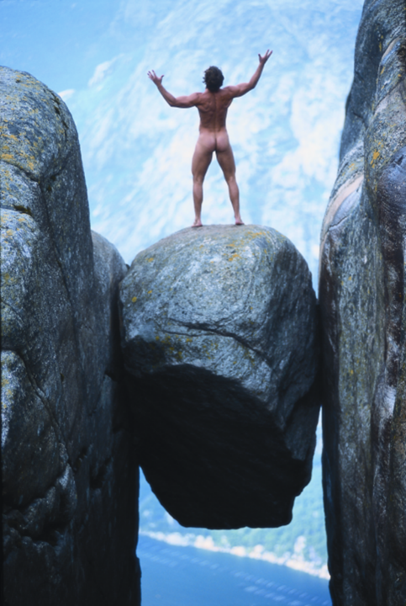
NORWAY –
POWERED BY NATURE
Notes:
Norway Convention Bureau provides an excellent starting point for buyers who would like to organize a conference, en event or an incentive in Norway. We can offer practical, relevant and honest advice and put you in direct contact with the best qualified suppliers to meet your needs.

Slide 2
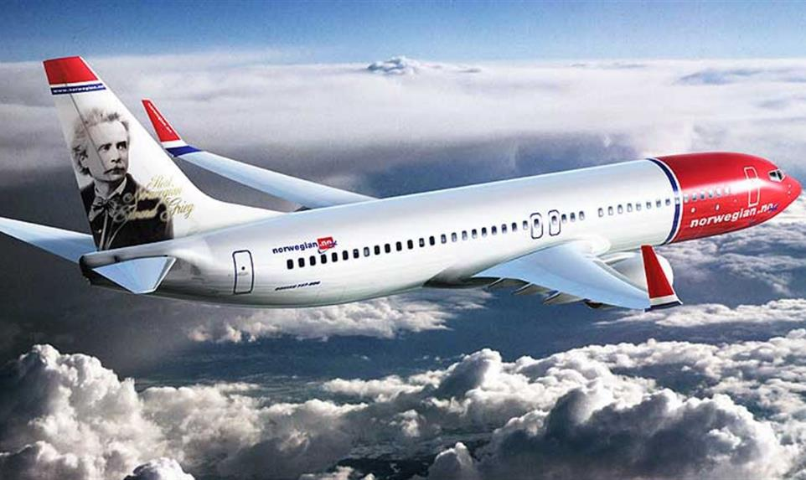
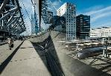
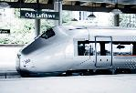
Norway is accessible

Slide 3
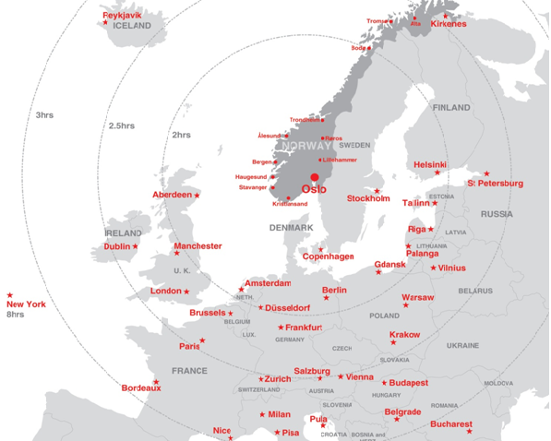
Notes:
Norway welcomes more than 240 direct flights from Europe every day, and it is only a two hour flight from south to north, and less than an hour from east to west. Norway is one of the countries with most airports, which makes every part of Norway easy to access. The distance from the airports to the city centres and meeting venues are short and the cities are compact and easily navigated by foot.
Norway also benefits from extensive national transport links, and regional infrastructure is of a high standard. Finally, the best of all is that when you are in Norway, nature is easily accessible and never far away.

Slide 4
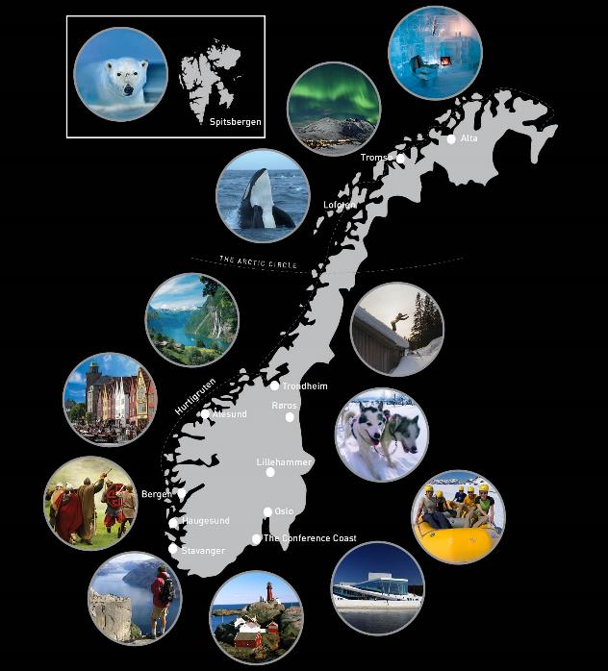
Notes:
Our different concepts in Norway are based on meetings in combination with nature. If that is what you are looking for, Norway is the destination for you. We want to give you some ideas as to what is possible to experience in Norway, for incentive groups and also activities combined with conferences. Norway is known for the famous Norwegian fjords, the midnight sun, northern lights and winter activities.

Slide 5
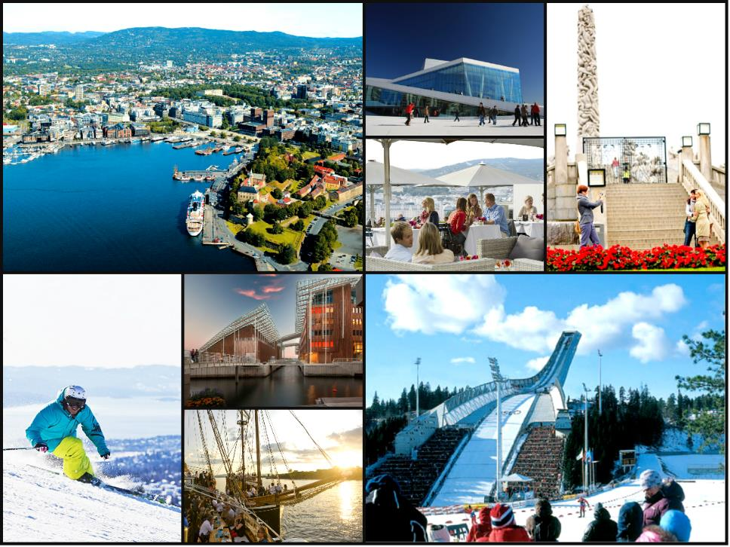
OSLO
THE BLUE AND THE GREEN AND THE CAPITAL IN BETWEEN
Notes:
In Oslo you can combine meetings with boat trips in the fjord among the islands, activities in the city or in the Holmenkollen area. Tjuvholmen is a new area by the sea with reatuarants and bars and it is also here the new Astrup Fearnley Museum and the hotel THE THIEF is situated. By the new Opera House they will soon start to build the new Munch Museum and the National Gallery.

Slide 6
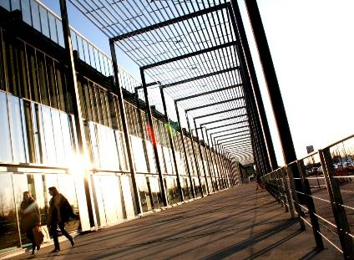


Capacity Oslo
112 direct international flights
80 hotels; 12.000 rooms and 20.000 beds
15 hotels in the surroundings of Oslo with 5.000 beds
Capacity: 8.000 delegates in plenary sessions
6.000 delegates in cinema seating
VENUES
Oslo Congress Centre
Norway Convention Centres

Slide 7
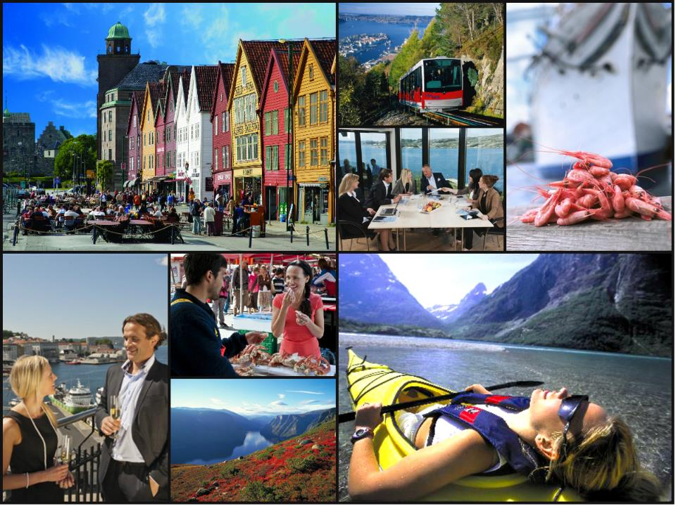
BERGEN
THE GATEWAY TO THE FJORDS OF NORWAY
Notes:
Bergen is a very convenient city for conference delegates since everything is within walking distance. Here groups often take a Pre- or post tour into the fjord areas.
The old wharf or Bryggen is on the UNESCO World Heritage List.

Slide 8
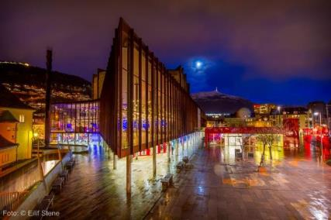
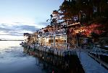
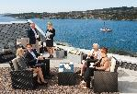
Capacity Bergen
40 international direct flights
From 2017: 45 hotels; 7.500 rooms and 15.000 beds
Capacity: 2.200 delegates in cinema seating
VENUES
Grieghallen
Notes:
Direct flights to Bergen from København, London, Roma, Amsterdam, Paris. New York and Toky in the summer season.

Slide 9
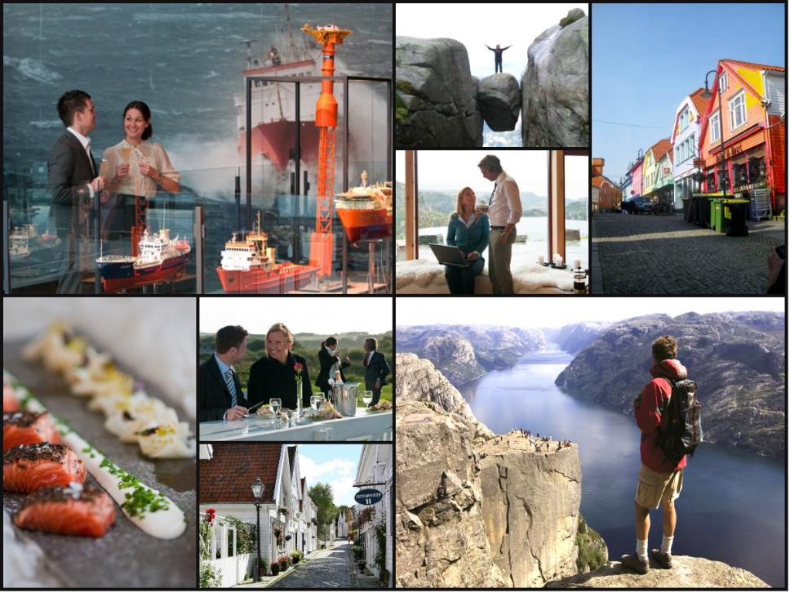
STAVANGER
THE OIL CAPITAL OF NORWAY
Notes:
Stavanger is the oil capital of Norway. The Norwegian Petroleum Museum has hosted several opening ceremonies for groups and conferences. Stavanger has a long tradition and expertise in hosting international events and conferences together with PCO’s. Stavanger has easy access with daily flights from most major European airports, and is well connected by sky team as well as Star Alliance carries. Go hiking to Pulpit Rock or take a cooking lesson with the Culinary Akademy.

Slide 10
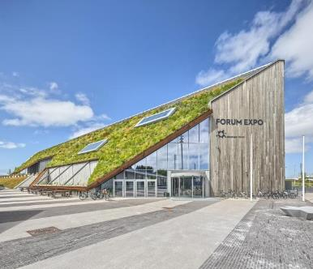

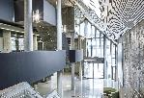
Capacity Stavanger
30 direct international flights
39 hotels: 5.300 rooms
Capacity: Meeting capacity 5.000 in plenary sessions and 1.700 delegates in cinema seating
ONS – 60.000 delegates
VENUES
Stavanger Forum
Stavanger Concert Hall

Slide 11
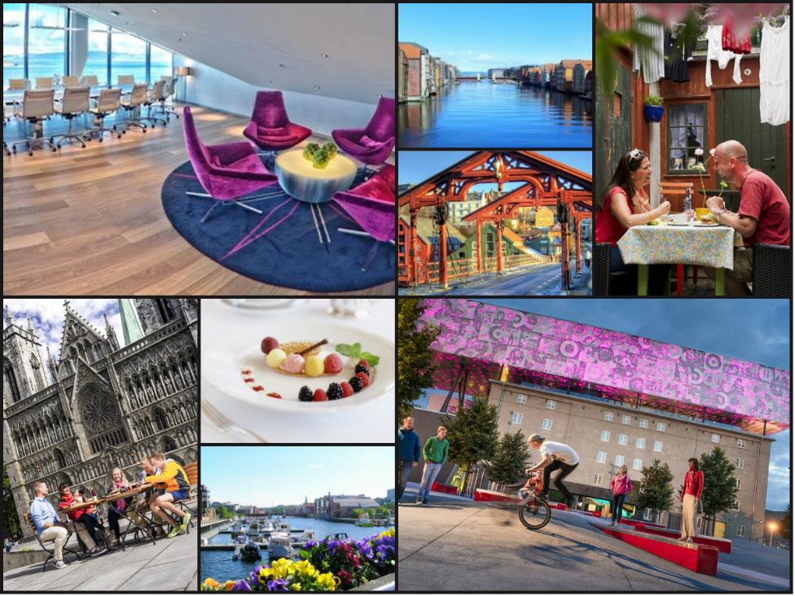
TRONDHEIM
NORWAY´S CAPITAL OF HISTORY AND TECHNOLOGY
Notes:
In central Norway is the capital of history and technology – Trondheim. The impressive Nidaros cathedral (on picture) is often used as a venue for conference opening ceremonies an concerts. Nidaros Cathedral was one of the most important places of pilgrimage in medivaeal Europe. Trondheim focuses on soft nature activities, like pilgrim light or hiking in the woods combined with high quality food and nice hotels - luxury version of the pilgrimage.

Slide 12
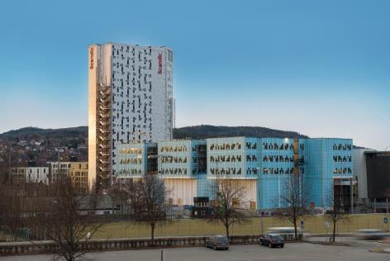

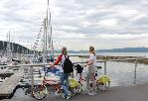
Capacity Trondheim
20 direct international flights
Hotels: 3.500 rooms and 5.500 beds
Capacity: Meeting capacity up to 3.000 and 1.800 delegates in cinema seating
From 2019: 8.000 delegates in plenary sessions
VENUES
Trondheim Spektrum

Slide 13
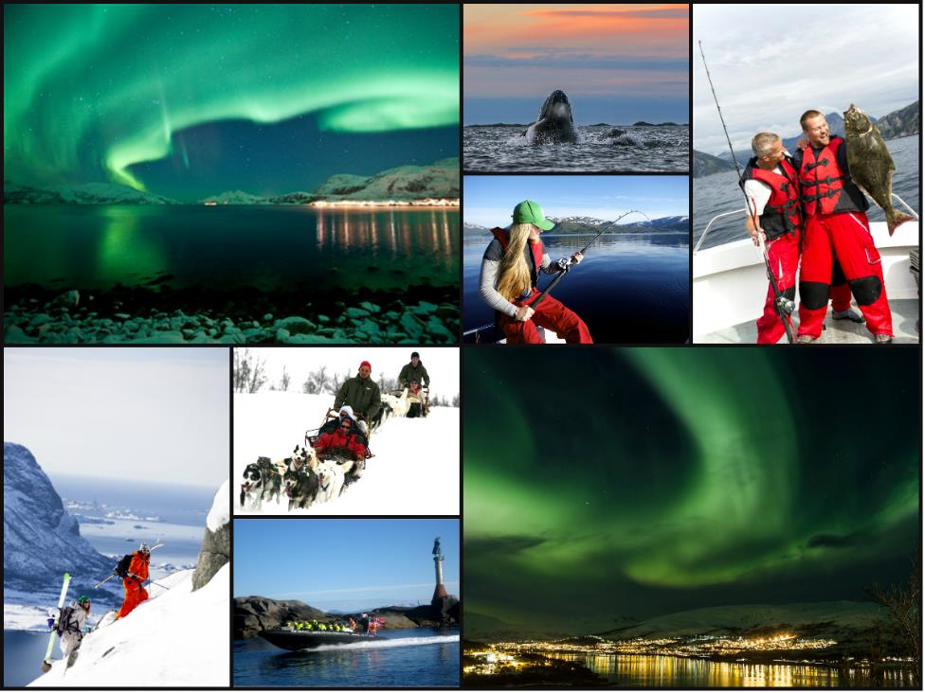
TROMSØ
WHERE YOUR ARCTIC ADVENTURE BEGINS
Notes:
Tromsø is the centre for arctic knowledge and science and a natural arena and meetingpoint in the arctic. The city is compact with all the hotels in the small city centre. Midnight sun: May 18 – July 25, polar night: Nov 21 – Jan 21. Arctic incentive activities or activities in combination with meetings during the winter are experiencing the nothern lights, dogsledding, reindeer safari, wilderness adventure on snowmobile, whale safari, meet the sami people, stay in a lavoo and do reindeer sledding.
Summer activities are hiking, canoing on forest rivers, wild bike rides, rib tours, kayaking on calm fjords or in the open sea or fishing trips late at night in the brigt light. Travel to the mountain 400 m above the sea with a cable car for a welcome champagne. Tromsø has Norway’s highest density of bars, cafés and restaurants.

Slide 14
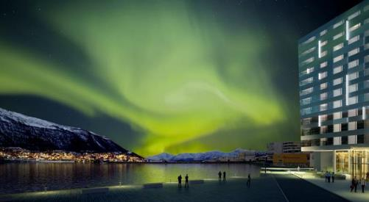
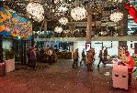
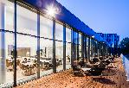
Capacity Tromsø
4 direct international flights
Hotels: 2.500 rooms and 4.600 beds
Capacity: 1.000 delegates in cinema seating
VENUE
Clarion Hotel The Edge

Slide 15
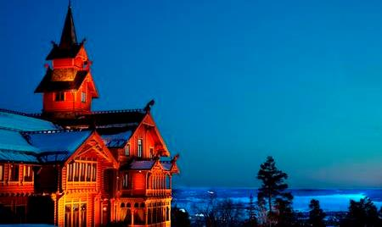
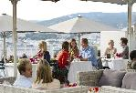
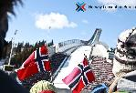
VENUES
Meetings in traditional style

Slide 16
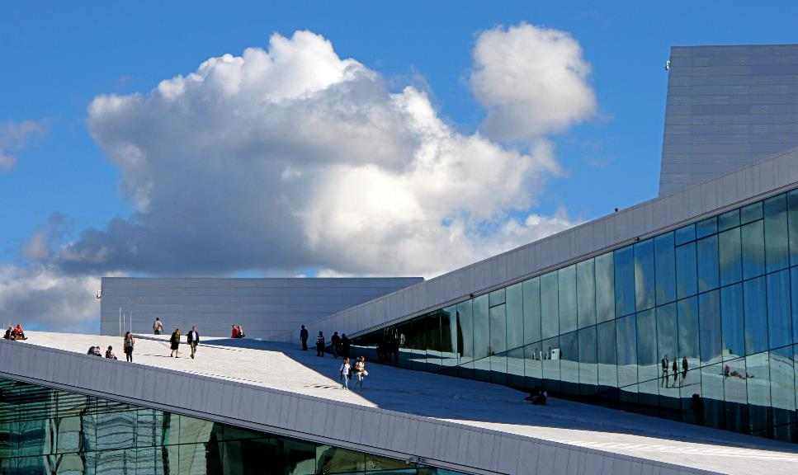
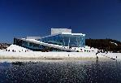
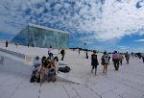
Meetings in the city

Slide 17
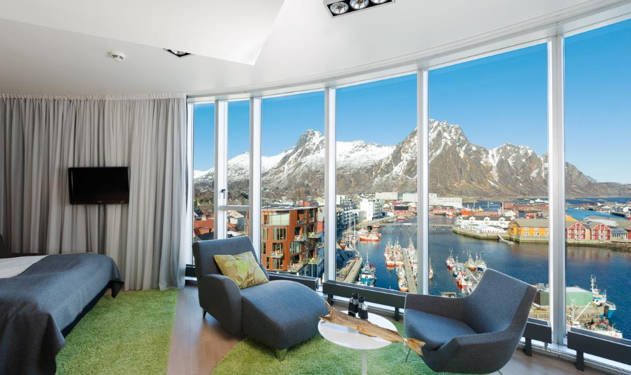
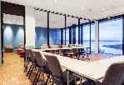
Meetings with a view

Slide 18
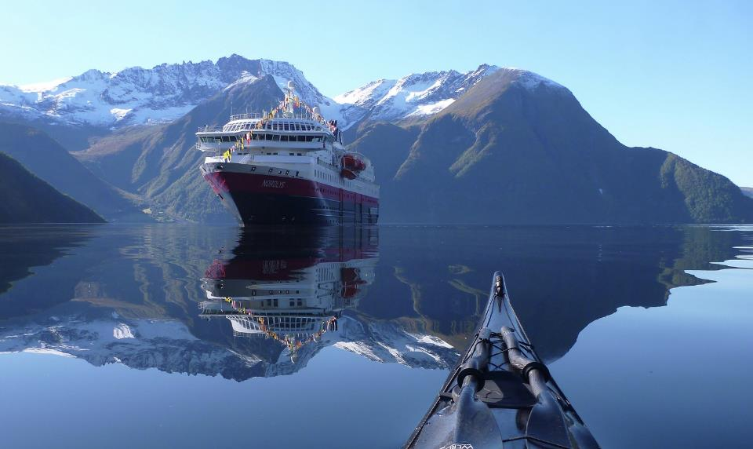
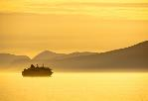
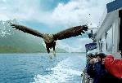
Meetings at sea

Slide 19
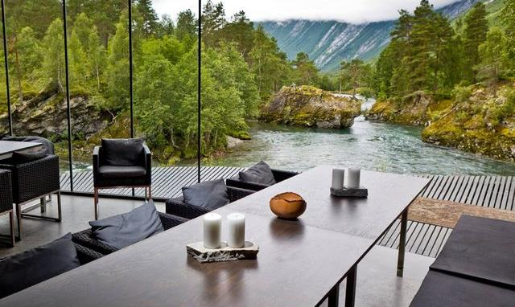
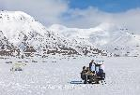
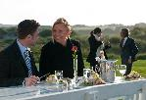
Meetings in nature

Slide 20
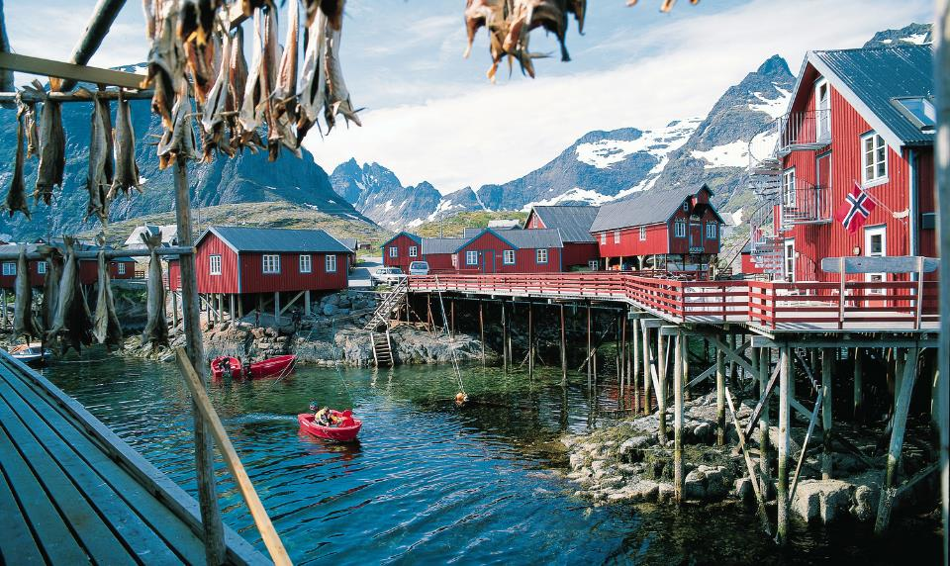
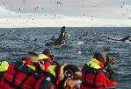
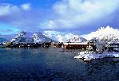
Meetings in Fishermens cabin

Slide 21
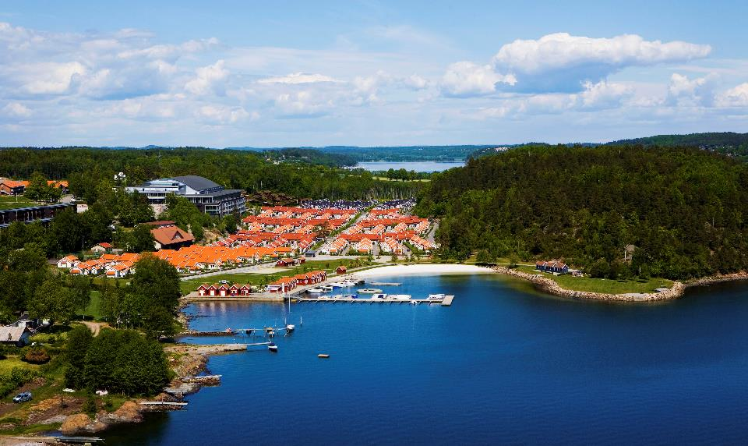
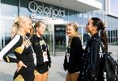
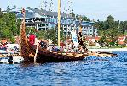
Meetings to explore big ideas
Notes:
Oslofjord Conference Center is situated 1 hour south of Oslo. 700 guests in cabins with more than 3.000 beds. Capacity 6.800 persons in cinema seating. Conference capacity – 4.800 sqm.

Slide 22
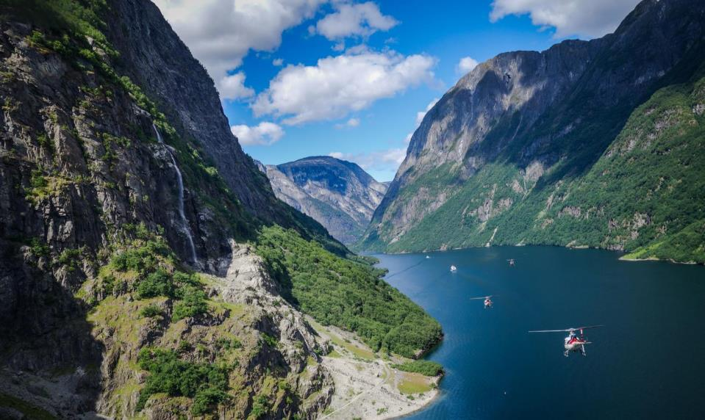
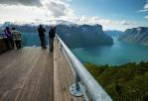
NATURE AND ACTIVITIES
Fjords
Notes:
Whenever you are in Norway, you will feel close to nature and get powered by nature. The landscape themselves are awe-inspiring, and the combination of outstanding scenery and fresh air can work wonders for a group itinerary. From snowy winters and the northern lights, to soaring fjords and the midnight sun, Norway’s natural charms are legendary. Use the nature for both soft and extreme activities, depending on the group. In any case, we guarantee experiences out of the ordinary in a land of huge contrasts.

Slide 23
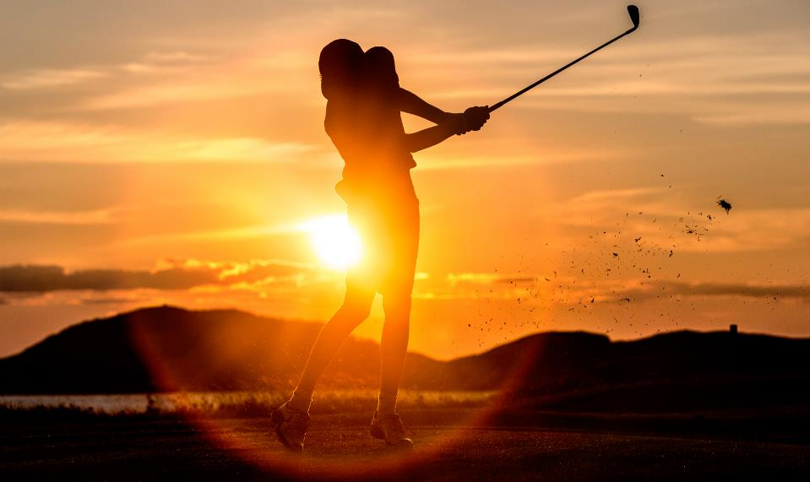
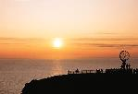
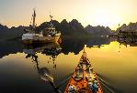
Playing golf in the midnight sun
Notes:
Jetlag? No worries, we have figured out a perfect activity for overseas delegates. How about some midnight sun golfing? This is in Lofoten at one o’clock in the night. The sun does not set in summer over the Arctic Circle, meaning visitors to Northern Norway enjoy 24 hours of daylight during summer.

Slide 24
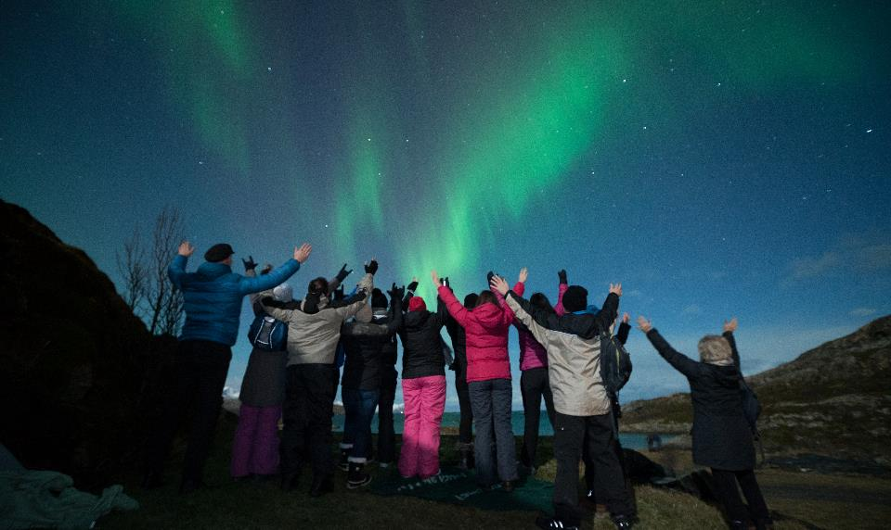
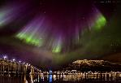
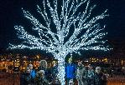
Northern Light
Notes:
The northern lights are a common natural phenomenon in Northern Norway, and are most commonly observed above the Arctic Circle between late autumn and early spring. Take your event to Tromsø, Alta or the Lofoten islands and offer a truly great nature experience to your delegates. Alternatively go hunting the lights onboard Hurtigruten.

Slide 25



Lofoten
Notes:
Or perhaps the group wants to test their limits by going sea kayaking. You would be surpriced of what you can learn from your fellow delegates during an active teambuilding. In Lofoten you can live in a rorbu (fishermanhouse) by the sea and the focus here is the strong nature in combination with the seafood. Lofoten has a hotel capasity of 880 rooms, and approx. 2000 beds. Meeting capacity up to 700 people.

Slide 26



Catch your own dinner
Notes:
Catch your own dinner together with your colleagues, prepear it together with professional chefs with delishious garnish, eat it in a spectacular evening event.

Slide 27



Winter activities
Notes:
Norway is a real winter wonderland, and there is no shortage of winter activities to choose from for those looking to organise an exciting incentive programme. These include skiing (Alpine, cross-country or Telemark) and snowboarding, but also snowkiting, ice climbing, ice fishing, ice skating, dog sledding, reindeer sledding, king crab safaris and more. Seeing the northern lights, and staying at an ice or snow hotel, are also high on many visitors list of things to do. The UNESCO listed town of Røros is a particularly picturesque winter destination.

Slide 28



Ski & Sail

Slide 29



Frozen
Notes:
Spend a night at the Sorrisniva Igloo Hotel in Alta. One time a group participated in building the igloo hotell as part of their teambuilding.

Slide 30



The Arctic Adventure
Notes:
Welcome to the Realm of the Polar Bear! Svalbard is one the most exciting areas in the world. In Svalbard you can experience reindeer outside your hotel room or see the polar fox as you walk around in the administrative center Longyearbyen (Longyear City). 60% of Svalbard is covered by glaciers and you can watch icebergs in many different shapes on the boat excursions in Isfjorden, and of course on the spectacular cruises taking you to more remote corners of the archipelago. Here the chances of seeing polar bears are usually good (but never guaranteed).

Slide 31



Value for money
€ is strong compared to the Norwegian Krone
Oslo Congress Centre is listed as 7th most price competitive venue in Europe 3 years in a row (by Meetpie)
No hidden costs
Taxes, wifi and full breakfast always included in the price given
Notes:
Oslo and Norway sometimes struggle with the reputation of being expensive. Therefore we are very pleased to see the results of the meetpie price comparison survey that Oslo convention centre scores as the 7th most price competitive venue in Europe 3rd year in a row. The survey compares conferences of 500 and 1000 delegates seated in Theatre style.
Now, the Euro and dollar strengthening towards the Norwegian Krone which also means it is the right timing for going north with your event.
A conference package in a conference hotel in Norway costs about USD 266 and this includes: Accommodation, breakfast, lunch, 3-course dinner, and breakfast is always included in a room rate.

Slide 32

Be safe & stress down
Notes:
Safety first is no longer an expression without a meaning. Norway is perceived as a secure destination, which is very important when trying to boost delegate numbers, or when being responsible for an incentive group. Norway is a safe destination with a staggeringly low crime rate, even in the main cities. Visitors can walk around at ease and enjoy a country which, according to the UN Human Development Index, offers the best quality of life in the world.
Sustainability: Also more and more of Norways tourism industry follow sustainable prinsiples, and one of our biggest task is to preserve the unspoiled and beautiful landscape. By certify and label destination and hotel/venues makes sure they follow strict rules and regulations in pollution, recycling and energy, which makes it easier for customers to choose to travel in an eco-friendly way.

Slide 33

FOR MORE INFORMATION ABOUT NORWAY:
Norway Convention Bureau
Phone: +47 21 06 32 12
post@norwayconventionbureau.no
www.visitnorway.com/meetings

