Slide 1
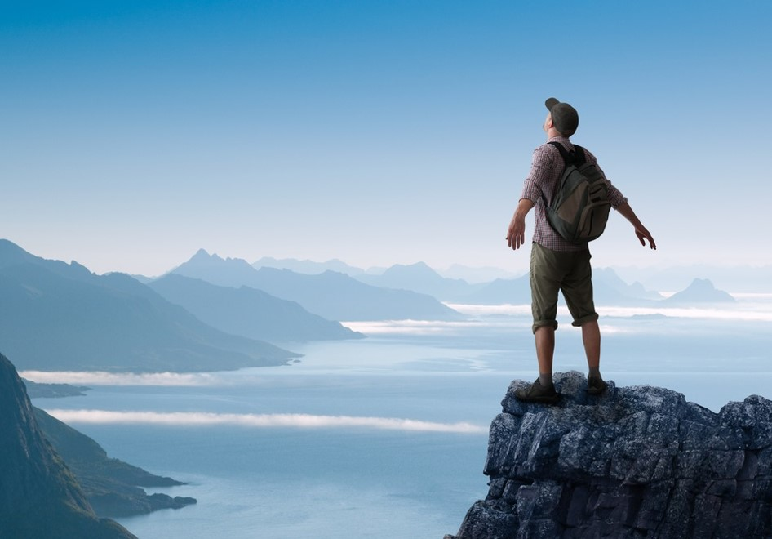
activating
The Norway brand
A report on holiday needs and segments in the Italian market
for Innovation Norway
Written by Kjetil Strømseth and Steven Naert 24th October 2017

Slide 2
CONTENT
1) The philosophy behind
p 6
2) The ideal holiday
p 19
3) Segments
p 30
4) Brand profile Norway
p 91
5)The competetive landscape
p 97
6) Global recommendations
p 100
7) Recommendations for Italy
p 111

Slide 3
Norway a true
The vision is «we give local ideas global opportunities»
Norway has unique advantages both in terms of natural resources and modern infrastructure that provides a great number of possibilities for tourists.
Innovation Norway manages not only one brand but the sum of all the brands that make up the destination Norway.
Some of these are iconic brands on a global scale.
The challenge is to secure a strong position for all of these so that the sum is stronger than individual parts, creating truly global power.
Global brand

Slide 4
The world is changing. The travel industry is changing. People change. How they interact with brands is changing. Their behavior in relation to vacation change.
You may have to adapt and make changes in the strategy to keep pace with the market.
Fundamental consumer insights in key markets is part of the basis for this.
Updated
insightful
proactive
Ipsos Report | September 2017 | Market report ITALY |

Slide 5
The purpose of the research:
TO IDENTIFY THE BEST MEANS OF STRENGTHENING THE FUTURE OF THE NORWEGIAN TRAVEL INDUSTRY
TO UNDERSTAND THE COMPETITIVE LANDSCAPE AND TARGET NEEDS TO PROMOTE INNOVATION AND COMMUNICATION
In order to do so, this research provides answers to the two questions:
- What is the ideal holiday?
- How are destinations (brands) positioned?

Slide 6
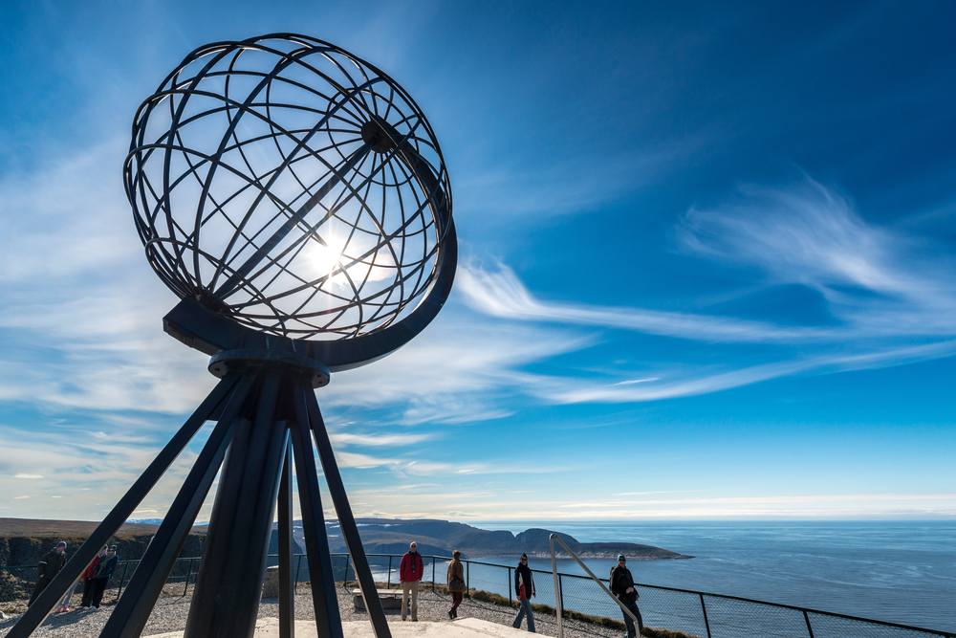
Behind the research
1
The philosophy
Point of view & approach

Slide 7
THE starting point:
understanding how brand building works
Brands that grow are brands that are chosen by…
MORE PEOPLE
At the Heart of Growing Brands is an understanding of how PEOPLE make CHOICES
And with increasing Brand Choices, it is more important than ever before to understand how the decision process works in people’s minds
MORE EASILY
MORE OFTEN
So how can Innovation Norway make it easier for more people to come to Norway more often?

Slide 8
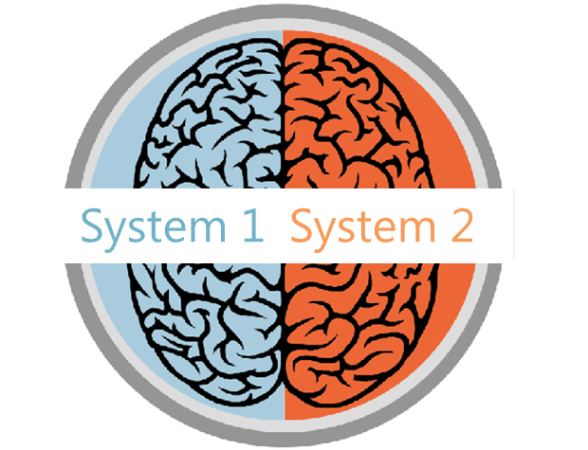
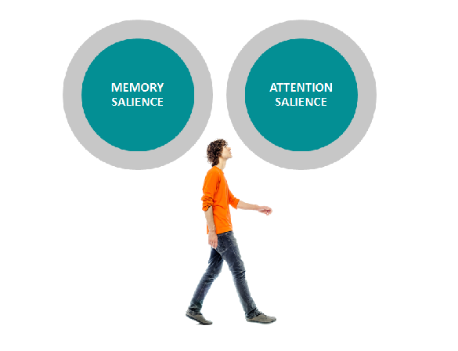
The key to brand building
is to think people first
How people make decisions
How people think about brands
How people are influenced
Decision-making is often more unconscious than conscious, using mental shortcuts to reduce effort.
Brands exist in peoples’ minds as a network: a unique memory structure of thoughts, feelings, experiences, images, stories, associations, colours, sounds, symbols and memories.
Memory salience refers to all the existing aspects of the brand’s mental network. Attention salience is about the cues and stimuli that capture our attention at any touchpoint.
So how do people make choices?

Slide 9
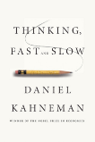
FORM
ARE SALIENT
ARE SALIENT
RELATIONSHIPS
They must come readily to mind in the moments that matter. They have strong brand networks or associative memory structures so they are easily retrieved in a fast-processing, automatic decision environment
They must fulfil the key motivational criteria for selection: meeting functional and emotional needs and creating connections
all the evidence points
ARE AVAILABLE
ARE AVAILABLE
To People being more
They must be accessible (e.g. pricing, distribution). The more easily people perceive that they can obtain one option rather than another similar option, the more likely it is to be selected
RANK FIRST
likely to choose
RANK FIRST
They must have the highest perceived value at the moment of choice, compared with alternatives
brands that…

Slide 10
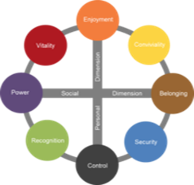
Building deep brand relationships with Censydiam
BE RELEVANT
Censydiam offers a validated approach to understand the different roles brands can play in the category.
Censydiam captures the needs & motivations that drive relevance in the category, while acknowledging that these needs & motivations can differ across various situations and occasions.
Brands can grow if they succeed in connecting themselves to more emotional & functional needs.
Associate your brand with relevant category roles
Censydiam
Motivational Framework

Slide 11
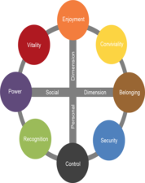
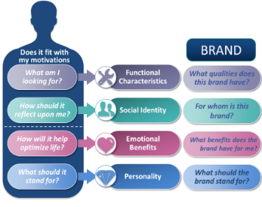
Censydiam in a nutshell
People first
All decisions are made with fundamental consumer needs at the heart
Universal currency
Comparison possible across markets
Common language
Customizable
Needs are tailored by context, category and markets.
theories about the unconscious mind and the mechanisms of release and repression
Each is deconstructed on key emotional and functional benefits, brands need deliver on in order to be relevant for consumers in various usage occasions/situations.
These benefits help build rich networks and allow consumers to easily identify the best solutions for their needs.
Validated
Over 30+ years experience across the globe & scientific thesis
The double mechanism for satisfaction: a striving for power & superiority and for belonging & community
Comparison
Allows comparison over time and markets

Slide 12
Censydiam seeks to uncover the different drivers
the brand needs to play on to be relevant
The ideal
holiday
Associations
to the
brand
First we uncover the ideal benefits sought in a specific holiday. Then we uncover what associations travelers have to different destinations
WHAT expectations are related to destinations?
DESTINATION CHARACTERISTICS
WHAT qualities does this destination have?
HOW should a holiday reflect upon me?
SOCIAL IDENTITY
WHO is the destination for?
WHY do people go on holiday?
EMOTIONAL BENEFITS
WHY do I go to
this destination?
WHAT should the destination stand for?
BRAND PERSONALITY
WHAT does this destination stand for?

Slide 13
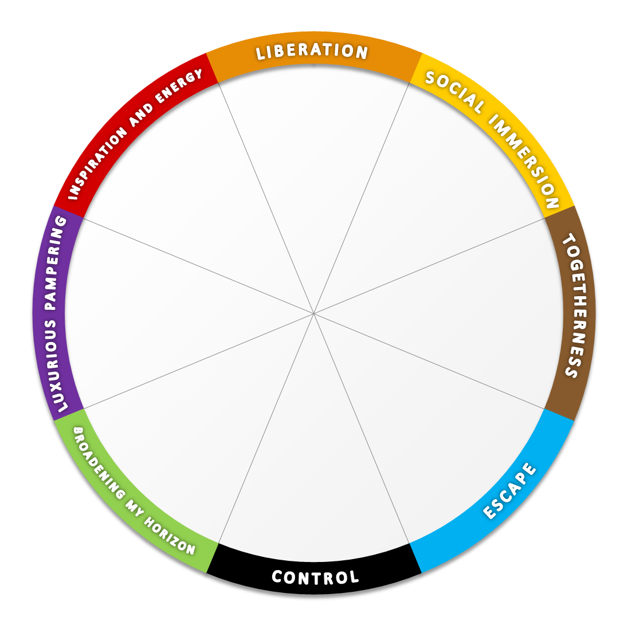
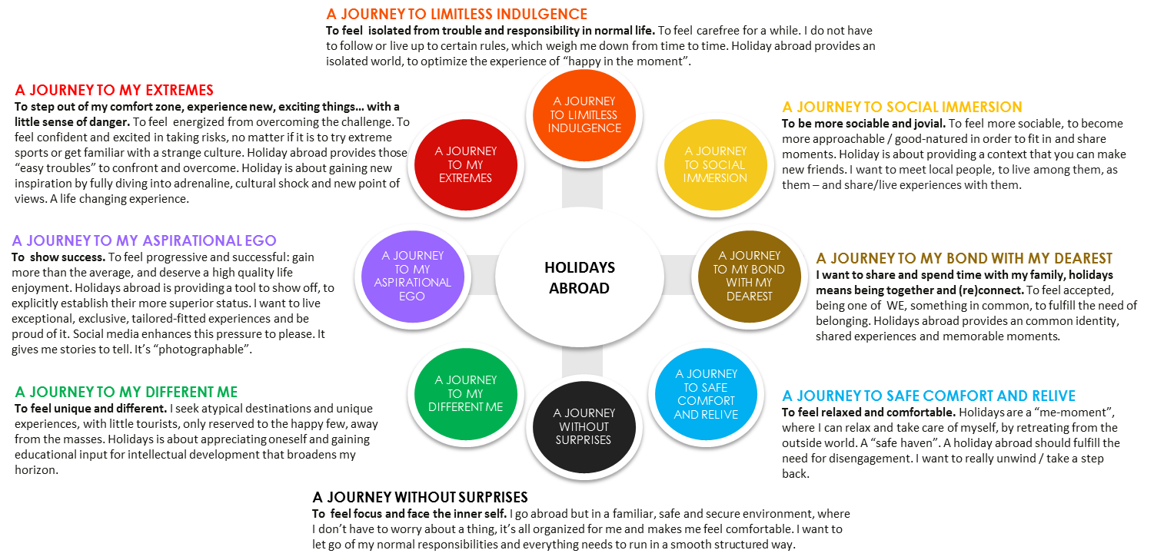
From Censydiam hypothesis to global category frame
We have conducted 1200 interviews in the market
Each respondent has profiled 2 holiday occasions – so we have 2400 cases for analysis
1. We start with the Censydiam model and explore it qualitatively in focus groups.
2. The qualitative part then creates a hypothesis on how the Censydiam frame looks like within the holiday category.
3. At this stage this hypothesis have been tested quantitativly in several markets to create one global segmentation model.

Slide 14
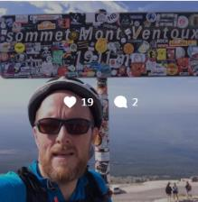
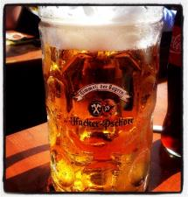
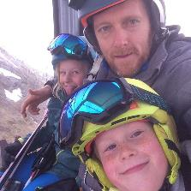
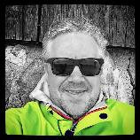
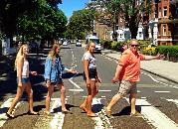
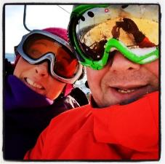
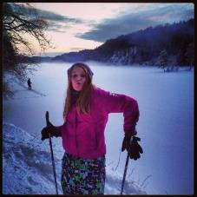
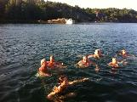
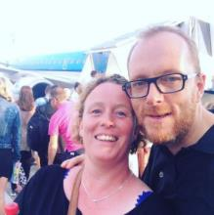
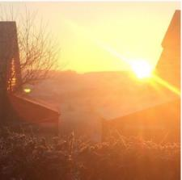
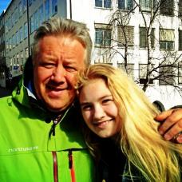
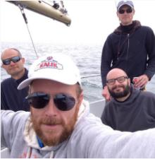
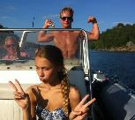
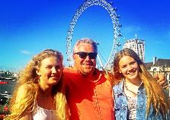
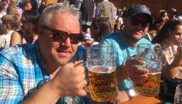
The same person, but different situations and different motivations
As consumers, we often have different needs depending on the situation. This also applies to holidays. A weekend getaway with a partner has to fulfil different needs than a skiing weekend with friends. This report is, therefore, based on different occasions – by occasion we mean different holidays. Each respondent has told us what the ideal holiday look like on two different holiday occasions.

Slide 15
Questionnaire structure in the quantitative interview
The model shows the structure of the interview the individual respondent was through
Section 1: Demographics and Screener
Section 2: Category use
Section 3: Awareness & usage
Gender
Age
Income
Etc.
Have been abroad for holiday last 3 years.
How often do you go on holiday abroad?
Where did you go the last 5 holidays ?
Time of year, duration and type of holiday
What destinations do you know of?
How many times have you been on holiday to the following countries?
Section 4: Profiling of two holiday occasions
Section 5: Profiling of 2 holiday occasions
Section 6: Profiling of destinations
Type of holiday
Destination
Duration
Who were you with?
Spending
Accommodation
Transport
Information sources
Influencers
Activities
Consideration set (what destinations would you consider).
Emotional benefits
Functional benefits
Personality
Social identity
Please choose the statements that you think are appropriate for each destination.
We use the same statements as in section 5.

Slide 16
How does the needs come alive in the actual interview?
The needs are formulated as statements on 4 levels
Emotional benefits
Functional benefits
Personality
Social identity
Imagine that you would go on a similar holiday in the future (with the same people, the same destination, the same time, etc.), please tick the feelings and needs the ideal holiday experience should meet for this occasion
Which are the qualities and characteristics the holiday experience would ideally need to have for this occasion?
Please tick the words that fit the character of your IDEAL future holiday experience for this occasion
Which of the following types of people would you expect to look for the same holiday experience as you?
Helps me to enjoy life to the fullest
Makes me feel completely liberated
Makes me feel full of energy
Allows me to immerse myself in the local life
Helps me to meet new people
Allows me to share good times with others
Creates precious moments of togetherness
Allows me to intensify the relationship with my loved one(s)
Allows me to spoil my loved ones
Allows me to pamper myself
Helps me to escape from my hectic daily life
Restores my sense of harmony and balance
Allows me to keep everything under control
Helps me avoid too much surprises
Gives me a safe feeling
Allows me to broaden my horizon
Allows me to broaden my knowledge
Enriches my view on the world
Allows me to indulge myself with a bit of luxury
Makes me feel on top of the world
Makes me stand out from the crowd
Allows me to discover new and interesting places
Gives me rich experiences
Gives me new inspiration
Allows me to be physical active
Allows me to live close to nature
Has a variety of accommodation offers
Has a variety of different restaurant offers
Has activities for kids
Has beautiful nature
Has environmentally friendly offers
Has few language barriers
Has friendly people
Has good beaches
Has good local cuisine
Has good medical care
Has good opportunities to meet local people
Has good service
Has good shopping
Has guaranteed sunshine
Has interesting culture & art
Has interesting sights
Has lots of organized trips and excursions
Has places to go out partying
Has quiet environments
Has rich cultural heritage
Has romantic spots
Has unspoiled nature
Is easy to travel around
Is easy to travel to
Is not for just anybody, is exclusive
Is not ruined by tourism
Is not too warm
Is well organized
Offers a wide range of possible activities
Good value for money
Active
Playful
Fresh
Open-minded
Sociable
Outgoing
Caring
Friendly
Cozy
Harmonious
Peaceful
Relaxed
Practical
Structured
Predictable
Authentic
Unique
Cultivated
Extravagant
Superior
Classy
Explorative
Adventurous
Daring
People who want to have as much fun as possible in life
People that like to do things spontaneously, impulsively
People who likes to party
People who are always looking to connect with others
People who enjoy spending time with friends
People who have an active and busy social life
People for whom family comes first above all
People who enjoy taking care of others
People who have strong family values
People who want to escape from the demands of life and relax and unwind
People who needs time for themselves
People who want to revitalize themselves
People who make rational choices
People who prefer the familiar over the unknown
People who avoid risk
People who are interested to learn more
People who want to make a different choice
People that like to do things the unconventional way
People who want the best and are willing to pay for it
People who like to have the best things, value high quality
People who is sophisticated and classy
People who like to explore and have new experiences
People who like adventure
People who wants a life changing experience

Slide 17
And now the results…

Slide 18
Sample N = 2168
People that have been abroad for holiday last 3 years. Natural fall out.
50%
50%

Slide 19
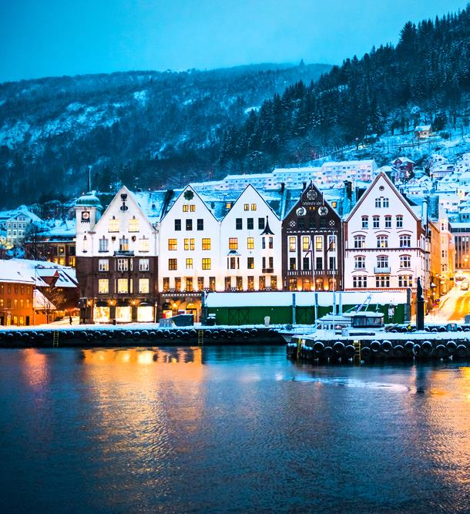
holiday
2
The ideal
Potential needs and drivers
Holidays abroad
experience
Main drivers in the market
Category needs in the total Italian market

Slide 20
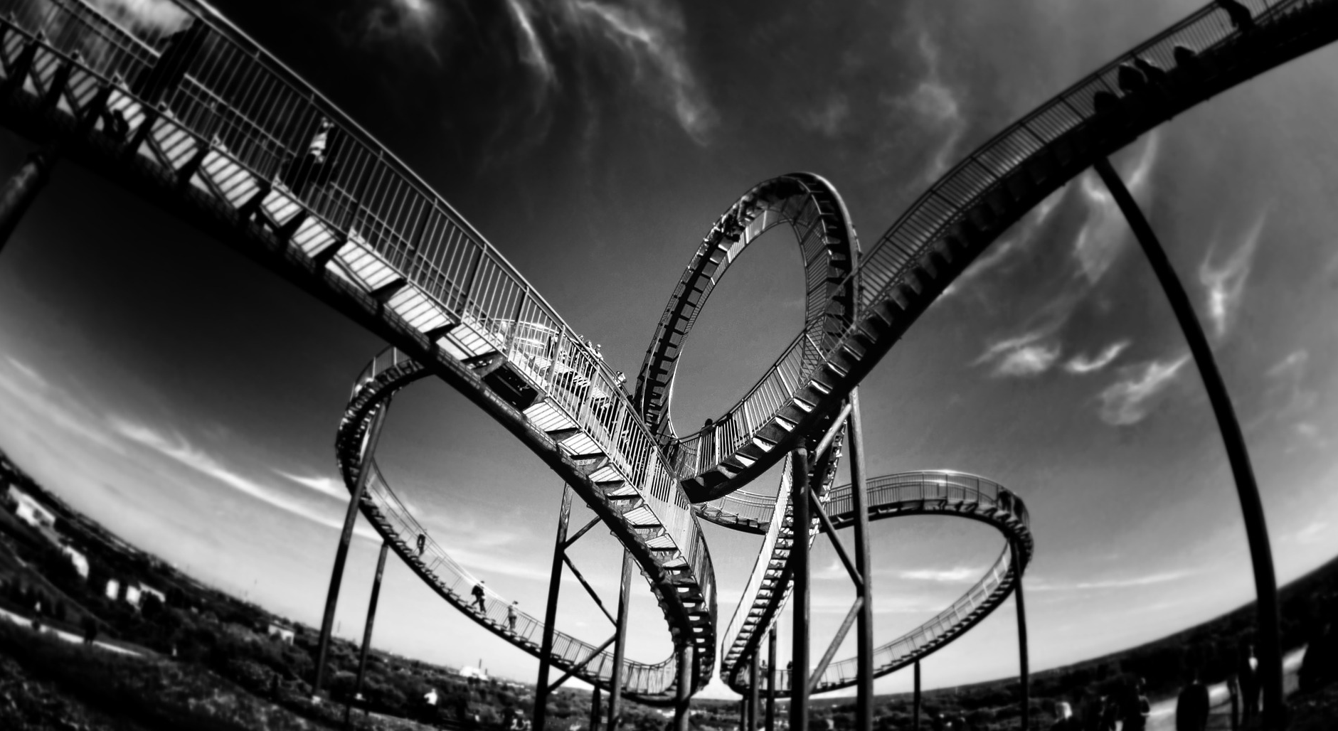
Emotional Benefits
WHY do people go on holiday?
NOTE: Indexed vs. average of all items in facet We report all items with a score which is 1 standard deviation higher than the average

Slide 21
Ideal destination characteristics
WHAT expectations are related to specific destination characteristics?
NOTE: Indexed vs. average of all items in facet We report all items with a score which is 1 standard deviation higher than the average

Slide 22
Ideal brand Personality
WHAT should the destination stand for?
NOTE: Indexed vs. average of all items in facet We report all items with a score which is 1 standard deviation higher than the average

Slide 23
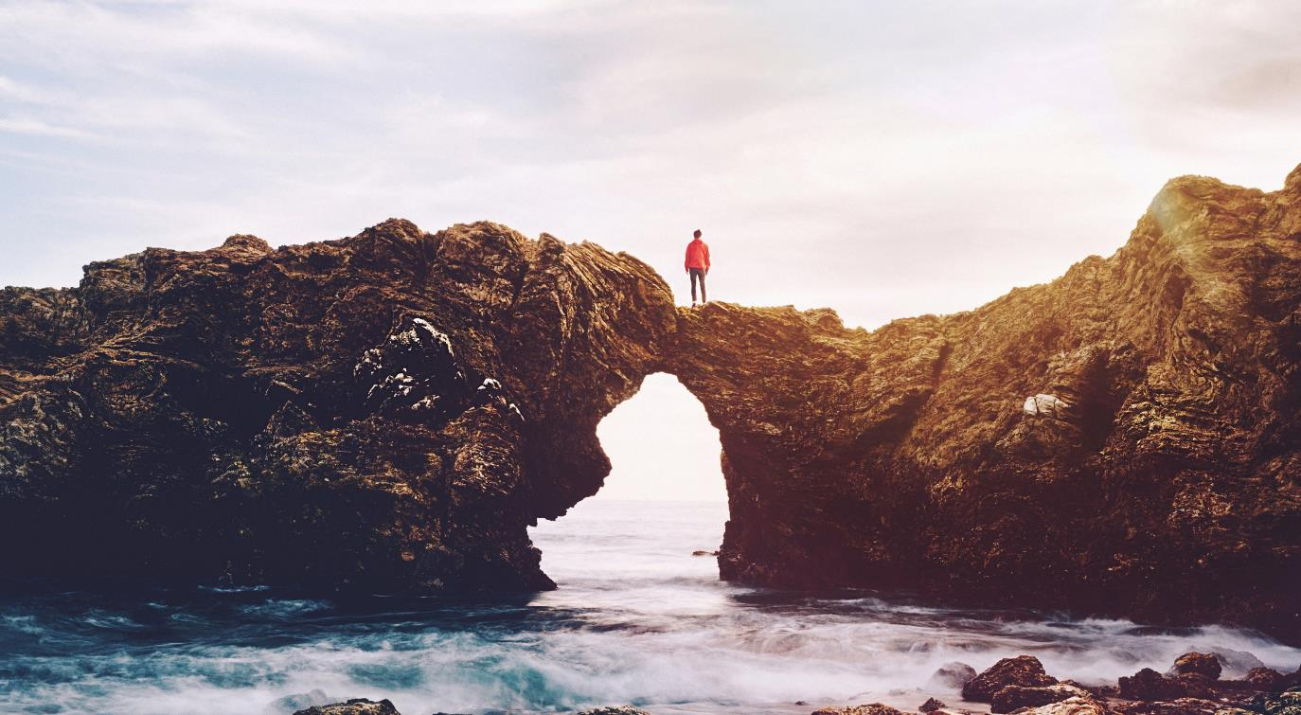
Ideal Social Identity
HOW should a holiday reflect upon me?
NOTE: Indexed vs. average of all items in facet We report all items with a score which is 1 standard deviation higher than the average

Slide 24
Category
behavior
With whom, how, when…

Slide 25
WHEN, WHO, HOW, where
Highlights on Italian category behavior
WHEN
WITH WHOM
HOW
TYPE OF ACCOMODATION
TRANSPORTATION
67 %
71 %
66%
68 %
People travel all year long
- Off course some peaks in summertime
Spouse/partner
I/we organized the trip myself/ourselves and travelled independently
Lived at a hotel, in most cases a medium standard hotel
Travels by plane
TRANSPORTATION DURING THE HOLIDAY

Slide 26
Sources of information before and during travel
The digital channels are most important
15%
Advice from friends / family
38%
Uses the homepage of the destination as a source of information and inspiration before going on holiday
59%
Uses the internet in general as a source of information and inspiration before going on holiday. I.e. the large search engines are highly important to direct traffic to sites that present Norway as a tourist destination.
19%
Uses the homepage of carriers, including airlines etc.
26%
Uses the homepage for hotels/ other accommodations
24%
Uses the homepage for attractions and sights
18%
Guidebooks
17%
Uses booking sites such as Expedia and Lastminute
Base: all respondents, n=2168

Slide 27
Most travels are decided upon between 1-6 months in advance
How long before your departure did you settle for this trip on this occasion?
Up to 1 month before departure
Up to 4-6 months before departure
Up to 3 months before departure
Up to 2 months before departure
Less than one week before departure
More than one year before departure
Up to 6-12 months before departure
1-3 weeks before departure
«Influence period 1%»
«Main decision period 50%»
«Last minute 44%»
Base: all respondents, n=2168

Slide 28
Ever visited this country?
The Italians goes to France and Spain
Visits to Norway all markets:
 | Ever visited | Repeat visits | Repeat ratio
Global | 32 % | 18 % | 55 %
US | 25 % | 11 % | 43 %
UK | 20 % | 6 % | 30 %
Denmark | 81 % | 62 % | 76 %
Sweden | 79 % | 56 % | 71 %
China | 16 % | 6 % | 36 %
Spain | 10 % | 3 % | 28 %
Italy | 17 % | 4 % | 25 %
Netherlands | 25 % | 9 % | 35 %
France | 15 % | 3 % | 19 %
Germany | 26 % | 10 % | 39 %

Slide 29
A note on planning horizons
China, US and Italy has shorter planning horizon than the rest of the markets
How long before your departure did you settle for this trip on this occasion?
 |  | Market
 | Global | US | UK | Denmark | Sweden | China | Spain | Italy | Netherlands | France | Germany
Antall intervju | 21928 | 2158 | 2134 | 2192 | 2258 | 2280 | 2213 | 2168 | 2179 | 2205 | 2141
Less than 3 weeks before departure | 18 % | 24 % | 8 % | 12 % | 12 % | 30 % | 12 % | 44 % | 13 % | 13 % | 10 %
Up to 3 months before departure | 50 % | 49 % | 46 % | 50 % | 48 % | 64 % | 63 % | 44 % | 43 % | 50 % | 44 %
Up to 4-12 months before departure | 28 % | 23 % | 40 % | 35 % | 36 % | 5 % | 23 % | 6 % | 41 % | 33 % | 42 %
More than one year before departure | 1 % | 3 % | 3 % | 1 % | 3 % | 0 % | 1 % | 0 % | 1 % | 2 % | 2 %
Don’t know | 2 % | 1 % | 3 % | 2 % | 2 % | 0 % | 1 % | 7 % | 2 % | 1 % | 2 %
These differences will have impact on when to deploy marketing campaigns in the different markets

Slide 30
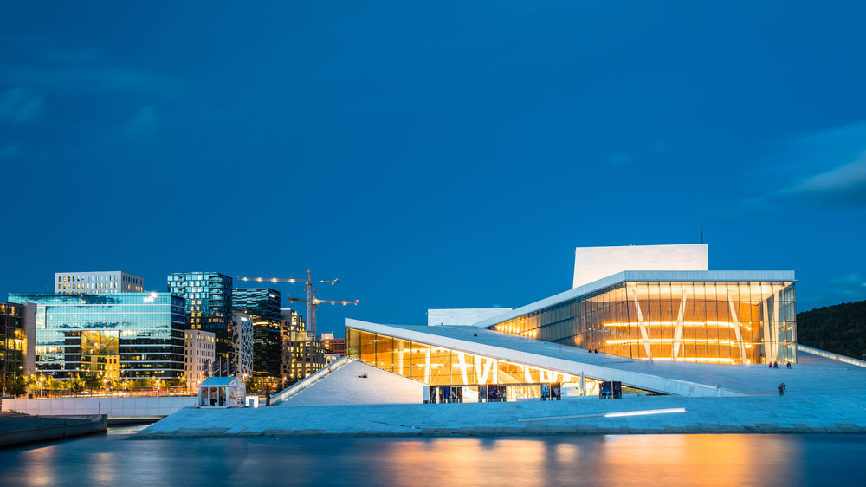
3
MOTIVATIONAL
SEGMENTS
Why
What
Who

Slide 31
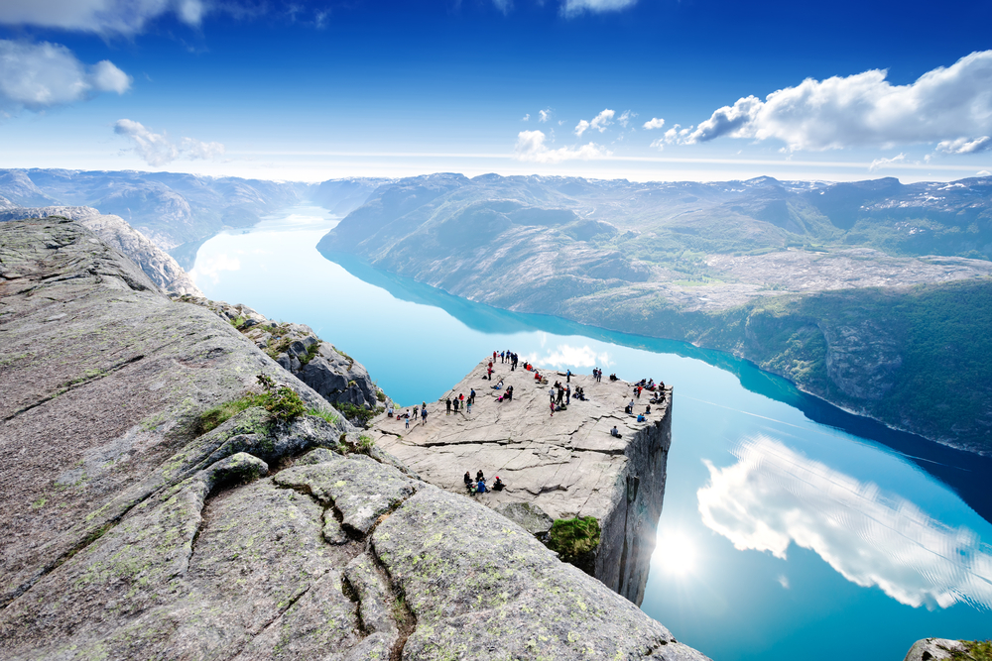
9 distinct segments
PLAYFUL LIBERATON
SOCIAL IMMERSION
SHARING & CARING
ESCAPE
CONTROL
BROADENING MY CULTURAL HORIZON
ADVENTURES IN the world of natural beauty
EXTRAVAGANT INDULGENCE
ENERGY

Slide 32
Segment overview and size*
Playful Liberation is all about maximizing the pleasure I get out of a holiday and enjoying myself without worrying about the consequences
PLAYFUL LIBERATION
19%
Energy
7%
SOCIAL IMMERSION
8%
Energy is about adventure, being active, testing your boundaries and discovering new things. It taps into the need to be energized.
Social immersion is all about wanting to be harmoniously connected with other people.
HOLIDAYS ABROAD
EXTRAVAGANT INDULGENCE
13%
SHARING & CARING
6%
Romantic luxury is about the need to indulge in some luxury. Find those romantic spots that really creates a feeling of extravagance.
Sharing & caring is all about spoiling my loved ones, intensify the relationship and Create precious moments of togetherness
The segment reflects the need to see something new, something spectacular like a natural phenomenon. It also connects with the need to immerse in unspoiled nature and travel to a destination not ruined by tourism.
ADVENTURES IN THE WORLD OF NATURAL BEAUTY
14%
ESCAPE
12%
Broadening my CULTURAL horizon
11%
Escape is about the experience of retreat, tranquility and quietness
CONTROL
11%
The segment reflects the need to learn about a foreign culture, stand out from the crowd. Something to talk about when coming home.
* Share of overnight stays: The segment volume is derived from the number of overnight stays on each occasion. The figures on the slide shows the share of overnight stays on all holidays
Control is about avoiding surprises and seek the familiar instead of the unknown.

Slide 33
Segment size* per market
* Share of overnight stays: The segment volume is derived from the number of overnight stays on each occasion. The figures on the slide shows the share of overnight stays on all holidays.

Slide 34
Major changes in the global segmentation VS LAST TIME
NUMBER OF SEGMENTS This time we have 9 decent sized segments, last there were 8. I.e. we see a more fragmented picture of holiday needs this time.
NEW MEANING OF THE BLUE SEGMENT In the last segmentation the meaning of the blue segment was more in the direction of a «spa center» experience. This time it’s more about retreating to a quiet place. This could be a quite fisherman's cottage in Lofoten or a cabin in the mountains.
THE PREVIOUS RED AND GREEN SEGMENTS ARE DIVIDED In stead of a pure “Exploration” segment and one “Broadening my horizon” segment, we have a red segment (Energy), all about activity and a two green segments (Adventures in the world of natural beauty) all about unspoiled nature, and “Broadening my cultural horizon” all about experiencing culture.

Slide 35
Segments share of occasion – global
- all destinations
 | Total | PLAYFUL LIBERATON | SOCIAL IMMERSION | SHARING & CARING | ESCAPE | CONTROL | BROADENING MY CULTURAL HORIZON | ADVENTURES IN THE WORLD OF NATURAL BEAUTY | EXTRAVAGANT INDULGENCE | ENERGY
# interviews | 21928 | 2217 | 2202 | 2265 | 2574 | 2471 | 2828 | 2528 | 2780 | 2063
Visits to historic sites | 57 % | 57 % | 61 % | 42 % | 47 % | 56 % | 72 % | 66 % | 58 % | 53 %
Sun and beach holiday | 53 % | 58 % | 48 % | 57 % | 63 % | 52 % | 37 % | 49 % | 59 % | 57 %
Holiday to experience nature, scenery and wildlife | 46 % | 46 % | 45 % | 31 % | 51 % | 43 % | 43 % | 68 % | 45 % | 46 %
Sightseeing/round trip | 45 % | 49 % | 48 % | 34 % | 36 % | 46 % | 48 % | 52 % | 49 % | 45 %
Cultural experience (focus on art, theatre etc.) | 42 % | 49 % | 43 % | 26 % | 29 % | 43 % | 54 % | 45 % | 48 % | 40 %
City break (focusing on cultural, shopping, Club, restaurant visits etc.) | 42 % | 41 % | 44 % | 38 % | 34 % | 39 % | 50 % | 43 % | 42 % | 43 %
Visiting friends and relatives | 31 % | 28 % | 37 % | 42 % | 26 % | 31 % | 27 % | 33 % | 30 % | 32 %
Culinary trip | 19 % | 29 % | 19 % | 12 % | 13 % | 21 % | 14 % | 18 % | 28 % | 18 %
Party & fun | 16 % | 23 % | 15 % | 14 % | 11 % | 16 % | 10 % | 14 % | 21 % | 20 %
Sports/active holiday | 15 % | 17 % | 10 % | 10 % | 10 % | 19 % | 7 % | 20 % | 20 % | 27 %
Travel to cottage/holiday home (hired/own/borrowed cottage/holiday home) | 15 % | 13 % | 12 % | 18 % | 20 % | 15 % | 8 % | 13 % | 17 % | 16 %
Ski holiday | 11 % | 15 % | 6 % | 7 % | 7 % | 17 % | 3 % | 7 % | 18 % | 22 %
Event holiday (festivals, sports etc.) | 10 % | 14 % | 9 % | 6 % | 5 % | 13 % | 5 % | 9 % | 16 % | 11 %
Countryside holiday | 10 % | 12 % | 9 % | 8 % | 12 % | 10 % | 6 % | 11 % | 10 % | 9 %
Health travel | 9 % | 15 % | 6 % | 5 % | 7 % | 15 % | 3 % | 6 % | 17 % | 10 %
Other type of winter holiday with snow | 7 % | 10 % | 4 % | 3 % | 4 % | 12 % | 2 % | 6 % | 13 % | 10 %
Cruise | 7 % | 7 % | 7 % | 5 % | 6 % | 7 % | 8 % | 8 % | 9 % | 5 %

Slide 36
Segments share of occasion – Italy
- all destinations
 | Total | PLAYFUL LIBERATON | SOCIAL IMMERSION | SHARING & CARING | ESCAPE | CONTROL | BROADENING MY CULTURAL HORIZON | ADVENTURES IN THE WORLD OF NATURAL BEAUTY | EXTRAVAGANT INDULGENCE | ENERGY
# interviews | 2168 | 391 | 185 | 132 | 247 | 272 | 274 | 216 | 305 | 146
Sun and beach holiday | 54 % | 56 % | 55 % | 58 % | 65 % | 51 % | 41 % | 53 % | 53 % | 51 %
Ski holiday | 4 % | 4 % | 2 % | 6 % | 3 % | 7 % | 1 % | 2 % | 8 % | 2 %
Other type of winterholiday with snow | 4 % | 2 % | 4 % | 5 % | 4 % | 6 % | 1 % | 1 % | 6 % | 5 %
Holiday to experience nature, scenery and wildlife | 26 % | 23 % | 23 % | 19 % | 36 % | 21 % | 21 % | 52 % | 24 % | 17 %
Cultural experience (focus on art, theatre etc) | 49 % | 49 % | 57 % | 37 % | 41 % | 49 % | 61 % | 52 % | 46 % | 45 %
Visits to historic sites | 49 % | 52 % | 52 % | 36 % | 39 % | 49 % | 57 % | 57 % | 46 % | 41 %
Sightseeing/round trip | 42 % | 39 % | 46 % | 40 % | 33 % | 48 % | 40 % | 40 % | 48 % | 47 %
Sports/active holiday | 7 % | 6 % | 3 % | 8 % | 4 % | 10 % | 3 % | 14 % | 9 % | 9 %
Visiting friends and relatives | 24 % | 22 % | 32 % | 42 % | 26 % | 24 % | 14 % | 20 % | 25 % | 16 %
Health travel | 13 % | 12 % | 12 % | 22 % | 18 % | 14 % | 8 % | 13 % | 15 % | 8 %
Culinary trip | 10 % | 11 % | 14 % | 11 % | 9 % | 10 % | 8 % | 13 % | 11 % | 6 %
City break (focusing on cultural, shopping, Club, restaurant visits etc.) | 20 % | 24 % | 18 % | 11 % | 20 % | 17 % | 21 % | 19 % | 21 % | 20 %
Travel to cottage/holiday home (hired/own/borrowed cottage/holiday home) | 9 % | 8 % | 8 % | 15 % | 13 % | 11 % | 7 % | 8 % | 10 % | 4 %
Event holiday (festivals, sports etc) | 8 % | 9 % | 6 % | 7 % | 4 % | 7 % | 4 % | 11 % | 10 % | 11 %
Party&fun | 30 % | 37 % | 27 % | 39 % | 25 % | 25 % | 23 % | 31 % | 32 % | 34 %
Countryside holiday | 4 % | 4 % | 3 % | 5 % | 6 % | 3 % | 1 % | 5 % | 3 % | 3 %
Cruise | 5 % | 6 % | 5 % | 5 % | 3 % | 6 % | 6 % | 7 % | 4 % | 1 %

Slide 37
Playful Liberation is all about maximizing the pleasure I get out of a holiday and enjoying myself without worrying about the consequences. I go a little crazy, overindulge myself and lose all inhibitions. I am spontaneous, follow my instincts and live for the moment. The purpose of the holiday is abundance and enjoyment. It is impulsive and sometimes excessive or even manic.
PLAYFUL LIBERATION
PLAYFUL AND FRESH
PARTY AND FUN

Slide 38
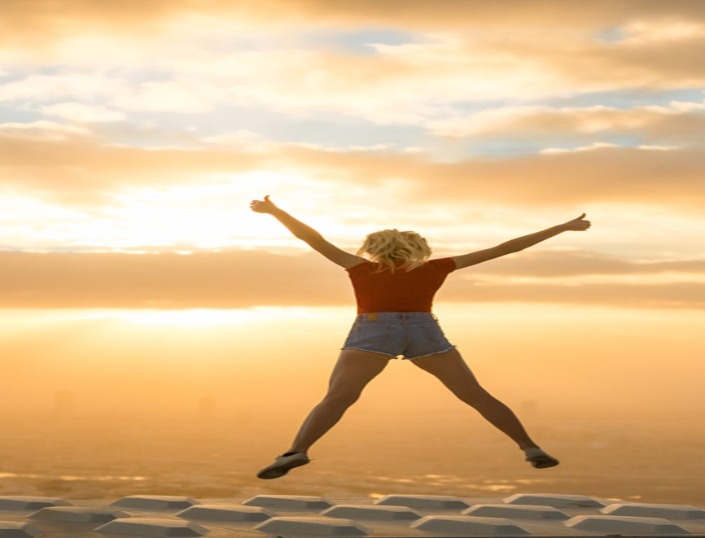
PLAYFUL LIBERATION
Emotional benefits; What SHOULD THE HOLIDAY give me ?
The core meaning of going on holiday is to feel full of energy and allow me to enjoy life to the fullest.
Destination features and activities; What AM I looking for?
I want to go to a place with a variety of accommodation offers, good shopping and good beaches. It should not be too warm and good service is also highly appreciated.
PERSONALITY; WHAT SHOULD IT STAND FOR?
The destination needs to be fresh and playful.
Social identity; how should it reflect upon me?
The destination should be for people who wants to have as much fun as possible in life and that likes to party. More or less people that like to do things spontaneously, impulsively and people who enjoy spending time with friends.
Sometimes I need to let go. Enjoy life to the fullest and feel completely liberated. I need to refill my energy and pamper myself. Its all about me.
50%
ARE BELOW
50 YEARS
52%
48%
SHARE OF OVERNIGHT STAYS
19%

Slide 39
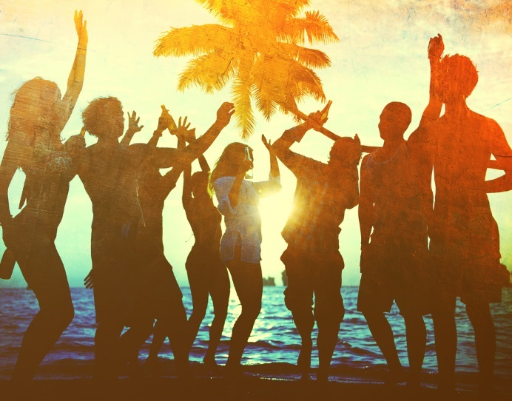
PLAYFUL LIBERATION
TYPICAL HOLIDAY OCCASIONS
Of course you will find the typical sun and beach vacation in this segment, but you will also find visits to historic sites and culture experiences. Although, most of the time it’s all about party and fun!
I TRAVEL TO FEEL GOOD
These consumers choose destinations that makes them feel good. They want to party, and enjoy themselves in the company of others. They want to travel to places that are fresh and playful. They want to have a informal, fun and relaxed holiday at the same time.
THE ROLE OF BRANDS
The segment is important for brands/destinations which wish to position themselves as hedonistic and pleasure-seeking (or giving); and for brands which will position themselves in the space of sensuality, sexuality and sensory enjoyment.
HOLIDAY EXPERIENCE
These consumers are spontaneous travellers. They have their favourite spots, but they are driven by the “feel good factor” of what they see in social media or at booking sites. They would rather stay at home than travel without friends, and will often end up going somewhere if their friends tell them.
SOURCES OF INSPIRATIONS
These consumers don’t spend a lot of time planning where to go. Most of them settle for the trip less than four weeks before they go. They act on what catches their eye in social media or on hompages for destinations, hotels or attractions/sites. It’s more like “in the spur of the moment”, a typical “last minute booker”. Friends and acquaintances heavily influences their choice.

Slide 40
Playful LIBERATION - Active, relaxed and fresh
Core motivations
Emotional Benefits
Social Identity
Personality
Destination features
NOTE: Indexed vs. average of all items in facet We report all items with a score which is 1 standard deviation higher than the average
Notes:
Here it is crucial to insist on 4 things:
Stakeholders interview as per my comment on page 1: it is fundamental to understand what all users expect; it does not mean that collectively we will say yes to everything, but understanding potential challenges will help address this together
Formal deployment to make things official is also fundamental and too often forgotten: that have to be done together
We know things will not be perfect thus the importance of monitoring and adjusting the SOW if needed
It would be a big mistake to run fast in implementation: time we spend there is time we save later

Slide 41
Segment profile – playful liberation
Significantly over indexed in segment
Significantly under indexed in segment
TYPOLOGY
TRANSPORT AND ACOMMODATION
ACTIVITIES
TYPE OF HOLIDAY
TRANSPORT TO DESTINATION
ACTIVITIES
TRANSPORT ON DESTINATION
DURATION
ACCOMMODATION
TIME OF YEAR

Slide 42
Segment profile - playful liberation
Significantly over indexed in segment
Significantly under indexed in segment
PLANNING
DECISION MADE
INFLUENCERS
INFORMATION SOURCES
TRAVEL COMPANIONS
WHO DID YOU TRAVEL WITH
NUMBER OF TRAVEL COMPANIONS
TRAVEL FREQUENCY (NUMBER OF TIMES ABROAD)
HOW DID YOU TRAVEL

Slide 43
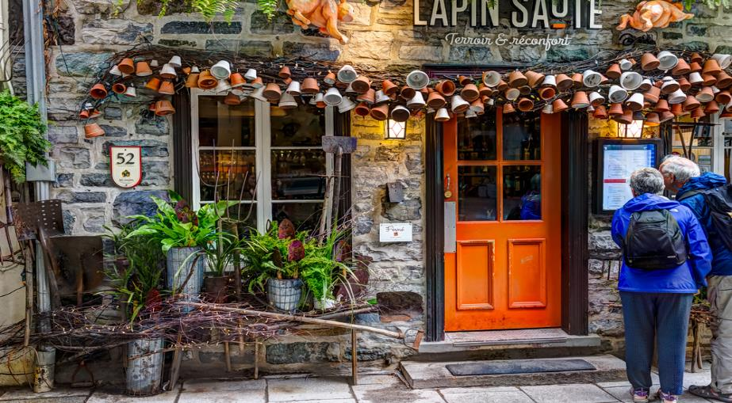
Social immersion is all about wanting to be harmoniously connected with other people. For me, meeting people is a joy. I love having good times with good friends and opening up and meeting new people.
SOCIAL IMMERSION
Sociable and open-minded
Meet local people, eat local cuisine

Slide 44
SOCIAL IMMERSION
Emotional benefits; What SHOULD THE HOLIDAY give me ?
The core meaning of going on holiday is to meet new people. I want to go a place where I can immerse myself in the local life and broaden my knowledge and horizon. A holiday should create precious moments of togetherness and I would like to go places that allows me to discover new and interesting places. Furthermore I want to enrich my view on the world. I want to discover new and interesting places.
Destination features and activities; What AM I looking for?
I want to destinations that has good opportunities to meet local people. It needs to be known for its friendly people and good local cuisine. Interesting sights, interesting culture & art and a rich cultural heritage is also important
PERSONALITY; WHAT SHOULD IT STAND FOR?
The destination needs to be sociable and friendly.
Social identity; how should it reflect upon me?
The destination should be for people who are always looking to connect with others. People who enjoy an active and busy social life. People who enjoy spending time with friends. People who like to explore and have new experiences. People who are interested to learn more.
Sometimes I need to IMMERSE MYSELF INTO LOCAL LIFE, MEET NEW PEOPLE AND EAT LOCAL CUISINE
38%
ARE ABOVE
60 YEARS
45%
55%
SHARE OF OVERNIGHT STAYS
8%

Slide 45
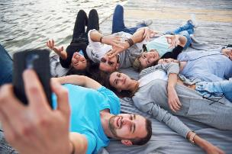
SOCIAL IMMERSION
TYPICAL HOLIDAY OCCASIONS
In this segment you will find trips to experience culture, typical sun and beach holiday, visits to historical sites and at lot of sightseeing/ round trips. You will also find this segment visiting friends and relatives more than the other segments.
I TRAVEL TO MEET THE LOCALS
These consumers want to visit cities and discover local culture and lifestyle. They want to visit historical buildings and sites, taste local food and drinks and visit museums more than the other segments.
The experience of national festivals and traditional celebrations are also most appreciated.
THE ROLE OF BRANDS
The segment is important for brands which try to position themselves as enhancers of friendships, as social brands which help bring people together, and brands which are open, inclusive, and seeking to reflect shared pleasures. It is important for brands which seek to support collaboration with their customers.
HOLIDAY EXPERIENCE
These are consumers that organize their trip themselves and travels independently. They often travel with friends and seek a social experience in a new to them culture. They want to immerse themselves in local life and culture, connect with others and spend time with friends.
SOURCES OF INSPIRATIONS
Most of these consumers make their decision less than 1 months before their departure (69%). They act more than the other segments on reviews from other travellers online. Internet in general is the most important information source. Their spouse/partner and friends heavily influences their choice.

Slide 46
SOCIAL IMMERSION - Active, relaxed and fresh
Core motivations
Emotional Benefits
Social Identity
Personality
Destination features
NOTE: Indexed vs. average of all items in facet We report all items with a score which is 1 standard deviation higher than the average
Notes:
Here it is crucial to insist on 4 things:
Stakeholders interview as per my comment on page 1: it is fundamental to understand what all users expect; it does not mean that collectively we will say yes to everything, but understanding potential challenges will help address this together
Formal deployment to make things official is also fundamental and too often forgotten: that have to be done together
We know things will not be perfect thus the importance of monitoring and adjusting the SOW if needed
It would be a big mistake to run fast in implementation: time we spend there is time we save later

Slide 47
Segment profile – SOCIAL IMMERSION
Significantly over indexed in segment
Significantly under indexed in segment
TYPOLOGY
TRANSPORT AND ACOMMODATION
ACTIVITIES
TYPE OF HOLIDAY
TRANSPORT TO DESTINATION
ACTIVITIES
TRANSPORT ON DESTINATION
DURATION
ACCOMMODATION
TIME OF YEAR

Slide 48
Segment profile - SOCIAL IMMERSION
Significantly over indexed in segment
Significantly under indexed in segment
PLANNING
DECISION MADE
INFLUENCERS
INFORMATION SOURCES
TRAVEL COMPANIONS
WHO DID YOU TRAVEL WITH
NUMBER OF TRAVEL COMPANIONS
TRAVEL FREQUENCY (NUMBER OF TIMES ABROAD)
HOW DID YOU TRAVEL

Slide 49
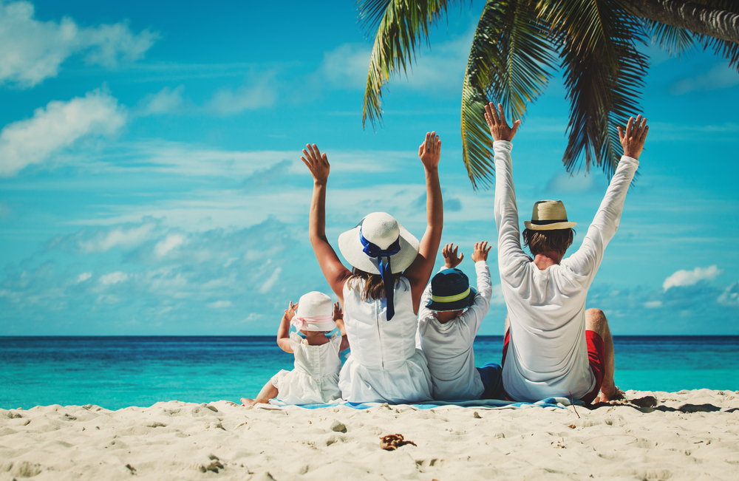
Sharing and caring is all about being surrounded by people who accept me as I am, as an equal and who make me feel welcome. Sharing and caring is about the need to be part of society or a group we really feel part of. Part of this is linked to following norms and traditions just because we are part of that culture or group. It is about togetherness, brotherhood, camaraderie, taking care of others, being taken care of by others, and doing and feeling good.
SHARING AND CARING
Sociable and friendly
Precious moments of togetherness

Slide 50
SHARING AND CARING
Emotional benefits; What SHOULD THE HOLIDAY give me ?
The core meaning of going on holiday is to create precious moments of togetherness share good times with others. I want to intensify the relationship with my loved one(s) and escape from my hectic daily life.
Destination features and activities; What AM I looking for?
It has to be a destination that has friendly people, good local cuisine and should be easy to travel to. I want guaranteed sunshine and good value for money. My family needs guaranteed sunshine and good beaches. The destination should be easy to travel around as well.
PERSONALITY; WHAT SHOULD IT STAND FOR?
The destination needs to be sociable, friendly, harmonious, relaxed, peaceful and cozy.
Social identity; how should it reflect upon me?
The destination should be for people for who have strong family values for people whom family comes first above all. People who enjoy spending time with friends and enjoy taking care of others. People who want to escape from the demands of life and relax and unwind
Sometimes I need to SPOIL MY LOVED ONES AND CREATE PRECIOUS MOMENTS OF TOGETHERNESS. My family comes first above all.
63%
ARE ABOVE
40 YEARS
53%
47%
SHARE OF OVERNIGHT STAYS
6%

Slide 51
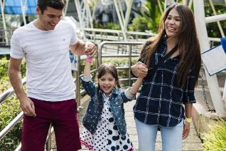
SHARING AND CARING
TYPICAL HOLIDAY OCCASIONS
You will find the typical sun and beach vacation in this segment also, but you will find more holidays to visit friends and family, health travels and travels to cottage/holiday homes here than in other segments. For these consumer it’s all about family.
I TRAVEL TO FEEL INCLUDED
These consumers choose destinations that enables them to spend time with their loved ones. They want to travel to places that are sociable, friendly and relaxed. They want to create those precious moments of togetherness.
THE ROLE OF BRANDS
Brands that want to tap into the needs in this segment should focus on support, empathy, care giving and true, deep friendships. They should position themselves as familiar and appealing to a broader audience and tap into those feelings that people get when they feel warm, included and accepted by the people or tribe they are with.
HOLIDAY EXPERIENCE
Relaxation and sunbathing and swimming is highly appreciated by this segment. They also like to taste visit cities and taste local food and drinks as well as observe the beauty of nature. The activities should be slow, warm and friendly. No pushing boundaries please!
SOURCES OF INSPIRATIONS
Of course they use the internet, but more than in other segments they act on advice from friends/family. Parents and other relatives heavily influences their choice. They travel with children and other family members and relatives.

Slide 52
SHARING AND CARING
Core motivations
Emotional Benefits
Social Identity
Personality
Destination features
NOTE: Indexed vs. average of all items in facet We report all items with a score which is 1 standard deviation higher than the average
Notes:
Here it is crucial to insist on 4 things:
Stakeholders interview as per my comment on page 1: it is fundamental to understand what all users expect; it does not mean that collectively we will say yes to everything, but understanding potential challenges will help address this together
Formal deployment to make things official is also fundamental and too often forgotten: that have to be done together
We know things will not be perfect thus the importance of monitoring and adjusting the SOW if needed
It would be a big mistake to run fast in implementation: time we spend there is time we save later

Slide 53
Segment profile – SHARING AND CARING
Significantly over indexed in segment
Significantly under indexed in segment
TYPOLOGY
TRANSPORT AND ACOMMODATION
ACTIVITIES
TYPE OF HOLIDAY
TRANSPORT TO DESTINATION
ACTIVITIES
TRANSPORT ON DESTINATION
DURATION
ACCOMMODATION
TIME OF YEAR

Slide 54
Segment profile - SHARING AND CARING
Significantly over indexed in segment
Significantly under indexed in segment
PLANNING
DECISION MADE
INFLUENCERS
INFORMATION SOURCES
TRAVEL COMPANIONS
WHO DID YOU TRAVEL WITH
NUMBER OF TRAVEL COMPANIONS
TRAVEL FREQUENCY (NUMBER OF TIMES ABROAD)
HOW DID YOU TRAVEL

Slide 55
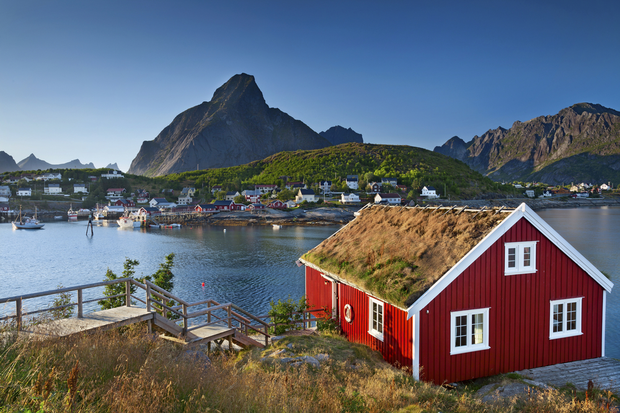
Escape is about the experience of retreat, tranquility and quietness. These are the holidays one feels the need to retreat and recharge. One is looking for an experience that sooths, comforts and takes away the stresses and strains of hectic daily life. These are the holidays one withdraws to a physical or mental space that is worry free - an almost childlike state of feeling safe and cared for.
ESCAPE
PEACEFUL AND HARMONIOUS
RESTORE MY SENSE OF HARMONY AND BALANCE

Slide 56
ESCAPE
Emotional benefits; What SHOULD THE HOLIDAY give me ?
The core meaning of going on holiday is to restore my sense of harmony and balance. I need to escape from my hectic daily life, and pamper myself. I want to feel full of energy and a holiday should allow me to intensify the relationship with my loved ones.
Destination features and activities; What AM I looking for?
I want to go to a place that has quiet environments, good beaches and unspoiled nature. It should allow me to live close to nature and should not be ruined by tourism. I need guaranteed sunshine, but it should not be too warm. I also appreciate beautiful nature. Furthermore the destination should have environmentally friendly offers and be good value for money.
PERSONALITY; WHAT SHOULD IT STAND FOR?
The destination needs to be harmonious, relaxed, peaceful and cozy.
Social identity; how should it reflect upon me?
The destination should be for people who needs escape from the demands of life and relax and unwind. People who need time for themselves. People who want to revitalize themselves, and for people for whom family comes first above all.
Sometimes I need to restore my sense of harmony and balance. Escape from the demands of life, relax and unwind.
43%
ARE BETWEEN
40-59 YEARS
51%
49%
SHARE OF OVERNIGHT STAYS
12%

Slide 57
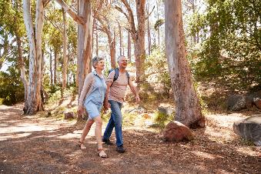
ESCAPE
TYPICAL HOLIDAY OCCASIONS
Of course you will find the typical sun and beach vacation in this segment, but you will also find more travels to experience nature, scenery and wildlife, health travels and countryside holidays than in other segments.
I TRAVEL TO A QUIET PLACE
These consumers choose destinations that makes them restore their sense of harmony. They travel by car to a greater extent than other segments and they are also more prune to stay at a cabin, holiday home or flat than in other segments. They normally stay for 7-14 days.
THE ROLE OF BRANDS
This segment is important when brands want to profile themselves as supporting people in relieving stress and tension. These are the brands and companies that focus on protection and prevention against danger and harm in everyday life. These brands function as a safety net around us, our families and loved ones.
HOLIDAY EXPERIENCE
Observe beauty of nature and relaxation is on top of the list more than in other segments. The same goes for activities like taste local food and drinks, sunbathing and swimming, hiking, visit the countryside and experience mountains, the wilderness or the wildlife. Visits to spa resorts and getting pampered is also appreciated by this segment.
SOURCES OF INSPIRATIONS
Most of these consumers decide on the trip shortly before departure. 66% of them settle for the trip less than four weeks before they go. They use the internet in general as information source, but use homepages for the destination and travel apps to a lager extent than the other segments.

Slide 58
ESCAPE
Core motivations
Emotional Benefits
Social Identity
Personality
Destination features
NOTE: Indexed vs. average of all items in facet We report all items with a score which is 1 standard deviation higher than the average

Slide 59
Segment profile – ESCAPE
Significantly over indexed in segment
Significantly under indexed in segment
TYPOLOGY
TRANSPORT AND ACOMMODATION
ACTIVITIES
TYPE OF HOLIDAY
TRANSPORT TO DESTINATION
ACTIVITIES
TRANSPORT ON DESTINATION
DURATION
ACCOMMODATION
TIME OF YEAR

Slide 60
Segment profile - ESCAPE
Significantly over indexed in segment
Significantly under indexed in segment
PLANNING
DECISION MADE
INFLUENCERS
INFORMATION SOURCES
TRAVEL COMPANIONS
WHO DID YOU TRAVEL WITH
NUMBER OF TRAVEL COMPANIONS
TRAVEL FREQUENCY (NUMBER OF TIMES ABROAD)
HOW DID YOU TRAVEL

Slide 61
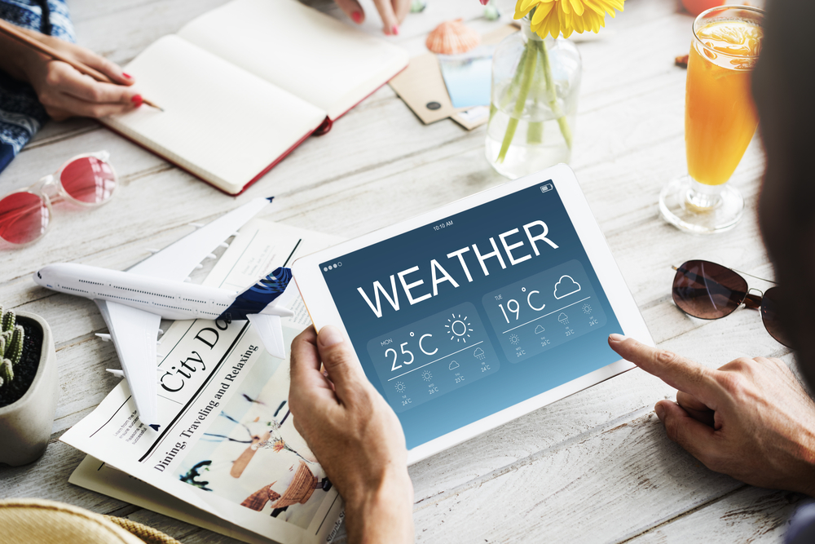
Control is about avoiding surprises and seek the familiar instead of the unknown. There are holidays when I like to be completely in control, to keep things in order, keeping it practical and predictable feels quite comfortable and safe. This gives me a sense of stability and structure.
CONTROL
PRACTICAL AND PREDICTABLE
AVOID SURPRISES

Slide 62
CONTROL
Emotional benefits; What SHOULD THE HOLIDAY give me ?
The core meaning of going on holiday is to avoid too much surprises. I want a holiday that gives me a safe feeling.
Destination features and activities; What AM I looking for?
I want to go to a place that is easy to travel to and which have good service.
PERSONALITY; WHAT SHOULD IT STAND FOR?
The destination needs to be structured and practical.
Social identity; how should it reflect upon me?
The destination should be for people who make rational choices. People who prefer the familiar over the unknown. Basically people who avoid risk and for whom family comes first above all.
I LIKE TO KEEP EVERYTHING UNDER CONTROL AND AVOID SURPRISES. I HAS TO BE WELL ORGANIZED, PRACTICAL AND PREDICTABLE.
52%
ARE BETWEEN
30-59 YEARS
47%
53%
SHARE OF OVERNIGHT STAYS
11%

Slide 63
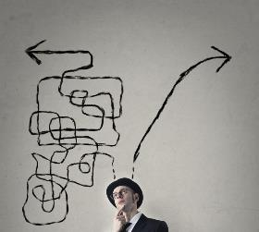
CONTROL
TYPICAL HOLIDAY OCCASIONS
Although the typical sun and beach vacation, cultural experiences and visits to historic sites dominates in this segment, you will also find sightseeing/round trips and party and fun as much as the next man.
I TRAVEL TO AVOID SURPRISES
These consumers choose destinations that is well organized. They want to travel to places that are structured and practical. They want to have a informal, fun and relaxed holiday at the same time.
I want to avoid too much surprises!
THE ROLE OF BRANDS
Control plays an important role for brands if they are aimed at structuring people’s lives or when the focus is on risk management, simplifying life, avoiding surprises. Brands that want to position themselves on Control should offer rational arguments and focus on functionality, maturity, health, purity, hygiene, and less in impulsiveness and fun.
HOLIDAY EXPERIENCE
Visit cities and relaxations is on top of the list. This segment is under indexing on many activities, so a less active segment. They would like to visit cities and have restaurant meals.
SOURCES OF INSPIRATIONS
These consumers travel with children so they are highly influenced by their spouse and their children. Many travel in a group with an organized tour (23%). They do not use that many information sources because the go to a place they know.

Slide 64
CONTROL
Core motivations
Emotional Benefits
Social Identity
Personality
Destination features
NOTE: Indexed vs. average of all items in facet We report all items with a score which is 1 standard deviation higher than the average
Notes:
Here it is crucial to insist on 4 things:
Stakeholders interview as per my comment on page 1: it is fundamental to understand what all users expect; it does not mean that collectively we will say yes to everything, but understanding potential challenges will help address this together
Formal deployment to make things official is also fundamental and too often forgotten: that have to be done together
We know things will not be perfect thus the importance of monitoring and adjusting the SOW if needed
It would be a big mistake to run fast in implementation: time we spend there is time we save later

Slide 65
Segment profile – CONTROL
Significantly over indexed in segment
Significantly under indexed in segment
TYPOLOGY
TRANSPORT AND ACOMMODATION
ACTIVITIES
TYPE OF HOLIDAY
TRANSPORT TO DESTINATION
ACTIVITIES
TRANSPORT ON DESTINATION
DURATION
ACCOMMODATION
TIME OF YEAR

Slide 66
Segment profile - CONTROL
Significantly over indexed in segment
Significantly under indexed in segment
PLANNING
DECISION MADE
INFLUENCERS
INFORMATION SOURCES
TRAVEL COMPANIONS
WHO DID YOU TRAVEL WITH
NUMBER OF TRAVEL COMPANIONS
TRAVEL FREQUENCY (NUMBER OF TIMES ABROAD)
HOW DID YOU TRAVEL

Slide 67
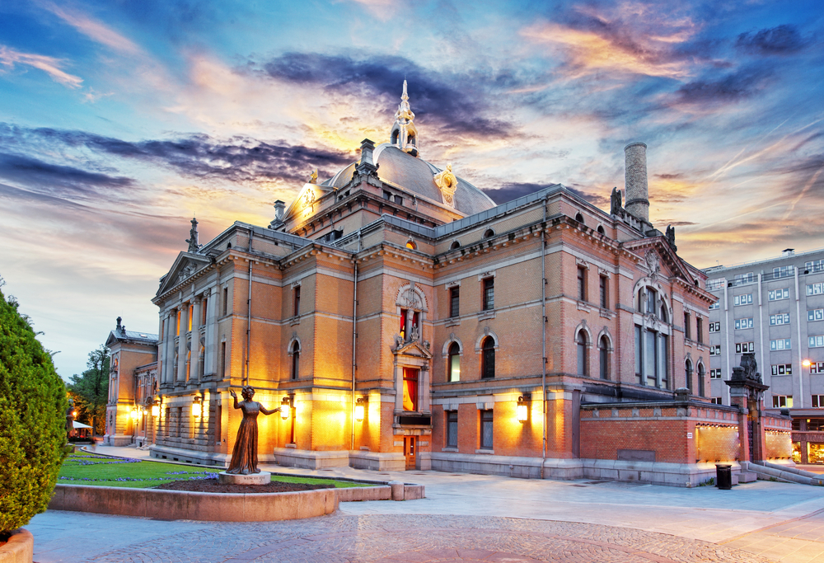
Broadening my cultural horizon is about feeling cultivated, special and ahead of the pack. The segment reflects the need to learn about a foreign culture, stand out from the crowd and break from convention. The segment is all about being proud of one’s own special ability and competence, intellectually, culturally and materially. Something to talk about when coming home.
BROADENING MY CULTURAL HORIZON
CULTIVATED, EXPLORATIVE AND AUTHENTIC
BROADENING MY KNOWLEDGE

Slide 68
BROADENING MY CULTURAL HORIZON
Emotional benefits; What SHOULD THE HOLIDAY give me ?
The core meaning of going on holiday is to broaden my knowledge and my horizon. I want to enrich my view on the world and discover new and interesting places. All in all I want rich experiences.
Destination features and activities; What AM I looking for?
I want to go to a place with interesting culture & art and a rich cultural heritage. There must be interesting sights. The destination needs to be easy to travel to and around.
PERSONALITY; WHAT SHOULD IT STAND FOR?
The destination needs to be cultivated, explorative, structured, active, unique and authentic.
Social identity; how should it reflect upon me?
The destination should be for people who are interested to learn more. For people who like to explore and have new experiences and who are always looking to connect with others. These people make rational choices. At the same time they like to have the best things and value high quality.
Sometimes I need to broaden my horizon and discover new and interesting places. I want to experience culture and art at a destination with a rich cultural heritage.
37%
ARE ABOVE
60 YEARS
55%
45%
SHARE OF OVERNIGHT STAYS
11%

Slide 69
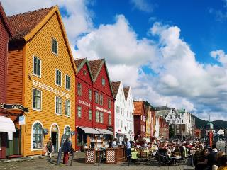
BROADENING MY CULTURAL HORIZON
TYPICAL HOLIDAY OCCASIONS
The dominant types of holiday is cultural experience (focus on art, theatre etc.), visits to historic sites, Sightseeing/round trip and city break (cultural, shopping, Club, restaurant visits etc.) It’s all about broadening my horizon!
I TRAVEL TO EXPAND MY HORIZON
These consumers want to see and learn more than other travelers. They seek destinations with a rich cultural heritage. There must be interesting sights.
THE ROLE OF BRANDS
The segment is important for brands which try to position themselves as creatively individualistic, unconventional, trendy and ahead of the rest, or as a tool for consumers to express their intelligence and cultural awareness.
HOLIDAY EXPERIENCE
These consumers you will find in cities and at historical buildings/sites. They discover local culture and lifestyle, visit museums, experience local architecture and explore local history and legends. They want to are of high interest. You will also find them at sightseeing tours and at art exhibitions.
SOURCES OF INSPIRATIONS
These consumers are, more than others inspired by homepages for the destination, homepages for attractions and sites, homepages for hotels/accommodation and carriers, booking sites, guidebooks and catalogues or brochures.

Slide 70
BROADENING MY CULTURAL HORIZON
Core motivations
Emotional Benefits
Social Identity
Personality
Destination features
NOTE: Indexed vs. average of all items in facet We report all items with a score which is 1 standard deviation higher than the average
Notes:
Here it is crucial to insist on 4 things:
Stakeholders interview as per my comment on page 1: it is fundamental to understand what all users expect; it does not mean that collectively we will say yes to everything, but understanding potential challenges will help address this together
Formal deployment to make things official is also fundamental and too often forgotten: that have to be done together
We know things will not be perfect thus the importance of monitoring and adjusting the SOW if needed
It would be a big mistake to run fast in implementation: time we spend there is time we save later

Slide 71
Segment profile – BROADENING MY CULTURAL HORIZON
Significantly over indexed in segment
Significantly under indexed in segment
TYPOLOGY
TRANSPORT AND ACOMMODATION
ACTIVITIES
TYPE OF HOLIDAY
TRANSPORT TO DESTINATION
ACTIVITIES
TRANSPORT ON DESTINATION
DURATION
ACCOMMODATION
TIME OF YEAR

Slide 72
Segment profile – BROADENING MY CULTURAL HORIZON
Significantly over indexed in segment
Significantly under indexed in segment
PLANNING
DECISION MADE
INFLUENCERS
INFORMATION SOURCES
TRAVEL COMPANIONS
WHO DID YOU TRAVEL WITH
NUMBER OF TRAVEL COMPANIONS
TRAVEL FREQUENCY (NUMBER OF TIMES ABROAD)
HOW DID YOU TRAVEL

Slide 73
Exploring the world of natural beauty is about feeling unique, daring and adventurous. The segment reflects the need to see something new, something spectacular like a natural phenomenon. It also connects with the need to immerse in unspoiled nature and travel to a destination not ruined by tourism. Staying ahead of the “charter pack”. The segment is all about being proud of one’s ability to “go where no one has gone before”.
ADVENTURES IN the world of natural beauty
adventurous, daring AND unique.
immerse myself in the local life. Unspoiled nature.

Slide 74
ADVENTURES IN the world of natural beauty
Emotional benefits; What SHOULD THE HOLIDAY give me ?
The core meaning of going on holiday is to enrich my view on the world, broaden my knowledge and my horizon and give me new inspiration and rich experiences. I want to restore my sense of harmony and balance, and enjoy life to the fullest. I want to discover new and interesting places which allows me to immerse myself in the local life.
Destination features and activities; What AM I looking for?
I want to go to a place that is not ruined by tourism. It should have unspoiled nature and allow me to live close to nature. I want quiet environments and beautiful nature. A destination that has good opportunities to meet local and friendly people.
PERSONALITY; WHAT SHOULD IT STAND FOR?
The destination needs to be daring adventurous, unique, authentic, active and explorative.
Social identity; how should it reflect upon me?
The destination should be for people who like adventure and who do things the unconventional way. People who want to make a different choice and who like to explore and have new experiences. All in all, people who are interested to learn more.
Sometimes I need to discover new and interesting places at a destination that has unspoiled nature and that s not ruined by tourism.
56%
ARE BETWEEN
30-59 YEARS
50%
50%
SHARE OF OVERNIGHT STAYS
14%

Slide 75
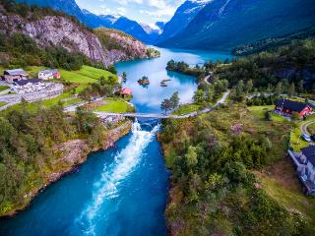
ADVENTURES IN the world of natural beauty
TYPICAL HOLIDAY OCCASIONS
The most common holiday type is a holiday to visit historic sites or holidays to experience nature, scenery and wildlife. They are also over indexing on sport/active holiday.
I TRAVEL TO SOMETHING UNIQUE
These consumers choose destinations that makes them feel adventurous and daring. They want to experience something unique. They want to travel to places that are fuelling their explorative side.
THE ROLE OF BRANDS
The segment is important for brands which try to position themselves as creatively individualistic, unconventional, trendy and ahead of the rest, or as a tool for consumers to express their uniqueness, seeing something others has not seen. Also act as a tool for consumers to express their environmental awareness. A sustainable destination, not ruined by tourism.
HOLIDAY EXPERIENCE
This is a very active segment. They want to observe beauty of nature and natural phenomenon, discover local culture and lifestyle, visit parks and gardens, sunbathing and swimming, hiking, experience national festivals and traditional celebrations and experience mountains, the wilderness or the wildlife.
SOURCES OF INSPIRATIONS
This segment seek their information for homepages for the destination and in guidebooks. They also over index on usage of travel agent in their homeland.

Slide 76
ADVENTURES IN the world of natural beauty
Core motivations
Emotional Benefits
Social Identity
Personality
Destination features
NOTE: Indexed vs. average of all items in facet We report all items with a score which is 1 standard deviation higher than the average
Notes:
Here it is crucial to insist on 4 things:
Stakeholders interview as per my comment on page 1: it is fundamental to understand what all users expect; it does not mean that collectively we will say yes to everything, but understanding potential challenges will help address this together
Formal deployment to make things official is also fundamental and too often forgotten: that have to be done together
We know things will not be perfect thus the importance of monitoring and adjusting the SOW if needed
It would be a big mistake to run fast in implementation: time we spend there is time we save later

Slide 77
Segment profile – ADVENTURES IN the world of natural beauty
Significantly over indexed in segment
Significantly under indexed in segment
TYPOLOGY
TRANSPORT AND ACOMMODATION
ACTIVITIES
TYPE OF HOLIDAY
TRANSPORT TO DESTINATION
ACTIVITIES
TRANSPORT ON DESTINATION
DURATION
ACCOMMODATION
TIME OF YEAR

Slide 78
Segment profile – ADVENTURES IN the world of natural beauty
Significantly over indexed in segment
Significantly under indexed in segment
PLANNING
DECISION MADE
INFLUENCERS
INFORMATION SOURCES
TRAVEL COMPANIONS
WHO DID YOU TRAVEL WITH
NUMBER OF TRAVEL COMPANIONS
TRAVEL FREQUENCY (NUMBER OF TIMES ABROAD)
HOW DID YOU TRAVEL

Slide 79
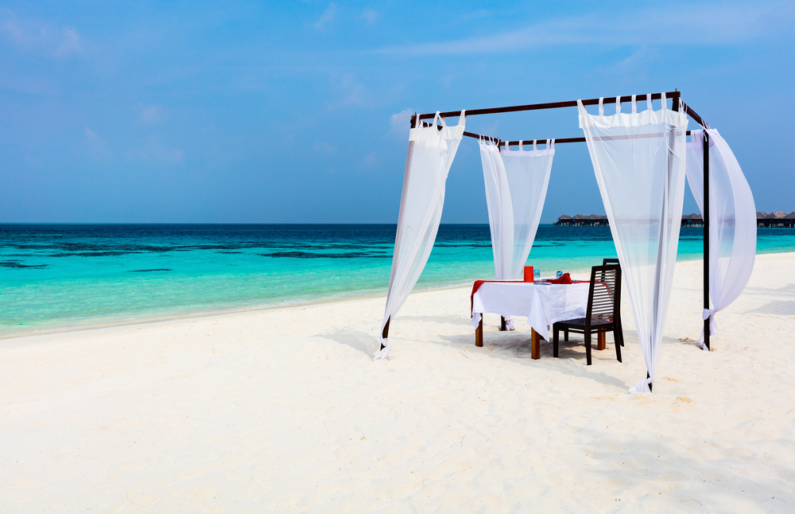
Romantic luxury is about the need to indulge in some luxury. Find those romantic spots that really creates a feeling of extravagance. It relates to the desire to feel on top of the world. The segment reflects that I want the best and are willing to pay for it.
EXTRAVAGANT INDULGENCE
EXTRAVAGANT AND SUPERIOR
SOPHISTICATED AND CLASSY

Slide 80
EXTRAVAGANT INDULGENCE
Emotional benefits; What SHOULD THE HOLIDAY give me ?
The core meaning of going on holiday is to allow me to indulge myself with a bit of luxury. I want a vacation that makes me feel on top of the world.
Destination features and activities; What AM I looking for?
I want to go to a place that has places to go out partying and romantic spots. A variety of different restaurant offers and good shopping is also important.
PERSONALITY; WHAT SHOULD IT STAND FOR?
The destination needs to be superior, classy, extravagant, and cultivated.
Social identity; how should it reflect upon me?
The destination should be for people who is sophisticated and classy. People who want the best and are willing to pay for it. Basically people who like to have the best things and value high quality.
Sometimes I NEED TO INDULGE MY SELF WITH A BIT OF LUXURURY AND FEEL ON TOP OF THE WORLD. I NEED A DESTINATION WITH ROMANTIC SPOTS.
50%
ARE BELOW
50 YEARS
42%
58%
SHARE OF OVERNIGHT STAYS
13%

Slide 81
EXTRAVAGANT INDULGENCE
TYPICAL HOLIDAY OCCASIONS
You will find most of the typical sun and beach vacations and sightseeing/round trips in this segment, but you will find ski/active holiday and other types of winter holidays here as well. Although, most of the time it’s all about romance!
I TRAVEL FOR ROMANCE AND LUXURY
These consumers choose destinations that enables them to indulge in a bit of luxury. Although most of the trips are in summertime it can even be in the winter. They often travel on organized tours or have others plan for them and travel independently.
THE ROLE OF BRANDS
The segment is important for brands trying to position themselves as premium, high-class and powerful. It appeals to the need to be respected and revered, to feel strong and ‘on-top-of-the-world’. It is also an important dimension for brands who want to be perceived as exclusive and only available for the lucky few.
HOLIDAY EXPERIENCE
These consumers over index on visits to amusements parks. They want their romantic spots which they can find both in cities and in traditional beach resorts. They stay at high standard hotels more than in other segments.
SOURCES OF INSPIRATIONS
These consumers don’t spend a lot of time planning. 60% of them settle for the trip less than four weeks before they go. They a browse the internet in general to get luxurious romantic inspiration. They travel with their partner and gets inspired by him or her.

Slide 82
EXTRAVAGANT INDULGENCE
Core motivations
Emotional Benefits
Social Identity
Personality
Destination features
NOTE: Indexed vs. average of all items in facet We report all items with a score which is 1 standard deviation higher than the average
Notes:
Here it is crucial to insist on 4 things:
Stakeholders interview as per my comment on page 1: it is fundamental to understand what all users expect; it does not mean that collectively we will say yes to everything, but understanding potential challenges will help address this together
Formal deployment to make things official is also fundamental and too often forgotten: that have to be done together
We know things will not be perfect thus the importance of monitoring and adjusting the SOW if needed
It would be a big mistake to run fast in implementation: time we spend there is time we save later

Slide 83
Segment profile – EXTRAVAGANT INDULGENCE
Significantly over indexed in segment
Significantly under indexed in segment
TYPOLOGY
TRANSPORT AND ACOMMODATION
ACTIVITIES
TYPE OF HOLIDAY
TRANSPORT TO DESTINATION
ACTIVITIES
TRANSPORT ON DESTINATION
DURATION
ACCOMMODATION
TIME OF YEAR

Slide 84
Segment profile - EXTRAVAGANT INDULGENCE
Significantly over indexed in segment
Significantly under indexed in segment
PLANNING
DECISION MADE
INFLUENCERS
INFORMATION SOURCES
TRAVEL COMPANIONS
WHO DID YOU TRAVEL WITH
NUMBER OF TRAVEL COMPANIONS
TRAVEL FREQUENCY (NUMBER OF TIMES ABROAD)
HOW DID YOU TRAVEL

Slide 85
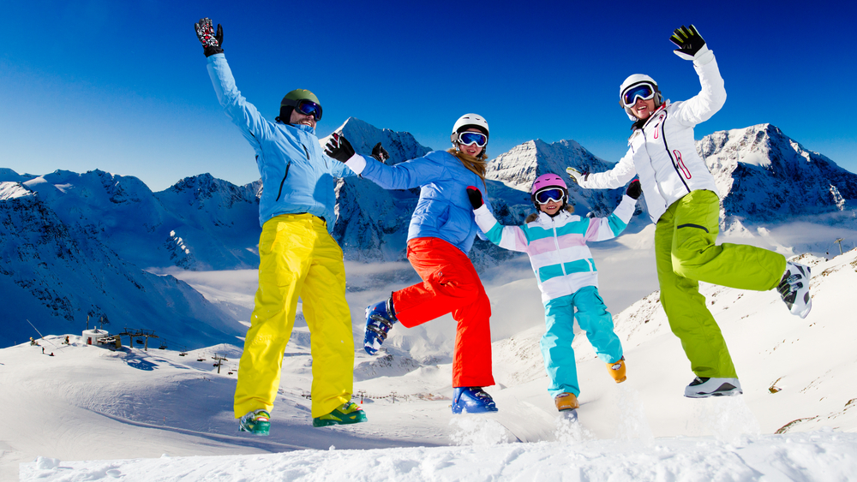
Energy is about adventure, being active, testing your boundaries and discovering new things. It taps into the need to be energized. Energy is all about being active and experiencing the freedom, passion, and adventure that comes with activities. Buzzing about, spending energy, and feeling very much alive and kicking.
ENERGY
ACTIVE AND ADVENTUROUS
HAVE AS MUCH FUN AS POSSIBLE

Slide 86
ENERGY
Emotional benefits; What SHOULD THE HOLIDAY give me ?
The core meaning of going on holiday is to feel allow me to intensify the relationship with my loved ones. A holiday should give me new inspiration and make me feel full of energy.
Destination; What AM I looking for?
I want to go to a place that offers a wide range of possible activities also for kids. A destination that allows me to be physical active.
PERSONALITY; WHAT SHOULD IT STAND FOR?
The destination needs to be active, explorative and adventurous.
Social identity; how should it reflect upon me?
The destination should be for people who like to do things spontaneously, impulsively. People for whom family comes first above all and people who want to revitalize themselves.
Sometimes I NEED a holiday that gives med energy and new inspiration. I need a destination with a wide range of activities that keeps me physical active.
38%
ARE BELOW
40 YEARS
52%
48%
SHARE OF OVERNIGHT STAYS
7%

Slide 87
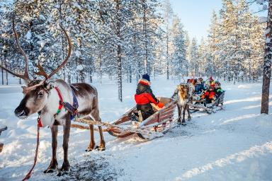
ENERGY
TYPICAL HOLIDAY OCCASIONS
As in most segments you will find the typical sun and beach vacation in this segment, but you will also find sightseeing/round trips, cultural experiences and visits to historic sites as much as the next man!
I TRAVEL TO GET ENERGY
These consumers choose destinations that enables them to feel full of energy. They often travel in groups (2 or more) with friends and with children, so the social element is also important. Many of them travel by car and they stay at a medium standard hotels. Travel mainly in summertime.
THE ROLE OF BRANDS
The energy segment is important for brands who position themselves as vital and energetic and who are always pushing the boundaries and stimulating consumers with change and challenge. A brand that wants to adopt a Vitality strategy needs to position itself as inquisitive and curious about the world, a brand that is entertaining, surprising and sometimes perhaps even shocking for its (temporary) consumers. It is important for these brands to offer constant renewal.
HOLIDAY EXPERIENCE
This segments don’t over index on any activities. But you will find observing beauty of nature, visits to historical sites and relaxation on the list over popular activities.
SOURCES OF INSPIRATIONS
These consumers don’t spend a lot of time planning where to go. Most of them settle for the trip less than 2 months before they go (63%). Their main source of information is the internet in general. I.e. it will be important to use search engines as a vehicle to reach this segment. Their partners children, friends and acquaintances heavily influences their choice.

Slide 88
ENERGY
Core motivations
Emotional Benefits
Social Identity
Personality
Destination features
NOTE: Indexed vs. average of all items in facet We report all items with a score which is 1 standard deviation higher than the average
Notes:
Here it is crucial to insist on 4 things:
Stakeholders interview as per my comment on page 1: it is fundamental to understand what all users expect; it does not mean that collectively we will say yes to everything, but understanding potential challenges will help address this together
Formal deployment to make things official is also fundamental and too often forgotten: that have to be done together
We know things will not be perfect thus the importance of monitoring and adjusting the SOW if needed
It would be a big mistake to run fast in implementation: time we spend there is time we save later

Slide 89
Segment profile – ENERGY
Significantly over indexed in segment
Significantly under indexed in segment
TYPOLOGY
TRANSPORT AND ACOMMODATION
ACTIVITIES
TYPE OF HOLIDAY
TRANSPORT TO DESTINATION
ACTIVITIES
TRANSPORT ON DESTINATION
DURATION
ACCOMMODATION
TIME OF YEAR

Slide 90
Segment profile - ENERGY
Significantly over indexed in segment
Significantly under indexed in segment
PLANNING
DECISION MADE
INFLUENCERS
INFORMATION SOURCES
TRAVEL COMPANIONS
WHO DID YOU TRAVEL WITH
NUMBER OF TRAVEL COMPANIONS
TRAVEL FREQUENCY (NUMBER OF TIMES ABROAD)
HOW DID YOU TRAVEL

Slide 91
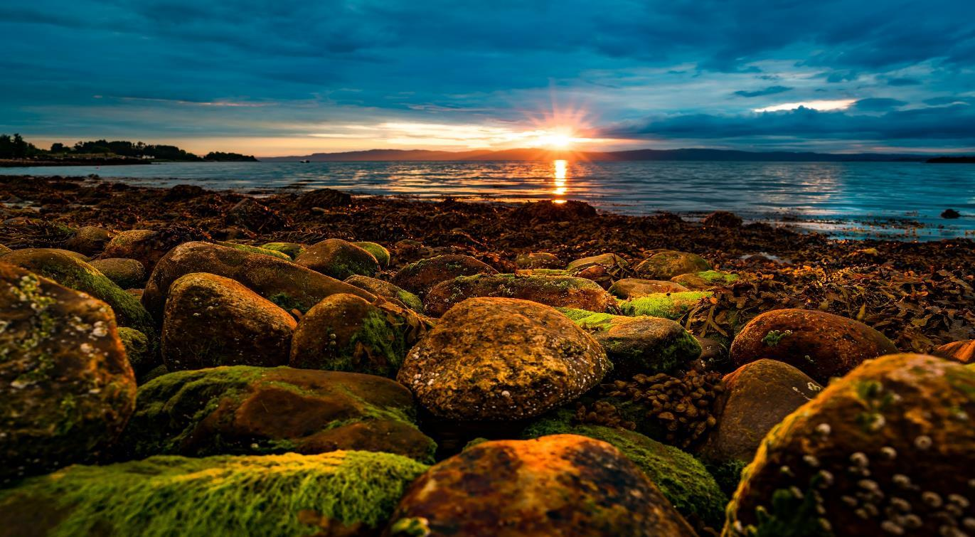
4
BRAND PROFILE OF
Norway
Associations
Emotional benefits associated with Norway
Destination characteristics associated with Norway
Brand personality associated with Norway
Social identity associated with Norway

Slide 92
EMOTIONAL associations
Compared to other destinations Norway does not have a really rich and strong emotional footprint in Italy.
Compared to other destinations the Italian travelers lacks a clear emotional benefit for travelling to Norway.

Slide 93
DESTINATION CHARACTERISTICS
The Italian travelers are generally very clear on what differentiates Norway to other destinations in terms of functional delivery: beautiful nature, unspoiled nature, not ruined by tourism, environmentally friendly offers, live close to nature, quiet environments, well organized, good medical care, good service, not too warm and Norway is not for just anybody, it’s exclusive.

Slide 94
BRAND PERSONALITY
In Italy, Norway is first and foremost seen as the fresh, as well as a structured and peaceful destination compared to other destinations.
For the Italian traveler Norway is also seen as the peaceful and caring destination compared to other destinations.

Slide 95
SOCIAL IDENTITY
Norway has distinct footprint when it comes to social identity in Italy. It’s for people who make a different choice.
Compared with other destinations, Norway is the destination for people who like to explore and have new experiences. People who like adventure.
At last but not least Norway is seen as the destination for people who like to have the best things in life and value high quality.

Slide 96
Top associations to Norway On all four facets
EMOTIONAL associations
DESTINATION CHARACTERISTICS
BRAND PERSONALITY
SOCIAL IDENTITY

Slide 97
5
The competitive
Landscape
Visits and repeat visits
Strengths and weaknesses

Slide 98
Norway’s fit to segments in all markets
A clear fit to «Exploring the world of natural beauty» in most markets
 | Broadening My Cultural Horizon | Extravagant indulgence | Escape | Exploring the World of Natural Beauty | Sharing & Caring | Control | Energy | Playful Liberation | Social Immersion
UK | 0.22 | -0.19 | 0.23 | 0.51 | -0.35 | -0.16 | -0.07 | -0.19 | -0.06
GERMANY | 0.13 | -0.09 | 0.24 | 0.51 | -0.39 | -0.14 | -0.02 | -0.10 | -0.16
USA | 0.45 | -0.34 | 0.25 | 0.32 | -0.08 | -0.26 | -0.09 | -0.31 | 0.21
DENMARK | -0.27 | -0.22 | 0.29 | -0.24 | 0.19 | 0.50 | 0.05 | 0.02 | -0.26
SWEDEN | -0.25 | -0.15 | 0.14 | -0.09 | 0.01 | 0.54 | 0.00 | 0.04 | -0.28
CHINA | 0.07 | -0.03 | 0.14 | 0.35 | -0.27 | -0.17 | -0.05 | 0.06 | -0.24
SPAIN | 0.07 | 0.03 | 0.19 | 0.27 | -0.32 | 0.12 | -0.13 | -0.03 | -0.28
ITALY | 0.08 | -0.03 | 0.21 | 0.37 | -0.38 | -0.06 | -0.05 | 0.10 | -0.19
NETHER-LANDS | 0.09 | -0.17 | 0.28 | 0.43 | -0.25 | -0.05 | 0.13 | -0.15 | -0.19
FRANCE | 0.06 | -0.11 | 0.26 | 0.36 | -0.36 | 0.03 | -0.09 | -0.06 | -0.19
AVERAGE | 0.06 | -0.13 | 0.22 | 0.28 | -0.22 | 0.03 | -0.03 | -0.06 | -0.16
Good fit
Neutral fit
Bad fit

Slide 99
Overview Destinations fit in the Italian market
Segments/ destinations | Playful Liberation | Social Immersion | Sharing & Caring | Escape | Control | Broadening My Cultural Horizon | Adventures in the World of Natural Beauty | Extravagant indulgence | Energy
Austria | -0.09 | -0.33 | 0.07 | 0.01 | 0.49 | 0.13 | -0.45 | 0.07 | -0.21
Canada | 0.04 | -0.26 | -0.53 | -0.06 | 0.06 | -0.05 | 0.42 | 0.14 | 0.04
Croatia | 0.19 | -0.06 | 0.47 | 0.36 | 0.16 | -0.45 | -0.40 | -0.25 | 0.15
Czech Republic | 0.06 | 0.06 | 0.15 | -0.08 | 0.09 | 0.15 | -0.20 | -0.08 | -0.13
Denmark | -0.02 | -0.05 | -0.13 | 0.09 | 0.16 | 0.13 | 0.00 | 0.01 | -0.14
Finland | 0.22 | -0.18 | -0.31 | 0.25 | -0.16 | -0.06 | 0.32 | -0.04 | 0.03
France | -0.13 | -0.14 | 0.11 | -0.30 | 0.32 | 0.27 | -0.56 | 0.34 | -0.27
Germany | -0.11 | -0.18 | 0.04 | -0.32 | 0.77 | 0.07 | -0.43 | 0.06 | -0.21
Iceland | 0.08 | -0.22 | -0.50 | 0.15 | -0.24 | -0.10 | 0.68 | 0.03 | 0.12
Netherlands | 0.10 | 0.29 | -0.03 | -0.29 | 0.19 | 0.17 | -0.25 | -0.07 | -0.02
New Zealand | -0.03 | -0.17 | -0.53 | 0.02 | -0.32 | -0.07 | 0.78 | 0.11 | 0.20
Norway | 0.10 | -0.19 | -0.38 | 0.21 | -0.06 | 0.08 | 0.37 | -0.03 | -0.05
Portugal | 0.03 | 0.48 | 0.52 | 0.13 | -0.14 | 0.05 | -0.35 | -0.30 | -0.06
Scotland | -0.03 | -0.08 | -0.22 | 0.22 | -0.13 | 0.26 | 0.22 | -0.10 | -0.27
Spain | 0.14 | 0.39 | 0.52 | 0.00 | -0.02 | -0.16 | -0.44 | -0.24 | 0.15
Sweden | 0.05 | -0.09 | -0.21 | 0.08 | 0.15 | 0.07 | 0.07 | -0.02 | -0.17
Switzerland | -0.11 | -0.43 | 0.01 | 0.01 | 0.57 | -0.02 | -0.39 | 0.26 | -0.27
Thailand | 0.21 | 0.05 | -0.01 | 0.29 | -0.46 | -0.22 | 0.21 | -0.04 | 0.24
USA | 0.12 | -0.17 | -0.42 | -0.54 | 0.10 | -0.14 | 0.06 | 0.48 | 0.25
Good fit
Neutral fit
Bad fit

Slide 100
6
Global recommendations
Brand positioning

Slide 101
The task at hand
The strategy to make Norway occupy a unique and credible position, relative to competing destinations, in the mind of the tourist.

Slide 102
In CONCLUSION …
Norway needs to diversify it's relevance
as a holiday destination
1
2
3
4
We have 9 decent size segments today
There are important differences by market
Highly relevant for one segment
Relevance for aditional 5 segments
Competitive destinations too are playing on multiple needs
Nature is a highly competitive area
Norway is already associated with a wide variety of holiday needs & activities
The whole of Norway, the whole year round
We see a further fragmentation of needs in the holiday segmentation
Norway connects reasonably well with multiple needs
It's the only way to stay competitive
Norway has a lot to offer

Slide 103
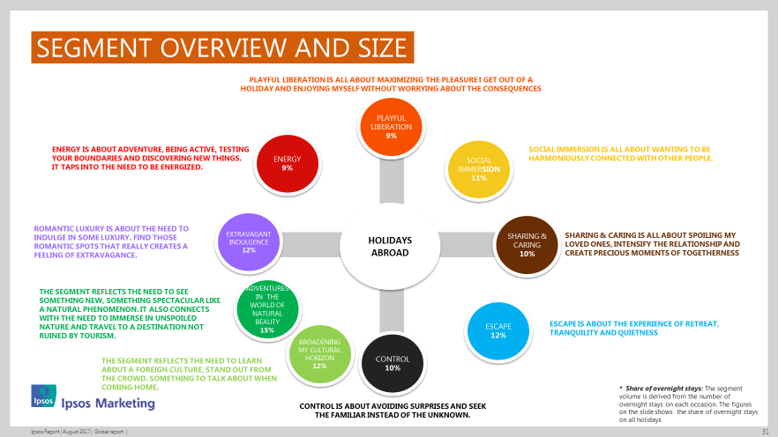
We see a further fragmentation of holiday needs
1
We have 9 decent size segments today (vs only 5 >6% in 2011)

Slide 104
We see a further fragmentation of holiday needs
1
There are a lot of differences in size by market
TOP 3 (% overnight stays*)
US
UK
Denmark
Sweden
China
Spain
Italy
Nether-lands
France
Germany
GLOBAL
26%
19%
9%
13%
12%
13%
14%
11%
14%
19%
10%
13%
17%
12%
21%
12%
17%
16%
15%
10%
13%
14%
21%
12%
13%
18%
18%
14%
14%
22%
19%
14%
15%
24%
23%
16%
13%
12%
9%
* Share of overnight stays: The segment volume is derived from the number of overnight stays on each occasion. The figures on the slide shows the share of overnight stays on all holidays.

Slide 105
Norway connects well with multiple needs
2
Highly relevant for one segment, decent relevance for additional 5 segments
EXTRAVAGANT INDULGENCE
ADVENTURES IN THE WORLD OF NATURAL BEAUTY
Fit with segments

Slide 106
Diversification is necessary to stay competitive
3
Nature is a highly competitive area
ADVENTURES IN the world of natural beauty
Fit with Adventures in the World of Natural Beauty

Slide 107
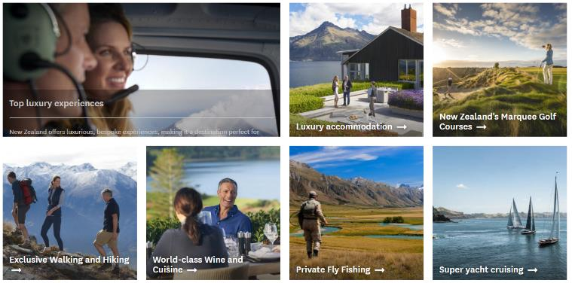
Diversification is necessary to stay competitive
3
Competitive destinations too are playing on multiple needs

Slide 108
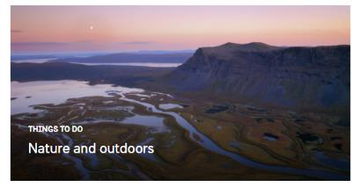
Diversification is necessary to stay competitive
3
Competitive destinations too are playing on multiple needs
Notes:
Playing on many different segments
Eg fika = social immersion
Relaxing
Exploring nature
Broadening
Energy

Slide 109
Norway has a lot to offer
4
Norway is used for a wide variety of holiday needs & activities
Base: holidays to Norway

Slide 110
Norway has a lot to offer
4
This fits with the ambition to promote “the whole of Norway, the whole year round”

Slide 111
Recommendations for Italy
Where do we go from here?

Slide 112
Norway Needs to continue to work on Holiday basics in Italy
Norway fails to meet some basic holiday expectations
Relaxed, playful, cozy.
New and interesting places, enriches my view of the world. Interesting sights.
Peaceful
Share good times with others. Friendly people.
Good value for money. Rich cultural heritage. Culture & art.
Easy to travel around.
People who like to explore and have new experiences
Maintain
Improve

Slide 113
Norway connects well with multiple needs in Italy
Highly relevant for one segment, and decent relevance for additionally three segments
Playful Liberation
Social Immersion
Sharing & Caring
Escape
Control
Broadening My Cultural Horizon
ADVENTURES IN the World of Natural Beauty
Extravagant indulgence
Energy
Fit with segments in the Italian market

Slide 114
Looking at Norway’s current strengths
And position different routes that can be explored
POSSIBLE ADDITIONS
ESCAPE
Norway’s nature is a perfect place for Italian travelers to escape from their hectic daily life, pamper themselves and restore their sense of harmony and balance. A peaceful and harmonious place to revitalize themselves.
THE OBVIOUS TARGET
ADVENTURES IN the world of natural beauty
BROADENING MY CULTURAL HORIZON
Norway has comparative advantages in combining nature and culture. It’s a unique possibility to broaden my knowledge and my horizon. Get rich experiences and enrich my view on the world. Norway should allow me to discover new and interesting places. But we need to work on interesting sights, cultural heritage and art.
PLAYFUL LIBERATON
Norway is a fresh destination with good service, that is not so warm. We need to work on the playfulness though. Norway needs to provide a holiday that makes the tourist feel full of energy and allows them to enjoy life to the fullest.

Slide 115
Questions?
Please contact…
kjetil.stromseth@ipsos.com
Oslo
+47 934 52 000
steven.naert@ipsos.com
Antwerpen
+ 32 497 70 64 57

