Slide 1
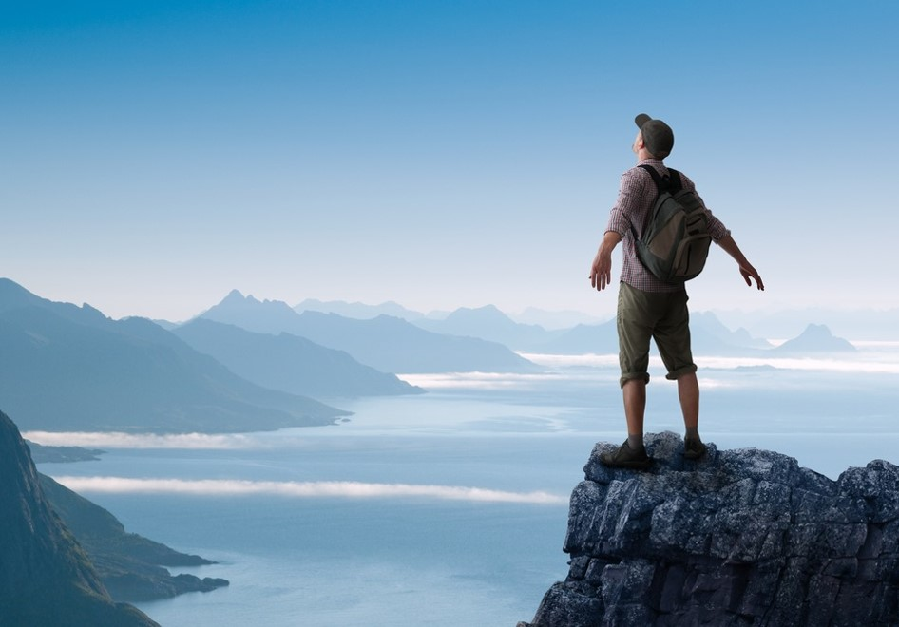
activating
The Norway brand
A report on holiday needs and segments in the Swedish market
for Innovation Norway
Written by Kjetil Strømseth and Steven Naert 19th October 2017

Slide 2
CONTENT
1) The philosophy behind
p 6
2) The ideal holiday
p 19
3) Segments
p 30
4) Brand profile Norway
p 91
5)The competetive landscape
p 97
6) Global recommendations
p 100
7) Recommendations for Sweden
p 111

Slide 3
Norway a true
The vision is «we give local ideas global opportunities»
Norway has unique advantages both in terms of natural resources and modern infrastructure that provides a great number of possibilities for tourists.
Innovation Norway manages not only one brand but the sum of all the brands that make up the destination Norway.
Some of these are iconic brands on a global scale.
The challenge is to secure a strong position for all of these so that the sum is stronger than individual parts, creating truly global power.
Global brand

Slide 4
The world is changing. The travel industry is changing. People change. How they interact with brands is changing. Their behavior in relation to vacation change.
You may have to adapt and make changes in the strategy to keep pace with the market.
Fundamental consumer insights in key markets is part of the basis for this.
Updated
insightful
proactive
Ipsos Report | September 2017 | Market report SWEDEN |

Slide 5
The purpose of the research:
TO IDENTIFY THE BEST MEANS OF STRENGTHENING THE FUTURE OF THE NORWEGIAN TRAVEL INDUSTRY
TO UNDERSTAND THE COMPETITIVE LANDSCAPE AND TARGET NEEDS TO PROMOTE INNOVATION AND COMMUNICATION
In order to do so, this research provides answers to the two questions:
- What is the ideal holiday?
- How are destinations (brands) positioned?

Slide 6
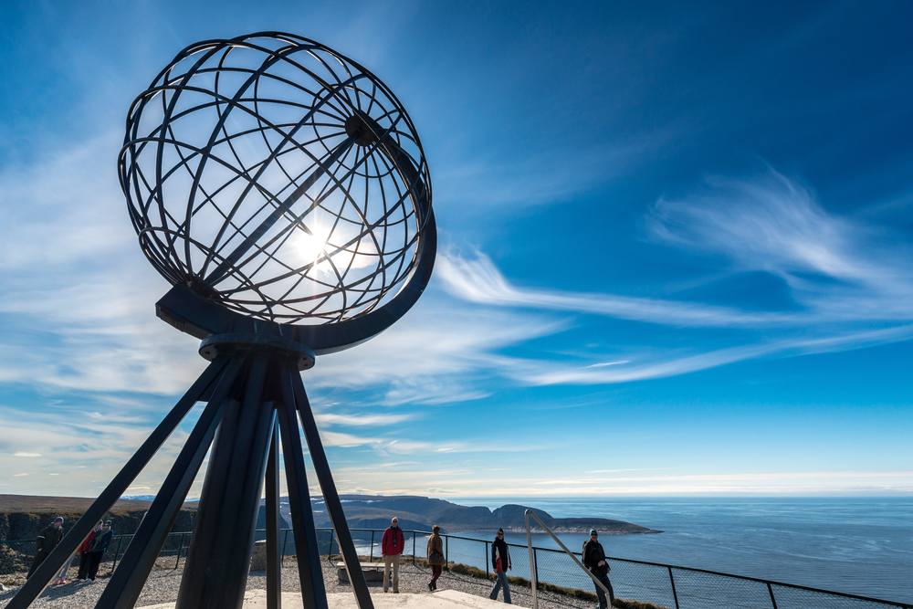
Behind the research
1
The philosophy
Point of view & approach

Slide 7
THE starting point:
understanding how brand building works
Brands that grow are brands that are chosen by…
MORE PEOPLE
At the Heart of Growing Brands is an understanding of how PEOPLE make CHOICES
And with increasing Brand Choices, it is more important than ever before to understand how the decision process works in people’s minds
MORE EASILY
MORE OFTEN
So how can Innovation Norway make it easier for more people to come to Norway more often?

Slide 8
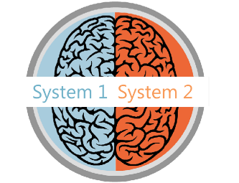
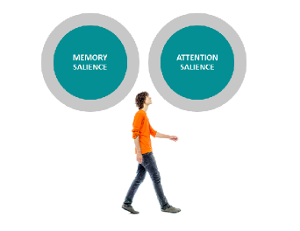
The key to brand building
is to think people first
How people make decisions
How people think about brands
How people are influenced
Decision-making is often more unconscious than conscious, using mental shortcuts to reduce effort.
Brands exist in peoples’ minds as a network: a unique memory structure of thoughts, feelings, experiences, images, stories, associations, colours, sounds, symbols and memories.
Memory salience refers to all the existing aspects of the brand’s mental network. Attention salience is about the cues and stimuli that capture our attention at any touchpoint.
So how do people make choices?

Slide 9
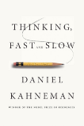
FORM
ARE SALIENT
ARE SALIENT
RELATIONSHIPS
They must come readily to mind in the moments that matter. They have strong brand networks or associative memory structures so they are easily retrieved in a fast-processing, automatic decision environment
They must fulfil the key motivational criteria for selection: meeting functional and emotional needs and creating connections
all the evidence points
ARE AVAILABLE
ARE AVAILABLE
To People being more
They must be accessible (e.g. pricing, distribution). The more easily people perceive that they can obtain one option rather than another similar option, the more likely it is to be selected
RANK FIRST
likely to choose
RANK FIRST
They must have the highest perceived value at the moment of choice, compared with alternatives
brands that…

Slide 10
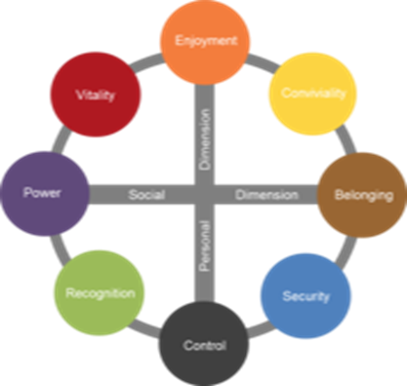
Building deep brand relationships with Censydiam
BE RELEVANT
Censydiam offers a validated approach to understand the different roles brands can play in the category.
Censydiam captures the needs & motivations that drive relevance in the category, while acknowledging that these needs & motivations can differ across various situations and occasions.
Brands can grow if they succeed in connecting themselves to more emotional & functional needs.
Associate your brand with relevant category roles
Censydiam
Motivational Framework

Slide 11
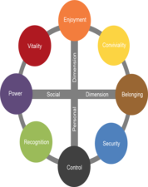
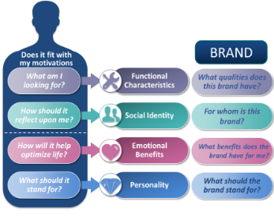
Censydiam in a nutshell
People first
All decisions are made with fundamental consumer needs at the heart
Universal currency
Comparison possible across markets
Common language
Customizable
Needs are tailored by context, category and markets.
theories about the unconscious mind and the mechanisms of release and repression
Each is deconstructed on key emotional and functional benefits, brands need deliver on in order to be relevant for consumers in various usage occasions/situations.
These benefits help build rich networks and allow consumers to easily identify the best solutions for their needs.
Validated
Over 30+ years experience across the globe & scientific thesis
The double mechanism for satisfaction: a striving for power & superiority and for belonging & community
Comparison
Allows comparison over time and markets

Slide 12
Censydiam seeks to uncover the different drivers
the brand needs to play on to be relevant
The ideal
holiday
Associations
to the
brand
First we uncover the ideal benefits sought in a specific holiday. Then we uncover what associations travelers have to different destinations
WHAT expectations are related to destinations?
DESTINATION CHARACTERISTICS
WHAT qualities does this destination have?
HOW should a holiday reflect upon me?
SOCIAL IDENTITY
WHO is the destination for?
WHY do people go on holiday?
EMOTIONAL BENEFITS
WHY do I go to
this destination?
WHAT should the destination stand for?
BRAND PERSONALITY
WHAT does this destination stand for?

Slide 13
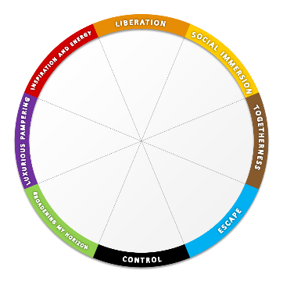
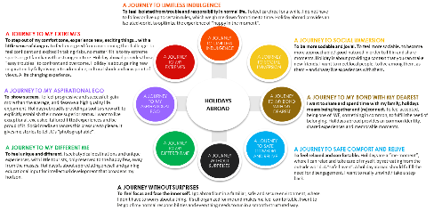
From Censydiam hypothesis to global category frame
We have conducted 1200 interviews in the market
Each respondent has profiled 2 holiday occasions – so we have 2400 cases for analysis
1. We start with the Censydiam model and explore it qualitatively in focus groups.
2. The qualitative part then creates a hypothesis on how the Censydiam frame looks like within the holiday category.
3. At this stage this hypothesis have been tested quantitativly in several markets to create one global segmentation model.

Slide 14
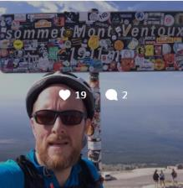
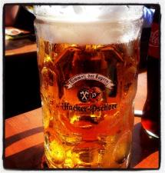
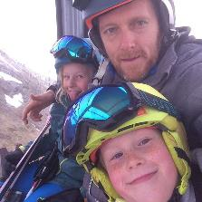
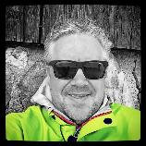
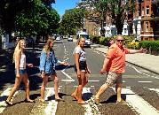
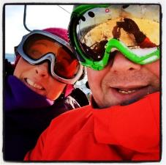
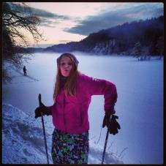
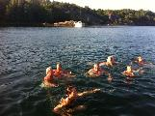
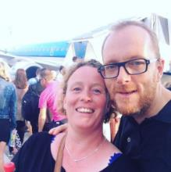
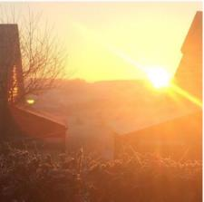
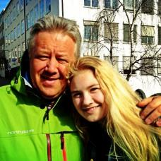
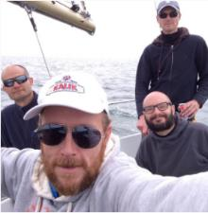
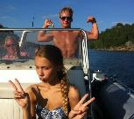
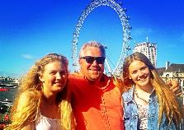
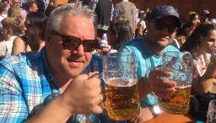
The same person, but different situations and different motivations
As consumers, we often have different needs depending on the situation. This also applies to holidays. A weekend getaway with a partner has to fulfil different needs than a skiing weekend with friends. This report is, therefore, based on different occasions – by occasion we mean different holidays. Each respondent has told us what the ideal holiday look like on two different holiday occasions.

Slide 15
Questionnaire structure in the quantitative interview
The model shows the structure of the interview the individual respondent was through
Section 1: Demographics and Screener
Section 2: Category use
Section 3: Awareness & usage
Gender
Age
Income
Etc.
Have been abroad for holiday last 3 years.
How often do you go on holiday abroad?
Where did you go the last 5 holidays ?
Time of year, duration and type of holiday
What destinations do you know of?
How many times have you been on holiday to the following countries?
Section 4: Profiling of two holiday occasions
Section 5: Profiling of 2 holiday occasions
Section 6: Profiling of destinations
Type of holiday
Destination
Duration
Who were you with?
Spending
Accommodation
Transport
Information sources
Influencers
Activities
Consideration set (what destinations would you consider).
Emotional benefits
Functional benefits
Personality
Social identity
Please choose the statements that you think are appropriate for each destination.
We use the same statements as in section 5.

Slide 16
How does the needs come alive in the actual interview?
The needs are formulated as statements on 4 levels
Emotional benefits
Functional benefits
Personality
Social identity
Imagine that you would go on a similar holiday in the future (with the same people, the same destination, the same time, etc.), please tick the feelings and needs the ideal holiday experience should meet for this occasion
Which are the qualities and characteristics the holiday experience would ideally need to have for this occasion?
Please tick the words that fit the character of your IDEAL future holiday experience for this occasion
Which of the following types of people would you expect to look for the same holiday experience as you?
Helps me to enjoy life to the fullest
Makes me feel completely liberated
Makes me feel full of energy
Allows me to immerse myself in the local life
Helps me to meet new people
Allows me to share good times with others
Creates precious moments of togetherness
Allows me to intensify the relationship with my loved one(s)
Allows me to spoil my loved ones
Allows me to pamper myself
Helps me to escape from my hectic daily life
Restores my sense of harmony and balance
Allows me to keep everything under control
Helps me avoid too much surprises
Gives me a safe feeling
Allows me to broaden my horizon
Allows me to broaden my knowledge
Enriches my view on the world
Allows me to indulge myself with a bit of luxury
Makes me feel on top of the world
Makes me stand out from the crowd
Allows me to discover new and interesting places
Gives me rich experiences
Gives me new inspiration
Allows me to be physical active
Allows me to live close to nature
Has a variety of accommodation offers
Has a variety of different restaurant offers
Has activities for kids
Has beautiful nature
Has environmentally friendly offers
Has few language barriers
Has friendly people
Has good beaches
Has good local cuisine
Has good medical care
Has good opportunities to meet local people
Has good service
Has good shopping
Has guaranteed sunshine
Has interesting culture & art
Has interesting sights
Has lots of organized trips and excursions
Has places to go out partying
Has quiet environments
Has rich cultural heritage
Has romantic spots
Has unspoiled nature
Is easy to travel around
Is easy to travel to
Is not for just anybody, is exclusive
Is not ruined by tourism
Is not too warm
Is well organized
Offers a wide range of possible activities
Good value for money
Active
Playful
Fresh
Open-minded
Sociable
Outgoing
Caring
Friendly
Cozy
Harmonious
Peaceful
Relaxed
Practical
Structured
Predictable
Authentic
Unique
Cultivated
Extravagant
Superior
Classy
Explorative
Adventurous
Daring
People who want to have as much fun as possible in life
People that like to do things spontaneously, impulsively
People who likes to party
People who are always looking to connect with others
People who enjoy spending time with friends
People who have an active and busy social life
People for whom family comes first above all
People who enjoy taking care of others
People who have strong family values
People who want to escape from the demands of life and relax and unwind
People who needs time for themselves
People who want to revitalize themselves
People who make rational choices
People who prefer the familiar over the unknown
People who avoid risk
People who are interested to learn more
People who want to make a different choice
People that like to do things the unconventional way
People who want the best and are willing to pay for it
People who like to have the best things, value high quality
People who is sophisticated and classy
People who like to explore and have new experiences
People who like adventure
People who wants a life changing experience

Slide 17
And now the results…

Slide 18
Sample N = 2258
People that have been abroad for holiday last 3 years. Natural fall out.
49%
51%

Slide 19
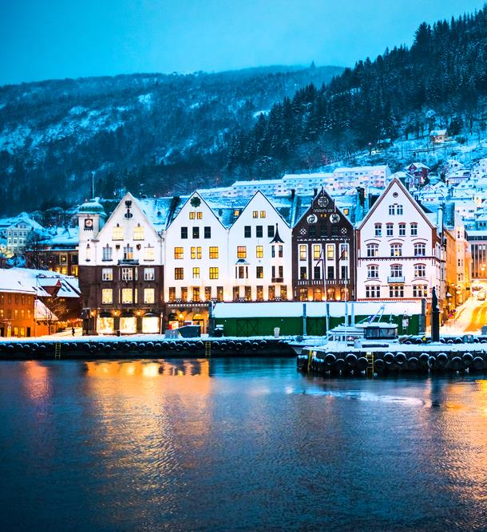
holiday
2
The ideal
Potential needs and drivers
Holidays abroad
experience
Main drivers in the market
Category needs in the total Swedish market

Slide 20
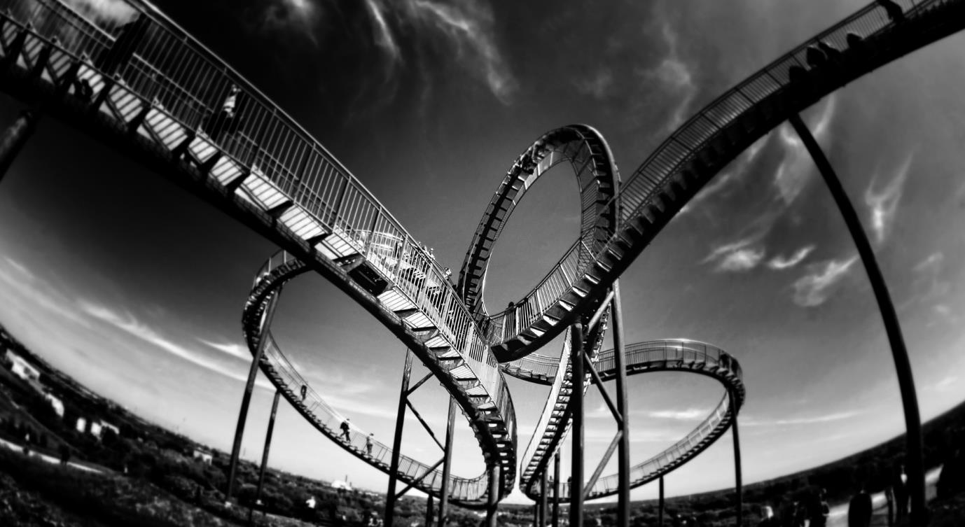
Emotional Benefits
WHY do people go on holiday?
NOTE: Indexed vs. average of all items in facet We report all items with a score which is 1 standard deviation higher than the average

Slide 21
Ideal destination characteristics
WHAT expectations are related to specific destination characteristics?
NOTE: Indexed vs. average of all items in facet We report all items with a score which is 1 standard deviation higher than the average

Slide 22
Ideal brand Personality
WHAT should the destination stand for?
NOTE: Indexed vs. average of all items in facet We report all items with a score which is 1 standard deviation higher than the average

Slide 23
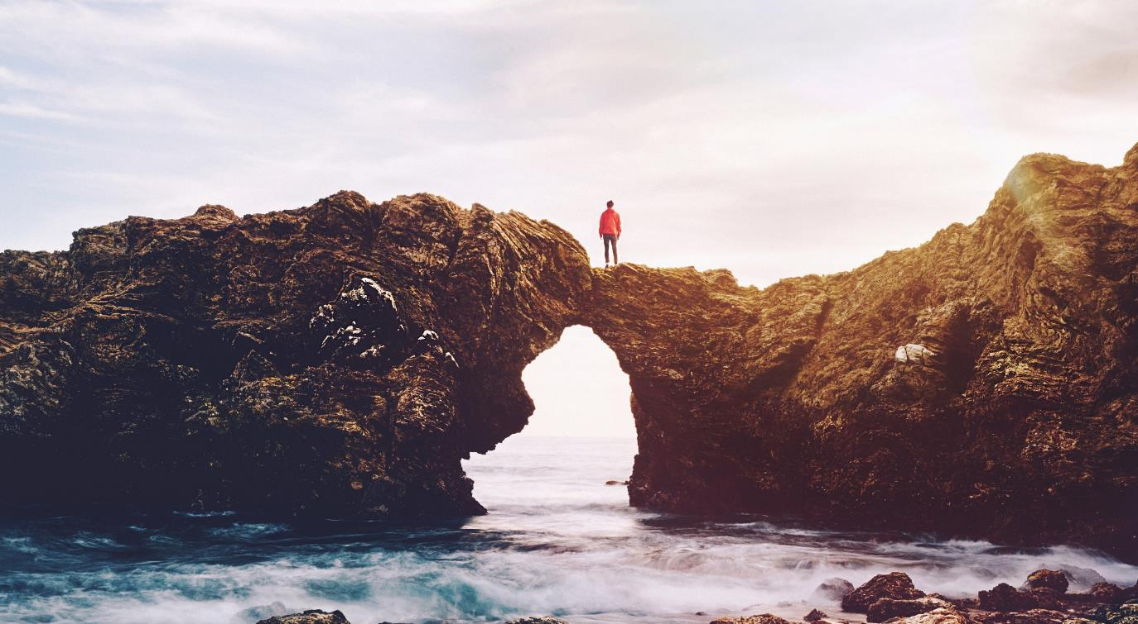
Ideal Social Identity
HOW should a holiday reflect upon me?
NOTE: Indexed vs. average of all items in facet We report all items with a score which is 1 standard deviation higher than the average

Slide 24
Category
behavior
With whom, how, when…

Slide 25
WHEN, WHO, HOW, where
Highlights on Swedish category behavior
WHEN
WITH WHOM
HOW
TYPE OF ACCOMODATION
TRANSPORTATION
60 %
67 %
76 %
66 %
People travel all year long
- Off course some peaks in summertime
Spouse/partner
I/we organized the trip myself/ourselves and travelled independently
Lived at a hotel, in most cases a medium standard hotel
Travels by plane
TRANSPORTATION DURING THE HOLIDAY

Slide 26
Sources of information before and during travel
The digital channels are most important
21%
Advice from friends / family
34%
Uses the homepage of the destination as a source of information and inspiration before going on holiday
56%
Uses the internet in general as a source of information and inspiration before going on holiday. I.e. the large search engines are highly important to direct traffic to sites that present Norway as a tourist destination.
22%
Uses the homepage of carriers, including airlines etc.
29%
Uses the homepage for hotels/ other accommodations
19%
Uses the homepage for attractions and sights
9%
Guidebooks
9%
Uses booking sites such as Expedia and Lastminute
Base: all respondents, n=2258

Slide 27
Most travels are decided upon between 1-6 months in advance
How long before your departure did you settle for this trip on this occasion?
Up to 1 month before departure
Up to 4-6 months before departure
Up to 3 months before departure
Up to 2 months before departure
Less than one week before departure
More than one year before departure
Up to 6-12 months before departure
1-3 weeks before departure
«Influence period 16%»
«Main decision period 71%»
«Last minute 11%»
Base: all respondents, n=2258

Slide 28
Ever visited this country?
The Swedes goes to Denmark
Visits to Norway all markets:
 | Ever visited | Repeat visits | Repeat ratio
Global | 32 % | 18 % | 55 %
US | 25 % | 11 % | 43 %
UK | 20 % | 6 % | 30 %
Denmark | 81 % | 62 % | 76 %
Sweden | 79 % | 56 % | 71 %
China | 16 % | 6 % | 36 %
Spain | 10 % | 3 % | 28 %
Italy | 17 % | 4 % | 25 %
Netherlands | 25 % | 9 % | 35 %
France | 15 % | 3 % | 19 %
Germany | 26 % | 10 % | 39 %

Slide 29
A note on planning horizons
China, US and Italy has shorter planning horizon than the rest of the markets
How long before your departure did you settle for this trip on this occasion?
 |  | Market
 | Global | US | UK | Denmark | Sweden | China | Spain | Italy | Netherlands | France | Germany
Antall intervju | 21928 | 2158 | 2134 | 2192 | 2258 | 2280 | 2213 | 2168 | 2179 | 2205 | 2141
Less than 3 weeks before departure | 18 % | 24 % | 8 % | 12 % | 12 % | 30 % | 12 % | 44 % | 13 % | 13 % | 10 %
Up to 3 months before departure | 50 % | 49 % | 46 % | 50 % | 48 % | 64 % | 63 % | 44 % | 43 % | 50 % | 44 %
Up to 4-12 months before departure | 28 % | 23 % | 40 % | 35 % | 36 % | 5 % | 23 % | 6 % | 41 % | 33 % | 42 %
More than one year before departure | 1 % | 3 % | 3 % | 1 % | 3 % | 0 % | 1 % | 0 % | 1 % | 2 % | 2 %
Don’t know | 2 % | 1 % | 3 % | 2 % | 2 % | 0 % | 1 % | 7 % | 2 % | 1 % | 2 %
These differences will have impact on when to deploy marketing campaigns in the different markets

Slide 30
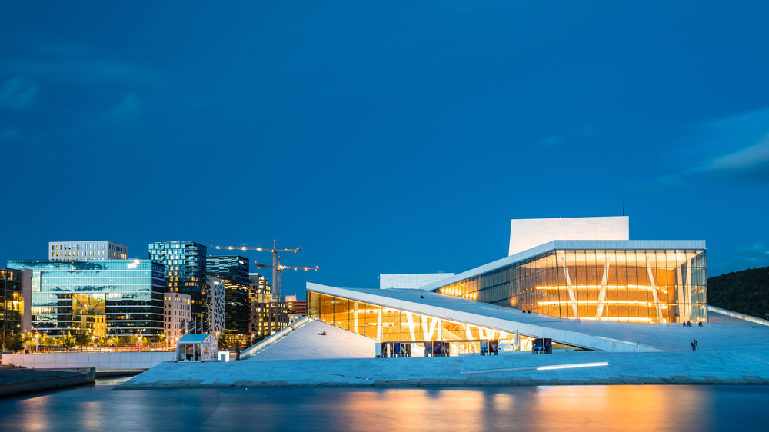
3
MOTIVATIONAL
SEGMENTS
Why
What
Who

Slide 31
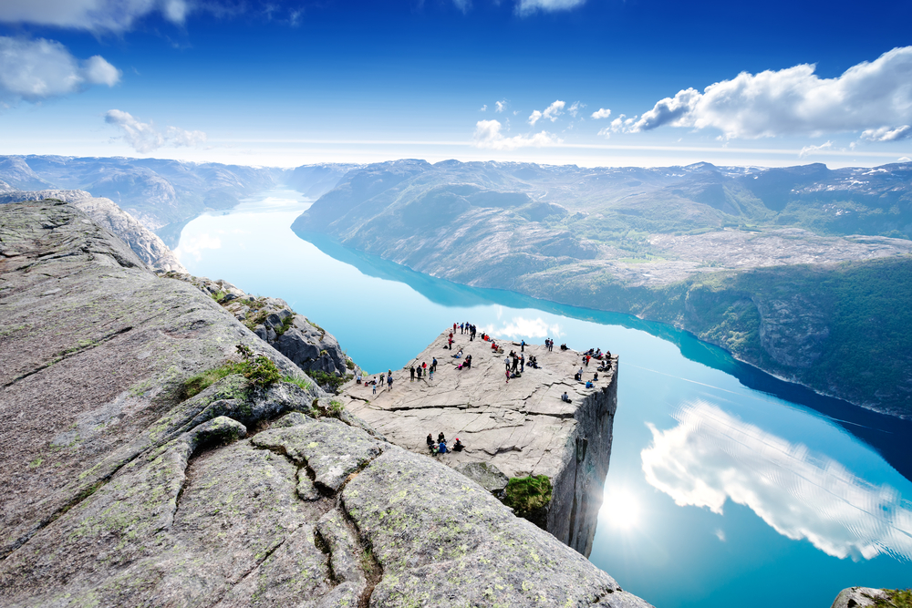
9 distinct segments
PLAYFUL LIBERATON
SOCIAL IMMERSION
SHARING & CARING
ESCAPE
CONTROL
BROADENING MY CULTURAL HORIZON
ADVENTURES IN the world of natural beauty
EXTRAVAGANT INDULGENCE
ENERGY

Slide 32
Segment overview and size*
Playful Liberation is all about maximizing the pleasure I get out of a holiday and enjoying myself without worrying about the consequences
PLAYFUL LIBERATION
8%
Energy
10%
SOCIAL IMMERSION
12%
Energy is about adventure, being active, testing your boundaries and discovering new things. It taps into the need to be energized.
Social immersion is all about wanting to be harmoniously connected with other people.
HOLIDAYS ABROAD
EXTRAVAGANT INDULGENCE
7%
SHARING & CARING
12%
Romantic luxury is about the need to indulge in some luxury. Find those romantic spots that really creates a feeling of extravagance.
Sharing & caring is all about spoiling my loved ones, intensify the relationship and Create precious moments of togetherness
The segment reflects the need to see something new, something spectacular like a natural phenomenon. It also connects with the need to immerse in unspoiled nature and travel to a destination not ruined by tourism.
ADVENTURES IN THE WORLD OF NATURAL BEAUTY
18%
ESCAPE
12%
Broadening my CULTURAL horizon
14%
Escape is about the experience of retreat, tranquility and quietness
CONTROL
7%
The segment reflects the need to learn about a foreign culture, stand out from the crowd. Something to talk about when coming home.
* Share of overnight stays: The segment volume is derived from the number of overnight stays on each occasion. The figures on the slide shows the share of overnight stays on all holidays
Control is about avoiding surprises and seek the familiar instead of the unknown.

Slide 33
Segment size* per market
* Share of overnight stays: The segment volume is derived from the number of overnight stays on each occasion. The figures on the slide shows the share of overnight stays on all holidays.

Slide 34
Segments share of occasion – global
- all destinations
 | Total | PLAYFUL LIBERATON | SOCIAL IMMERSION | SHARING & CARING | ESCAPE | CONTROL | BROADENING MY CULTURAL HORIZON | ADVENTURES IN THE WORLD OF NATURAL BEAUTY | EXTRAVAGANT INDULGENCE | ENERGY
# interviews | 21928 | 2217 | 2202 | 2265 | 2574 | 2471 | 2828 | 2528 | 2780 | 2063
Visits to historic sites | 57 % | 57 % | 61 % | 42 % | 47 % | 56 % | 72 % | 66 % | 58 % | 53 %
Sun and beach holiday | 53 % | 58 % | 48 % | 57 % | 63 % | 52 % | 37 % | 49 % | 59 % | 57 %
Holiday to experience nature, scenery and wildlife | 46 % | 46 % | 45 % | 31 % | 51 % | 43 % | 43 % | 68 % | 45 % | 46 %
Sightseeing/round trip | 45 % | 49 % | 48 % | 34 % | 36 % | 46 % | 48 % | 52 % | 49 % | 45 %
Cultural experience (focus on art, theatre etc.) | 42 % | 49 % | 43 % | 26 % | 29 % | 43 % | 54 % | 45 % | 48 % | 40 %
City break (focusing on cultural, shopping, Club, restaurant visits etc.) | 42 % | 41 % | 44 % | 38 % | 34 % | 39 % | 50 % | 43 % | 42 % | 43 %
Visiting friends and relatives | 31 % | 28 % | 37 % | 42 % | 26 % | 31 % | 27 % | 33 % | 30 % | 32 %
Culinary trip | 19 % | 29 % | 19 % | 12 % | 13 % | 21 % | 14 % | 18 % | 28 % | 18 %
Party & fun | 16 % | 23 % | 15 % | 14 % | 11 % | 16 % | 10 % | 14 % | 21 % | 20 %
Sports/active holiday | 15 % | 17 % | 10 % | 10 % | 10 % | 19 % | 7 % | 20 % | 20 % | 27 %
Travel to cottage/holiday home (hired/own/borrowed cottage/holiday home) | 15 % | 13 % | 12 % | 18 % | 20 % | 15 % | 8 % | 13 % | 17 % | 16 %
Ski holiday | 11 % | 15 % | 6 % | 7 % | 7 % | 17 % | 3 % | 7 % | 18 % | 22 %
Event holiday (festivals, sports etc.) | 10 % | 14 % | 9 % | 6 % | 5 % | 13 % | 5 % | 9 % | 16 % | 11 %
Countryside holiday | 10 % | 12 % | 9 % | 8 % | 12 % | 10 % | 6 % | 11 % | 10 % | 9 %
Health travel | 9 % | 15 % | 6 % | 5 % | 7 % | 15 % | 3 % | 6 % | 17 % | 10 %
Other type of winter holiday with snow | 7 % | 10 % | 4 % | 3 % | 4 % | 12 % | 2 % | 6 % | 13 % | 10 %
Cruise | 7 % | 7 % | 7 % | 5 % | 6 % | 7 % | 8 % | 8 % | 9 % | 5 %

Slide 35
Segments share of occasion – Sweden
- all destinations
 | Total | PLAYFUL LIBERATON | SOCIAL IMMERSION | SHARING & CARING | ESCAPE | CONTROL | BROADENING MY CULTURAL HORIZON | ADVENTURES IN THE WORLD OF NATURAL BEAUTY | EXTRAVAGANT INDULGENCE | ENERGY
# interviews | 2258 | 168 | 237 | 302 | 235 | 197 | 396 | 316 | 153 | 254
Sun and beach holiday | 63 % | 70 % | 58 % | 69 % | 76 % | 60 % | 46 % | 60 % | 72 % | 67 %
Sightseeing/round trip | 55 % | 43 % | 60 % | 43 % | 46 % | 53 % | 68 % | 65 % | 57 % | 44 %
City break (focusing on cultural, shopping, Club, restaurant visits etc.) | 52 % | 48 % | 54 % | 46 % | 42 % | 53 % | 59 % | 56 % | 52 % | 56 %
Visits to historic sites | 46 % | 35 % | 50 % | 33 % | 37 % | 38 % | 63 % | 60 % | 43 % | 41 %
Holiday to experience nature, scenery and wildlife | 42 % | 30 % | 44 % | 27 % | 39 % | 32 % | 45 % | 72 % | 35 % | 36 %
Visiting friends and relatives | 38 % | 33 % | 46 % | 51 % | 31 % | 30 % | 32 % | 41 % | 37 % | 37 %
Cultural experience (focus on art, theatre etc) | 35 % | 29 % | 36 % | 24 % | 24 % | 32 % | 55 % | 38 % | 36 % | 28 %
Party&amp;fun | 18 % | 26 % | 23 % | 21 % | 14 % | 17 % | 11 % | 17 % | 24 % | 21 %
Sports/active holiday | 16 % | 15 % | 15 % | 10 % | 11 % | 14 % | 9 % | 22 % | 15 % | 34 %
Culinary trip | 16 % | 17 % | 20 % | 12 % | 12 % | 10 % | 18 % | 16 % | 20 % | 15 %
Event holiday (festivals, sports etc) | 11 % | 13 % | 18 % | 10 % | 9 % | 13 % | 7 % | 12 % | 12 % | 13 %
Travel to cottage/holiday home (hired/own/borrowed cottage/holiday home) | 9 % | 7 % | 8 % | 10 % | 10 % | 11 % | 7 % | 10 % | 6 % | 11 %
Ski holiday | 7 % | 9 % | 4 % | 4 % | 4 % | 8 % | 4 % | 5 % | 8 % | 25 %
Cruise | 7 % | 7 % | 7 % | 8 % | 5 % | 7 % | 7 % | 9 % | 8 % | 6 %
Countryside holiday | 5 % | 7 % | 4 % | 5 % | 6 % | 9 % | 3 % | 7 % | 3 % | 6 %
Health travel | 4 % | 6 % | 4 % | 3 % | 5 % | 2 % | 5 % | 3 % | 6 % | 5 %
Other type of winterholiday with snow | 2 % | 2 % | 1 % | 1 % | 1 % | 2 % | 0 % | 2 % | 2 % | 3 %

Slide 36
Major changes in the global segmentation VS LAST TIME
NUMBER OF SEGMENTS This time we have 9 decent sized segments, last there were 8. I.e. we see a more fragmented picture of holiday needs this time.
NEW MEANING OF THE BLUE SEGMENT In the last segmentation the meaning of the blue segment was more in the direction of a «spa center» experience. This time it’s more about retreating to a quiet place. This could be a quite fisherman's cottage in Lofoten or a cabin in the mountains.
THE PREVIOUS RED AND GREEN SEGMENTS ARE DIVIDED In stead of a pure “Exploration” segment and one “Broadening my horizon” segment, we have a red segment (Energy), all about activity and a two green segments (Adventures in the world of natural beauty) all about unspoiled nature, and “Broadening my cultural horizon” all about experiencing culture.

Slide 37
Playful Liberation is all about maximizing the pleasure I get out of a holiday and enjoying myself without worrying about the consequences. I go a little crazy, overindulge myself and lose all inhibitions. I am spontaneous, follow my instincts and live for the moment. The purpose of the holiday is abundance and enjoyment. It is impulsive and sometimes excessive or even manic.
PLAYFUL LIBERATION
PLAYFUL AND FRESH
PARTY AND FUN

Slide 38
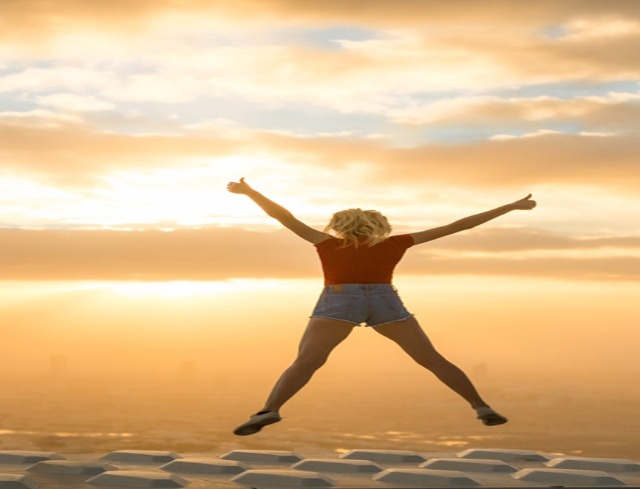
PLAYFUL LIBERATION
Emotional benefits; What SHOULD THE HOLIDAY give me ?
The core meaning of going on holiday is to feel completely liberated and give me new energy.
Destination features and activities; What AM I looking for?
I want to go to a place with good service and with a variety of different restaurants offers. The site needs to have good beaches, guaranteed sunshine and needs to be good value for money.
PERSONALITY; WHAT SHOULD IT STAND FOR?
The destination needs to be playful and fresh.
Social identity; how should it reflect upon me?
The destination should be for people who likes to party. The kind that wants to have as much fun as possible in life. More or less people that like to do things spontaneously, impulsively and who wants to revitalize themselves.
Sometimes I need to let go. Enjoy life to the fullest and feel completely liberated. I need to refill my energy and pamper myself. Its all about me.
52%
ARE BELOW
50 YEARS
46%
54%
SHARE OF OVERNIGHT STAYS
8%

Slide 39
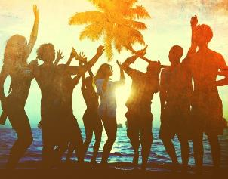
PLAYFUL LIBERATION
TYPICAL HOLIDAY OCCASIONS
Of course you will find the typical sun and beach vacation in this segment, but you will also find city breaks and cultural experiences. Although, most of the time it’s all about party and fun!
I TRAVEL TO FEEL GOOD
These consumers choose destinations that makes them feel good. They want to party, and enjoy themselves in the company of others. They want to travel to places that are playful and fresh . They want to have a informal, fun and relaxed holiday at the same time.
THE ROLE OF BRANDS
The segment is important for brands/destinations which wish to position themselves as hedonistic and pleasure-seeking (or giving); and for brands which will position themselves in the space of sensuality, sexuality and sensory enjoyment.
HOLIDAY EXPERIENCE
These consumers are spontaneous travellers. They have their favourite spots, but they are driven by the “feel good factor” of what they see in social media or at booking sites. They would rather stay at home than travel without friends, and will often end up going somewhere if their friends tell them.
SOURCES OF INSPIRATIONS
These consumers don’t spend too much time planning where to go. Most of them settle for the trip less than four months before they go. They browse the Internet in general or uses homepages to find inspiration. Spouse/partner and friends and acquaintances heavily influences their choice.

Slide 40
Playful LIBERATION - Active, relaxed and fresh
Core motivations
Emotional Benefits
Social Identity
Personality
Destination features
NOTE: Indexed vs. average of all items in facet We report all items with a score which is 1 standard deviation higher than the average
Notes:
Here it is crucial to insist on 4 things:
Stakeholders interview as per my comment on page 1: it is fundamental to understand what all users expect; it does not mean that collectively we will say yes to everything, but understanding potential challenges will help address this together
Formal deployment to make things official is also fundamental and too often forgotten: that have to be done together
We know things will not be perfect thus the importance of monitoring and adjusting the SOW if needed
It would be a big mistake to run fast in implementation: time we spend there is time we save later

Slide 41
Segment profile – playful liberation
Significantly over indexed in segment
Significantly under indexed in segment
TYPOLOGY
TRANSPORT AND ACOMMODATION
ACTIVITIES
TYPE OF HOLIDAY
TRANSPORT TO DESTINATION
ACTIVITIES
TRANSPORT ON DESTINATION
DURATION
ACCOMMODATION
TIME OF YEAR

Slide 42
Segment profile - playful liberation
Significantly over indexed in segment
Significantly under indexed in segment
PLANNING
DECISION MADE
INFLUENCERS
INFORMATION SOURCES
TRAVEL COMPANIONS
WHO DID YOU TRAVEL WITH
NUMBER OF TRAVEL COMPANIONS
TRAVEL FREQUENCY (NUMBER OF TIMES ABROAD)
HOW DID YOU TRAVEL

Slide 43
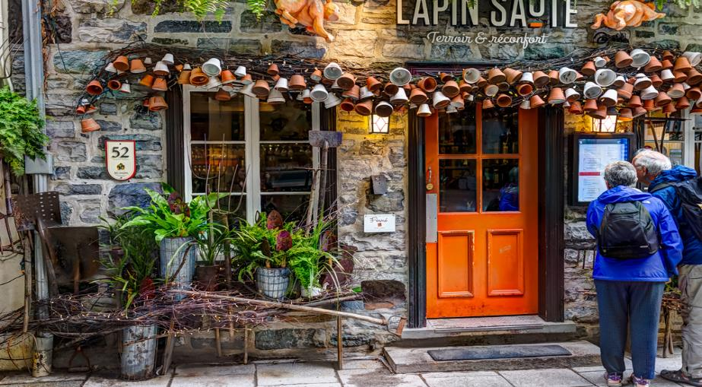
Social immersion is all about wanting to be harmoniously connected with other people. For me, meeting people is a joy. I love having good times with good friends and opening up and meeting new people.
SOCIAL IMMERSION
Sociable and open-minded
Meet local people, eat local cuisine

Slide 44
SOCIAL IMMERSION
Emotional benefits; What SHOULD THE HOLIDAY give me ?
The core meaning of going on holiday is to meet new people. I want to go a place where I can immerse myself in the local life and broaden my horizon. A place that enriches my view on the world and allows me to broaden my knowledge.
Destination features and activities; What AM I looking for?
I want to destinations that has good opportunities to meet local people. It needs to be known for its friendly people. I want good local cuisine and interesting sights, and a variety of different restaurant offers.
PERSONALITY; WHAT SHOULD IT STAND FOR?
The destination needs to be sociable, open-minded, friendly and authentic.
Social identity; how should it reflect upon me?
The destination should be for people who are always looking to connect with others. People who enjoy an active and busy social life. People who enjoy spending time with friends. People who are interested to learn more.
Sometimes I need to IMMERSE MYSELF INTO LOCAL LIFE, MEET NEW PEOPLE AND EAT LOCAL CUISINE
56%
ARE ABOVE
60 YEARS
51%
49%
SHARE OF OVERNIGHT STAYS
12%

Slide 45
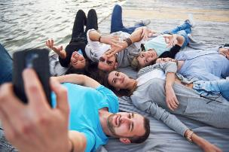
SOCIAL IMMERSION
TYPICAL HOLIDAY OCCASIONS
In this segment you will find more trips to visit friends and relatives, and event holidays than in the other segments.
Sightseeing/ round trips, sun & beach holidays, city breaks and visits to historical sites are also popular.
I TRAVEL TO MEET THE LOCALS
These consumers want to taste local food and drink and want to discover local culture and lifestyle. Visits to the countryside and trips to discover local history and legends are also of interest.. The experience of national festivals and to attend concerts and festivals are most appreciated.
THE ROLE OF BRANDS
The segment is important for brands which try to position themselves as enhancers of friendships, as social brands which help bring people together, and brands which are open, inclusive, and seeking to reflect shared pleasures. It is important for brands which seek to support collaboration with their customers.
HOLIDAY EXPERIENCE
These consumers organize their trip themselves and travels independently (68%). They often travel with friends and seek a social experience in a new to them culture. They want to immerse themselves in local life and culture, connect with others and spend time with friends.
SOURCES OF INSPIRATIONS
Most of these consumers make their decision less than 4 months before their departure (55%). They search for travel information on the internet in general or on homepages for destinations, hotels. Carriers and sites. Their spouse/partner and friends heavily influences their choice.

Slide 46
SOCIAL IMMERSION - Active, relaxed and fresh
Core motivations
Emotional Benefits
Social Identity
Personality
Destination features
NOTE: Indexed vs. average of all items in facet We report all items with a score which is 1 standard deviation higher than the average
Notes:
Here it is crucial to insist on 4 things:
Stakeholders interview as per my comment on page 1: it is fundamental to understand what all users expect; it does not mean that collectively we will say yes to everything, but understanding potential challenges will help address this together
Formal deployment to make things official is also fundamental and too often forgotten: that have to be done together
We know things will not be perfect thus the importance of monitoring and adjusting the SOW if needed
It would be a big mistake to run fast in implementation: time we spend there is time we save later

Slide 47
Segment profile – SOCIAL IMMERSION
Significantly over indexed in segment
Significantly under indexed in segment
TYPOLOGY
TRANSPORT AND ACOMMODATION
ACTIVITIES
TYPE OF HOLIDAY
TRANSPORT TO DESTINATION
ACTIVITIES
TRANSPORT ON DESTINATION
DURATION
ACCOMMODATION
TIME OF YEAR

Slide 48
Segment profile - SOCIAL IMMERSION
Significantly over indexed in segment
Significantly under indexed in segment
PLANNING
DECISION MADE
INFLUENCERS
INFORMATION SOURCES
TRAVEL COMPANIONS
WHO DID YOU TRAVEL WITH
NUMBER OF TRAVEL COMPANIONS
TRAVEL FREQUENCY (NUMBER OF TIMES ABROAD)
HOW DID YOU TRAVEL

Slide 49
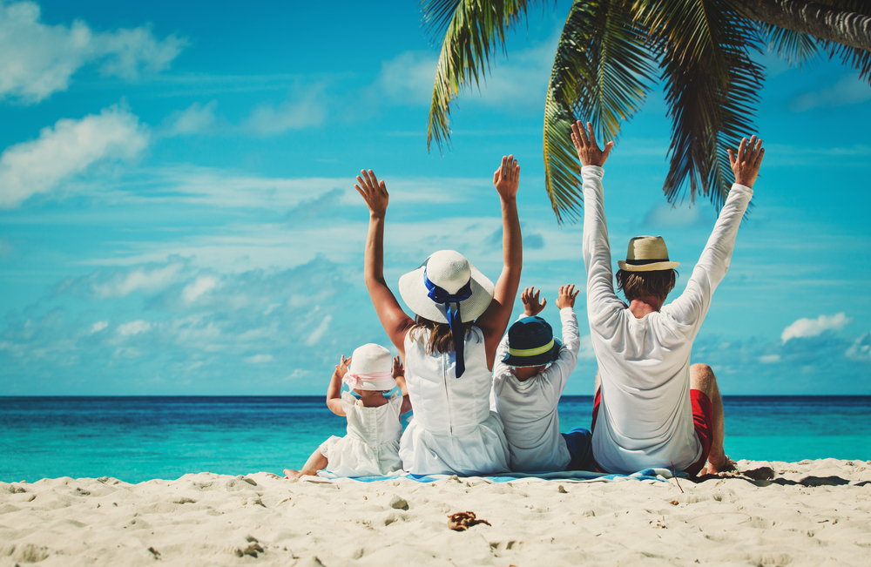
Sharing and caring is all about being surrounded by people who accept me as I am, as an equal and who make me feel welcome. Sharing and caring is about the need to be part of society or a group we really feel part of. Part of this is linked to following norms and traditions just because we are part of that culture or group. It is about togetherness, brotherhood, camaraderie, taking care of others, being taken care of by others, and doing and feeling good.
SHARING AND CARING
Sociable and friendly
Precious moments of togetherness

Slide 50
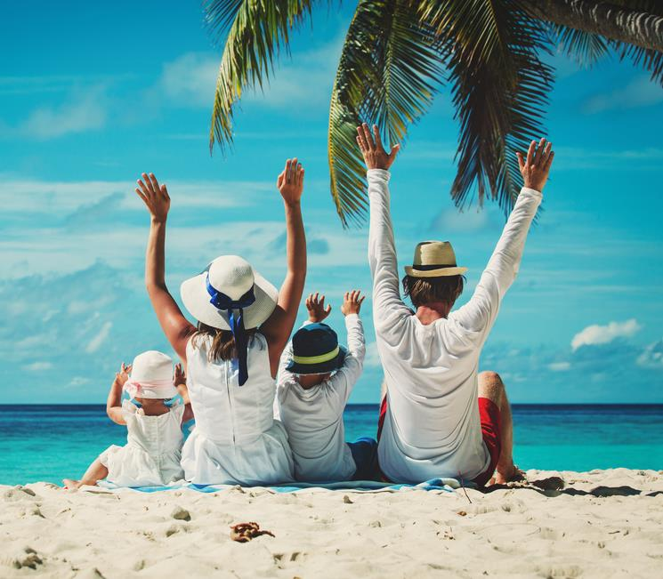
SHARING AND CARING
Emotional benefits; What SHOULD THE HOLIDAY give me ?
The core meaning of going on holiday is to spoil my loved ones. I want to intensify the relationship with my loved one(s) and create precious moments of togetherness and to share good times. A holiday should allow me to pamper myself and indulge with a bit of luxury.
Destination features and activities; What AM I looking for?
It has to be a destination that is easy to travel to. My family needs guaranteed sunshine and the destination need to have nice beaches, and good shopping. It should have a variety of different restaurant offers and to be easy to travel around.
PERSONALITY; WHAT SHOULD IT STAND FOR?
The destination needs to be sociable, cozy, harmonious, friendly, relaxed and peaceful.
Social identity; how should it reflect upon me?
The destination should be for people for whom family comes first above all. This is people who have strong family values. People who enjoy spending time with and enjoy taking care of others. People who want to escape from the demands of life and relax and unwind.
Sometimes I need to SPOIL MY LOVED ONES AND CREATE PRECIOUS MOMENTS OF TOGETHERNESS. My family comes first above all.
76%
ARE ABOVE
40 YEARS
57%
43%
SHARE OF OVERNIGHT STAYS
12%

Slide 51
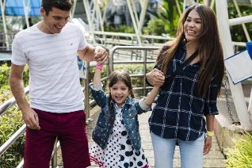
SHARING AND CARING
TYPICAL HOLIDAY OCCASIONS
You will find the typical sun and beach vacation in this segment also, but you will find more holidays to visit friends and family. For these consumer it’s all about family.
I TRAVEL TO FEEL INCLUDED
These consumers choose destinations that enables them to spend time with their loved ones. They want to travel to places that are sociable, cozy, harmonious, friendly, relaxed and peaceful. They want to create those precious moments of togetherness.
THE ROLE OF BRANDS
Brands that want to tap into the needs in this segment should focus on support, empathy, care giving and true, deep friendships. They should position themselves as familiar and appealing to a broader audience and tap into those feelings that people get when they feel warm, included and accepted by the people or tribe they are with.
HOLIDAY EXPERIENCE
Relaxation is on top of the list. Activities visit restaurants, sunbathing and swimming and getting pampered is also appreciated by this segment. No pushing boundaries please!
SOURCES OF INSPIRATIONS
Of course they use the internet, but more than in other segments they act on advice from friends/family. Parents and other relatives heavily influences their choice. They travel with children and the oldest children are a part of the decision process.

Slide 52
SHARING AND CARING
Core motivations
Emotional Benefits
Social Identity
Personality
Destination features
NOTE: Indexed vs. average of all items in facet We report all items with a score which is 1 standard deviation higher than the average
Notes:
Here it is crucial to insist on 4 things:
Stakeholders interview as per my comment on page 1: it is fundamental to understand what all users expect; it does not mean that collectively we will say yes to everything, but understanding potential challenges will help address this together
Formal deployment to make things official is also fundamental and too often forgotten: that have to be done together
We know things will not be perfect thus the importance of monitoring and adjusting the SOW if needed
It would be a big mistake to run fast in implementation: time we spend there is time we save later

Slide 53
Segment profile – SHARING AND CARING
Significantly over indexed in segment
Significantly under indexed in segment
TYPOLOGY
TRANSPORT AND ACOMMODATION
ACTIVITIES
TYPE OF HOLIDAY
TRANSPORT TO DESTINATION
ACTIVITIES
TRANSPORT ON DESTINATION
DURATION
ACCOMMODATION
TIME OF YEAR

Slide 54
Segment profile - SHARING AND CARING
Significantly over indexed in segment
Significantly under indexed in segment
PLANNING
DECISION MADE
INFLUENCERS
INFORMATION SOURCES
TRAVEL COMPANIONS
WHO DID YOU TRAVEL WITH
NUMBER OF TRAVEL COMPANIONS
TRAVEL FREQUENCY (NUMBER OF TIMES ABROAD)
HOW DID YOU TRAVEL

Slide 55
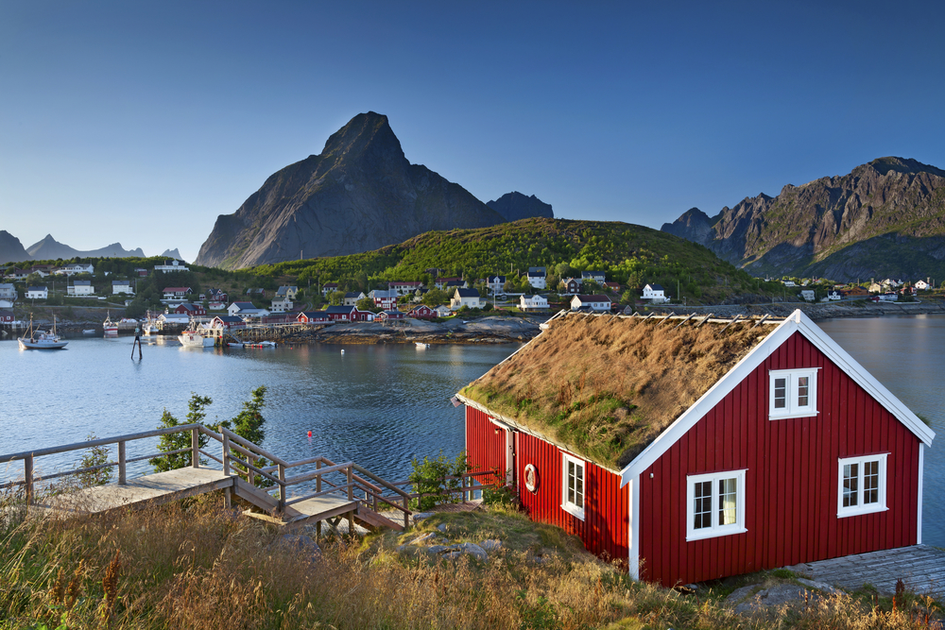
Escape is about the experience of retreat, tranquility and quietness. These are the holidays one feels the need to retreat and recharge. One is looking for an experience that sooths, comforts and takes away the stresses and strains of hectic daily life. These are the holidays one withdraws to a physical or mental space that is worry free - an almost childlike state of feeling safe and cared for.
ESCAPE
PEACEFUL AND HARMONIOUS
RESTORE MY SENSE OF HARMONY AND BALANCE

Slide 56
ESCAPE
Emotional benefits; What SHOULD THE HOLIDAY give me ?
The core meaning of going on holiday is to escape from my hectic daily life and restore my sense of harmony and balance. I want to feel completely liberated and a holiday should make me full of energy. I would also like to pamper myself. Its all about enjoying life to the fullest and recharge.
Destination features and activities; What AM I looking for?
I want to go to a place that has quiet environments and guaranteed sunshine. The destination should not be ruined by tourism, have nice beaches and beautiful nature. Furthermore it should not be too warm, and be good value for money.
PERSONALITY; WHAT SHOULD IT STAND FOR?
The destination needs to be peaceful, harmonious, relaxed and cozy.
Social identity; how should it reflect upon me?
The destination should be for people who needs time for themselves. People who want to escape from the demands of life and relax and unwind, and for whom family comes first.
Sometimes I need to restore my sense of harmony and balance. Escape from the demands of life, relax and unwind.
41%
ARE under
40 YEARS
58%
42%
SHARE OF OVERNIGHT STAYS
12%

Slide 57
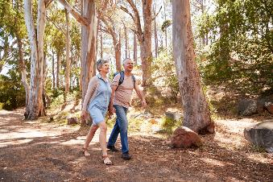
ESCAPE
TYPICAL HOLIDAY OCCASIONS
You will find the typical sun and beach vacation in this segment, but you will find travels experience nature, scenery and wildlife and visiting friends and relatives as much as the next man.
I TRAVEL TO A QUIET PLACE
These consumers choose destinations that makes them restore their sense of harmony. They travel by charter to a greater extent than other segments. They normally go away for 7-14 days.
THE ROLE OF BRANDS
This segment is important when brands want to profile themselves as supporting people in relieving stress and tension. These are the brands and companies that focus on protection and prevention against danger and harm in everyday life. These brands function as a safety net around us, our families and loved ones.
HOLIDAY EXPERIENCE
Relaxation is on top of the list more than in other segments. The same goes for observing the beauty of nature. Activities like sunbathing and swimming, hiking and getting pampered is also appreciated by this segment.. As long as the activities are in quiet environments close to nature we are in line with segment needs.
SOURCES OF INSPIRATIONS
Many of these consumers decide on the trip well ahead of departure. 42% of them settle for the trip four months or more before they go. They use reviews from other travellers as information source to a greater extent than the other segments, Internet in general is the largest point of inspiration.

Slide 58
ESCAPE
Core motivations
Emotional Benefits
Social Identity
Personality
Destination features
NOTE: Indexed vs. average of all items in facet We report all items with a score which is 1 standard deviation higher than the average
Notes:
Here it is crucial to insist on 4 things:
Stakeholders interview as per my comment on page 1: it is fundamental to understand what all users expect; it does not mean that collectively we will say yes to everything, but understanding potential challenges will help address this together
Formal deployment to make things official is also fundamental and too often forgotten: that have to be done together
We know things will not be perfect thus the importance of monitoring and adjusting the SOW if needed
It would be a big mistake to run fast in implementation: time we spend there is time we save later

Slide 59
Segment profile – ESCAPE
Significantly over indexed in segment
Significantly under indexed in segment
TYPOLOGY
TRANSPORT AND ACOMMODATION
ACTIVITIES
TYPE OF HOLIDAY
TRANSPORT TO DESTINATION
ACTIVITIES
TRANSPORT ON DESTINATION
DURATION
ACCOMMODATION
TIME OF YEAR

Slide 60
Segment profile - ESCAPE
Significantly over indexed in segment
Significantly under indexed in segment
PLANNING
DECISION MADE
INFLUENCERS
INFORMATION SOURCES
TRAVEL COMPANIONS
WHO DID YOU TRAVEL WITH
NUMBER OF TRAVEL COMPANIONS
TRAVEL FREQUENCY (NUMBER OF TIMES ABROAD)
HOW DID YOU TRAVEL

Slide 61
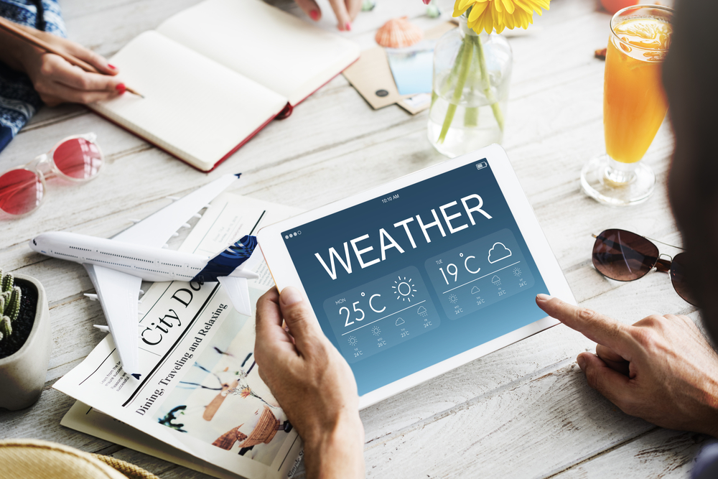
Control is about avoiding surprises and seek the familiar instead of the unknown. There are holidays when I like to be completely in control, to keep things in order, keeping it practical and predictable feels quite comfortable and safe. This gives me a sense of stability and structure.
CONTROL
PRACTICAL AND PREDICTABLE
AVOID SURPRISES

Slide 62
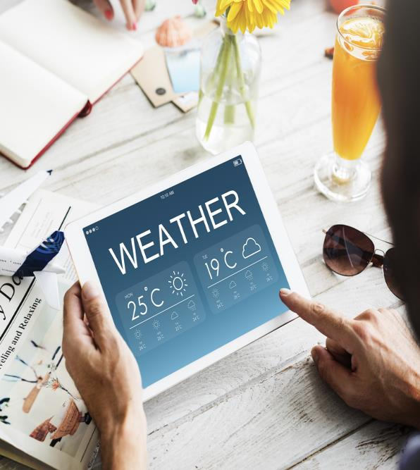
CONTROL
Emotional benefits; What SHOULD THE HOLIDAY give me ?
The core meaning of going on holiday is to give me a safe feeling. It should also allow me to spoil my loved ones.
Destination features and activities; What AM I looking for?
I want to go to a place that is well organized and with few language barriers. It should have a variety of accommodation offers and good service is of high importance.
PERSONALITY; WHAT SHOULD IT STAND FOR?
The destination needs to be predictable, practical and structured.
Social identity; how should it reflect upon me?
The destination should be for people who make rational choices. People who prefer the familiar over the unknown. Basically people who avoid risk.
I LIKE TO KEEP EVERYTHING UNDER CONTROL AND AVOID SURPRISES. I HAS TO BE WELL ORGANIZED, PRACTICAL AND PREDICTABLE.
40%
ARE UNDER
50 YEARS
40%
60%
SHARE OF OVERNIGHT STAYS
7%

Slide 63
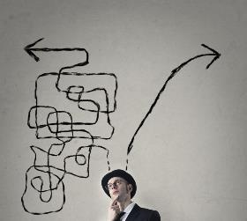
CONTROL
TYPICAL HOLIDAY OCCASIONS
Although the typical sun and beach vacation and sightseeing/round trip and city breaks dominates in this segment, you will also find cultural experiences and sports/active holidays as much as in the other segments.
I TRAVEL TO AVOID SURPRISES
These consumers choose destinations that is well organized. They want to travel to places that are predictable, practical and structured. They want to have a informal, fun and relaxed holiday at the same time.
I want to avoid too much surprises!
THE ROLE OF BRANDS
Control plays an important role for brands if they are aimed at structuring people’s lives or when the focus is on risk management, simplifying life, avoiding surprises. Brands that want to position themselves on Control should offer rational arguments and focus on functionality, maturity, health, purity, hygiene, and less in impulsiveness and fun.
HOLIDAY EXPERIENCE
Relaxation is on top of the list. This segment is under indexing on many activities, so a less active segment. They would like to visit cities and go shopping.
SOURCES OF INSPIRATIONS
These consumers travel mostly with their partner but also with children so they are highly influenced by their spouse and their children. Most of them organizes the trip themselves and travels independently (66%). They do not use that many information sources because the go to a place they know.

Slide 64
CONTROL
Core motivations
Emotional Benefits
Social Identity
Personality
Destination features
NOTE: Indexed vs. average of all items in facet We report all items with a score which is 1 standard deviation higher than the average
Notes:
Here it is crucial to insist on 4 things:
Stakeholders interview as per my comment on page 1: it is fundamental to understand what all users expect; it does not mean that collectively we will say yes to everything, but understanding potential challenges will help address this together
Formal deployment to make things official is also fundamental and too often forgotten: that have to be done together
We know things will not be perfect thus the importance of monitoring and adjusting the SOW if needed
It would be a big mistake to run fast in implementation: time we spend there is time we save later

Slide 65
Segment profile – CONTROL
Significantly over indexed in segment
Significantly under indexed in segment
TYPOLOGY
TRANSPORT AND ACOMMODATION
ACTIVITIES
TYPE OF HOLIDAY
TRANSPORT TO DESTINATION
ACTIVITIES
TRANSPORT ON DESTINATION
DURATION
ACCOMMODATION
TIME OF YEAR

Slide 66
Segment profile - CONTROL
Significantly over indexed in segment
Significantly under indexed in segment
PLANNING
DECISION MADE
INFLUENCERS
INFORMATION SOURCES
TRAVEL COMPANIONS
WHO DID YOU TRAVEL WITH
NUMBER OF TRAVEL COMPANIONS
TRAVEL FREQUENCY (NUMBER OF TIMES ABROAD)
HOW DID YOU TRAVEL

Slide 67
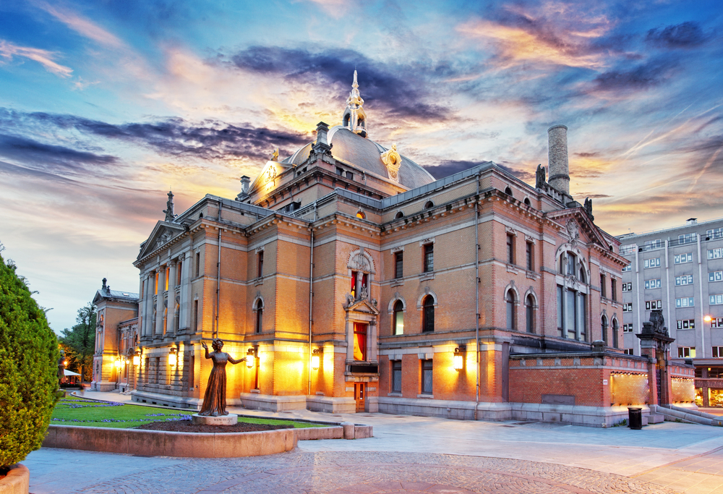
Broadening my cultural horizon is about feeling cultivated, special and ahead of the pack. The segment reflects the need to learn about a foreign culture, stand out from the crowd and break from convention. The segment is all about being proud of one’s own special ability and competence, intellectually, culturally and materially. Something to talk about when coming home.
BROADENING MY CULTURAL HORIZON
CULTIVATED, EXPLORATIVE AND AUTHENTIC
BROADENING MY KNOWLEDGE

Slide 68
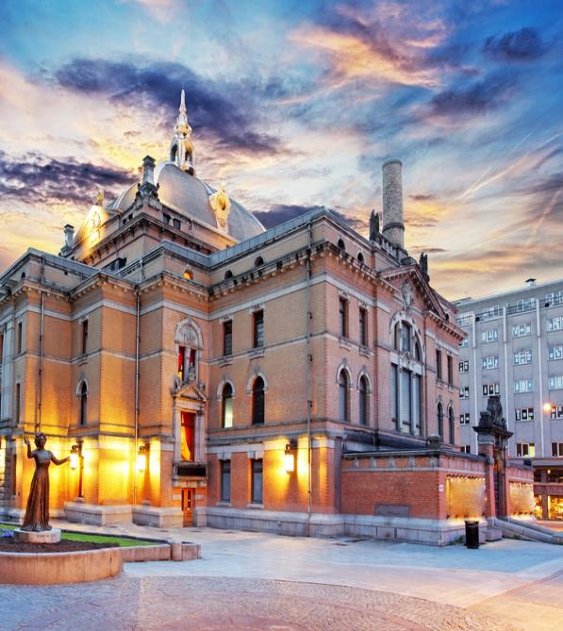
BROADENING MY CULTURAL HORIZON
Emotional benefits; What SHOULD THE HOLIDAY give me ?
The core meaning of going on holiday is to broaden my knowledge and my horizon. I want to enrich my view on the world, discover new and interesting places and get rich experiences.
Destination features and activities; What AM I looking for?
I want to go to a place with interesting culture & art and a rich cultural heritage. There must be interesting sights. The destination needs to be easy to travel to.
PERSONALITY; WHAT SHOULD IT STAND FOR?
The destination needs to be cultivated and explorative.
Social identity; how should it reflect upon me?
The destination should be for people who like to explore and have new experiences. These are people who want to revitalize themselves and they are interested to learn more. People who like to do things the unconventional way.
Sometimes I need to broaden my horizon and discover new and interesting places. I want to experience culture and art at a destination with a rich cultural heritage.
66%
ARE ABOVE
60 YEARS
46%
54%
SHARE OF OVERNIGHT STAYS
14%

Slide 69
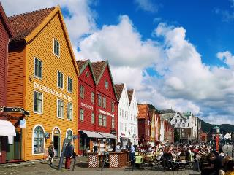
BROADENING MY CULTURAL HORIZON
TYPICAL HOLIDAY OCCASIONS
The dominant types of holiday is Sightseeing/round trip, visits to historic sites, city break (cultural, shopping, Club, restaurant visits etc.), and cultural experience (focus on art, theatre etc.).
It’s all about broadening my horizon!
I TRAVEL TO EXPAND MY HORIZON
These consumers want to see and learn more than other travelers. They seek destinations with a rich cultural heritage. There must be interesting sights.
THE ROLE OF BRANDS
The segment is important for brands which try to position themselves as creatively individualistic, unconventional, trendy and ahead of the rest, or as a tool for consumers to express their intelligence and cultural awareness.
HOLIDAY EXPERIENCE
These consumers you will find at historical buildings/sites, they visit cities, attend sightseeing tours and discover local culture and lifestyle. They want to visit museums and experience local architecture. Local history and legends are of high interest. You will also find them ingardens/parks and at concerts/festivals.
SOURCES OF INSPIRATIONS
These consumers are, more than others inspired by homepages for the destination, homepages for hotels, attractions and sites, guidebooks and catalogues or brochures. They also look for inspiration in newspapers and magazines.

Slide 70
BROADENING MY CULTURAL HORIZON
Core motivations
Emotional Benefits
Social Identity
Personality
Destination features
NOTE: Indexed vs. average of all items in facet We report all items with a score which is 1 standard deviation higher than the average
Notes:
Here it is crucial to insist on 4 things:
Stakeholders interview as per my comment on page 1: it is fundamental to understand what all users expect; it does not mean that collectively we will say yes to everything, but understanding potential challenges will help address this together
Formal deployment to make things official is also fundamental and too often forgotten: that have to be done together
We know things will not be perfect thus the importance of monitoring and adjusting the SOW if needed
It would be a big mistake to run fast in implementation: time we spend there is time we save later

Slide 71
Segment profile – BROADENING MY CULTURAL HORIZON
Significantly over indexed in segment
Significantly under indexed in segment
TYPOLOGY
TRANSPORT AND ACOMMODATION
ACTIVITIES
TYPE OF HOLIDAY
TRANSPORT TO DESTINATION
ACTIVITIES
TRANSPORT ON DESTINATION
DURATION
ACCOMMODATION
TIME OF YEAR

Slide 72
Segment profile – BROADENING MY CULTURAL HORIZON
Significantly over indexed in segment
Significantly under indexed in segment
PLANNING
DECISION MADE
INFLUENCERS
INFORMATION SOURCES
TRAVEL COMPANIONS
WHO DID YOU TRAVEL WITH
NUMBER OF TRAVEL COMPANIONS
TRAVEL FREQUENCY (NUMBER OF TIMES ABROAD)
HOW DID YOU TRAVEL

Slide 73
Exploring the world of natural beauty is about feeling unique, daring and adventurous. The segment reflects the need to see something new, something spectacular like a natural phenomenon. It also connects with the need to immerse in unspoiled nature and travel to a destination not ruined by tourism. Staying ahead of the “charter pack”. The segment is all about being proud of one’s ability to “go where no one has gone before”.
ADVENTURES IN the world of natural beauty
adventurous, daring AND unique.
immerse myself in the local life. Unspoiled nature.

Slide 74
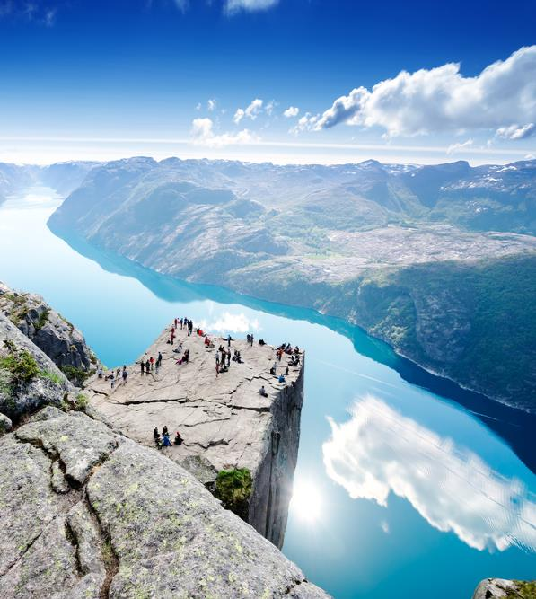
ADVENTURES IN the world of natural beauty
Emotional benefits; What SHOULD THE HOLIDAY give me ?
The core meaning of going on holiday is to broaden my horizon and my knowledge. I want to enrich my view on the world and discover new and interesting places. A place that allows me to immerse myself in the local life. All in all I want rich experiences and new inspiration.
Destination features and activities; What AM I looking for?
I want to go to a place that allows me to live close to nature. The destination should have unspoiled nature and not ruined by tourism. It has and allow me to live close to nature. I want quiet environments and beautiful nature. A destination that has good opportunities to meet local people and also interesting sights. A rich cultural heritage would also be good.
PERSONALITY; WHAT SHOULD IT STAND FOR?
The destination needs to be adventurous, unique, explorative, authentic and active.
Social identity; how should it reflect upon me?
The destination should be for people who like adventure and wants a life changing experience. People who want to make a different choice and do things the unconventional way. People who like to revitalize themselves, learn more and have new experiences.
Sometimes I need to discover new and interesting places at a destination that has unspoiled nature and that s not ruined by tourism.
48%
ARE OVER
60 YEARS
51%
49%
SHARE OF OVERNIGHT STAYS
18%

Slide 75
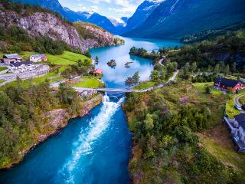
ADVENTURES IN the world of natural beauty
TYPICAL HOLIDAY OCCASIONS
The most common holiday type is a holiday to experience nature, scenery and wildlife. They are also over indexing on sightseeing/round trips, visits to historical sites and sport/active holiday.
I TRAVEL TO SOMETHING UNIQUE
These consumers choose destinations that makes them feel adventurous. They want to experience something unique. They want to travel to places that are fuelling their explorative side.
THE ROLE OF BRANDS
The segment is important for brands which try to position themselves as creatively individualistic, unconventional, trendy and ahead of the rest, or as a tool for consumers to express their uniqueness, seeing something others has not seen. Also act as a tool for consumers to express their environmental awareness. A sustainable destination, not ruined by tourism.
HOLIDAY EXPERIENCE
This is a very active segment. They want to observe beauty of nature and discover local culture and lifestyle. They also want to experience mountains, the wilderness or the wildlife, visit the countryside, and observe natural phenomenon’s, and like to go hiking. Local history and legends, sightseeing tours and experience national festivals and traditional celebrations is also of high interest.
SOURCES OF INSPIRATIONS
This segment seek their information for homepages for the destination and attractions and sights. They also use guidebooks. Catalogues or brochures are also popular.

Slide 76
ADVENTURES IN the world of natural beauty
Core motivations
Emotional Benefits
Social Identity
Personality
Destination features
NOTE: Indexed vs. average of all items in facet We report all items with a score which is 1 standard deviation higher than the average
Notes:
Here it is crucial to insist on 4 things:
Stakeholders interview as per my comment on page 1: it is fundamental to understand what all users expect; it does not mean that collectively we will say yes to everything, but understanding potential challenges will help address this together
Formal deployment to make things official is also fundamental and too often forgotten: that have to be done together
We know things will not be perfect thus the importance of monitoring and adjusting the SOW if needed
It would be a big mistake to run fast in implementation: time we spend there is time we save later

Slide 77
Segment profile – ADVENTURES IN the world of natural beauty
Significantly over indexed in segment
Significantly under indexed in segment
TYPOLOGY
TRANSPORT AND ACOMMODATION
ACTIVITIES
TYPE OF HOLIDAY
TRANSPORT TO DESTINATION
ACTIVITIES
TRANSPORT ON DESTINATION
DURATION
ACCOMMODATION
TIME OF YEAR

Slide 78
Segment profile – ADVENTURES IN the world of natural beauty
Significantly over indexed in segment
Significantly under indexed in segment
PLANNING
DECISION MADE
INFLUENCERS
INFORMATION SOURCES
TRAVEL COMPANIONS
WHO DID YOU TRAVEL WITH
NUMBER OF TRAVEL COMPANIONS
TRAVEL FREQUENCY (NUMBER OF TIMES ABROAD)
HOW DID YOU TRAVEL

Slide 79
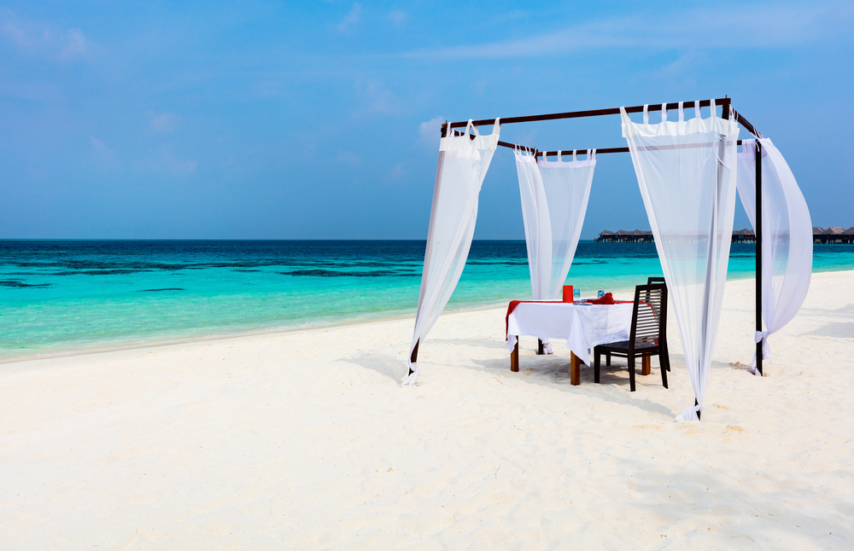
Romantic luxury is about the need to indulge in some luxury. Find those romantic spots that really creates a feeling of extravagance. It relates to the desire to feel on top of the world. The segment reflects that I want the best and are willing to pay for it.
EXTRAVAGANT INDULGENCE
EXTRAVAGANT AND SUPERIOR
SOPHISTICATED AND CLASSY

Slide 80
EXTRAVAGANT INDULGENCE
Emotional benefits; What SHOULD THE HOLIDAY give me ?
The core meaning of going on holiday is to allow me to indulge myself with a bit of luxury. I want a vacation that allows me to pamper myself.
Destination features and activities; What AM I looking for?
I want to go to a place that has good shopping. I want a destination that has guaranteed sunshine and good service.. Of course it needs to have a variety of different restaurant offers, good beaches and a wide range of possible activities.
PERSONALITY; WHAT SHOULD IT STAND FOR?
The destination needs to be extravagant, superior, classy and unique.
Social identity; how should it reflect upon me?
The destination should be for people who want the best and are willing to pay for it. People who are sophisticated and classy. Basically people who like to have the best things and value high quality.
Sometimes I NEED TO INDULGE MY SELF WITH A BIT OF LUXURURY AND FEEL ON TOP OF THE WORLD. I NEED A DESTINATION WITH ROMANTIC SPOTS.
42%
ARE BELOW
40 YEARS
54%
46%
SHARE OF OVERNIGHT STAYS
7%

Slide 81
EXTRAVAGANT INDULGENCE
TYPICAL HOLIDAY OCCASIONS
You will find most of the typical sun and beach vacations in this segment, but you will also find. Sightseeing/round trips, city breaks and visits to historic sites.
Although, most of the time it’s all about romance!
I TRAVEL FOR ROMANCE AND LUXURY
These consumers choose destinations that enables them to indulge in a bit of luxury. Although most of the trips are in the spring and summertime, it can even be in the winter. They often have others plan for them and travel independently.
THE ROLE OF BRANDS
The segment is important for brands trying to position themselves as premium, high-class and powerful. It appeals to the need to be respected and revered, to feel strong and ‘on-top-of-the-world’. It is also an important dimension for brands who want to be perceived as exclusive and only available for the lucky few.
HOLIDAY EXPERIENCE
These consumers over index on shopping. Relaxation, restaurant visits are also very important. They want their romantic spots which they can find both in cities and in traditional beach resorts. They often rent a car for their romantic getaways. They stay at high standard hotels more than in other segments.
SOURCES OF INSPIRATIONS
These consumers spend a bit of time planning. 51% of them settle for the trip more than 3 months before they go. They browse the internet in general to get luxurious romantic inspiration. They travel with their partner and gets inspired by him or her.

Slide 82
EXTRAVAGANT INDULGENCE
Core motivations
Emotional Benefits
Social Identity
Personality
Destination features
NOTE: Indexed vs. average of all items in facet We report all items with a score which is 1 standard deviation higher than the average
Notes:
Here it is crucial to insist on 4 things:
Stakeholders interview as per my comment on page 1: it is fundamental to understand what all users expect; it does not mean that collectively we will say yes to everything, but understanding potential challenges will help address this together
Formal deployment to make things official is also fundamental and too often forgotten: that have to be done together
We know things will not be perfect thus the importance of monitoring and adjusting the SOW if needed
It would be a big mistake to run fast in implementation: time we spend there is time we save later

Slide 83
Segment profile – EXTRAVAGANT INDULGENCE
Significantly over indexed in segment
Significantly under indexed in segment
TYPOLOGY
TRANSPORT AND ACOMMODATION
ACTIVITIES
TYPE OF HOLIDAY
TRANSPORT TO DESTINATION
ACTIVITIES
TRANSPORT ON DESTINATION
DURATION
ACCOMMODATION
TIME OF YEAR

Slide 84
Segment profile - EXTRAVAGANT INDULGENCE
Significantly over indexed in segment
Significantly under indexed in segment
PLANNING
DECISION MADE
INFLUENCERS
INFORMATION SOURCES
TRAVEL COMPANIONS
WHO DID YOU TRAVEL WITH
NUMBER OF TRAVEL COMPANIONS
TRAVEL FREQUENCY (NUMBER OF TIMES ABROAD)
HOW DID YOU TRAVEL

Slide 85
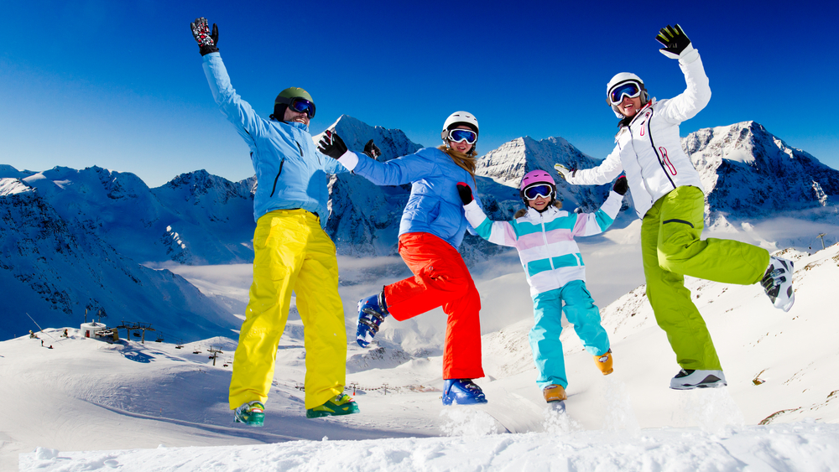
Energy is about adventure, being active, testing your boundaries and discovering new things. It taps into the need to be energized. Energy is all about being active and experiencing the freedom, passion, and adventure that comes with activities. Buzzing about, spending energy, and feeling very much alive and kicking.
ENERGY
ACTIVE AND ADVENTUROUS
HAVE AS MUCH FUN AS POSSIBLE

Slide 86
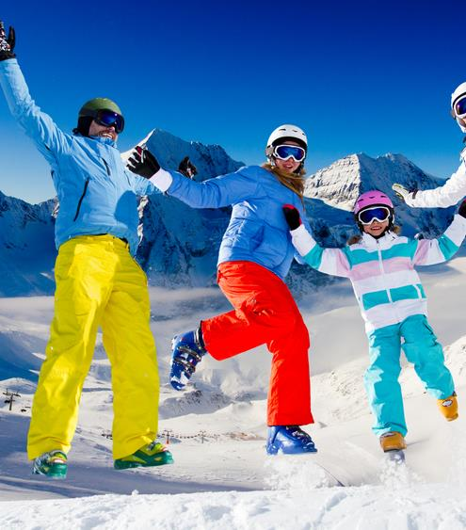
ENERGY
Emotional benefits; What SHOULD THE HOLIDAY give me ?
The core meaning of going on holiday is to feel full of energy. A holiday should allow me to intensify the relationship to my loved ones and create precious moments of togetherness. Of course it should allow me to share good times with others, create and help me to enjoy life to the fullest. I also want new inspiration.
Destination; What AM I looking for?
I want to go to a place that offers a wide range of possible activities also for kids. A destination that allows me to be physical active.
PERSONALITY; WHAT SHOULD IT STAND FOR?
The destination needs to be active, adventurous and sociable.
Social identity; how should it reflect upon me?
The destination should be for people who want to have as much fun as possible in life, and who likes adventure. These are people who have an active and busy social life, who enjoy spending time with friends, and who like to do things spontaneously and impulsively.
Sometimes I NEED a holiday that gives med energy and new inspiration. I need a destination with a wide range of activities that keeps me physical active.
23%
ARE BELOW
30 YEARS
52%
48%
SHARE OF OVERNIGHT STAYS
10%

Slide 87
ENERGY
TYPICAL HOLIDAY OCCASIONS
As in most segments you will find the typical sun and beach vacation in this segment, but you will also find sports/active holidays and ski holiday!
I TRAVEL TO GET ENERGY
These consumers choose destinations that enables them to live life to the fullest. They often travel in larger groups (4 or more) with friends and with children, so the social element is also important. Many of them travel by car and they stay at a rented cabin/holiday home. More than in other segments they travel in wintertime.
THE ROLE OF BRANDS
The energy segment is important for brands who position themselves as vital and energetic and who are always pushing the boundaries and stimulating consumers with change and challenge. A brand that wants to adopt a Vitality strategy needs to position itself as inquisitive and curious about the world, a brand that is entertaining, surprising and sometimes perhaps even shocking for its (temporary) consumers. It is important for these brands to offer constant renewal.
HOLIDAY EXPERIENCE
More than in other segments you will find activities like winter activities (Alpine skiing/snowboarding, cross country skiing, dog-sleigh, snowmobile etc.), hiking and visits to amusement parks. And of course they enjoy relaxation, observe beauty of nature and taste local food and drink as much as the next man.
SOURCES OF INSPIRATIONS
These consumers don’t spend a lot of time planning where to go. Most of them settle for the trip less than 2 months before they go (45%). Their main source of information is the internet in general. I.e. it will be important to use search engines as a vehicle to reach this segment but more than other segments they act on advice from friends/family. Their children, friends and acquaintances heavily influences their choice.

Slide 88
ENERGY
Core motivations
Emotional Benefits
Social Identity
Personality
Destination features
NOTE: Indexed vs. average of all items in facet We report all items with a score which is 1 standard deviation higher than the average
Notes:
Here it is crucial to insist on 4 things:
Stakeholders interview as per my comment on page 1: it is fundamental to understand what all users expect; it does not mean that collectively we will say yes to everything, but understanding potential challenges will help address this together
Formal deployment to make things official is also fundamental and too often forgotten: that have to be done together
We know things will not be perfect thus the importance of monitoring and adjusting the SOW if needed
It would be a big mistake to run fast in implementation: time we spend there is time we save later

Slide 89
Segment profile – ENERGY
Significantly over indexed in segment
Significantly under indexed in segment
TYPOLOGY
TRANSPORT AND ACOMMODATION
ACTIVITIES
TYPE OF HOLIDAY
TRANSPORT TO DESTINATION
ACTIVITIES
TRANSPORT ON DESTINATION
DURATION
ACCOMMODATION
TIME OF YEAR

Slide 90
Segment profile - ENERGY
Significantly over indexed in segment
Significantly under indexed in segment
PLANNING
DECISION MADE
INFLUENCERS
INFORMATION SOURCES
TRAVEL COMPANIONS
WHO DID YOU TRAVEL WITH
NUMBER OF TRAVEL COMPANIONS
TRAVEL FREQUENCY (NUMBER OF TIMES ABROAD)
HOW DID YOU TRAVEL

Slide 91
4
BRAND PROFILE OF
Norway
Associations
Emotional benefits associated with Norway
Destination characteristics associated with Norway
Brand personality associated with Norway
Social identity associated with Norway

Slide 92
EMOTIONAL associations
Compared to other destinations Norway has a really strong emotional footprint in Sweden. Norway is first and foremost associated with no surprises and a safe feeling, but also a place you will find an element of liberation as well as energizing.

Slide 93
DESTINATION CHARACTERISTICS
The Swedes are generally very clear on what differentiates Norway compared with other destinations in terms of functional delivery: environmentally friendly offers, unspoiled nature, quiet environments, well organized, few language barriers and generally safe.
But also a destination that allows you to be physical active.

Slide 94
BRAND PERSONALITY
In Sweden, Norway has quite a outspoken brand personality compared to other destinations.
For Sweden Norway is mostly seen as more practical, predictable & structured compared to other destinations.
The Swedes also sees Norway as more fresh and active, as well as peaceful, than other destinations.
This indicates a multi faceted view of Norway in the Swedish market.

Slide 95
SOCIAL IDENTITY
Compared to other destinations Norway has a strong footprint when it comes to social identity in Sweden.
For Sweden, Norway is the destination for people that make rational choices, avoid risk and who prefer the familiar over the unknown.
In addition it is the destination for people who needs time for themselves.
Norway is also seen as a place for people who have strong family values. There is even an element of adventure in the Norwegian social identity in Sweden.
So again a multi faceted image of Norway.

Slide 96
Top associations to Norway On all four facets
EMOTIONAL associations
DESTINATION CHARACTERISTICS
BRAND PERSONALITY
SOCIAL IDENTITY

Slide 97
5
The competitive
Landscape
Visits and repeat visits
Strengths and weaknesses

Slide 98
Norway’s fit to segments in all markets
A clear fit to «Exploring the world of natural beauty» in most markets
 | Broadening My Cultural Horizon | Extravagant indulgence | Escape | Adventures in the World of Natural Beauty | Sharing & Caring | Control | Energy | Playful Liberation | Social Immersion
UK | 0.22 | -0.19 | 0.23 | 0.51 | -0.35 | -0.16 | -0.07 | -0.19 | -0.06
GERMANY | 0.13 | -0.09 | 0.24 | 0.51 | -0.39 | -0.14 | -0.02 | -0.10 | -0.16
USA | 0.45 | -0.34 | 0.25 | 0.32 | -0.08 | -0.26 | -0.09 | -0.31 | 0.21
DENMARK | -0.27 | -0.22 | 0.29 | -0.24 | 0.19 | 0.50 | 0.05 | 0.02 | -0.26
SWEDEN | -0.25 | -0.15 | 0.14 | -0.09 | 0.01 | 0.54 | 0.00 | 0.04 | -0.28
CHINA | 0.07 | -0.03 | 0.14 | 0.35 | -0.27 | -0.17 | -0.05 | 0.06 | -0.24
SPAIN | 0.07 | 0.03 | 0.19 | 0.27 | -0.32 | 0.12 | -0.13 | -0.03 | -0.28
ITALY | 0.08 | -0.03 | 0.21 | 0.37 | -0.38 | -0.06 | -0.05 | 0.10 | -0.19
NETHER-LANDS | 0.09 | -0.17 | 0.28 | 0.43 | -0.25 | -0.05 | 0.13 | -0.15 | -0.19
FRANCE | 0.06 | -0.11 | 0.26 | 0.36 | -0.36 | 0.03 | -0.09 | -0.06 | -0.19
AVERAGE | 0.06 | -0.13 | 0.22 | 0.28 | -0.22 | 0.03 | -0.03 | -0.06 | -0.16
Good fit
Neutral fit
Bad fit

Slide 99
Overview Destinations fit in the Swedish market
Segments/ destinations | Playful Liberation | Social Immersion | Sharing & Caring | Escape | Control | Broadening My Cultural Horizon | Adventures in the World of Natural Beauty | Extravagant indulgence | Energy
Austria | -0.12 | -0.16 | 0.03 | 0.09 | 0.28 | 0.00 | -0.17 | -0.15 | 0.00
Canada | 0.02 | 0.10 | -0.45 | -0.17 | -0.02 | 0.06 | 0.54 | -0.14 | 0.18
Croatia | 0.07 | 0.16 | 0.50 | 0.55 | -0.33 | -0.18 | -0.20 | -0.37 | 0.26
Czech Republic | 0.13 | 0.05 | 0.23 | -0.05 | 0.29 | 0.08 | -0.33 | -0.11 | -0.05
Denmark | 0.04 | -0.03 | 0.33 | -0.04 | 0.66 | -0.22 | -0.54 | -0.12 | -0.08
Finland | -0.03 | -0.24 | 0.06 | 0.04 | 0.72 | -0.20 | -0.25 | -0.07 | -0.18
France | -0.01 | -0.14 | 0.04 | -0.16 | -0.10 | 0.16 | -0.35 | 0.35 | -0.04
Germany | -0.05 | -0.10 | 0.05 | -0.34 | 0.74 | 0.04 | -0.46 | 0.05 | -0.17
Iceland | -0.06 | -0.10 | -0.45 | 0.16 | -0.25 | 0.17 | 0.71 | -0.16 | -0.02
Italy | 0.07 | 0.11 | 0.19 | 0.06 | -0.37 | 0.16 | -0.28 | 0.09 | -0.04
Netherlands | 0.03 | 0.29 | 0.15 | -0.35 | 0.29 | 0.25 | -0.26 | -0.25 | -0.07
New Zealand | 0.06 | -0.10 | -0.53 | -0.01 | -0.33 | -0.03 | 0.75 | 0.04 | 0.23
Norway | 0.04 | -0.28 | 0.01 | 0.14 | 0.54 | -0.25 | -0.09 | -0.15 | 0.00
Portugal | 0.17 | 0.03 | 0.32 | 0.31 | -0.08 | -0.07 | -0.27 | -0.24 | 0.07
Scotland | -0.18 | 0.24 | -0.17 | 0.23 | -0.35 | 0.34 | 0.49 | -0.45 | 0.03
South Africa | -0.19 | 0.02 | -0.29 | -0.08 | -0.30 | 0.04 | 0.60 | -0.02 | 0.05
Spain | 0.25 | -0.06 | 0.50 | 0.19 | 0.26 | -0.35 | -0.65 | -0.05 | 0.14
Switzerland | -0.10 | -0.33 | -0.15 | 0.06 | 0.19 | 0.01 | -0.04 | 0.11 | -0.04
Thailand | 0.20 | -0.06 | 0.45 | 0.46 | -0.16 | -0.42 | -0.34 | 0.05 | 0.16
USA | 0.17 | -0.12 | -0.15 | -0.43 | 0.15 | -0.19 | -0.16 | 0.41 | 0.23
Good fit
Neutral fit
Bad fit

Slide 100
6
Global recommendations
Brand positioning

Slide 101
The task at hand
The strategy to make Norway occupy a unique and credible position, relative to competing destinations, in the mind of the tourist.

Slide 102
In CONCLUSION …
Norway needs to diversify it's relevance
as a holiday destination
1
2
3
4
We have 9 decent size segments today
There are important differences by market
Highly relevant for one segment
Relevance for aditional 5 segments
Competitive destinations too are playing on multiple needs
Nature is a highly competitive area
Norway is already associated with a wide variety of holiday needs & activities
The whole of Norway, the whole year round
We see a further fragmentation of needs in the holiday segmentation
Norway connects reasonably well with multiple needs
It's the only way to stay competitive
Norway has a lot to offer

Slide 103
We see a further fragmentation of holiday needs
1
We have 9 decent size segments today (vs only 5 >6% in 2011)

Slide 104
We see a further fragmentation of holiday needs
1
There are a lot of differences in size by market
TOP 3 (% overnight stays*)
US
UK
Denmark
Sweden
China
Spain
Italy
Nether-lands
France
Germany
GLOBAL
26%
19%
9%
13%
12%
13%
14%
11%
14%
19%
10%
13%
17%
12%
21%
12%
17%
16%
15%
10%
13%
14%
21%
12%
13%
18%
18%
14%
14%
22%
19%
14%
15%
24%
23%
16%
13%
12%
9%
* Share of overnight stays: The segment volume is derived from the number of overnight stays on each occasion. The figures on the slide shows the share of overnight stays on all holidays.

Slide 105
Norway connects well with multiple needs
2
Highly relevant for one segment, decent relevance for additional 5 segments
EXTRAVAGANT INDULGENCE
ADVENTURES IN THE WORLD OF NATURAL BEAUTY
Fit with segments

Slide 106
Diversification is necessary to stay competitive
3
Nature is a highly competitive area
ADVENTURES IN the world of natural beauty
Fit with Adventures in the World of Natural Beauty

Slide 107
Diversification is necessary to stay competitive
3
Competitive destinations too are playing on multiple needs

Slide 108
Diversification is necessary to stay competitive
3
Competitive destinations too are playing on multiple needs
Notes:
Playing on many different segments
Eg fika = social immersion
Relaxing
Exploring nature
Broadening
Energy

Slide 109
Norway has a lot to offer
4
Norway is used for a wide variety of holiday needs & activities
Base: holidays to Norway

Slide 110
Norway has a lot to offer
4
This fits with the ambition to promote “the whole of Norway, the whole year round”

Slide 111
Recommendations for Sweden
Where do we go from here?
Notes:
Still a bit early to have digested all of this, but some first, broad recommendations can already be formulated.

Slide 112
Norway Needs to continue to work on Holiday basics in Sweden
Norway fails to meet some basic holiday expectations
Good value for money.
Interesting sights. Relaxed. Cozy.
Is easy to travel to.
Share good times with others. Friendly people.
Discover new and interesting places. Rich experiences. Explorative.
Beautiful nature
People who like adventure.
Maintain
Improve

Slide 113
Norway connects well with multiple needs in Sweden
Highly relevant for 1 segment, decent relevance for additionally 2-3 segments
Playful Liberation
Social Immersion
Sharing & Caring
Escape
Control
Broadening My Cultural Horizon
ADVENTURES IN the World of Natural Beauty
EXTRAVAGANT INDULGENCE
Energy
Fit with segments in the Swedish market

Slide 114
Looking at Norway’s current strengths
And position different routes that can be explored
BUT IMPORTANT ADDITIONS ARE NEEDED
To add some content to the most dominant need (control) we need to combine it with another need OR focus on another segment entirely
THE OBVIOUS TARGET
ESCAPE
A safe escape to Norway. Norway has those quiet environments you are looking for. A trip to Norway restores my sense of harmony and balance. It helps you escape from your hectic daily life.
CONTROL
PLAYFUL LIBERATON
For Swedes, Norway could be a place to feel completely liberated and full of energy. A playful and fresh destination. It’s safe to have party & fun in Norway.
BUT!!
«ENERGY» and «SHARING & CARING» could also be worth looking at when developing concepts for the Swedish market.

Slide 115
Questions?
Please contact…
kjetil.stromseth@ipsos.com
Oslo
+47 934 52 000
steven.naert@ipsos.com
Antwerpen
+ 32 497 70 64 57

