Slide 1
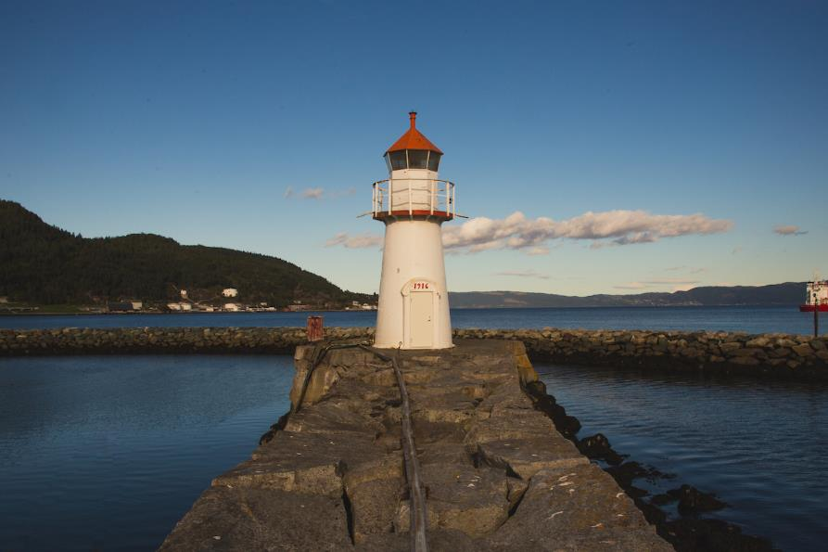


Trondheim - Norway’s hidden gem

Slide 2
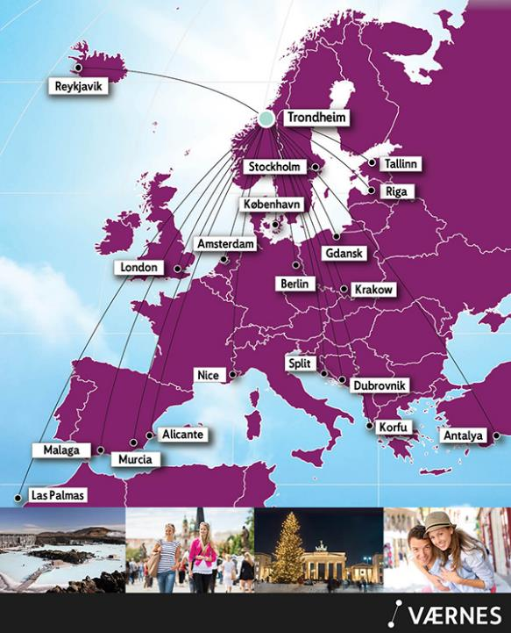
Direct international flights to Trondheim
Schedules vary depending on season

Slide 3
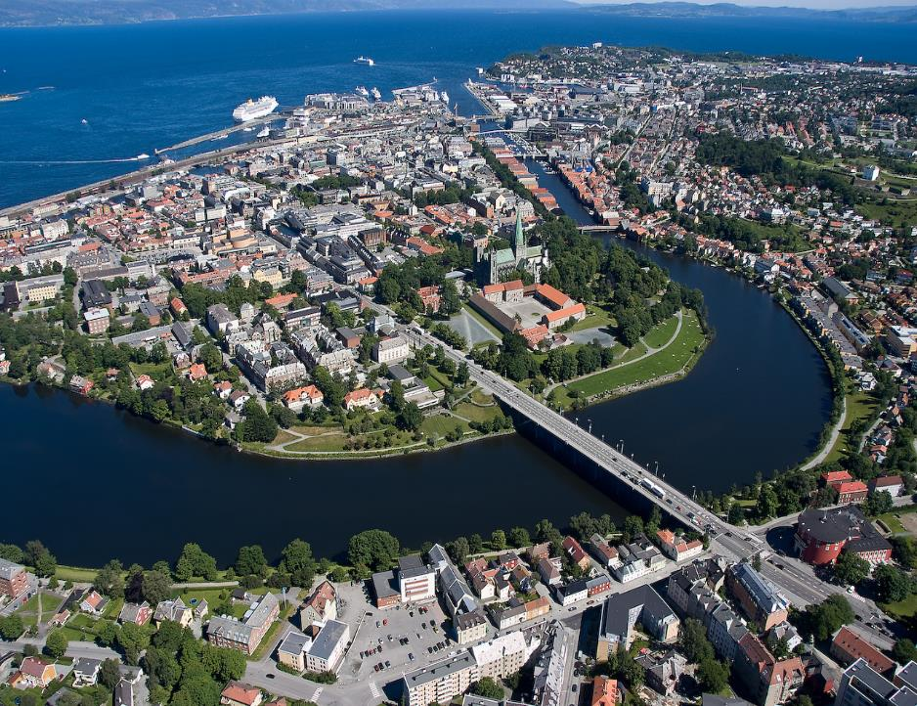
The creative city
located by the fjord!

Slide 4
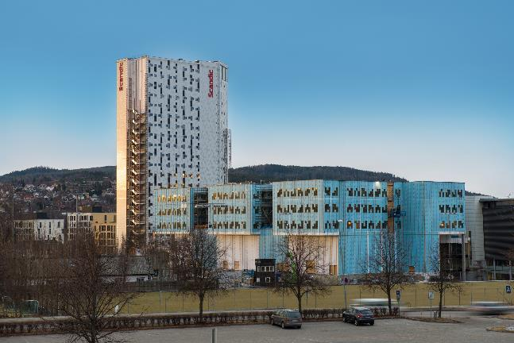
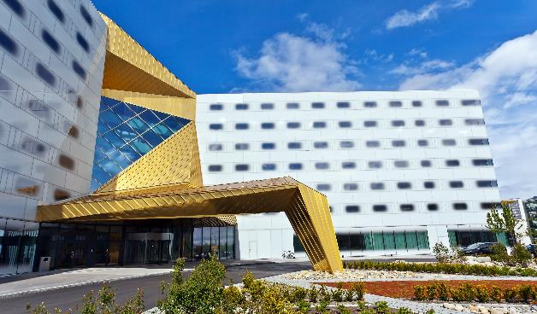
Two of Norway’s largest congress hotels with 400 rooms and plenary for 1.800 persons each.
Scandic Lerkendal is located 15 minutes walk from the city center, next to Rosenborg Football Club’s home arena.
Clarion Hotel & Congress is located next to the fjord, a few minutes walk from the city center.
Hotel chains in Trondheim:
*Best Western Hotels *Nordic Choice Hotels
*Radisson BLU Hotels *Scandic Hotels
*Thon Hotels
You will also find two less expensive summer hotels and a youth hostel

Slide 5
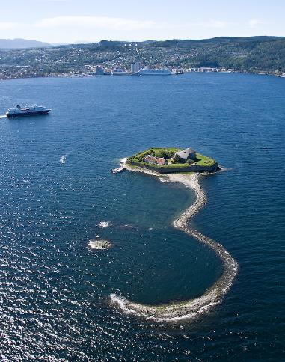
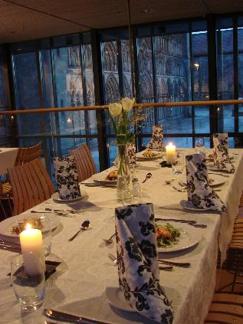
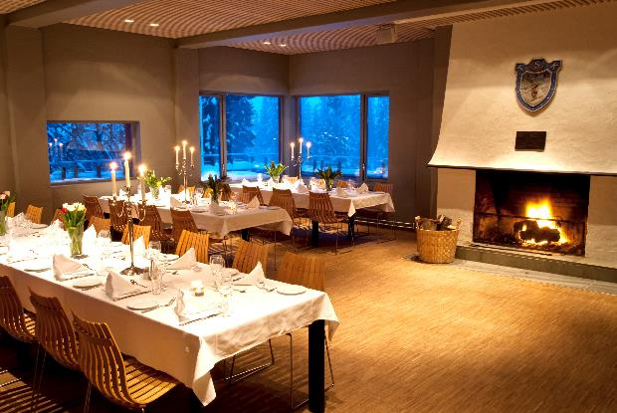
Cozy venues
- urban, in the woods and on the fjord

Slide 6
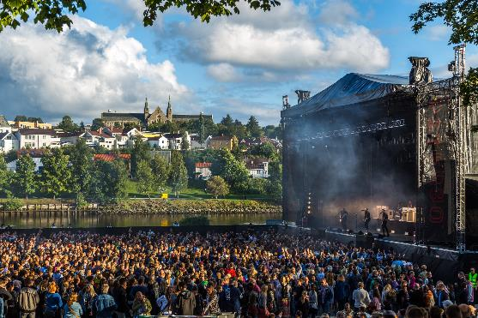
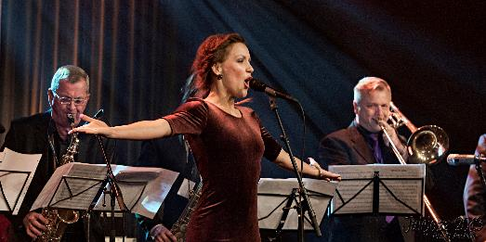
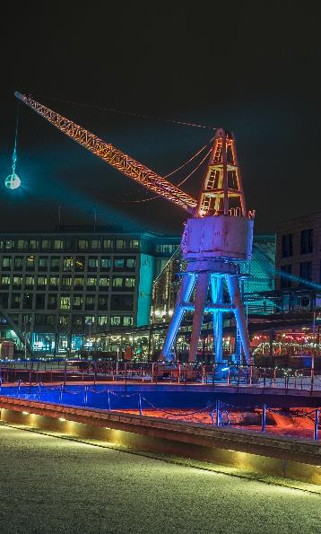
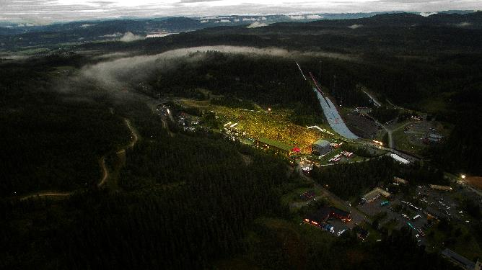
Culture & festivals

Slide 7
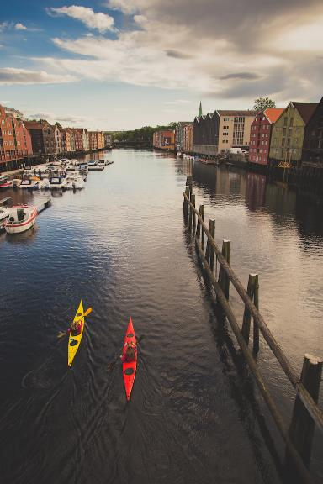

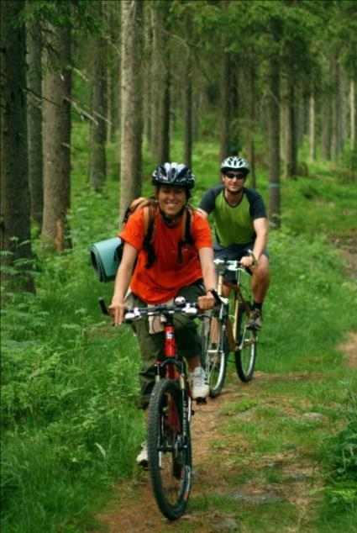
Summer activities

Slide 8
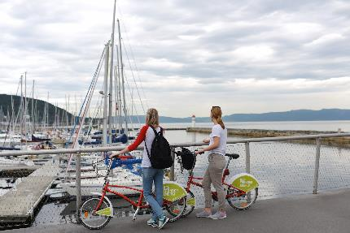
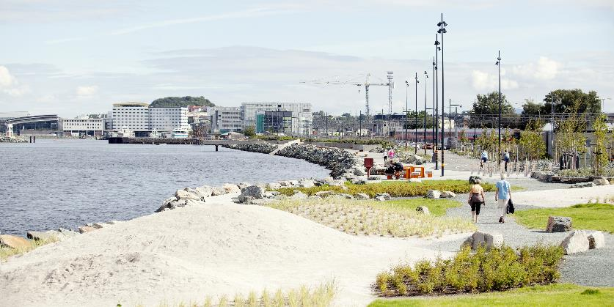
Trondheim along the water front, on city bikes or on foot
Time for picnics, fishing, sand volleyball and swimming in the fjord

Slide 9
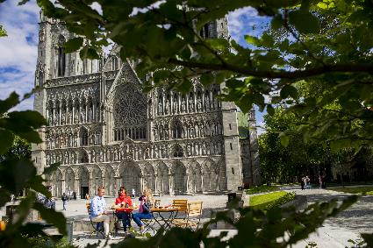

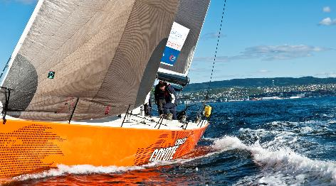
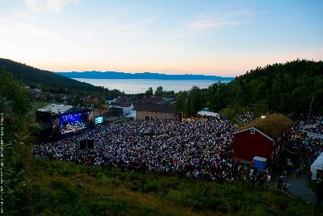
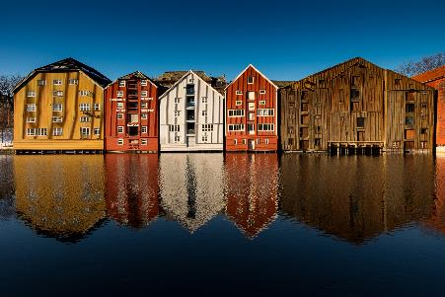
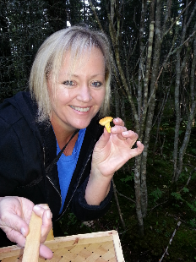
Enjoy summer Trondheim

Slide 10
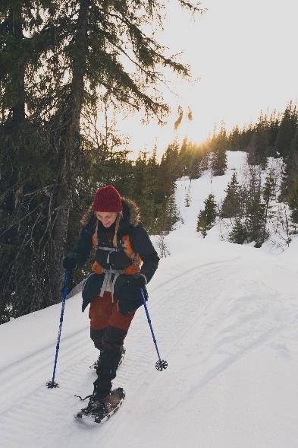
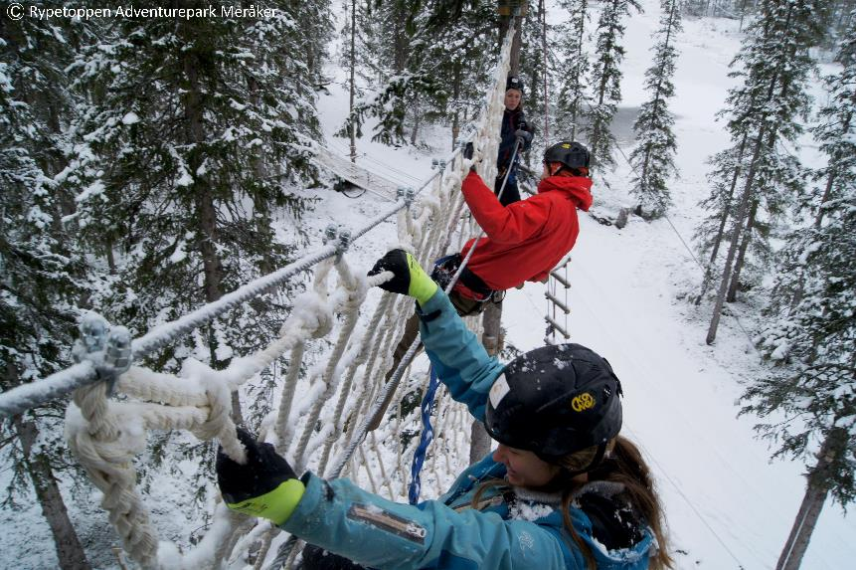
Winter activities

Slide 11
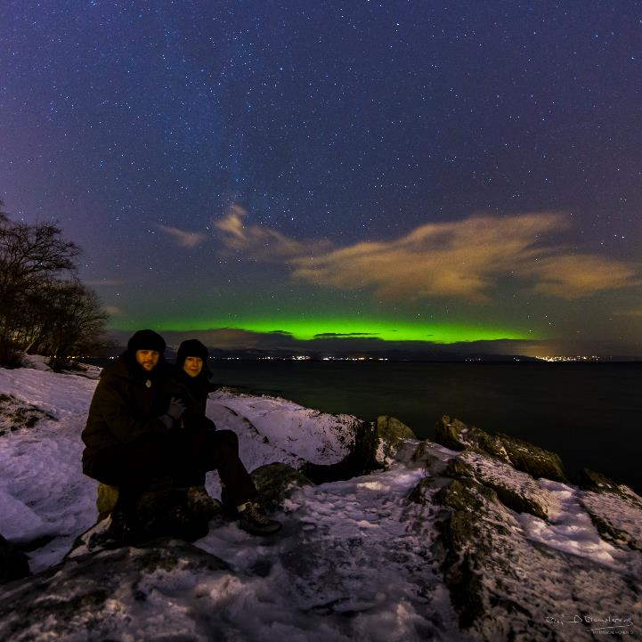
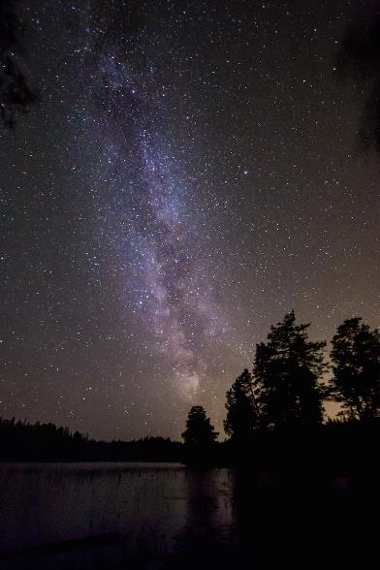
Hunting for the Northern Lights and the Milky Way

Slide 12
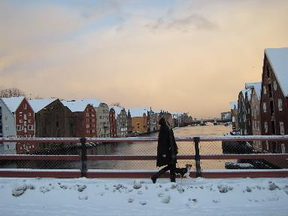
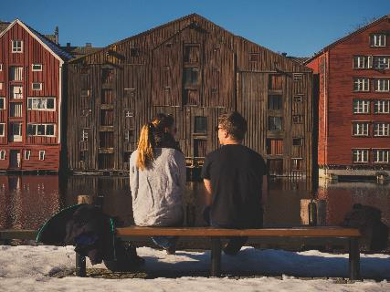
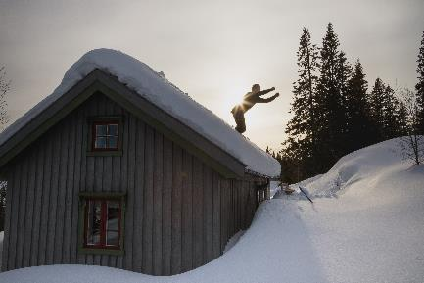
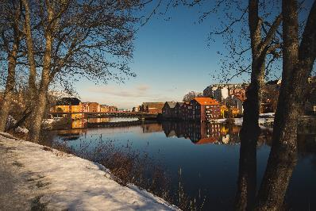
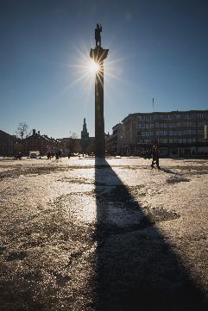
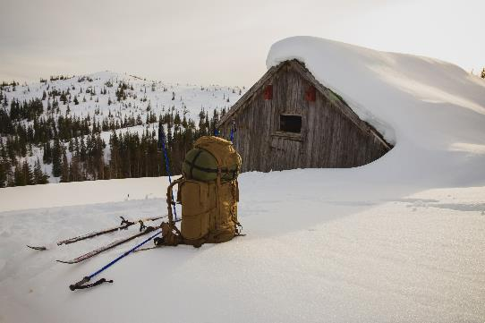
Enjoy winter Trondheim

Slide 13
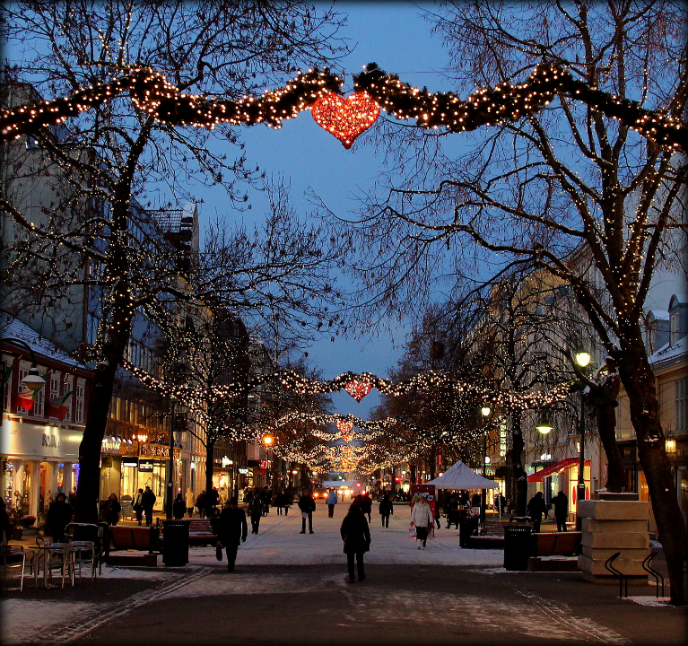
Welcome to Trondheim!

Slide 14


Contact person:
Lisbeth Fallan
lisbeth@visittrondheim.no
Mobile: +47 90996619

