Slide 2
Be a Host Program Partners
Notes:
We invest in our local hosts event’s success – work together to make hosts’ conference a success
Make it about them not us and our beautiful destination

Slide 3
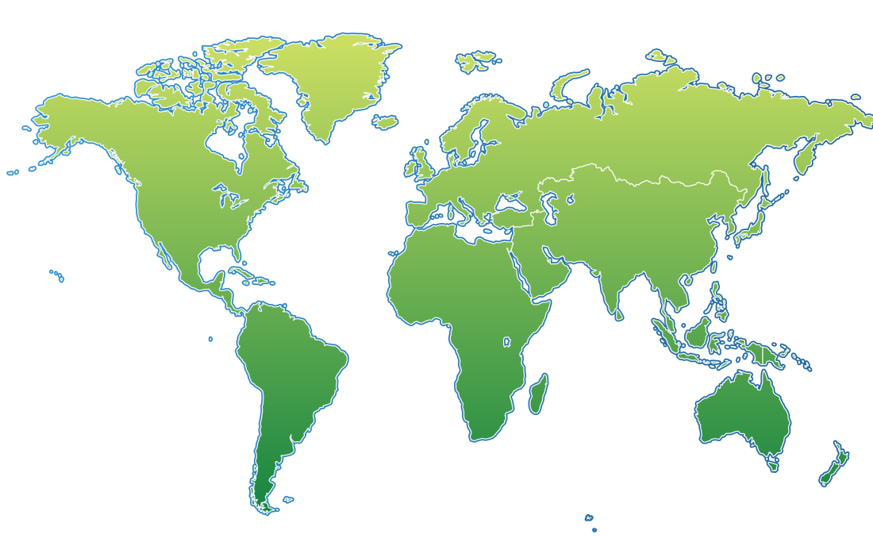
Why do we need Local Hosts?
Notes:
80% of international meetings require local host
Smaller Cdn meeting can lead to the US meeting – or a joint Cdn/American meeting. We have found also that the US may put in a bid with Cdn counterparts to win larger Intl meetings etc.
Institute of Auditors – Cdn meeting first then Intl

Slide 4
Notes:
What is BAH – history and activities
Sales and Marketing initiative - 1996
Partnership btwn VHDA, VCC, Tvan
Supports Canadian members of provincial, national and international association members to bring their conferences to Vancouver
Our goal is to create a partnership between us, the CVB and its members, and you as the local host. 10 people to 20,000 pax
Can’t bring intl mtgs without them– 80 to 90% of intl meetings require local organizing committee
We value the time and effort you take to make this happen – you are really the heart of the program
Complimentary services – want to make this process as easy as possible
Activities – research, presentations at universities, hospitals and institutions
Catalyst newsletter to keep our local hosts informed
Bid seminars, mini – educational events thru year
ANYONE CAN BE A LOCAL HOST
Sales and Marketing initiative - 1996
Partnership btwn VHDA, VCC, Tvan
Supports Canadian members of provincial, national and international association members to bring their conferences to Vancouver
Our goal is to create a partnership between us, the CVB and its members, and you as the local host. 10 people to 20,000 pax
Can’t bring mtgs without you – 80 to 90% of intl meetings require local organizing committee
We value the time and effort you take to make this happen – you are really the heart of the program
Complimentary services – want to make this process as easy as possible
Activities – research, presentations at universities, hospitals and institutions
Catalyst newsletter to keep our local hosts informed
Bid seminars, mini – educational events thru year

Slide 5
The Usual Procedure
Call for Proposals by the Intl Assn
Bids Created & Submitted
Bid Presentation & Vote
STEP 1
STEP 2
STEP 3
STEP 4
STEP 5
STEP 6
Expression of Interest submitted by members
Short list of bidders
Decision
Be a Host starts here
Notes:
The Usual Procedure
Call for Proposals by the Intl Assn
Expressions of Interests submitted by members
Bids Created & Submitted
Short list of bidders (sometimes after site inspection)
Bid Presentation & Vote
Decision

Slide 6
Current Clients= Potential Hosts
Notes:
Board meetings in your property? Who is already visiting who you can enquire about other meetings?

Slide 7
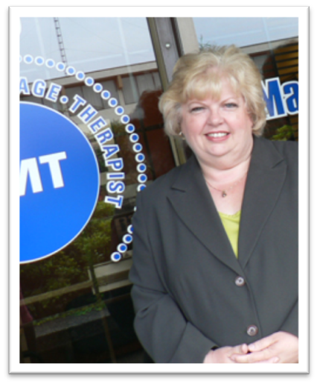
Referrals from our Partners
Brenda Locke - Local Host for the International Fascia Research Congress Vancouver 2012
Notes:
Executive Director of the Massage Therapists Association of British Columbia
Great example of referral to the larger meetings – this Fascia meeting was largest and most successful ever and we are in current discussion with Brenda on other intl meetings
Site of the Fairmont for their BC meeting
Locals new of this Fascia meeting and mentioned it to Fairmont Sales Manager –
New at conference game but was very enthusiastic
Sales Manager referred her to the BAH program
Tourism Vancouver assisted with presentation materials, and with support from the Canadian Tourism Commission, attended the association’s meeting in Europe to present the bid.
1000 pax

Slide 8
Science and Research in your city
Notes:
You likely already know what are the hot industries, movers and shakers for your city
This is key for finding linkages and local hosts for our program –
Dr. Julio Montaner, Director of the BC Centre for Excellence in HIV/AIDS.
Former President of the International Aids Society
In the mid-1990s, Dr. Montaner’s innovative research led to the development of highly active antiretroviral therapy (HAART),
a triple-drug therapy now the gold standard of HIV treatment
We partnered with Dr. Montaner to bring the Intl Conference on AIDS in 1996, 15000pax. Not often a society would do repeat business for such a large
Conference but due to Dr. Montaner’s global reputation in the field of HIV/AIDS, IAS is coming back to Vancouver in 2015 with a different 7000 person Congress

Slide 9
Key Local Partnerships
Notes:
IEEE Vancouver Section – named strongest section in North America in 2010. We have partnered with the Section on over 60 events
Fam – perfect opportunity for the meeting planners to meet our local hosts on the Section
Due to our unique partnerships and involvement with Vancouver Section, Vancouver was invited to speak at the IEEE Panel of Conference Organizers this past summer in Portland
For future IEEE Meetings, I can reach out to the Section and find out much inside information and potential for Vancouver
Associate member so I receive member info that assists with research, invited to events to network, and have the opportunity to advertise in various ways Nationally and Internationally with IEEE that I wouldn’t without membership.

Slide 10
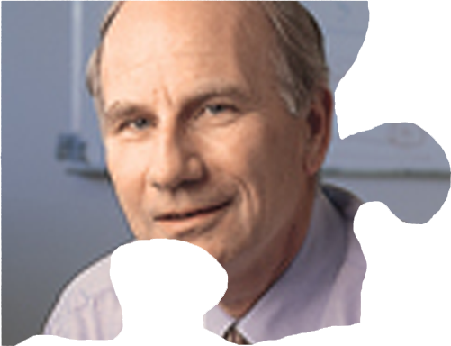
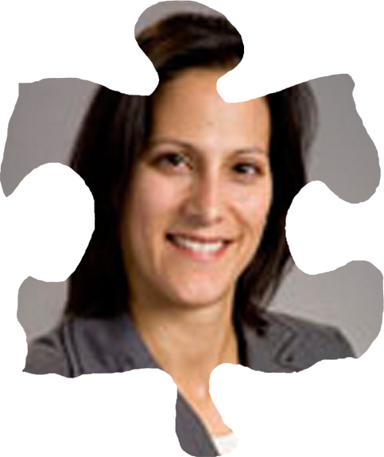
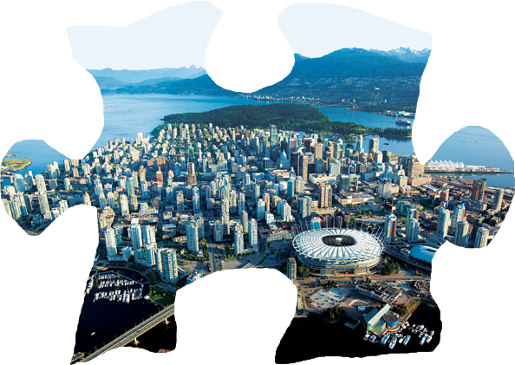
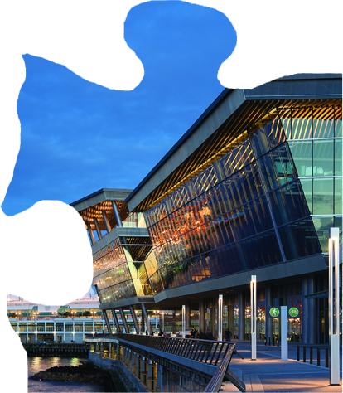
Notes:
Local Industry Leader – Dr. Alan Winter & Suzanne Gill
Local Chapter – Genome BC
Canadian Association – Genome Canada – link to another local in Calgary who wanted to bring IUBMB to Vancouver – attended one of our bid seminars
International Association
PCO - got involved to create preliminary budgets for each bid. PCO Rotation – invaluable complimentary service in the bid stage
BAH – centre of this; making the connections for the local hosts, PCO’s and venues

Slide 11
Recognition: Be a Local Host Day
Notes:
RECOGNITON OF OUR LOCAL HOST PARTNERS VERY IMPORTANT TO BAH PROGRAM
April 18
Workshop – had new and potential local hosts mixing with past local hosts
Be a Local Host Day Proclamation from City Hall
Recognition Event – awards for city wide business -
Bid wins – champagne, flowers and thanks you letter from VCC, Tvan and VHDA

Slide 12
Notes:
Largest event ever brought to Vancouver needed Local Hosts – not only that but
So successful in Vancouver in 2011, coming back this year
Great organization to have in the city – this group had to have a wide range of hotels and
There are room blocks around the city for their program

Slide 13
Be a Host Video (Click to play - Internet Connection Required)
Notes:
Be a Host Video: http://www.youtube.com/watch?v=6meyUaUJr9Y

Slide 14
Q&A and Discussion

