Slide 1
LOOKING FORWARD TO WELCOMING YOU TO

Slide 2
Notes:
Spectacular waterfront city surrounded by majestic mountains

Slide 3
Notes:
Walk across the compact downtown core in 30 minutes

Slide 4
Notes:
A stunning place to live and visit

Slide 5
Best City
in Canada
-Condé Nast
Traveler
World’s Best
Convention
Centre
-AIPC
#1 Conference Destination in
North America
-ICCA
#1 Airport
In North
America
-Skytrax
Notes:
Award winning convention destination

Slide 6
Notes:
Fly into the award winning Vancouver International Airport

Slide 7
Notes:
Winner:
YVR Best Airport in North America – Skytrax World Airport Awards (2010 - 2016)
“Airport of the Year” – CAPA Aviation Awards for Excellence (October 2016)

Slide 8
Notes:
Get from the airport to downtown for $9 in 30 minutes

Slide 9
Notes:
Walkable neighbourhoods

Slide 10
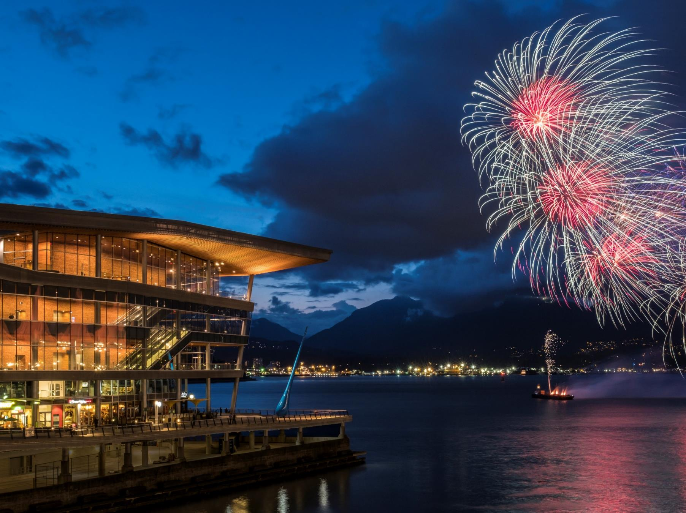
Presented by:
AAA
BBB
Notes:
Award winning Vancouver Convention Centre

Slide 11
Notes:
Green roof

Slide 17
Notes:
North Shore Excursion to Capilano Suspension Bridge

Slide 18
Notes:
North Shore Excursion to Grouse Mountain

Slide 19
Notes:
Stanley Park

Slide 20
Notes:
Free yoga Wednesdays at Jack Poole Plaza beside the Vancouver Convention Centre

Slide 21
Notes:
Biking the Stanley Park Seawall

Slide 22
Notes:
English Bay

Slide 23
Notes:
Dr. Sun Yat Sen Chinese Classical Garden

Slide 24
Notes:
Unforgettable Dining

Slide 25
Notes:
Incredible Cuisine

Slide 26
Notes:
Bard on the Beach Shakespeare Festival

Slide 27
Notes:
Granville St

Slide 30
Notes:
Olympic City

Slide 31
Notes:
International City

Slide 32
Discover more at tourismvancouver.com

