Slide 1
Session 7: Holidays

Slide 2
What you will learn today
you will…
know some important holidays in the German-speaking world
know how these holidays are celebrated and how this differs from celebrations in the US
know the months of the year in German
be able to ask when someone's birthday is and answer this question
be able to name the colors in German
recognize the German names for some countries

Slide 3
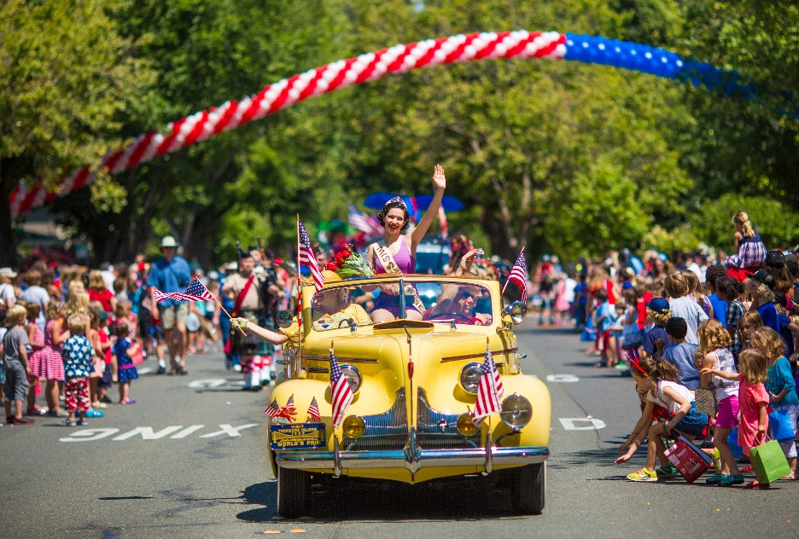
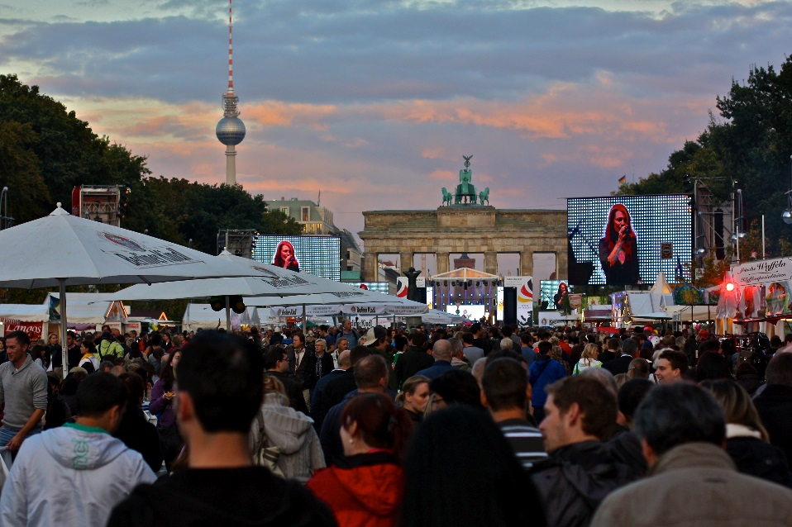
national Holidays in Germany and in the US
©flickr.com/Thomas Hawk
©flickr.com/Juska Wendland

Slide 4
reflection round: What have you learned?
Write down the words and chunks from today's session in your personal word bank.
What have you learned today about the German language? Was there anything that surprised you?
What have you learned today about the German-speaking world – about culture, people, about differences and similarities to your own country and culture, etc.? What surprised you most and why?
What are you curious about now? What else would you like to know about the German-speaking world? Write down questions that you have.

Slide 5
my word bank sheet
Months of the year (write down as many as you remember)
Wann hast du Geburtstag?
Ich habe im … Geburtstag. / Mein Geburtstag ist im …
Holidays in Germany (write down as many as you remember)
Colors (write down as many as you remember)

Slide 6
Auf Wiedersehen!
Bis nächstes Mal!
Tschüss!

